Slide 1
Map­reduce: Design patterns for BigData Computing
Bibliographic Research Work
Mário Ferreira
Vitor Teixeira
Pedro Sousa
Pedro Faria

Slide 2
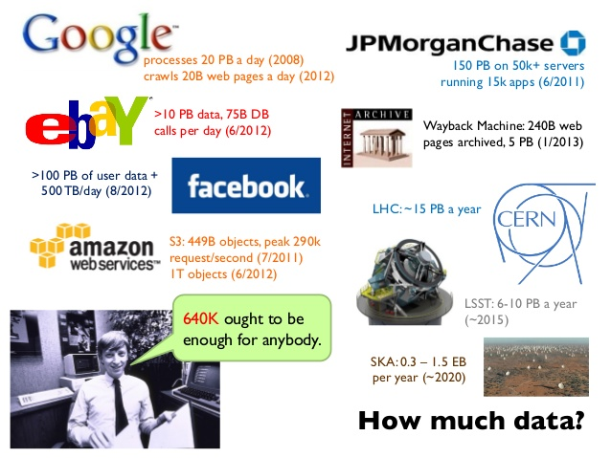
Why was MapReduce created?
Large scale data processing was difficult!
Managing hundreds or thousands of processors
Managing parallelization and distribution
I/O Scheduling Status and monitoring
Fault/crash tolerance
MapReduce provides all of these, easily!

Slide 3
What is MapReduce?
MapReduce is a programming model, inspired by the map and reduce functions, and an associated implementation for processing and generating large data sets with a parallel, distributed algorithm on a cluster. Between the two main steps there is an extra one called shuffle.
The Map function performs filtering and sorting by processing a key/value pair to generate a set of intermediate key/value pairs.
The Reduce function that performs a summary operation and merges all intermediate values associated with the same intermediate key.
The shuffle function redistributes data based on the output keys (produced by the Map function), such that all data belonging to one key is located on the same worker node.

Slide 4
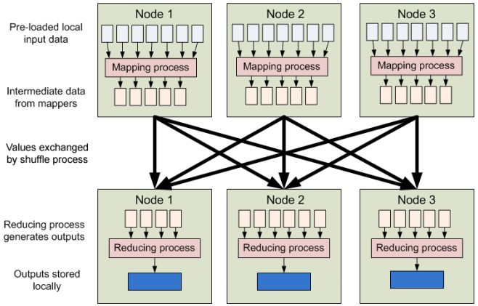
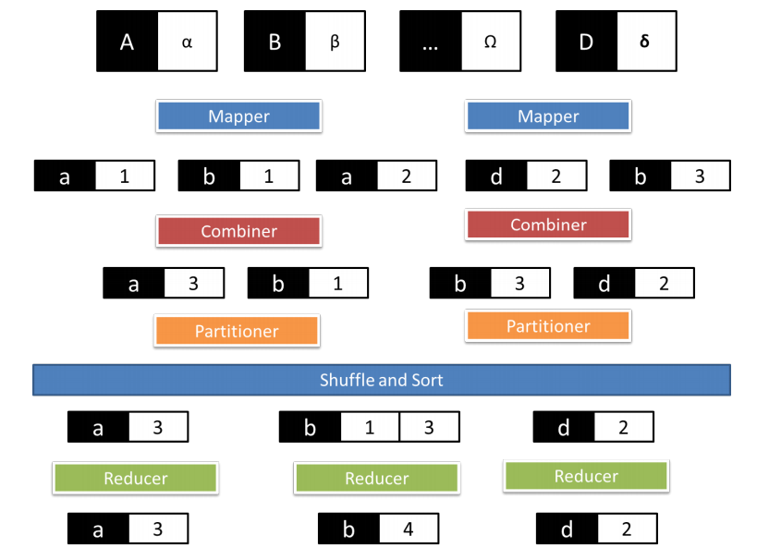
MapReduce
Simple MapReduce
MapReduce using combine

Slide 5
MapReduce features/benefits
In multi-threaded implementations of MapReduce the scalability, fault-tolerance and performance of the program are largely increased when compared with single-threaded implementations of MapReduce or non-MapReduce.
MapReduce programs are automatically parallelized and executed on a large cluster. The run-time system takes care of the details of partitioning the input data, scheduling the program' s execution across a set of machines, handling machine failures, and managing the required inter-machine communication.
This allows programmers without any experience with parallel and distributed systems to easily utilize the resources of a large distributed system

Slide 6
Programming model
Input/ Output: key/value pairs.
Map, defined by the user, takes an input pair and produces a set of intermediate key/value pairs. The MapReduce library groups together all intermediate values associated with the same intermediate key X and passes them to the Reduce function.
The Reduce function, also provided by the user, accepts an intermediate key X and a set of values for that key . It merges together these values to form a possibly smaller set of values. Typically just zero or one output value is produced per Reduce in vocation. The intermediate values are supplied to the user' s reduce function via an iterator . This allows to handle lists of values that are too large to fit in memory

Slide 7
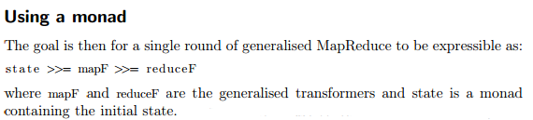
Monad
Monads are a language feature that allow the definition of language-integrated DSLs in a way where semantic peculiarities are abstracted away from the syntactic interface.
It was found that MapReduce can be expressed naturally, using functional programming techniques, as a form of monad. The basic idea is to convert each map / reduce stage into a monadic function, so MapReduce becomes a composition:
Monads have known success in languages such as Haskell, Scala and Clojure.

Slide 8
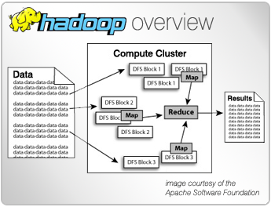
Known MapReduce implementations
Apache Hadoop
Apache Hadoop is an open-source software framework for distributed storage and distributed processing of Big Data on clusters.
Its Hadoop Distributed File System (HDFS) splits files into large blocks (default 64MB or 128MB) and distributes the blocks amongst the nodes in the cluster.
For processing the data, the Hadoop Map/Reduce ships code (specificallyJar files) to the nodes that have the required data, and the nodes then process the data in parallel. This approach takes advantage of data locality, in contrast to conventional HPC architecture which usually relies on a parallel file system.

Slide 9

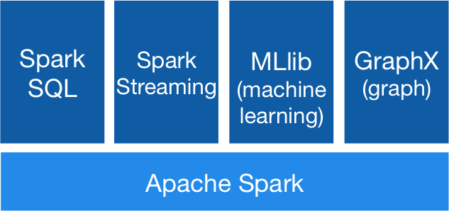
Known MapReduce implementations
Spark
Nowadays an Apache Incubator project, defined as "Next-generation" map/reduce because its designed for performance and speed.
Provides high level APIs for Scala, Java and Python as well as a rich set of higher-level tools including Shark (SQL) for SQL and structured data processing, MLlib for machine learning, GraphX for graph processing and a self-made streaming API(Spark Streaming).

Slide 10
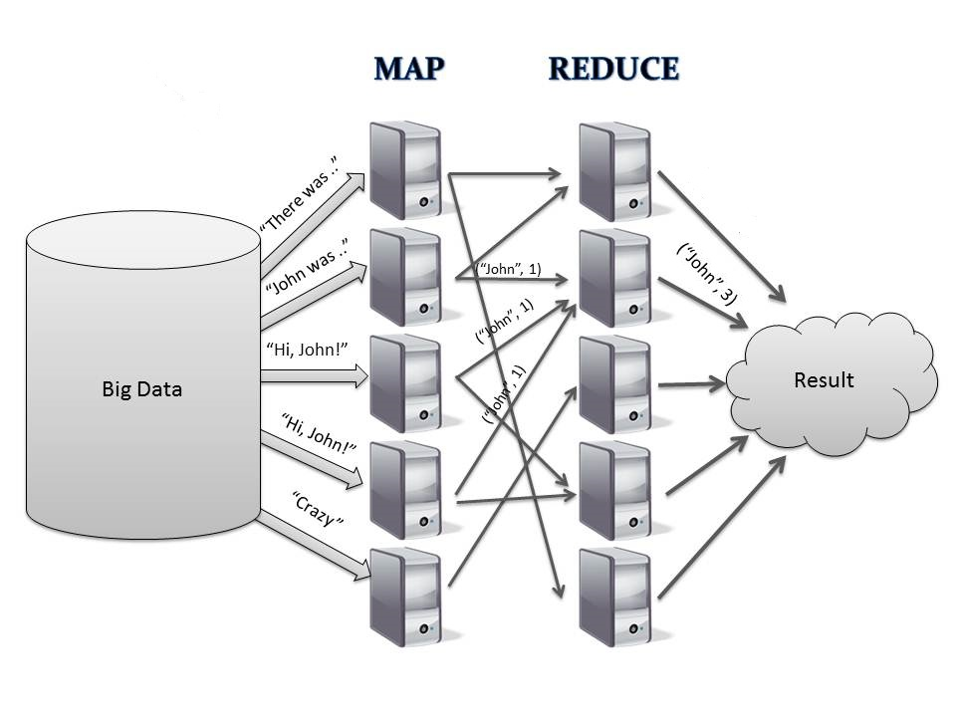
Practical example
Mapping the number of occurrences of a certain word in a collection of books.

Slide 11
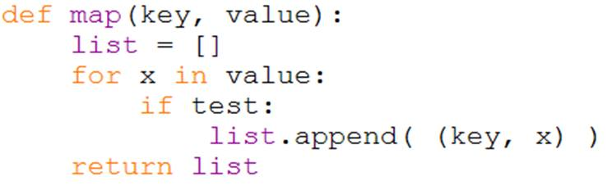
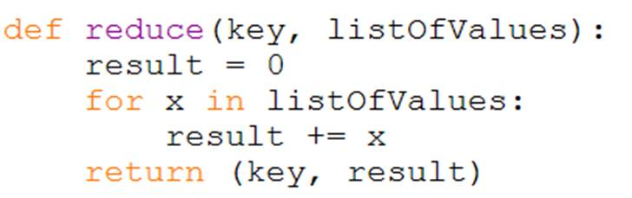
Pseudo-coded MapReduce

Slide 12
Large-Scale PDF Generation
The New York Times needed to generate PDF files for 11,000,000 articles (every article from 1851-1980) in the form of images scanned from the original paper
Each article is composed of numerous TIFF images which are scaled and glued together
4TB of scanned articles were sent to Amazon Simple Storage Service
A cluster of Amazon Elastic Compute Cloud(EC2) machines was configured to distribute the PDF generation via Hadoop
Using 100 EC2 instances and 24 hours, the New York Times was able to convert 4TB of scanned articles to 1.5TB of PDF documents

Slide 13
