Slide 1


Slide 2
Network Protocols

Slide 3
What is Network
A network consists of two or more computers that are linked in order to share resources (such as data, storage devices,and printers), exchange files, or allow electronic communications. The computers on a network may be linked through

Slide 4
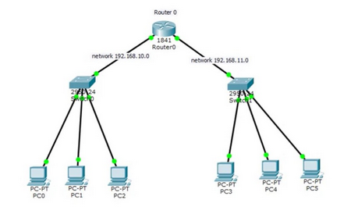
Cables

Slide 5
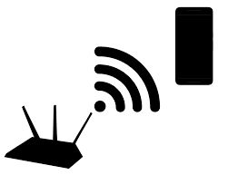
Radio waves

Slide 6
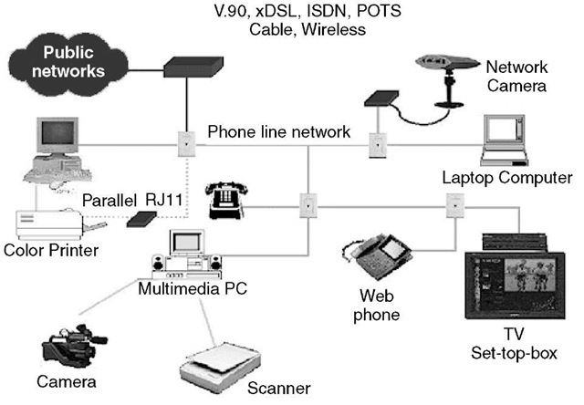
Telephone lines

Slide 7
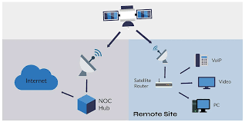
Setelite

Slide 8
What is protocol
Network protocol is an established set of rules that determine how data is transmitted between different devices in the network, regardless of any differences in their internal processes, structure or design.Network protocols are the reason you can easily communicate with people all over the world

Slide 9
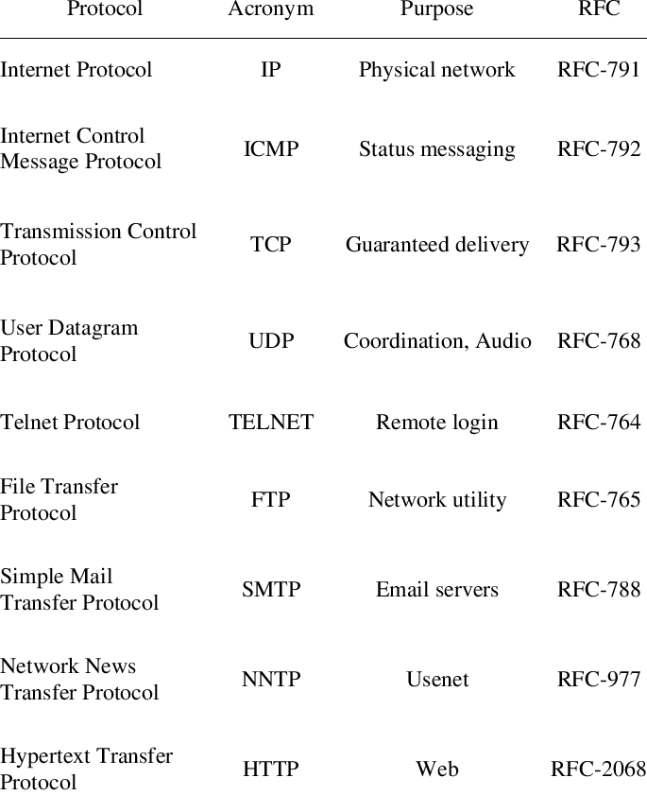
Request For Comments(RFCs)
RFCs produced by the Internet Engineering Task Force (IETF).
RFCs cover many aspects of computer networking. They describe the Internet's technical foundations, such as addressing, routing, and transport technologies. RFCs also specify protocols.
We can imagine RFCs as the language which make difference devices speak with each other.

Slide 10
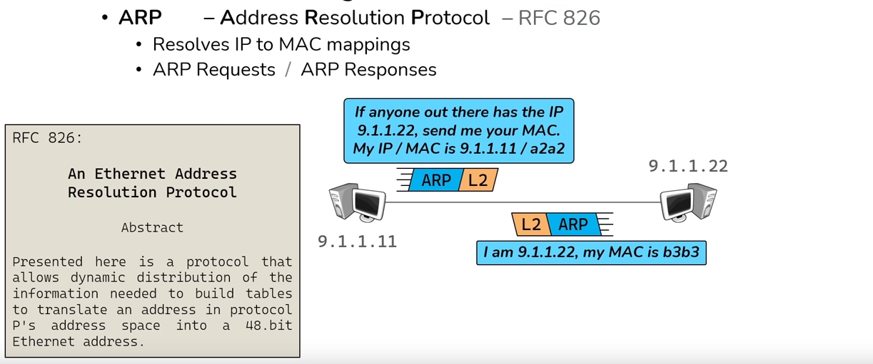
ARP
used for discovering the link layer address, such as a MAC address, associated with a given internet layer address , such as Ipv4 and put it in a table

Slide 11
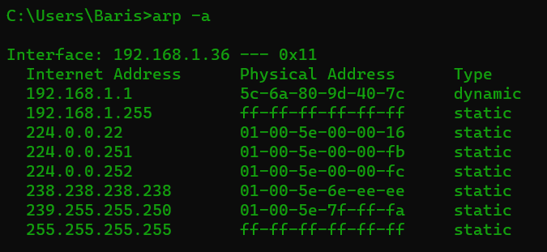
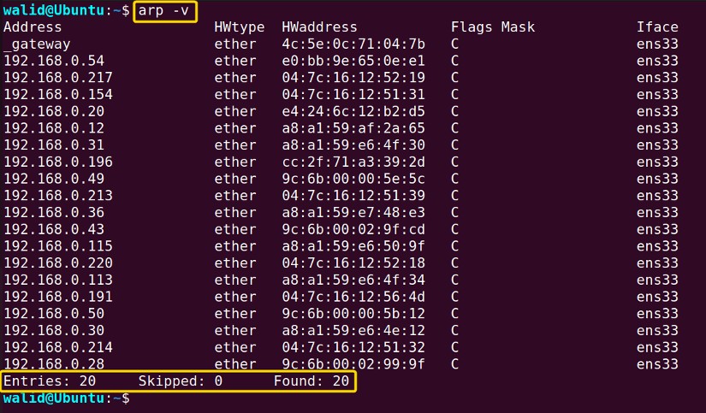
Windows
linux(ubuntu)

Slide 12
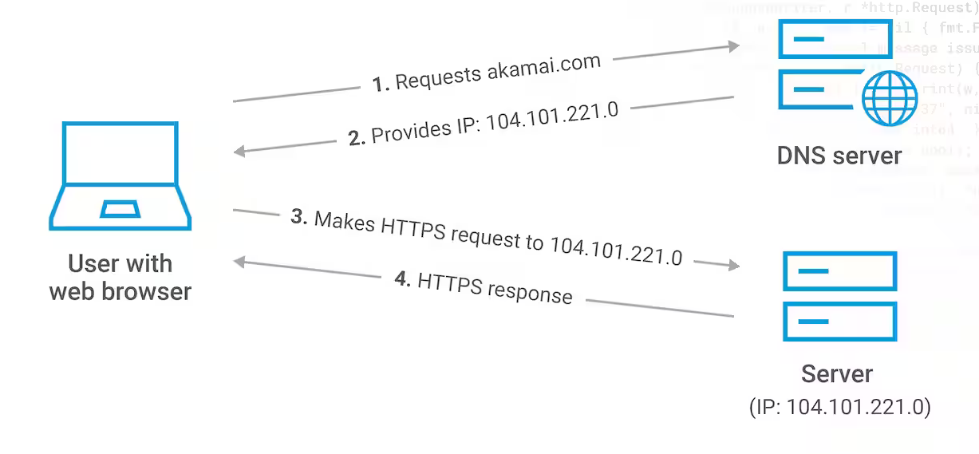
DNS
The Domain Name System (DNS) turns domain names into IP addresses,
which browsers use to load internet pages

Slide 13
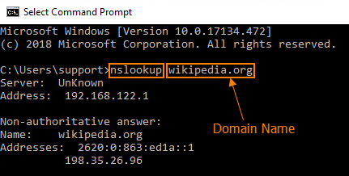
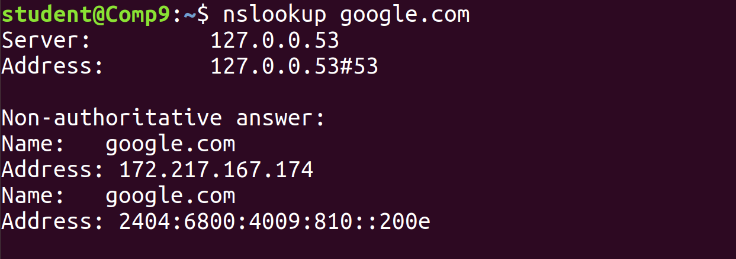
Windows
Linux(ubuntu)

Slide 14
Main types of network protocols
Network management protocols: These protocols set out policies designed to monitor, manage and maintain a network. Examples include SNMP, FTP, POP3 ,Telnet,etc...
Network communication protocols: A group of protocols used to establish rules and formatting (such as syntax, synchronization and semantics) for exchanging data across a network. Types of network communication protocols include TCP, UDP, IP, HTTP, IRC, BGP , ARP, etc...
Network security protocols: Security protocols are protocols that use security measures such as cryptography and encryption to protect data. Examples include SFTP, SSL ,HTTPS, etc...

Slide 15
SNMP
Simple Network Management Protocol (SNMP) is an application-layer protocol for monitoring and managing network devices on a local area network (LAN) or wide area network (WAN).
The SNMP manager acts as the client, the SNMP agent acts as the server and the MIB acts as the server's database. When the SNMP manager asks the agent a question, the agent uses the MIB to supply the answer.
There are dozens of network monitoring & management tools
i.e. (ZABBIX , Nagios, CACTI , Icinga)

Slide 16
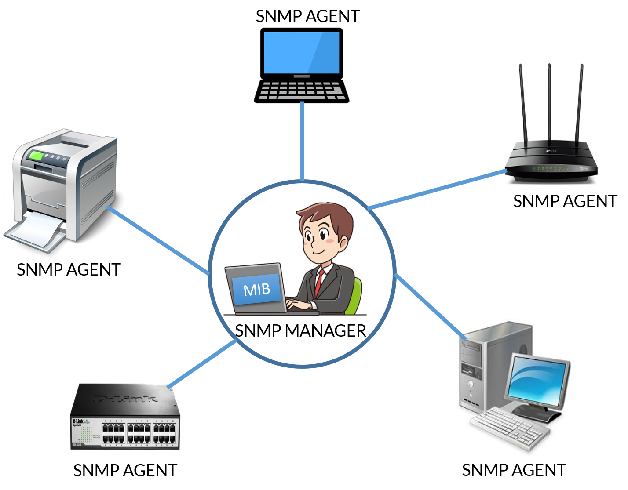

Slide 17
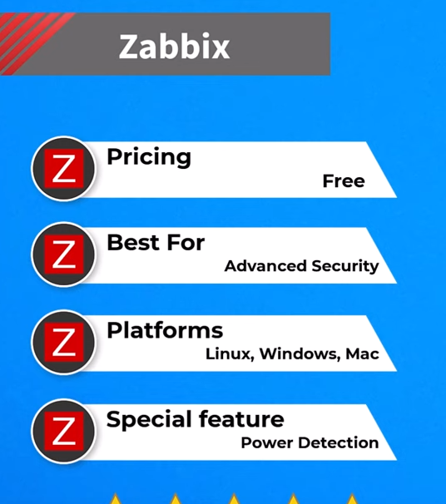
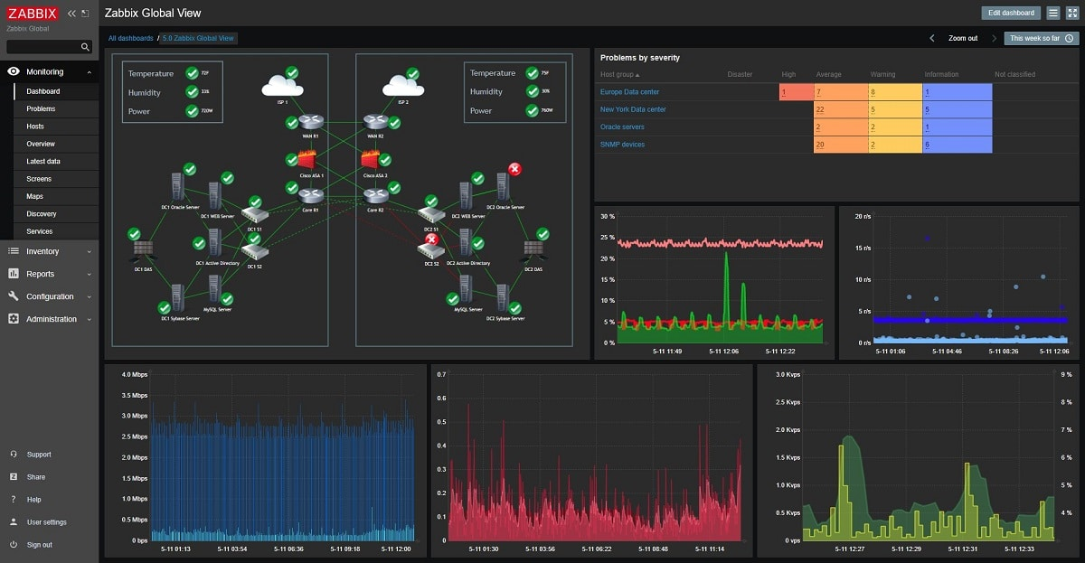
ZABBIX

Slide 18
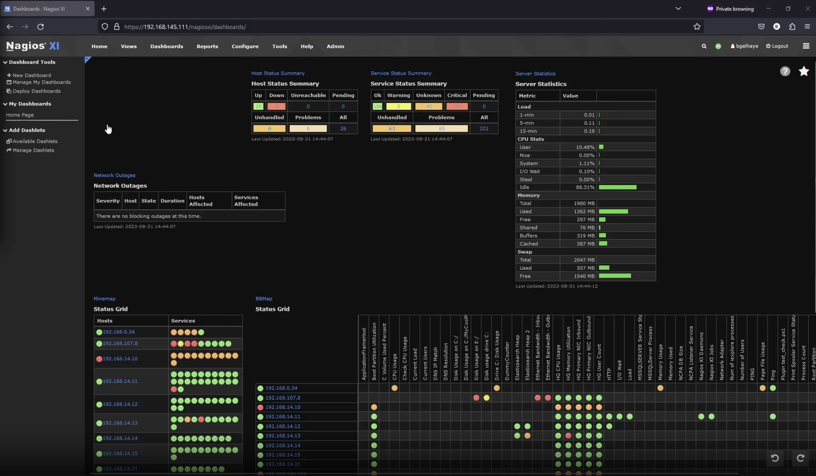
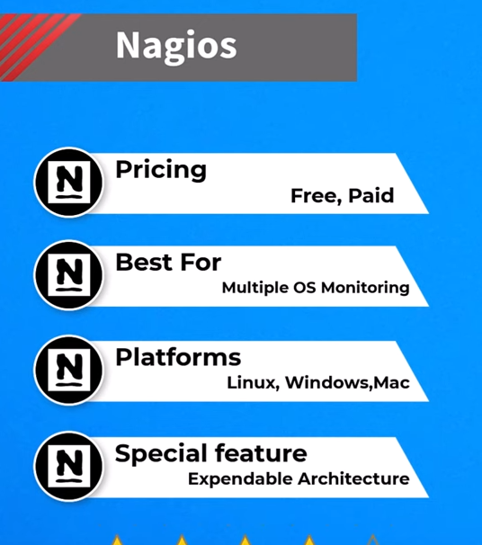
Nagios

Slide 19
Protocol suite
A protocol suite is a group of inter-related protocols necessary to perform a communication function.
i.e. open systems interconnection (OSI) model which later became TCP/IP

Slide 20
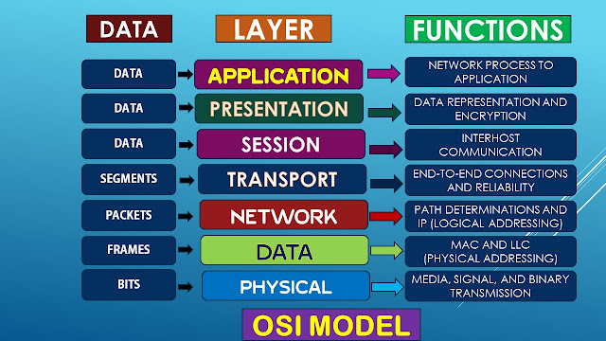
OSI Model

Slide 21
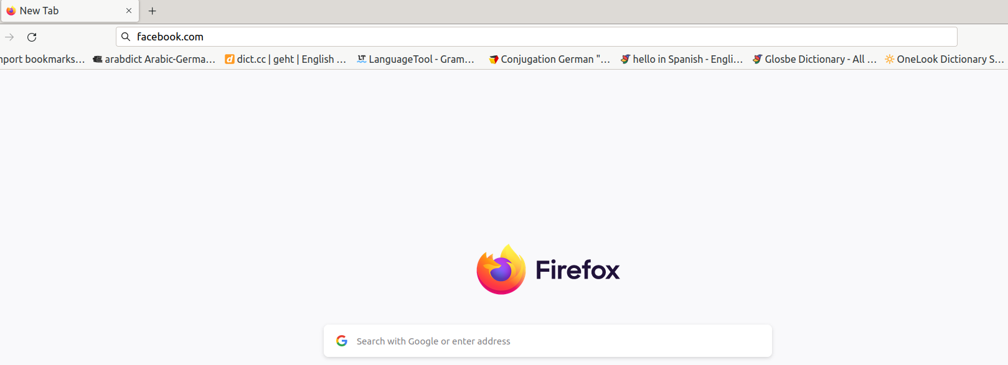
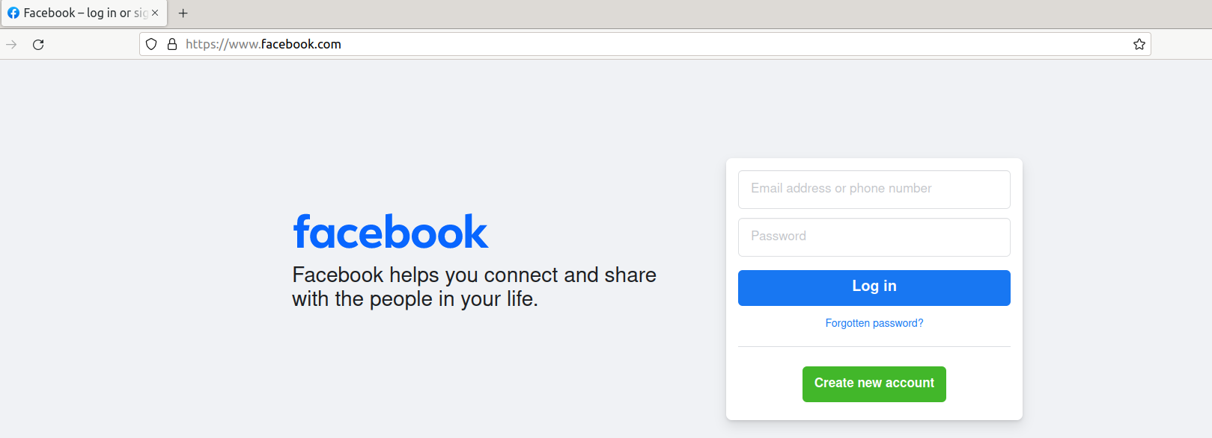
Let us start from the point when user enter facebook.com

Slide 22
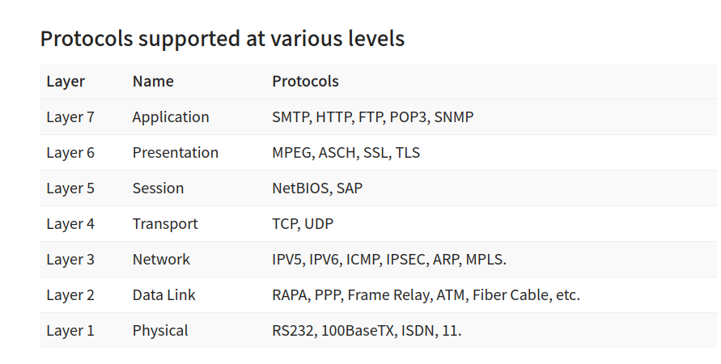

Slide 23
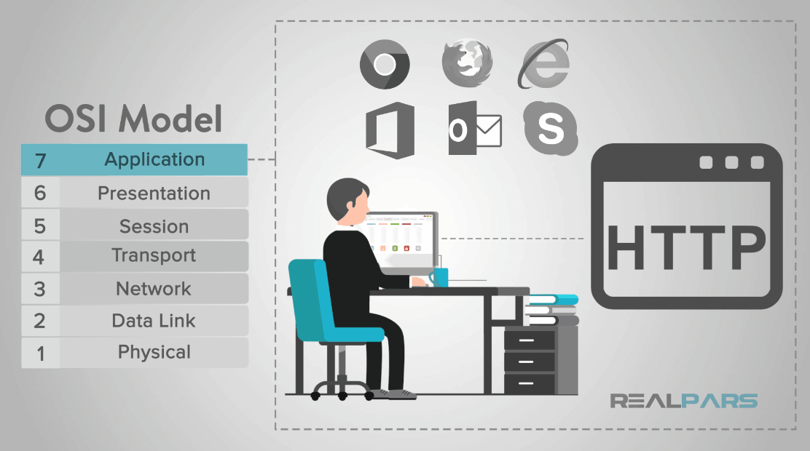

Slide 24
DNS server will convert https://www.facebook.com/ to 157.240.252.35

Slide 25
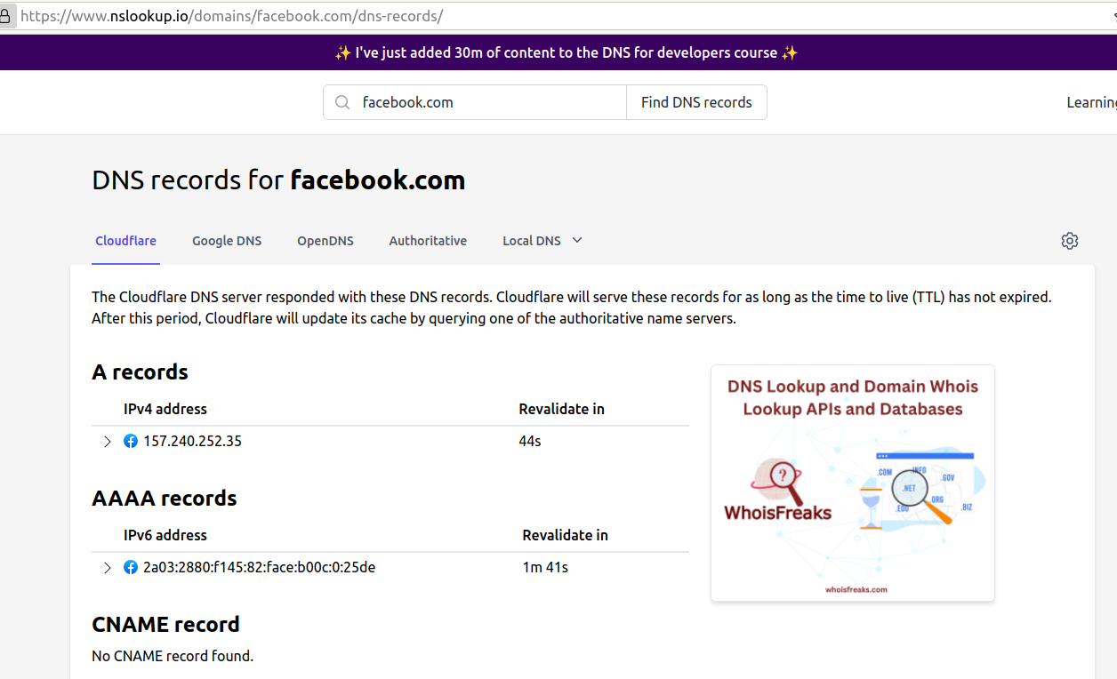

Slide 26
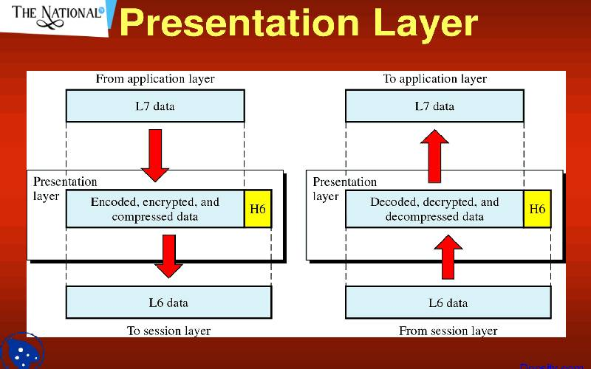

Slide 27
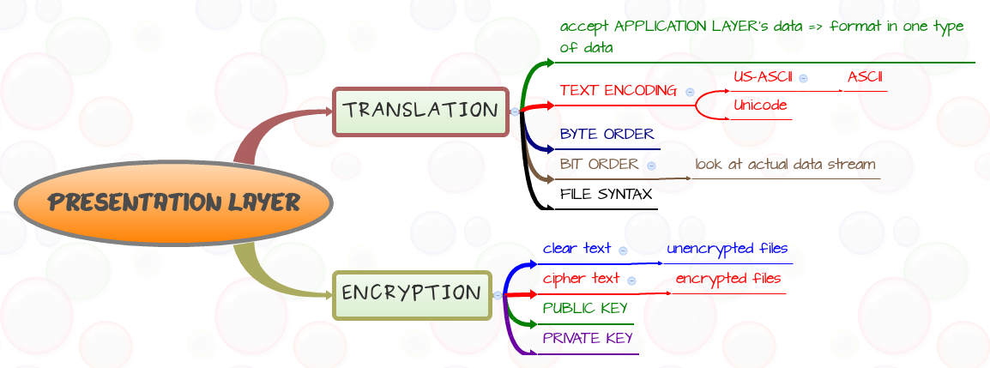

Slide 28
ASCI encode: from (157.240.252.35) to(49 53 55 46 50 52 48 46 50 53 50 46 51 53)
AES encryption: from (49 53 55 46 50 52 48 46 50 53 50 46 51 53) to (tmIYmEmNPuc/NtfiANiwubVLeySzTFcfhPPSkBS0ILojYNC5b5mFzyoLh1KcwuG/)
Then it compress the data to make it small in size

Slide 29
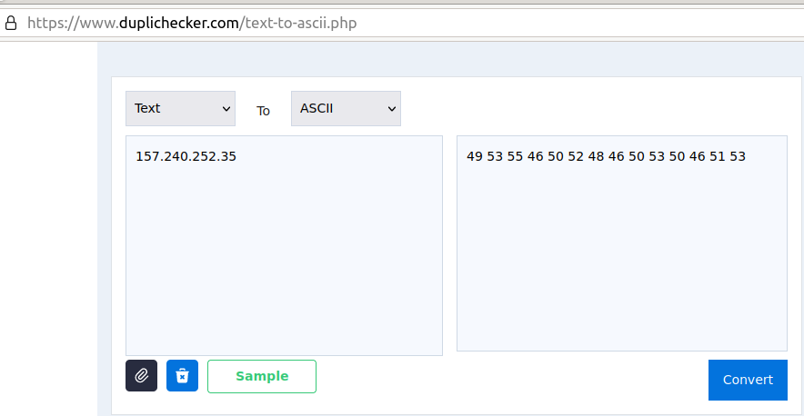

Slide 30
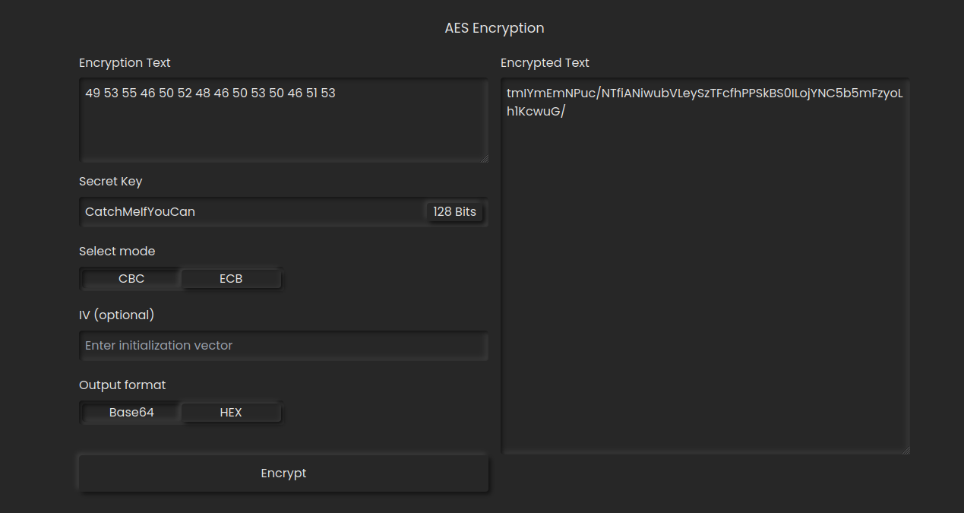

Slide 31
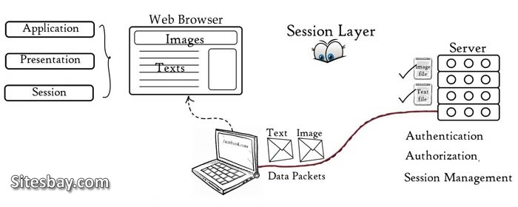

Slide 32
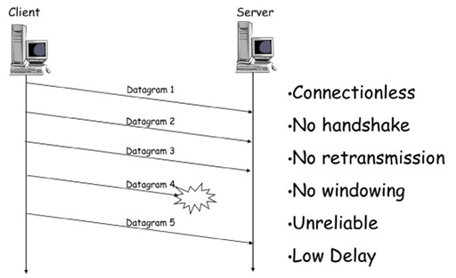
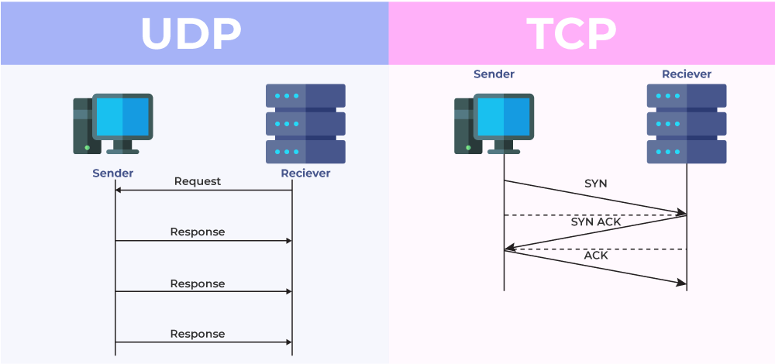
Transport Layer
UDP
Video calls
Emails

Slide 33
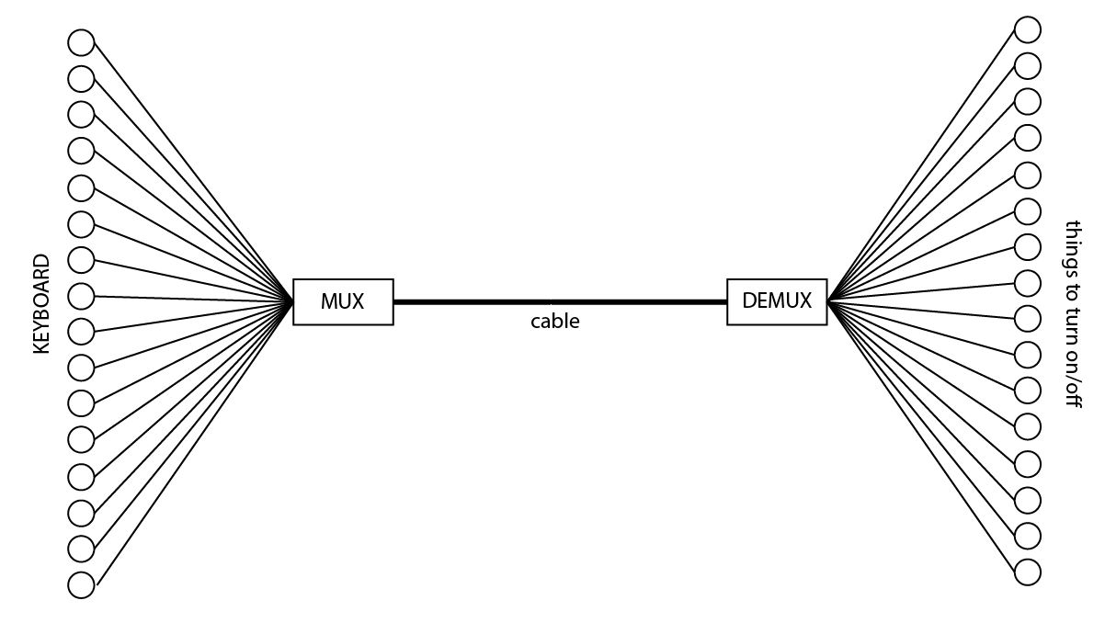

Slide 34
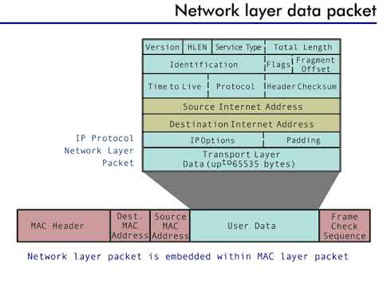

Slide 35
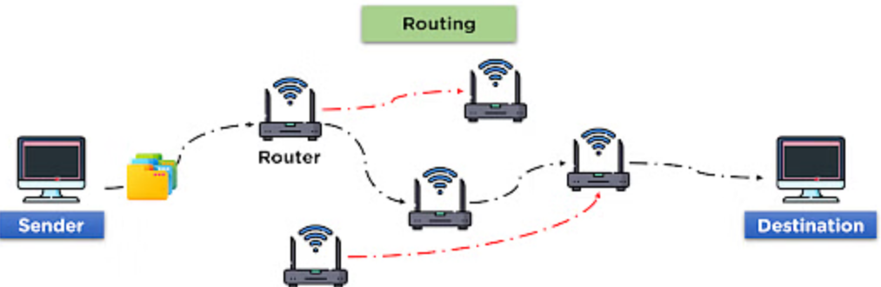

Slide 36
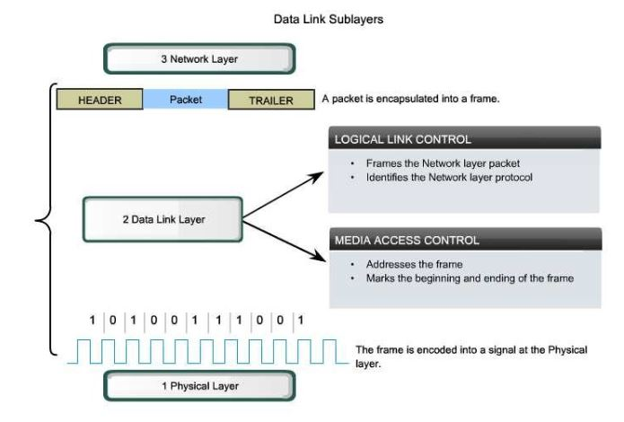
Error Control
Access Control
Flow Control
Addressing
Framing

Slide 37
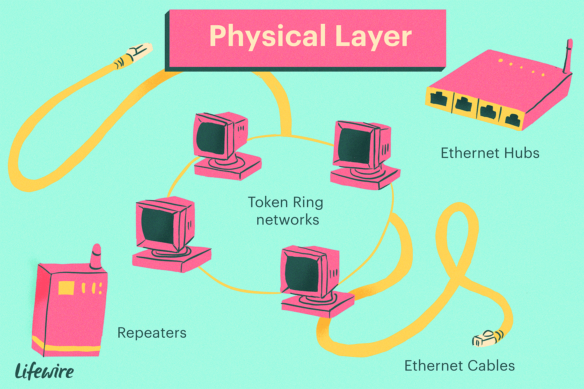

Slide 38
Application Layer
It determines the communication partner to whom data will be transmitted.
It allows access to network resources
File Transfer, Access, and Management (FTAM): An application allows a user to access files in a remote computer, to retrieve files from a computer and to manage files in a remote computer
It enables users to communicate with other software applications.

Slide 39
Presentation layer
This layer carries out the encoding at the transmitter and decoding at the receiver.
Also It carries out the encryption at the transmitter and decryption at the receiver.
As well It carries out data compression to reduce the bandwidth of the data to be transmitted (the primary goal of data compression is to reduce the number of bits which is to be transmitted).
This layer basically deals with the presentation part of the data.

Slide 40
Session Layer
Session Establishment: it establishes connections between devices which is known as sessions
Data Transfer: it handles the exchange of data between systems
Dialog Management: it keeps log data on which connections are established to send and receive data, which is called dialog management. It is accountable for establishing, synchronizing, preserving, and ending the conversation between the sender and the receiver
Synchronization: it maintains proper connectivity between systems, and if any error occurs, then it provides a recovery option
Authentication & Authorization: It checks if the user is the right one to access the data if so it provids him with the data

Slide 41
Transport Layer
The Process to Process Delivery: Transport Layer requires a Port number to correctly deliver the segments of data to the correct process amongst the multiple processes running on a particular host
It divids the data into small pieces calls segments
End-to-end Connection between Hosts: which it mainly uses TCP and UDP.
TCP is used in various applications because it ensures the reliable delivery of messages by using (3 Way handshake)
UDP on the other hand, is a stateless and unreliable protocol that ensures best-effort delivery. It is suitable for applications that have little concern with flow or error control
Multiplexing and Demultiplexing: Multiplexing is the process of collecting data from different application processes running on the sender's end and then enveloping that gathered data with the header and then transmitting the whole to the receiver
Demultiplexing is just the reverse of the multiplexing process

Slide 42
Congestion Control: is a mechanism that controls the entry of data packets into the network to avoid overflow on the router
Data integrity and Error Correction: it checks for errors using error detection codes, and computing checksums then uses the ACK and NACK services to inform the sender if the data has arrived or not and checks for the integrity of data.
Flow Control: it provides a flow control mechanism to prevent data lose

Slide 43
Network Layer
The main responsibility of the Network layer is to carry the data packets from the source to the destination without changing
It converts data from [ Segments to packets ]
It decides the route to be taken by the packets to travel from the source to the destination among the multiple routes available in a network (also called routing).
The source and destination addresses [ IP ] are added to the data packets inside the network layer.

Slide 44
Data link layer(DLL)
Error Control: it performs error detection and correction techniques on the transmitted data. Due to the noise or signal loss, errors might occur in the data while being transmitted.
Access Control: it performs checks on the devices with the same network channel to avoid data loss. Due to the collision of data being transmitted in the same channel
Flow Control: During data transmission, the sender or receiver's data flow may differ, causing network traffic in the channel. in such situations DLL acts as a flow control for the sender side to prevent data overflow at the receiver side.
Addressing: it adds the physical address (MAC) to the frame’s header
Framing: it converts data from [ Packets To Frames ]

Slide 45
Physical layer
defines electrical and physical specifications for devices.
defines the connection between difference devices whether using wire(cable) or via radio waves(wireless)
This layer uses Bit Synchronization , Bit rate control
to define how data will be transmitted
it converts data from [ Frames to Bits ]

Slide 46
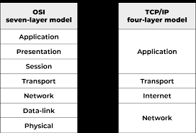
TCP/IP

Slide 47
Sources
Types of cables https://medium.com/@CaramellAa/cisco-equipments-in-packet-tracer-e6ca16cb05c1
RDP
https://medium.com/@CaramellAa/setup-rdp-4f7e28cf2f78

