Slide 1


Slide 2
What is ASCII?
ASCII (American Standard Code for Information Interchange) is the most common character encoding format for text data in computers and on the internet. In standard ASCII-encoded data, there are unique values for 128 alphabetic, numeric or special additional characters and control codes.

Slide 3
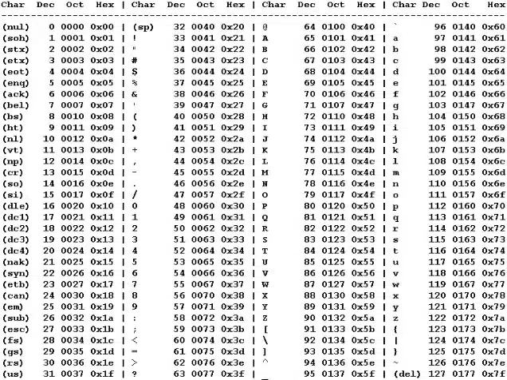

Slide 4
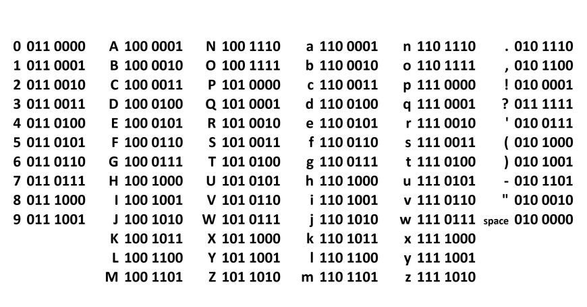
Here every ASCII character represented in 7bits

Slide 5
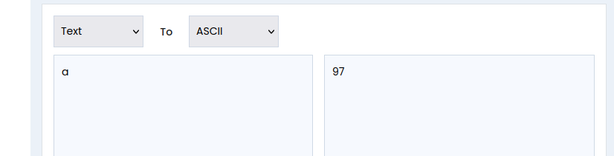
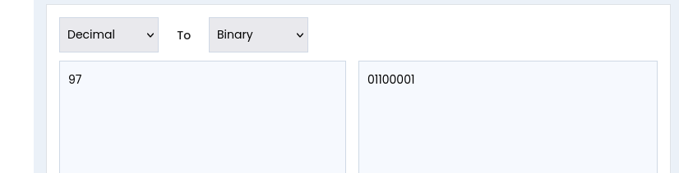

Slide 6
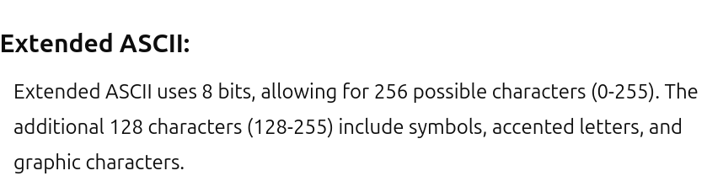
Every ASCII character is represented in 8bits instead of 7bits

Slide 7
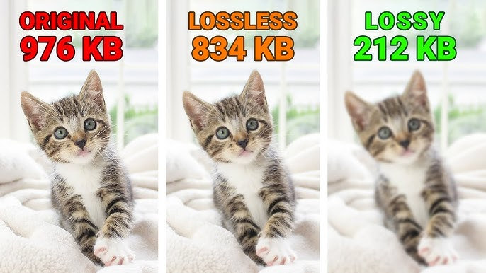
1-Compressing texts are lossless
2-Videos and photos can be lossless or lossy
We are not just concern about speed we also concern about memory

Slide 8
2. UTF-8 (Unicode Transformation Format - 8-bit)
Bytes per Character: 1 to 4 bytes.
1 byte for standard ASCII characters (U+0000 to U+007F).
2 bytes for characters from U+0080 to U+07FF (e.g., Latin-1).
3 bytes for characters from U+0800 to U+FFFF (e.g., most characters from other languages).
4 bytes for characters from U+10000 to U+10FFFF (e.g., emojis).
Description: Compatible with ASCII, widely used for web content, and can represent all Unicode characters.

Slide 9
Other encoding methods
UTF-16
UTF-32
ISO-8859-1
Windows-1252
……...

Slide 10
Huffman Encoding
Huffman coding is a lossless data compression algorithm. The idea is to assign variable-length codes to input characters, lengths of the assigned codes are based on the frequencies of corresponding characters.
So if we want to encode this text “hey it is me whenever you are free give me a call” without compression it will take = 49(number of characters including space) * 8 = 392 bits
Lets see how much it will take with Huffman encoding

Slide 11
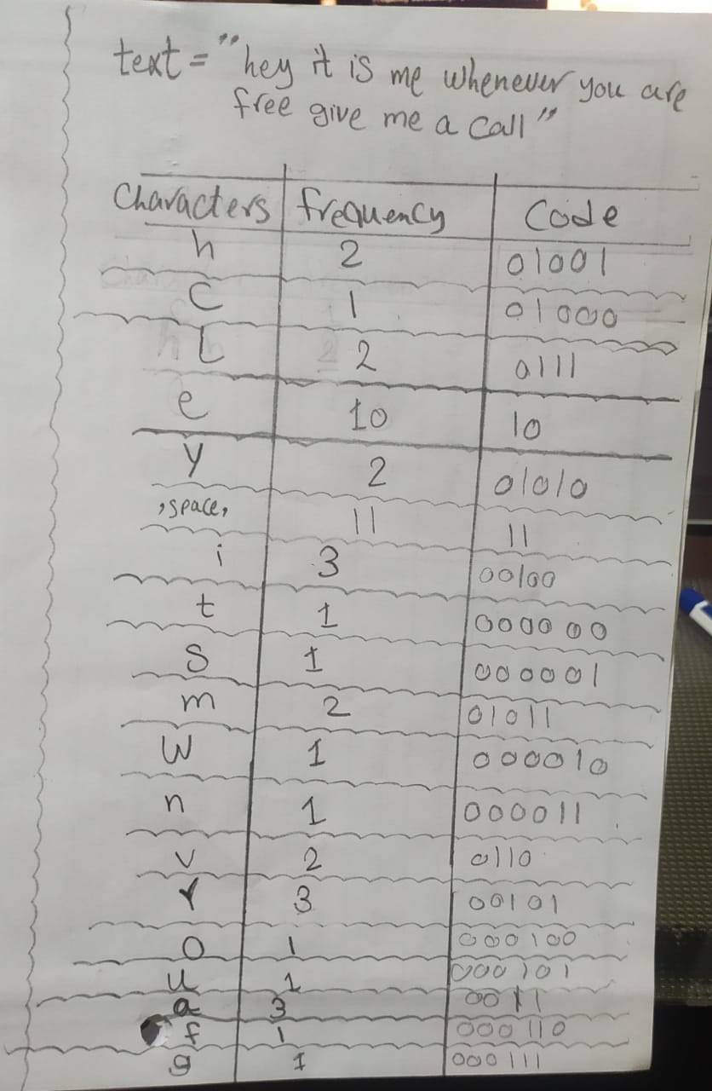

Slide 12
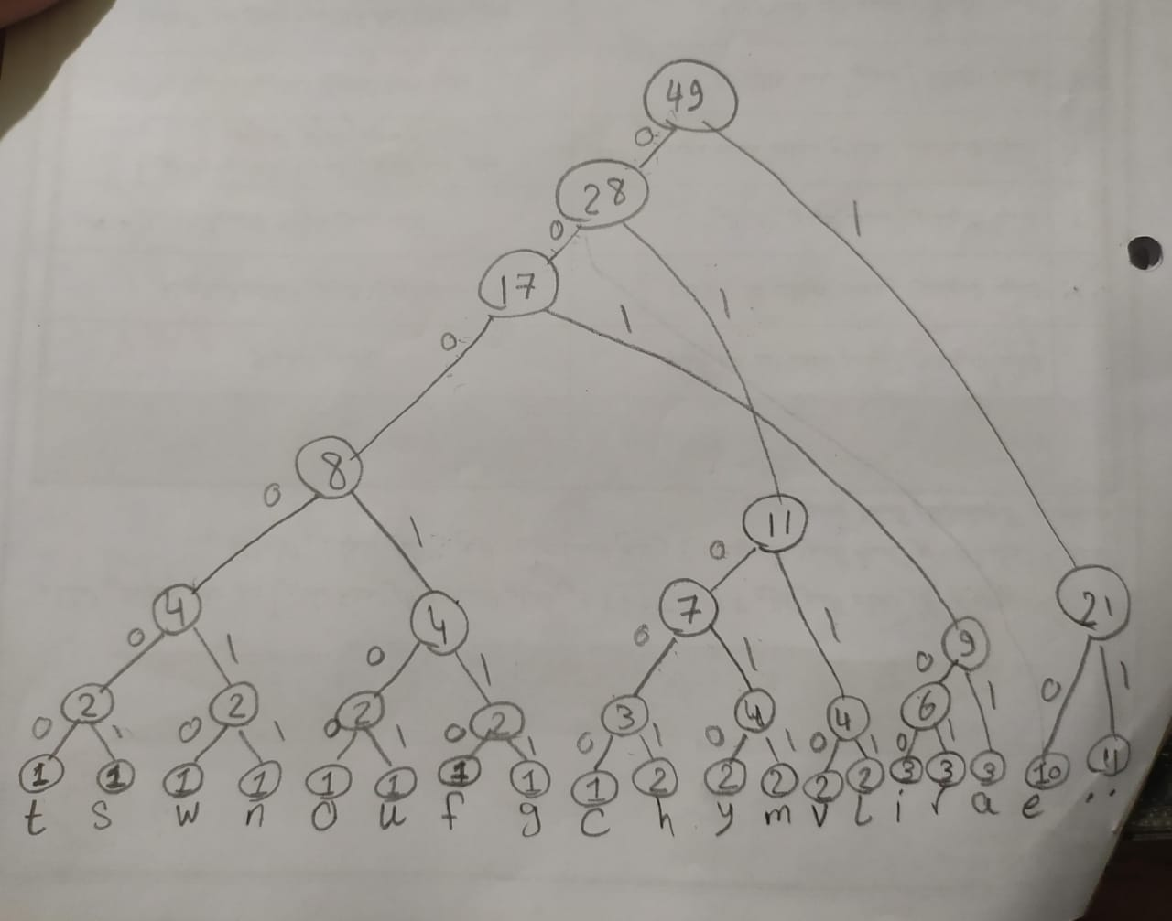

Slide 13
Our text after the compression becomes 87-bits instead of 392-bits

Slide 14
Steps of compression
Access the file and extract text from that file
Calculate frequency of each text and store it in freq dictionary
Minimum heap for two minimum frequency
Constructing binary tree from heap
Construct code from binary tree and stored it in dictionary
Construct encoder text
We have to return that binary file as an output

Slide 15
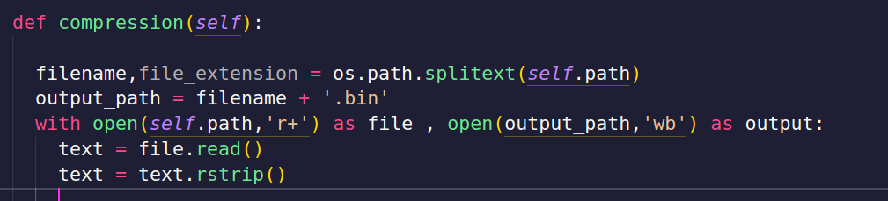
Access the file and extract text from that file

Slide 16
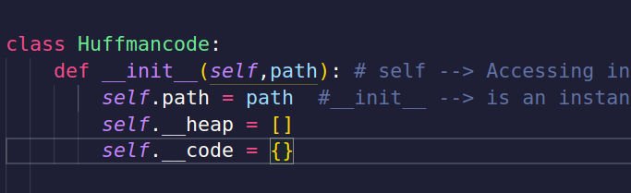
Initiating our Huffman Class
Path → for our file
__heap → for storing the noods of the tree in our heap
__code → for storing the binary code for each character

Slide 17
Initiating our Huffman Class
Path → for our file
__heap → for storing the noods of the tree in our heap
__code → for storing the binary code for each character

Slide 18
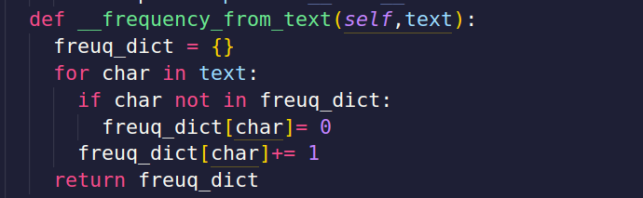
Making dictionary and Calculating the frequency

Slide 19
It is stored as
key : value
The text in our file= hey it is me whenever you are free give me a call

Slide 20
Steps of compression
Access the file and extract text from that file
Calculate frequency of each text and store it in freq dictionary
Minimum heap for two minimum frequency
Constructing binary tree from heap
Construct code from binary tree and stored it in dictionary
Construct encoder text
We have to return that binary file as an output

Slide 21
Construct binary tree from heap
Why we are using the heap :
in order to find the minimum frequency characters
what we are storing in heap :
we are storing the key and its value

Slide 22

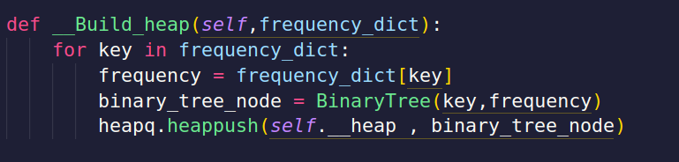
Notes in python:
We use
Square brackets [] are used for arrays.
Curly brackets {} are used to set scope
Converts each character and its frequency into a BinaryTree node and pushes it into the heap.

Slide 23
Steps of compression
Access the file and extract text from that file
Calculate frequency of each text and store it in freq dictionary
Minimum heap for two minimum frequency
Constructing binary tree from heap
Construct code from binary tree and stored it in dictionary
Construct encoder text
We have to return that binary file as an output

Slide 24
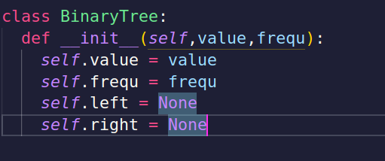
Creating the class of the (Binary Tree)

Slide 25
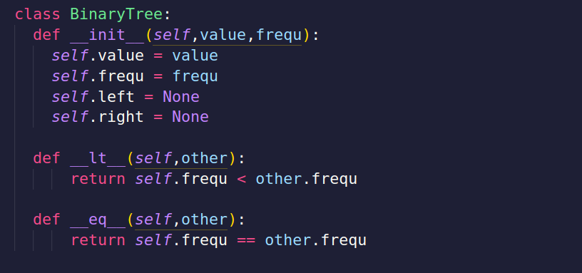
defining our tree’s methods

Slide 26
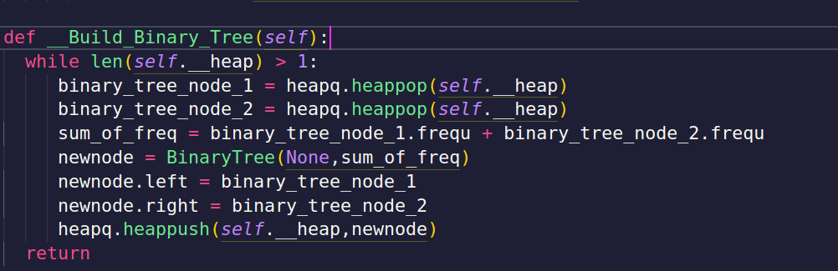
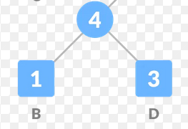
Combines the two smallest frequency nodes into a new node with their combined frequency.

Slide 27
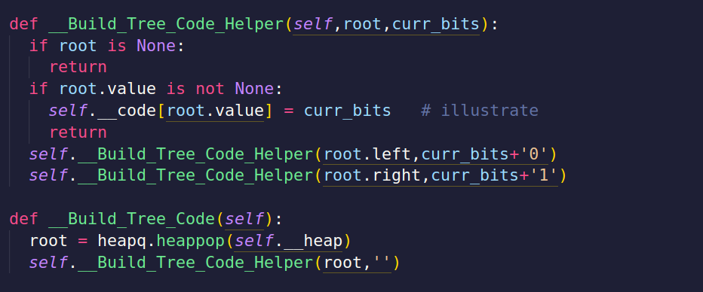
These methods recursively traverse the Huffman Tree to assign binary codes to each character.
Example: The character 'a' might get the code 0, 'b' might get 10, and 'c' might get 11.

Slide 28
Steps of compression
Access the file and extract text from that file
Calculate frequency of each text and store it in freq dictionary
Minimum heap for two minimum frequency
Constructing binary tree from heap
Construct code from binary tree and stored it in dictionary
Construct encoder text
We have to return that binary file as an output

Slide 29
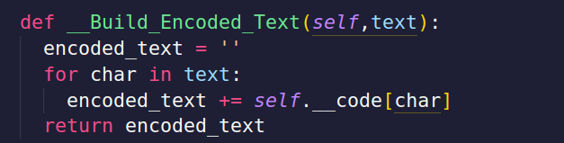
Converts the original text into a long string of binary digits by replacing each character with its corresponding code.
Example: If 'a' is 0, 'b' is 10, and 'c' is 11, then the text "abc" would become 01011.

Slide 30
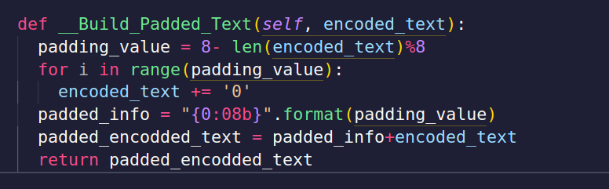
Adds extra 0's to the end of the binary string to make its length a multiple of 8
(because files are written in bytes, and each byte is 8 bits).

Slide 31
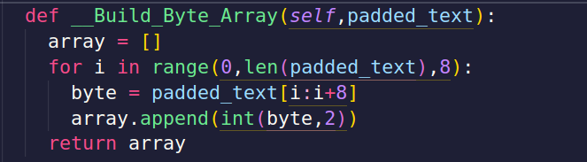
Converts the padded binary string into actual bytes, which can be written to a file.

Slide 32
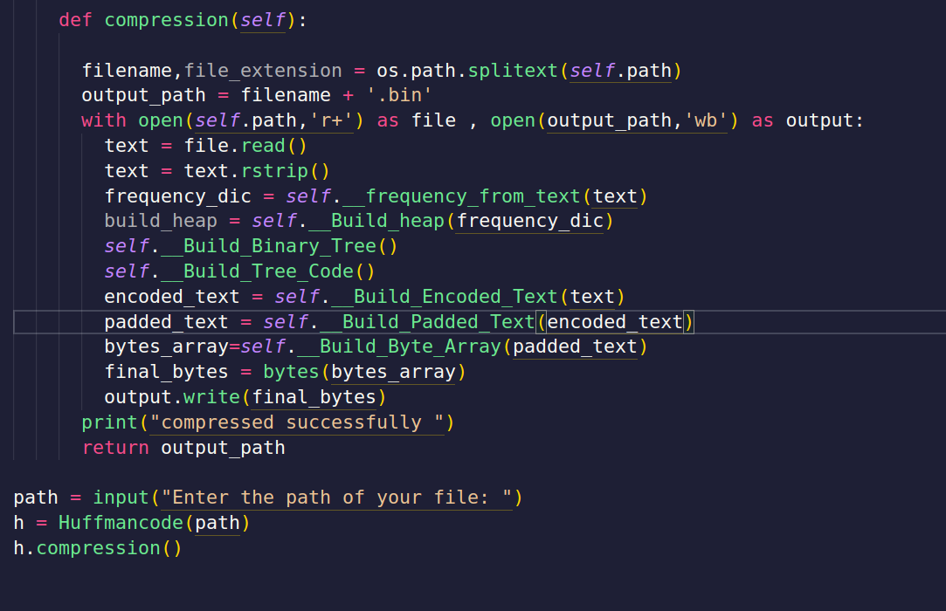
Lastly let us tie everything

