Slide 1


Slide 2
What is list
How many ways in HTML to make lists
It is the way we used to represent a set of data in specific manner
We have three ways to make lists
ordered List
Unordered List
Description List

Slide 3
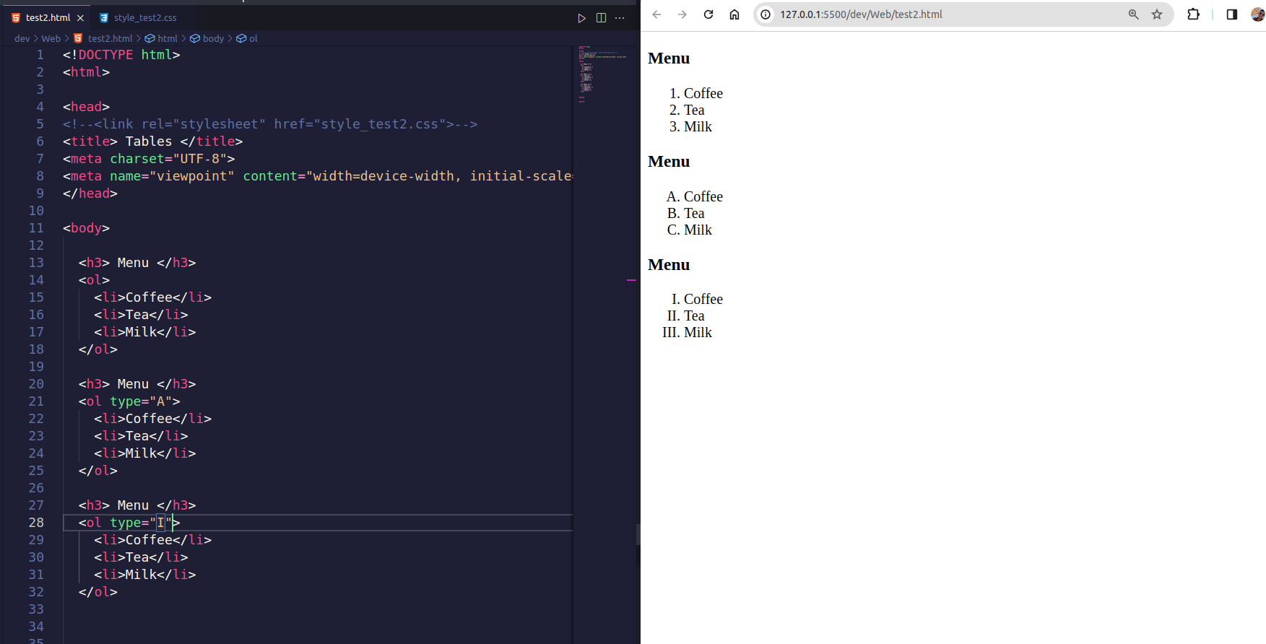
Ordered List

Slide 4
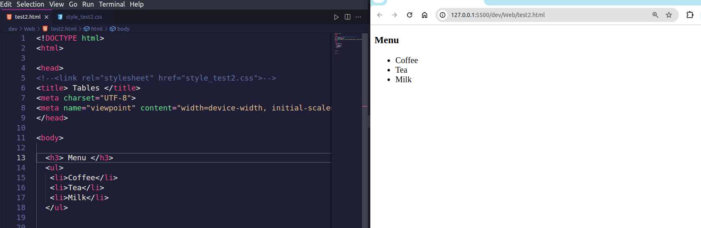
Unorderd List

Slide 5
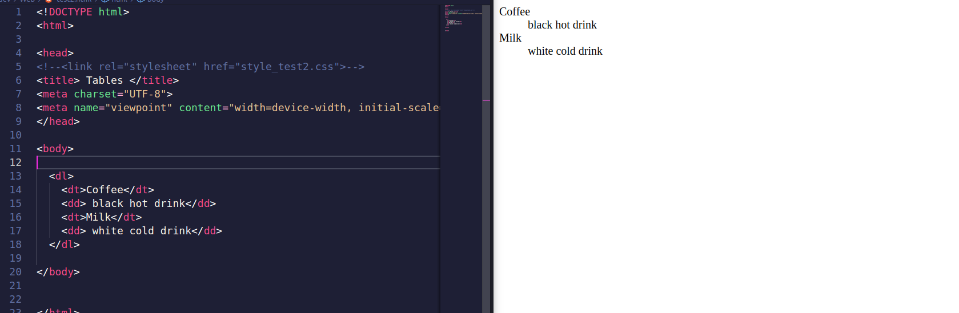
Description List

Slide 6
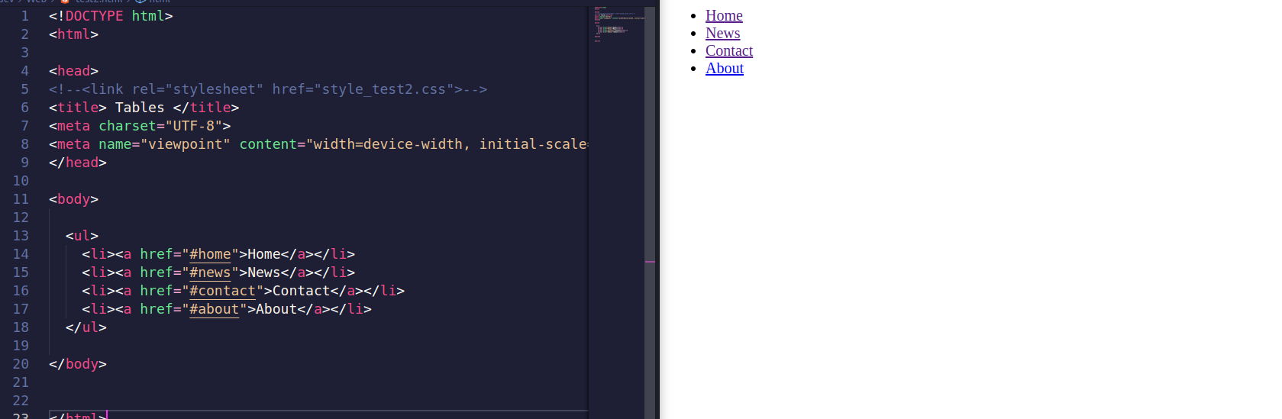

Slide 7
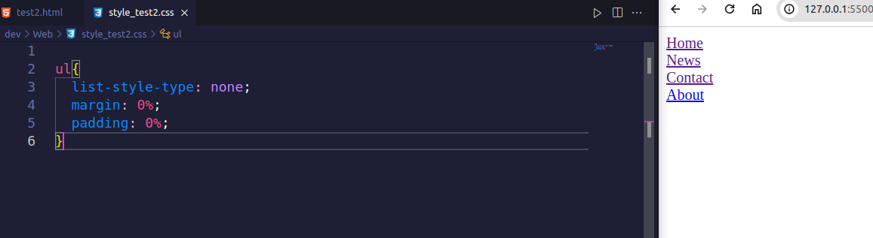
list-style-type: none;
margin: 0;
padding: 0;

Slide 8
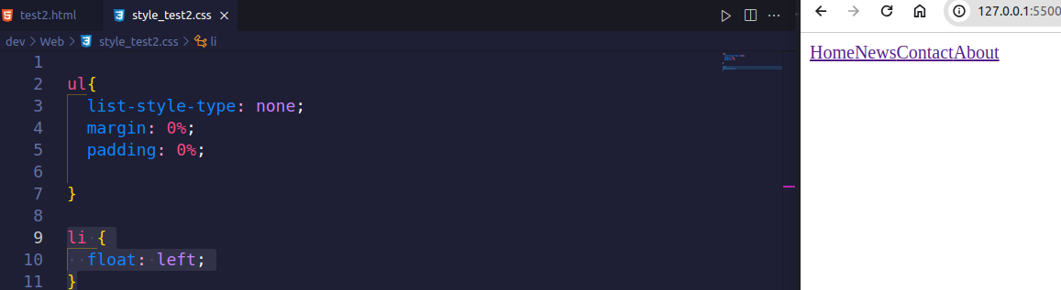
li {
float: left;
}

Slide 9
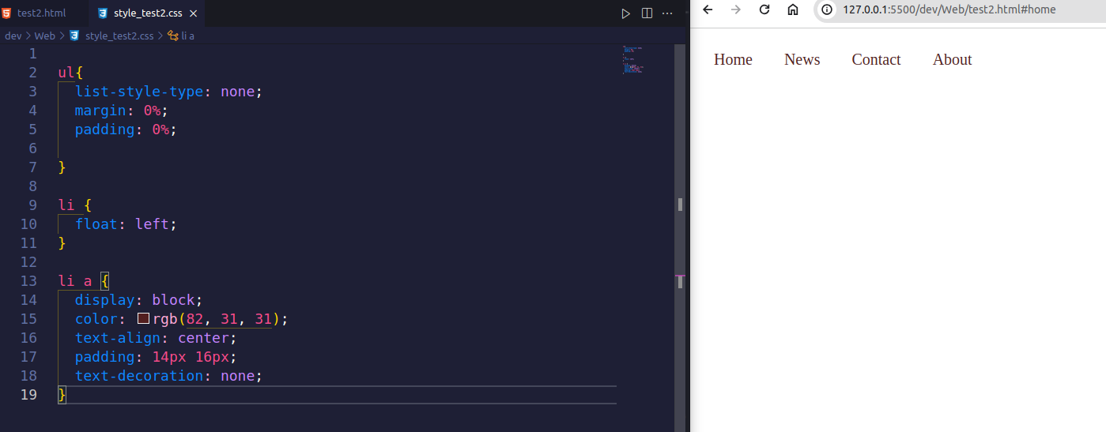
li a {
display: block;
color: rgb(82, 31, 31);
text-align: center;
padding: 14px 16px;
text-decoration: none;
}

Slide 10
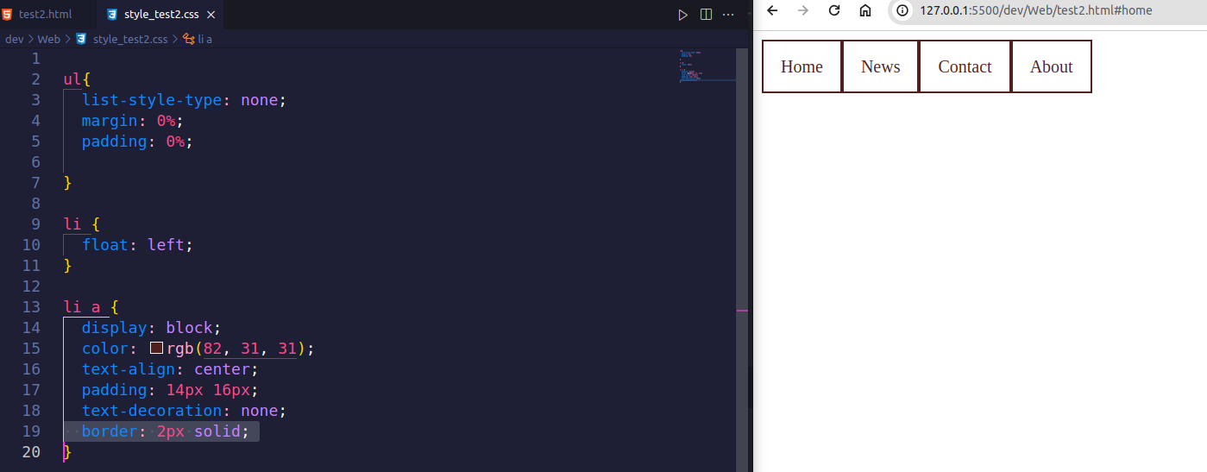
border: 2px solid;

Slide 11
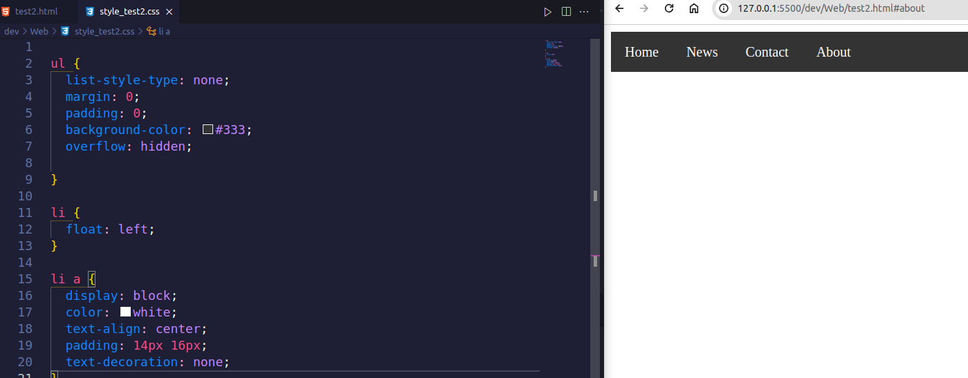

Slide 12
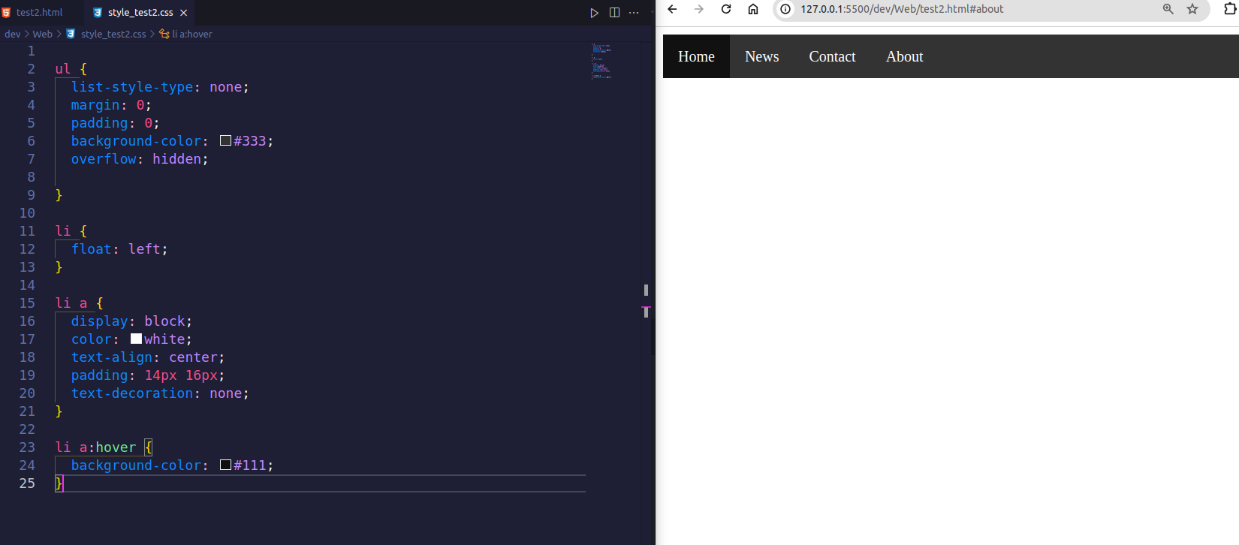

Slide 13
