Slide 2
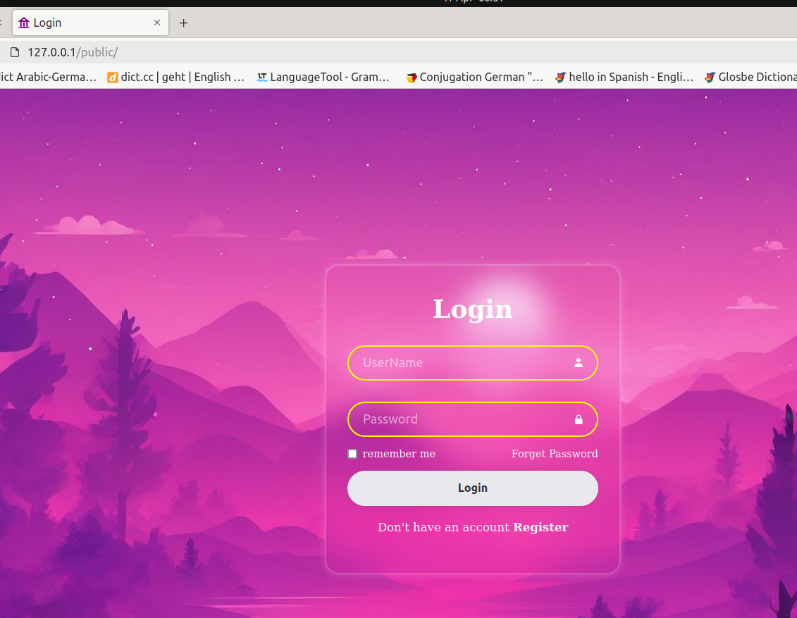
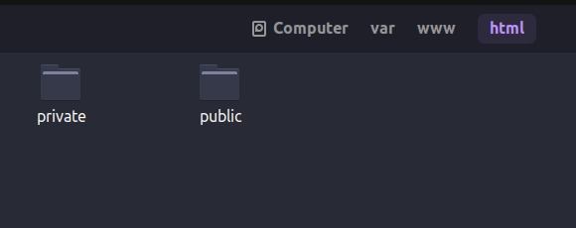
Keep functioal code private
My page is in public folder

Slide 3
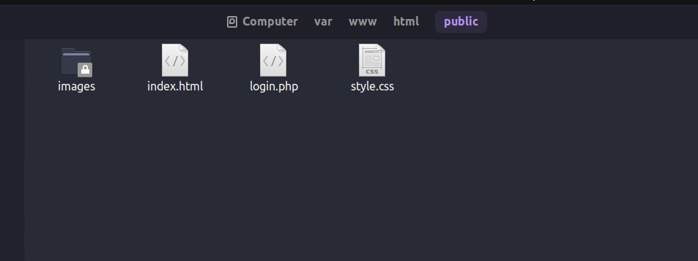
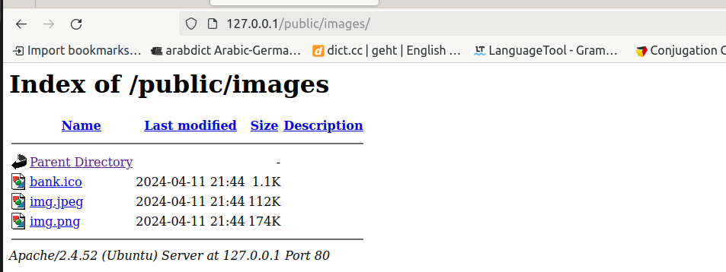
Avoid directory listing

Slide 4
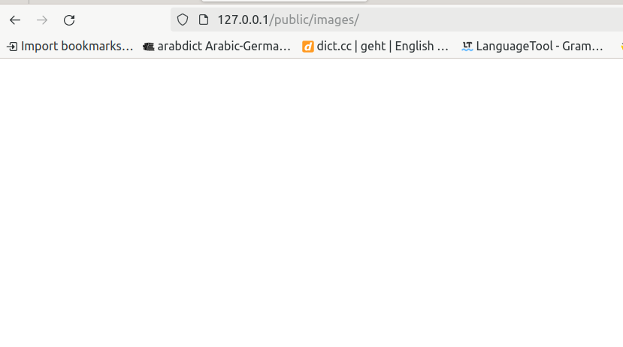
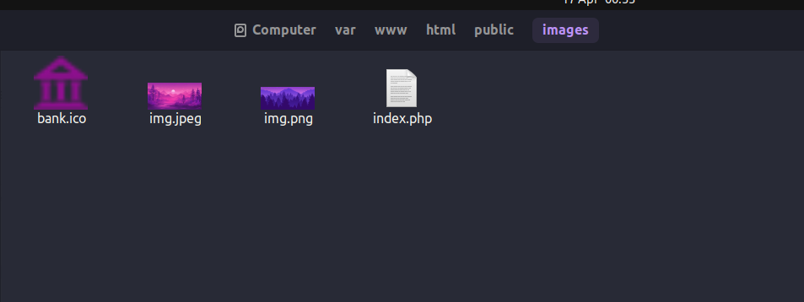
By making an empty index.php

Slide 5
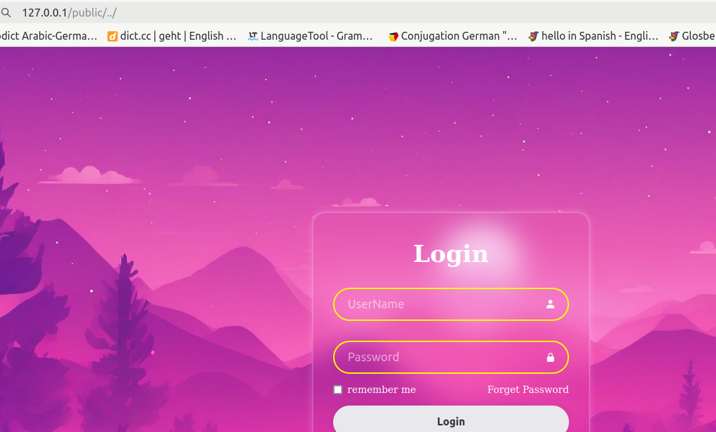
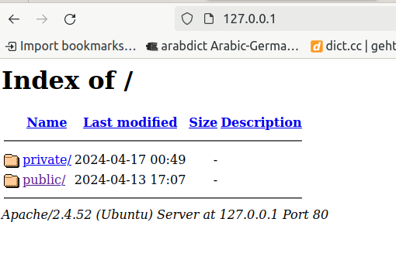
../ → upper direcotry
127.0.0.1/public/../

Slide 6
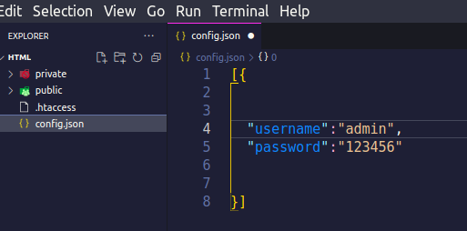
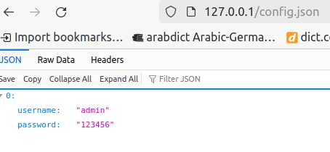
Always use php extension

Slide 7
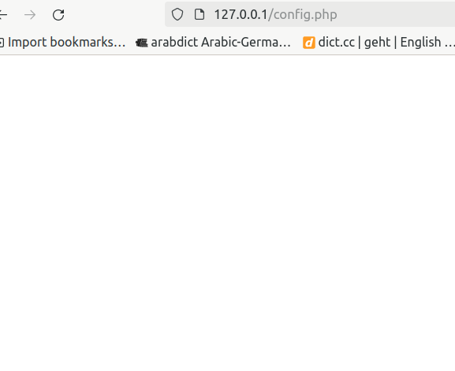
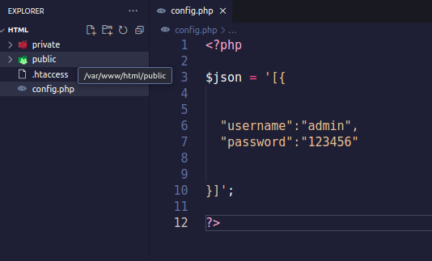

Slide 8
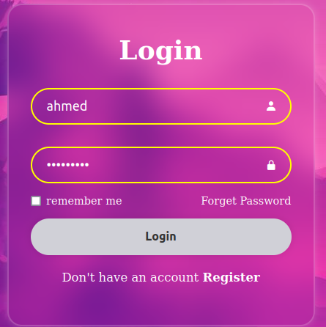

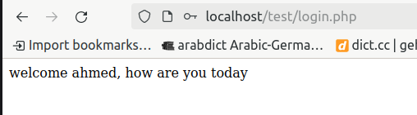
The normal thing for any client is to enter his username as well as his password To be redirected to his profile , data , account ,etc ...
In my case when fill the login form by entering my username and password I redirected to login.php
Notice: I have to enter a username and password without leaving them empty

Slide 9
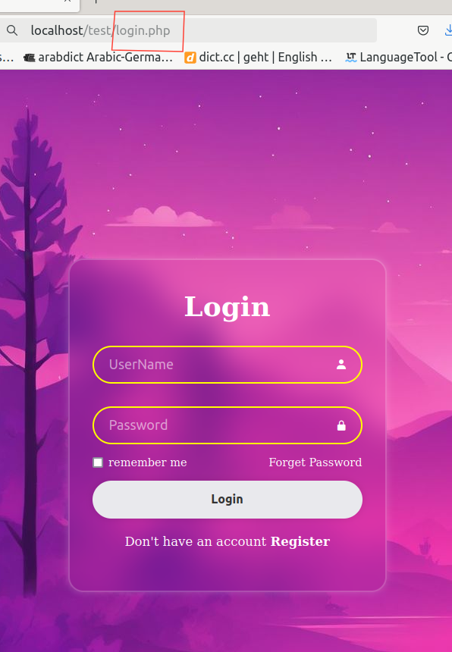
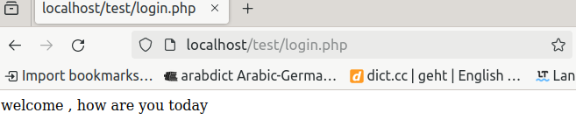
The previous slide was how the cleint deal with things, in other hand we have the hacker
Who thinks how to baypass such thing without entering a username and password
,let us say that the hacker by any way got to know our "redirected to" file or page , he can
Just put the name of the file in the URL and redirected to the new page as we see below
URL: http://localhost/test/
Adding the loging.php
URL: http://localhost/test/login.php

Slide 10
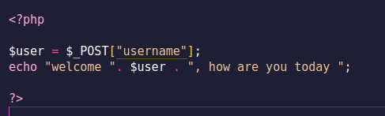
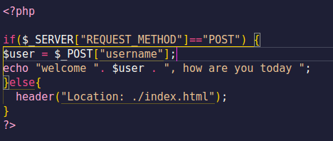
To overcome such bug we will use if statement to check the REQUEST_METHOD
,let us firstly look at the previous vulnerable code
Because we are using POST method in our login form, the if statement will check if the
method coming from the login form is POST , if so it will redirect us to the file login.php
If not it will redirect us to our login_form again
<?php
if($_SERVER["REQUEST_METHOD"]=="POST") {
$user = $_POST["username"];
echo "welcome ", $user , ", how are you today ";
}else{
header("Location: ./index.html");
}
?>

Slide 11
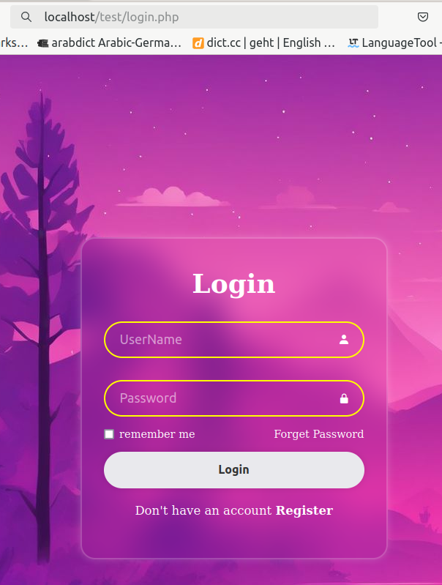
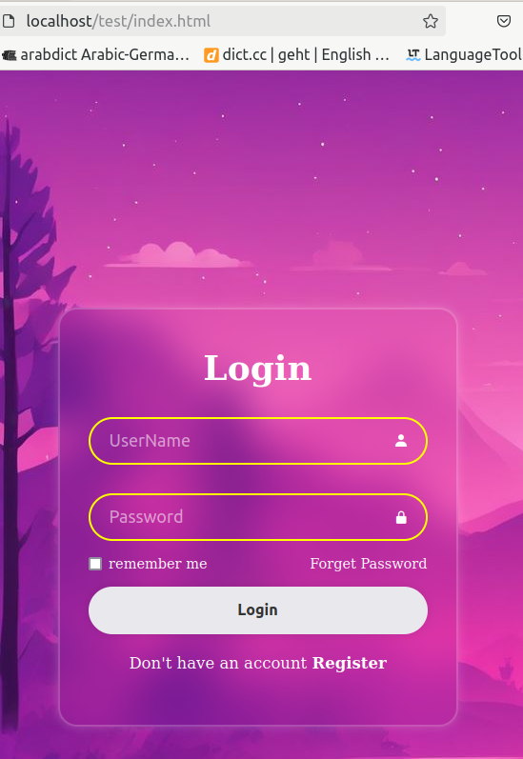
We use $_SERVER["REQUEST_METHOD"] to retreive our method whether it is(POST,GET,HEAD,PUT),So in previous code we used it to check for our method and if the statement is true we execute the code between
The curly brackets and if false we execute our else statement header("Location: ./index.html"); we here redirect our page to the index.html(which is in our case the login_form)
So if the hacker tried the previous way of baypassing the page he will be redirected to the login_form again

Slide 12
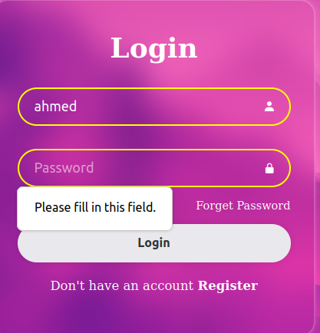
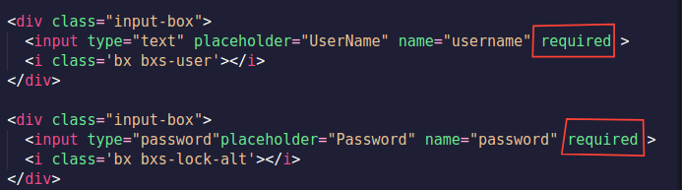
The hacker then will think about making the POST method with ,for instace with wrong credentials or username without password
Someone may say we can make the username and password “required “ in the html so it is
mandatory to write them both
As follows

Slide 13
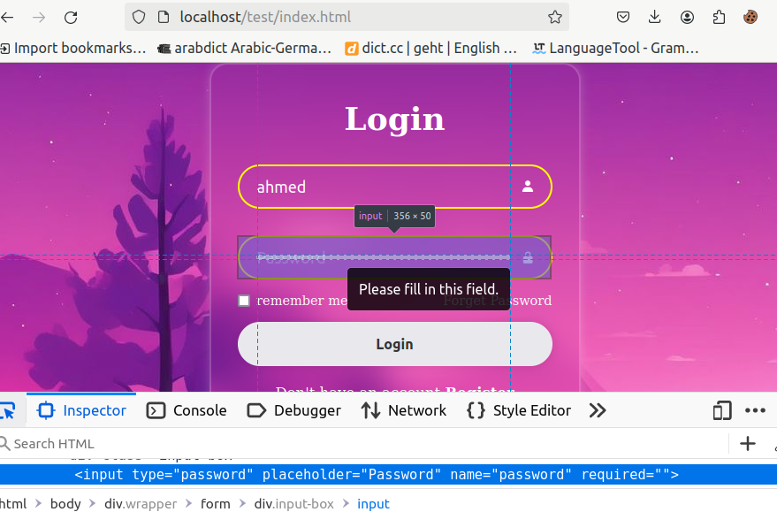
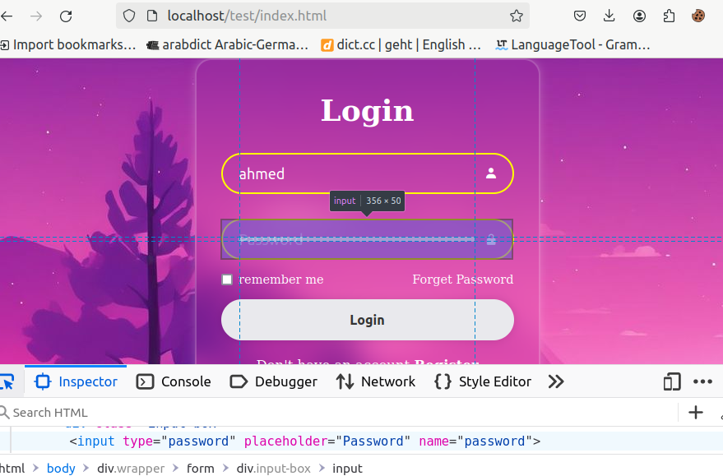
Hacker then will manapulate the HTML to make it not “required”

Slide 14
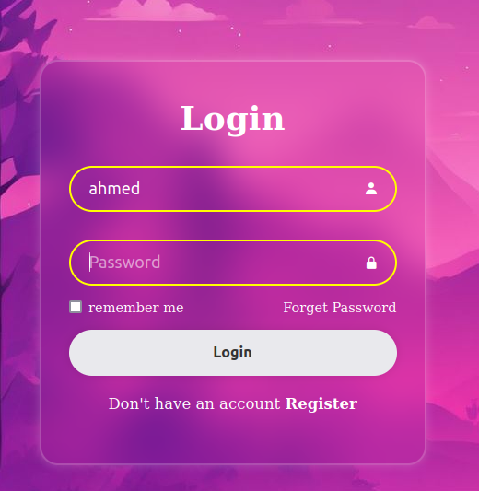
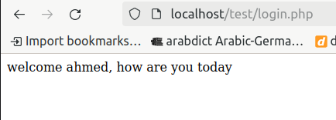
And eventually will be able to baypass it
Press Login
The fruit here is not to rely completely on the validation of html,css , java script

Slide 15
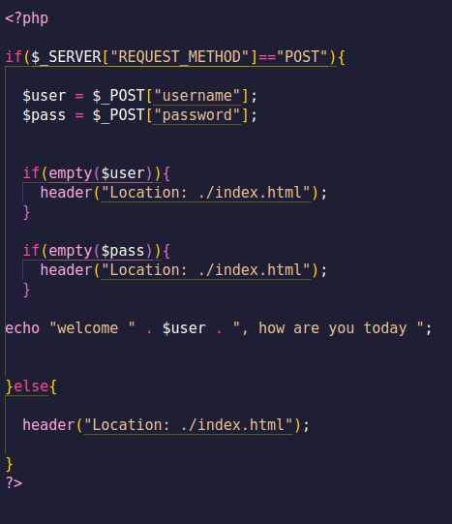
Let us now make the check point in the server side(PHP)

Slide 16
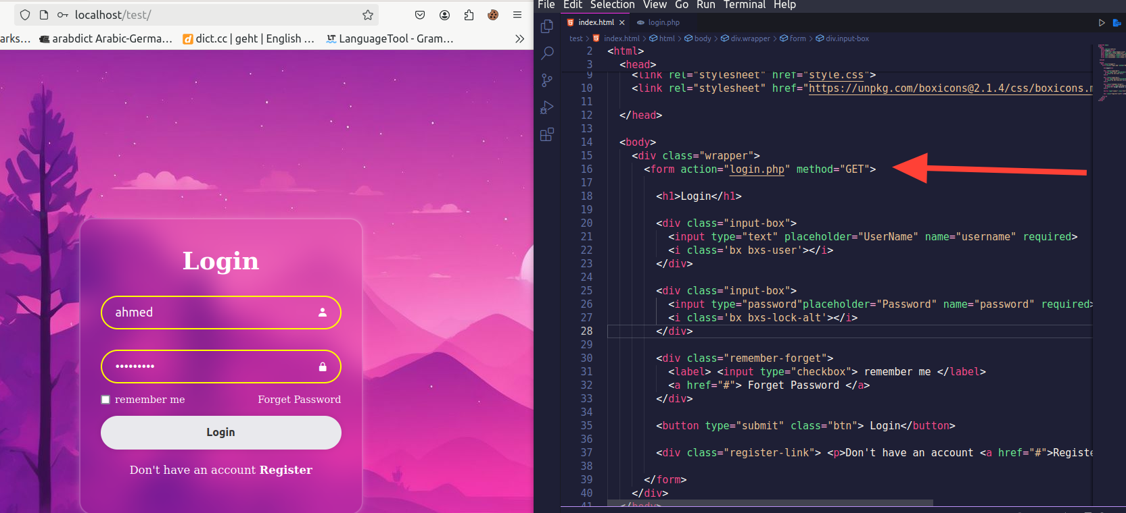
we have two ways in order to get the data from our login_page and these are:
GET and POST methods , Let us start with GET method

Slide 17
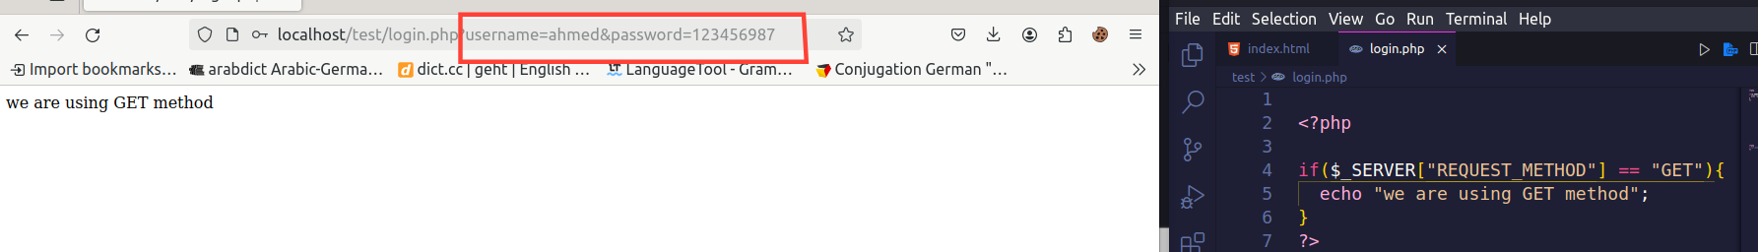
The security hole when using GET method is we are getting the username and the
password In the parameter even worse it is not encrypted
URL: http://localhost/test/login.php?username=ahmed&password=123456987

Slide 18
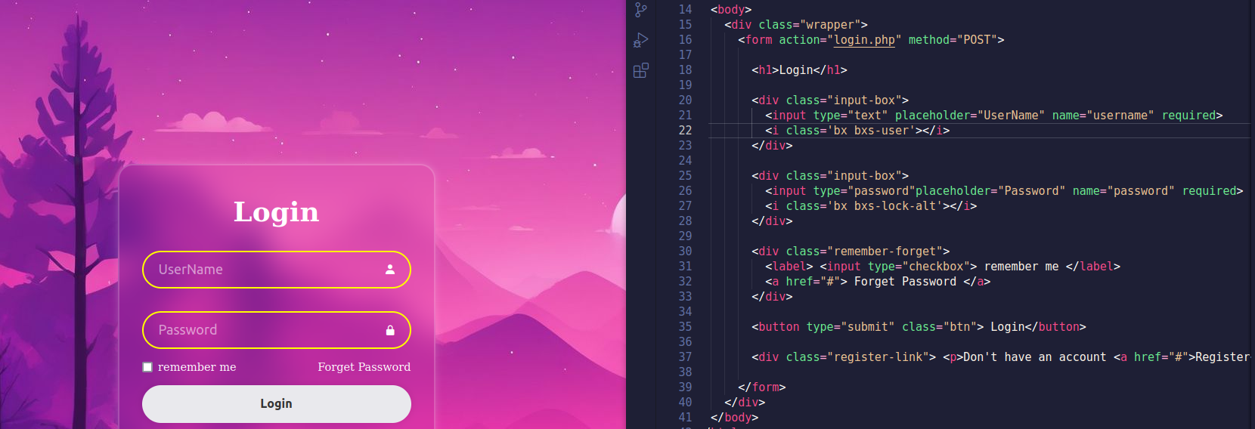
We can overcome the previous problem using POST method instead

Slide 19
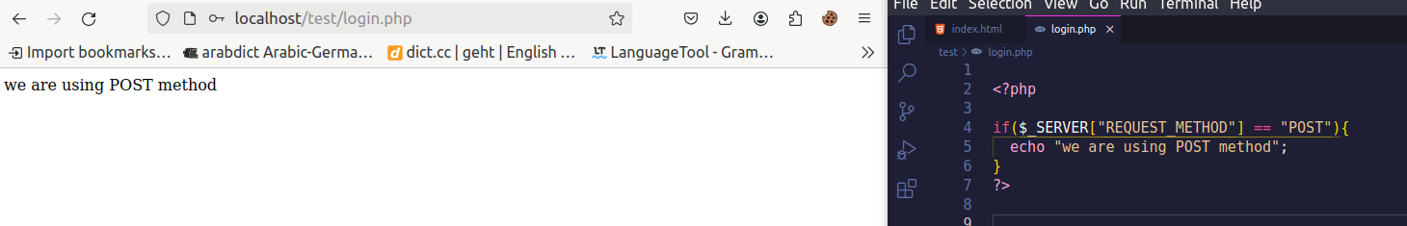
Here we got non of the username or the password in out url
URL: http://localhost/test/login.php

