Slide 1
QubitCo
A Decentralized Governance Platform
Uzan
Kyo

Slide 2
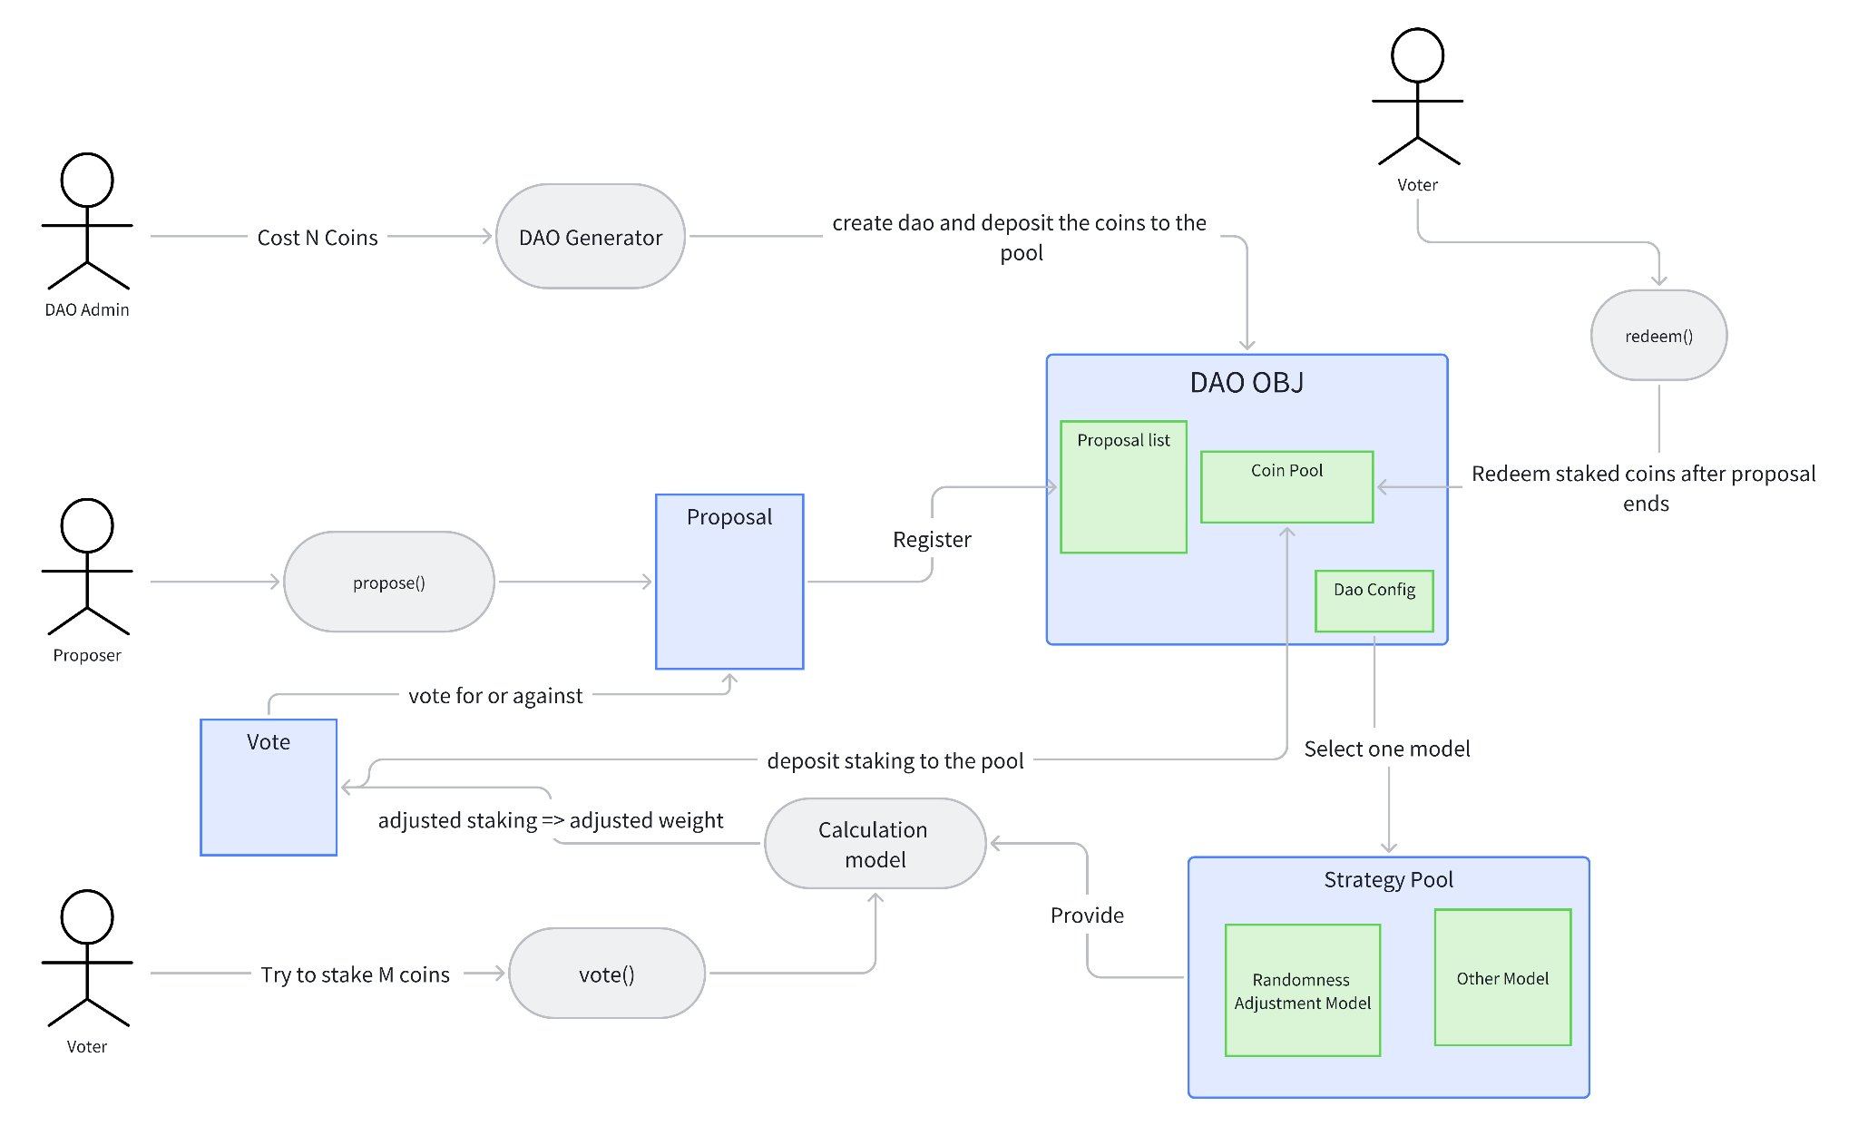
Minimum Viable Product for Hackathon

Slide 3
Aptos randomness: voting weight adjustment strategy
A very simple mathematical model, only for demonstration purposes
max_adjustment_ratio=51% x log2(stake/supply+1)
note: if you stake the number of total supply, your staking coul be reduced by 51% at most
final_staking= staking- random[0,1]*max_adjustment_ratio
note: in move coding, float number = one nominator integer + one denominator integer, log2(float)=lookup table

Slide 4
Demo
webpage:
https://qubitco.netlify.app/
Test report
https://docs.google.com/document/d/1CO5WP-11K6els_2vaWnVbmOJMMWfo1eyP_mpjL_2TUs/edit?usp=sharing

Slide 5
Business Value
Assist web3 teams in rapidly launching a DAO. More focus on market trends rather than technical details
Modularization of voting strategy and more in future
More transparent decision-making process
Data on-chain
Process on-chain
Potential low-code web3 platform

Slide 6
Thank you
DApp page: https://qubitco.netlify.app/
Code repo: https://github.com/uzan-uz18/QubitCo-Hackathon-Shenzhen

