Slide 1

Undefined behaviours in P4 progams: find them, fix them or exploit them.
University Politehnica of Bucharest
Costin Raiciu
Thanks to
CORNET H2020

Slide 2
P4 by example: route and encapsulate
IN
Ingress Pipeline
Egress Pipeline
ipv4_lpm
encap
OUT
PARSER
TTL>0
Buffers
DEPARSER
10.0.0.0/8
Ge0
*
1.2.3.4
5.6.7.8
Control program – what sequence of
M/A tables is applied to a packet
Match-action (M/A) tables - how
a P4 switch can tranform packets
What packets the switch accepts and outputs

Slide 3
P4 by example: route and encapsulate
IN
Ingress Pipeline
Egress Pipeline
ipv4_lpm
encap
OUT
PARSER
TTL>0
Buffers
DEPARSER
10.0.0.0/8
Ge0
*
1.2.3.4
5.6.7.8
parser start {
extract(eth);
return select(eth.type){
0x800 : parse_ipv4;
default: ingress; }}
parser parse_ipv4 {
extract(ipv4);
return ingress; }
Deparsing uses the same parser specification.
Common problem: forget to parse output packets.
Notes:
Mai in detaliu

Slide 4
P4 by example: route and encapsulate
IN
Ingress Pipeline
Egress Pipeline
ipv4_lpm
encap
OUT
PARSER
TTL>0
Buffers
DEPARSER
10.0.0.0/8
Ge0
*
1.2.3.4
5.6.7.8
parser start {
extract(eth);
return select(eth.type){
0x800 : parse_ipv4;
default: ingress; }}
parser parse_ipv4 {
extract(ipv4);
return select(ipv4.protocol){
0x5E : parse_inner_ipv4;
default: ingress; }}
parser parse_inner_ipv4 {
extract(inner_ipv4);
return ingress; }}
Notes:
Mai in detaliu

Slide 5
P4 by example: route and encapsulate
Ingress Pipeline
parser start {
extract(eth);
return select(eth.type){
0x800 : parse_ipv4;
default: ingress; }}
parser parse_ipv4 {
extract(ipv4);
return select(ipv4.protocol){
0x5E : parse_inner_ipv4;
default: ingress; }}
parser parse_inner_ipv4 {
extract(inner_ipv4);
return ingress; }}
IN
Egress Pipeline
ipv4_lpm
encap
OUT
PARSER
TTL>0
Buffers
DEPARSER
10.0.0.0/8
Ge0
*
1.2.3.4
5.6.7.8
control ingress(){
if (ipv4.TTL>0)
apply(ipv4_lpm);
}
Reading unparsed header fields will return
undefined values

Slide 6
P4 by example: route and encapsulate
IN
Ingress Pipeline
Egress Pipeline
ipv4_lpm
encap
OUT
PARSER
valid(ipv4)
&&TTL>0
DEPARSER
Buffers
10.0.0.0/8
Ge0
*
1.2.3.4
5.6.7.8
control ingress(){
if (valid(ipv4) and ipv4.TTL>0)
apply(ipv4_lpm);
}
Non IPv4 packets will be sent directly to buffering resulting
in undefined behavior because the egress_spec is not set
Notes:
Undefined behavior?

Slide 7
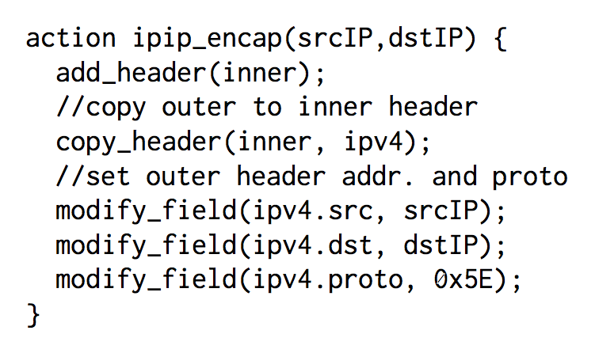
P4 by example: route and encapsulate
IN
Ingress Pipeline
Egress Pipeline
ipv4_lpm
encap
OUT
PARSER
valid(ipv4)
&&TTL>0
DEPARSER
Buffers
10.0.0.0/8
Ge0
*
1.2.3.4
5.6.7.8
Re-adding existing header fields: undefined
behavior
Notes:
Fara mers inapoi

Slide 8

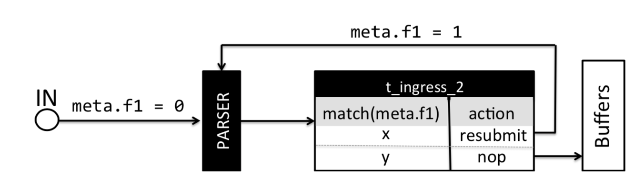
Undefined behaviours in P4
Accessing invalid headers.
Valid headers not deparsed.
Reviving dropped packets.
Out-of-bounds array accesses.
Overflows / underflows.
Infinite loops.
control ingress(){
if (ipv4.TTL>0)
apply(ipv4_lpm);
}
parser start {
extract(eth);
return select(eth.type){
0x800 : parse_ipv4;
default: ingress; }}
parser parse_ipv4 {
extract(ipv4);
return ingress; }
apply(acl) //triggers action that drops packet
apply(lpm) //triggers action that sets egress_spec to a valid value

Slide 9
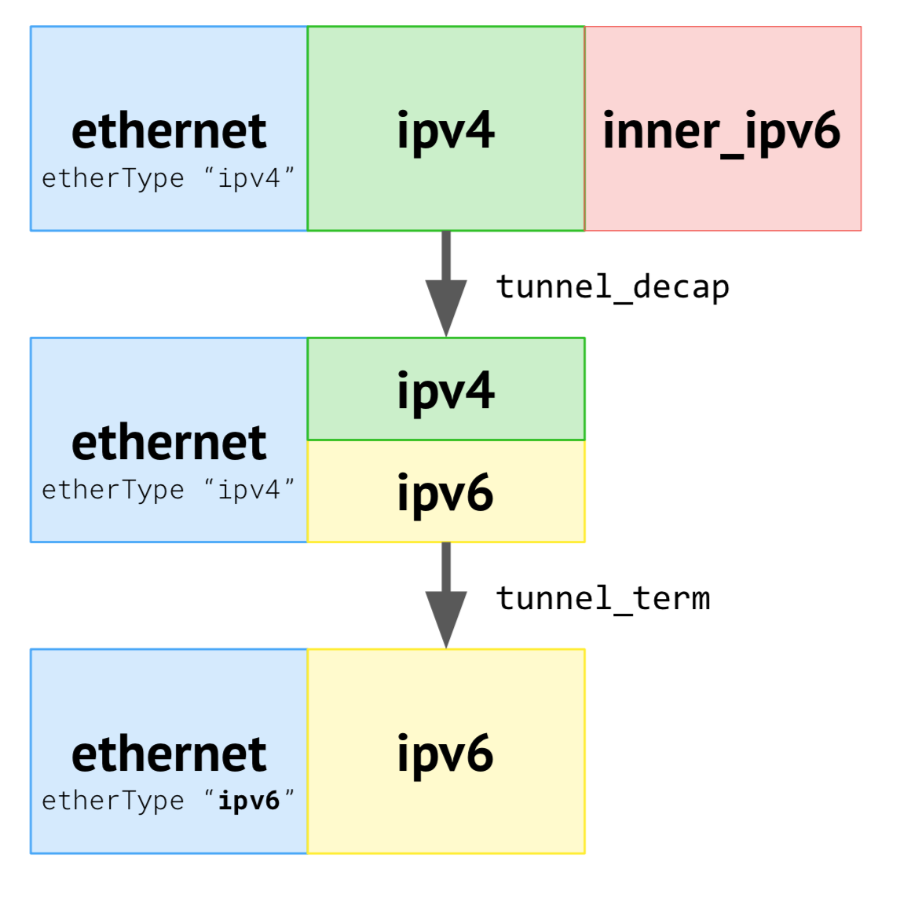
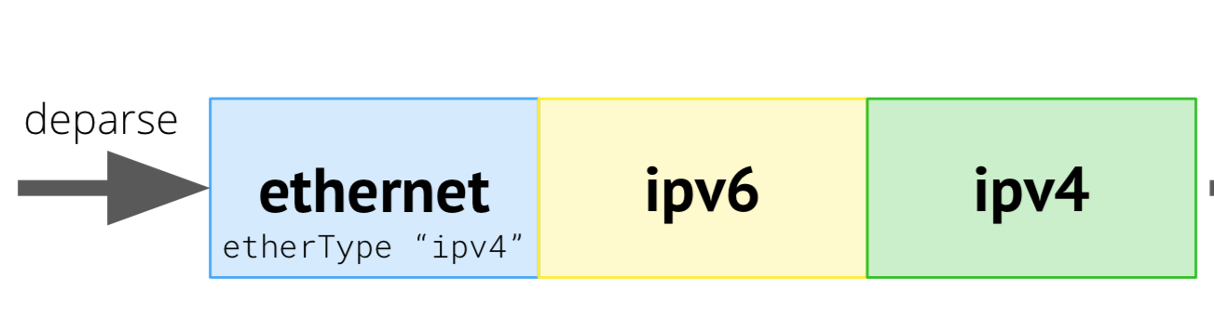
Architecture-specific behaviour
Reparseability
Live mutually exclusive headers (cf. parser)
Ambiguous forwarding.
Ingress
pipeline
parse
egress
pipeline
?

Slide 10
Undefined behaviour is bad.
What happens on actual targets?

Slide 11
Test to find out
Craft buggy programs
Inject packets to trigger undefined behaviour
Observe results on
Tofino, P4NetFPGA,Bmv2 SimpleSwitch

Slide 12
Testing undefined header accesses
ethertype
src dst
Good packet
Faulty packet
Ethernet
IPv4
Ethernet
0x800
0x809
control ingress() {
if (!isValid(ipv4))
apply(m);
}
table m, default action copy
copy (){
ether.etherType = ipv4.check;
}
Bmv2 Previous packets’ IPV4 checksum field
P4NetFPGA etherType field set to 0.
Tofino etherType field set to 0.

Slide 13
Testing undefined header accesses (2)
ethertype
src dst
Good packet
Faulty packet
Ethernet
IPv4
Ethernet
Explore
0x800
0x809
control ingress() {
if (isValid(Explore))
apply(m)
}
Table m default action copyALL
copyAll(){
explore.srcAddr = ip.srcAddr;
//…
explore.proto = 0x13
}
Bmv2 Values from previous ipv4 headers.
P4NetFPGA Explore fields set to zero.
Tofino Explore unchanged except for proto field

Slide 14
Writing invalid headers
ethertype
src dst
Good packet
Faulty packet
Ethernet
IPv4
Ethernet
Explore
0x800
0x809
if (isValid(explore){
ipv4.src= 0.0.0.0
//…
}
if (ipv4.src==0.0.0.0)
eth.etherType = 0x1
Bmv2 Writes and read succeed.
P4NetFPGA Writes and read succeed.
Tofino Writes and read succeed, explore changed

Slide 15
Loops
Write infinite loops using resubmit and clone egress to egress.
Insert 1 packet to trigger each bug.
P4NetFPGA Does not support recirculation.
Tofino Clone egress-to-egress: DDoS on egress.
Bmv2 +Resubmitted packets block ingress pipeline.

Slide 16
Resurrecting dropped packets
mark_to_drop()
set_egress_spec
Tofino OK: drop sets flag,must be cleared on purpose to resurrect
P4NetFPGA Drop sets egress_spec to 0
Bmv2 Drop sets egress spec to 511

Slide 17
Can we exploit P4 programs?
Assume strongest possible attacker
Directly connected to switch
Knows both program and table rules.

Slide 18
Impossible attacks *
Code injection
Control flow hijacking
Return oriented programming
Possible attacks
Data flow attacks
Denial of service
Privilege escalation

Slide 19
Some attacks we mounted
SimpleNAT
Bypass ACL with resurrected packets
Denial of Service
Privilege Escalation
Switch
Privilege Escalation

Slide 20
Good cop
Finding P4 bugs
before deployment

Slide 21
Verification value proposition
Inspect P4 program before deployment.
Flag (all) bugs to programmer.
Ensure deployed programs are bug-free.

Slide 22
A growing number of verification tools for P4
p4-nod [MSR TR ]
p4-pktgen [SOSR 2018]
p4v [Sigcomm 2018]
Vera [Sigcomm 2018]
p4-assert [Conext 2018]
af4 - ongoing work

Slide 23
A P4 program is only half a program Full functionality: P4 program + table rules
Key decision: how to deal with missing rules:
Concrete rules (commands.txt) – Vera, p4pktgen.
Assume all rules possible, have programmer to provide control-plane annotations - p4v, p4-assert.
Derive control plane annotations automatically – af4.
Burden on programmer to provide relevant snapshots; poor coverage, fast (seconds).
Great coverage, burden on programmer to provide annotations, a bit slower (minutes).

Slide 24
Verification approach
Translate P4-14 program to another language with clearer semantics, or use P4-16.
Instrument code to add „traps” that detect bugs.
Find reachable bugs, report to programmer with example packets.
GCL (p4v), SEFL (Symnet), C (p4-assert), P4-16 (p4-pktgen, af4)
Symbolic execution or verification condition generation

Slide 25
Vera [Sigcomm18]
P4 program
P4 table entries
P4 to SEFL Compiler
Implicit bug checks
Symnet verification engine[Sigcomm’16]
For each possible path:
full instruction trace, header field values, constraints and, if needed, bug type
Notes:
Beyond these bugs -> policy

Slide 26
Generating all header layouts
parser start {
extract(eth);
return select(eth.type){
0x800 : parse_ipv4;
default: ingress; }}
parser parse_ipv4 {
extract(ipv4);
return select(ipv4.protocol){
0x5E : parse_inner_ipv4;
default: ingress; }}
parser parse_inner_ipv4 {
extract(inner_ipv4);
return ingress; }}

Slide 27
Generating all header layouts
parser start {
extract(eth);
return select(eth.type){
0x800 : parse_ipv4;
default: ingress; }}
parser parse_ipv4 {
extract(ipv4);
return select(ipv4.protocol){
0x5E : parse_inner_ipv4;
default: ingress; }}
parser parse_inner_ipv4 {
extract(inner_ipv4);
return ingress; }}
Eth
IPv4
Inner_IPv4

Slide 28
Generating all header layouts
Eth
Eth
IPv4
Inner_IPv4

Slide 29
Generating all header layouts
Eth
Eth
Eth
IPv4
IPv4
Inner_IPv4

Slide 30
Generating all header layouts
Eth
Eth
Eth
IPv4
IPv4
Eth
IPv4
Inner_IPv4
Inner_IPv4

Slide 31
Symbolic execution of P4 models
Eth
Eth
IPv4
Eth
IPv4
Inner_IPv4
Notes:
Valori simbolice – exemplu header
Ce inseamna executie simbolica
why

Slide 32
Symbolic execution of P4 models
Ethernet
IPv4
Eth
IPv4
Dst | Src | EtherType
* | * | 0x800
Src | Dst | TTL | ...
* | * | * | *
Notes:
Valori simbolice – exemplu header
Ce inseamna executie simbolica
why

Slide 33
Symbolic execution of P4 models
Ethernet
IPv4
Eth
IPv4
Dst | Src | EtherType
* | * | 0x800
Src | Dst | TTL | ...
* | * | * | *
control ingress(){
if (ipv4.TTL>0)
apply(lpm);
}
Notes:
Valori simbolice – exemplu header
Ce inseamna executie simbolica
why

Slide 34
Symbolic execution of P4 models
P414
control ingress(){
if (ipv4.TTL>0)
apply(lpm);
}

Slide 35
Symbolic execution of P4 models
SEFL
P414
‘ingress’:
If(Constrain(‘ipv4.TTL’>0))
Forward(‘table.lpm’)
else
Forward(‘buffer.in’)
control ingress(){
if (ipv4.TTL>0)
apply(lpm);
}
Notes:
Ce fac instructiunile

Slide 36
Symbolic execution of P4 models
SEFL
‘ingress’:
If(Constrain(‘ipv4.TTL’>0))
Forward(‘table.lpm’)
else
Forward(‘buffer.in’)
Ethernet
IPv4
Dst | Src | EtherType
* | * | 0x800
Src | Dst | TTL | ...
* | * | * | *

Slide 37
Symbolic execution of P4 models
SEFL
‘ingress’:
If(Constrain(‘ipv4.TTL’>0))
Forward(‘table.lpm’)
else
Forward(‘buffer.in’)
Ethernet
IPv4
Dst | Src | EtherType
* | * | 0x800
Src | Dst | TTL | ...
* | * | * | *
Dst | Src | Ether Type
* | * | 0x800
Src | Dst | TTL | ...
* | * | >0 | *
Dst | Src | Ether Type
* | * | 0x800
Src | Dst | TTL | ...
* | * | ==0 | *

Slide 38
Symbolic execution of P4 models
SEFL
‘ingress’:
If(Constrain(‘ipv4.TTL’>0))
Forward(‘table.lpm’)
else
Forward(‘buffer.in’)
Ethernet
IPv4
Dst | Src | EtherType
* | * | 0x800
Src | Dst | TTL | ...
* | * | * | *
Dst | Src | Ether Type
* | * | 0x800
Src | Dst | TTL | ...
* | * | >0 | *
Dst | Src | Ether Type
* | * | 0x800
Src | Dst | TTL | ...
* | * | ==0 | *
Apply LPM

Slide 39
Symbolic execution of P4 models
SEFL
‘ingress’:
If(Constrain(‘ipv4.TTL’>0))
Forward(‘table.lpm’)
else
Forward(‘buffer.in’)
Ethernet
IPv4
Dst | Src | EtherType
* | * | 0x800
Src | Dst | TTL | ...
* | * | * | *
Dst | Src | Ether Type
* | * | 0x800
Src | Dst | TTL | ...
* | * | >0 | *
Dst | Src | Ether Type
* | * | 0x800
Src | Dst | TTL | ...
* | * | ==0 | *
Goto buffer in

Slide 40
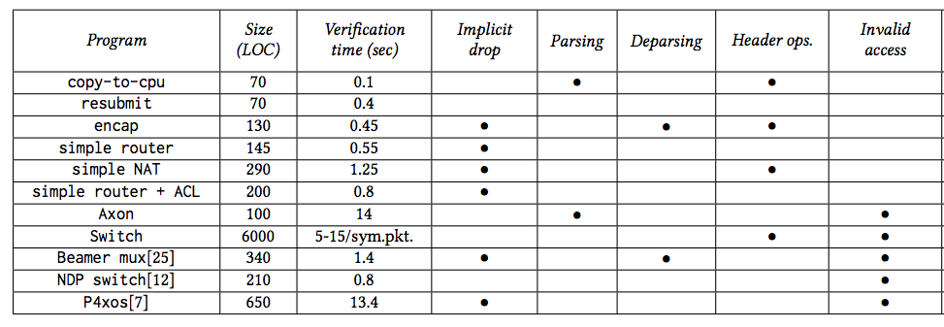
Vera evaluation summary

Slide 41
Vera works great for concrete table rules, but the rules are only known at runtime.
Apply Vera at runtime, catching rules before they are inserted and re-check the entire program.
Assume all table entries are possible – symbolic table entries
Too slow!
Repeatedly finds same bugs, does not scale
Notes:
Concrete -> symbolic explaination

Slide 42
p4v [Sigcomm 18]
assume
action(tunnel_decap) == decap_6in4
iff
action(tunnel_term) == term_6in4
P4 program
Control-plane interface
FAILED
counterexample
GCL Program
Z3
PASSED
GCL (Annotated, Optimized)
Verification condition

Slide 43
p4v evaluation
switch.p4 ~ 2 minutes
Control plane interface: 758LOC
Found 10 bugs: 2 parser bugs, 4 action flaws, 3 infeasible control plane, 1 invalid table read.

Slide 44
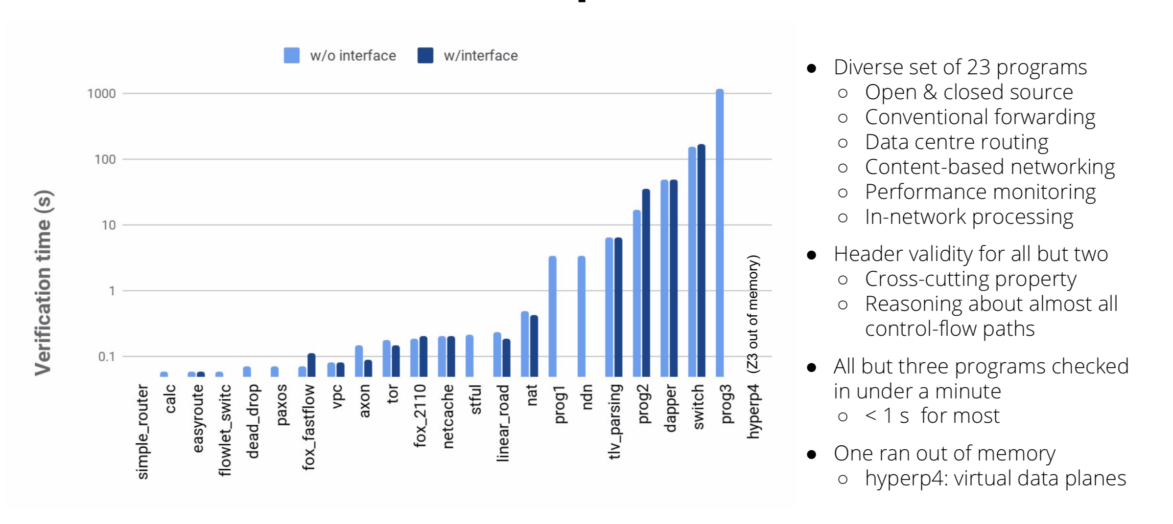
p4v performance

Slide 45
p4v vs. Vera
Catches fewer bug types, e.g. no loops.
Covers all possible dataplanes
Scales much better, but requires manual annotations
700 annotations for 6KLOC program

Slide 46
af4 – annotation-free verification&repair
Automatically infer annotations for table rules
Backend for the p4c compiler (11KLOC)
Inhibit many (ideally all) unsafe behaviours
Do not prevent any safe behaviours
No manual annotations required

Slide 47
Key idea
Find table rules that always lead to faulty behaviour
table nat {
actions={
drop();//...
nat_hit_int_to_ext();
}
key = { //...
hdr.ipv4.isValid(): exact
hdr.ipv4.srcAddr : ternary}
}
isValid hdr.ipv4.srcAddr action
GOAL: AUTOMATICALLY DERIVE PREDICATES
TO FILTER BAD RULES
0
10.10.10.10, 255/8
drop
ALL PACKETS TRIGGER BUG
0
*, 255/8
*
ALL PACKETS TRIGGER BUG
0
*, != 0
*
ALL PACKETS TRIGGER BUG

Slide 48
af4 operation summary
P4 program
Transform &
instrument

Slide 49
af4 operation summary
Expand table calls
P4 program
Transform &
instrument
Generate
reachability conditions

Slide 50
af4 operation summary
Expand table calls
P4 program
Transform &
instrument
Generate
reachability conditions
SAT(reach(bug))​
Find reachable
bugs

Slide 51
af4 operation summary
Expand table calls
P4 program
Transform &
instrument
Generate
reachability conditions
SAT(reach(bug))​
Infer predicates &
add missing keys
Find reachable
bugs
For each bug, find assert point and

Slide 52
af4 operation summary
Expand table calls
P4 program
Transform &
instrument
Generate
reachability conditions
SAT(reach(bug))​
Infer predicates &
add missing keys
Find reachable
bugs
For each bug, find assert point and

Slide 53
af4 operation summary
Expand table calls
P4 program
Transform &
instrument
Generate
reachability conditions
SAT(reach(bug))​
Infer predicates &
add missing keys
Find reachable
bugs
For each bug, find assert point and
Output controller assertions
Output fixed
P4 program

Slide 54
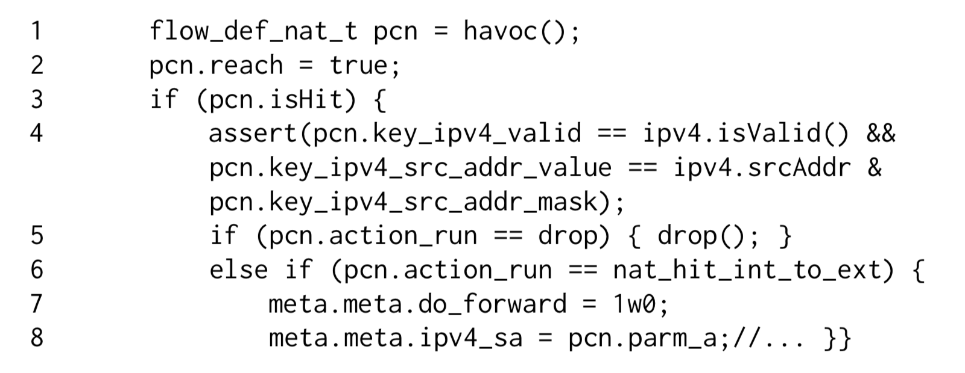
Expanding NAT table call
5
6
7
8
9
if (pcn.key_ipv4_valid==0 &&
pcn.key_ipv4_src_addr_mask!=0)
bug();

Slide 55
Build control flow graph
ingress
pcn = havoc<flowdef_nat>;
pcn.reach = 1;
ASSERT POINT
true
true
true
true
pcn.action_run
== drop
pcn.hit==1
key_match
key_valid
false
false
true
false
BUG
pcn.action_run== nat_hit_int_to_ext
mark_to_drop()
false
true
meta.do_forward=1
meta.ipv4_sa = …
false
ACCEPT

Slide 56
Generating verification condition
ingress
true
ASSERT POINT
pcn.hit==true &&
key_matches &&
key_is_valid
true
pcn.hit==true
true
pcn.hit=true &&
key_matches &&
! key_is_valid
…
pcn.hit==true &&
key_matches &&
key_is_valid &&
pcn.action_run==drop
pcn.hit==false ||
(pcn.hit==true &&
key_matches &&
key_is_valid &&
pcn.action_run==drop)

Slide 57
Algorithm
Inputs:
OK – good runs – weakest precondition for accept.
BUG – bad runs – weakest precondition for bug.
P – controlled variables – table keys and action
Candidate keys
Output: constraints for controlled variables.

Slide 58
Infer: Automatically infering predicates
Get model
Get model
Get model
P3
OK
P2
BUG
P1
Intersect?
NO
Unsat core
P1
P2
YES
Add Keys
P3

Slide 59
af4 at work
switch.p4 - 6KLOC ,372 keys, 129 tables
Runtime: 11 minutes.
Reachable bugs before Infer: 164
Reachable bugs after Infer: 86
Reachable bugs after Infer+Fix: 0
44 keys (isValid) added to 17 tables.

Slide 60
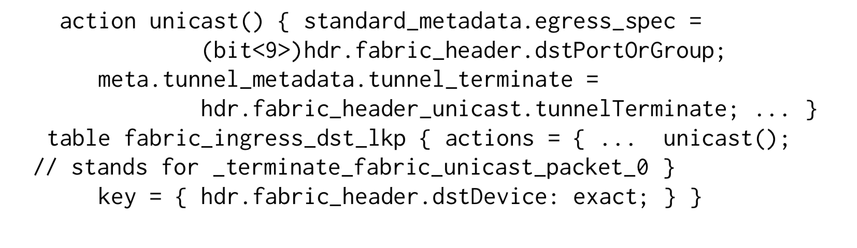
Example bug
Need to add key isValid(hdr.fabric_header)
Need to add key isValid(hdr.fabric_header_unicast)

Slide 61
Limitations of af4
Does not support all types of bugs
e.g egress spec not set.
Assumes tables have a fixed no-op default entry
It may not always manage to remove all bugs.

Slide 62
Conclusions
Easy to code bugs in P4 programs
Verification before deployment is crucial, or be pwned
We can automatically find all instances of certain types of bugs in P4 programs
Vera, p4-pktgen: concrete snapshots
p4v: all paths, requires annotations.
af4: all snapshots, generates annotations, automatically fixes certain types of bugs.

Slide 63
Backup slides

Slide 64
Simple NAT bugs
Internal
SimpleNat
External
Attacker
Attack 1. Bypassing ACL.
Controller marks packets from attacker port to be dropped in if_info table
Attacker guesses mapping in NAT table.
Packet is resurrected.

Slide 65
Simple NAT bugs
Internal
SimpleNat
External
Attacker
Attack 2. Denial of Service
Attacker’s dropped packet misses in NAT table
Controller inserts rule for flow
Flow table overflows

Slide 66
Simple NAT bugs
Internal
SimpleNat
External
Attacker
Attack 3. Privilege escalation
Attacker spoofs controller packet
Can do whatever it wants.

Slide 67
switch.p4
Much better engineered than simple NAT.
Privilege escalation attack still possible
Craft CPU packet with proper bypass flags
Inject IPv4 packet that bypasses the ACL.

