Slide 1
Cardiac Sinusoidal Analysis

Slide 2
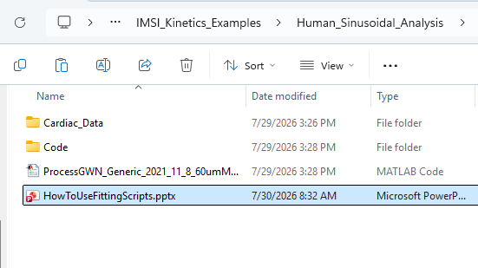
1—
For human cardiac sinusoidal length perturbation analysis data fitting, load or open the script.
ProcessGWN_Generic_2021_11_8_60umMotor.m
2—
Then just run the script and it should make some plots for data fitting.

Slide 3
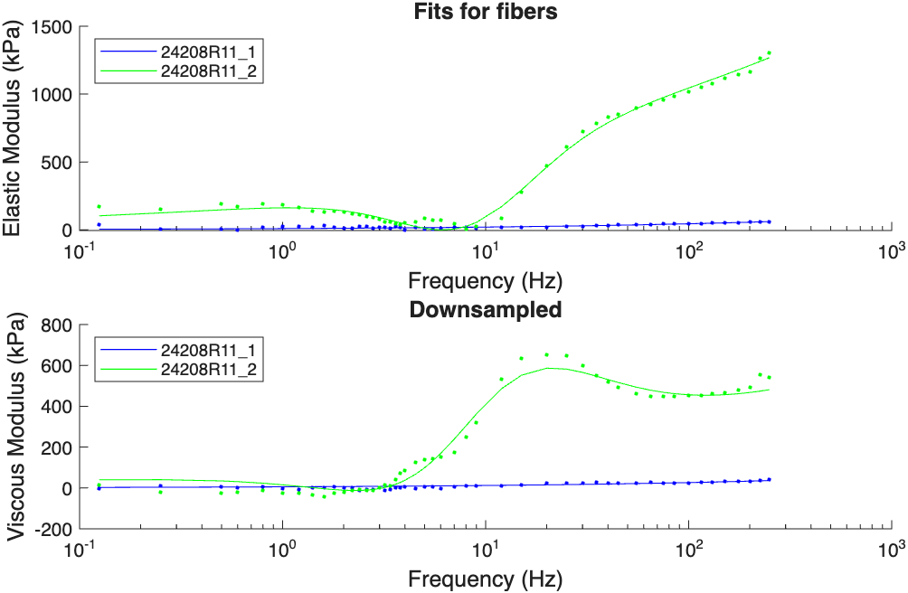
24208R11_1 (blue line) -> Sinusoid Analysis at pCa 8
24208R11_2 (green line -> sinusoid analysis at pCa 4
Elastic Modulus -> shows the stiffness of the fiber in phase with sinusoidal length change. Reflects how strongly cross-bridges are attached.
Viscous Modulus Graph -> shows the amount of energy stored by the fiber/how much resistance the fiber has out of phase with sinusoidal length change. Reflects cross-bridge cycling.

Slide 4
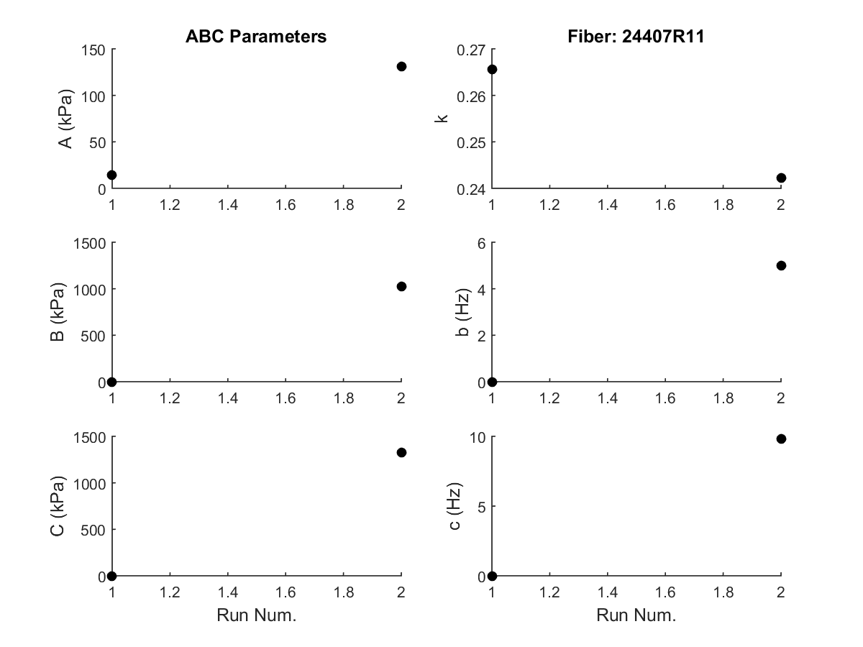
Run 1 -> multiple sinusoid at pCa 8
Run 2 -> multiple sinusoid at pCa 4
A -> The work absorbed at low frequencies
B -> Muscle’s generation of oscillatory work
C -> The work absorbed at high frequencies
From B and C we can find 2pib and 2pic
2pic is the rate constant of how quickly force decays in time
2pib is the exponential rate constant of how fast the force recovers after decay

