Slide 1
Cardiac Step Analysis

Slide 2
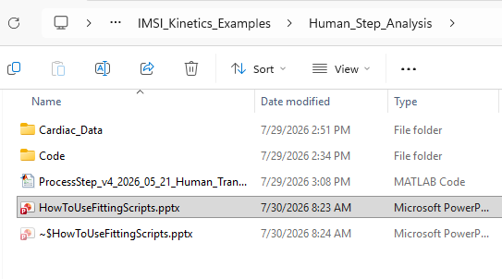
1—
For human cardiac step stretch data fitting, load or open the script.
ProcessStep_v4_2026_05_21_Human_Transmural.m
2—
Then just run the script and it should make some plots for data fitting.

Slide 3
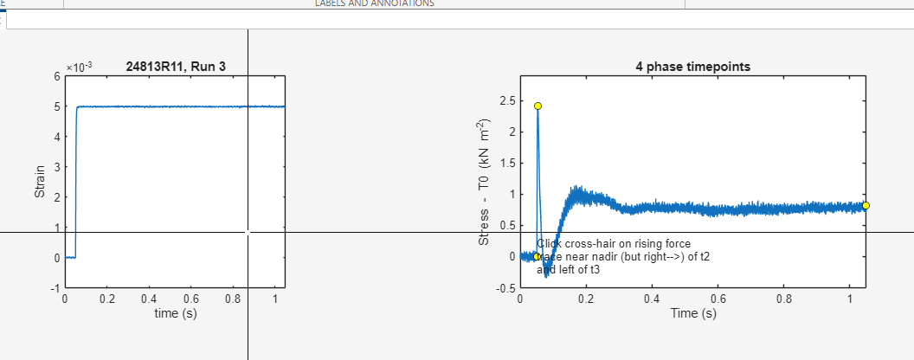
The strain v time of all the fibers compared (left)
Step Stress vs. time for all the fibers (rigor titration).
This is a little more involved, click somewhere near the minimum of the rise in force after the nadir of t_2
This is telling the computer how to find t_3

Slide 4
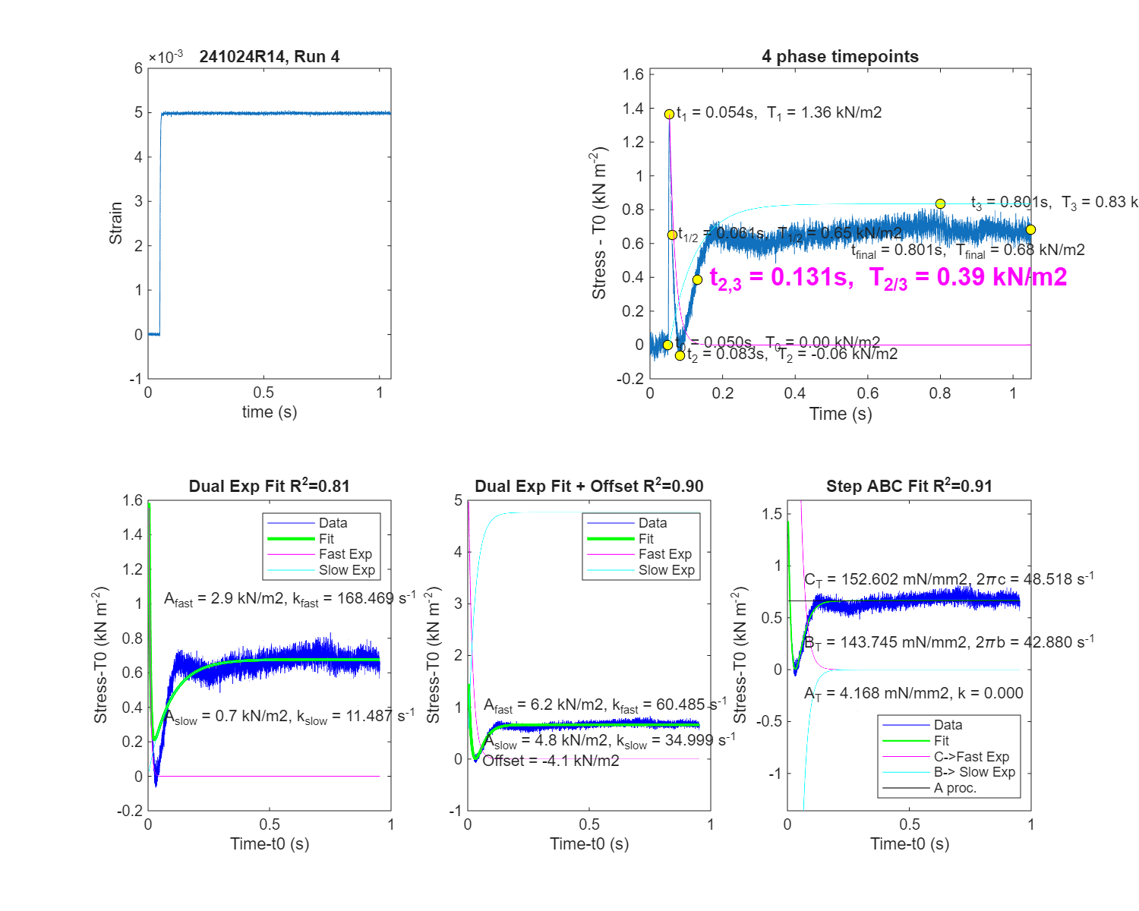
Top Left: The strain placed on the fiber during the rapid step increase which held for one second
4 phase timepoints: The four phase tension transient timepoints
t0 – t1 -> The early elastic response
T1/2 -> Rapid decay of force which is in response to cross-bridges being strained
t2 -> start of recovery of the system where crossbridges move between conformation
T2/3 -> shift of cross-bridges toward new states which generates force at the new length
t3 -> slow exponential drift toward the final steady state which include slower cross-bridge adjustments
Dual exponential with offset:
The offset accounts for the baseline shift
Afast and kfast describe the fast phase while Aslow and kslow describe the slower phse
Capture the two exponential components of the transient
Offset allows for the fit to determine that there is the final steady force level, because after a step experiment the muscle force does not typically return to zero
Step ABC:
C -> almost instantaneous elastic jump
B -> rapid redistribution among attached states
A -> structural adjustments

Slide 5
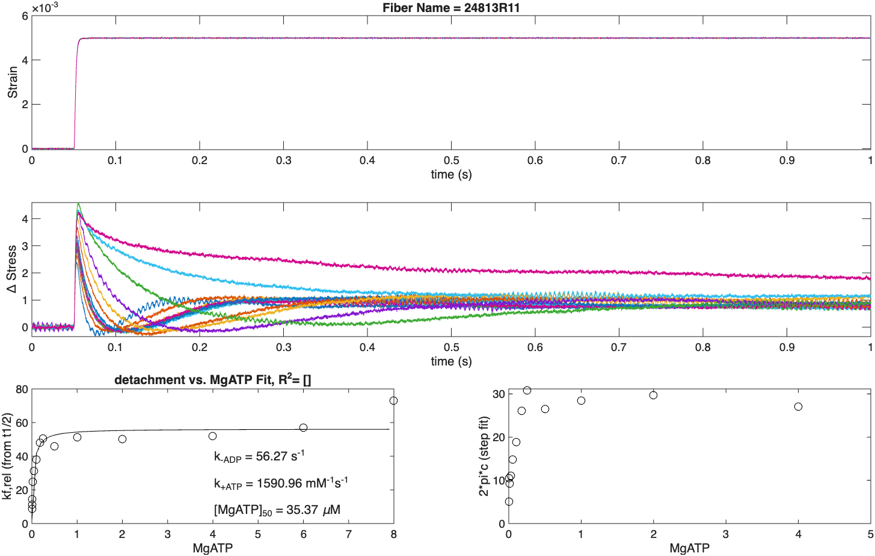
The strain v time of all the fibers compared
The change in stress v time of all the fibers
Kf,rel is the detachment rate v the amount of MgATP
MgATP causes rigor
2pic rate constant of how quickly force decays compared to the amount of MgATP
The 2pic is based on the step fit from the step done at rigor

