Slide 1
Skeletal Step Analysis

Slide 2
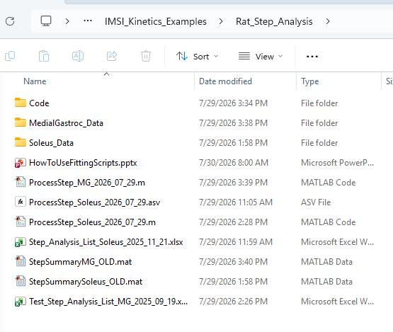
1a—
For Soleus Fitting (low twitch muscle), load or open the script:
ProcessStep_Soleus_2026_07_29.m
1b—
For Medial Gastrocnemius (fast twitch muscle) fitting, load or open the script:
ProcessStep_Soleus_2026_07_29.m
2—
Then just run the script and it should make some plots for data fitting.

Slide 3
3—
The scripts will import some data from the Excel file(s).
This data in the Excel files has some information for file import (i.e. loading the raw data traces) and the types of data to analyze.
4—
The raw data are either in the folder(s)
MedialGastroc_Data or
Soleus_Data
5—
The folder named Code has some function files to perform the data analysis

Slide 4
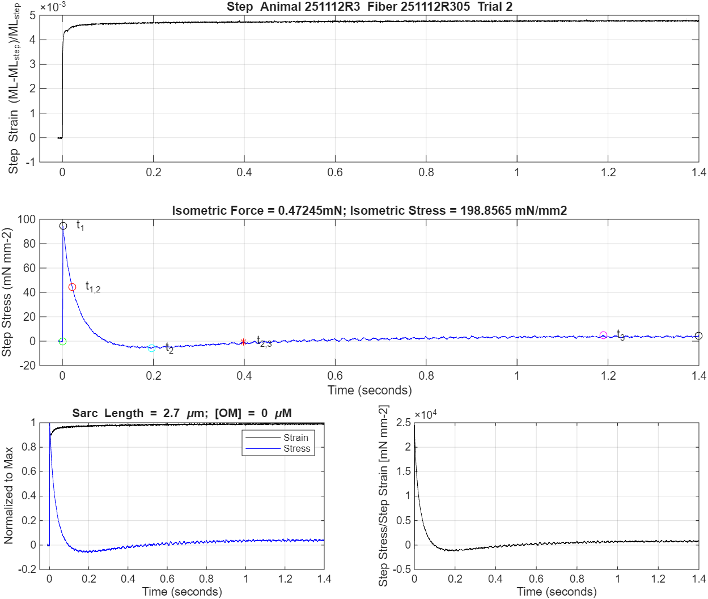
Solus Data Fitting:
Figure 2—
Step-length vs. time
Step-stress
(force/cross-sectional area)
vs. time
Normalized Stress and Strain
vs. time (left)
Modulus (i.e. Stress/Strain)
vs. time (right)

Slide 5
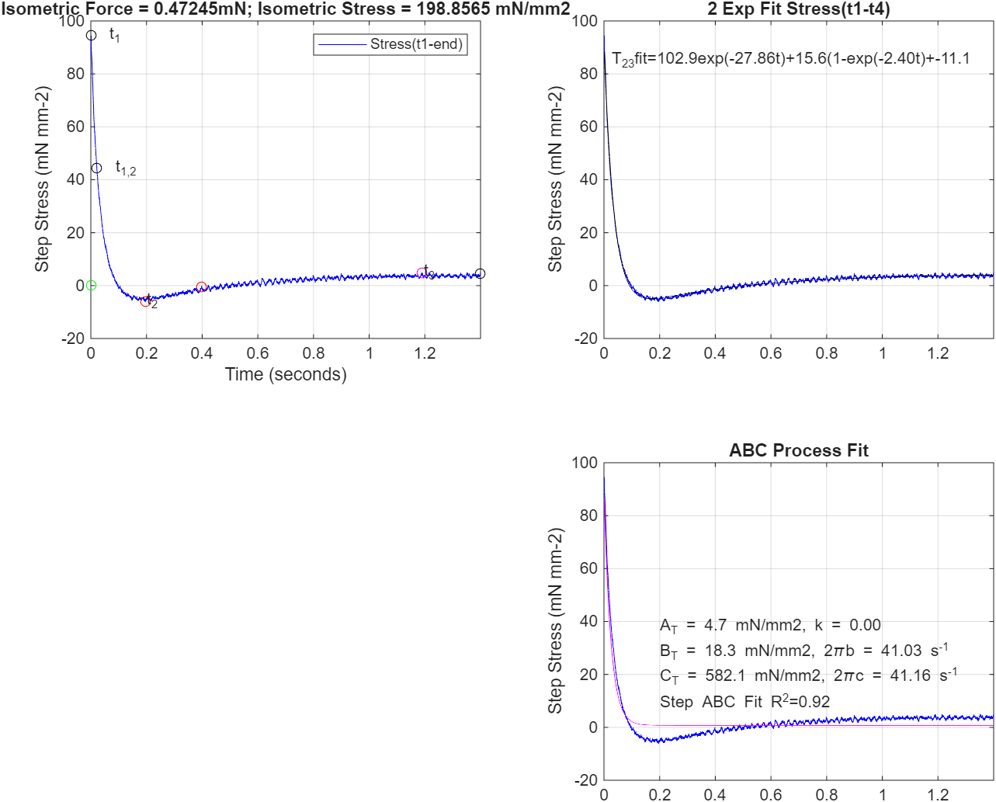
Solus Data Fitting:
Figure 3—
Step-stress vs. time with the specific time points of each phase (top left)
Step-stress vs. time, with fit to a dual exponential function, with offset term (top right).
Step-stress vs. time, with fit to the time-based ABC process model (Palmer et al. 2007 Biophysical Journal)
(bottom right).

Slide 6
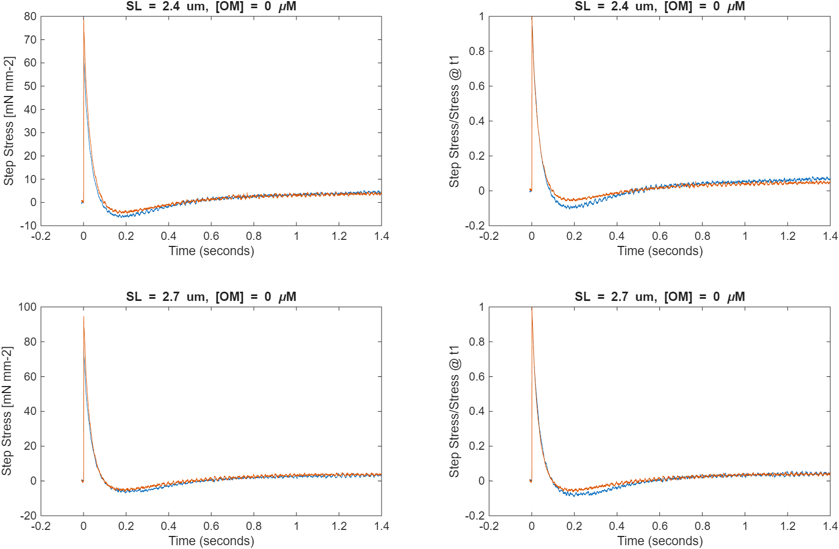
Solus Data Fitting:
Figure 4—
Summary plots for all traces analyzed under each condition
Top = sarcomere length of 2.4 microns
Bottom = sarcomere length of 2.7 microns
The plots on the right are normalized to the peak stress following the step stretch.

Slide 7
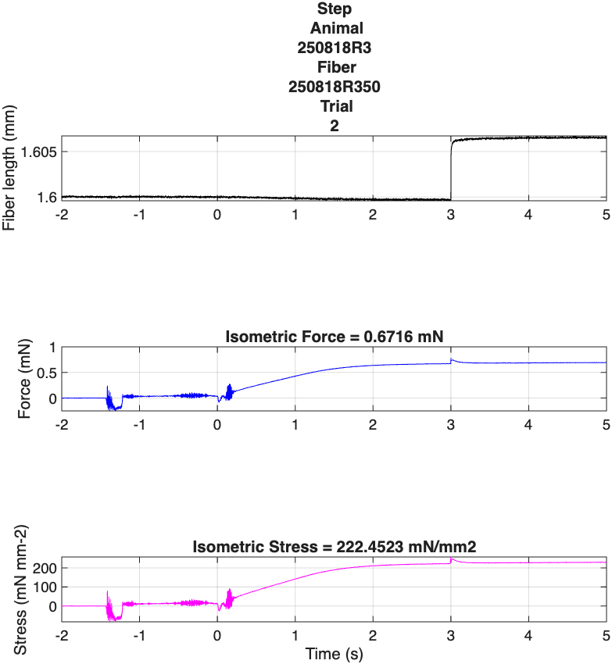
MG Data Fitting:
Figure 1—
Step-length vs. time for total data set
Step-force
vs. time for total data set
Step-stress
(force/cross-sectional area)
vs. time for total data set

Slide 8
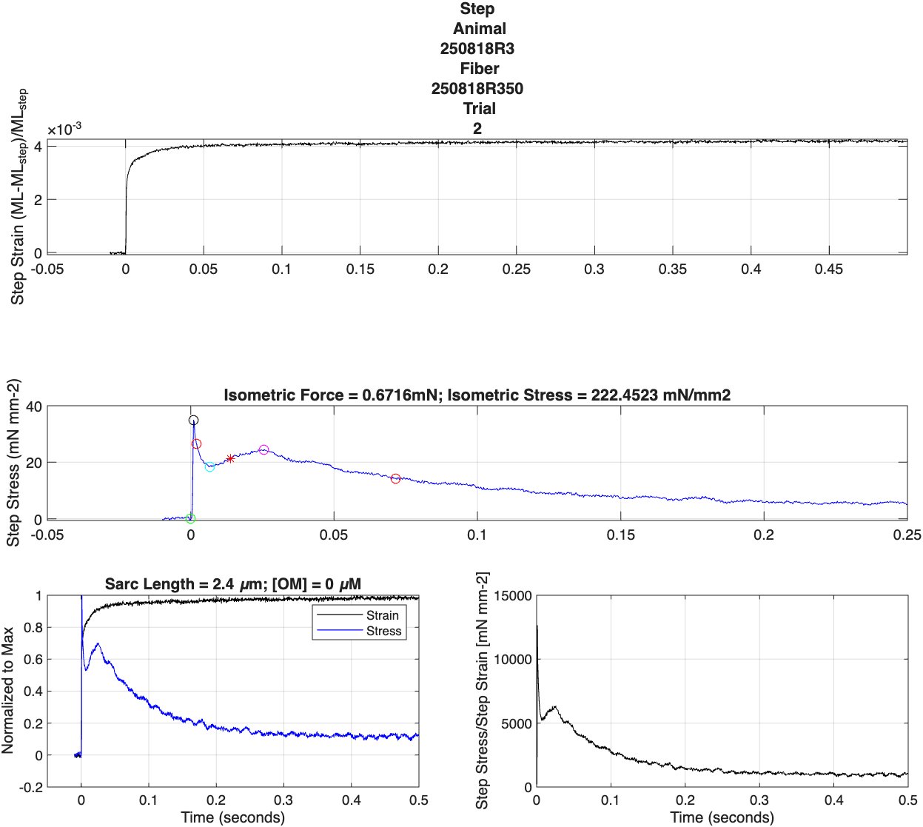
MG Data Fitting:
Figure 2—
Step-length vs. time
Step-stress
(force/cross-sectional area)
vs. time
Normalized Stress and Strain
vs. time (left)
Modulus (i.e. Stress/Strain)
vs. time (right)

Slide 9
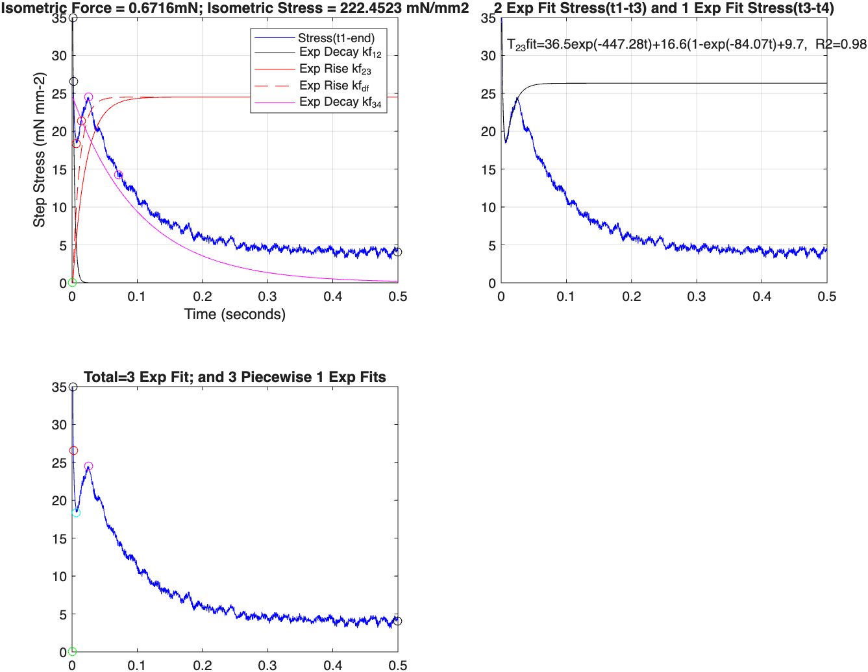
Solus Data Fitting:
Figure 3—
Step-stress vs. time with the specific time points of each phase. Also some ‘piecewise’ exponential fits, since the whole fitting to the 3 processes was being difficult
(top left)
Step-stress vs. time, with fit to a dual exponential function, with offset term (top right).
Step-stress vs. time, with fit to the time-based phases on specific data points
(bottom left).

Slide 10
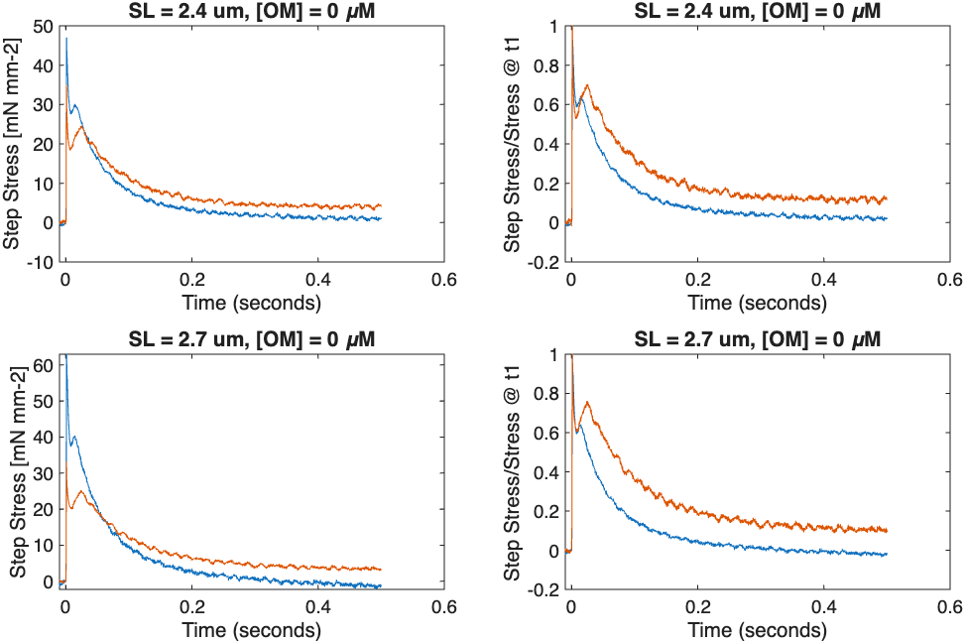
MG Data Fitting:
Figure 4—
Summary plots for all traces analyzed under each condition
Top = sarcomere length of 2.4 microns
Bottom = sarcomere length of 2.7 microns
The plots on the right are normalized to the peak stress following the step stretch.

