Slide 1

Final Project Big Data Case Study in Social Media
Del Pino Ruiz, Vicente Rubén
csci e63 Big Data Analytics, 2014
Harvard Extension School
Professor: Zoran B. Djordjević

Slide 2
Movie Trender
The goal of this project is to analyze in near real time information from Twitter related to movies.
This information will help me to see and compare relevance between them.

Slide 3
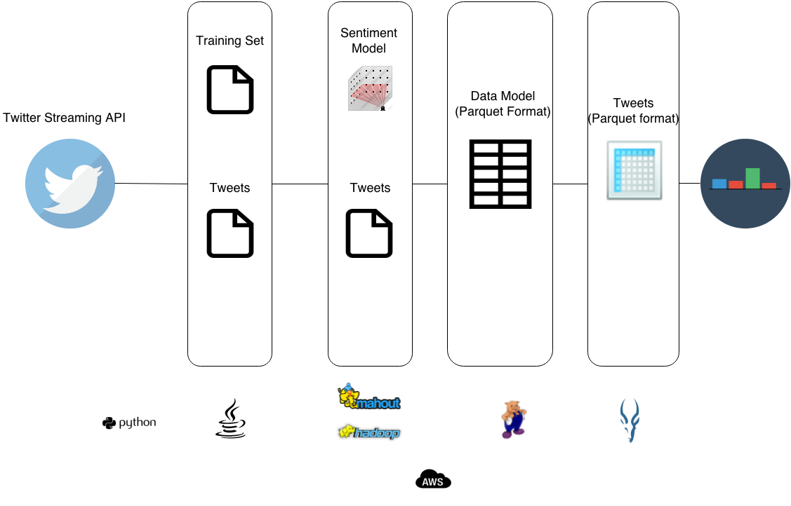
Movie Trender (II)
Design

