Slide 1



Continuous Build, Integration,
Deployment and Delivery

Slide 2
Summary
CB, CI, CD : what are those weird acronyms ?
How does it work ?
Why is it useful ?
Best practices
Common mistakes to avoid
The competitors
Feedback from project experience in the banking sector

Slide 3
CB, CI, CD : what are those weird acronyms ?
Continuous Build is based on Unit Tests
Continuous Integration relates to the code’s environment
Continuous Delivery is for testers and demos makers
Continuous Deployment is for infrastructure purposes

Slide 4
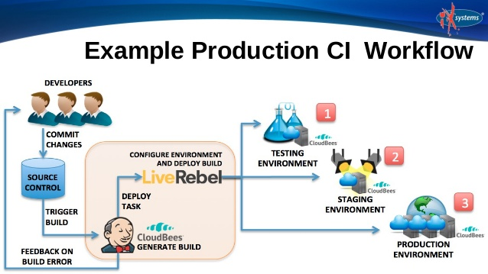
How does it work ?

Slide 5
How does it work ?
Developers work on features and run the Unit Tests locally
Changes are pushed to the VCS ; application is built and Integration tests are run (triggered, scheduled or on-demand)
Upon demand, the Deployment Pipeline may be triggered (can involve code quality and code security scans)
If all the lights are green, the build is deployed on Test/QA environments

Slide 6
Why is Continuous Integration useful ?
A successful build does not mean a working build
Fail-fast : developers know immediately if their changes broke something
Smaller and more frequent changes mean easier debugging and faster fixing
Every change is tested against the entire environment
Avoid defects survival until deployment
Visibility is granted for the whole team
The whole process is automated (build servers)
Part of Xtreme programming, Test-driven development, DevOps and Agile methodologies

Slide 7
Why are Continuous Deployment and Delivery useful ?
Every new build is tested against the entire environment and infrastructure
Visibility is granted for the whole team
The whole process is also automated
Services can be virtualized
Stable builds are always available for testing and demo purposes
Deployment steps can be measured in order to anticipate production issues (metrics gathering)

Slide 8
Best practices
Developers check in their working and tested changes every day
Developers check out every morning
Make the Test/QA environment a clone of the Production
Document the deployment pipelines (what should happen next ?)
Use an external provider to host your build and deployment infrastructure if you can
If you host your own infrastructure, scale it !
Use a central binary repository (e.g Nexus) to store artefacts
Automate, automate, automate (just like pizza)

Slide 9

Common mistakes

Slide 10
Common mistakes
Avoid best practices for best practices
A mess is a mess ; continuously integrating a mess won’t make it any better
Build and Deployment infrastructure must be scaled and stress-tested
Take your time, analyze deeply, make sure everyone gets the point
Is it really relevant ?

Slide 11




The competitors

Slide 12
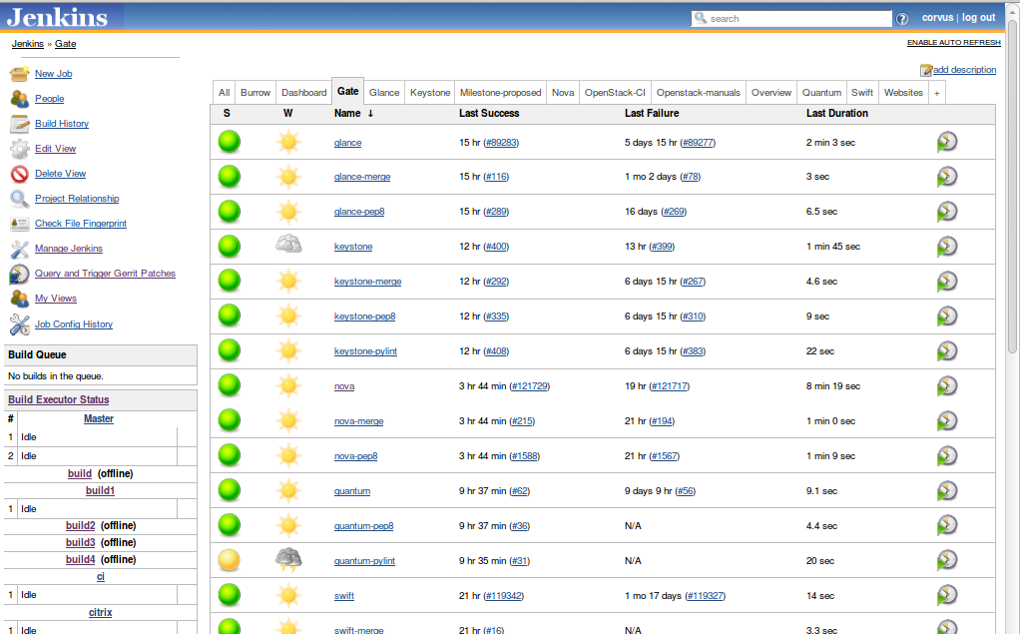
The competitors - Jenkins

Slide 13
Feedback from project experience in the banking sector
Infrastructure availability is critical, especially in large corporations
The earlier you begin, the easier it gets
Support team must be trained ; external support is a requirement when the business depends on the CI platform
Always backup, and make it redundant if possible
Streamline the deployment process for your users

Slide 14

Any Questions ?
info@movify.be

