Slide 1
Project Sidewalk
DJ SMU Dallas Remix

Slide 2
Original Format
We had planned to replicate “Project Sidewalk” from the University of Maryland: https://sidewalk.umiacs.umd.edu/
Execute the same operation for the City of Dallas
We look to explore spatial relationships in the city of Dallas to observe any evidence of social, ecological, and engineered susceptibility. We plan to look specifically at sidewalks and explore accessibility for all users including those requiring crutches, walkers or wheelchairs

Slide 3
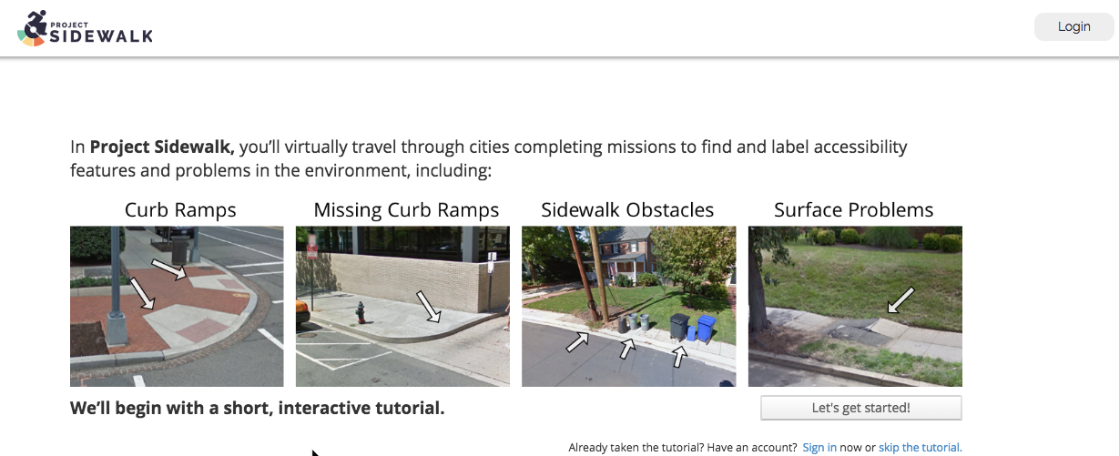
The Context of the Maryland Project

Slide 4
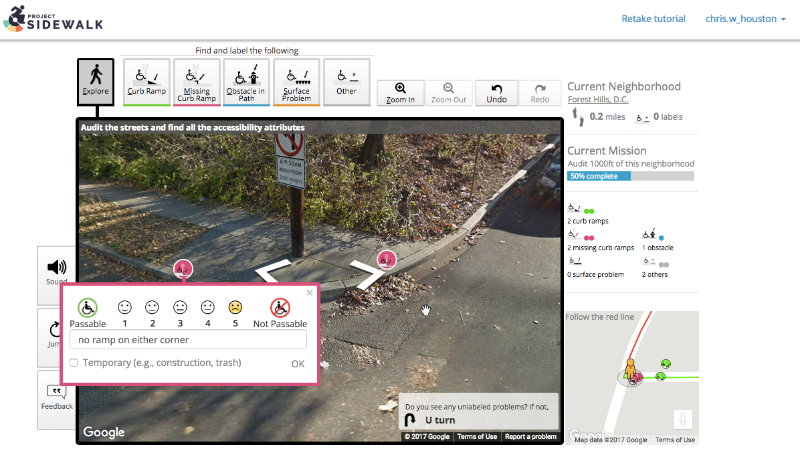
The Context of the Maryland Project
Google Street View is utilized and marked for side walk health and improvement opportunities

Slide 5
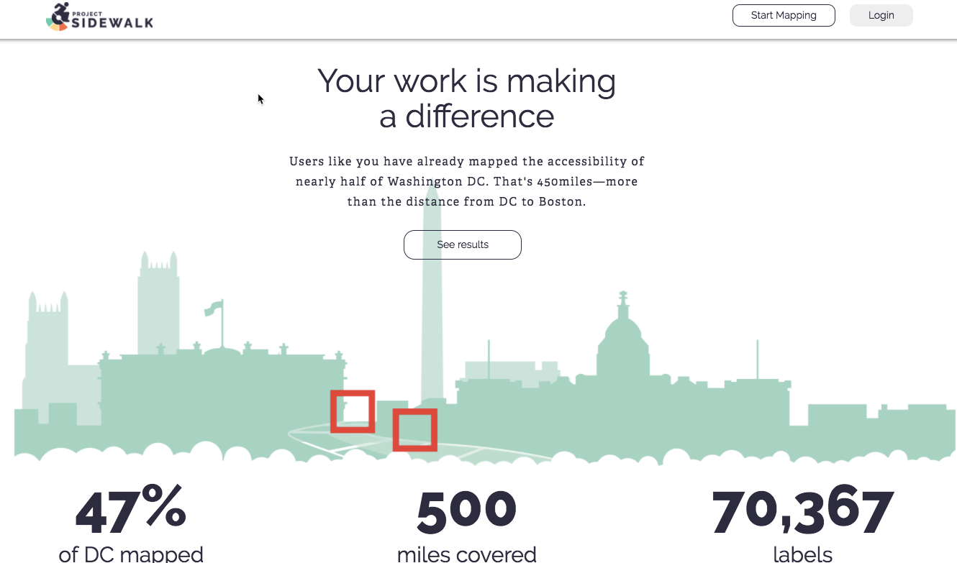
The Context of the Maryland Project

Slide 6
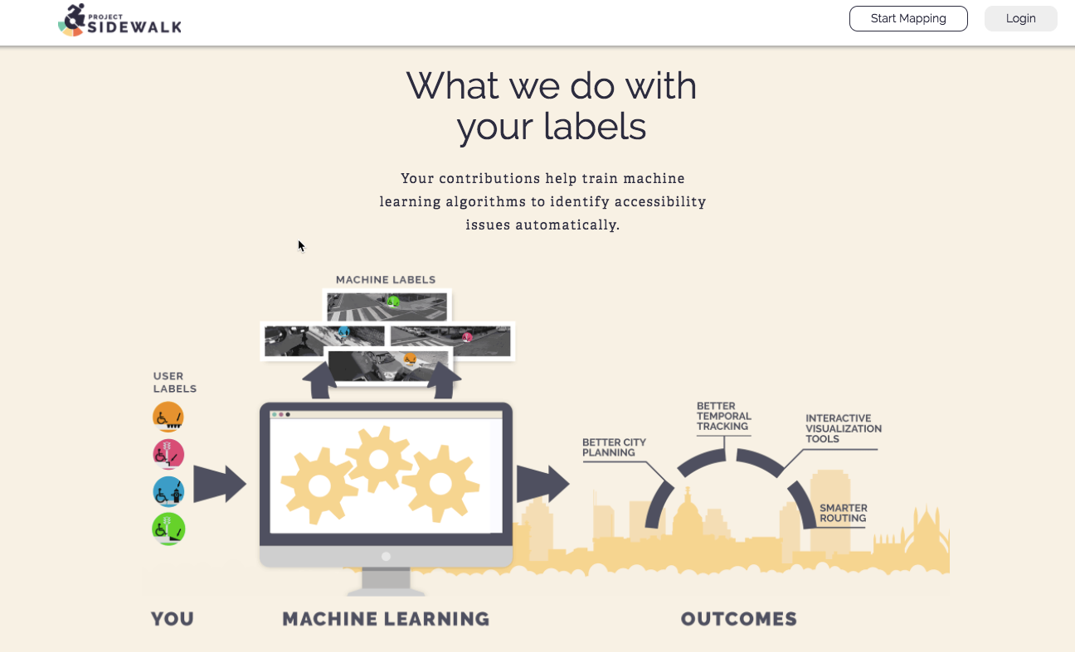
The Context of the Maryland Project
Data utilization:

Slide 7
The Remix
The goal has evolved: We will utilize UofM data
JSON file with tags and lat/long
Correlations with UoM data with crime data set & housing API
Plan to break DC into segments/grid to capture location
Will look to find trends with sidewalk information and other data
Will provide feedback to UoM for the ease of use of their API
Initial methods to include predictive:
Clustering
KNN
Random Forrest
Logistic Regression

Slide 8
Next Steps
GitHub established/Flat Field
Slack Established
Initial GANT chart (Friday – June 9)
Capture json file (Wednesday – June 14)
Capture crime data (find site – June 16)
Capture API from Zillow(find site – June 22)
Clean data – June 26
Analysis – July 1
Paper Draft – July 5th
Second Café – July 11
Paper submitted – August 28-work through the break because we bleed data science!!!

