Slide 1
Project Sidewalk
DJ SMU Dallas Remix

Slide 2
Original Format
We had planned to replicate “Project Sidewalk” from the University of Maryland: https://sidewalk.umiacs.umd.edu/
Execute the same operation for the City of Dallas
We look to explore spatial relationships in the city of Dallas to observe any evidence of social, ecological, and engineered susceptibility. We plan to look specifically at sidewalks and explore accessibility for all users including those requiring crutches, walkers or wheelchairs

Slide 3
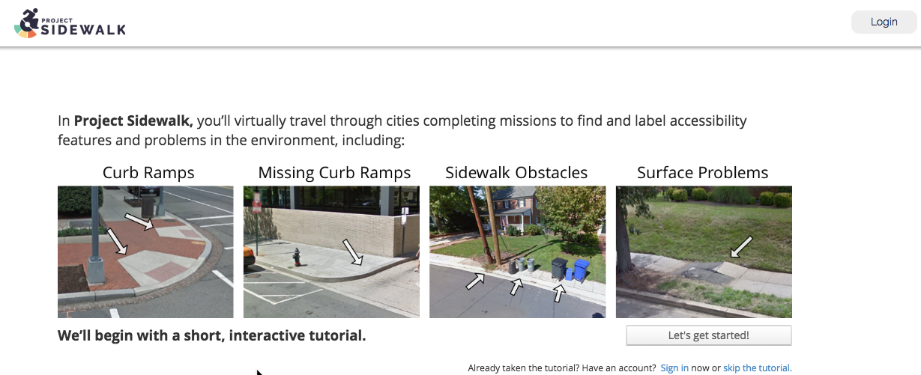
The Context of the Maryland Project

Slide 4
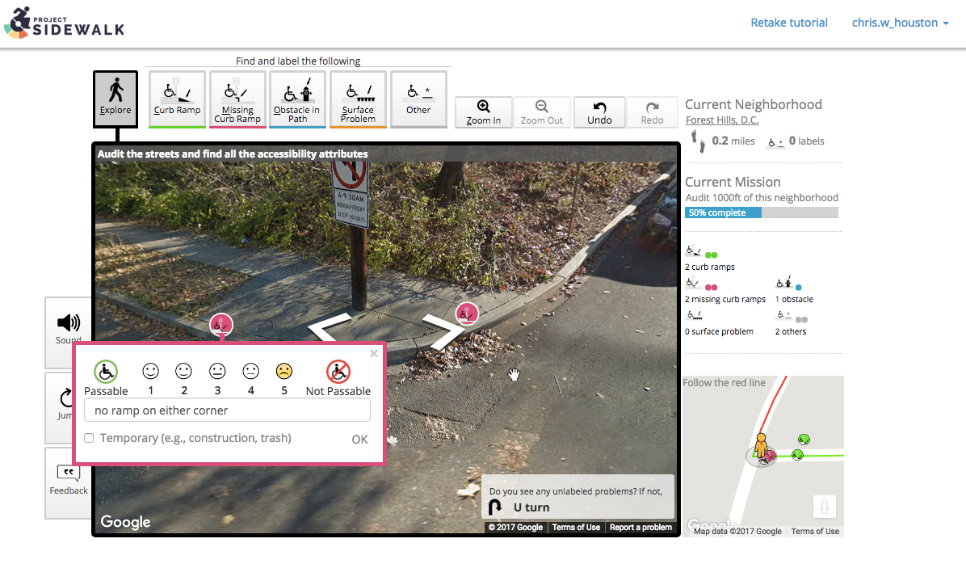
The Context of the Maryland Project
Google Street View is utilized and marked for side walk health and improvement opportunities

Slide 5
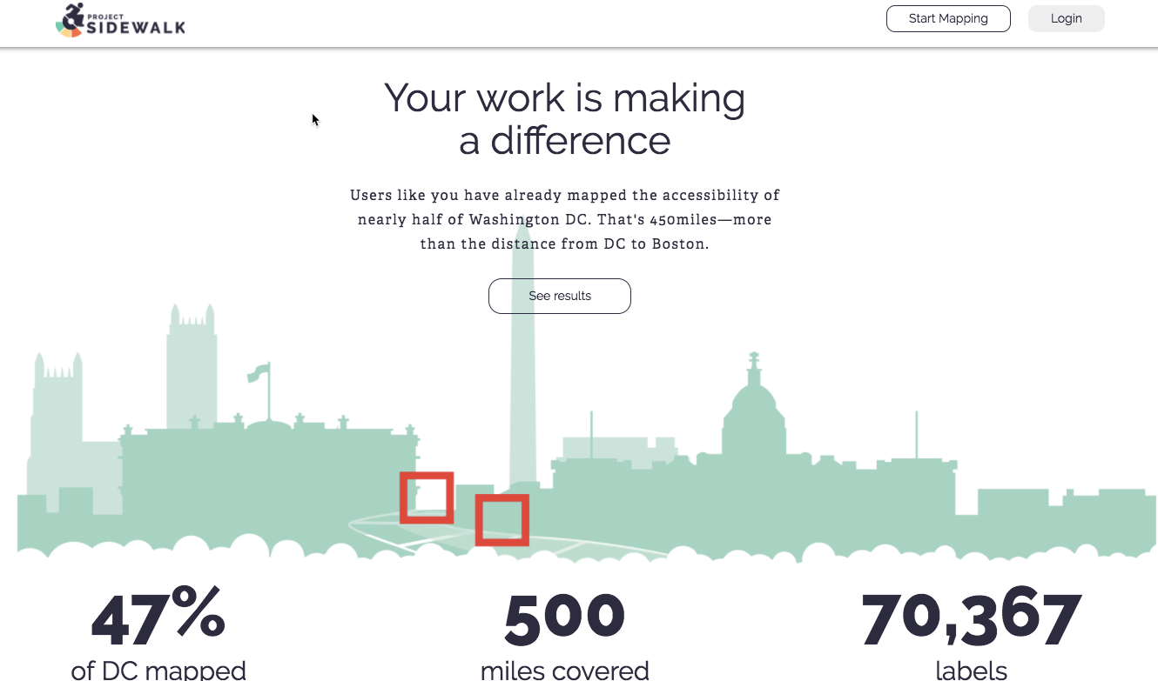
The Context of the Maryland Project

Slide 6
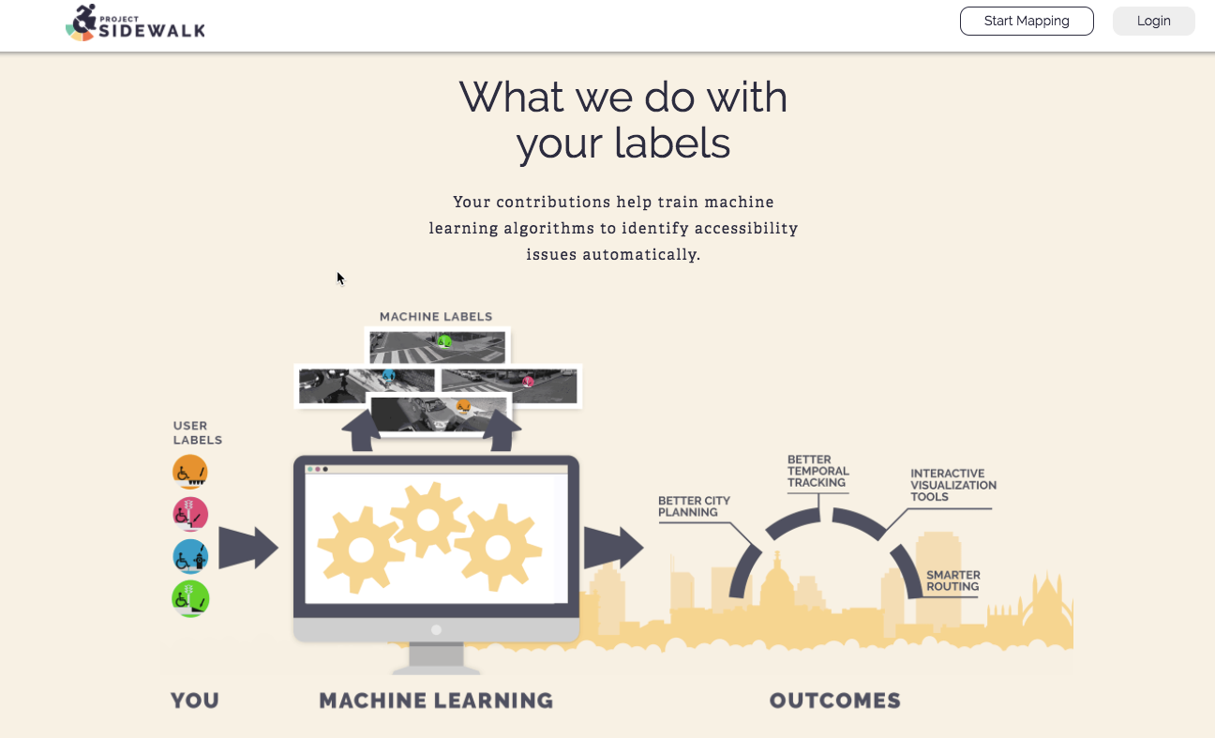
The Context of the Maryland Project
Data utilization:

Slide 7
The Remix
After correspondence with UofM, we have adjusted the scope of our project
We will look to execute machine learning techniques to observe if any noticeable correlations exist with property values, known crime data and the sidewalk data set
PI of project sidewalk is sharing mapping sidewalk infrastructure
Housing factor predictive?
Crime rate predictive?
In what format is the data?
What is being tracked
DC area for gathering crime data?
.gov website freely available up to date
Dallas crime data set? Updated?
Querry public API – json serialized file – has labels with lat/long
Aggregate : tiling, clustering for purpose of scoring
.25 for sidewalk/curb cuts for region
Same size region and score for crime/violent crime/loitering crime
Surrounding regions – all relationships
Regression?
All the places chris got pulled over in 2002 in maryland on the way to regan airport
Observations – these variables move up/down together – these x1, x2, x3, variables show R measurment of ____
Fall hazzards – slopes
Depth mapping in google street view
http post request – curl request -- all the labels in the ”box” – an array in a json file – huge plain text file – all kinds of json parses –
Value add to working with their data set, errors, usability, share ideas on what is useful, “what does a data scientist want/find desirable from the API
HOW DO WE WORK WITH THIS API? WHAT DATA DO WE WANT TO CORRELATE?
GANTT chart by the end of the week?
Separate channel on SLACK
Types of analytics – linear regression , KNN, random forests, (can we pick up a relationship)??

