Slide 1
Deep learning project
Team7

Slide 2
Outline
Image Classfication
Super Resolution
Object Dection

Slide 3
Image Classfication
Dataset: CINIC-10
Model: resnet20_cifar
Pre-processing: Save the image as numpy
Data augmentation:
transforms.RandomCrop(32, padding=4),
transforms.RandomHorizontalFlip(),
transforms.Normalize(mean=cinic_mean, std=cinic_std),
Cutout(n_holes=1, length=16) -> Regularization
Ngraph :batch size 960 – CPU Inference

Slide 4
Image Classfication - results
CPU inference time : 286.98
CPU accuracy: 84.663978
GPU inference time : 12.08
GPU accuracy: 84.52777
Number of weight: 274063
Model size = 1.0454673MB

Slide 5
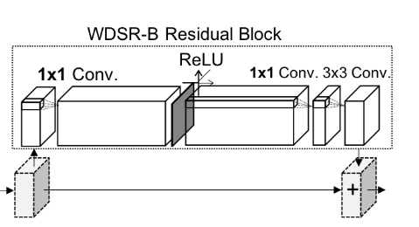
Super Resolution
Dataset: DIV2K
Model: wdsr_b
n_resblocks:12
n_feats:32
block_feats:96
res_scale:0.1
patch_size:96
https://arxiv.org/pdf/1808.08718.pdf

Slide 6
Super Resolution
MODE | PSNR | SIZE(MB)
EDSR | 35.552 | 5.239257813
EDSR_v2 | 35.968 | 155.3964844
MDSR | 35.556 | 6.8046875
MDSR_v2 | 35.659 | 24.88183594
WDSR-A | 35.342 | 4.557617188
WDSR-b | 34.967 | 1.18359375
WDSR-b_v2 | 35.014 | 1.18359375
proSR | 36.12 | 118.6640625

Slide 7
Super Resolution
CPU inference: 2356.12
CPU PSNR: 33.6466
GPU inference: 21.31
GPU PSNR: 33.6466
Number of weight: 229036
Model size : 0.8737

Slide 8
Object Dection
Dataset: clothes 2000 pieces
Model:tiny-yolo-v3
CPU f-score: 0.4892511825659466
GPU f-score: 0.4892511825659466
CPU inference time : 27.218275785446167
GPU inference time: 2.3918251991271973
Number of weight: 8692425.0
Model size = 33.15896987915039

Slide 9
