Slide 1
Financial Risk Assessment & Loan Default Prediction
Excel dashboard project
Focus: finding customers who may need support

Slide 2



Problem Statement
A faster review can help staff notice risk earlier.
Repayment risk
Risk signals
Faster review
Some customers may not repay on time.
Income, credit score, payment history, and debt matter.
A dashboard brings the signals together.
Banks need to find customers who may not repay on time.
Loan risk depends on income, credit score, payment history, and debt.
A dashboard helps staff review risk faster.
02

Slide 3



Technology Used
Excel
PivotTables
Charts and slicers
Stores and organizes the data.
Summarize customer and loan information.
Make results easier to understand.
Microsoft Excel stores and organizes the data.
PivotTables summarize customer and loan information.
Charts and slicers make the results easier to understand.
03

Slide 4
Dataset Overview
15,000
4
1,500
customers
loan purposes
High risk
The file contains 15,000 customers across four loan purposes.
Important fields include income, credit score, loan amount, debt-to-income ratio, and payment history.
Risk ratings include 9,000 Low, 4,500 Medium, and 1,500 High.
Risk Rating is a workbook label. It is not proof of observed default; validation is still needed.
04

Slide 5
Pivot Tables
Pivot category | Largest group | Customers
Loan purpose | Personal | 3,771
Employment status | Employed | 5,026
Payment history | Good | 3,822
PivotTables turn 15,000 rows into focused summaries that are easier to compare.
Personal loans are the largest group with 3,771 customers.
Employed customers are the largest employment group with 5,026 customers.
Good payment history is the largest payment group with 3,822 customers.
05

Slide 6
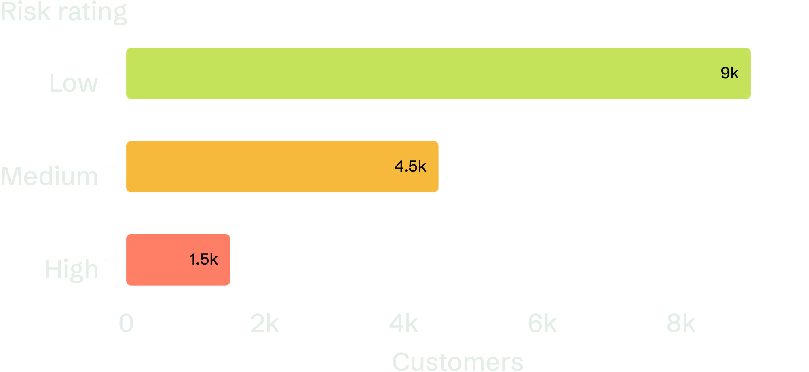
Overview of Charts
15,000
699
average credit score
customers
The risk chart compares Low, Medium, and High customers; KPI cards show 15,000 customers and an average credit score of 699. Charts help users compare customer groups quickly.
06

Slide 7
Slicers and Interactive Filtering
1
2
3
Choose
Focus
Refresh
Loan purpose, age, employment, or risk.
Review one customer group.
Charts and PivotTables update together.
Slicers filter the dashboard by loan purpose, age, employment, and risk.
Users can focus on one customer group in a few clicks.
Charts and PivotTables update when the filters change.
07

Slide 8

Dashboard Explanation
1
Start with the KPIs
See the whole portfolio first.
2
Use the slicers
Select a group for closer review.
3
Check the evidence
Use charts and PivotTables to decide where attention is needed.
Start with the KPI cards to understand the whole portfolio.
Use slicers to select a group for closer review.
Use charts and PivotTables to decide where attention is needed.
08

Slide 9

Make risk visible before support is needed.
The dashboard makes loan risk easier to understand and review.
It helps identify the 1,500 High-risk customers who may need attention first.
Using real repayment results can make the risk assessment more reliable.
T.
09

Slide 10
Who is Benefit ?
Banks can identify high-risk customers earlier.
Credit teams can review loans faster using data.
Customers can receive support before repayment problems grow.
10

Slide 11
Conclusion
The dashboard makes loan risk easier to understand.
It helps teams focus on customers who may need support.
The results should be checked against real repayment outcomes.
11

