Slide 1


SMART INDIA HACKATHON 2024
AIML BASED VEHICULAR MOVEMENT DETECTION
Problem Statement ID – SIH1740
Problem Statement Title- Algorithm using AIML to distinguish vehicular movement
Theme- Smart Automation
PS Category- Software
Team ID-
Team Name (Registered on portal)- N_HUSTLE SQUAD

Slide 2
MOBILE APP FOR DIRECT MARKET ACCESS FOR FARMERS
N_HUSTLE SQUAD
Proposed Solution
Gather GPS data, video footage from traffic cameras, and sensor data (speed, acceleration, traffic density) from vehicles and roads.
Clean and map GPS data onto road infrastructure (highway vs. service road) while calculating key metrics like speed and vehicle flow.
Extract key features such as average speed, acceleration patterns, lane changes, vehicle density, and road type from the raw data.
Choose suitable ML models like Random Forest, Logistic Regression, or Support Vector Machines (SVM) for classification; use CNNs for image/video data.
Train the model using labeled data and evaluate its accuracy, precision, recall, and F1-score through validation techniques.
Deploy the model in real-time systems like traffic sensors or vehicle GPS systems, monitor performance, and continuously update the model with new data for improved accuracy.

Slide 3
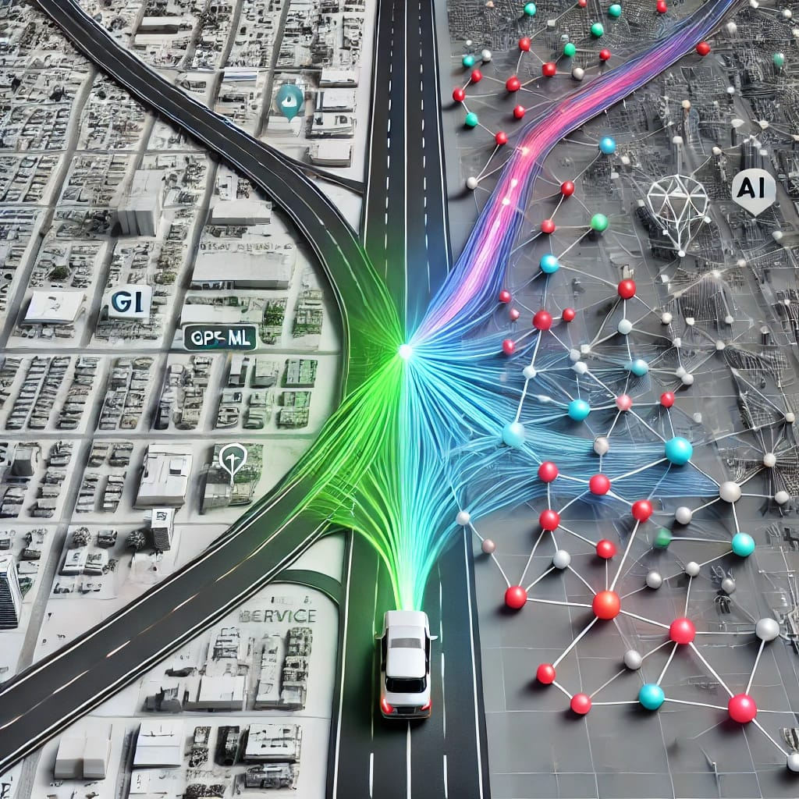
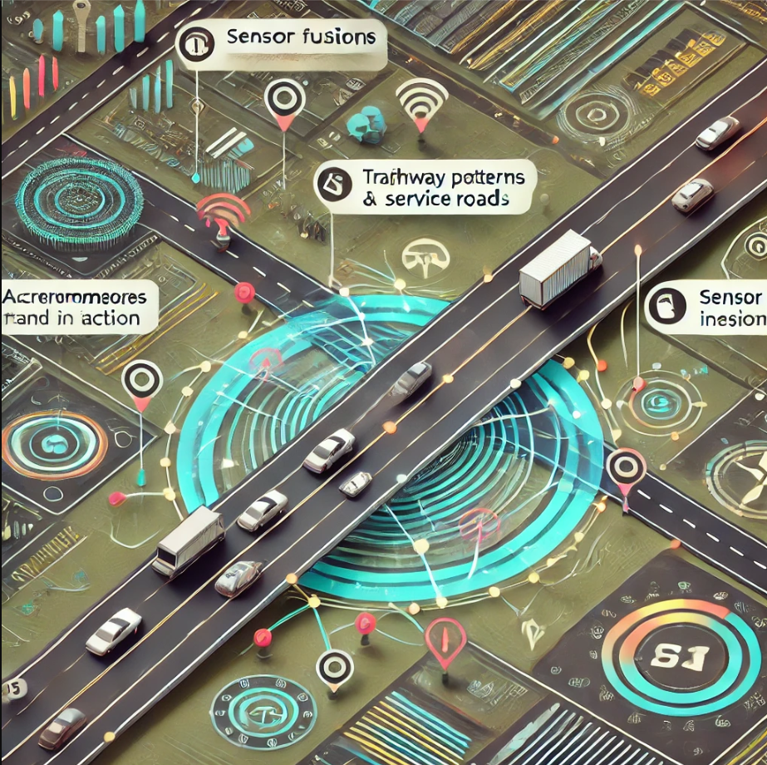
TECHNICAL APPROACH
N_HUSTLE SQUAD
Technologies:
Frontend- Flutter.
Backend- Node.js with Express/Django.
Database- MongoDB
API- Fast API
AIML- Tensorflow and Scikit-Learn
Cloud-AWS and Apache kafka
Mapping-GeoPandas/OpenStreetMap
Unique Features:
GPS Signal Processing: Use AI to filter noisy GPS data.
Speed Patterns: Analyze speed and turns to differentiate between
highways and service roads.
Sensor Fusion: Combine GPS with accelerometer/gyroscope data for higher accuracy.
4.Real-Time Learning: Implement adaptive models to improve accuracyas new data comes in.

Slide 4
FEASIBILITY AND VIABILITY
N_HUSTLE SQUAD
Feasibility
Data Availability: High feasibility due to easy access to GPS, traffic sensors, and video data from vehicles and infrastructure.
AI/ML Development: Feasible with mature frameworks (TensorFlow, PyTorch) and geospatial tools like GeoPandas for accurate classification models.
Infrastructure & Scalability: Cloud services (AWS, GCP) and edge devices enable scalable processing and real-time analysis.
Viability
Technical Viability: High, as proven AI/ML frameworks, cloud platforms, and real-time processing tools can handle vehicular movement classification.
Data Viability: Sufficient, with accessible GPS, sensor, and traffic data sources ensuring robust model training and real-time updates.
Cost Viability: Moderate, with cloud-based infrastructure scaling cost-effectively, though real-time processing and hardware costs (edge devices) could increase for large-scale deployment.
Operational Viability: High, with feasible integration into existing traffic systems and strong potential for enhancing traffic management and safety.

Slide 5
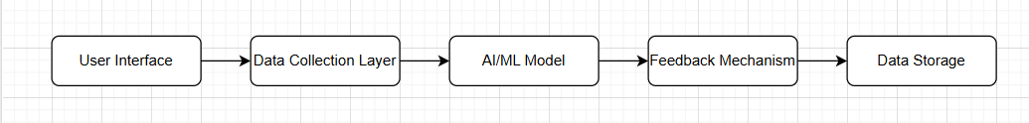
IMPACT AND BENEFITS
N_HUSTLE SQUAD
Impact
The AI/ML vehicular movement app can significantly improve traffic management by accurately distinguishing between highway and service road activity.
This leads to better route optimization, reduced congestion, and enhanced safety.
Additionally, it can support smart city initiatives and efficient infrastructure planning.
Architectural Diagram
Benefits of the Solution
Improved Traffic Flow
Enhanced Safety
Smart City Integration
Cost Efficiency

Slide 6
RESEARCH AND REFERENCES
N_HUSTLE SQUAD
References
Reference1:Automated Approach for Computer Vision-based Vehicle Movement Classification at Traffic Intersections.
Link:Read more on arXiv​(ar5iv).
Reference2: Artificial Intelligence-based Traffic Flow Prediction: A Comprehensive Review
Link:hRead more on Springer​(SpringerOpen).

