Slide 1
Predicting Carbon Dioxide Emission Levels
CMPE 272 - Enterprise Software Platform
Dr. Vidhyacharan Bhaskar
Computer Engineering
San Jose State University
Team Members:
Nguyen Bui (010732150)
Moxank Patel (016041064)

Slide 2
Outline
Introduction Slide 3
System Model
Slide 6
Best Model
Slide 11
Data Dive
Slide 13
Background Work
Slide 4
System Design & Implementation
Slide 8
Pseudo Code
Slide 12
Results
Slide 18
Literature Review
Slide 5
Pseudo Code for Linear Regression Algorithm
Slide 9

Slide 3
Introduction
The Primary Driver of Climate Change: Carbon Dioxide (CO2)
Challenge: CO2 measurement is labor-intensive, especially in hard-to-reach regions like Rwanda, Everest, Mariana Trench and etc.
Solution: Implement a Machine Learning Algorithm to predict CO2 emissions, minimizing manual work and the need for on-site data collection.
Data Source: The Sentinel-5P satellite provides direct measurements of key factors (Available on Kaggle):
SO₂: Sulfur Dioxide
CO: Carbon Monoxide
NO₂: Nitrogen Dioxide
HCHO: Formaldehyde
Aerosol Index: UV Aerosol Index
These indicators serve as the algorithm's predictive variables for CO2 emission levels.

Slide 4
Background Work
Global Warming Driver: Increasing Carbon Dioxide (CO2) emissions [1].
Urgency: Critical need for countermeasures against global warming [2].
Measurement Method: Ground-level CO2 measurement with sensors [3].
NDIR Sensors: High accuracy in CO2 detection using infrared technology [3].
Predictive Solutions: Algorithm-based prediction without on-site measurement [4].
Notes:
REFERENCES
[1] L. Zhou, Y. He, Q. Zhang, and L. Zhang, "Carbon Dioxide Sensor Module Based on NDIR Technology," Micromachines, vol. 12, no. 7, Art. no. 845, 2021. [Online]. Available: https://doi.org/10.3390/mi12070845

Slide 5
Literature Review
Advancements in Predictive Modeling for CO2 Emissions
SVM Approach: Research by Qin et al. utilized Support Vector Machines for predicting CO2 levels, showcasing the potential of machine learning in environmental monitoring [2].
Comparative Study: Yang Meng and Hossain analyzed four distinct models to forecast CO2 levels, providing insights into the most effective methods [3].
Traffic-Related Emissions: A study in Seoul applied Machine Learning to estimate CO2 emissions from traffic, considering factors such as traffic volume and wind speed [4].
Data Collection:
Collaborative Data Collection: Darius Moruri’s team, in partnership with Zindi and Kaggle, gathered extensive data on key indicators like traffic patterns and atmospheric conditions to advance research in this field [5].
Notes:
REFERENCES
[2] X. Qin et al., "China’s carbon dioxide emission forecast based on improved marine predator algorithm and multi-kernel support vector regression," Environmental Science and Pollution Research International, vol. 30, no. 3, pp. 5730–5748, 2023. [Online]. Available: https://doi.org/10.1007/s11356-022-22302-7
[3] Y. Meng and H. Noman, "Predicting CO2 Emission Footprint Using AI through Machine Learning," Atmosphere, vol. 13, no. 11, Art. no. 1871, 2022. [Online]. Available: https://doi.org/10.3390/atmos13111871
[4] C. Park et al., "Machine Learning Based Estimation of Urban On-road CO2 Concentration in Seoul," Environmental Research, vol. 231, p. 116256, 2023. [Online]. Available: https://doi.org/10.1016/j.envres.2023.116256
[5] D. Moruri, A. Bray, W. Reade, and A. Chow, "Predict CO2 Emissions in Rwanda," Kaggle, 2023. [Online]. Available: https://kaggle.com/competitions/playground-series-s3e20

Slide 6
System Model
Components of the System
Predictive Model:
Core functionality to estimate CO2 emission levels.
Utilizes advanced algorithms like regression, or neural networks informed by remote sensing data.
User Interface (UI):
Interactive portal for user engagement with the model.
Facilitates input of parameters and displays predictive outcomes.

Slide 7
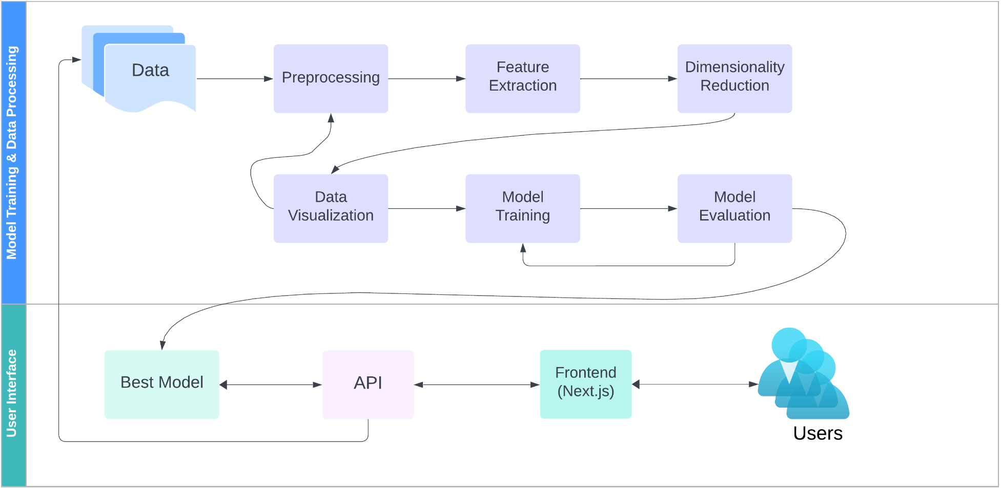
System Model
Figure 1. Schematic of the Predictive CO2 Measurement System

Slide 8
System Description
Backend - Predictive Model:
Primary Role: Estimation of CO2 Emission Levels.
Data Processing: Analyzes and interprets input data for forecasting.
Technological Stack: Built with advanced analytics and machine learning libraries.
Frontend - User Interaction:
User Engagement: Interface for inputting prediction parameters.
Results Display: Showcases CO2 Emission predictions and insights.
Design Framework: Developed using Next.js for a responsive, user-friendly experience.

Slide 9
System Description: Predictive Model
Predictive Model Development Phases
Data Collection & Preprocessing:
Acquire relevant datasets.
Cleanse and normalize data.
Feature Extraction & Dimensionality Reduction:
Identify predictive attributes.
Simplify data without losing critical information.
Data Visualization:
Create visual representations of datasets.
Identify patterns and outliers.
Model Training & Hyperparameter Tuning:
Train models with the dataset.
Optimize settings for best performance.
Model Selection:
Evaluate and choose the best-performing model.

Slide 10
System Design & Implementation
Frontend Design:
Framework: Next.js (React-based).
Capabilities: Parameter input and emission prediction display.
API Layer:
Framework: Django for robust API development.
Function: Facilitates communication between UI and model.
Data Handling: Accepts input parameters; returns emission levels.
Backend Model:
Operation: Processes data to predict CO2 emissions.
Integration: Seamlessly connected with API for data exchange.
Data Management:
Storage: MongoDB for efficient data handling and scalability.
Role: Archives new data, supports model updates and analytics.

Slide 11
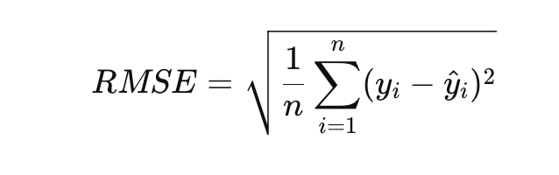
Determining Best Model?
Using Root Mean Square Error
Definition:
A standard way to measure the error of a model in predicting quantitative data.
Indicates how closely a regression model predicted values match the actual values.
Formula:
Where n = number of observation
y_{i} = Actual Value, y_{i}^ = Predicted Value

Slide 12
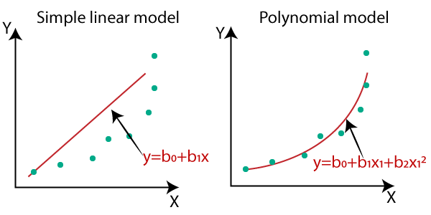
Predictive Algorithms Under Consideration
Traditional Regression Models:
Linear Regression: To predict outcomes with linear relationships.
Polynomial Regression: For capturing non-linear trends.
Ridge Regression: Linear regression with L2 regularization.
Lasso Regression: Linear regression with L1 regularization for feature selection.
Advanced Machine Learning Techniques:
Support Vector Machine (SVM): Effective in high-dimensional spaces.
Neural Network: Powerful for modeling complex relationships.
Figure 2. Different types Regression Model
Notes:
Image Reference: https://www.javatpoint.com/machine-learning-polynomial-regression

Slide 13
Dive Into Data
Dataset Overview:
Source: Kaggle Playground Series S3E20.
Composition: 76 Attributes; 80,000 Records.
Data collected in Rwanda in 2019
Data Strategy:
Dimensionality Reduction: Implement Principal Component Analysis (PCA) to streamline data.
Model Optimization: Evaluate and select the best-performing predictive model.

Slide 14
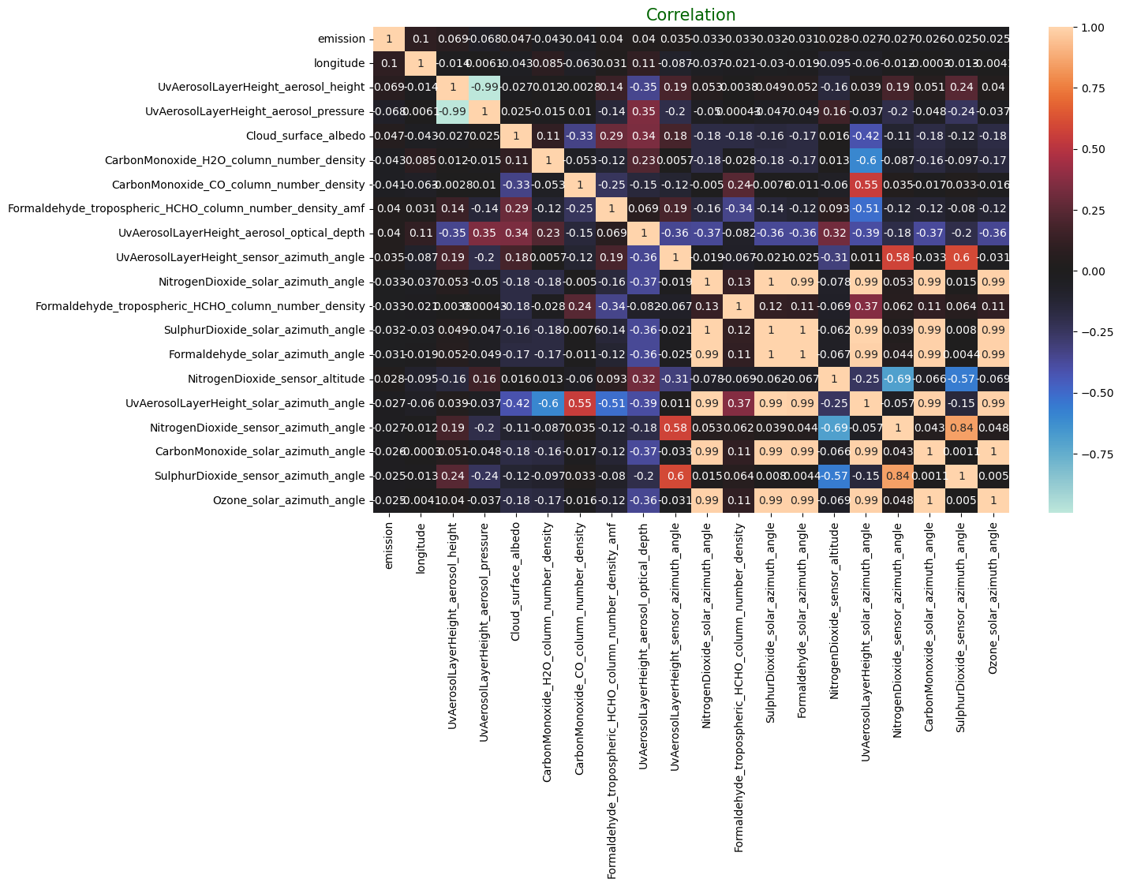
Data Visualization: Correlation Heatmap
Figure 2. Correlation Matrix

Slide 15
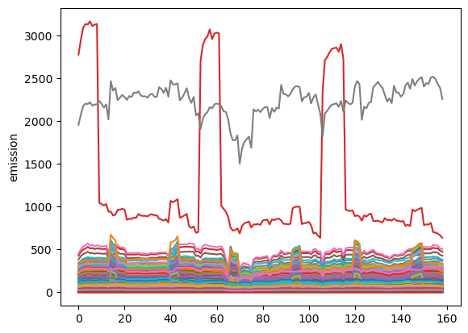
Emission Over Period of weeks
weeks
Figure 3. Time Series Plot: Emission vs Weeks for different location

Slide 16
Split Data into Training-Test Dataset
Training Data: 80% of original dataset
Test Data: 20% of original dataset
Further used K Fold validation to check the correctness of the model

Slide 17
Regression Models Used
Linear Regression
Polynomial Regression
Lasso Regression
Ridge Regression
DecisionTreeRegressor
RadiusNeighborsRegressor
KNeighborsRegressor
Ensemble (RandomForestRegressor, BaggingRegressor)
Ensemble (XGBRegressor, BaggingRegressor)
MLPRegressor

Slide 18
Results
# | Model | Root Mean Square Error
1 | LinearRegression | 135.52
2 | Lasso Regression | 140.57
3 | Ridge Regression | 135.81
4 | Decision Tree Regressor | 22.40
5 | Radius Neighbors Regressor | 22.40
6 | K Neighbors Regressor | 22.40
7 | Ensemble (Random Forest Regressor) | 15.38
8 | MLP Regressor (Neural Networks) | 138.97
9 | Ensemble (XGBRegressor) | 10.15

Slide 19
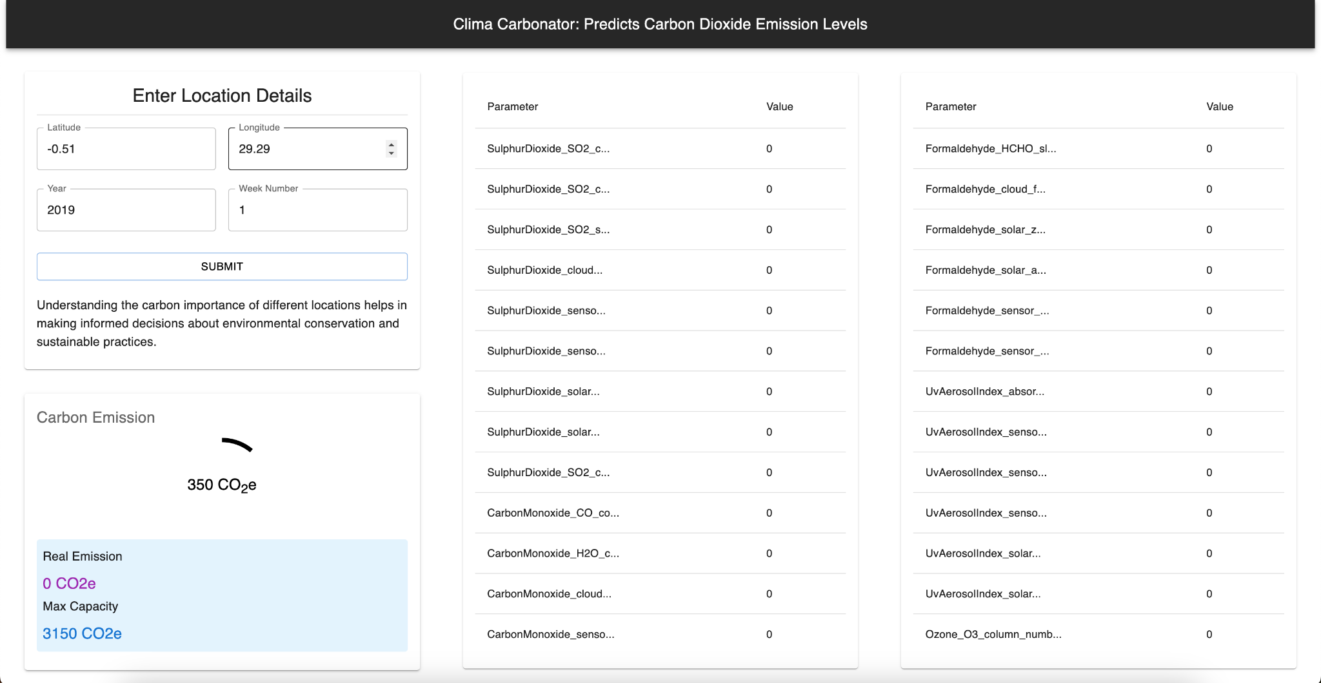
User Interface
Figure. Snapshot of the User Interface

Slide 20

Timeline
Figure 4. Timeline for Implementation and System Development

Slide 21
DEMONSTRATION

Slide 22
Future Works
Using Maps API to select coordinates directly.
Visualization of Emission on maps directly as heatmap.
Integrating API with real time sensor.

Slide 23
References
[1] I. C. Ward, "Will global warming reduce the carbon emissions of the Yorkshire Humber Region’s domestic building stock—A scoping study," Energy and Buildings, vol. 40, no. 6, pp. 998–1003, 2008. [Online]. Available: https://doi.org/10.1016/j.enbuild.2007.08.007
[2] U. Olausson, "Global warming—global responsibility? Media frames of collective action and scientific certainty," Public Understanding of Science (Bristol, England), vol. 18, no. 4, pp. 421–436, 2009. [Online]. Available: https://doi.org/10.1177/0963662507081242
[3] L. Zhou, Y. He, Q. Zhang, and L. Zhang, "Carbon Dioxide Sensor Module Based on NDIR Technology," Micromachines, vol. 12, no. 7, Art. no. 845, 2021. [Online]. Available: https://doi.org/10.3390/mi12070845
[4] X. Qin et al., "China’s carbon dioxide emission forecast based on improved marine predator algorithm and multi-kernel support vector regression," Environmental Science and Pollution Research International, vol. 30, no. 3, pp. 5730–5748, 2023. [Online]. Available: https://doi.org/10.1007/s11356-022-22302-7
[5] Y. Meng and H. Noman, "Predicting CO2 Emission Footprint Using AI through Machine Learning," Atmosphere, vol. 13, no. 11, Art. no. 1871, 2022. [Online]. Available: https://doi.org/10.3390/atmos13111871
[6] C. Park et al., "Machine Learning Based Estimation of Urban On-road CO2 Concentration in Seoul," Environmental Research, vol. 231, p. 116256, 2023. [Online]. Available: https://doi.org/10.1016/j.envres.2023.116256
[7] D. Moruri, A. Bray, W. Reade, and A. Chow, "Predict CO2 Emissions in Rwanda," Kaggle, 2023. [Online]. Available: https://kaggle.com/competitions/playground-series-s3e20

Slide 24
Questions & Answers

Slide 25
Thank You

