Slide 1

Welcome
Iowa Data Professionals
July 2022
Des Moines SQL Server User Group
Virtual Meeting

Slide 2
Thank You!! Our Sponsors:
Iowa Data Professionals Association
Denny Cherry & Associates Consulting
Microsoft Azure Technical Groups

Slide 3






Azure Tech Groups - Code of Conduct
Microsoft is dedicated to empowering every person and every organization on the planet to achieve more.
Harassment in any form is not tolerated.
Please report any concerns
Please report any concerns, suspicious activity, or disruptive behavior to the Azure Tech Groups team at azure-tech-groups@microsoft.com.
Read our full Code of Conduct
https://developer.microsoft.com/en-us/azure-tech-groups/code-of-conduct

Slide 4



Juan
Moya
He/Him
Sr Database Administrator
I’m the Local Group Leader for the Iowa Data Professionals Association (IDPA) - Des Moines SQL Server User Group as well as the Organizer for Meetup.com/dsmsql.
Currently I'm working at Farm Bureau Financial Services, West Des Moines, in the Infrastructure & Operations Department.
Farm Bureau Financial Services
@MoyaJuanM
https://www.linkedin.com/in/juanmmoya
https://www.meetup.com/dsmsql/

Slide 5
Why You Should Take an Azure Fundamentals Certification Exam

Slide 6
Agenda
What is the Problem?
What is the Solution?
What are the Benefits?
Summary

Slide 7
What is the Problem?

Slide 8

“Disrupt With Data” – Microsoft Windows

Slide 9
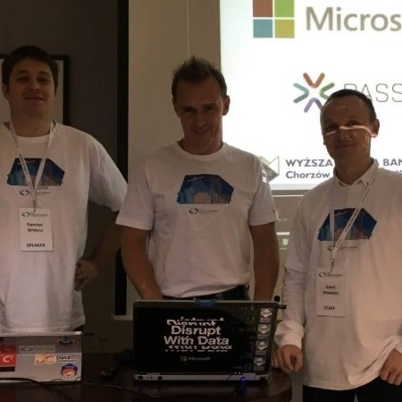
“Disrupt with Data” – Microsoft Windows (Laptop Sticker)
Ask SQL Family (ASF) 026: Aaron Bertrand, Sentry One, Interview Oct 2019 sqlplayer.net

Slide 10
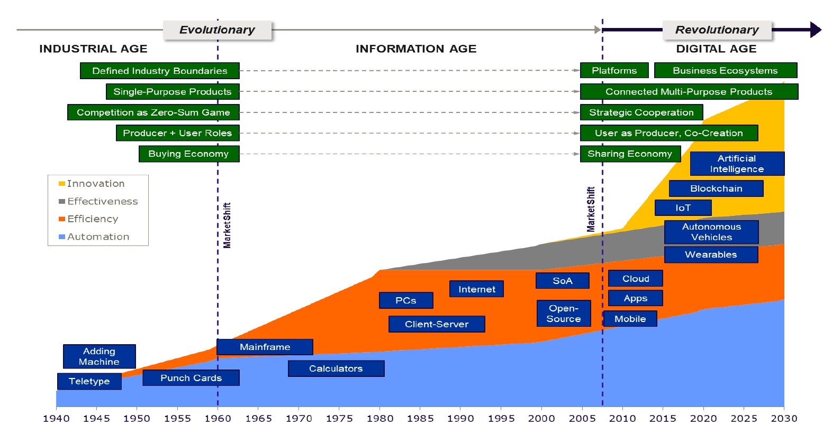
The Rapid Pace of Technological Innovation

Slide 11
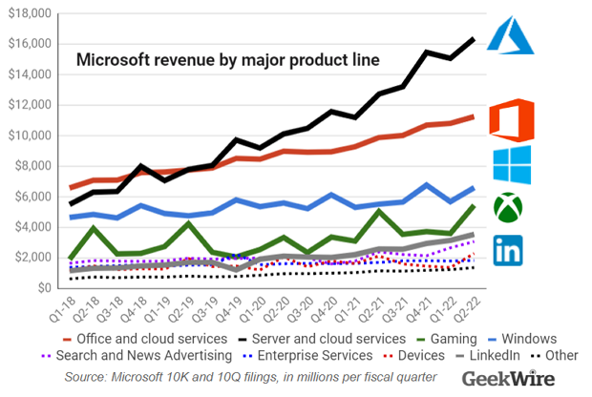
“Microsoft earnings preview: Wall Street expects 18% revenue growth on continued cloud strength” BY TODD BISHOP on April 25, 2022 at 8:32 am

Slide 12
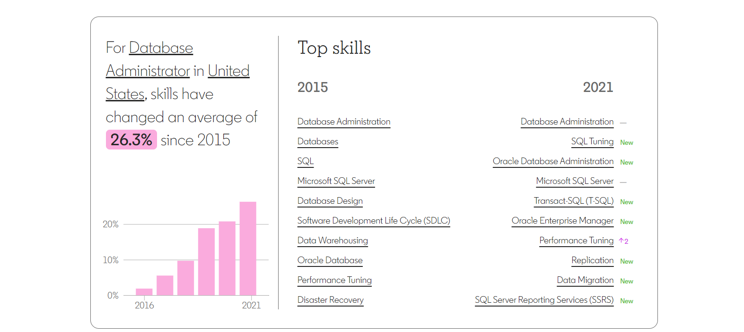
Technical Skills required to do our job are changing significantly!
https://linkedin.github.io/future-of-skills/#explore

Slide 13
What is the Solution?

Slide 14
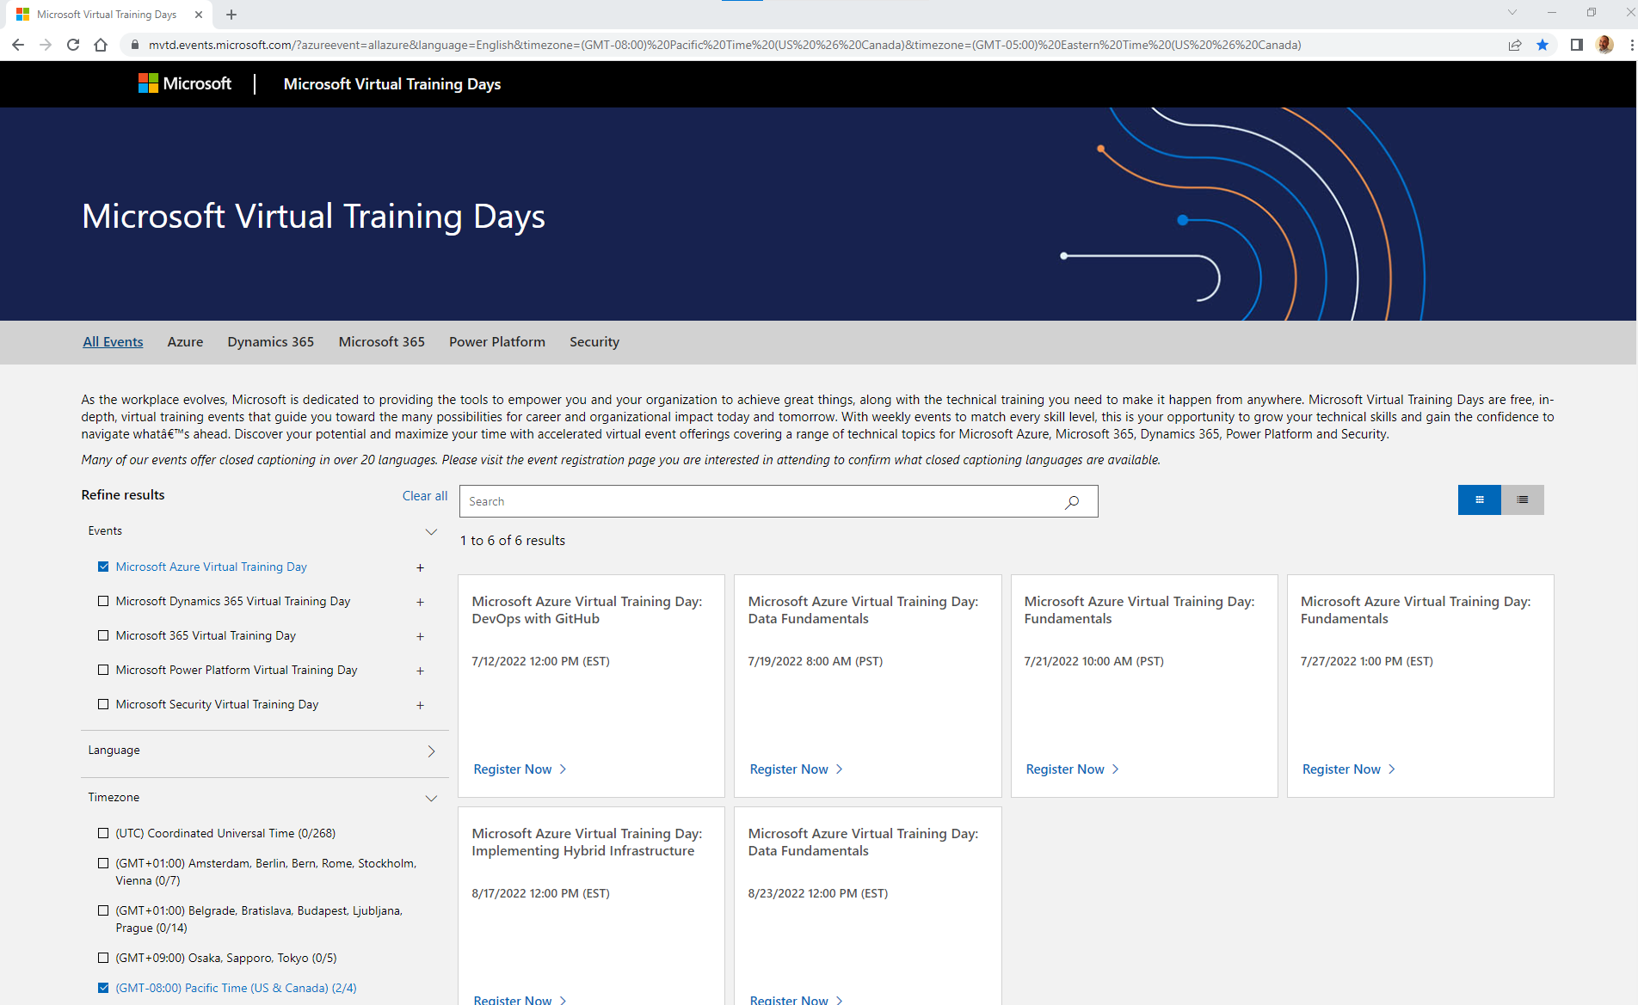
Register for FREE Microsoft Azure Virtual Training Days
Refine results: Events | Language | Time zone

Slide 15
Microsoft Azure Fundamentals Virtual Training Day Webinars are FREE!
Azure Data Fundamentals (DP-900) - 2 Day Webinar
Azure Fundamentals (DZ-900) - 2 Day Webinar

Slide 16
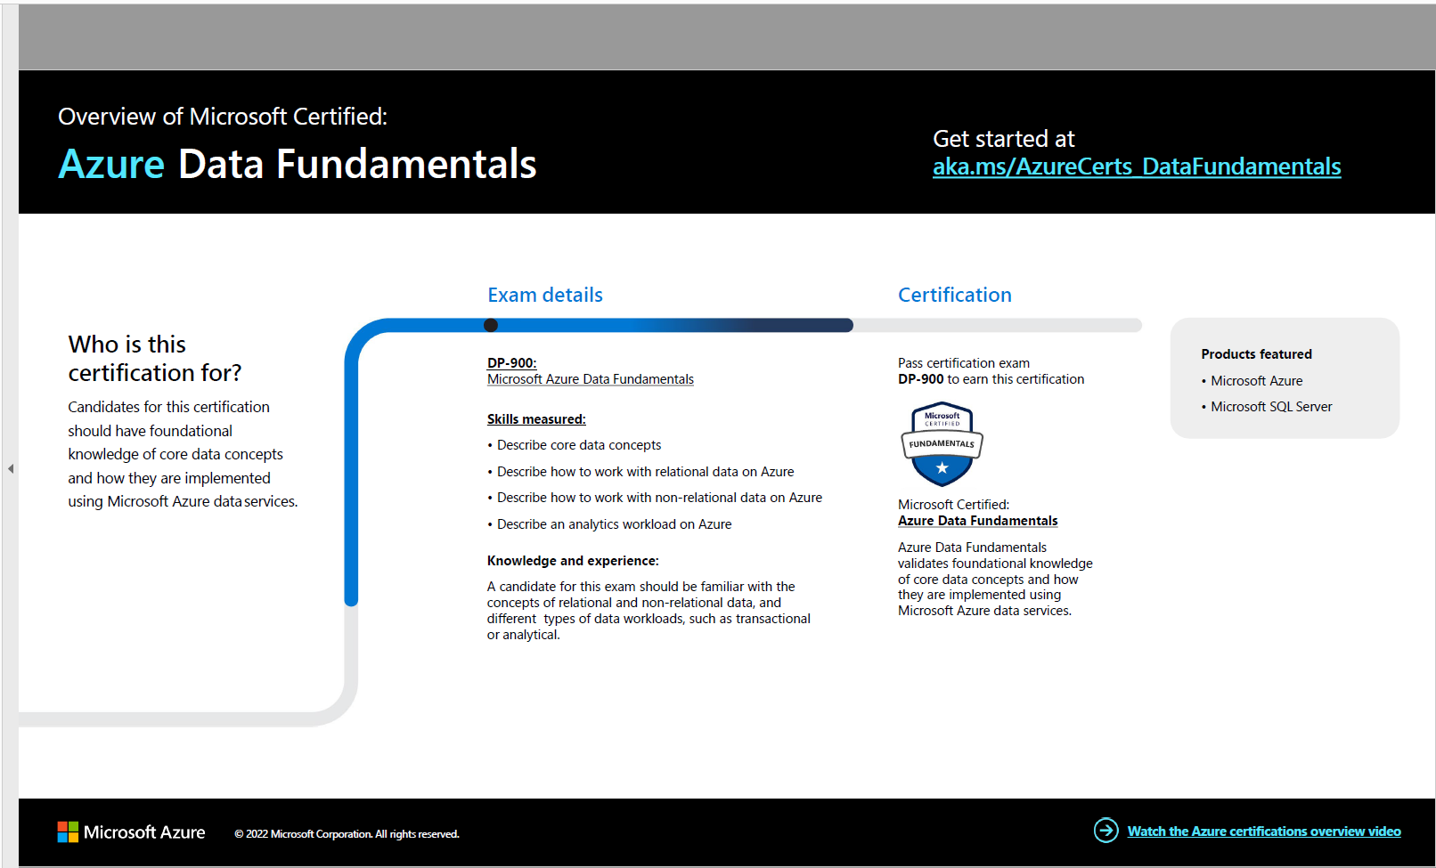

Slide 17
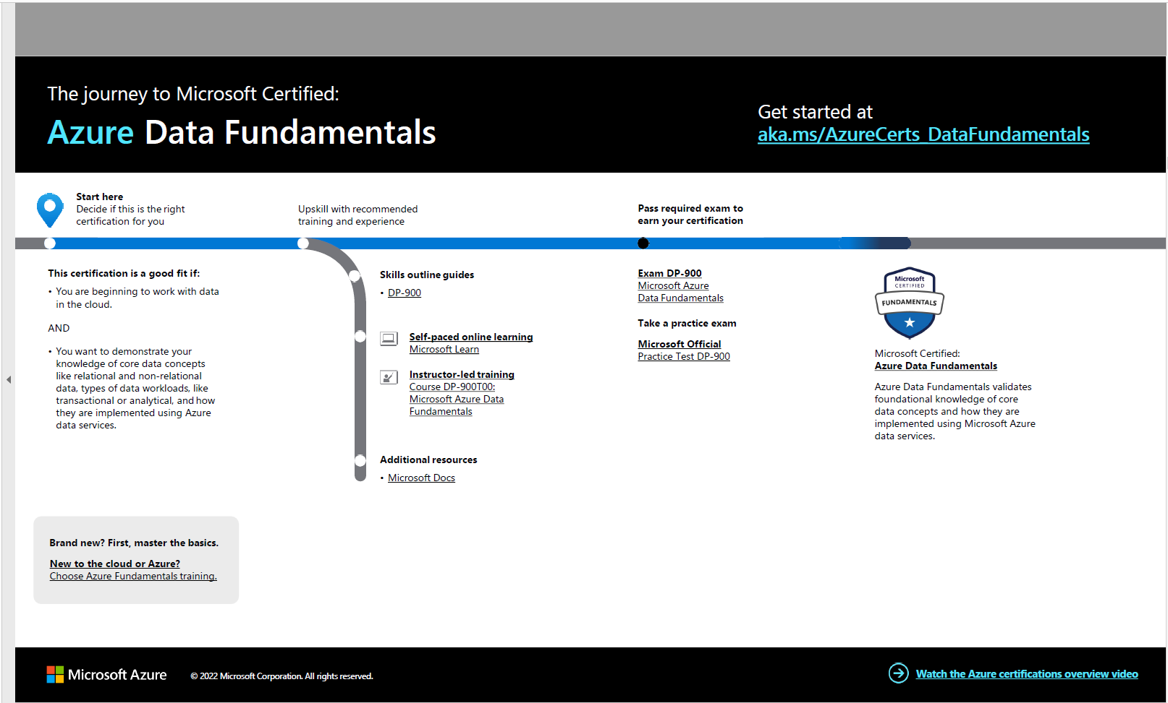

Slide 18
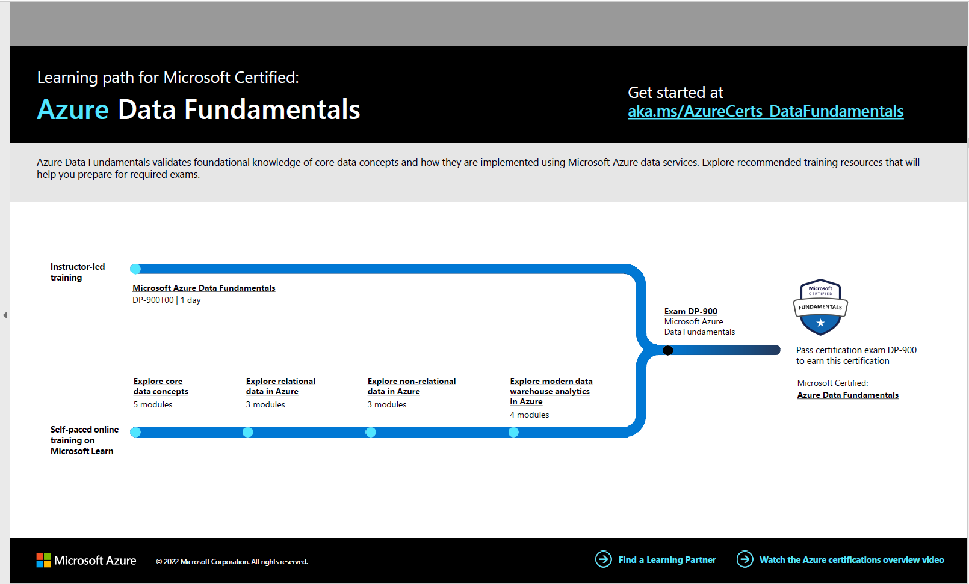

Slide 19
Azure Data Fundamentals 4 modules (6 hours)
Microsoft Self-Paced Study option – LEARNING PATH
Explore core data concepts (2 modules) 45 minutes
Explore relational data in Azure (2 modules) 1 hour and 13 minutes
Explore non-relational data in Azure (2 modules) 1 hour and 9 minutes
Explore data analytics in Azure (3 modules) 2 hours and 52 minutes
Exam DP-900 Azure Data Fundamentals
Skills measured
Describe core data concepts (25–30%)
Identify considerations for relational data on Azure (20–25%)
Describe considerations for working with non-relational data on Azure (15–20%)
Describe an analytics workload on Azure (25–30%)

Slide 20
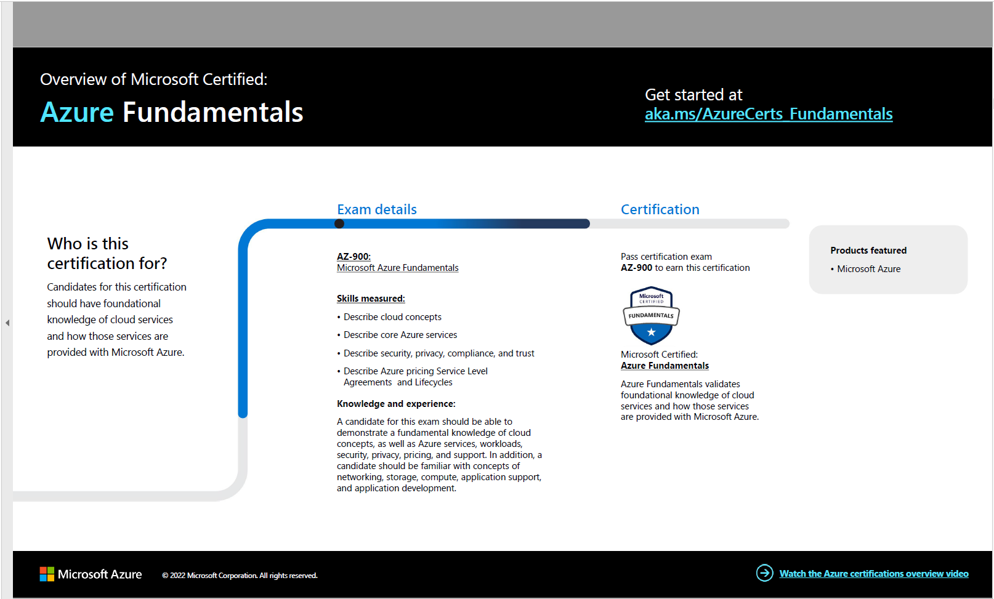

Slide 22
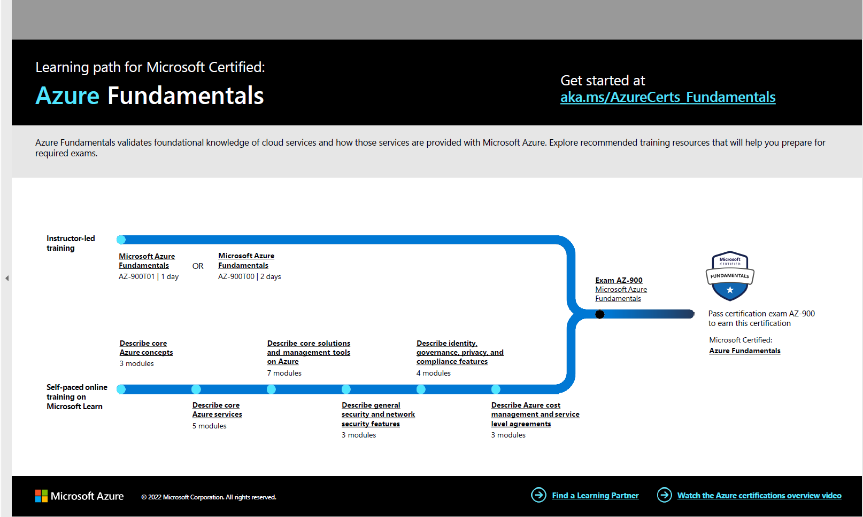

Slide 23
Azure Fundamentals 18 modules
Microsoft Self-Paced Study option – LEARNING PATH
Describe core Azure concepts (3 modules)
Describe core Azure services (4 modules)
Describe core solutions and management tools on Azure (6 modules)
Describe general security and network security features (2 modules)
Describe identity, governance, privacy, and compliance features (3 modules)
EXAM: AZ-900 Azure Fundamentals
Skills measured
Describe cloud concepts (25–30%)
Describe Azure architecture and services (35–40%)
Describe Azure management and governance (30–35%)

Slide 24
Solution
Register for your FREE Azure Fundamentals Webinar (Choice: Azure Data Fundamentals)
Complete the Free Webinar to get the Exam voucher email and Claim your discount
Refresh your knowledge with Microsoft Learn Paths

Slide 25

You completed the Azure Fundamentals Webinar. You received the email to claim your voucher for a FREE exam. You have the knowledge and the skills now. Why schedule the free exam? Why go for chance to get an Azure Fundamentals certification?

Slide 26
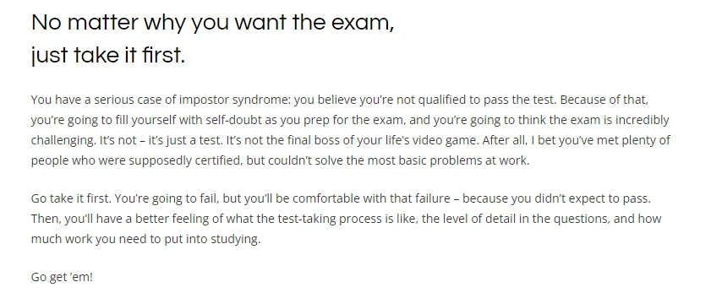
Brent Ozar, SQL Server Consultant, Microsoft Certified Masters, Brent Ozar Unlimited Which Microsoft Certification Should You Get? https://www.brentozar.com/archive/2021/01/which-microsoft-certification-should-you-get/

Slide 27
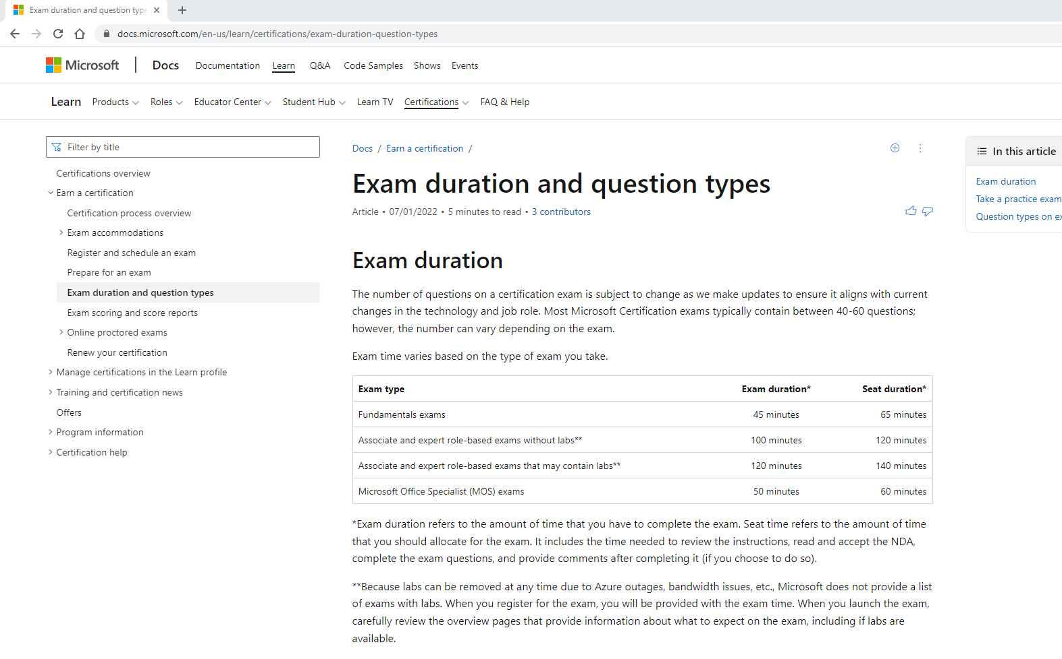
Microsoft Exam Types Fundamental exams (45 minutes) “Most Microsoft Certification exams typically contain between 40-60 questions; …”

Slide 28
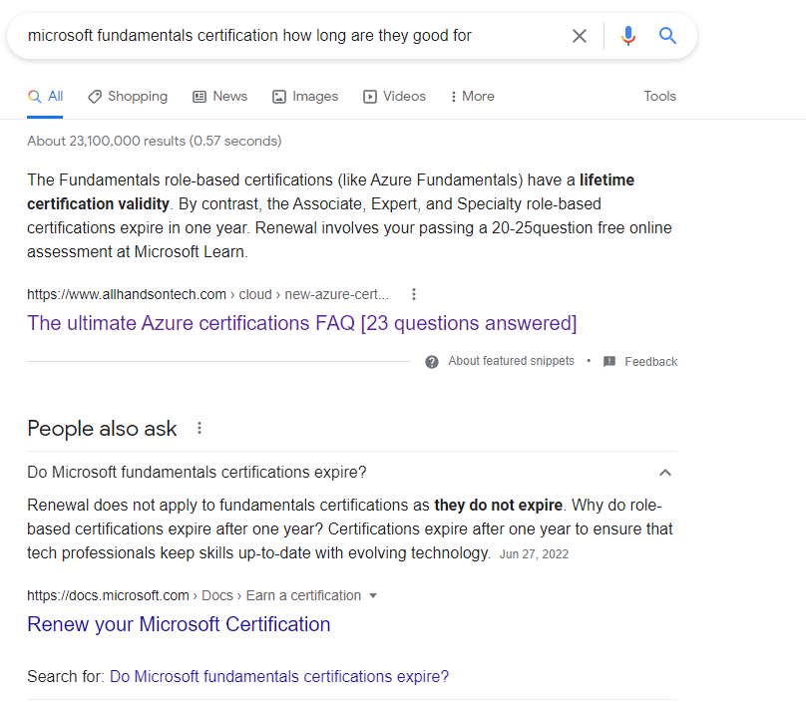
Azure Fundamentals have a lifetime certification validity

Slide 29
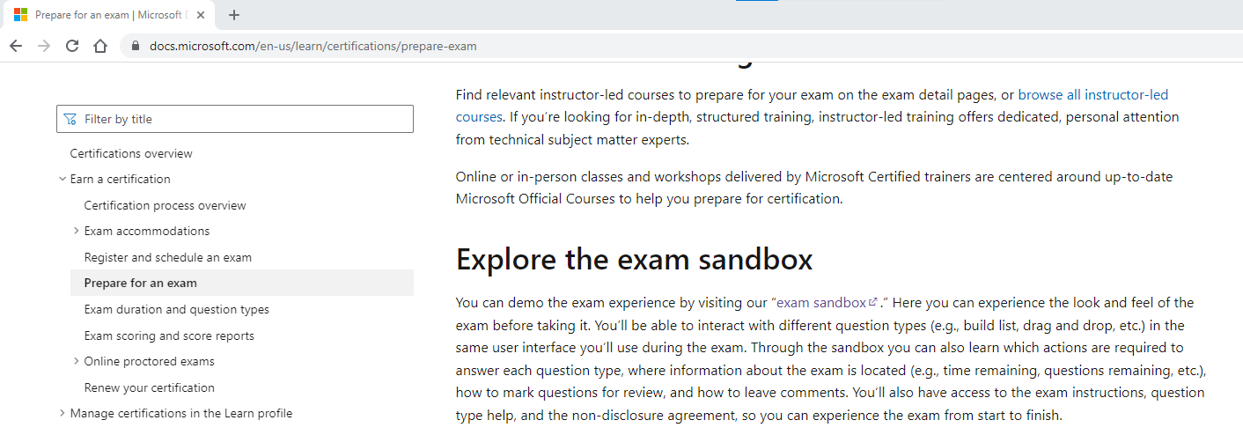
Explore the exam sandbox (Microsoft Learn)
https://docs.microsoft.com/en-us/learn/certifications/prepare-exam

Slide 30
What are the Benefits?

Slide 31

The Benefits of Certification
91% of certified IT professionals say certification has given them increased confidence to do their jobs. 2021 Pearson Vue Value of Certification
74% of certified IT professionals say they have greater work autonomy and independence. 2021 Pearson Vue Value of Certification
94% of decision-makers worldwide say that certified team members provide added value. Global Knowledge 2020 IT skills and salary report

Slide 32
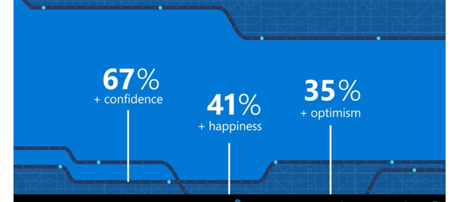
2021 Pearson VUE Value of IT Certification
61% of tech professionals say they earned a promotion,
73% upskilled to keep pace with changing technologies
76% have greater job satisfaction

Slide 33

Career Development Enrich your Professional Brand

Slide 34
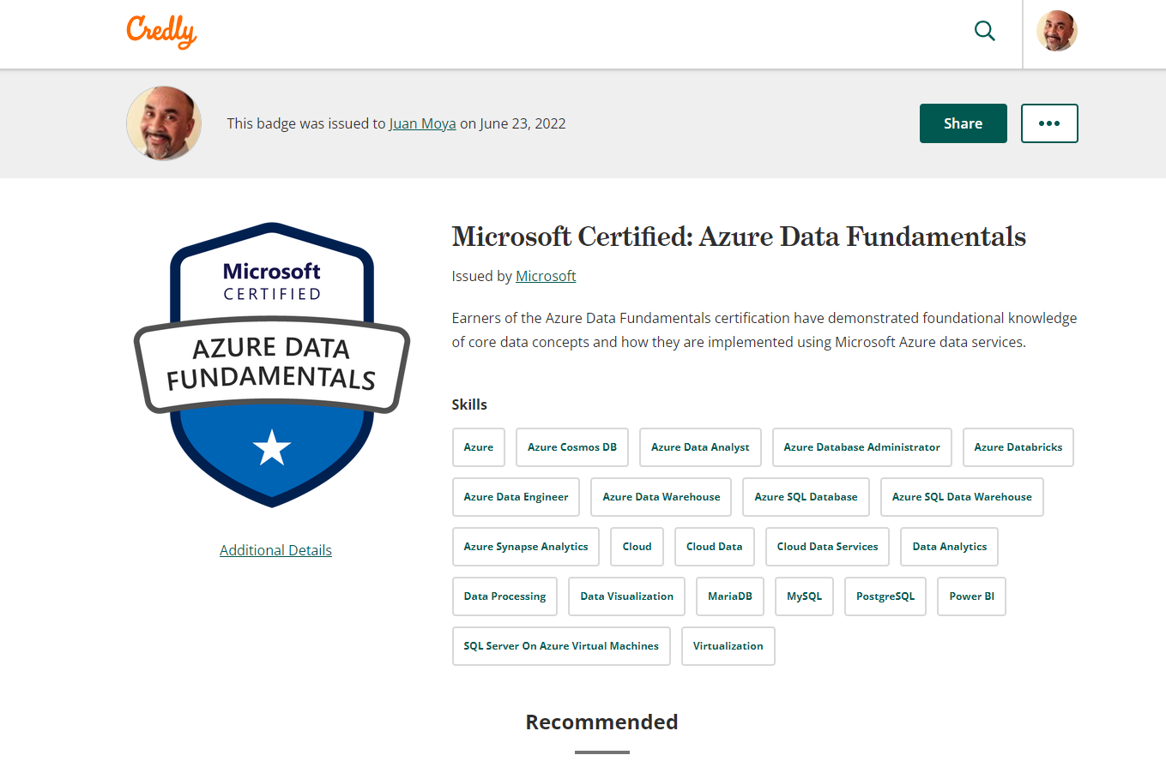
Credly.com Digital Credentials Profile URL https://www.credly.com/users/juan-moya.c7ac3 https://www.credly.com/badges/abb8b768-e61e-47ae-89af-11ca0f602ece571

Slide 35
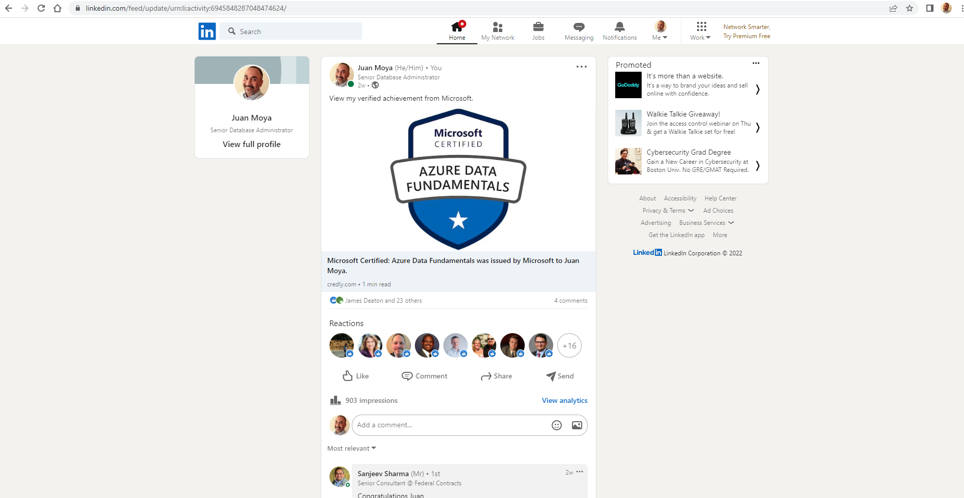
LinkedIn – Analytics for your posting from Credly.com

Slide 36
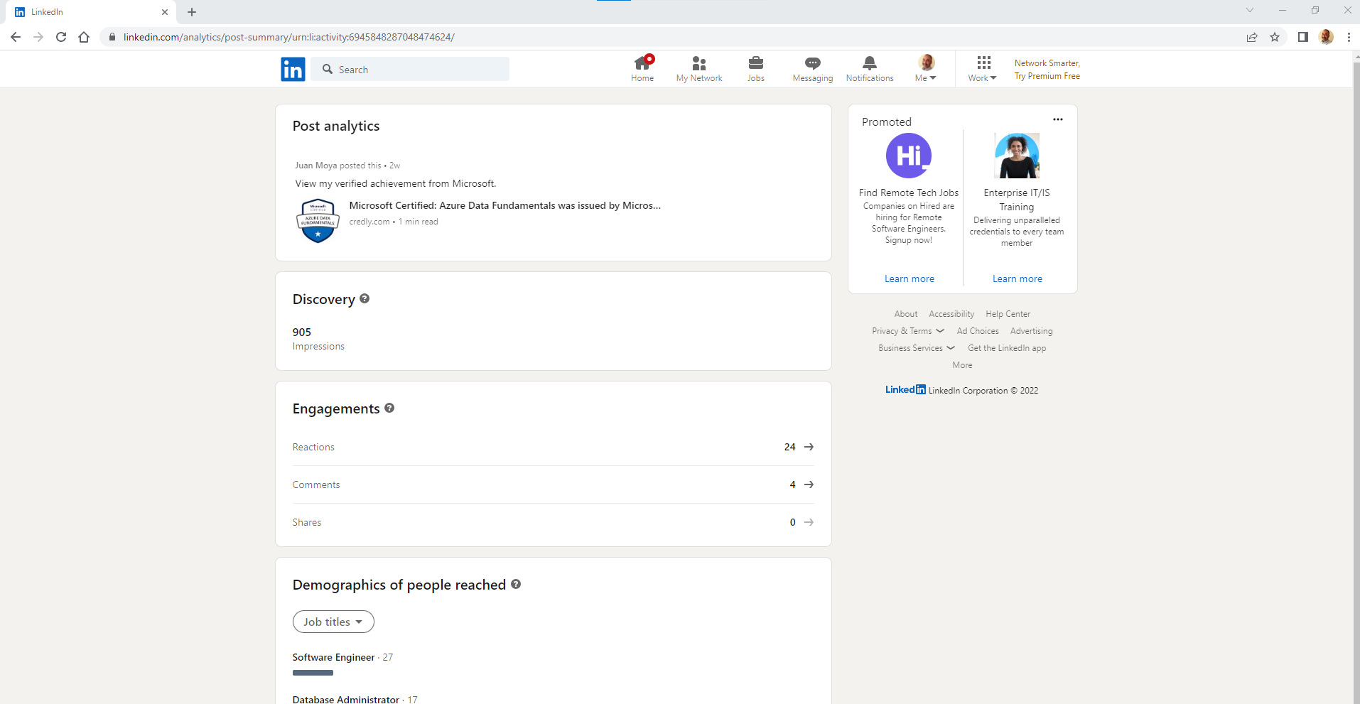

Slide 37
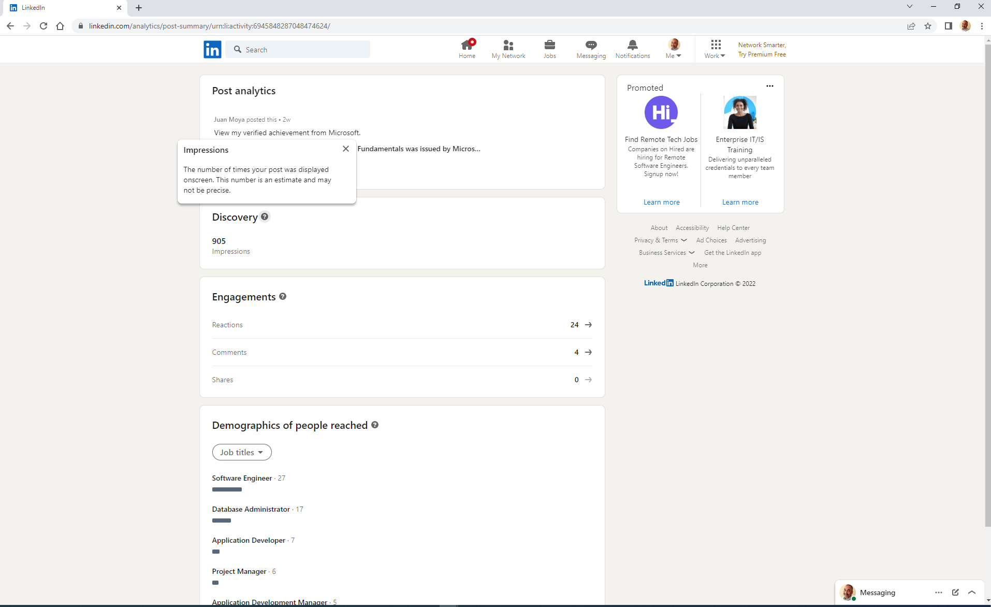

Slide 38
Summary
The rapid pace of tech innovation combined with corporations need to manage vast amounts of data is disruptive to financial planning and workforce stability.
Microsoft Azure 2022 revenue growth and popularity offers an opportunity to boost our technical skills and personal brand.
We should take advantage of the benefits of Microsoft Azure Fundamentals certification exams.

Slide 39
My Experience
The Azure Data Fundamentals Webinar material was too fundamental to keep my attention for two sessions. However, the DP-900 exam was challenging for the time I invested in preparing.
There was no way to rewatch the webinar as a video to prepare for the exam.
The Learning Paths in Microsoft Learn are a good review the exam’s Skills measured areas.
I enjoyed the gamification of the learning experience with XP (experience), Badges and Trophies.
I learned after taking the exam that my Certification Profile (MCID) should be linked to my personal Microsoft Account (MSA). This will allow me to manage my certification from my Microsoft Learn Profile. I will get an email when it is time to renew.
LinkedIn (Microsoft owned) provided the best experience after posting my certification badge.

Slide 40
Thank You
Thank you for attending our Virtual Meetup!!
Any questions?
Please email juan@iowadatapro.org

