Slide 1


Coding 365
資料庫語言
主講：Emma Huang
日期：2022/10/21、2022/10/28

Slide 2
PART 01
關聯式資料庫
PART 01
PART 02
SQL語法

Slide 3
01
PART ONE
關聯式資料庫

Slide 4

資料庫基礎知識
儲存資料的集合，可以想像成一個表格(Table)
由好幾個Table資料組成稱之為一個資料庫
資料分類儲存在各個資料表 (Table)中
Tables
DataBase

Slide 5
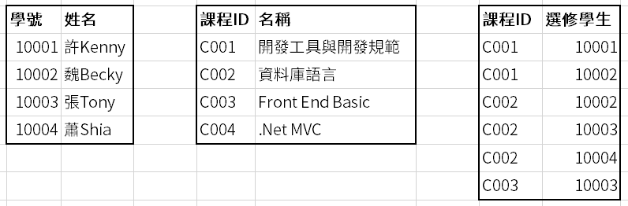
資料庫基礎知識
每張表都會有一個唯一識別(主鍵)
也就是ID。ID是資料庫中重要的概念，叫做唯一識別碼／主鍵，用來表示資料的唯一性。就相當於我們的身分證字號、學號
資料庫是表的集合

Slide 6
關聯式資料庫
使用SQL語法作為溝通方法
SQL(Structured Query Language)
資料完整性
資料完整性是指資料整體完備無缺、準確而且一致
透過如主鍵，外來鍵，預設值等來確保資料完整性
交易處理
要嘛全部成功要嘛全部失敗
Commit,Rollback

Slide 7
關聯式資料庫的重要面向
ACID 原則
即不可分割性 (Atomic)
交易必須整體成功執行，若是交易有一部分操作失敗，整個交易都會失效
一致性 (Consistent)
要求做為交易的一部分寫入資料庫的資料，必須遵守所有明定規則以及約束，包括限制條件、級聯、觸發
獨立性 (Isolated)
是達成並行控制的重要關鍵，可以確保每一個交易都是獨立的
耐用性 (Durable)
要求在一個交易成功完成後，對資料庫所做的變更都是永久性的

Slide 8
02
PART TWO
SQL語法

Slide 9
01
寫 SELECT 查詢
寫個簡單的 SELECT 查詢
使用 DISTINCT 來消除重覆的資料
使用Column 別名及Table 別名
使用 CASE ... WHEN ... END

Slide 10
寫個簡單的 SELECT 查詢
簡單的 Select
顯示欄位的方式
SQL 語句的執行順序
5: SELECT <select list>
1: FROM <table source>
2: WHERE <search condition>
3: GROUP BY <group by list>
4: HAVING <search condition>
6: ORDER BY <order by list>

Slide 11
簡單的 Select
Keyword | Expression
SELECT | <select list>
FROM | <table source>
SELECT companyname, country
FROM Sales.Customers;
SELECT unitprice, qty, (unitprice * qty) as Total
FROM sales.orderdetails;

Slide 12

顯示欄位的方式
顯示所有欄位
在一個專案產品內的程式建議不要使用此方式
顯示特定欄位
SELECT *
FROM Sales.Customers;
SELECT companyname, country
FROM Sales.Customers;

Slide 13
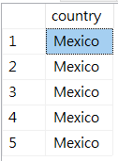

使用 DISTINCT 來消除重覆的資料
SELECT DISTINCT <column list>
FROM <table or view>
SELECT DISTINCT country
FROM Sales.Customers
Where country = 'Mexico';

Slide 14

欄位別名的使用方式
SELECT orderid, unitprice, qty AS [quantity]
FROM Sales.OrderDetails;
SELECT orderid, unitprice, quantity = qty
FROM Sales.OrderDetails;
SELECT orderid, unitprice , qty quantity
FROM Sales.OrderDetails;

Slide 15
Table別名的使用方式
在 From 子句為 Table 使用別名
使用AS
不使用AS
在 Select 子句使用 Table 別名
SELECT custid, orderdate
FROM Sales.Orders AS SO;
SELECT custid, orderdate
FROM Sales.Orders SO;
SELECT SO.custid, SO.orderdate
FROM Sales.Orders AS SO;

Slide 16
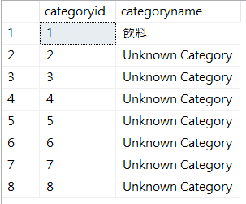
使用 CASE ... WHEN ... END
Keyword | Expression component
SELECT | <select list>
CASE | <value to compare>
WHEN | <value to match>
THEN | <result>
END | N/A
FROM | <table source>
SELECT categoryid,
CASE categoryid
WHEN 1 THEN '飲料'
ELSE 'Unknown Category'
END as categoryname
FROM Production.Categories;

Slide 17
1. 可以用什麼消除重覆的資料? 2. 為什麼要用欄位別名呢? 3. 為什麼要用Table 別名呢? 4. 欄位別名可以放在 Where 嗎?
5: SELECT <select list>
1: FROM <table source>
2: WHERE <search condition>
3: GROUP BY <group by list>
4: HAVING <search condition>
6: ORDER BY <order by list>
Notes:
1.Distinct
2.運算欄位，簡化，多墊一個
3.簡化(如Join)
4.No

Slide 18
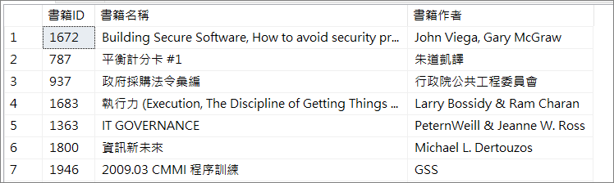
Mission
練習
USE GSSWEB 取得書籍ID、書籍名稱、作者資料的欄位資料，並將結果給上別名 Sample：(排序結果可能不一樣)
延伸學習：3.1. - Demonstration A.sql
執行語法並觀察產出結果

Slide 19
02
Querying Multiple Tables
了解 Joins 合併查詢
使用 Inner Joins
使用 Outer Joins
使用 Cross Joins
Self-Joins 自我關聯(主管-員工)

Slide 20
了解 Joins 合併查詢
Join Terminology: Cartesian Product(笛卡爾乘積)
Join 種類
T-SQL 語法選擇

Slide 21
Cartesian Product(笛卡爾乘積)
Name | Product
Davis | Alice Mutton
Davis | Crab Meat
Davis | Ipoh Coffee
Funk | Alice Mutton
Funk | Crab Meat
Funk | Ipoh Coffee
King | Alice Mutton
King | Crab Meat
King | Ipoh Coffee
Name
Davis
Funk
King
Product
Alice Mutton
Crab Meat
Ipoh Coffee

Slide 22
Join 種類
Join Type | Description
Cross | 笛卡爾乘積 不需要給ON
Inner | 等值連接，必須指定等值連接的條件(使用ON)，而查詢結果只會返回符合連接條件的資料。
LEFT|RIGHT|FULL (Outer) | 保留指定表中的所有行，檢索另一個表中的匹配行。 若未找到匹配行則插入 NULL 代替

Slide 23


Slide 24
T-SQL 語法選擇
ANSI SQL-1992
From 子句再加上 Join 關聯兩個表
建議用此寫法
ANSI SQL-1989
From 子句中使用逗號關聯，關聯條件寫在 Where
不建議此寫法!
SELECT ...
FROM Table1 INNER JOIN Table2
ON <on_predicate>
SELECT ...
FROM Table1, Table2
WHERE <where_predicate>

Slide 25
Querying with Inner Joins
只有一個 join 條件
多個 join 條件
SELECT ...
FROM Production.Categories AS C
JOIN Production.Products AS P
ON C.categoryid = P.categoryid;
-- List cities and countries where both -- customers and employees live
SELECT DISTINCT e.city, e.country
FROM Sales.Customers AS c
JOIN HR.Employees AS e
ON c.city = e.city AND
c.country = e.country;

Slide 26
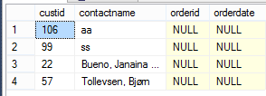
Querying with Outer Join
列出所有客戶的訂單(不管有沒有訂單):
找出哪些客戶沒有訂單 (outer可省略):
SELECT c.custid, c.contactname, o.orderid, o.orderdate
FROM Sales.Customers AS C
LEFT OUTER JOIN Sales.Orders AS O
ON c.custid = o.custid;
SELECT c.custid, c.contactname, o.orderid, o.orderdate
FROM Sales.Customers AS C
LEFT OUTER JOIN Sales.Orders AS O
ON c.custid = o.custid
WHERE o.orderid IS NULL;

Slide 27
使用Join要注意的事
把 Table 間要 matching 的欄位寫在 ON
要篩選資料的條件寫在 Where
Inner Join 的話，篩選條件在 ON 跟在 Where 是一樣的
Outer Join 的話，就有差別了哦!
--因為Orders沒資料，所以 Orders 的值是 NULL
SELECT c.custid, c.contactname, o.orderid, o.orderdate
FROM Sales.Customers AS c
LEFT JOIN Sales.Orders AS o
ON c.custid = o.custid
AND o.orderid IS NULL;
--找出沒有下訂單的客戶
SELECT c.custid, c.contactname, o.orderid, o.orderdate
FROM Sales.Customers AS c
LEFT JOIN Sales.Orders AS o
ON c.custid = o.custid
WHERE o.orderid IS NULL;

Slide 28
Querying with Self-Joins(自我關聯)
Self-Join Syntax
Self-Join Examples

Slide 29
Self-Join 語法
可以使用 inner join, outer join, cross join 關聯相同的 Table
在 ON 子句中也可以使用不等式連接
可以是自我配對(1對1), 鏡像對稱(1對2, 2對1)
SELECT ...
FROM T1 AS t1 JOIN T1 AS t2
ON t1.Col1 = t2.Col2;
SELECT ...
FROM T1 AS t1 JOIN T1 AS t2
ON t1.Col1 < t2.Col1;

Slide 30
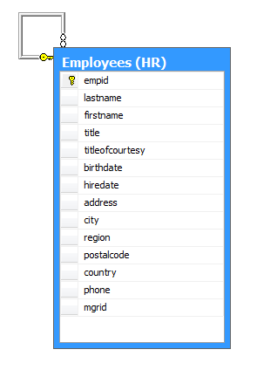
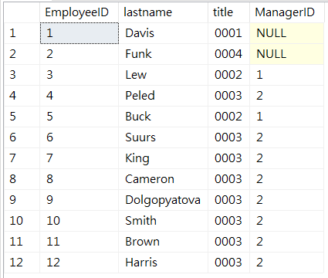
Self-Join Examples
列出員工及它的主管編號
SELECT e.empid, e.lastname,
e.title, m.mgrid
FROM HR.Employees AS e
LEFT OUTER JOIN HR.Employees AS m
ON e.mgrid=m.empid;

Slide 31
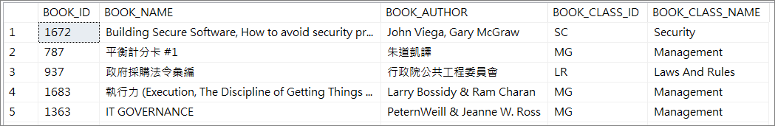
Mission
練習
USE GSSWEB 取得書籍ID、書籍名稱、作者資料、書籍類別(需關聯BOOK_CODE找出類別中文名稱)的欄位資料
Sample：
該使用 INNER JOIN 還是 LEFT JOIN ?
延伸學習：4.1. - Demonstration A.sql
執行語法並觀察產出結果

Slide 32
03
排序及篩選資料
排序
篩選資料
使用TOP
操作NULL
5: SELECT <select list>
1: FROM <table source>
2: WHERE <search condition>
3: GROUP BY <group by list>
4: HAVING <search condition>
6: ORDER BY <order by list>

Slide 33
排序
ORDER BY (欄位名稱):
ORDER BY (欄位別名):
ORDER BY 降冪排列(大到小):
SELECT orderid, custid, orderdate
FROM Sales.Orders
ORDER BY orderdate;
SELECT orderid, custid, YEAR(orderdate) AS orderyear
FROM Sales.Orders
ORDER BY orderyear;
SELECT orderid, custid, orderdate
FROM Sales.Orders
ORDER BY orderdate DESC;

Slide 34
篩選資料
找出來自西班牙的客戶
找出訂單日期大(晚)於 2007/01/01
找出特定日期區間的訂單
SELECT contactname, country
FROM Sales.Customers
WHERE country = N’Spain’; --National = Unicode
SELECT orderid, orderdate
FROM Sales.Orders
WHERE orderdate > '2007/01/01';
SELECT orderid, custid, orderdate
FROM Sales.Orders
WHERE orderdate >= '20070101' AND orderdate < '20080101';

Slide 35
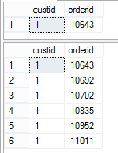
使用 TOP
SELECT TOP (1) custid, orderid
FROM Sales.Orders;
SELECT TOP (1) WITH TIES custid, orderid
FROM Sales.Orders
ORDER BY custid;
Notes:
SET ROWCOUNT 1
USE TSQL2012
go
SELECT TOP(2)WITH TIES *
FROM HR.Employees AS e
LEFT OUTER JOIN HR.Employees AS m
ON e.mgrid=m.empid
ORDER BY e.title;
SELECT TOP 1 custid, orderid
FROM Sales.Orders;
SELECT TOP 1 WITH TIES custid, orderid
FROM Sales.Orders
ORDER BY custid;
http://www.codeproject.com/Tips/480781/SQL-Server-TOP-WITH-TIES-A-Beauty-of-TSQL

Slide 36
操作NULL
要用 IS
SELECT custid, city, region, country
FROM Sales.Customers
WHERE region IS NOT NULL;
Notes:
SET ANSI_NULLS OFF
但不建議

Slide 37
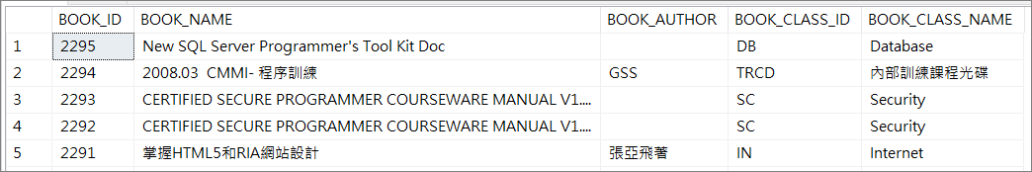
Mission
練習
USE GSSWEB 依上一節的Mission 接續，請依書本ID做大到小的排序 Sample：
延伸學習：5.1. - Demonstration A.sql
執行語法並觀察產出結果

Slide 38
04
Grouping and Aggregating Data
使用彙總函數
使用 GROUP BY 子句
使用 HAVING 篩選 GROUP BY 完的結果
5: SELECT <select list>
1: FROM <table source>
2: WHERE <search condition>
3: GROUP BY <group by list>
4: HAVING <search condition>
6: ORDER BY <order by list>

Slide 39
Working with Aggregate Functions
Aggregate functions(彙總函數):
彙總函數指的也就是 AVG()、COUNT()、MAX()、MIN()、SUM() 等這些內建函數
回傳純量數(不會有欄位名稱)
會忽略 NULL ，除了 COUNT(*)
可於 SELECT, HAVING, ORDER BY 子句使用
一般會搭配 GROUP BY
SELECT AVG(unitprice) AS avg_price,
MIN(qty) AS min_qty,
MAX(discount) AS max_discount
FROM Sales.OrderDetails;
avg_price min_qty max_discount
---------- ---------- -------------
26.2185 1 0.250

Slide 40
Using DISTINCT with Aggregate Functions
可用 DISTINCT 來消除重覆的值，再給Aggregate Function使用
DISTINCT 聚合彙總消除重複值, 不是行(與 SELECT DISTINCT 不同)
SELECT empid, YEAR(orderdate) AS orderyear,
COUNT(custid) AS all_custs,
COUNT(DISTINCT custid) AS unique_custs
FROM Sales.Orders
GROUP BY empid, YEAR(orderdate);
empid orderyear all_custs unique_custs
----------- -------------- ---------------- ------------
1 2006 26 22
1 2007 55 40
1 2008 42 32
2 2006 16 15

Slide 41
Using Aggregate Functions with NULL
大部分彙總函式會忽略NULL
COUNT(<column>)忽略NULL
COUNT(*) 計算資料筆數
NULL 有可能產生錯誤的結果(例如使用AVG)
彙總前，使用 ISNULL 或 COALESCE 來替換NULL值
SELECT
AVG(c2) AS AvgWithNULLs,
AVG(COALESCE(c2,0)) AS AvgWithNULLReplace
FROM dbo.t2;

Slide 42
Using the GROUP BY Clause
使用 GROUP BY 子句
GROUP BY 的操作與邏輯順序
GROUP BY 流程
在彙總函式內使用 GROUP BY

Slide 43
使用 GROUP BY 子句
GROUP BY 搭配彙總函數用來對資料做分組
根據 GROUP BY 子句中指定的欄位進行分組，計算分組後彙總函數的值，每個群組都會回傳一個資料列
SELECT <select_list>
FROM <table_source>
WHERE <search_condition>
GROUP BY <group_by_list>;
SELECT empid, COUNT(*) AS cnt
FROM Sales.Orders
GROUP BY empid;

Slide 44
GROUP BY 的操作與邏輯順序
Logical Order | Phase | Comments
5 | SELECT
1 | FROM
2 | WHERE | 過濾明細資料
3 | GROUP BY | Creates groups
4 | HAVING | 過濾Group後的資料
6 | ORDER BY
若在 query 使用 GROUP BY，所有後續階段是對 group 的結果而非原source
所有在 SELECT, HAVING, ORDER BY 的欄位 必須在 GROUP BY 子句 或在 彙總函數內使用

Slide 45


GROUP BY 流程
SELECT orderid, empid, custid
FROM Sales.Orders;
orderid | empid | custid
10643 | 6 | 1
10692 | 4 | 1
10926 | 4 | 2
10625 | 3 | 2
orderid | empid | custid
10643 | 6 | 1
10692 | 4 | 1
10926 | 4 | 2
10625 | 3 | 2
10365 | 3 | 3
WHERE custid IN(1,2)
GROUP BY empid
SELECT output
empid | COUNT(*)
6 | 1
4 | 2
3 | 1

Slide 46
在彙總函式內使用 GROUP BY
SELECT 子句中常使用到彙總函數，按組彙總：
彙總函數可以使用資料表的欄位，不限定只能在Group By之中的欄位
SELECT custid, COUNT(*) AS cnt
FROM Sales.Orders
GROUP BY custid;
SELECT productid, MAX(qty) AS largest_order
FROM Sales.OrderDetails
GROUP BY productid;

Slide 47
Filtering Grouped Data Using the HAVING Clause
要過濾Group的資料，請使用Having
SELECT custid, COUNT(*) AS count_orders
FROM Sales.Orders
GROUP BY custid
HAVING COUNT(*) > 10;

Slide 48
Compare HAVING to WHERE
WHERE 在分組建立之前過濾資料
控制將哪些資料進行分組
HAVING 過濾分組後的資料
控制哪些組要進入下一個邏輯階段

Slide 49
Compare HAVING to WHERE
在 HAVING 子句中使用 COUNT(*) 能有助於解決常見的商業邏輯:
顯示訂單數量超過一筆的客戶
顯示出現在 10 筆訂單(含)以上的商品
SELECT c.custid, COUNT(*) AS cnt
FROM Sales.Customers AS c
JOIN Sales.Orders AS o ON c.custid = o.custid
GROUP BY c.custid
HAVING COUNT(*) > 1;
SELECT p.productid, COUNT(*) AS cnt
FROM Production.Products AS p JOIN Sales.OrderDetails AS od ON p.productid = od.productid
GROUP BY p.productid
HAVING COUNT(*) >= 10;

Slide 50
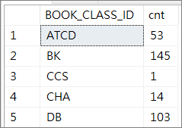
Mission
練習
USE GSSWEB 請列出每個書籍類別的書籍總數
Sample：
延伸學習：6.1. - Demonstration A.sql
執行語法並觀察產出結果

Slide 51
Using Window Ranking, Offset & Aggregate Functions
Creating Windows with OVER
Exploring Window Functions(視窗函數)

Slide 52
Creating Windows with OVER
使用 OVER
Partitioning Windows

Slide 53
Using OVER
在套用相關的視窗函數之前，決定資料列集的資料分割和排序。OVER 子句會定義查詢結果集內的視窗或使用者指定的資料列集
使用 partition 子句，將查詢結果集分成幾個資料分割
如果需要，可以在單個查詢中使用多個OVER()子句，每個子句都有各自的分區和排序
OVER ( [ <PARTITION BY clause> ]
[ <ORDER BY clause> ]
[ <ROWS or RANGE clause> ]
)
Notes:
For example,
SUM(<col>) OVER () means to calculate the aggregate (SUM) using the underlying query's result set (all rows).
SUM(<col>) OVER (PARTITION BY <col>) means to calculate the aggregate once for each window of rows restricted to only those rows that have the same value in <col> as in the current row.

Slide 54
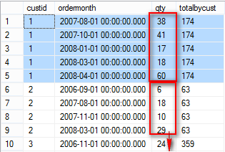
Partitioning Windows
將列中具有相同值的行分成同區
在 OVER() 子句中使用 PARTITION BY
沒有定義 PARTITION BY 子句，OVER() 只將所有資料列當成單一群組
SELECT custid, ordermonth, qty,
SUM(qty) OVER(PARTITION BY custid)
AS totalbycust
FROM Sales.CustOrders;
Notes:
Don't take the comparison too far, but PARTITION is conceptually similar to a GROUP BY, even if the mechanisms are very different.
SELECT custid ,
ordermonth ,
qty ,
SUM(qty) OVER ( PARTITION BY custid ) AS totalbycust
, SUM(qty) Over() AS TotalQty
FROM Sales.CustOrders;
SELECT custid ,
ordermonth ,
qty ,
( SELECT SUM(qty)
FROM Sales.CustOrders B
WHERE A.custid = B.custid
GROUP BY B.custid
) AS totalbycust
FROM Sales.CustOrders A;

Slide 55
Exploring Window Functions
定義 Window Functions
Window Aggregate Functions
Window Ranking Functions

Slide 56
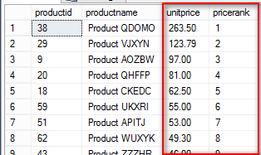
Defining Window Functions
Window function(視窗函數) 應用於一個窗口或一組行的函數
視窗函數包含 aggregate(彙總), ranking(排序), distribution(分布), and offset(偏移) functions
視窗函數依賴於由 OVER() 組成的集合
SELECT productid, productname, unitprice,
RANK() OVER(ORDER BY unitprice DESC) AS pricerank
FROM Production.Products
ORDER BY pricerank;

Slide 57
Window Aggregate Functions
與彙總函數的 Group By 相似
Eg. SUM, MIN, MAX, 等.
需與 OVER() 搭配使用
可應用於分區、排序、框架
SELECT custid, ordermonth, qty,
SUM(qty) OVER(PARTITION BY custid) AS totalpercust
FROM Sales.CustOrders;

Slide 58
Window Ranking Functions
排序函數需要加上 ORDER 子句
Partition 非必要
但要顯示排序過的結果仍需加上ORDER BY
Function | Description
RANK | 傳回結果集分割區內，每個資料列的次序。 資料列的次序等於一加上前述資料列之前的次序數目。如 1, 1, 3, 4…..
DENSE_RANK | 此函式會傳回結果集分割區內每個資料列的次序，次序值中沒有任何間距。特定資料列的次序是一加上該特定資料列前面之相異次序值的數目。如 1, 1, 2, 3…..
ROW_NUMBER | 為每一筆資料產生一個序號，一次排序且不會重複。 流水號
NTILE | 將排序分割區中的資料列散發到指定數目的群組中。 這些群組從 1 開始編號。 對於每個資料列，NTILE 都會傳回資料列所屬群組的號碼。 分幾群
Notes:
Reminder that any order by within an OVER clause does not determine order of the final result set. See the notes in the workbook about using an additional ORDER BY clause to set output order.
SELECT productid ,
productname ,
unitprice ,
RANK() OVER ( ORDER BY unitprice DESC ) AS pricerank ,
DENSE_RANK() OVER ( ORDER BY unitprice DESC ) AS priceDenseRank ,
NTILE(4) OVER ( ORDER BY unitprice DESC ) AS priceNtile ,
ROW_NUMBER() OVER ( ORDER BY unitprice DESC ) AS sn
FROM Production.Products
ORDER BY sn

Slide 59
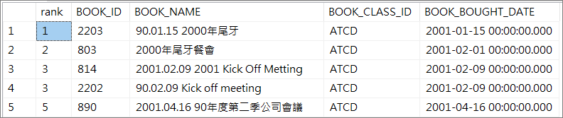
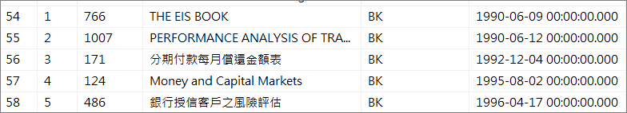
Mission
練習
USE GSSWEB 請依照每個書籍類別，找出每個類別內的書籍中購買日期從舊到新的排名
Sample：以ATCD、BK為例
延伸學習：10.1. - Demonstration A.sql
執行語法並觀察產出結果

Slide 60
08
Data Manipulation Language (DML)
資料操作語言：SQL中處理資料庫中的資料
主要命令有 INSERT, UPDATE, DELETE

Slide 61
INSERT
語法：INSERT...VALUES
新增一筆資料
新增多筆資料 (用逗號串接)
INSERT INTO Sales.OrderDetails(
orderid, productid, unitprice, qty, discount)
VALUES(12000,39,18,2,0.05);
INSERT INTO Sales.OrderDetails(
orderid, productid, unitprice, qty, discount)
VALUES
(12001,39,18,2,0.05),
(12002,39,18,5,0.10);

Slide 62
Using INSERT with SELECT and EXEC
可將查詢的結果直接插入Table ：INSERT...SELECT
也可將SP執行結果或動態SQL的結果插入Table
INSERT INTO Sales.OrderHist(
orderid,custid,empid,orderdate)
SELECT orderid,custid,empid,orderdate
FROM Sales.Orders
WHERE orderdate < '20080101';
INSERT INTO dbo.T1 (productid, productname, unitprice)
EXEC Production.ProdsByCategory
@numrows = 5, @catid=1;

Slide 63
SELECT INTO
SELECT...INTO 類似於 INSERT...SELECT 但 SELECT...INTO 每次執行時都會創建一個新Table
複製列名、數據類型和是否可為NULL
不復制constraints或index
SELECT orderid, custid, empid, orderdate, shippeddate
INTO Sales.OrderArchive
FROM Sales.Orders
WHERE orderdate < '20080101';

Slide 64
UPDATE DATA
Where 就是前面學的Query部份
UPDATE Production.Products
SET unitprice = (unitprice * 1.04)
WHERE categoryid = 1
AND discontinued = 0;
--Update Join 2 Table
UPDATE T1
SET T1.NAME = T2.NAME
FROM TAB1 T1 INNER JOIN TAB2 T2
ON T1.ID = T2.ID

Slide 65
DELETE DATA
DELETE FROM Sales.OrderDetails
WHERE orderid = 10248;

Slide 66
TRUNCATE TABLE
一次性刪除全部資料
TRUNCATE TABLE dbo.MyTable;

Slide 67
Mission
16.1. - Demonstration A.sql
執行語法並觀察產出結果

