Slide 1

Banking Transaction & Account Management System
DATABASE MANAGEMENT SYSTEMS · PROJECT
Database design, SQL logic and a FastAPI backend for core banking records
ER Diagram
SQL
PostgreSQL
FastAPI

Slide 2



Project Team
Bank Management System · DBMS Project
Moyukh Mondal
Koushik Maity
Rajeev Lalawat
Roll No. 252123017
Roll No. 252123014
Roll No. 252123022

Slide 3
Table of Contents
1
Entity-Relationship Diagram
Slide 4
How all banking entities are related
2
Project Summary
Slide 5
Tables, parts and integrity rules at a glance
3
Overview & Database Design
Slides 6–7
Project objective and relational schema
4
SQL, Triggers & Stored Procedures
Slides 8–11
Setup scripts, automation, procedures and integration flow
5
Backend & Technology Stack
Slides 12–13
FastAPI, PostgreSQL and the three-layer structure

Slide 4
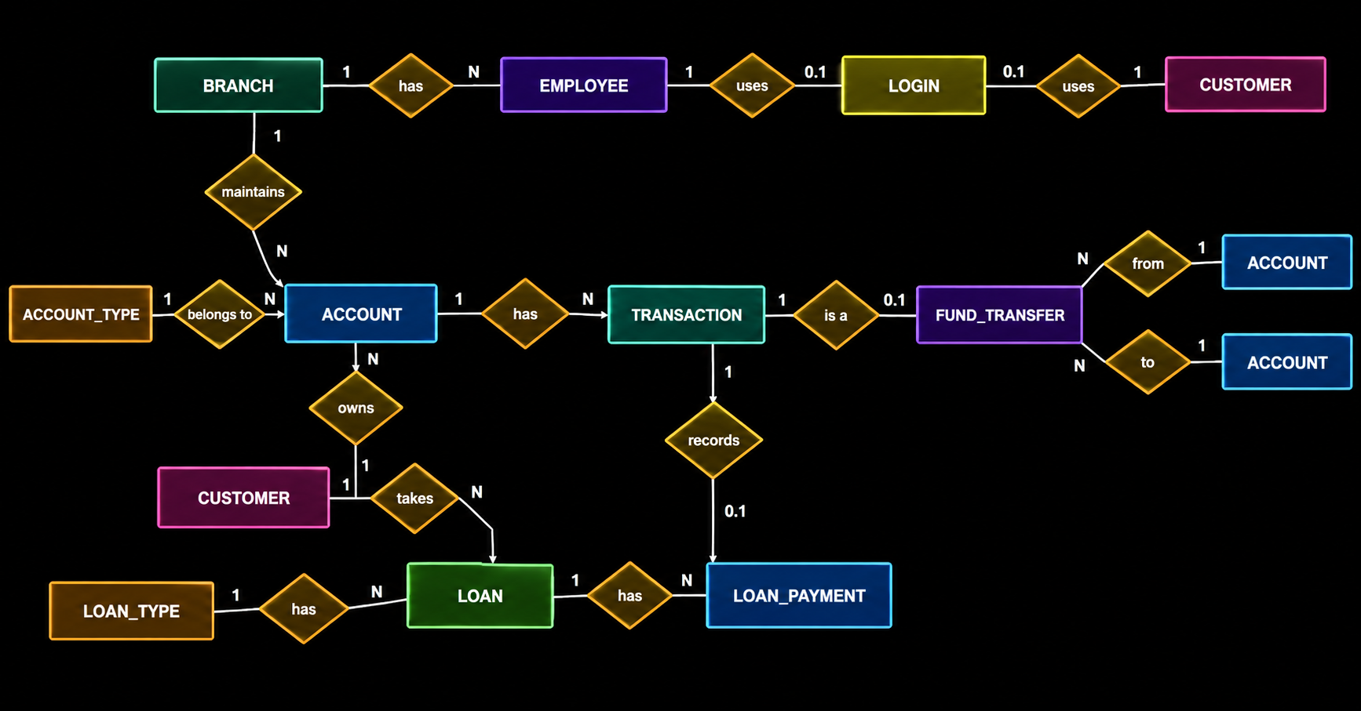
Entity-Relationship Diagram
BRANCH
1
has
N
EMPLOYEE
1
uses
0.1
LOGIN
0.1
uses
1
CUSTOMER
1
maintains
N
N
from
1
ACCOUNT
ACCOUNT_TYPE
1
belongs to
N
ACCOUNT
1
has
N
TRANSACTION
1
is a
0.1
FUND_TRANSFER
N
to
1
ACCOUNT
N
1
owns
records
1
CUSTOMER
1
takes
N
0.1
LOAN
1
has
N
LOAN_PAYMENT
LOAN_TYPE
1
has
N

Slide 5
Project Summary
11 tables in 4 parts, connected by keys and protected by integrity rules
5
TABLES
Part 1
2
TABLES
Part 2
3
TABLES
Part 3
1
TABLE
Part 4
Core Banking
Transaction & Fund Transfer
Loan Management
Authentication & Integrity
Branch · Customer · Employee · Account Type · Account
Transaction · Fund Transfer
Loan Type · Loan · Loan Payment
Login, plus the rules that keep data valid
DATA INTEGRITY
PRIMARY KEY
FOREIGN KEY
UNIQUE
NOT NULL
CHECK
DEFAULT
KEY OUTCOME A complete schema covering customers, accounts, transactions, loans and login.

Slide 6
Project Overview
Objective Build a database-driven system for managing core banking records.
1
Database
2
SQL Logic
Relational tables for branches, customers, accounts, transactions, transfers and loans.
Constraints, triggers and stored procedures for consistency and reusable operations.
3
Backend
4
Integration
A Python / FastAPI foundation that connects application requests to PostgreSQL.
Database, backend and web interface organised as connected application layers.
KEY OUTCOME The core structure for a banking management application.

Slide 7
Database Design
Relational database representing the main entities in banking operations.
Primary keys and foreign keys connect related records.
Data split into related tables to reduce duplication and improve consistency.
Covers branches, customers, accounts, transactions, transfers, loans and loan payments.
CORE TABLES
Branches
Customers
Accounts
Transactions
Fund Transfers
Loans
Loan Payments
KEY OUTCOME A structured schema for storing and linking core banking data.

Slide 8
SQL Implementation
1
2
3
4
Setup Scripts
Constraints
Test Data
Branch Identifiers
SQL scripts that create and update the tables and their relationships.
Rules that keep data valid and maintain referential integrity.
Realistic dummy data for testing the schema and relationships.
Branch data follows Indian banking formats, including IFSC and MICR.
KEY OUTCOME Repeatable SQL setup scripts and test data for database development.

Slide 9
Triggers and Data Integrity
Triggers automate selected actions when records are inserted or updated.
Database-level rules keep related records consistent.
Constraints and relationships reduce invalid or disconnected records.
Sample data used to check database behaviour during development.
Banking data change
Trigger / rule runs
Database stays consistent
KEY OUTCOME Improved consistency and automated selected operations within the database.

Slide 10
Stored Procedures: Core Banking Operations
Account Management
Fund Transfers
sp_open_account
sp_fund_transfer
Validates customer, branch, account type and minimum opening balance.
Records debit and credit transactions and maintains transfer records.
Deposits & Withdrawals
Loan Management
sp_deposit, sp_withdraw
sp_apply_loan, sp_approve_loan
Validate transaction amounts and channels.
Handle loan applications and approval or rejection.
Loan Repayment
Account Information
sp_loan_payment
sp_check_balance, sp_get_transaction_history, sp_generate_account_statement
Records repayments and connects them with transactions.
Support balance inquiries and transaction reporting.
KEY OUTCOME Reusable procedures covering accounts, transfers, loans and reporting.

Slide 11
Integration Flow
STEP 1
Frontend Request
STEP 2
FastAPI Backend
STEP 3
PostgreSQL Connection
STEP 4
Stored Procedure Call
STEP 8
Response to Frontend
STEP 7
Result to the Backend
STEP 6
Triggers / Data Updates
STEP 5
Validation & SQL Operations
KEY OUTCOME Each request travels browser to database and back, with validation done in SQL.

Slide 12
Backend Development
FastAPI Framework
Python-based backend using FastAPI as the API framework.
1
PostgreSQL Connection
Backend connected to the PostgreSQL database.
2
Authentication & Security
Login handling, password hashing and JWT-based authentication.
3
Communication Layer
Acts as the link between the frontend and the database.
4
KEY OUTCOME The foundation for API-based communication with the banking database.

Slide 13
Technology Stack and System Integration
Database
PostgreSQL: stores banking records and manages relationships
Database Logic
SQL: tables, constraints, triggers, stored procedures, test data
Backend
Python + FastAPI: handles API requests and application logic
Security
Password hashing and JWT-based authentication components
Frontend
HTML, CSS, JavaScript: browser interface that talks to the backend
SYSTEM FLOW
Frontend
HTML / CSS / JS
Backend
Python / FastAPI
Database
PostgreSQL
KEY OUTCOME A three-layer structure separating user interaction, logic and data storage.

