Slide 1
NEEROG JEEVAN
{ A SOLUTION TO COVID-19 }

Slide 2
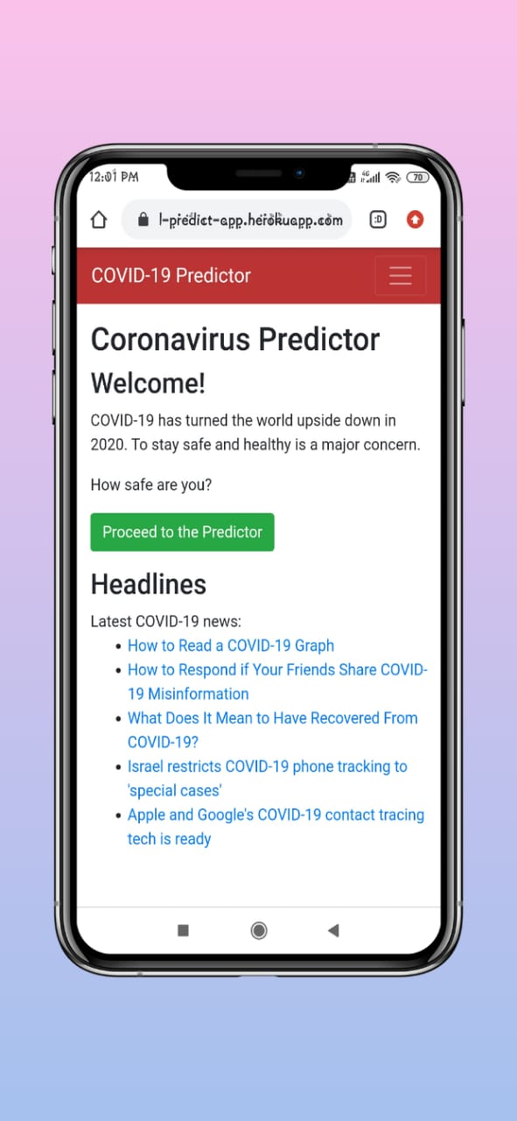
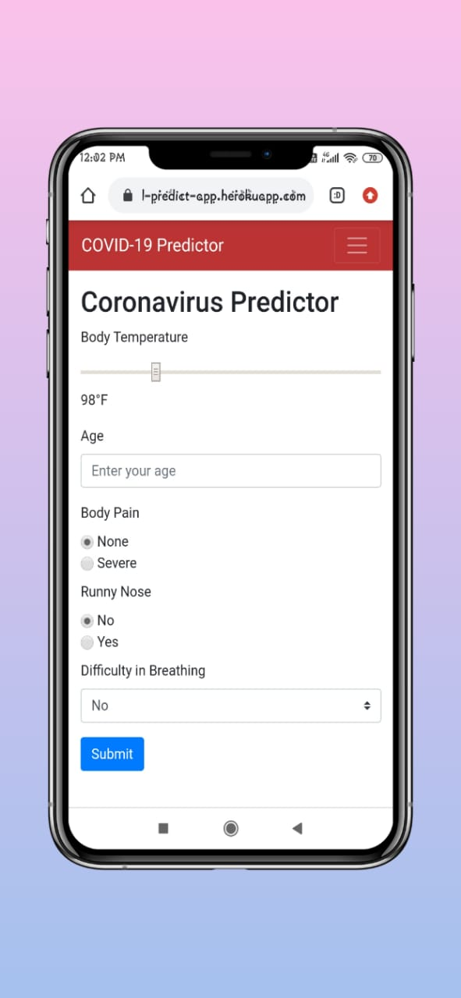
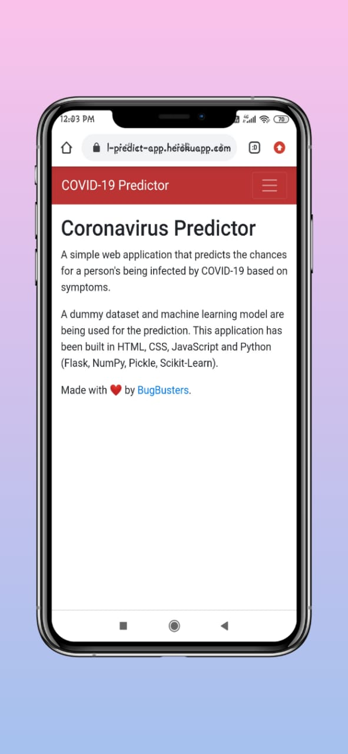
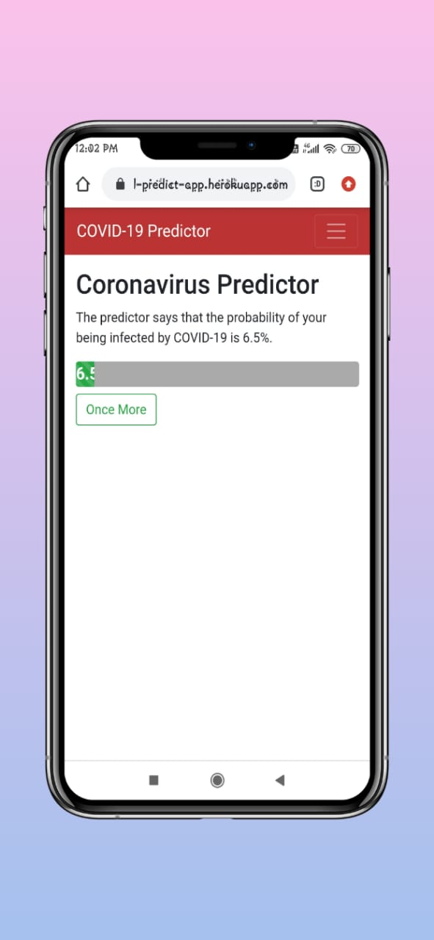
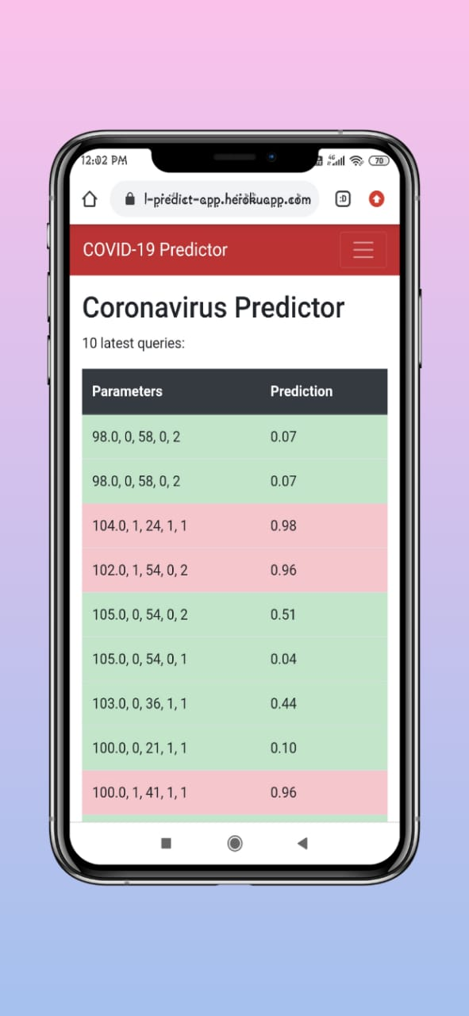
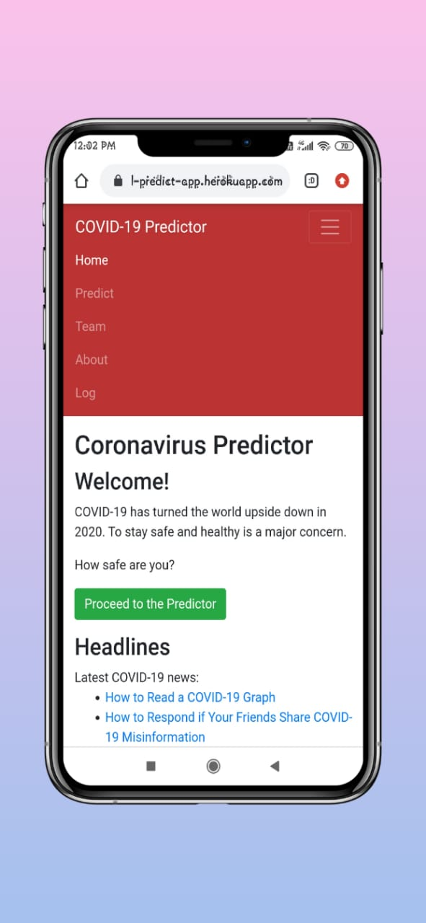

Slide 3
About Neerog Jeevan!!
Neerog Jeevan is a web-application created by team Bug Busters to tackle the COVID-19 pandemic . COVID-19 has turned the world upside down and also increasing day by day, till now now if we look at the stats of india , their is a daily increase of 20,000 to 30,000 infected people in the covid-19 india list.
To handle and reduce the increase of death’s by Covid-19 in india ,as we all know that covid has a life cycle of 14 days , and if the person infected from covid-19 get know that he is infected before 14 days then there is a more probability that he/she can be saved.
The above situation can be handled by our web-application very easily ,hence making our india a COVID-19 free country.
Get to know your chances of COVID-19 in Seconds !!!
Track the latest and authentic news regarding COVID-19 with daily updates !!
Fetch and store your previous report in seconds !!

Slide 4
How we came up with this Idea?
COVID-19 Dashboard were becoming very common now a days ,the thing’s which we can find in Covid-19 dashboard are the stats,geographical statistic that’s it. We wanted to do something new and interesting, Something which never done before.
We wanted to build an application that integrate machine learning with web interface.It would be a learning experience.
The application can easily be integrated with hospital patient database to help in contactless recognition of Coronavirus suspects.
As COVID-19 grows asymptomatic,there won’t be a need to keep a track of the technology needed for prediction. The log database can easily be used to build another database , ready for use with the evolved virus.

Slide 5
FUNCTIONALITIES
A good place to go if you wish to make sure that your symptoms don’t point towards a COVID-19 infection.
By having a look at recent queries, one can get an idea of the performance of the virus in surrounding.
A glimpse of the Covid-19 news headlines in the homepage.
A user-friendly environment, where the user doesn’t have to be concerned about the intimidating stuff going on in the background.
A time ready model trained perfectly for predicting COVID-19 infection probability while only making itself better with each prediction.
The application can be used by any age group as it as very handy and user friendly.

Slide 6
Technologies Used to Create Solution?
FRONTEND:
HTML ,CSS and Javascript is used to create the basic structure of our project ,which are public webpages .
To make our web pages responsive and enhancing it’s UI ,we have used Bootstrap and Jquery.
BACKEND:
Flask is Used for creating the Backend-Server for our application , which also allows us to make async request to our server at the time of development.
Jinja2 is used for creating templates for our project, hence it provide us a clean architecture for future UI testing and enhancement.
DATABASE:
SQL is used for storing the logs of the users in SQLite3 database
REST API’S:
News API is used for fetching COVID-19 news from http://newsapi.org.
I

Slide 7
MACHINE LEARNING USED FOR MODEL TRAINING TO PREDICT PROBABILITY OF COVID-19
LIBRARIES USED:
Numpy is used for doing mathematical operations and computations over an array.
Pandas is used for doing Exploratory data analysis over the dataset.
Sklearn is used for Logistic Regression [To train our model over dataset]
JUPYTER NOTEBOOK:
Jupyter notebook is used as a codespace for training our model on the dataset created by our team ,we have used Logistic Regression technique of supervised learning to train our model and predict the probabilities over certain features like fever, age, body pain, runny nose.

Slide 8
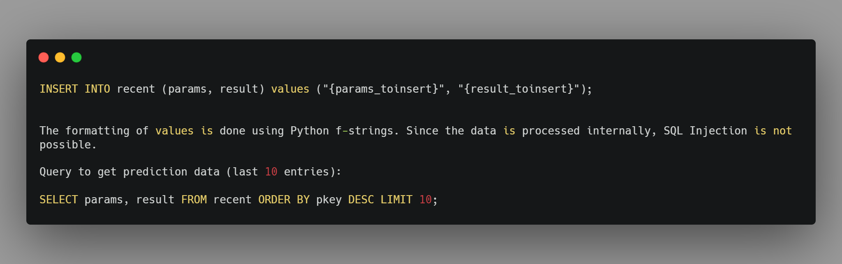
HOW WE CREATED DATASET AND CONNECTED TO SQL DATABASE?
Dataset is created using Excel in which we have used random function to generate the values of fever , age ,runny nose ,Body Pain and Infection Probability . The dataset is having 3000 rows with random values used for training our model to make prediction over certain values of user entered data.
We have uploaded one data.csv file in our project which is used by our model to make prediction using Regression techniques.

Slide 9
HOW WE TRAIN OUR MODEL OVER DATASET TO MAKE PROBABILITIES?
LOGISTIC REGRESSION
One of the famous regression technique is used to train our model over certain dataset, we have used Logistic Regression,according to the logistic regression used for making probability of any event let’s understand that if we want to do house price prediction then there are many factors which will depend on the prediction of the price of the house ,let’s mention some of the factors like connectivity,rooms,school etc these factor always make a certain effect over the price,
So also logistic regression can be used over that place where we need to do a binary classification like if we need to predict whether it is a Cat or a Dog then there's only two choices 1 or 0 , as logistic regression is also a best technique to make binary classification because it uses sigmoid function for every iteration or epoch’s.

Slide 10
PROJECT FILE STRUCTURE/TREE
Covid.ipynb : A jupyter notebook used for training model
Data.csv : A training and testing dataset for our model .if absent ,execute dummydata.py to generate dummy dataset.
Main.db: A SQLite database to store the logs of the user’s.
app.py: The main flask application
Apikey.py: Contains api key for fetching news from server,which must be modified before deployment.
Procfile: Contains the info regarding the heroku deployment.
model.pkl: It is a pickle files generated by Data.csv using Scikit-learn .if it is not present generate it using by running training.py with Dataset.
training.py : Generates model.pkl using dataset by training model.
Requirement.txt: An extended list of PyPi Packages and libraries that might be needed for future enhancement in project.

Slide 11
DEPLOYMENT USING HEROKU ENGINE
Heroku is used for deploying our application on the cloud-based server. For deploying we have used heroku cli which makes our project scalable and fast deployment.
FUTURE PLANS ON DEPLOYMENT:
We are deciding to make our project to be deployed on a particular domain ,Which is short as google and can be accessed using short-urls.

Slide 12
WHAT PROBLEMS WE HAVE FACED DURING HACKATHON?
Array Computation on dataset sometime becomes a very tough task for us because according to Logistic Regression we should have a good shape of array if we don’t make a good shape of array using reshape we will get a error Bad Fit.
Jinja2 was something a new domain which we have explored during the hackathon,by reading its documentation and learning from youtube videos.
Async call for our API has become tough for us to configure but at the end we have resolve this error.

Slide 13
WHAT ARE OUR FUTURE PLANS?
A web server would be required to host it online.
A static IP, preferably with a domain/subdomain name attached , would be good for serving the application to user.
The server must support Python for hosting a Flask web application.
An SSL Certificate would be good for increasing security and customer trust.
Other details on deployment are available in the README.md file.
We are planning to convert web app to a Android/IOS application using Kotlin and Flutter.
The UI is easily customizable because the layout and templates are preformatted with Jinja2. The Service would only require to make the relevant changes in the layout files.
The future model will be trained using Deep L - Artificial Neural Network (ANN) with RELU and sigmoid as a activation function,Due to this enhancement we can get better and faster probabilities.

Slide 14
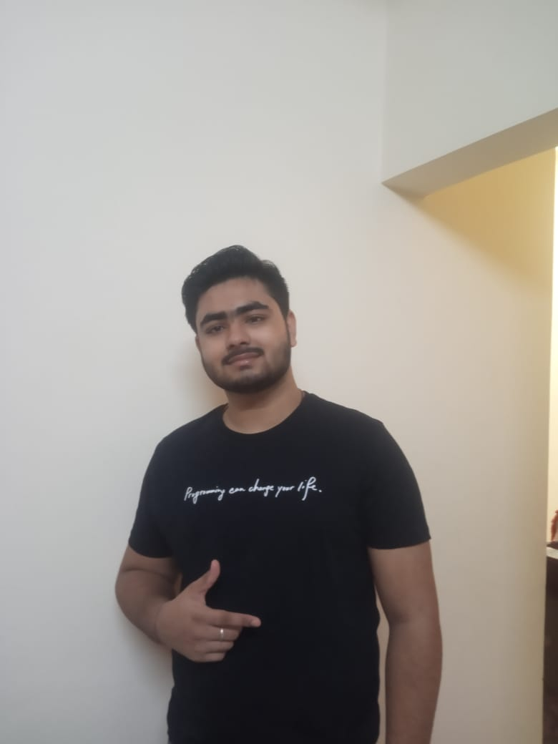
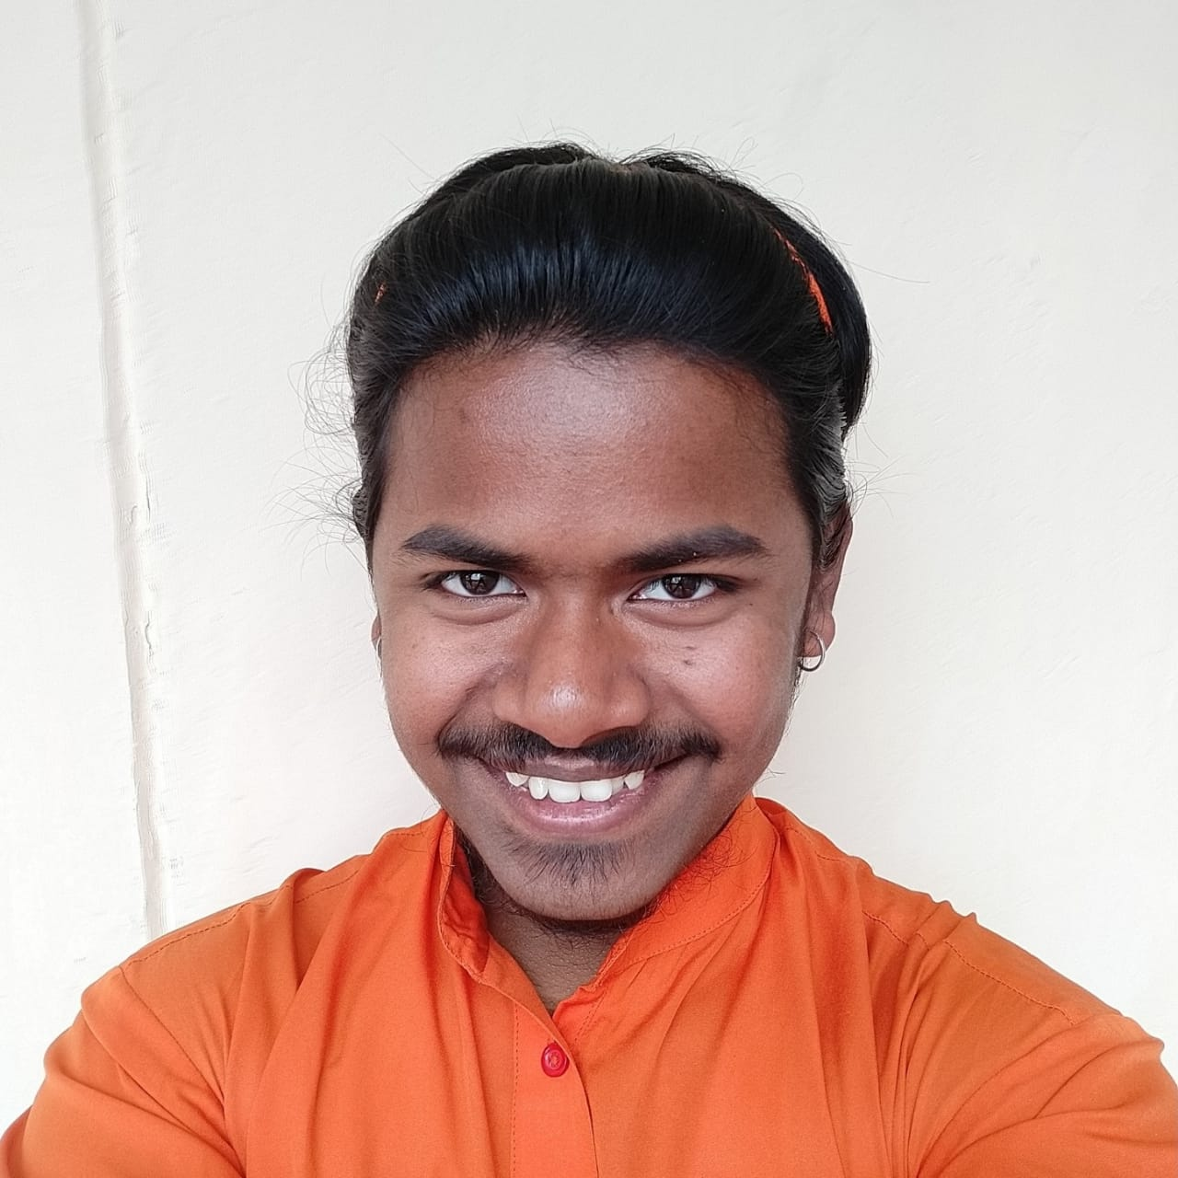



OUR TEAM!!

Slide 15
Thank You !!
RUNNING LIVE AT : https://covid-predict-app.herokuapp.com

