Slide 1

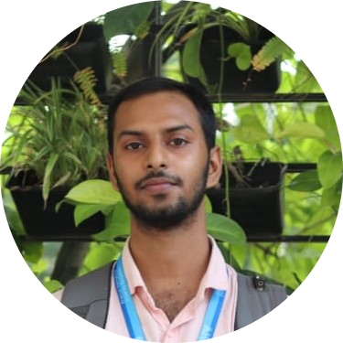
MOZAHIDUL ISLAM
Programmer | Tech Consultant
Profile Summary
A passionate Programmer and Software Developer with expertise in Python, Java, C#, and .NET. Skilled in data analysis, database management, and competitive programming. Currently pursuing a Bachelor of Science in CSE at AIUB. Dedicated to delivering innovative solutions and mentoring students.
CONTACT
Address
128/C , Basundhara , Dhaka.
Career Objective
To pursue a rewarding teaching career driven by dedication, integrity, and hard work, within a supportive environment of excellence and innovation. Committed to utilizing and enhancing my skills and knowledge to inspire and nurture future generations while achieving personal and professional growth
Phone
+8801707591255
Email
Educational Background
mozahidislam343@gmail.com
LinkedIn linkedin.com/in/mozahid343
Bachelor in Science (BSC), American International University-Bangladesh (AIUB), Dhaka, Bangladesh 2023 – Present (Expected Graduation: 2026) Result: 3.54/4.0 Higher School Certificate, Govt. Khan Bahadur Ahsanullah College ,2021 Department: Science Result: 5.0/5.0 Secondary School Certificate, Town Sripur S.C. High School Department: Science Result: 5.0/5.0
LANGUAGES
Bengali English
HOBBIES
Traveling and exploring new cultures
Reading about technology and innovation
Participating in coding competitions
Mentoring and guiding students in programming
REFERENCES
Project
Patient Management Section (Hospital Management) October 2023 - January 2024 Developed a Java-based application using Java Swing, enhancing patient services and improving healthcare accessibility. Event Management System May 2024 - October 2024 Designed UML diagrams, including use case, activity, and sequence diagrams, to map system interactions and workflows effectively. Organ Transplant Management System May 2024 - August 2024 Collaborated on a database project using Oracle DBMS, emphasizing data normalization and table creation to ensure efficient database structure. Junior Teacher October 2024 – Present Taught and guided students across various subjects for grades 1 to 10, ensuring concept clarity and academic improvement . Created customized lesson plans to cater to individual learning needs and foster academic success.
ANWARUL KABIR
ASSOCIATE PROFESSOR, Faculty, DEPARTMENT OF COMPUTER SCIENCE
kabir@aiub.edu
MD. MAZID-UL-HAQUE
LECTURER, Faculty , DEPARTMENT OF COMPUTER SCIENCE
mazid@aiub.edu

Slide 2

Skills
Programming Languages: Python, C, C++, Java, C#
Core Skills: Data Structures, Algorithms, Problem Solving, Competitive Programming
Frameworks & Tools: .NET, Cisco Networking, Oracle DBMS, MS Office
Data Analytics: Data Cleaning, Processing, Visualization
Database Management: Table Creation, Normalization, ER Diagrams
Project Management: Software Development, Cross-Functional Collaboration
Organizational Effectiveness
Team Collaboration, Effective Communication, Leadership and Mentorship, Time Management.
Specific Tools and Technologies
Git/GitHub , Visual Studio, VS Code, CodeBlocks
Professional Certifications
Python for Beginners
Earned a certificate from Microsoft for completing the "Learn Python" course.
C# Development Microsoft
Achieved a certification for proficiency in C# programming from Microsoft .
Database Management and SQL Certified in Oracle DBMS essentials, focusing on normalization, ER diagrams, and table creation.
Competitive Programming
Achievements Recognized for outstanding performance in inter-university competitive programming contests.
Networking Fundamentals Certified
In Cisco Networking basics, demonstrating knowledge of network setup and troubleshooting from AIUB.
Signature
Mozahidul Islam

