Slide 1

HealthNexus BD
An AI-Powered Unified Patient Health Record (UPHR) System for Bangladesh
Presented By-
Khorshed Alam Mozahid (0242310005341228)
Supervisor:
MD. Rajib Mia
Lecturer (Senior Scale)
1

Slide 2




Outlines
Project Gap and Scope
Project Planning and Initiation
Feasibility Study
Target User and Tentative Elicitation Process
Project Scheduling
Functional Requirements
System Design
‹#›

Slide 3
Project Gap and Scope
3

Slide 4
Objectives
1
Build a Unified Patient Health Record with one lifelong Health ID (UHID) nationwide.
2
Give patients full control via OTP-based, session-scoped consent.
3
Provide AI clinical summaries with drug-interaction & allergy alerts (Gemini).
4
Secure all data with AES-256 encryption and an immutable, patient-visible audit log.
5
Verify doctors via BMDC and enable verified lab report uploads.
4

Slide 5
Project Gap
Fragmented Records
No Unified Identity
History Unavailable
Patient data scattered across hospitals & labs — mostly on paper.
No lifelong patient ID linking a citizen's full health history.
New doctors can't see past diseases, allergies, or medications.
Repeated Tests & Risk
No Patient Control
No AI / Audit
Leads to redundant tests, misdiagnosis & drug-interaction danger.
Patients can't see or control who accesses their health data.
Existing systems lack AI summaries & transparent audit trails.
5

Slide 6
Project Scope
✔ In Scope
✘ Out of Scope
• Role-based platform: Patient, Doctor, Lab, Admin.
• Unique lifelong Unified Health ID (UHID).
• OTP-based, session-scoped consent access.
• AI clinical summary + interaction / allergy alerts.
• AES-256 encrypted records & lab reports (PDF).
• Mock BMDC doctor verification.
• Immutable, patient-visible audit log.
• Telemedicine / video consultation.
• Online payment gateways.
• Autonomous AI diagnosis.
• Real BMDC / NID integration.
• Hospital-grade device integration.
6

Slide 7
Project Planning and Initiation
Methodology: Agile / iterative development — delivered in five incremental phases.
1
2
3
4
5
Requirement
System Design
Development
Frontend & Security
Testing & Deploy
Problem study, gap analysis & requirement gathering.
Use Case, Activity, Sequence & ERD in draw.io.
PostgreSQL + Prisma, REST APIs & Gemini AI integration.
React UI, OTP consent, AES-256 & audit logging.
Unit / integration testing, evaluation & deployment.
7

Slide 8
Feasibility Study
Technical Feasibility
Economic Feasibility
Proven, documented tech — Node.js, PostgreSQL, React, Gemini API.
Open-source stack + low-cost cloud hosting; affordable for a capstone.
Operational Feasibility
Schedule Feasibility
Simple, mobile-responsive role-based UI fit for BD healthcare.
Scope achievable within the capstone timeline via an iterative plan.
8

Slide 9
Target Users and Tentative Elicitation Process
9

Slide 10
Target Users
1
2
3
4
Patient
Doctor
Diagnostic Lab
System Admin
Data owner; holds UHID and controls access to their history.
BMDC-verified clinician; consults & creates verified records.
Approved center; uploads verified test reports (PDF).
Verifies doctors/labs, manages users, monitors activity.
10

Slide 11
Tentative Elicitation Process
1
2
3
4
5
Interviews
Surveys
Observation
Literature
Brainstorming
Patients & doctors — real pain points.
Questionnaires on records & privacy.
Current hospital record workflows.
Study existing health-record systems.
Sessions with team & supervisor.
11

Slide 12
Project Scheduling
Week 1-2
Week 3-4
Week 5-7
Week 8-10
Week 11-12
Requirement Analysis
System Design (UML + ERD)
Database & Backend API
Frontend & AI Integration
Testing & Deployment
Completed
Completed
In Progress
Planned
Planned
Completed
In Progress
Planned
12

Slide 13
Functional Requirements (1 / 2)
ID | Requirement | User
FR-1 | User registration with valid credentials | All
FR-2 | Secure login (JWT authentication) | All
FR-3 | Password hashing / encryption | System
FR-4 | Role-based access control (RBAC) | System
FR-5 | Generate lifelong Unique Health ID (UHID) | System
FR-6 | Manage patient health profile | Patient
FR-7 | BMDC doctor verification + admin approval | System/Admin
FR-8 | Search patient by UHID / mobile | Doctor/Lab
FR-9 | Send OTP consent request to patient | System
FR-10 | Verify OTP (expiry + attempt limit) | System
FR-11 | Session-scoped access, auto-revoke | System
13

Slide 14
Functional Requirements (2 / 2)
ID | Requirement | User
FR-12 | AI clinical summary + interaction/allergy alerts | System
FR-13 | Record diagnosis, symptoms & prescription | Doctor
FR-14 | Encrypt medical records at rest (AES-256) | System
FR-15 | Upload verified lab reports (PDF) | Lab
FR-16 | Immutable audit logging of all access | System
FR-17 | View personal audit log (who accessed data) | Patient
FR-18 | Approve / deactivate doctors and labs | Admin
FR-19 | Monitor platform activity & statistics | Admin
FR-20 | Secure logout | All
FR-21 | Follow-up & new-report notifications | System
14

Slide 15
System Design
15

Slide 16
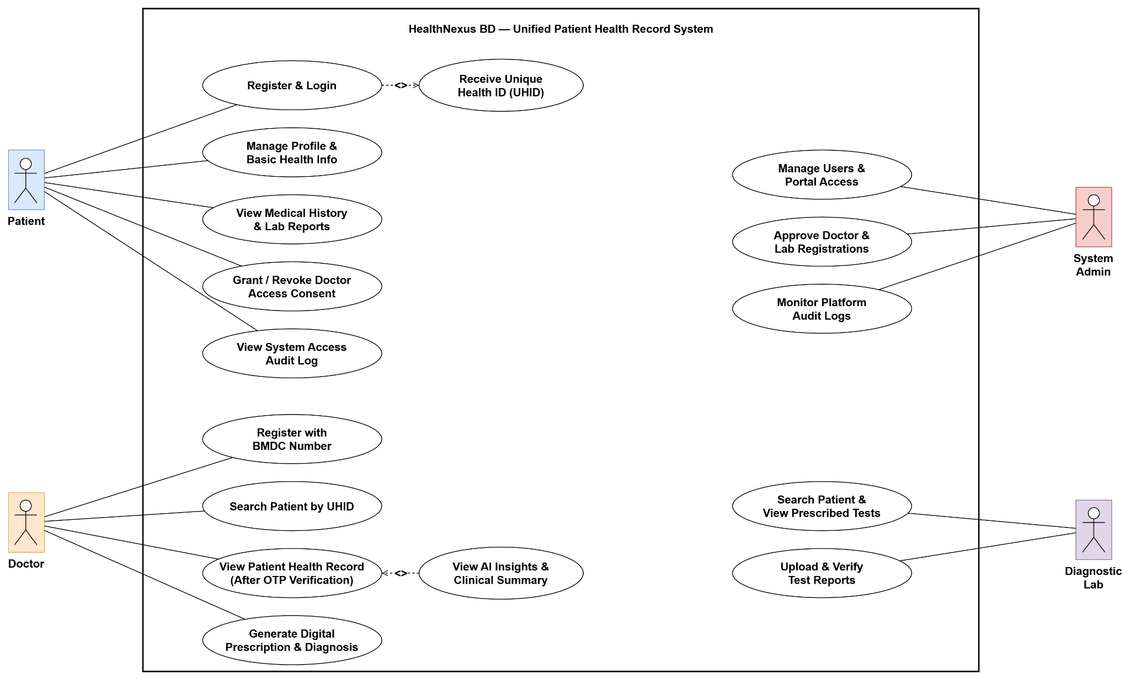
Use Case Diagram
16

Slide 17
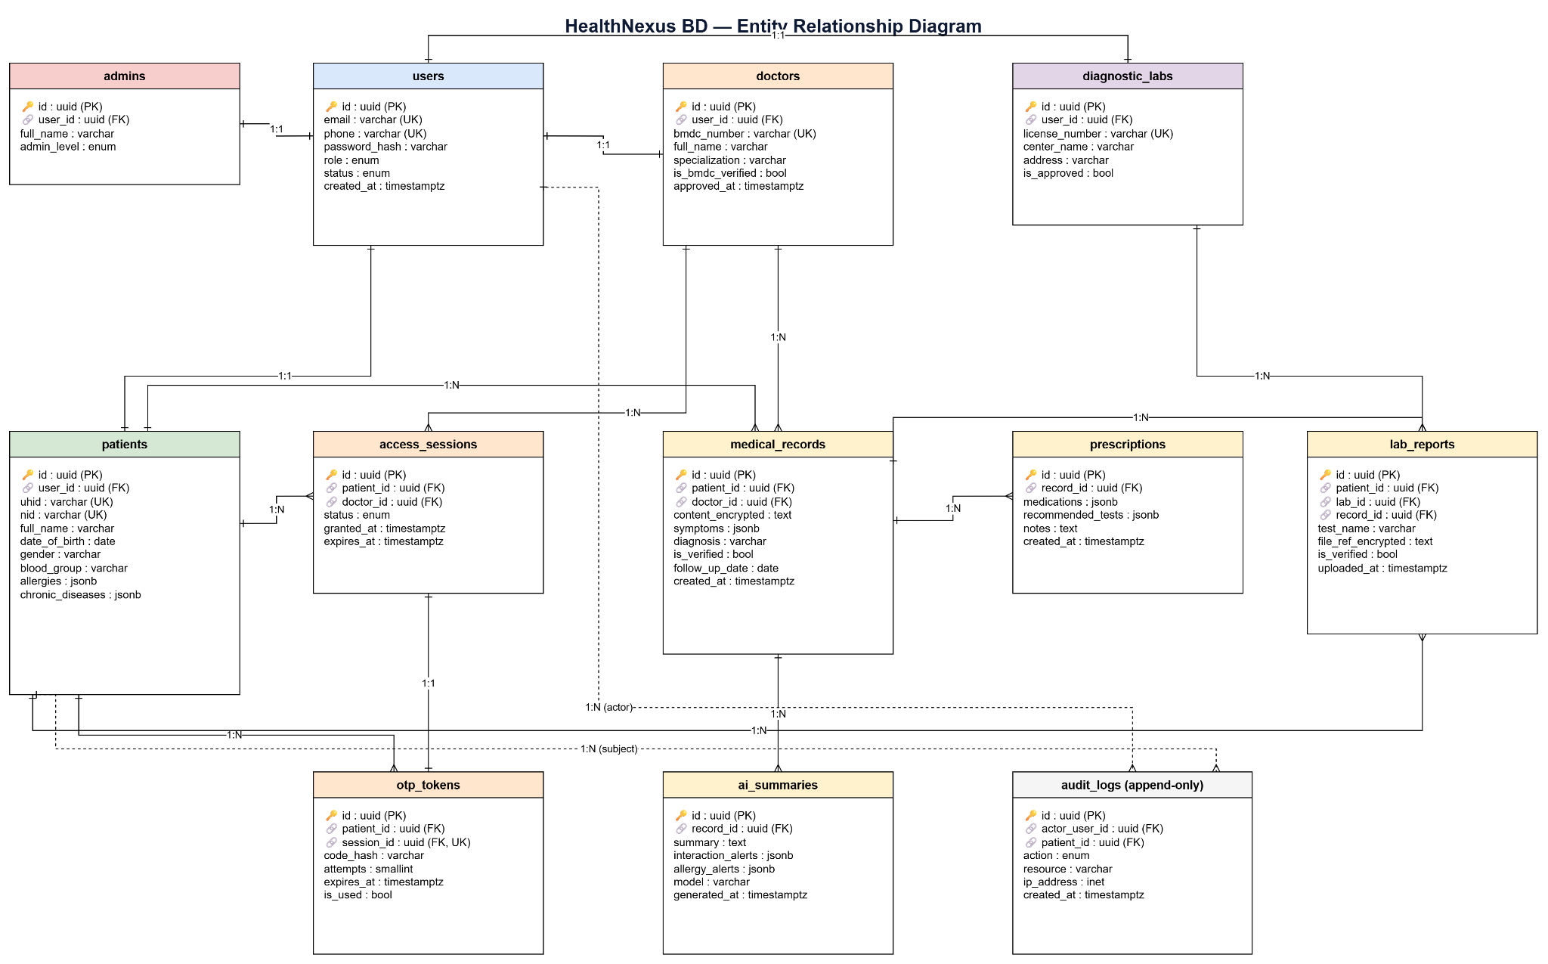
ER Diagram (ERD)
17

Slide 18
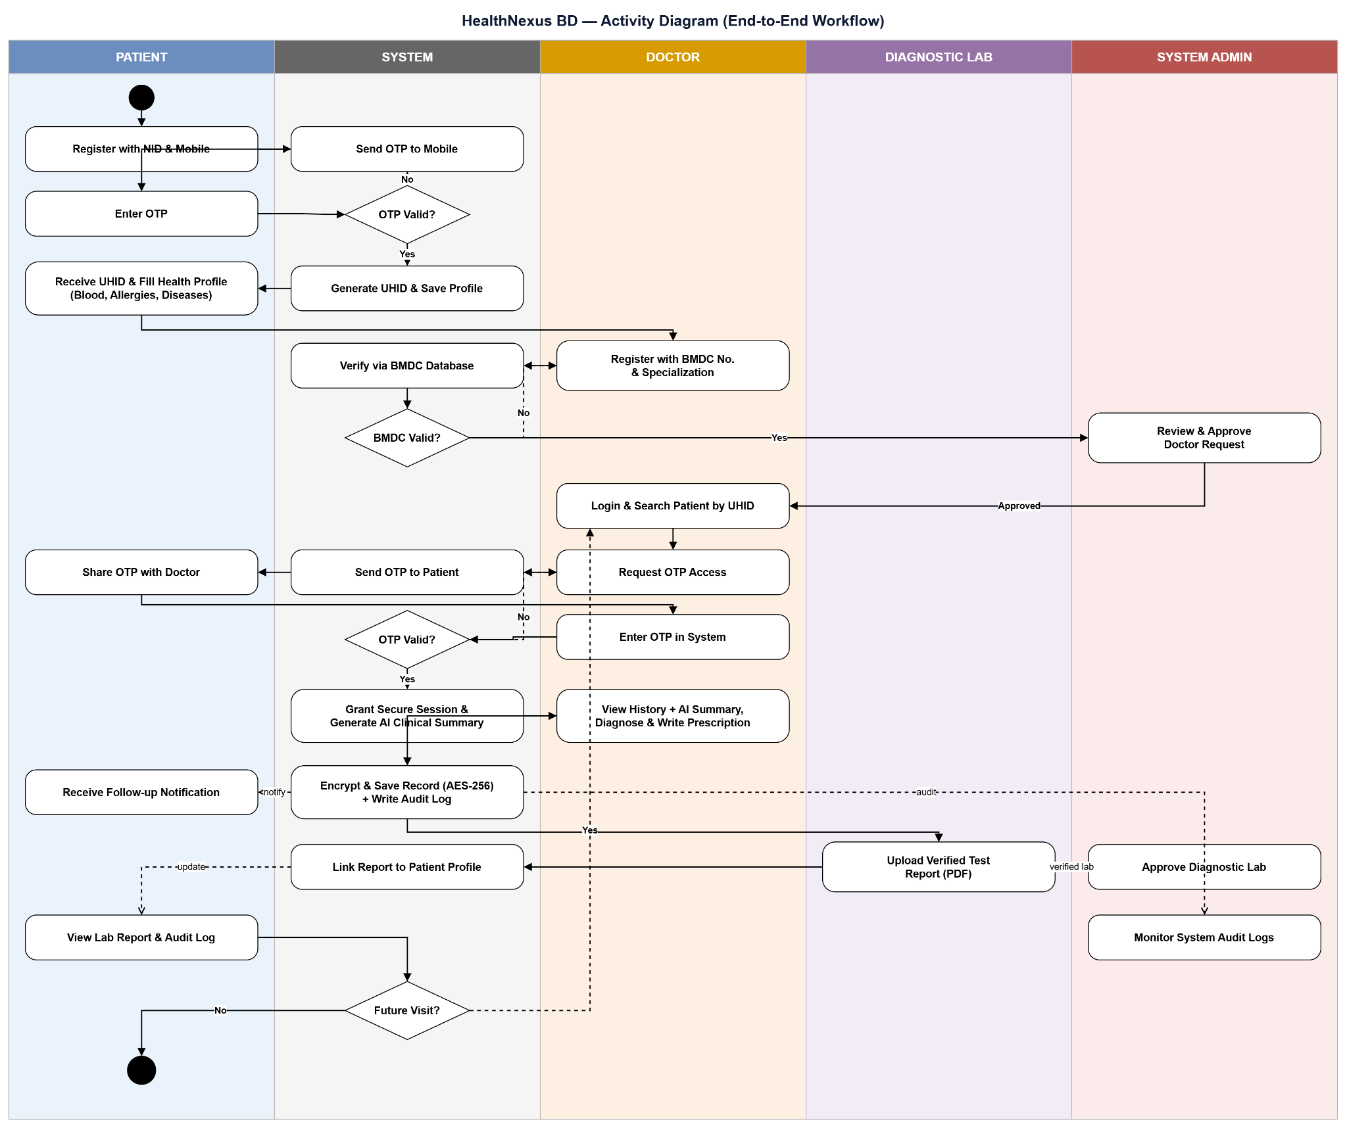
Activity Diagram
18

Slide 19
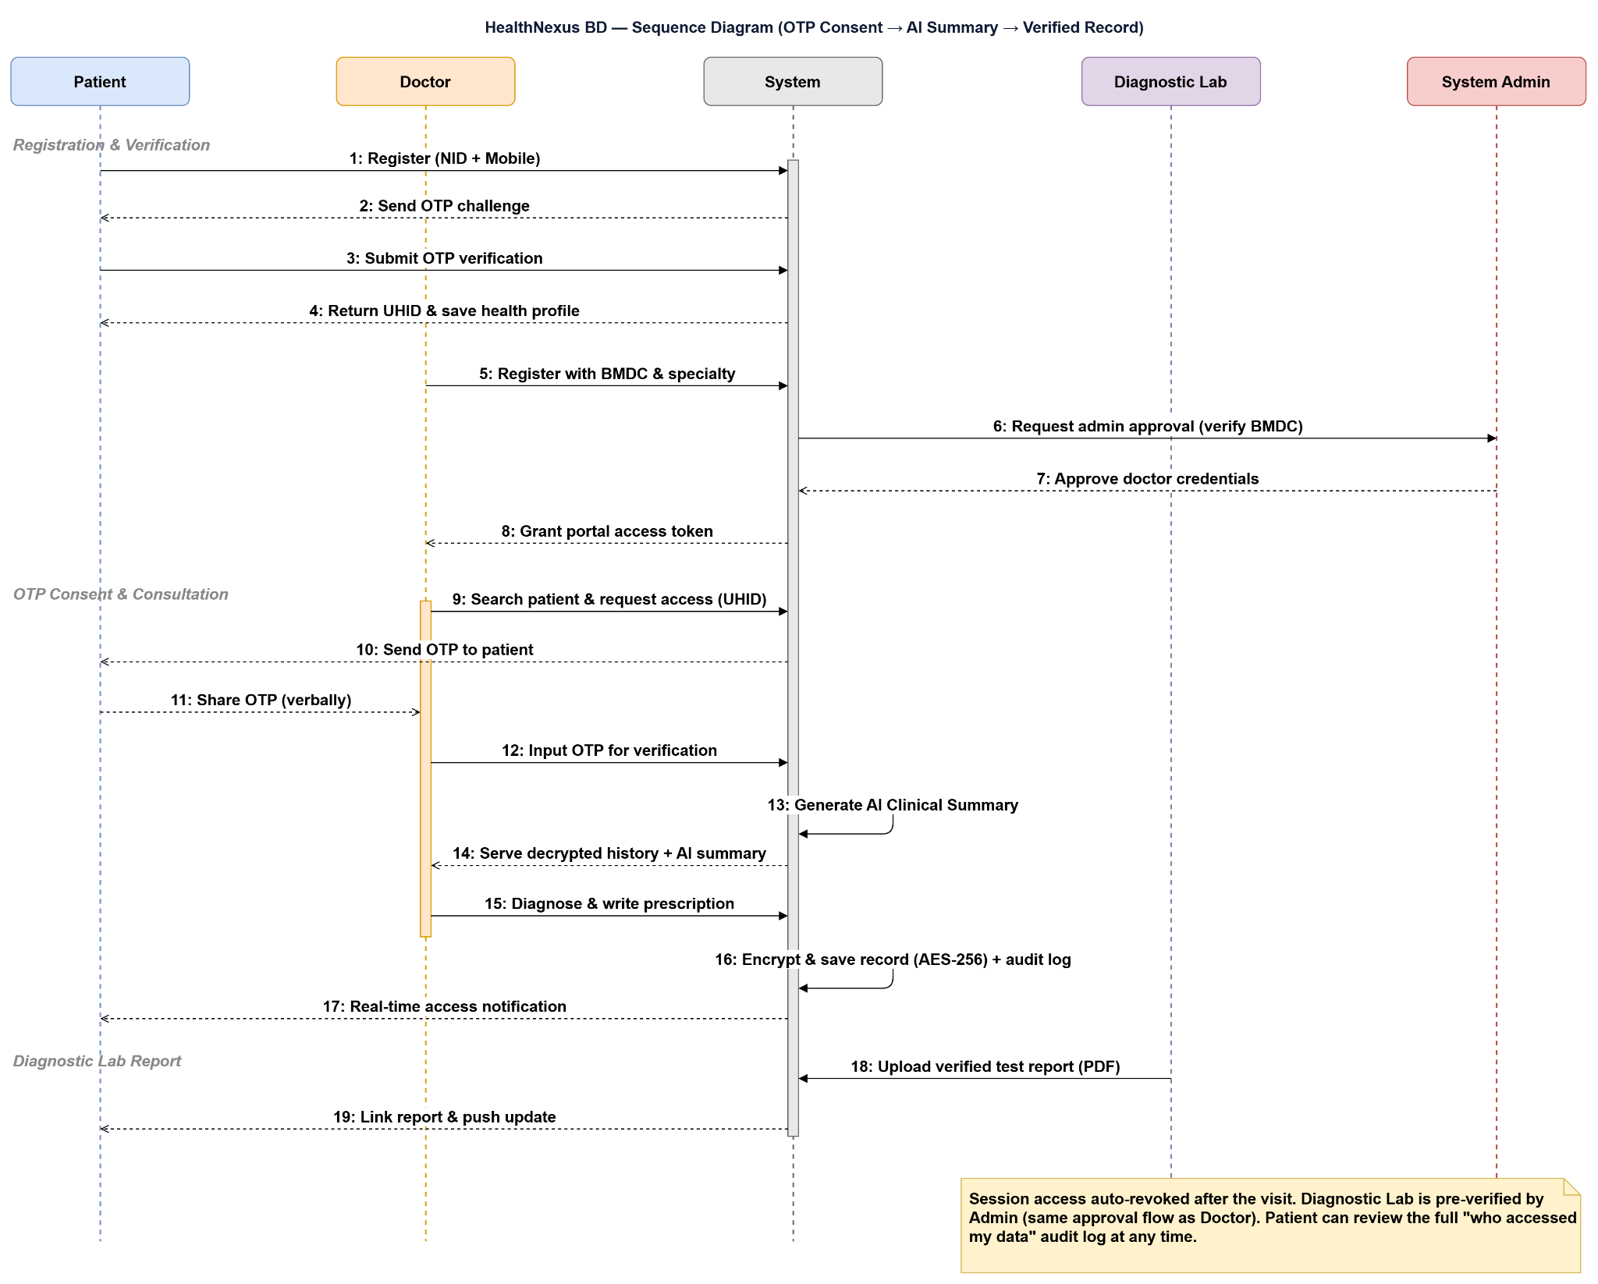
Sequence Diagram
19

Slide 20
References
[1] Bangladesh Medical & Dental Council (BMDC), "Registered Doctor Search," bmdc.org.bd.
[2] World Health Organization, Electronic Health Records: Manual for Developing Countries, WHO, 2006.
[3] Directorate General of Health Services (DGHS), Bangladesh, "Shared Health Record (SHR) & DHIS2," dghs.gov.bd.
[4] HL7 International, "FHIR R5 Specification — Patient & Consent Resources," hl7.org/fhir.
[5] U.S. HHS, "HIPAA Security Rule — Technical Safeguards (45 CFR 164.312)," hhs.gov.
[6] Google, "Gemini API Documentation," ai.google.dev.
[7] PostgreSQL Global Development Group, PostgreSQL 16 Documentation, postgresql.org/docs.
[8] Prisma, "Prisma ORM Documentation," prisma.io/docs.
[9] NIST, FIPS 197: Advanced Encryption Standard (AES), 2001.
[10] IETF, RFC 7519: JSON Web Token (JWT), 2015.
20

Slide 21
THANK YOU
21

Slide 22
Question
???
22

