Slide 1
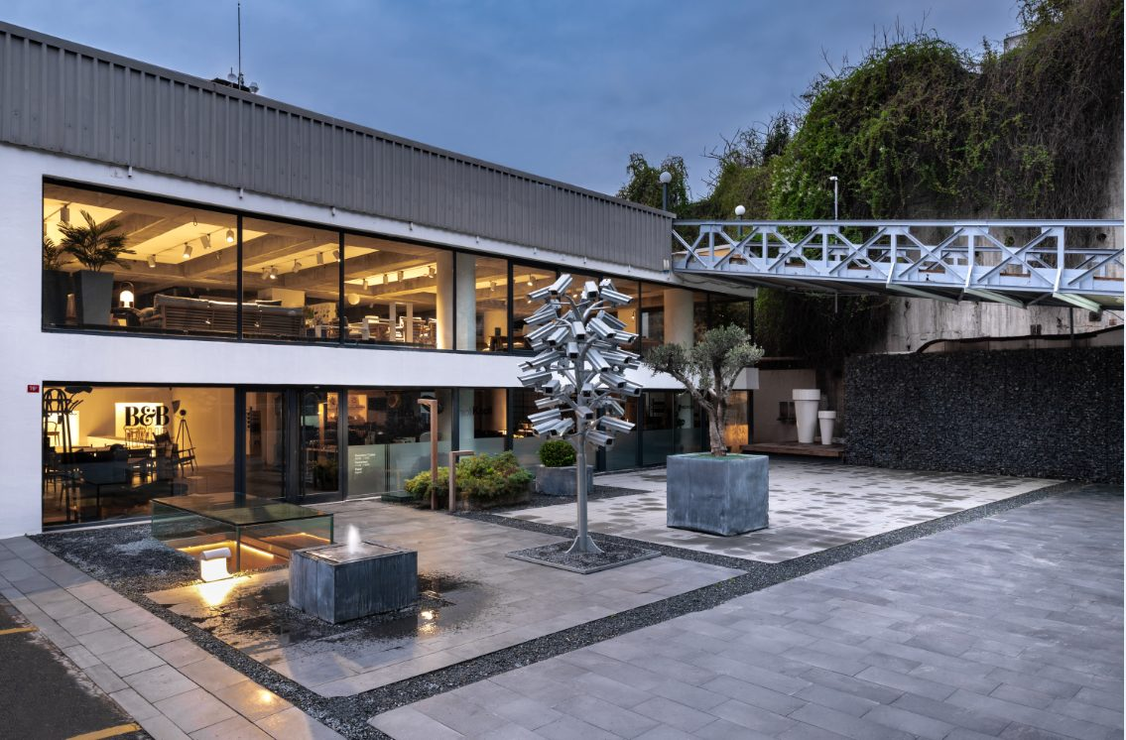

MOZAİK
HIGHLIGHTS

Slide 2
SOFAS

Slide 3
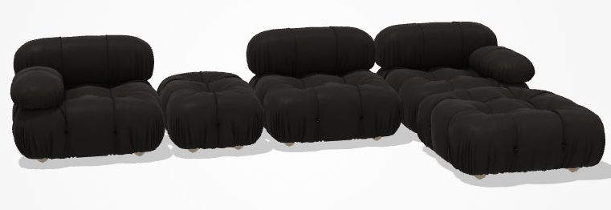






80492151
B&B ITALIA CAMALEONDA SOFA
288 cm x 96/192 cm H: 67 cm
1 pcs
Mario Bellini
CM96C
CM96B_TS1
CM96B_TD1
CM96P
CM96PQ
Finish: Kasia 350 Dark Brown Leather

Slide 4
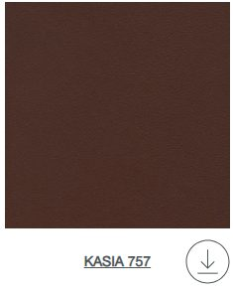
80492142
B&B ITALIA CAMALEONDA SOFA
288 cm x 96/192 cm H: 67 cm
Mario Bellini
CM96C
CM96B_TS1
CM96B_TD1
CM96P
CM96PQ
Finish: Kasia 757 Cinnamon Leather

Slide 5
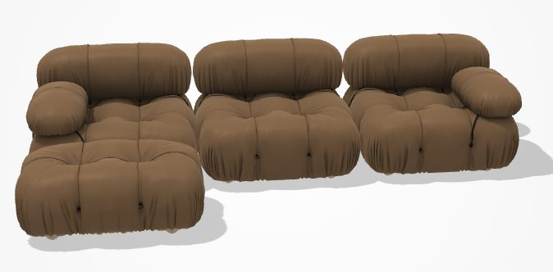
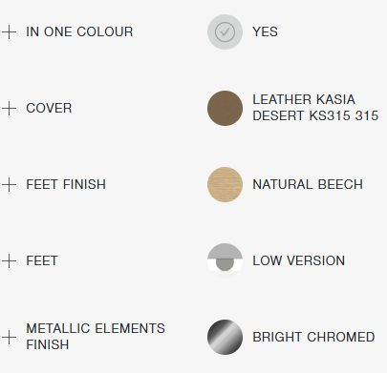
SH2642
B&B ITALIA CAMALEONDA SOFA
288 cm x 162 cm H: 40/67 cm
CM96C
CM96B_TD1
CM96B_TS1
CM66P

Slide 6
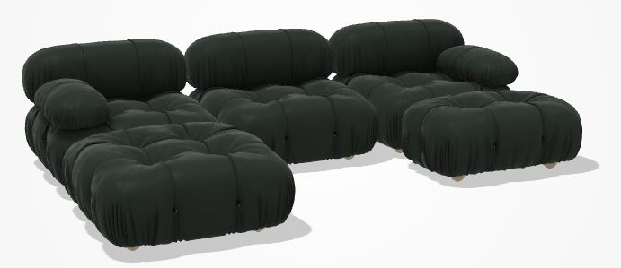
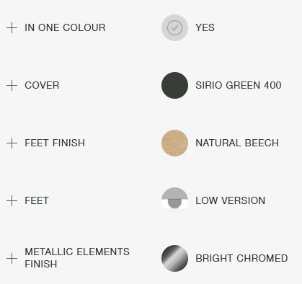
SH2642
B&B ITALIA CAMALEONDA SOFA
288 cm x 192cm H: 40/67 cm
CM96C
CM96B_TD1
CM96B_TS1
CM96PQ

Slide 7
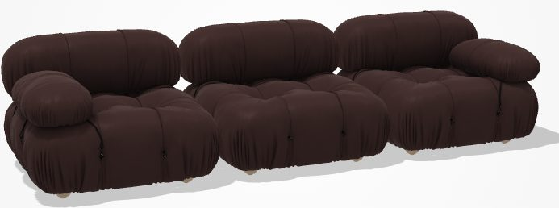
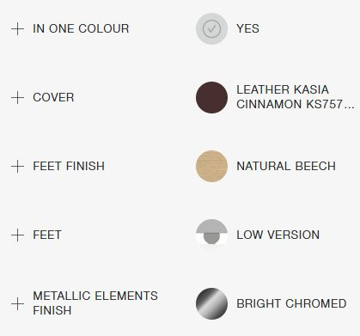
SH2642
B&B ITALIA CAMALEONDA SOFA
288 cm x 96 cm H: 40/67 cm
CM96C
CM96B_TD1
CM96B_TS1

Slide 8
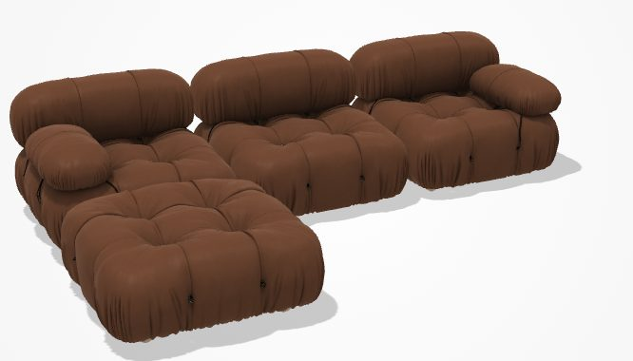
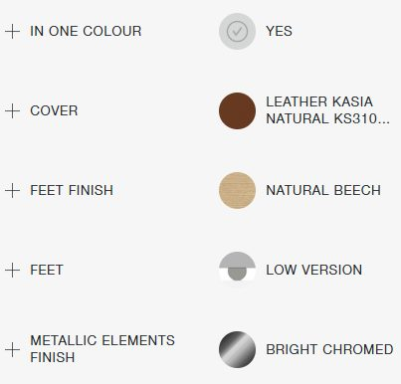
SH2642
B&B ITALIA CAMALEONDA SOFA
288 cm x 96 cm H: 40/67 cm
CM96C
CM96B_TD1
CM96B_TS1
CM96PQ

Slide 9
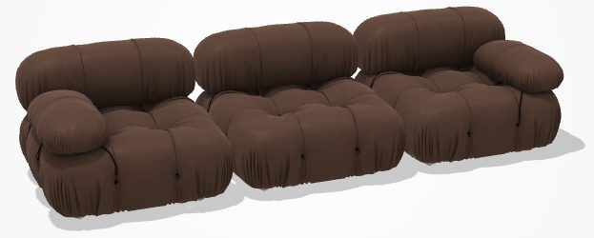
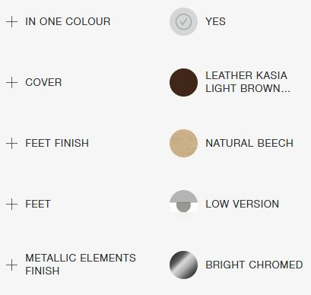
SH2642
B&B ITALIA CAMALEONDA SOFA
288 cm x 96 cm H: 40/67 cm
CM96C
CM96B_TD1
CM96B_TS1

Slide 10
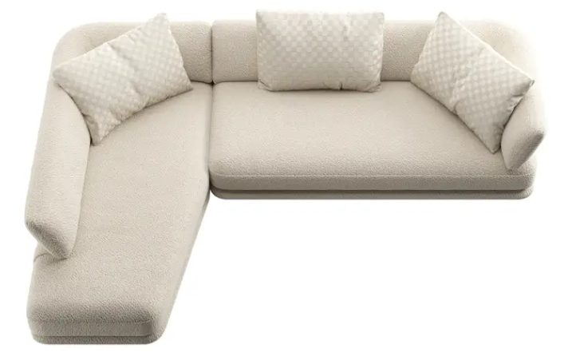

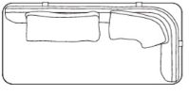
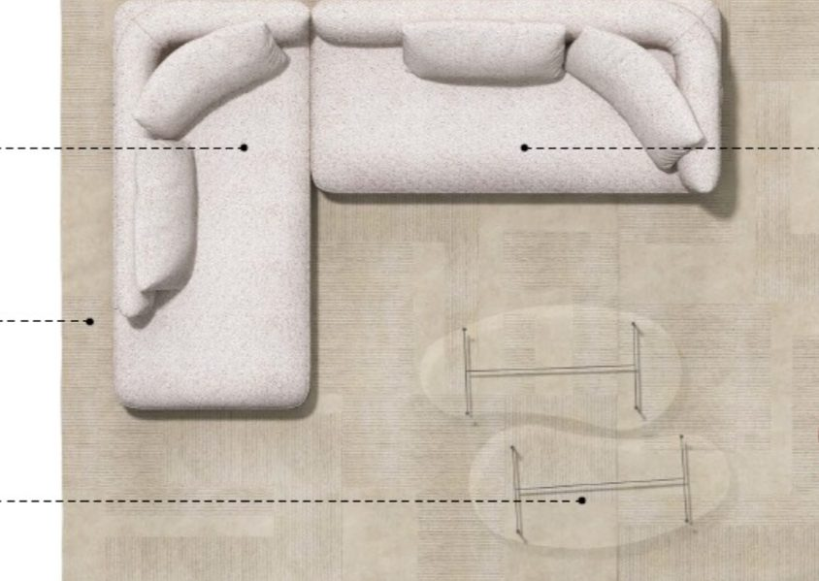
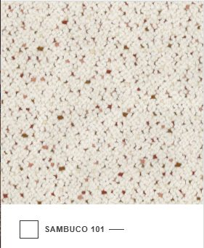
80492151
B&B ITALIA COCUN SOFA
335 cm x 220 cm H: 41/75 cm
1 pcs
Antonio Citterio
CO220LS_1
CO220TD_1
Cover: Sambuco Neve 101
Feet finish: Bright brushed
3x Back cushion (90x60) : Sambuco Neve 101

Slide 11
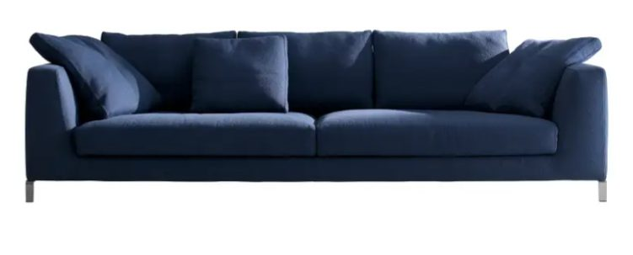
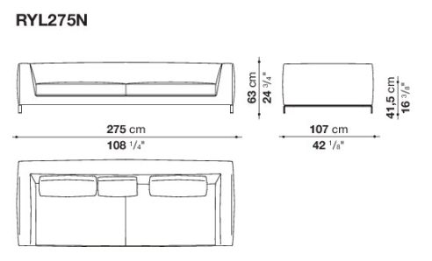
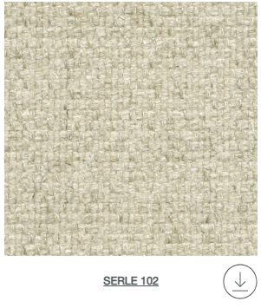


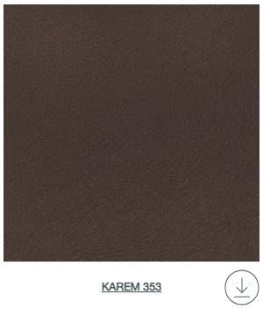
80504255
B&B ITALIA RAY SOFA
Antonio Citterio, 2010
275 x 107 cm H:41,5/63 cm
1 pc
2 pcs 48x48 cushions

Slide 12
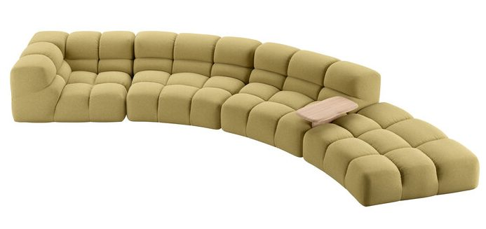
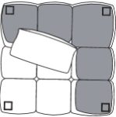
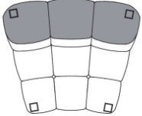
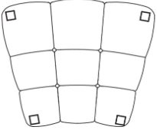




B&B -ACTION
B&B ITALIA TUFTY TIME 20 SOFA
370 x 180 cm H:38/68cm
2pcs
KASIM 2026
Fabric: Sirte White
Finish: Black
2x Cushion: Leather KT151 Koto Ash Grey
(60x60cm)
Back Cushion: Fabric Milo Natural (60x60cm)

Slide 13
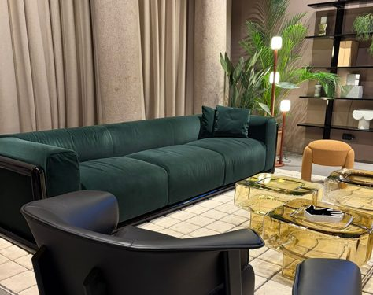
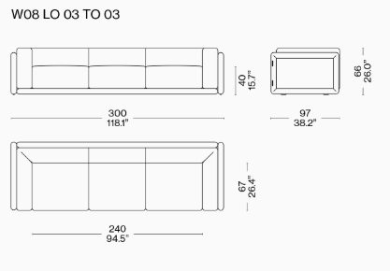
SALONE 2026
CASSINA CORNARO SOFA
300 cm x 97 cm H: 40/66 cm
2pcs
Structure: Polished Lacquered
Fabric: Tess. Ortigia Bosco
Lp-Nero
13L685/139314

Slide 14
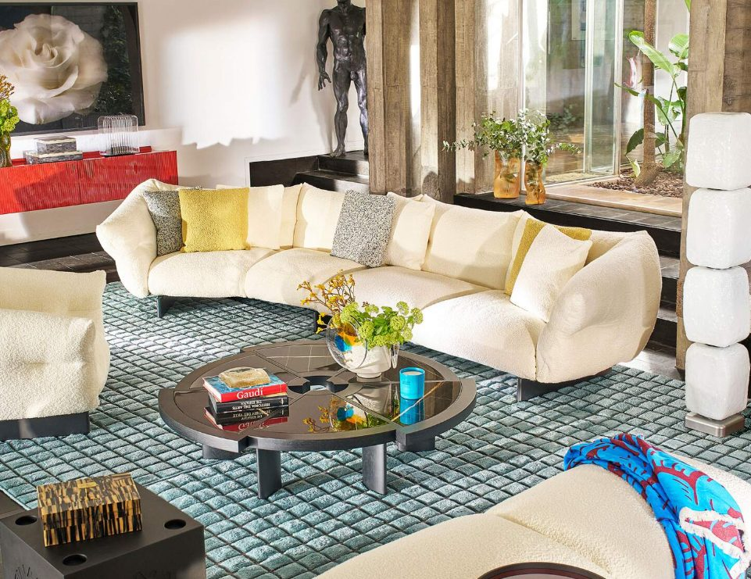
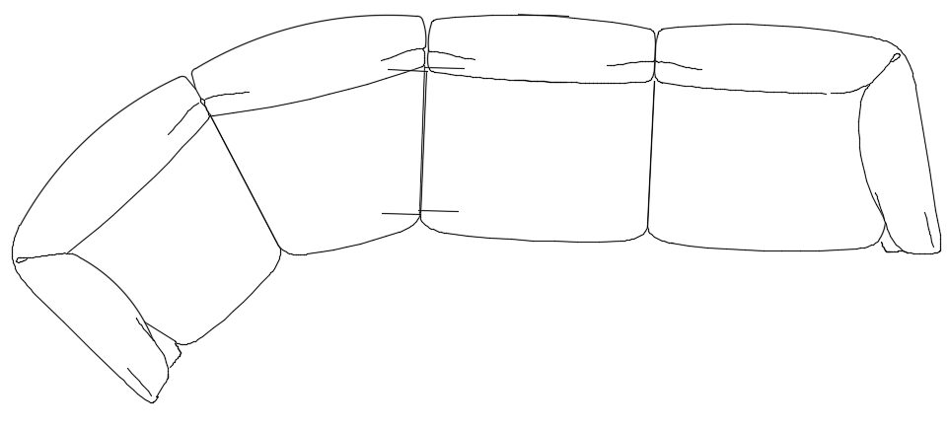
PO.2631
CASSINA MONCLOUD SOFA
470 x 185 cm H:40/85cm
KASIM 2026

Slide 15
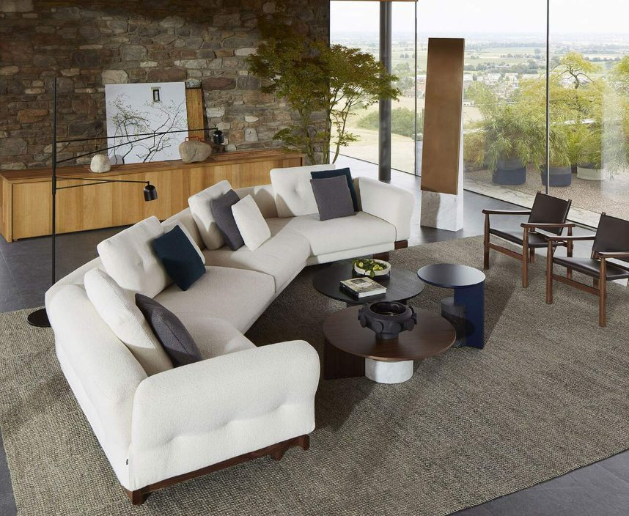
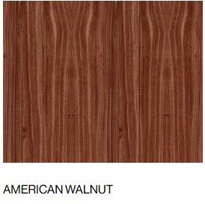
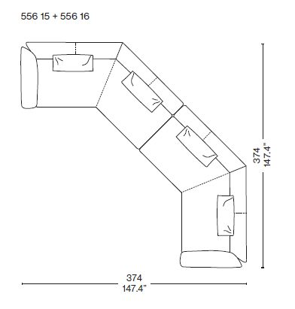
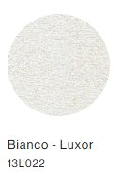
PO.2631
CASSINA SENGU SOFA
374 x 374 cm H:40/85cm

Slide 16
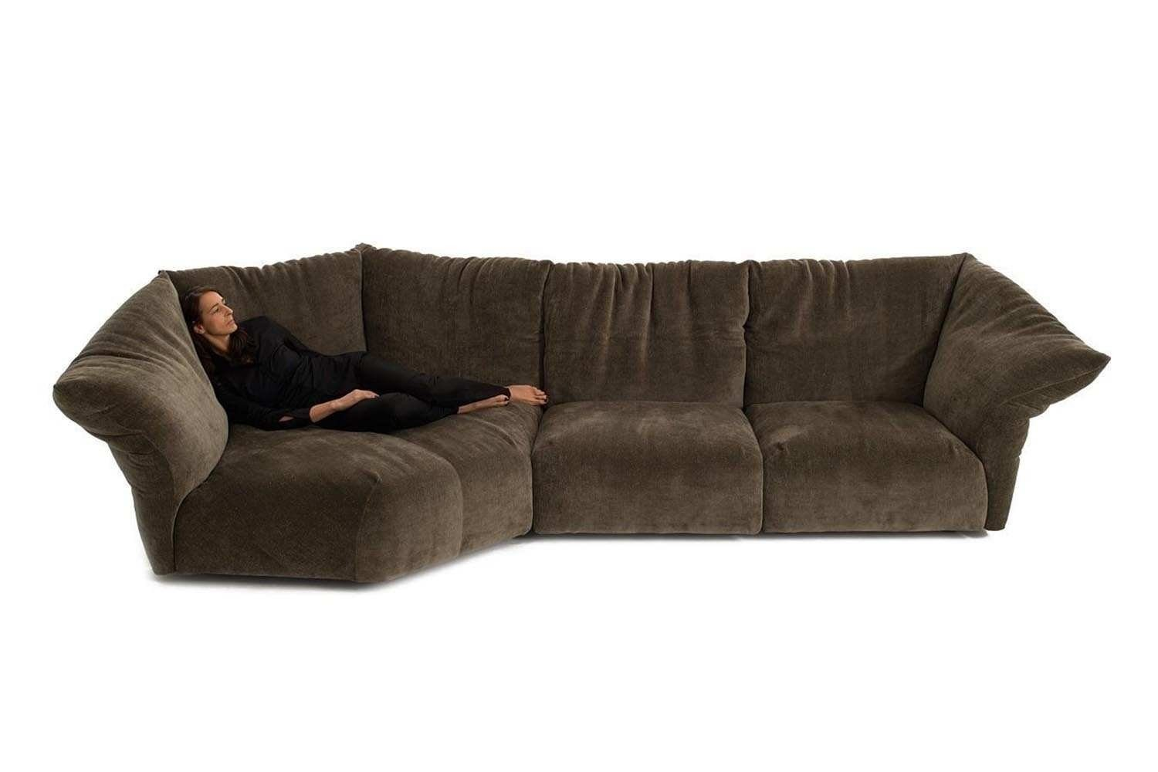


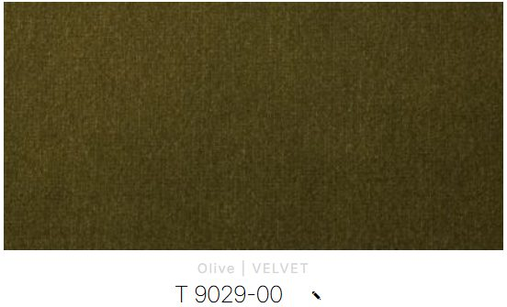

EDRA STANDARD SOFA
334 cm x 154 cm H: 40/92 cm
Francesco Binfare
STDN10
STDEC
STDTX

Slide 17
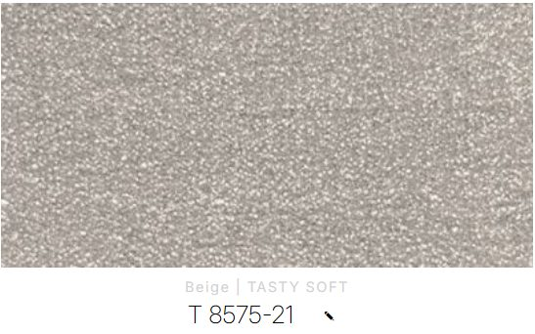
EDRA STANDARD SOFA
334 cm x 154 cm H: 40/92 cm
Francesco Binfare
STDN10
STDEC
STDTX

Slide 18
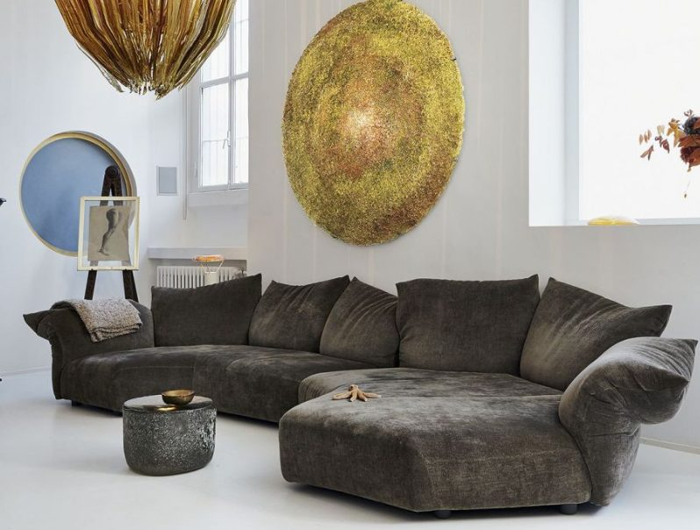
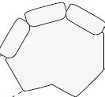


EDRA STANDARD SOFA
354 cm x 184 cm H: 40/92 cm
Francesco Binfare
STDN10
STDN20

Slide 19
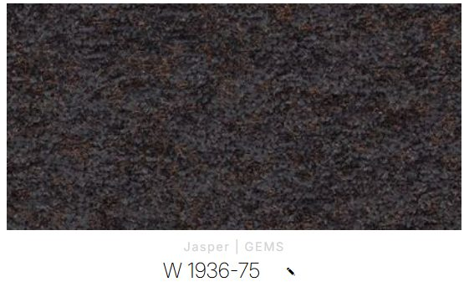
EDRA STANDARD SOFA
334 cm x 154 cm H: 40/92 cm
Francesco Binfare
STDN10
STDEC
STDTX

Slide 20
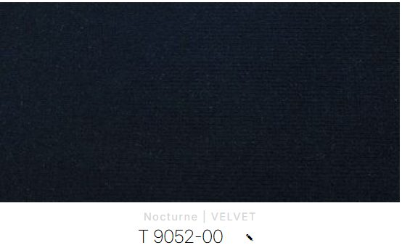
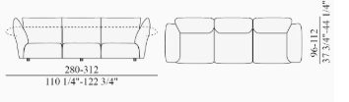
EDRA STANDARD SOFA
280 cm x 60 cm H: 96/112 cm

Slide 21
EDRA STANDARD SOFA
280 cm x 60 cm H: 96/112 cm
Fabric: Coral 8711-48

Slide 22
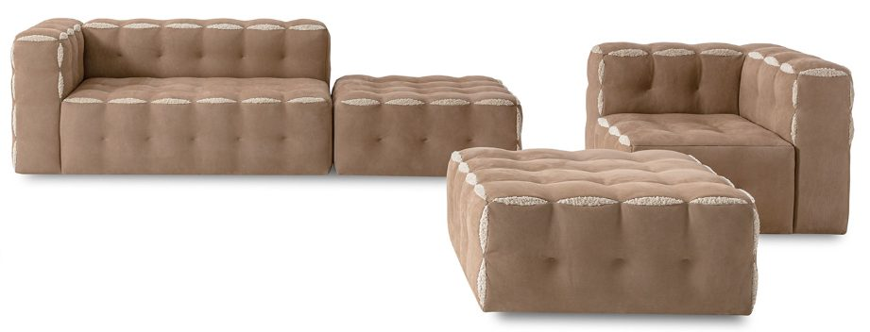



FENDICASA FUN FENDI SOFA
362 x 264 cm H:42/72,5cm
Calle Wine T0026_018

Slide 23
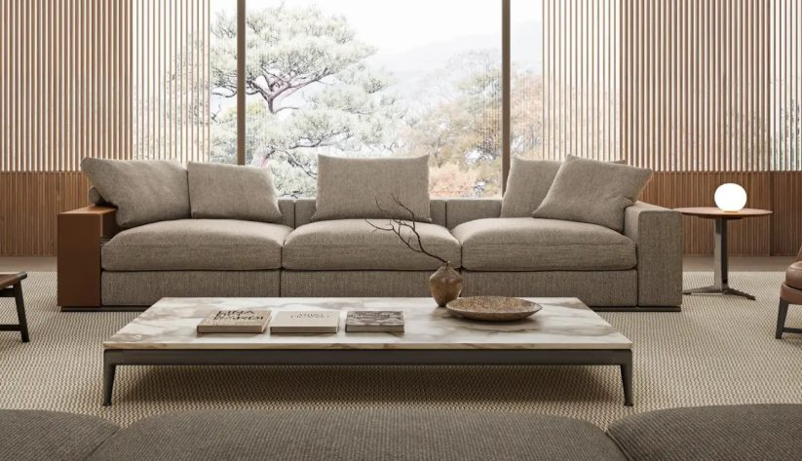

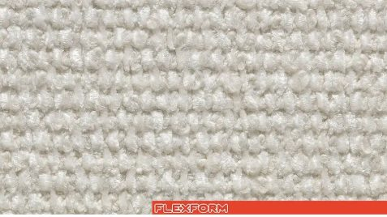
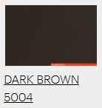

FLEXFORM GROUNDPIECE SOFA
384 x 97 cm H:40/56cm

Slide 24
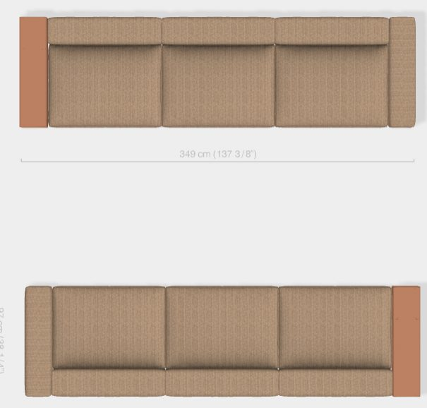
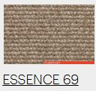
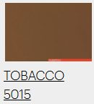
PO.2640
FLEXFORM GROUNDPIECE SOFA
349 x 97 cm H:40/56cm
2pcs

Slide 25



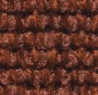

PO.25161
FLEXFORM GROUNDPIECE SOFA
348cm x 97cm H:40/56cm
Cover: Elettra N. 200
Leather: Russian Red 5008
3x Cushion (80x60cm) : Elettra 200
2x Cushion (60x55cm) : Essence 67
1x Cushion (60x55cm) : Pelle 630

Slide 26
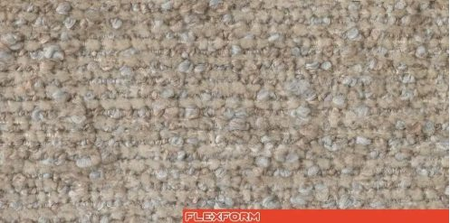


MDW 2026
FLEXFORM GROUNDPIECE SOFA
Cover: Loira N.147
Leather: Dark Brown 5004
3x Cushion: Pelle N.702
(60x55cm)
3x Cushion: Loira N.147
(80X60cm)

Slide 27



PO.2640
FLEXFORM LOUNGESPACE DORMEUSE
264 x 144 cm H:40/70cm

Slide 28



PO.2640
FLEXFORM LOUNGESPACE SOFA
393 x 183 cm H:40/70cm

Slide 29




MDW 2026
FLEXFORM LOUNGESPACE SOFA
417 x 242 cm H:40/70cm
Finish: Esme N.1290
3x Cushion: Esme N.1290
(80x60cm)

Slide 30




FLEXFORM PERRY SOFA
278 x 156 cm H:41/71cm
2 pcs 65x65 cushion;

Slide 31





GERVASONI GHOST SOFA
220 cm x 110 cm H:42/80 cm
2 pcs
CUSHION 50x50cm (x2)
CUSHION 60x60cm (x2)
CUSHION 80x80cm (x3)

Slide 32



GERVASONI SAMET SOFA
340 cm x 115 cm H:38/103 cm
CUSHION 50x50cm (x3)

Slide 33




LIN BRASIL MOLE SOFA
220 x 110 cm H:82 cm
Design Sergio Rodrigues, 1957
PARAGON BLACK

Slide 34

LIN BRASIL MOLE SOFA
220 x 110 cm H:82 cm
Design Sergio Rodrigues, 1957
PUEBLO K30456

Slide 35




SDM2026
MAXALTO AMOENUS SOFT SOFA
140 cm x 140 cm h: 73/90 cm
EKİM 2026
Cover: Tessuto Loira Mattone 370
Finish: Bronzed Nickel Painted 0174B

Slide 36

SDM2026
MAXALTO AMOENUS SOFT SOFA
140 cm x 140 cm h: 73/90 cm
EKİM 2026
Cover: Tessuto Loira Mattone 370
Finish: Bronzed Nickel Painted 0174B

Slide 37






MAXALTO APOLLO CURVED SOFA
285 cm x 134,5 cm h: 73/87 cm
Fabric: Sirio Stone 258
Finish: Bronzed Nickel Painted 0174B
Simplice Stitching
1x Cushion: Lille Silver 155 (48x48cm)
1x Cushion: Sirio Slate 111 (48x48cm)
2x Cushion: Sirio Stone 258 (48x48cm)

Slide 38



MAXALTO APOLLO DORMEUSE
245cm x 108/134,5cm h: 42/87cm

Slide 39





SDM2026
MAXALTO APOLLO CURVED SOFA
285 cm x 134,5 cm h: 73/87 cm
EKİM 2026
Fabric: Liveri White 100 / White Yarn
Finish: Bronzed Nickel Painted 0174B
4x Cushion: Milo Natural 200
(48x48cm)

Slide 40




260518
MAXALTO AURAE SOFA
250 cm x 105 cm H: 43/63/90 cm
Fabric: Sambuco Neve 2619101
Ecoleather Brown Profile
Finish: Graphite Painted
2x Back Cushion: 90x90cm Sambuco Neve
4x Cushion: 48x48cm Sambuco Neve

Slide 41






MAXALTO AURAE SOFA
250cm x 105cm h: 43/63 cm
2 pcs
EKIM 2026
Cover: Fabric 000TE / Fabric Elettra Ecru 102
Profile Cover: Ecoleather Tortora
Finish: Amber Painted
2x Back Cushion (AU90C) Elettra Ecru 102
2x Back Cushion (AU60C) Elettra Ecru 102
1x Cushion (48x48) Milo Tortora
1x Cushion (48x48) Leather KS257

Slide 42





MAXALTO FLORIUS SOFA
330 x 105 cm H:42/70 cm
Design Antonio Citterio, 2021
LIVERI 100
SOYA SHELLAC

Slide 43





SDM2026
MAXALTO FLORIUS SOFA
260 cm x 105 cm h: 71/90 cm
2 pcs
EKİM 2026
Upholstery: Tessuto Loira Tortora 280 /
Bellano Ecru 102 (profile)
Finish: Amber Painted 0137A
2x Cushion: Tessuto Loira Tortora 280
(65x65cm)

Slide 44




MAXALTO LUCREZIA SOFT SOFA
Antonio Citterio
275cm x 107cm h: 64/42cm
3pcs 60x60 cushions
kasia 310
kasia 310 bronzed nickel painted

Slide 45






SDM2026
MAXALTO OTIUM SOFT SOFA
250 cm x 96 cm h: 43/65 cm
EKİM 2026
Upholstery: Shilo Stripe Bianco/Nera 151
Profile: Ecoleather Dark Grey 255
Finish: Bronzed Nickel Painted 0174B
2x Cushion: Shilo Stripe Bianco/Nera 151
(60x60cm)
2x Cushion: Shilo Stripe Bianco/Nera 151
(90x60cm)
2x Cushion: Fabric Milo Camel 132
(48x48cm)

Slide 46



SDM2026
MAXALTO OTIUM SOFT SOFA
250 cm x 96 cm h: 43/65 cm
EKİM 2026
Upholstery: Shilo Stripe White/Hazelnut 372
Profile: Ecoleather Tortora 280
Finish: Bronzed Nickel Painted 0174B
2x Cushion: Shilo Stripe White/Hazelnut 372
(60x60cm)
2x Cushion: Shilo Stripe White/Hazelnut 372
(90x60cm)
2x Cushion: Fabric Milo Brick 370
(48x48cm)

Slide 47




MOROSO RICH CUSHION SOFA
209 cm x 60 cm H: 45/73 cm
Leather: B0208 Aubergine Z
Finish: Beech Matt Black Lacquered

Slide 48




MOROSO VICTORIA AND ALBERT SOFA 290 LEFT
297 cm x 125 cm h: 43/107/142 cm
Fabric: Petrollo Z A2332
Ral 7016 Anthracite

Slide 49
ARMCHAIRS / BENCHES

Slide 50




80504255
B&B ITALIA EDA-MAME CHAISE LONGUE
247 x 109 cm H: 32,5/77cm
Pierro Lissoni, 2018

Slide 51



80504255
B&B ITALIA TERMINAL DAY BED
209 x 81 cm H: 43/75cm
Jean-Marie Massaud, 2008

Slide 52


CASSINA TOKYO CHAISE LONGUE
65,5cm x 150cm h:65 cm
Charlotte Perriand, 1940

Slide 53





PO.2607
GALLOTTI RADICE SENSEI BENCH WITH COFFEE TABLE
180 cm x 45 cm h: 39,5 cm
Structure: Deep Black
Leather: Fard Silt 2324 Category L1
Marble: Arabescato Orobico Rosso

Slide 54




LIVING DIVANI TRACK BENCH
190 cm x 80 cm H: 33 cm
Leather: Nabuck 401
Finish: Black 9017

Slide 55





ACERBIS PALLA SWIVEL ARMCHAIR & POUF
90 cm x 90 cm h: 40/69,5 cm
86 cm x 72 cm H:36,5 cm
1pcs
Fabric: Brionne 385 102
Structure: Chromed Base

Slide 56




AZUCENA CATILINA ARMCHAIR
Luigi Caccia Dominioni,1960
58 x 47 cm H:45/70 cm

Slide 57




SALONE
AZUCENA CATILINA ARMCHAIR
77 cm x 63,5 cm H: 50/90 cm
KASIM 2026
2 pcs
Cover: Leather Koto Bordeaux KT750
Seat: Black Glossy 3764L
Frame Finish: Chromed Finish 0600C

Slide 58




B&B ITALIA HARBOR ARMCHAIR & OTTOMAN
Naoto Fukasawa , 2017
80 x 89 cm H:40/104 cm
61 x 61 cm H:40 cm

Slide 59




80504255
B&B ITALIA DO MARU ARMCHAIR
106 cm x 90 cm h: 44/80 cm
Nipa Doshi & Jonathan Levien, 2016
2 PCS

Slide 60




B&B ITALIA HUSK ARMCHAIR
Patricia Uriquiola , 2011
84 x 84 cm H:45/86 cm
2 pcs

Slide 61




B&B ITALIA HUSK SWIVEL ARMCHAIR
84 cm x 84 cm H: 44/92 cm
2 pcs
Cover: Leather KS360 Kasia Light Brown
Shell Finish: Black Shell
Base Frame Finish: Black Painted

Slide 62





80492142
B&B ITALIA HUSK SWIVEL ARMCHAIR
84cm x 84cm h: 63/86 cm
2 pcs
Cover: Leather Kasia 310
Shell Finish: Dove Grey 0028T
Base Frame Finish:Grey Oak 0378G

Slide 63




B&B ITALIA MART ARMCHAIR
76 cm x 101 cm H: 47/84 cm

Slide 64


B&B ITALIA SERIE UP ARMCHAIR
Gaetano Pesce,2000
120 cm x 130 cm H:42/103 cm
57 cm x 57 cm
1 pc

Slide 65



80492151
B&B ITALIA SERIE UP 2000 ARMCHAIR
120 cm x 120 cm H: 67/103 cm
Gaetano Pesce
Fabric: Lora Black 150

Slide 66



B&B ITALIA SERIE UP JUNIOR ARMCHAIR
Gaetano Pesce , 2014
71cm x 81 cm H:42/66 cm
38,5cm x 38,5 cm

Slide 67


B&B ITALIA UP 2000 JUNIOR ARMCHAIR
Gaetano Pesce , 2014
71cm x 81 cm H:42/66 cm
38,5cm x 38,5 cm
2 pcs

Slide 68


BONACINA GALA ARMCHAIR
Franco Albini , 1951
90 x 90 h:43/110 cm
2 pcs

Slide 69




CAPPELLINI LOW PAD ARMCHAIR
58cm x 72cm h: 40,5/79cm
JASPER MORRISON , 1999
1 pc
LEATHER BASE

Slide 70



CARL HANSEN&SON SAFARI CHAIR&FOOTREST
Design Kaare Klint
57cm x 57cm h: 34/80cm
2 pcs

Slide 71



CARL HANSEN&SON SIDEWAYS LOUNGE CHAIR
Design, Rikke Frost
92cm x 75cm h: 41/74cm
Walnut oil structure
Fabric;

Slide 72


PO.2631
CASSINA 3 Fauteuil Grand Confort, grand modele ARMCHAIR
99 cm x 53 cm h:41/63cm
2 pcs

Slide 73

PO.2631
CASSINA 3 Fauteuil Grand Confort, grand modele ARMCHAIR
99 cm x 53 cm h:41/63cm
2 pcs

Slide 74

PO.2631
CASSINA 3 FauteuIl Grand Confort ARMCHAIR
99 cm x 53 cm h:41/63cm
2 pcs

Slide 75



SALONE 2026
CASSINA BACK WING ARMCHAIR
91 cm x 73 cm H: 43/69 cm
2 pcs
Structure: Ash Stained Black
Leather: Pelle Extra Nero 13Y253

Slide 76




SALONE 2026
CASSINA BACK WING ARMCHAIR
91 cm x 73 cm h: 43/69 cm
2 pcs
Finish: Walnut
Fabric: Bianco 13L010

Slide 77


SALONE 2026
CASSINA BACK WING ARMCHAIR
91 cm x 73 cm h: 43/69 cm
2 pcs
Finish: Walnut
Leather: Pelle ZZ Colore Fango 13Z362

Slide 78


SALONE 2026
CASSINA BACK WING ARMCHAIR
91 cm x 73 cm h: 43/69 cm
2 pcs
Finish: Ashwood Stained Black
Leather: Pelle ZZ Colore Naturale 13Z360

Slide 79


SALONE 2026
CASSINA CORNARO ARMCHAIR
115 cm x 89 cm h: 40/66 cm
2 pcs
Structure: Polished Lacquered
Fabric: Tess. Ortigia Bosco
Lp-Nero
13L685/139314

Slide 80


CASSINA 1 FAUTEUIL DOSSIER BASCULANT
LIMITED EDITION
60 x 65 cm H:40/64cm
2 pcs

Slide 81


PO.2631
CASSINA 1 FAUTEUIL DOSSIER BASCULANT
LIMITED EDITION
60 x 65 cm H:40/64cm
2 pcs

Slide 82



CASSINA SORIANA ARMCHAIR
Design Afra & Tobia Scarpa , 1969/2021
95 cm x 105 cm H: 42/71 cm
2 pcs
Fabric: Cemento Look 13L012
Metal: Black

Slide 83



CASSINA SORIANA ARMCHAIR
Design Afra & Tobia Scarpa , 1969/2021
95cm x 105cm h:42/71cm
2 pcs

Slide 84




PO.2631
CASSINA UTRECHT ARMCHAIR
Design Gerrit Thomas Rietveld , 1988
64cm x 85cm h:37/70cm
2 pcs

Slide 85





PO.2631
CASSINA UTRECHT XL ARMCHAIR
Design Gerrit Thomas Rietveld , 1988
66cm x 89cm h:39/75cm
2 pcs

Slide 86





CECCOTTI COLLEZIONI ICOLOUNGE ARMCHAIR
Roberto Lazzeroni
80cm x 75cm h: 40/70cm
2 pcs

Slide 87



CECCOTTI ICOLOUNGE ARMCHAIR
70 cm x 57 cm H: 40/70 cm
1pc
Fabric: Amazonie Col.042
Finish: American Walnut Stained Moka

Slide 88

CECCOTTI ICOLOUNGE ARMCHAIR
70 cm x 57 cm H: 40/70 cm
1pc
Fabric: Amazonie Col.018
Finish: American Walnut Stained Moka

Slide 89



CECCOTTI JANINE LOUNGE ARMCHAIR
73 cm x 63,5 H:59/71 cm
2 pcs
KASIM 2026
Leather: Pelle Peach Moro
Finish: Ash Stained Brown

Slide 90


CLASSICON BIBENDUM ARMCHAIR 100 YEARS EDITION
Eileen Gray, 1926
90cm x 79cm h: 42/72cm

Slide 91





CLASSICON EUVIRA ROCKING CHAIR
Jader Almeida, 2013
72cm x 77cm h: 41/68cm
2 pcs

Slide 92



EDRA CHIARA + OTTOMAN
88 cm x 90-112 cm H: 40/96 cm
72 cm x 56 cm H: 40 cm
2026
Leather: PLX 9791-00

Slide 93

EDRA CHIARA + OTTOMAN
88 cm x 90-112 cm H: 40/96 cm
72 cm x 56 cm H: 40 cm
2026
Leather: PLX 9792-00

Slide 94



EDRA GRINZA CHAIR
106 cm x 88 cm H: 43/75 cm
2pcs
2026

Slide 95




PO.25161
FLEXFORM ABC ARMCHAIR
109cm x 65cm h: 34/82cm
2 pcs
Cover: Emblema 871
Frame: Black Chrome

Slide 96


FLEXFORM GUSCIOALTO LIGHT ARMCHAIR
Antonio Citterio , 2011
90cm x 92cm h:40/98cm
2 pcs

Slide 97




PO.25161
FLEXFORM GUSCIOALTO LIGHT ARMCHAIR
90cm x 92cm h: 40/98cm
2 pcs
Inside: Emerald 1315
Outside: Pelle 702
Piping: Gros Grain 44
Feet: Burnished
2x Cushion (29x16cm)

Slide 98




FLEXFORM LEE ARMCHAIR
Antonio Citterio , 2021
78cm x 71cm h:35/73cm
2 pcs
BASE;
SEAT;

Slide 99



MDW 2026
FLEXFORM OZZY ARMCHAIR
84 cm x 68 cm H: 40/73 cm
2 pcs
Leather: Dark Brown 5004
Finish: Loira N.147

Slide 100




FLEXFORM LUCHINO ARMCHAIR
Antonio Citterio, 2024
63 x 51 cm H:40/76cm
2 pcs

Slide 101





PO.2640
FLEXFORM SVEVA ARMCHAIR
84cm x 95cm h: 43/90 cm
Carlo Colombo, 2018
2 pcs

Slide 102





PO.25161
FLEXFORM TESSA ARMCHAIR
74cm x 76cm h: 38/76 cm
2 pcs
Leather : Black 5005
Frame: Mahogany Glossy
Finish: Black Chrome

Slide 103


FLEXFORM LOUNGESCAPE ARMCHAIR
104cm x 92cm h: 40/70 cm

Slide 104




FREDERICIA THE SPANISH LOUNGE CHAIR
Borge Mogensen
82cm x 60cm h:33/67cm
2 pcs

Slide 105


FRITZ HANSEN PK4 LOUNGECHAIR
Poul Kjaerholm
62,5 x 74,5 cm H:38/72 cm
2 pcs

Slide 106



FRITZ HANSEN SWAN CHAIR
Arne Jacobsen , 1958
74 x 68 cm H: 40/77cm
2 pcs

Slide 107




KNOLL KLISMOS LOUNGE CHAIR
Antonio Citterio
60 x 68 cm H:40/71 cm
4 pcs
55,5 x 51cm
2pc;
Black Leather
Base;
Black,felt glides

Slide 108



KNOLL BARCELONA RELAX CHAIR
Ludwig Mies van der Rohe
77 x 75 cm H:43/77 cm
2 pcs

Slide 109

KNOLL BARCELONA CHAIR
75 cm x 77 cm h: 43/77 cm
2 pcs

Slide 110



KNOLL DIAMOND CHAIR
Designed by Harry Bertoia, 1952
77 x 75 cm H:43/77 cm

Slide 111

KNOLL WASSILY LOUNGE CHAIR
63 cm x 66,5 cm h: 68,5 cm
4 pcs

Slide 112

KNOLL WASSILY CHAIR
79 cm x 69 cm H: 73 cm
4 pcs

Slide 113

KNOLL WASSILY CHAIR
79 cm x 69 cm H: 73 cm
6 pcs

Slide 114




KNOLL WASSILY CHAIR
Marcel Breuer
79 x 69 cm H:42/73 cm
2 pcs
Cognac Cowhide
Matt Black Onyx

Slide 115

KNOLL WASSILY CHAIR
Marcel Breuer
79 x 69 cm H:42/73 cm
2 pcs
Taupe Belting Leather
Matt Black Onyx

Slide 116

KNOLL POLLOCK ARMCHAIR
Charles Pollock
64 x 66 cm H:70,5/41 cm
1 pcs

Slide 117



KNOLL BARCELONA CHAIR RELAX
75 cm x 77cm H:43/77 cm
2 pcs

Slide 118

KNOLL BARCELONA CHAIR RELAX
75 cm x 77cm H:43/77 cm
2 pcs

Slide 119


KNOLL BARCELONA CHAIR RELAX
75 cm x 77cm H:43/77 cm
1 pc

Slide 120



PO.2536166
LIN BRASIL JIMI ARMCHAIR
72 cm x 80 cm H: 75 cm
2 PCS
Fabric: Malibu Velvet
Imbuia stain

Slide 121


PO.2626XX
LIN BRASIL JIMI ARMCHAIR
72 cm x 80 cm H: 75 cm
2 PCS
Fabric: Nubby Offwhite
Arms: La Paz Earth

Slide 122




PO.2626XX
LIN BRASIL JIMI ARMCHAIR
72 cm x 80 cm H: 75 cm
2pcs
Fabric: Pocker Gold
Arms: Effeti Brown
Cherry 04

Slide 123




PO.262609
LIN BRASIL MOLE ARMCHAIR
120 x 105 h:45/82 cm
82 x 59 h:45 cm
1 PC
Leather: La Paz Coffee

Slide 124




PO.2626XX
LIN BRASIL MOLE ARMCHAIR
120 cm x 105 cm H: 82 cm
59 cm x 82 cm H: 45 cm
Leather: La Paz Nero

Slide 125




LIVING DIVANI CONFIDENT SWIVEL ARMCHAIR
72cm x 66cm h: 37/62cm
Design Piero Lissoni, 2017
1 pc

Slide 126




LIVING DIVANI HI TECH ARMCHAIR
85 cm x 83 cm h: 35/66 cm
2pcs
Structure: Stainless Steel Mesh
Cushion (2x): Fabric Erfoud 9261

Slide 127



LIVING DIVANI LEMNI ARMCHAIR
73 cm x 71 cm h: 46/71 cm
2pcs
Leather: Cuoietto 22

Slide 128



MAXALTO AMOENUS SOFT ARMCHAIR
Antonio Citterio
64cm x 69cm h: 63/37cm
2 pcs
koto 350 bronzed nickel painted

Slide 129




MAXALTO APOLLO SMALL ARMCHAIR (velvet version – APL759_VE)
75cm x 71cm h: 42/65 cm
2pcs
Cover: Fabric Londra Black
Finish: Bronze Nickel Painted
Velvet version

Slide 130

MAXALTO APOLLO SMALL ARMCHAIR 75cm x 71cm h: 42/65 cm
2pcs
Cover: Leather KT355 Koto Dark Brown
Finish: Bronze Nickel Painted

Slide 131


264299
MAXALTO APOLLO SMALL ARMCHAIR 75cm x 71cm h: 42/65 cm
2pcs

Slide 132




MAXALTO-ACTION
MAXALTO APOLLO SMALL ARMCHAIR
75 cm x 71 cm h: 42/65 cm
2pcs
Cover: Fabric Sirte White
Finish: Bronzed Nickel Painted 0174B

Slide 133


SDM2026
MAXALTO APOLLO SMALL ARMCHAIR
75 cm x 71 cm H: 42/65 cm
EYLUL 2026
2pcs
Cover: KT600 Koto Purple Leather
Finish: Bronzed Nickel Painted 0174B

Slide 134

SDM2026
MAXALTO APOLLO SMALL ARMCHAIR
75 cm x 71 cm H: 42/65 cm
EYLUL 2026
2pcs
Cover: Pelle Karem Argilla 374 Leather
Finish: Bronzed Nickel Painted 0174B

Slide 135

SDM2026
MAXALTO APOLLO SMALL ARMCHAIR
75 cm x 71 cm H: 42/65 cm
EYLUL 2026
2pcs
Cover: Pelle Karem Torba 353 Leather
Finish: Bronzed Nickel Painted 0174B

Slide 136





MAXALTO CARATOS SMALL ARMCHAIR
Antonio Citterio
68,5cm x 67cm h: 68/43cm
2 pcs

Slide 137



MAXALTO CARATOS SMALL ARMCHAIR
68,5cm x 67cm h: 43/68 cm
2pcs
Cover: Fabric Milo Tobacco
Finish: Amber Painted

Slide 138



SDM2026
MAXALTO IMPRIMATUR ARMCHAIR
72 cm x 85 cm H: 57/68 cm
EKİM 2026
4pcs
Cover: Kasia 310 Leather
Finish: Bronzed Nickel Painted 0174B

Slide 139




MOROSO CLARISSA SANTONI ARMCHAIR
96 cm x 103 cm h: 45/103 cm
1pcs
Leather: B0441 Santoni Green
Fabric: 0484 Petrolio
Finish: Oak Black / With Steel Base
Ral 7016 Anthracite

Slide 140



MOROSSO CLARISSA LOUNGE CHAIR & STOOL
96 cm x 103 cm h: 45/103 cm
56 x 63 cm H:43 cm
1pcs
Leather: B0242 Black Cire Soft
Fabric: A7187 Elastic 3o Blur
Ral 7016 Anthracite

Slide 141



MOROSO PACIFIC ARMCHAIR
Patricia Urquiola , 2021
100cm x 92cm h: 40/73cm
Cover: Yellowstone Pebble
2 pcs
A8837

Slide 142



MOROSO RUFF ARMCHAIR SWIVEL
Patricia Urquiola , 2020
100cm x 92cm h: 40/73cm
Cover: A1504
2 pcs

Slide 143


MOROSO RUFF ARMCHAIR LARGE
Patricia Urquiola , 2020
103cm x 89cm h: 41/71cm
A7070
2 pcs

Slide 144


MOROSO RUFF ARMCHAIR LARGE
Patricia Urquiola , 2020
103cm x 89cm h: 41/71cm
2 pcs
Fabric: Samoiedo 98/19 Anthracite A7152

Slide 145



MOROSO GET LUCKY SWIVEL SMALL ARMCHAIR
61 cm x 57 cm H: 48/77 cm
Patricia Urquiola
1pcs
Seat Covering: A1432 Trono 22/388 Silver

Slide 146



THONET S 411 CANTILEVER ARMCHAIR
1932
63cm x 79cm H:40/79 cm
2 pcs

Slide 147




THONET S 35L CANTILEVER ARMCHAIR & STOOL
Marcel Breuer, 1929
65cm x 83cm h:37/84 cm
65cm x 66cm h: 37cm

Slide 148


VITRA LA CHAISE LOUNGE CHAIR
147 x 87 cm H:88cm
Charles & Ray Eames, 1948
1 pc

Slide 149




VITRA ALUMINIUM EA 124 & OTTOMAN EA 125
65 x 78 cm H:30,5/98,5cm
Charles & Ray Eames, 1958
1 PC

