Slide 1
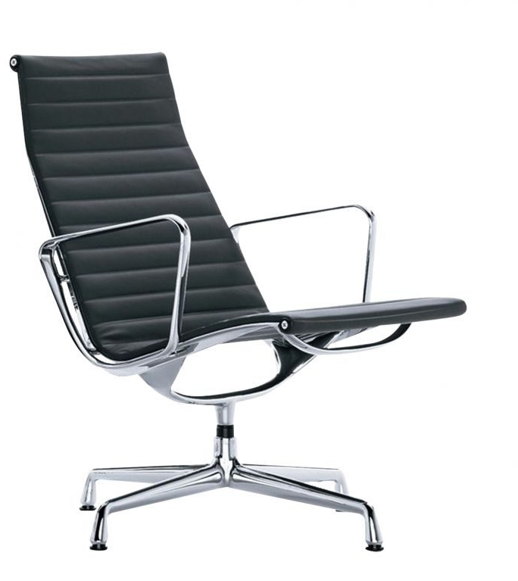
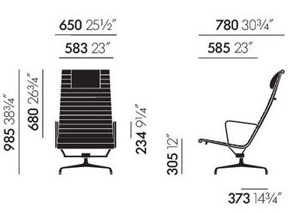
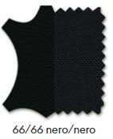

VITRA ALUMINIUM EA 124 LOUNGE CHAIR
65 x 78 cm H:30,5/98,5cm
Charles & Ray Eames, 1958
2 PCS

Slide 2
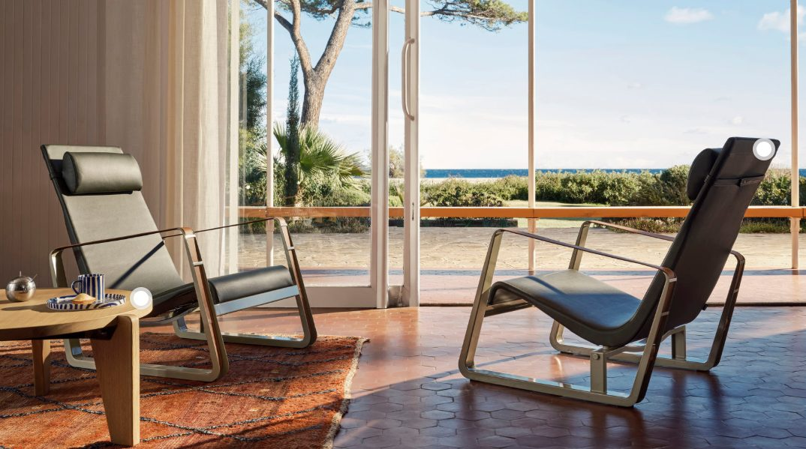
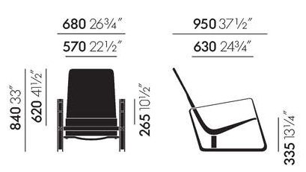


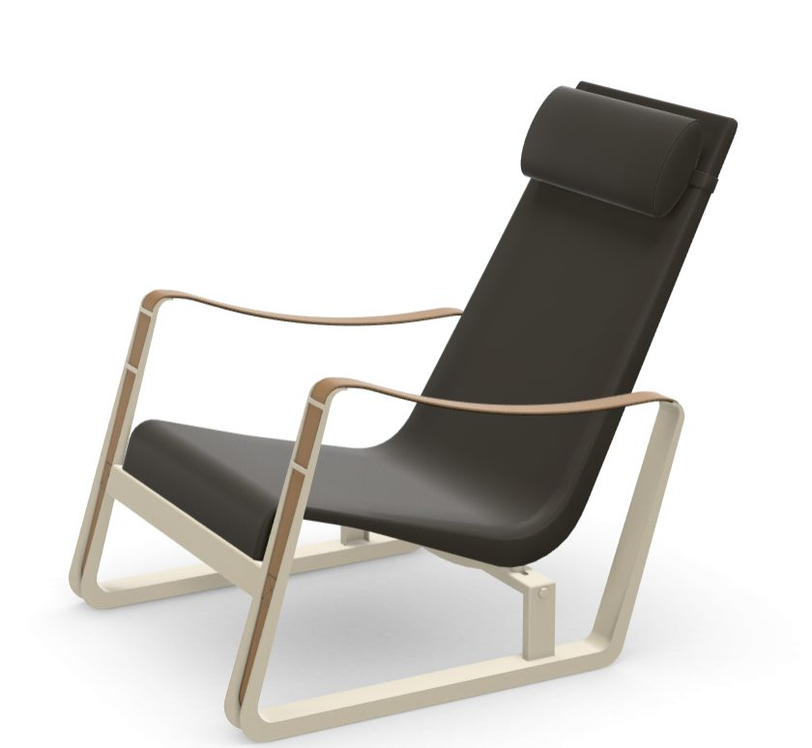
VITRA CITE ARMCHAIR
68 x 95cm H:33,5/84cm
Jean Prouvé, 1930
2 pcs

Slide 3
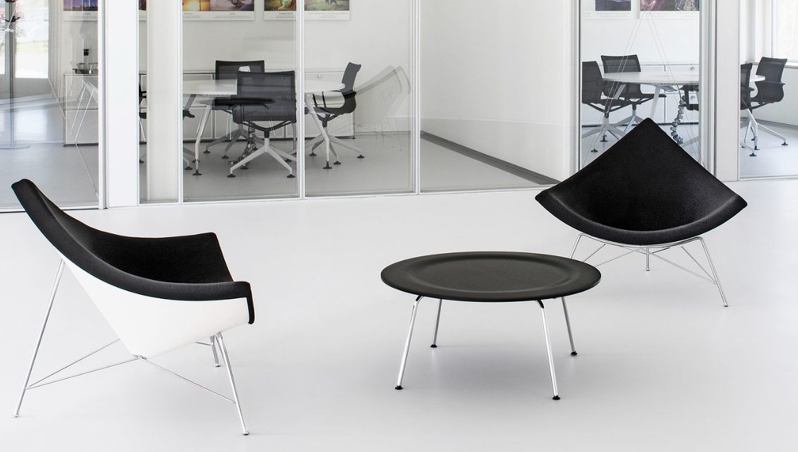
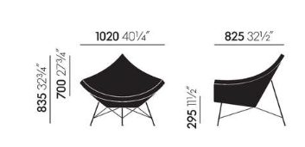
VITRA COCONUT ARMCHAIR
102 x 82,5cm H:29,5/83,5cm
George Nelson, 1955
2 PCS

Slide 4
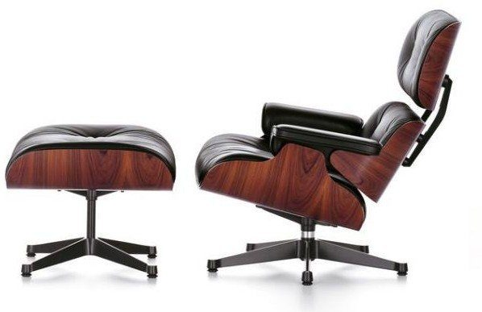
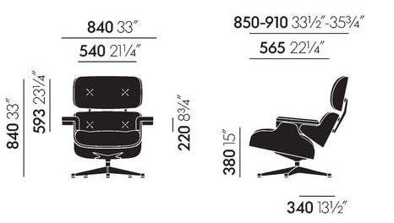
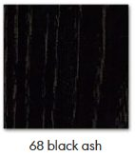
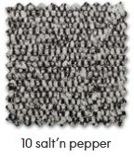
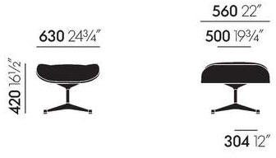
VITRA EAMES LOUNGE CHAIR & OTTOMAN
Charles & Ray Eames ,1956
1 PC;

Slide 5
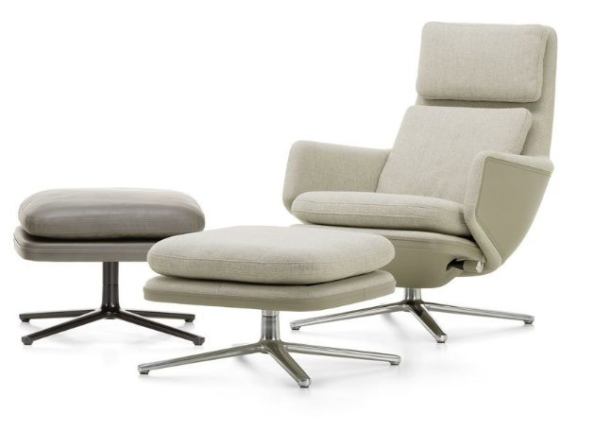
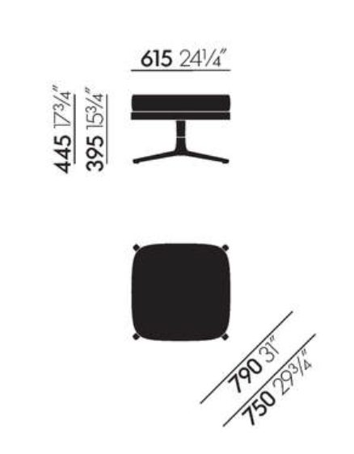
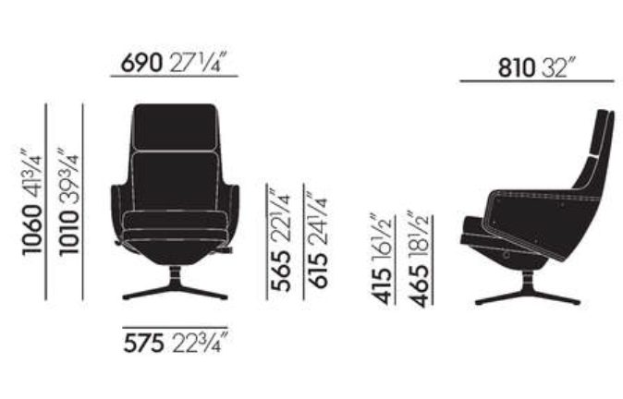
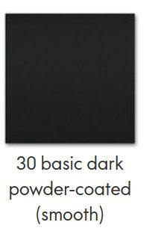

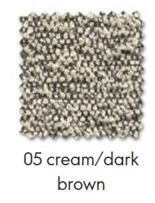
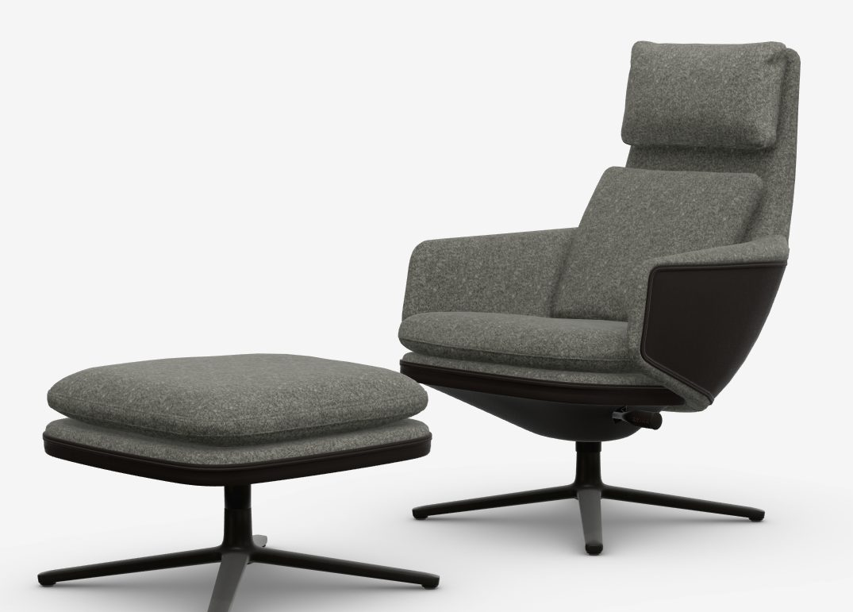
VITRA GRAND RELAX & OTTOMAN
69 x 81 cm H:41,5/101cm
Antonio Citterio, 2019
2 PCS

Slide 6
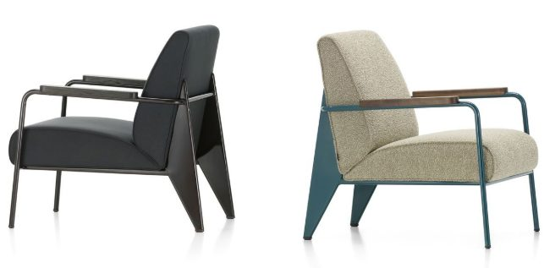
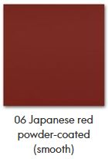
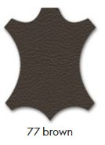
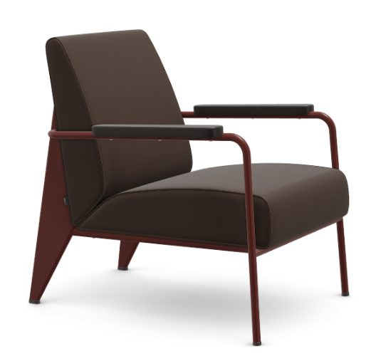
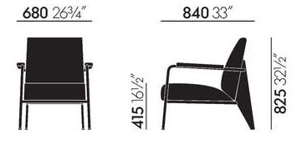
VITRA FAUTEIL DE SALON ARMCHAIR
68 x 84 cm H:41,5/82,5cm
Jean Prouvé, 1939
2 PCS

Slide 7
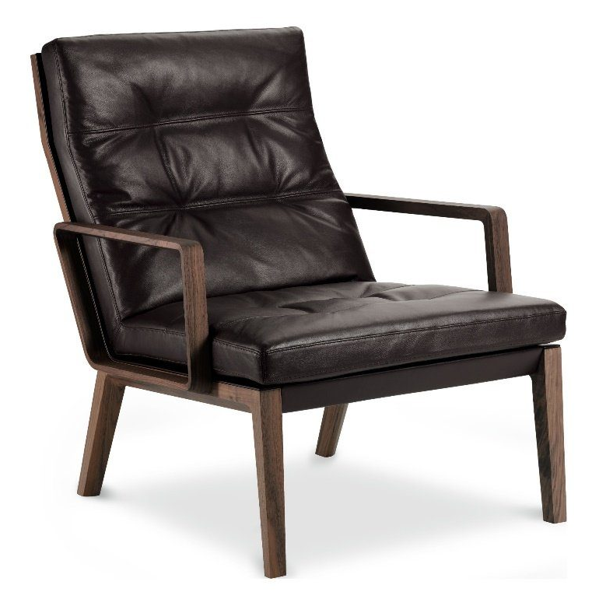
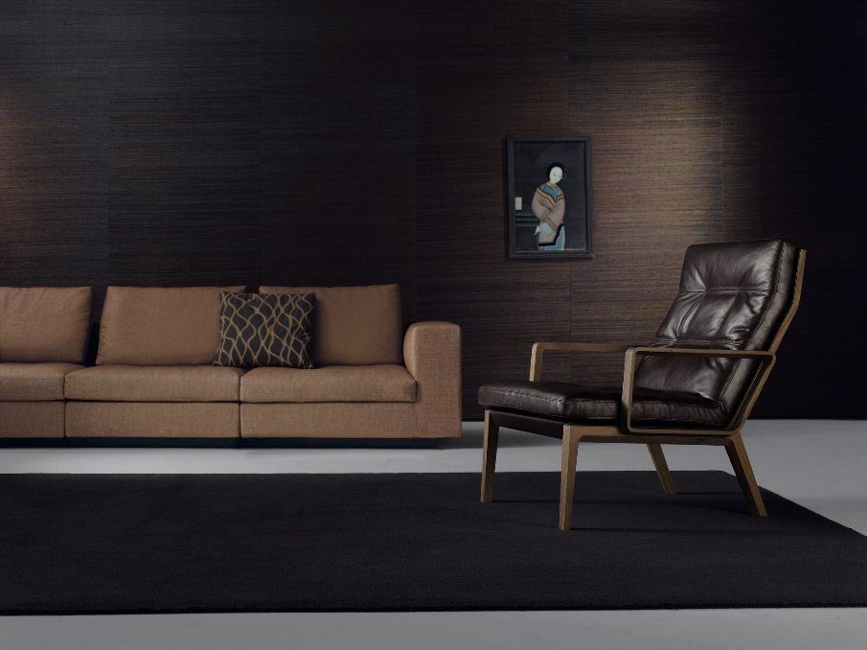
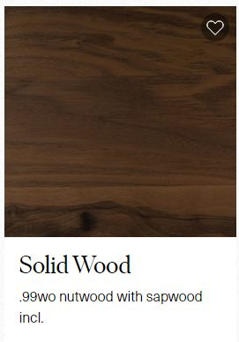
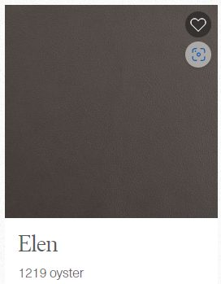
WALTER KNOLL ANDOO LOUNGE ARMCAHIR
72cm x 91cm h:42/89cm
1 pc

Slide 8
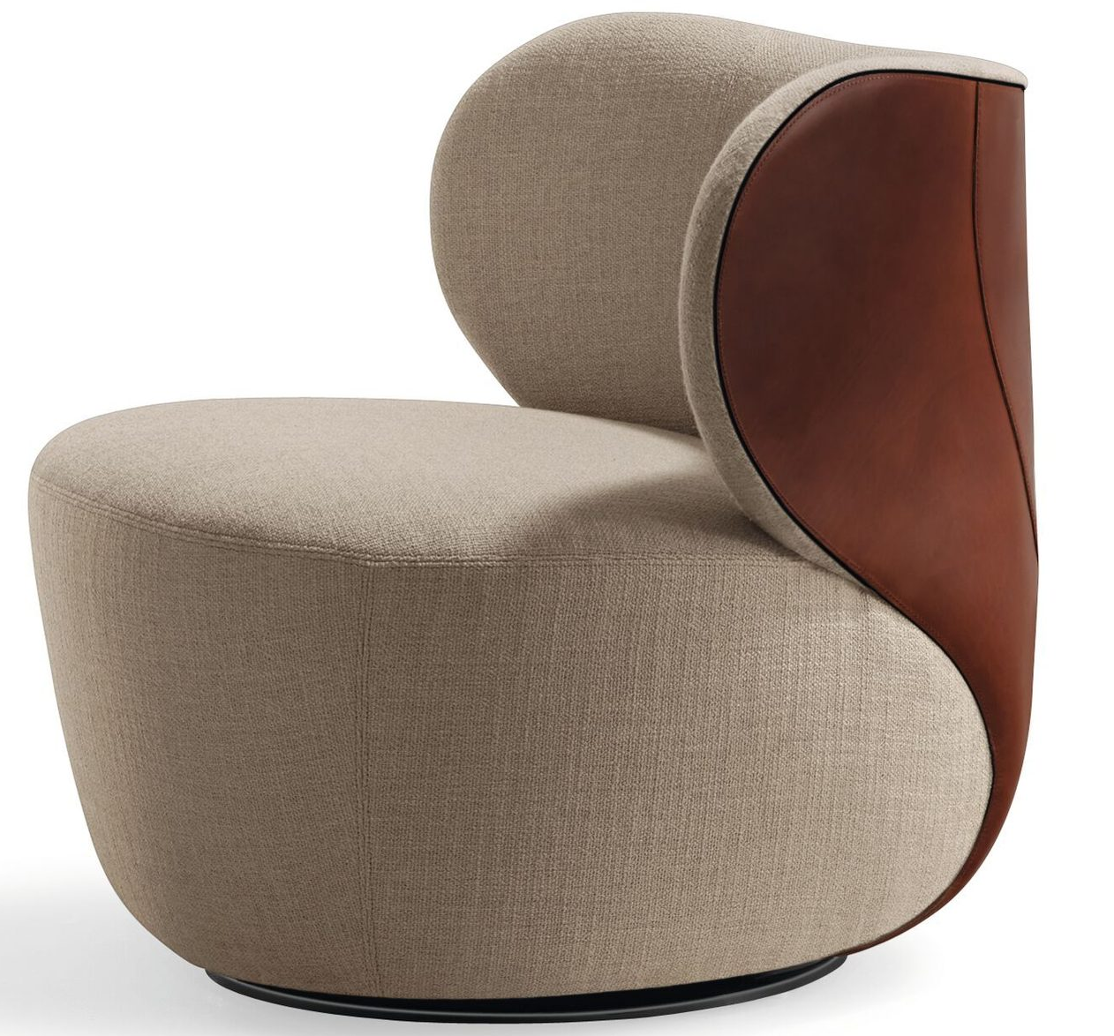
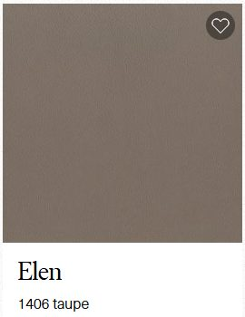
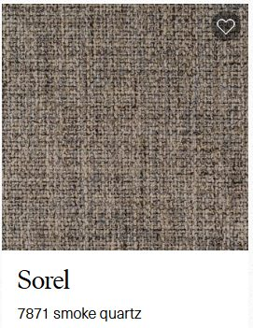
WALTER KNOLL BAO ARMCHAIR
82cm x 76cm h:42cm/71cm
2 pcs

Slide 9
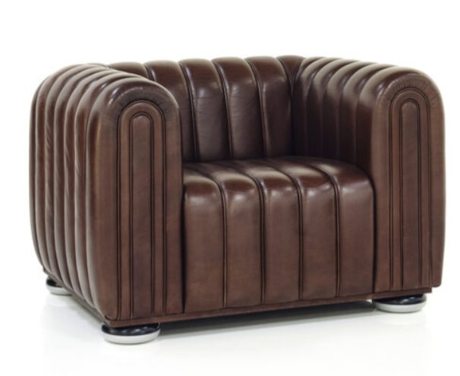
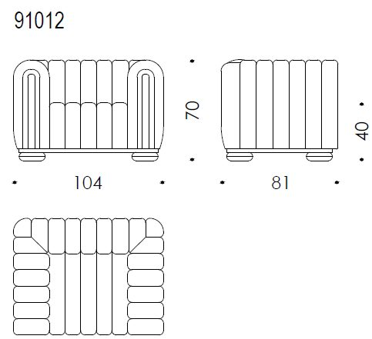

WITTMAN CLUB 1910 ARMCHAIR
104 cm x 81 cm H: 40/70 cm
2pcs
Leather: Natural Umbra
Structure: Beech Wood Black Silver
Wooden Transport Crate

Slide 10
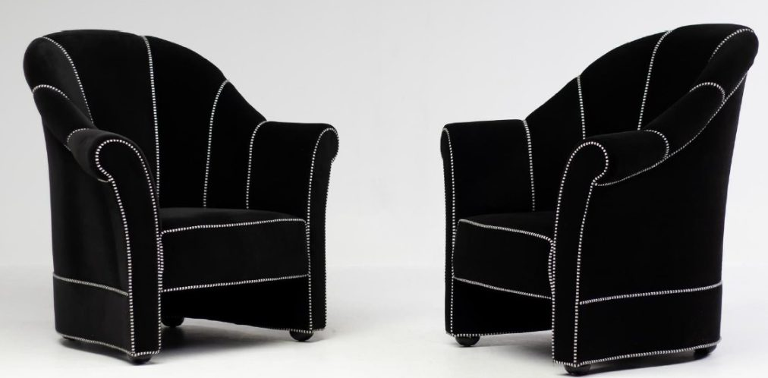
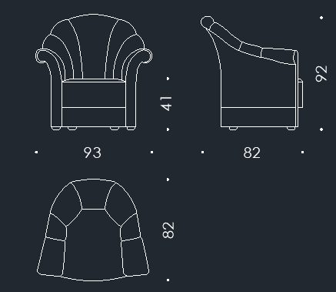
WITTMANN HAUS KOLLER ARMCHAIR
93 cm x 82 cm H:41/92 cm
Navy Blue fabric

Slide 11
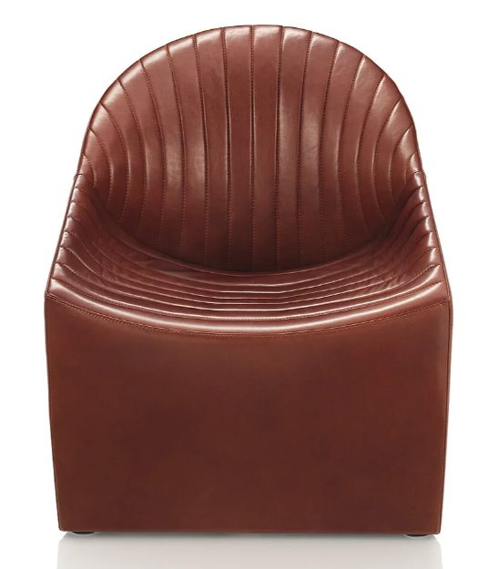
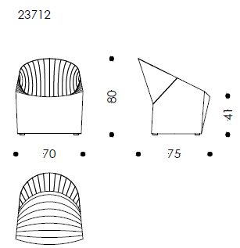
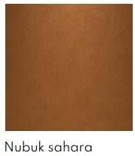
WITTMAN OYSTER ARMCHAIR
70 cm x 75 cm h: 41/80 cm
2pcs

Slide 12
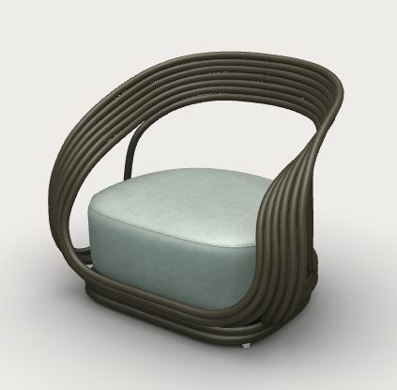
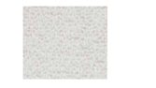
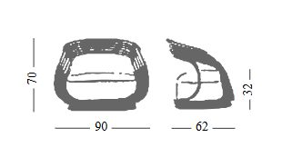
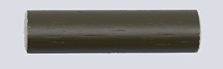
BONACINA EVA ARMCHAIR
Giovanni Travasa , 1965
62cm x 90cm H:32/70cm
2 pcs
Fabric;
Lacquered Olivo

Slide 13
CHAIRS

Slide 14
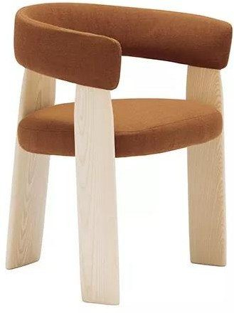
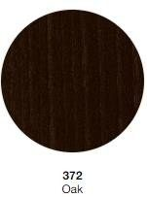
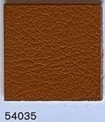
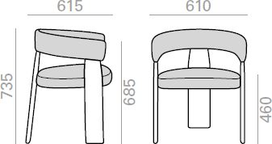
ANDREU WORLD ORU CHAIR
Patricia Urquiola
61 x 61,5 cm H:46/73,5 cm
2 pcs

Slide 15
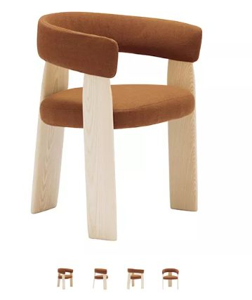
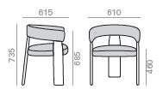
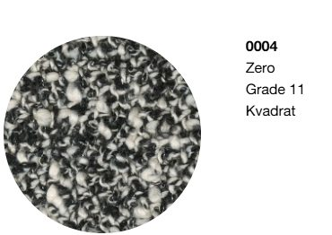
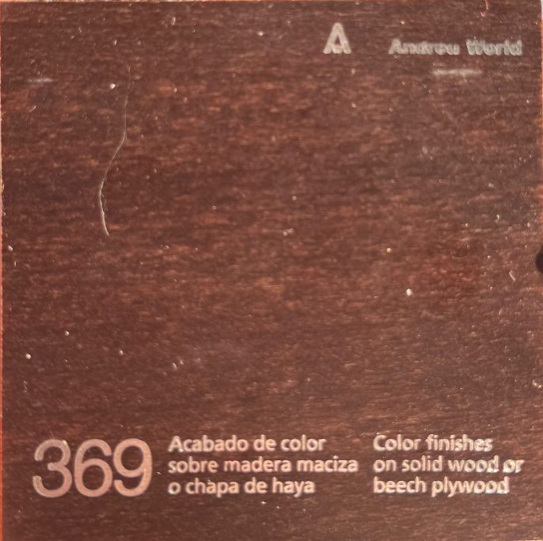
ANDREUWORLD ORU ARMCHAIR SO2273
61,5 cm x 61 cm h: 46/73,5 cm
6 pcs

Slide 16


ANDREU WORLD SAIL CHAIR
Piergiorgio Cazzangia
48 x 49,5 cm H:46/77 cm
4 pcs
BASE in SADDLE LEATHER;

Slide 17



80504255
B&B ITALIA FLAIR O CHAIR
Monica Armani, 2021
60 x 60 cm H:56/73 cm
6 pcs

Slide 18





B&B ITALIA HUSK CHAIR
Patricia Urquiola , 2012
61 x 60 cm H:51/86 cm
2 pcs

Slide 19



B&B ITALIA HUSK CHAIR
Patricia Urquiola , 2012
61 x 60 cm H:51/86 cm
1 pc

Slide 20





B&B ITALIA HUSK SMALL ARMCHAIR WITH WHEELS
61 cm x 60 cm H: 51/86 cm
NISAN 2026
1pcs
Cover: Fabric Elletra Ecru
Shell Finish: Dark Brown Thick Leather
Base Frame Finish: Black Painted

Slide 21




B&B ITALIA JENS CHAIR WITH ARMS
61 cm x 58 cm H: 45/76,5 cm
2pcs

Slide 22




B&B ITALIA JENS CHAIR WITH ARMS
61 cm x 58 cm H: 45/76,5 cm
8 pcs
Cover: Dark Brown Embossed Thick Leather
Frame Finish: Smoked Stained Oak

Slide 23



80504255
B&B ITALIA VOL AU VENT LARGE
60 cm x 58 cm H: 49/82 cm
6 pcs

Slide 24




CARL HANSEN & SON CH4 WISHBONE CHAIR
Limited Edition
Hans J. Wegner
55 cm x 51 cm H:76
6 pcs

Slide 25




CARL HANSEN&SON WISHBONE CHAIR CHILDREN
Design Hans J.Wegner
38cm x 34cm h: 34/51cm
2 pcs

Slide 26




CASSINA DUDET CHAIR
60cm x 51cm H:46/75 cm
2 PCS

Slide 27

CASSINA DUDET CHAIR
60cm x 51cm H:46/75 cm
2 PCS

Slide 28



CASSINA Fauteuil tournant
Charlotte Perriand,1928
51 x 55 cm H:46/86 cm
1 piece
WEGNER CAMELLO LEATHER

Slide 29



SALONE 2026
CASSINA SCARPA 121 DINING CHAIR
47 cm x 54cm h: 45/80 cm
6pcs
Structure: Stained Black Ashwood
Fabric: Eremo Vinaccia 13E508

Slide 30




CASSINA ZIG ZAG CHAIR
Gerrit Thomas Reietveld , 1973
43 cm x 37 cm h:43/74cm
280 10
2 pcs;
2 pcs in red

Slide 31

PO.2631
CASSINA ZIG ZAG CHAIR
Gerrit Thomas Reietveld , 1973
43 cm x 37 cm h:43/74cm
1 pc
280 10

Slide 32


CASSINA CAB OFFICE CHAIR EXECUTIVE
Marrio Bellini,1977
66 x 63 cm H:44/123 cm
2 PCS
With headrest cushion

Slide 33





CECCOTTI TEAHOUSE CHAIR
59 cm x 59 cm H: 41,5/75 cm
4pcs
Wood: American Walnut Stained Moca
Leather: Testa Di Moro

Slide 34



CECCOTTI VOSSIA CHAIR
65 x 73 cm H:43-50/116-120cm
EKIM 2026
Leather: SC Col.29
Finish: American Walnut Stained Moka

Slide 35




CECCOTTI EUGENE SMALL ARMCHAIR
65 cm x 58 cm H: 46/72 cm
EKİM 2026
2pcs
Leather: SC Col 29
Finish: American Walnut Stained Moka

Slide 36



CLASSICON MARS CHAIR
48 cm x 54 cm H:46 cm
Konstantin Grcic
1pcs
106MAR01-06
Finish: Clasic Leather Bordaux

Slide 37


EDRA ELLA CHAIR
61 cm x 62 cm H: 47/80 cm
4pcs
2026
Finish: Black Base Anthracite

Slide 38





FREDERICIA THE SPANISH CHAIR
Borge Mogensen,1958
64,5cm x 48cm h:46/84,5cm
8 pcs

Slide 39



HAY REY CHAIR
44 cm x 49 cm H: 80 cm
2026
6pcs
Finish: Glider Red Water /
Based Lacquered Beech

Slide 40


HAY X-LINE CHAIR
50 cm x 45 cm h: 77 cm
6pcs
2026
Finish: Chromed Base Indoor
Chromed Seat / Back
6 x Seat Pad: Scozia Leather Cognac

Slide 41




KNOLL PLATNER SIDE CHAIR
74 cm x 57 cm H: 51/76 cm
6 pcs

Slide 42


KNOLL MR SIDE CHAIR
49 cm x 69 cm H: 46/79 cm
6 pcs

Slide 43



KNOLL HAT TRICK CHAIR
59 x 57 cm H:85 cm
5pcs

Slide 44




KNOLL KLISMOS CHAIR
59 x 60cm H:46/73 cm
4pcs
Frame/Seat Cushion;
Natural
45,5 x 42
6pc;
Natural leather

Slide 45


MAGIS BISHOP CHAIR
50 cm x 49 cm H: 45/78 cm
2026
6pcs
Finish: Orange 5300C
6x Cushion: Leather Natural L0090

Slide 46




MAXALTO CARATOS HIGH CHAIR
57cm x 54,5cm h: 47/73 cm
2pcs

Slide 47



MOROSO TROPICALIA CHAIR
Patricia Urquiola ,2008
59 x 56 cm H:45/81 cm
6 pcs
concrete legs

Slide 48





MDF ITALIA FLOW CHAIR
54 cm x 55,5 cm h:44/80,5 cm
Design Jean Marie Massaud, 2009
6 pcs

Slide 49


MOOOI CARBON CHAIR
Bertjan Pot ,2004
47 x 49 cm H:46/79 cm
2 pcs

Slide 50



THONET BENTWOOD CHAIR
Michael Thonet,1859
43 x 52 cm H:46/84 cm
6 pcs

Slide 51



THONET BENTWOOD CHAIR
GebrüderThonet , 1900
54 x 57 cm H:47/75 cm
6 pcs

Slide 52



THONET S 64 V CANTILEVER CHAIR
Marcel Breuer , 1929
58 x 62 cm H:46/82 cm
6 pcs;
Matt sage structure

Slide 53


THONET S 64 P SERIOUS CHAIR
Jil Sander Collaboration, 2025
58 x 62 cm H:48/82 cm
6 pcs ruby red

Slide 54

THONET S 64 P SERIOUS CHAIR
Jil Sander Collaboration, 2025
58 x 62 cm H:48/82 cm
6 pcs green

Slide 55


TOLIX A56 CHAIR
Jean Pauchard, 1956
51 x 51 cm H:43/73,5 cm
6 PCS

Slide 56






VITRA FAUTEUIL DIRECTION PIVOTANT
Jean Prouvé, 1951
67 x 55 cm H:40,5-52/83,5-95 cm
1 pc

Slide 57



VITRA FAUTEUIL DIRECTION PIVOTANT
Jean Prouvé, 1951
67 x 55 cm H:40,5-52/83,5-95 cm
1 pc

Slide 58










VITRA EAMES PACC CHAIR
Jean Prouvé, 1950
63 x 60,5 cm H:37,5-50/77-89,5cm

Slide 59








VITRA SOFTSHELL CHAIR
Ronan & Erwan Bouroullec, 2008
62 x 56,5 cm H:44/81,5cm
2 PCS (3 SET)

Slide 60





VITRA STANDART CHAIR
Jean Prouvé, 1934/1950
42 x 49 cm H:46,5/82cm
2 PCS

Slide 61




VITRA EAMES PLASTIC CHAIR RE DSW
46,5 x 55 cm H:43/83cm
4 pcs
PO: 260263

Slide 62





VITRA ALUMINIUM CHAIR EA 117
Charles & Ray Eames ,1958
58 x 56,5-65 cm H:38,5-50,5/83-95 cm
8 pcs

Slide 63


VITRA ALUMINIUM CHAIR EA 119
Charles & Ray Eames,1958
58 x 58,5-72,5 cm H:39,2-50,8/101,5-113,5 cm
2 pcs

Slide 64








VITRA ID TRIM OFFICE CHAIR
Antonio Citterio,2010/2021
59 x 66-79,5 cm H:40-52/99-110cm
1 pc

Slide 65




VITRA SOFT PAD CHAIR EA 217
Charles&Ray Eames , 1969
58 x 57-65 cm H:38,5-50/81,5-92,5cm
8 pcs

Slide 66



VITRA SOFT PAD CHAIR EA 219
Charles&Ray Eames , 1969
58 x 59-65 cm H:38,5-50/99,5-110,5cm

Slide 67



WALTER KNOLL LIZ WOOD CHAIR
59 cm x 60cm h:49/60 cm
6 pcs

Slide 68





WALTER KNOLL LEADCHAIR EXECUTIVE
78cm x 78cm h:43-52cm/127-135cm
4 pcs
1 pc;
1 pc;
1 pc (castors hard);
1 pc (castors soft);

Slide 69


WALTER KNOLL LEADCHAIR EXECUTIVE
78cm x 78cm h:43-52cm/105-113cm
6 pcs

Slide 70


ZANOTTA APRIL CHAIR
Gae Aulenti,1964
51 x 55 cm H:46/86 cm
6 pcs
GOLD LEATHER

Slide 71
BAR STOOLS / POUFS

Slide 72



ANDREU WORLD ORU BAR STOOL
Patricia Urquiola
55 x 51 cm H:81/112 cm
3 pcs

Slide 73



ANDREUWORLD SMILE BARSTOOL BQ0377
47 cm x 47 cm h: 76/101,5 cm
4 pcs
Cover: 381 Black Finish
Finish: Plastic Glides

Slide 74



PO.2631
CASSINA 410 CAB BARSTOOL
55 x 51 cm h:68/ 100 cm
2 pcs
EYLUL 2026
Design Mario Bellini, 2009

Slide 75





FLEXFORM FEEL GOOD BAR STOOL
Antonio Citterio, 2009
48 x 47 cm H:84/99 cm
4 pcs

Slide 76



HAY REY BAR STOOL
45 cm x 49 cm H: 65 cm
4pcs

Slide 77


LIN BRASIL NINE BARSTOOL
Height 01: 42 x 40 x 62h (cm )
2 ADET

Slide 78





MAXALTO CARATOS LOW SWIVEL STOOL
47cm x 48,5cm h: 66/87 cm
1pcs
Cover: Leather KS350 Kasia Dark Brown
Upper Base Finish: Graphite Painted
Lower Base Finish: Bright Brushed

Slide 79

MAXALTO CARATOS LOW SWIVEL STOOL
47cm x 48,5cm h: 66/87 cm
4pcs
Cover: Fabric Sirio Anthracite
Upper Base Finish: Graphite Painted
Lower Base Finish: Bright Brushed

Slide 80



MDF ITALIA NEIL BAR STOOL
50 cm x 58 cm h:78/107 cm
Design Jean Marie Massaud
4 pcs
Black chromed frame

Slide 81





MUUTO COVER BARSTOOL
Marcel Wanders
50 x 58 cm H:75/106 cm
2 pcs

Slide 82

TOLIX HA75 BAR STOOL
Charles&Ray Eames,1950
43,5 x 43 cm H:103cm
6 PCS

Slide 83




VITRA EAMES PLASTIC STOOL
Charles&Ray Eames,1950
46 x 46,5 cm H:79,5/120cm
4 pcs

Slide 84



WALTER KNOLL SADDLE BAR STOOL
48,5 x 50 cm H:78/104cm
4 pcs

Slide 85



B&B -ACTION
B&B ITALIA DOUBLE DIP BENCH
230 cm x 47 cm H: 34/44 cm
1pcs
Finish: Stainless Steel 0772C

Slide 86


PO.2631
CASSINA GUERIDON J.M LOW TABLE
62 x 40 cm H:50 cm
EKİM 2026
1pcs

Slide 87


SALONE 2026
CASSINA GUERIDON J.M. LOW TABLE
62 cm x 40 cm H: 48 cm
1pcs
EKİM 2026
Leather: Cuoio Rosso Bulgaro

Slide 88

SALONE 2026
CASSINA GUERIDON J.M. LOW TABLE
62 cm x 40 cm H: 48 cm
1pcs
EKİM 2026
Leather: Cuoio Nero

Slide 89




CECCOTTI DUO BENCH
130 cm x 40 cm h: 49,5 cm
EKİM 2026
Leather: Velvety Sesame
Finish: Ash Stained Wenge PF

Slide 90
CECCOTTI DUO BENCH
130 cm x 40 cm h: 49,5 cm
EKİM 2026
Leather: Ctegory Soul Woven Peach Moro (12mm)
Finish: Ash Stained Wenge PF

Slide 91

CECCOTTI DUO STOOL
130 cm x 40 cm h: 49,5 cm
2pcs
AĞUSTOS 2026
Leather: Velvety Sesame (30mm)
Finish: Ash Stained Wenge PF

Slide 92




B&B ITALIA FRANK OTTOMAN
59cm x 40cm h: 40cm
1 pc

Slide 93




B&B ITALIA FRANK POUF
Antonio Citterio ,2015
59cm x 40cm h:40cm
2 pcs

Slide 94




B&B ITALIA MIRTO OTTOMAN
55 x 41 cm H:44 cm
2 pcs

Slide 95



CASSINA RUUNA POUF
Patricia Urquiola, 2025
Ø93 H:42cm
1 pc

Slide 96


CASSINA RUUNA POUF
Patricia Urquiola, 2025
148 x 42 cm H:47cm
1 pc

Slide 97




2542242
FLEXFORM OZZY OTTOMAN
47 cm x 44 cm H:42/50cm
1 PC

Slide 98




KNOLL KLISMOS STOOL
Antonio Citterio
71,5 x 48cm H:43 cm
2 pcs
Base;
Black,felt glides
62 x 38cm
2pc;
Black Leather

Slide 99




MAXALTO CARATOS BENCH
142 cm x 51 cm H: 50 cm
NISAN 2026
1pcs
Cover: Leather KS310 Kasia Natural
Finish: Bronzed Nickel Painted

Slide 100




MAXALTO CARATOS OTTOMAN
Antonio Citterio,2018
61,5cm x 56,5cm h:43cm
2 pcs
BASE;
SEAT;

Slide 101

MAXALTO CARATOS OTTOMAN
Antonio Citterio,2018
61,5cm x 56,5cm h:43cm
2 pcs
BASE;
SEAT;

Slide 102



MAXALTO INTERVALLUM OTTOMAN
Antonio Citterio, 1999
61,5cm x 56,5cm h:43cm
2 pcs
ŞUBAT 2026

Slide 103




MAXALTO LITHOS OTTOMAN
Antonio Citterio
40cm x 40cm h:45,5cm
2 pcs
BASE;
SEAT;

Slide 104




MOROSO DEW LARGE STOOL
Ø100 cm h: 35 cm 1 pc
Ø70 cm h: 35 cm 1 pc
Leather: B0243 Cire Walnut

Slide 105




VITRA NELSON BENCH
George Nelson,1946
122cm x 47cm h:35,3cm
1 pc

Slide 106




VITRA EAMES STOOL
Charles & Ray Eames, 1960
Ø33 cm h:38cm

Slide 107



VITRA TABOURET BOIS
Jean Prouvé, 1941
Ø35 cm h:45cm
1 PC;

Slide 108
TABLES

Slide 109



ACERBIS MAXWELL TABLE
300 cm x 125 cm h: 75 cm
1pcs
Top: Matt Alpi Green Marble MR07
Structure: Matt Alpi Green Marble MR07

Slide 110


ACERBIS MAXWELL TABLE
300 cm x 125 cm h: 75 cm
1pcs
Top: Matt Levanto Red Marble MR06
Structure: Matt Levanto Red Marble MR06

Slide 111



AGAPECASA EROS TABLE
Angelo Mangiarotti, 1971
300 x 150 cm H:72 cm
1 pc

Slide 112


AGAPECASA EROS TABLE
Angelo Mangiarotti, 1971
260 x 130 cm H:72 cm
1 pc

Slide 113

AGAPECASA EROS TABLE
Angelo Mangiarotti, 1971
300 x 150 cm H:72 cm
2 pcs

Slide 114


ANDREU WORLD REVERSE TABLE
Ø 160cm h:72cm
1 pc

Slide 115



BOTTEGA GHIANDA GABBIANO TABLE
123 cm x 87,3 h:71cm
1 pc
Beech wood ;
Lacquered white top;

Slide 116




80492142
B&B ITALIA ALLURE O TABLE
245 cm x 125 cm h: 72 cm
1pcs
TAO245E_T
Top Finish: Glossy Marquinia Black Marble 0185P
Base and Lower Top Finish: Brushed Black Oak 0381N

Slide 117

B&B ITALIA ALLURE O TABLE
320 cm x 125 cm h: 72 cm
1pcs

Slide 118



B&B ITALIA MIRTO TABLE
300 x 110 cm H:73 cm
1 pc

Slide 119



80492151
B&B ITALIA TOBI-ISHI TABLE
D: 162 cm H: 72 cm
1 pcs
Jay and Barber Osgerby

Slide 120



B&B ITALIA TOBI ISHI TABLE
162 cm h: 72 cm
1pcs
Finish: Glossy Marquinia Black Marble 0185P

Slide 121


CASSINA TL59 DOUBLE BASE TABLE
360 cm x 120 cm H: 73 cm
1pcs
Finish: Metal Bronze

Slide 122



CASSINA TABLE EN FORME LIBRE TABLE
Design Charlotte Perriand, 1959
236 cm x 107 cm H:74 cm
1 pc

Slide 123


EXTETA 10TH JOINT TABLE
400cm x 150cm h:75 cm
1 pc
Design Massimo Castagna, 2017

Slide 124




HENGE OXYMORON TABLE
330 cm x 120 cm H: 75 cm
1pcs
Wood: Forest Fusion Black
Finish: Sand Cast Bronze

Slide 125




HENGE TED TABLE
340 cm x 110 cm H: 75 cm
AĞUSTOS 2026
1pcs
Top: Black Burnished Brass
Finish: Black Burnished Brass /
Standard Stone OKapı

Slide 126


HENGE SISMA TABLE SPECIAL DIMENSION
300 cm x 120 cm H: 75 cm
AĞUSTOS 2026
1pcs

Slide 127




KNOLL FLORENCE KNOLL CONFERENCE TABLE
Florence Knoll
244cm x 137cm H:73 cm
BASE;
TOP;

Slide 128

KNOLL FLORENCE KNOLL CONFERENCE TABLE
Florence Knoll
244cm x 137cm H:73 cm
BASE;
TOP;

Slide 129


KNOLL SAARINEN HIGH OVAL TABLE
198 cm x 121 cm h: 72 cm
Finish: Emperedor Light Marble Polished
White

Slide 130



KNOLL SAARINEN HIGH OVAL TABLE
198 cm x 120 cm H: 73 cm
5 pcs
Finish: Nero Marquina Marble Polished
Black

Slide 131




KNOLL SAARINEN TABLE
Eero Saarinen
198 x 121 cm H:74 cm
1 pc
BASE;
TOP;

Slide 132

KNOLL SAARINEN TABLE
Eero Saarinen
198 x 121 cm H:74 cm
1 pc
BASE;
TOP;

Slide 133



KNOLL SAARINEN DINING TABLE OVAL LARGE
244 cm x 137 cm H: 73 cm
1 pc
Marble: Brown Emperador
Finish: Black

Slide 134



KNOLL SAARINEN HIGH OVAL TABLE
244 cm x 137 cm H: 73 cm
3 pcs
Finish: Arabescato Marble Polished /
White

Slide 135



KNOLL SAARINEN DINING TABLE OVAL LARGE
198 cm x 121 cm h: 73 cm
1 pc
Marble: Arabescato
Finish: White

Slide 136


KNOLL SAARINEN DINING TABLE ROUND SMALL
Ø107 cm H:73 cm
1 pc
Marble: Nero Marquinia
Finish: Black

Slide 137




KNOLL SAARINEN HIGH ROUND TABLE
Ø120 cm H:72 cm
Finish: Walnut Veneer / Black

Slide 138


KNOLL SAARINEN ROUND TABLE
Eero Saarinen
Ø90 cm h:73 cm
1 pc
BASE
TOP

Slide 139




MAXALTO ASTRUM TABLE
Antonio Citterio ,2017
230cm x 120cm h:74 cm
1 pc

Slide 140



MAXALTO ASTRUM OVAL TABLE
280cm x 130cm h: 74 cm
1pcs
Finish: Glossy Calacatta White Marble
Frame Colour: Graphite Painted

Slide 141



MDF ITALIA ROCK MAXI TABLE
240 cm x 115 cm h: 72 cm
1pcs
Finish: Anthracite Cement

Slide 142




MDF ITALIA ROCK TABLE MAXI
Jean Marie Massaud ,2023
240cm X 115cm h: 72cm

Slide 143




PROMEMORIA GOFFREDO TABLE
300 cm x 120 cm h:74cm
1 pc

Slide 144



VITRA EAMES DINING TABLE 130CM
Ø130 cm h:74 cm
1 pc

Slide 145


ZANOTTA POKER TABLE
98 cm x 98 cm h:70cm
1 pc

Slide 146
WRITING DESKS / VANITY

Slide 147



CASSINA x KARAKTER
Bodıl Kjær, 1959
236cm x 107cm h: 74cm

Slide 148



CECCOTTI TEAHOUSE TABLE
183 cm x 70 cm H: 66,5 cm
1pcs
Finish: American Walnut

Slide 149


CECCOTTI 604 DESK
255 cm x 107,5 cm H: 76 cm
KASIM 2026
Top: American Walnut Moka
Leather: SC29 Ardesia

Slide 150




CLASSICON ORCUS HOME DESK
48 cm x 54 cm H:46/76 cm
Konstantin Grcic
1pcs
110ORC03-01
Finish: Walnut Veneer
Base: Chrome Plated
Inside: Black Leather

Slide 151





SDM2026
MAXALTO RECIPIO 14 WRITING DESK
130 cm x 60 cm H:74,5 cm
1pcs
EYLUL 2026
Cover: Leather AF157N Alfa Black 1425
Structure: Bronzed Nickel Painted 0174B
Finish: Soya Shellac 6805G

Slide 152





VITRA COURIER DESK
120 x 72,5 cm h:74,5 cm
1 pc

Slide 153


VITRA EAMES DESK EDU
152,5 x 71 cm h:74 cm
1 pc

Slide 154
COFFEE TABLES

Slide 155




AGAPECASA TRIANGLE COFFEE TABLE
142 x 135 cm H:40 cm
BIANCA CARRARA

Slide 156




ANDREU WORLD ALLA COFFEE TABLE
41 x 44 cm H:39,5 cm 1pc (372)
41 x 44 cm H:46 cm 1pc (318)

Slide 157




BIEKE CASTELEYN ORGANIC SIDE TABLE
Bieke Casteleyn
60 cm x 40 cm H:47,5 cm
2 pcs

Slide 158





B&B ITALIA ALANDA SMALL TABLE
Paolo Piva,2018
120 x 120cm H:27 cm
1 pcs
Top Finish;
Clear Glass
1 pc
Frame Finish;
Glossy Black Painted

Slide 159




B&B -ACTION
B&B ITALIA ALANDA 18 SMALL TABLE
120 cm x 120 cm h: 27 cm
2pcs
MAYIS 2026
Frame: Glossy Black Painted 0125N
Finish: Extra Light Glass 0200T

Slide 160




B&B ITALIA ALANDA ‘18 SMALL TABLE
180 cm x 120 cm h: 27cm
2pcs
MAYIS 2026
Top Finish: Smoky Glass 0129F
Frame Finish: Glossy Black Painted 0125N

Slide 161




80492151
B&B ITALIA COZY SMALL TABLE
D: 110 cm H: 23 cm
1pcs
Antonio Citterio
Top Finish: Smoked oak
Frame Finish: Pewter painted

Slide 162




B&B ITALIA DIESIS TABLE
190 cm x 130 cm H:34,5 cm
1pcs
Top: Glossy Sahara Noir Marble 0940S
Metal: Bright Brushed 0189A

