Slide 1

Pawsitive Pet Academy
Our website and mobile app: design, build and demo
Meridian Tech Group
Mohamed Motala | Kelebogile Tema | Theolin Chetty
XHAW5112 Work Integrated Learning | Group presentation
Notes:
Welcome everyone. We are Meridian Tech Group. We built a website and a native Android app for Pawsitive Pet Academy. Today we explain why we chose this design, how it looks, how it works, and then we show it running.

Slide 2
Meet the team
Three members, three lead roles, one shared project
Kelebogile Tema
Mohamed Motala
Theolin Chetty
Website Development Lead
UI/UX Design Lead
Mobile App Lead
Leads the website build and the colour palette we chose.
Logo and branding, wireframes, Git workflow, Fees Calculator and Contact Us pages.
Leads the native Android app built in Kotlin.
All three of us built the presentation, recorded the video and wrote the final report together.
Notes:
Each of us had a lead role, but we all worked across the project. Kelebogile leads the website, Mohamed leads UI/UX design, Theolin leads the mobile app.

Slide 3
The client and the brief
Pawsitive Pet Academy, run by Sarah Smith in Morningside, Durban
• A pet care and training academy with 7 courses
• Four 6-month courses: Canine Obedience, Pet Grooming, Animal Behaviour, Pet Business Management (R1,500 each)
• Three 6-week courses: Puppy Care, Pet First Aid, Basic Dog Walking (R750 each)
• Customers: individuals, families, schools and corporate clients
• Sarah wants people to browse courses and get an accurate quote, with a discount for booking more than one course
What we delivered
• A website with 6 page types
• A native Android app
• A fees calculator on both
• One shared brand
Notes:
Our client is Sarah Smith, who runs Pawsitive Pet Academy in Durban. She offers seven courses. Her goals: let people browse, get a quote, and be rewarded with a discount for taking more than one course.

Slide 4
Why this design was selected
We scored each member's Phase 1 proposal against the same criteria
Criteria
Kelebogile
Theolin
Mohamed
Our reasons
Strong branding potential
3
5
4
• Pawsitive Pet Academy scored highest overall (27)
• Theolin's gaming idea fitted a different topic
• The pet academy proposal had the most detail, so it was the easiest to build from
Easy to develop
3
4
5
Suitable for mobile app
3
4
5
Suitable for website
3
5
5
Easy to research
4
3
4
Strong user experience
4
3
4
Total
20
24
27
Notes:
We scored the three proposals. The Pawsitive Pet Academy proposal scored 27, ahead of 24 and 20. It also had the most detail, so it was easier to turn into a real website and app. That is the motivation for our design selection.

Slide 5
Choosing the logo and the palette
We combined the strongest parts of two proposals
Logo: Mohamed's dog, 27 vs 21
Palette: Kelebogile's
• Scored higher for representing the business, being easy to recognise and suiting the app
• Kept the design and changed only the colours
• Recolour vs redesign was a 50-50 vote, broken by a wheel spin
#FFFDD0
#B0E0E6
#C68B59
Chosen over Mohamed's coral and sage palette because it felt softer and more welcoming, while still caring and professional.
Notes:
Logo: Mohamed's dog logo scored 27 against 21. Palette: Kelebogile's cream, powder blue and tan was chosen because it felt softer and more welcoming. The final design combines both.

Slide 6
01
PART 01 OF 03
Kele
Website
Sitemap and journeys
Tools
Website tour
Course pages and contact
Notes:
Section 1: Kele covers the website.

Slide 7
Presenter: Kelebogile (suggested)
Sitemap and user journeys
Both platforms share the same structure
Home
Journey 1: Viewing courses
Journey 2: Requesting a quote
└ About Us
1. Land on Home
1. Select courses
└ Summary page (all courses)
2. Open Courses
2. Open Fees Calculator
└ Detail pages (one per course)
3. Pick a course
3. Discount calculated automatically
└ Fees Calculator
└ Contact Us
4. Read description, length and fee
4. Submit request, Sarah follows up
Notes:
We planned the structure before designing. Home, About Us, a summary of courses, a detail page per course, the Fees Calculator and Contact Us. The two journeys we designed for are browsing courses and getting a quote.

Slide 8
Presenter: Kelebogile (suggested)
How we built it
Different tools for each platform, shared tools for teamwork
Website
Android app
Teamwork
• HTML5 for structure
• CSS for colours, fonts and layout
• JavaScript for the calculator, forms and menu
• Written in Visual Studio Code
• Kotlin in Android Studio
• XML layouts for every screen
• One page per screen
• Tested in the Android emulator
• Figma for wireframes
• GitHub for version control
• Teams and WhatsApp for communication
• OneDrive and Drive for documents
Notes:
Website: HTML, CSS and JavaScript. App: native Android in Kotlin with XML layouts. We started the app in React Native but moved to Kotlin. For teamwork: Figma, GitHub, Teams, WhatsApp and shared drives.

Slide 9
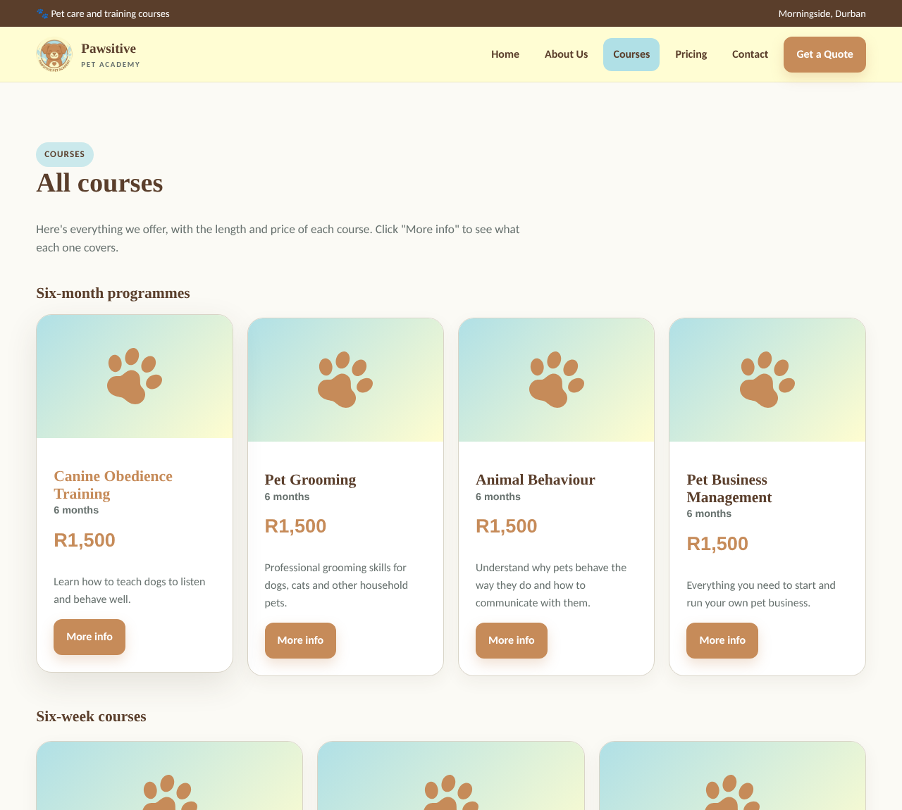
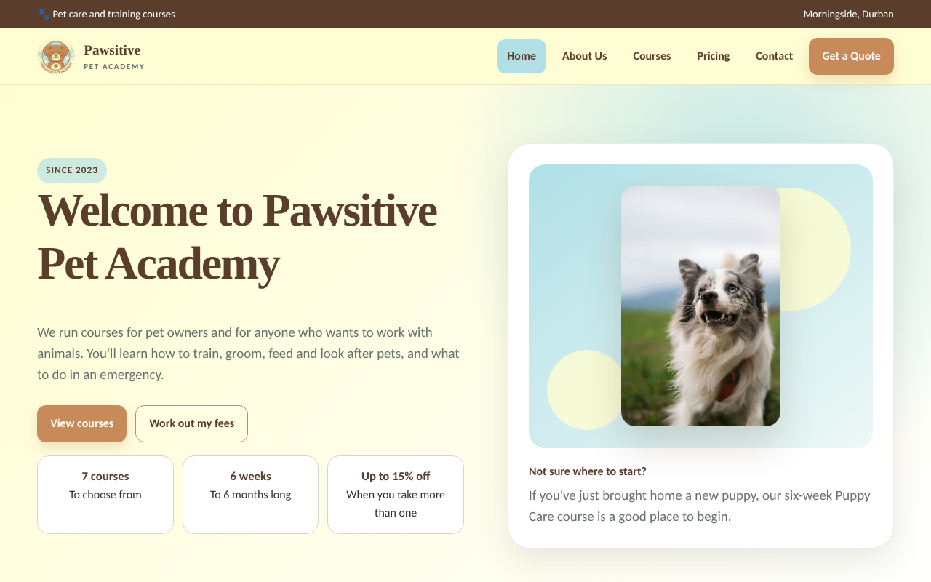
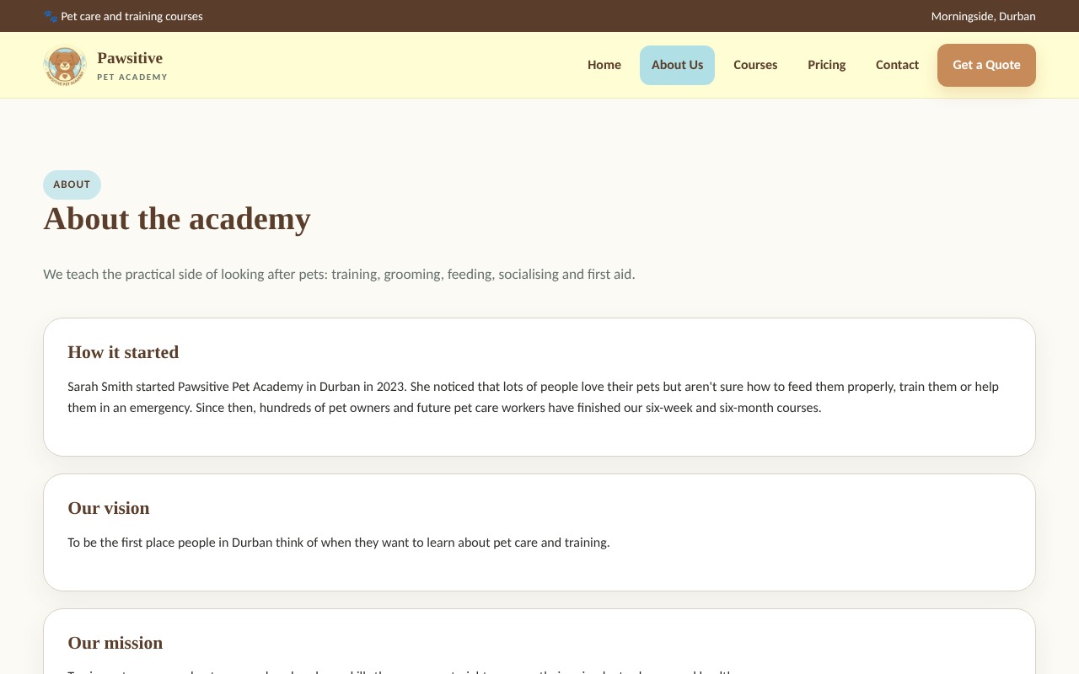
Presenter: Kelebogile (suggested)
The website
Home page, course overview and About Us
Home
Courses
About Us
A persistent top bar, tan buttons, powder blue highlights and the same logo throughout. On small screens the menu becomes a drop-down.
Notes:
These are screenshots of the finished website. Home gives a quick welcome, key facts and a clear way to view courses or work out fees. Courses lists all seven courses with price and length. About Us introduces Sarah and the team.

Slide 10
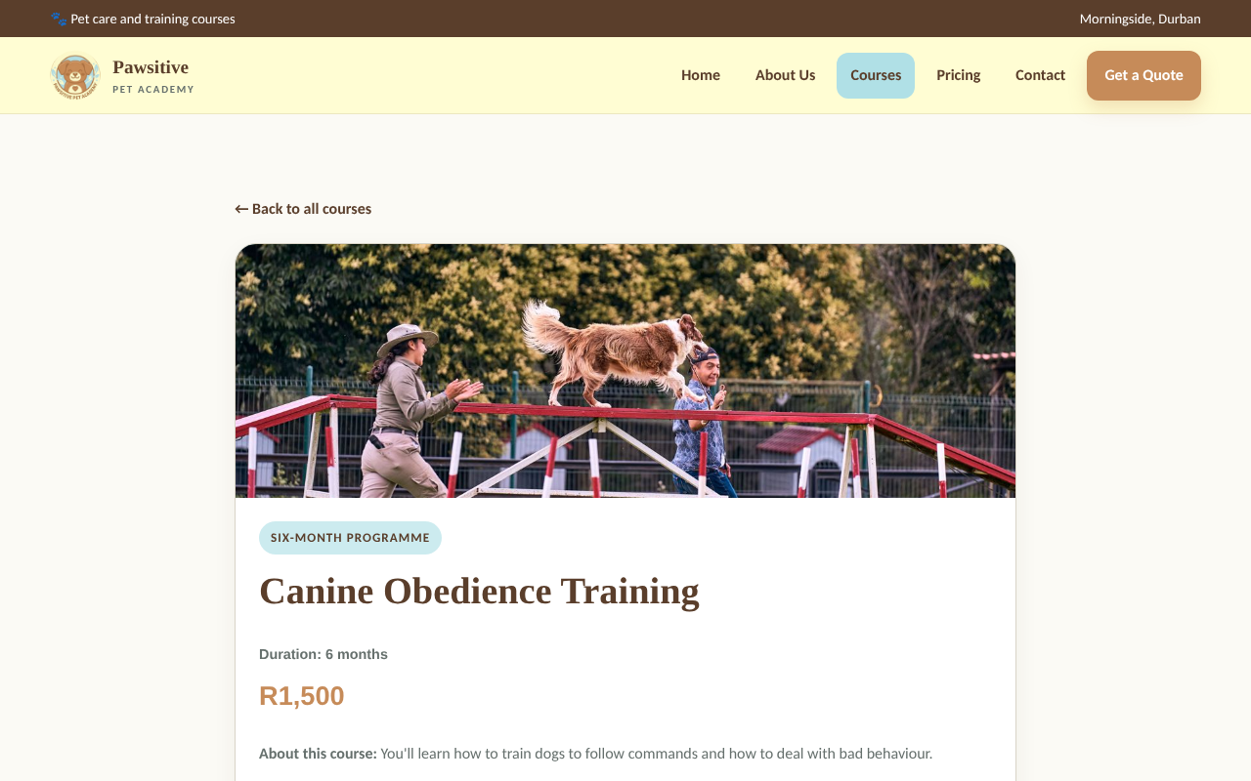
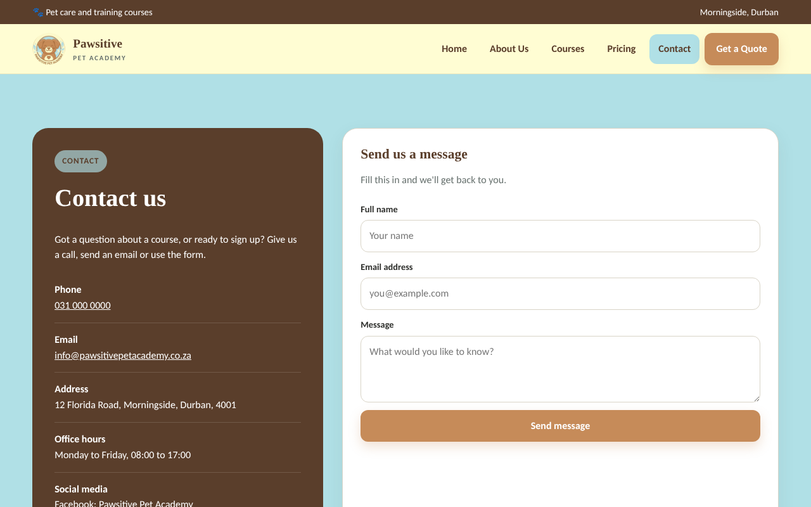
Presenter: Kelebogile (suggested)
Course detail pages and Contact Us
Every course has its own page; Contact Us has a map and a message form
Left: course detail page. Right: Contact Us on the finished website.
Notes:
Each of the seven courses has a detail page with description and fee. Contact Us shows phone, email, address, office hours and a map, plus a message form.

Slide 11
02
PART 02 OF 03
Theolin
The mobile app
Android app
Challenges and lessons
Notes:
Section 2: Theolin covers the mobile app and what we learned.

Slide 12

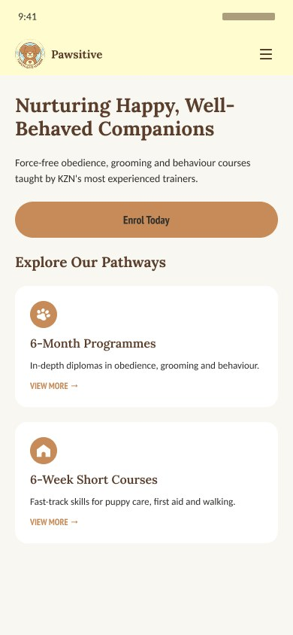
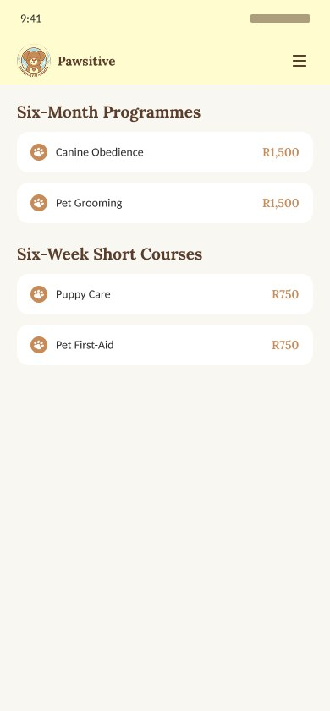
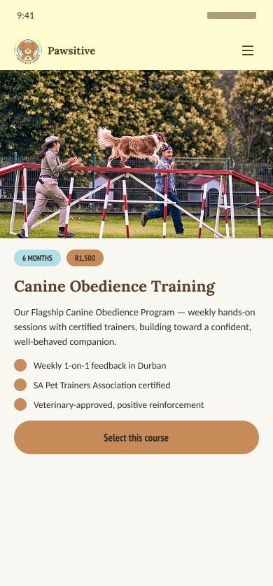
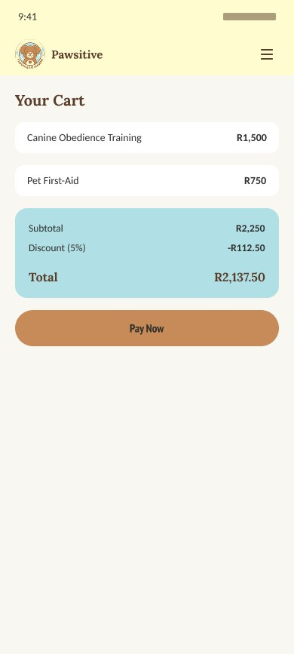
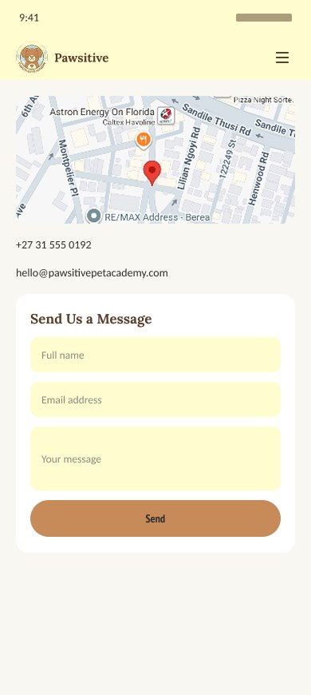
Presenter: Theolin (suggested)
The mobile app
A native Android app in Kotlin that mirrors the website
• Bottom bar: Home, Courses, Fees and Contact. About Us and Pricing sit in a top menu
• Each screen is its own page with an XML layout; shared course data keeps the website and app consistent
• Screens shown are the high-fidelity designs from Figma; the finished app follows them and lists all 7 courses
Notes:
The app is a native Android app. It follows the same structure and brand as the website. The bottom bar gives one-tap access to Home, Courses, Fees and Contact. The screens here are the Figma designs the app was built from; the finished app lists all seven courses and adds VAT to the fees calculator.

Slide 13
Presenter: Theolin (suggested)
Challenges and lessons
Problems we hit and what we learned
Merge conflicts
Missing courses
Several branches changed the same files. We learned to pull first and to review before merging.
The first build had only 3 of 7 courses, so the 15% tier could not trigger. We added all seven.
Build errors
Images
A manifest merger error in Android Studio, fixed while splitting the code into separate pages.
Paid stock images had to be replaced with royalty-free icons.
Notes:
Four real problems. Merge conflicts taught us to pull before pushing and review before merging. The app first had only three courses, which meant the 15 percent discount could never show, so we added all seven. We fixed a manifest merger error and replaced paid stock images with royalty-free icons.

Slide 14
03
PART 03 OF 03
Mohamed
Design, my pages and Git
Logo
Wireframes
Design choices
Fees Calculator
Contact Us
Git
Live demo
Notes:
Section 3: Mohamed covers the logo, wireframes, design choices, his pages, Git and the live demo.

Slide 15

Presenter: Mohamed
Our logo: from Phase 1 to final
My dog logo was chosen in Phase 1, then recoloured to the group palette
→
Original
Final
Notes:
Left is my original Phase 1 logo: sage green background and charcoal outline with a brown dog. Right is the final logo. The dog, the layout, the heart and the vines are all kept. Only the colours changed, to cream, powder blue and tan, so the logo matches the website and the app. When we voted between a full redesign and a simple recolour it was a 50-50 tie, so we spun a wheel and it landed on recolour. Everyone was happy with that.

Slide 16
Presenter: Mohamed
Why the dog, the heart and the vines
Every part of the logo says something about the academy
The dog
The heart
The vines
Most of our courses are dog-based, so the dog is the main focus. The smiling face feels friendly and approachable, which is what Sarah wanted.
A soft heart on the chest shows the care that owners should give their animals. It is the caring side of what the academy teaches.
Vines and leaves around the dog stand for nature, growth and wellbeing. That fits pet care, training and a calm, healthy brand.
Why recolour and not redesign? The brand mark already worked. Recolouring kept it simple and professional and tied it to the group palette.
Notes:
Explain each symbol in one sentence. Dog: most courses are about dogs, and the smile makes the brand friendly. Heart: care for animals. Vines: nature, growth and wellbeing. Then say why we recoloured: it kept a design that already worked and made it match the palette.

Slide 17
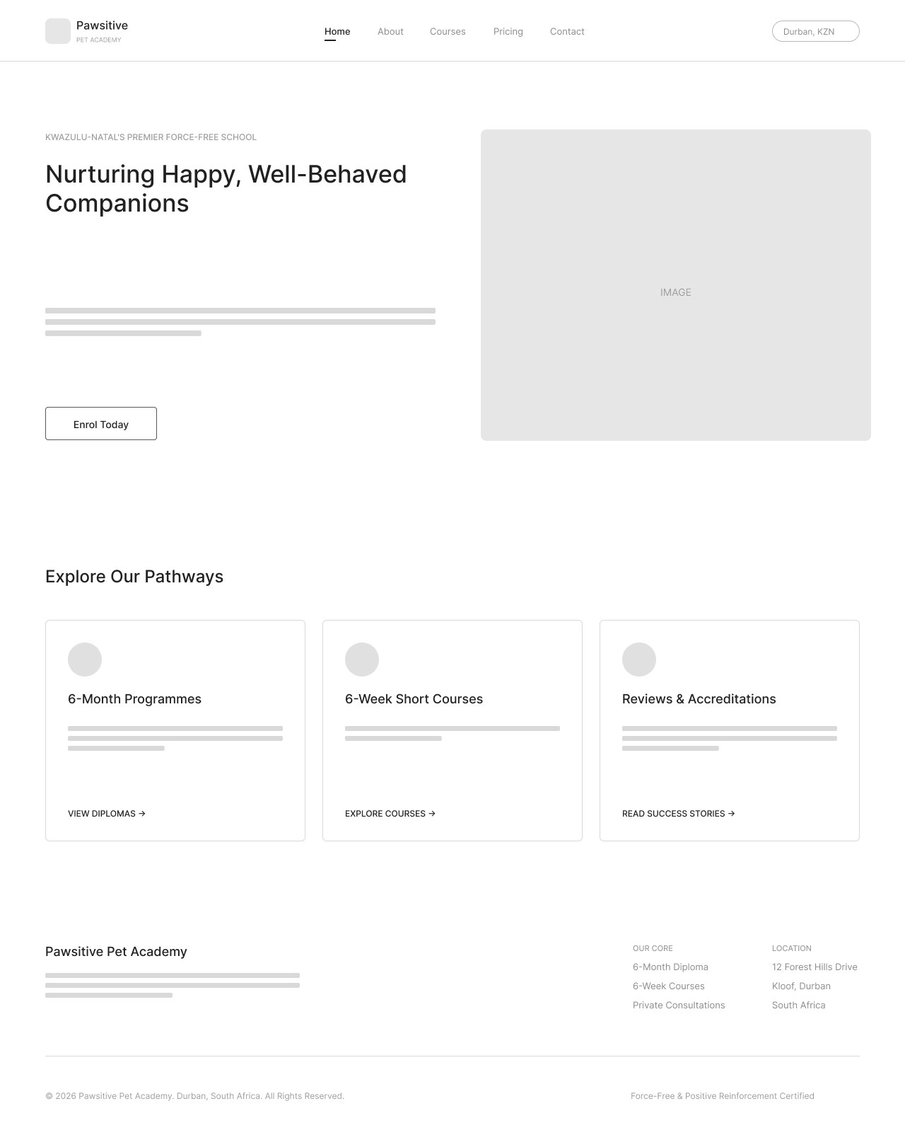
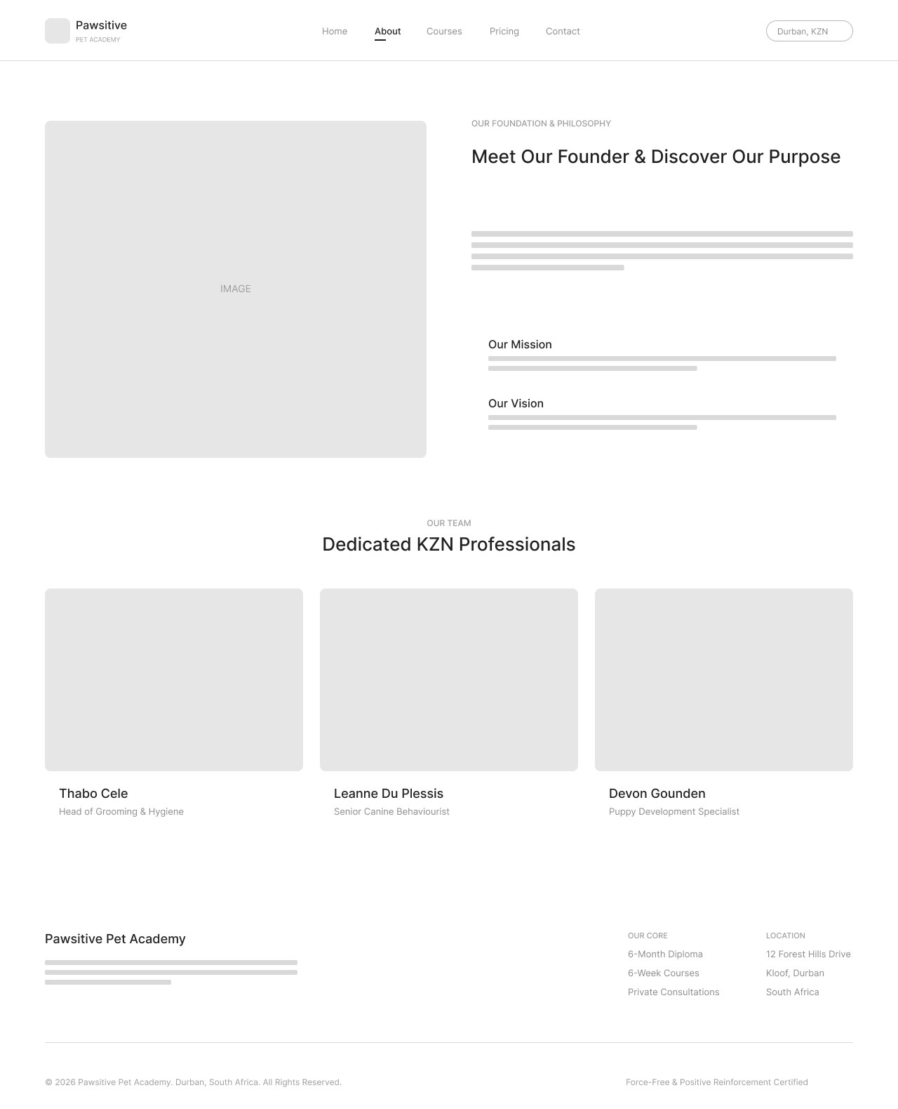
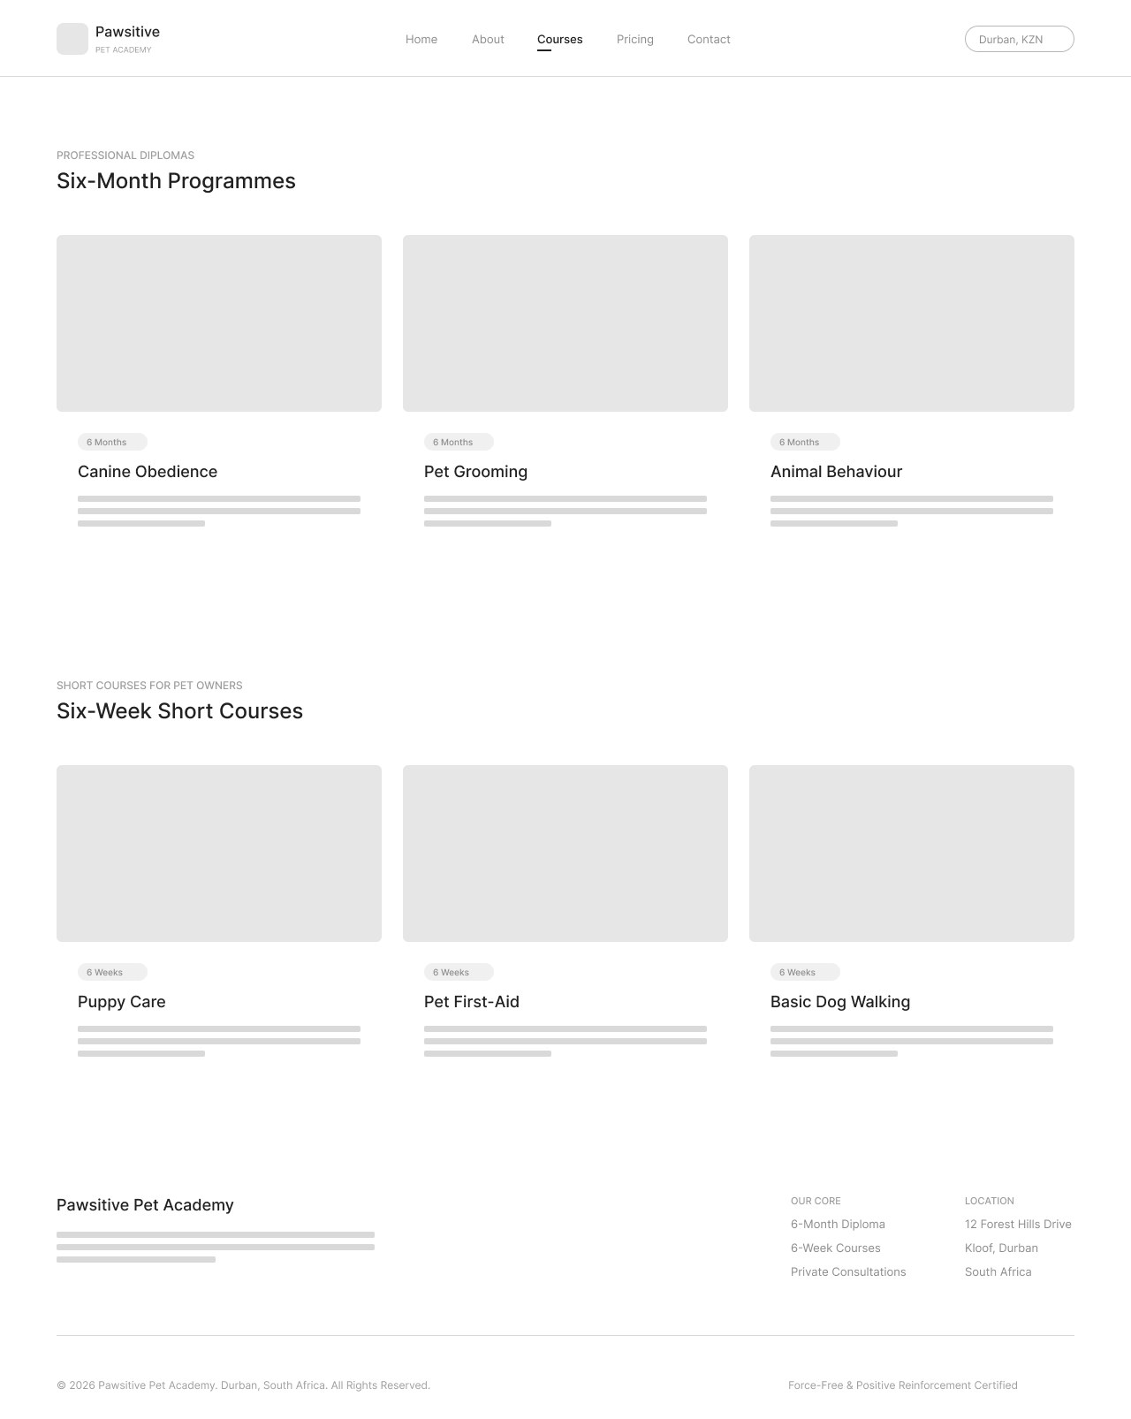
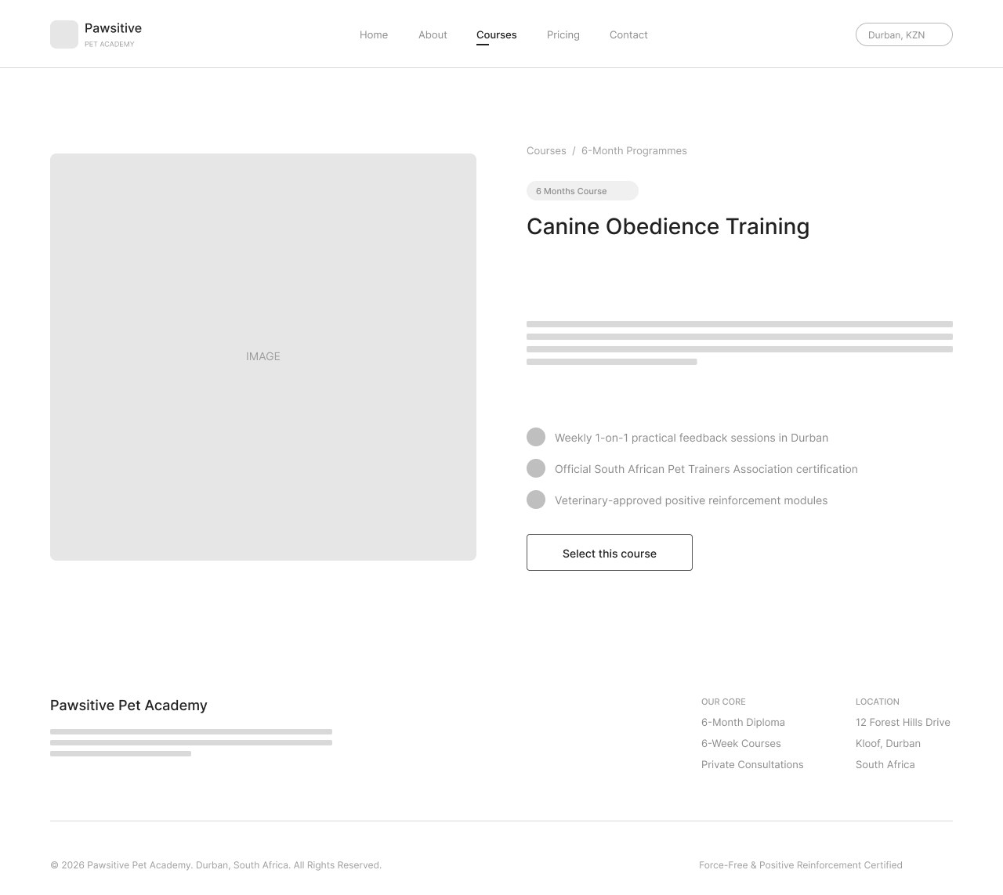
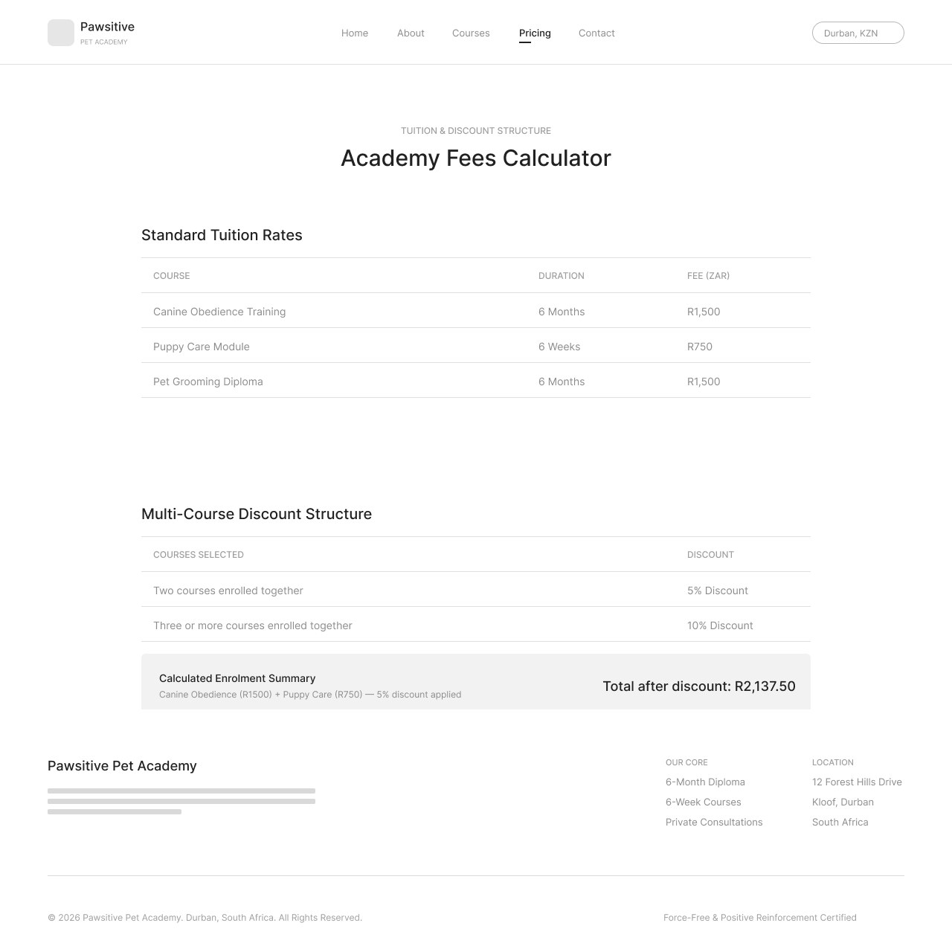
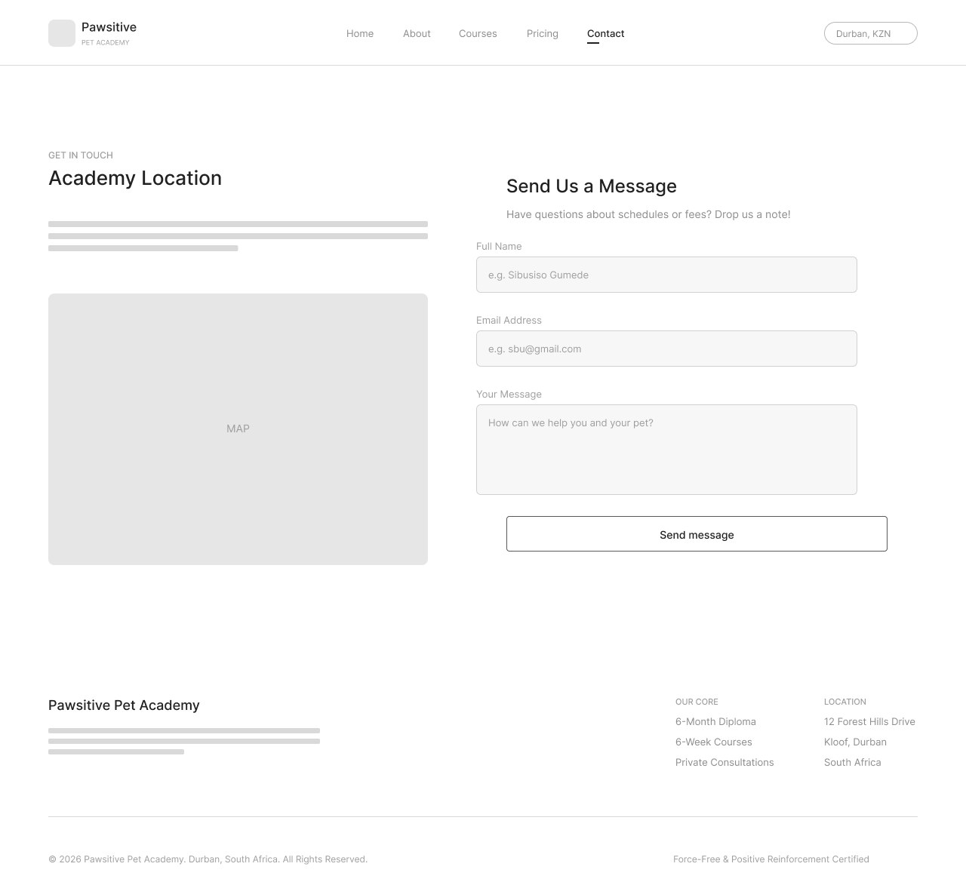
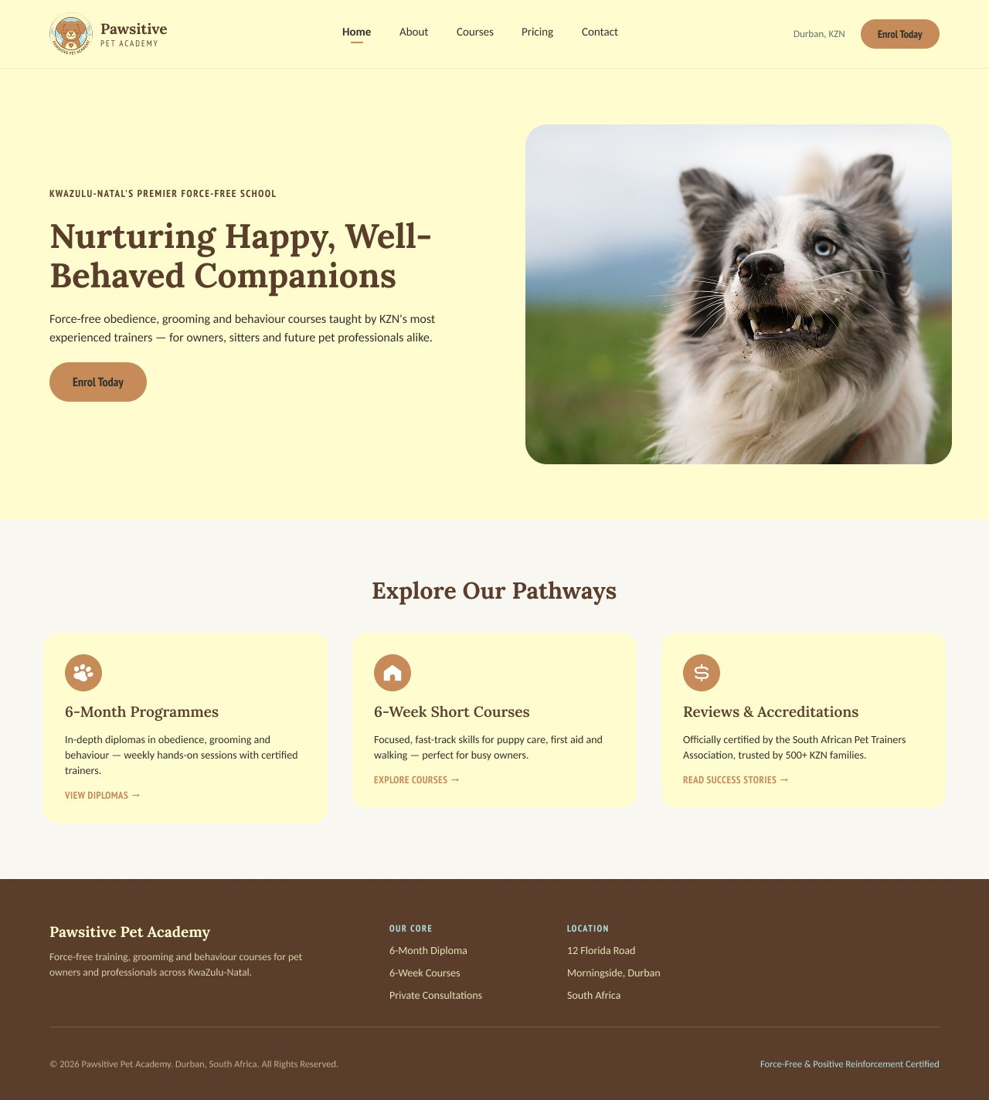
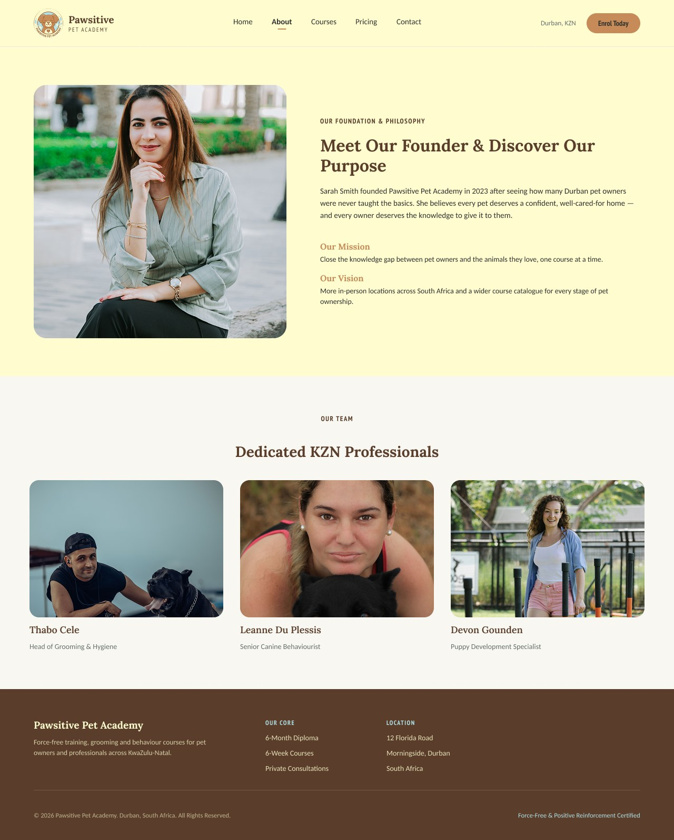
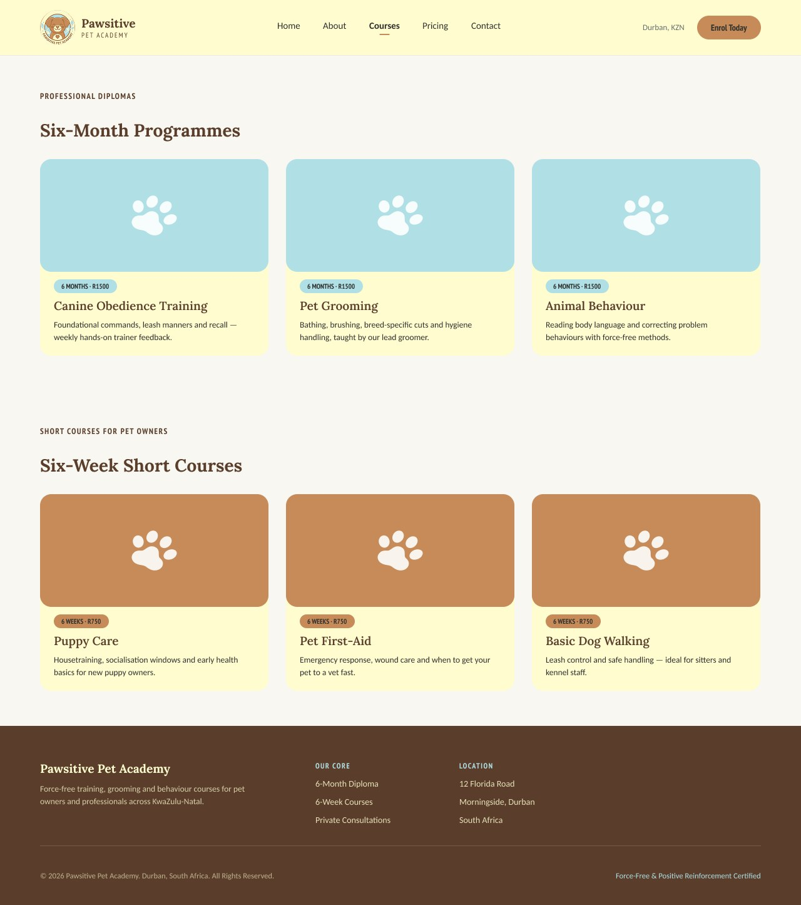
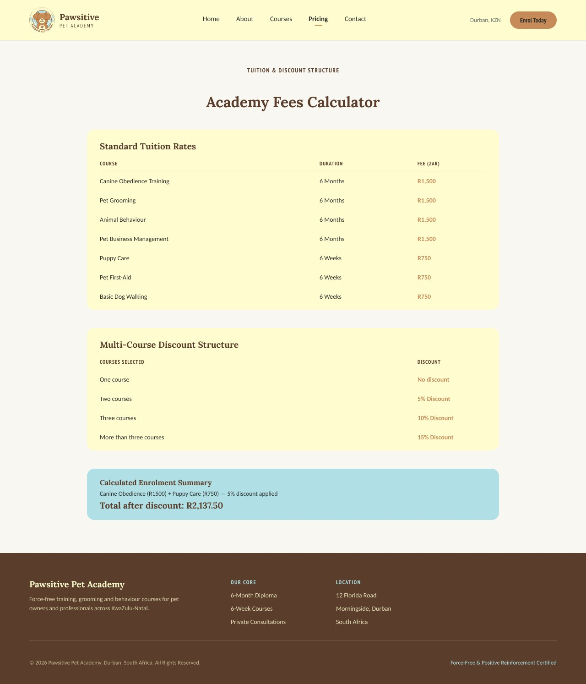
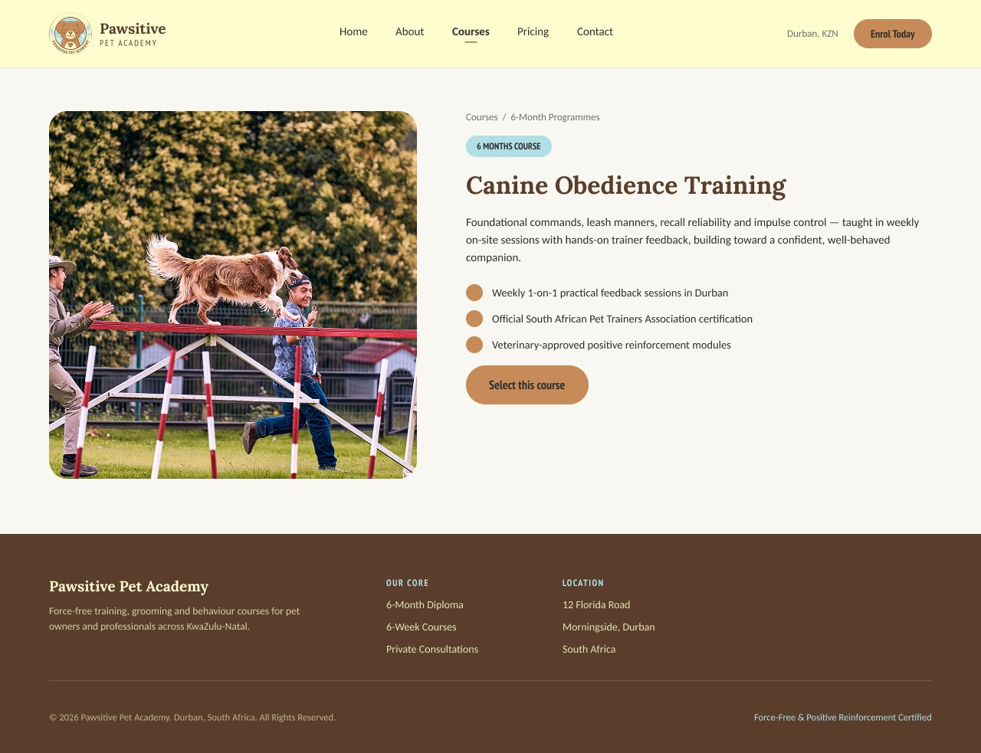
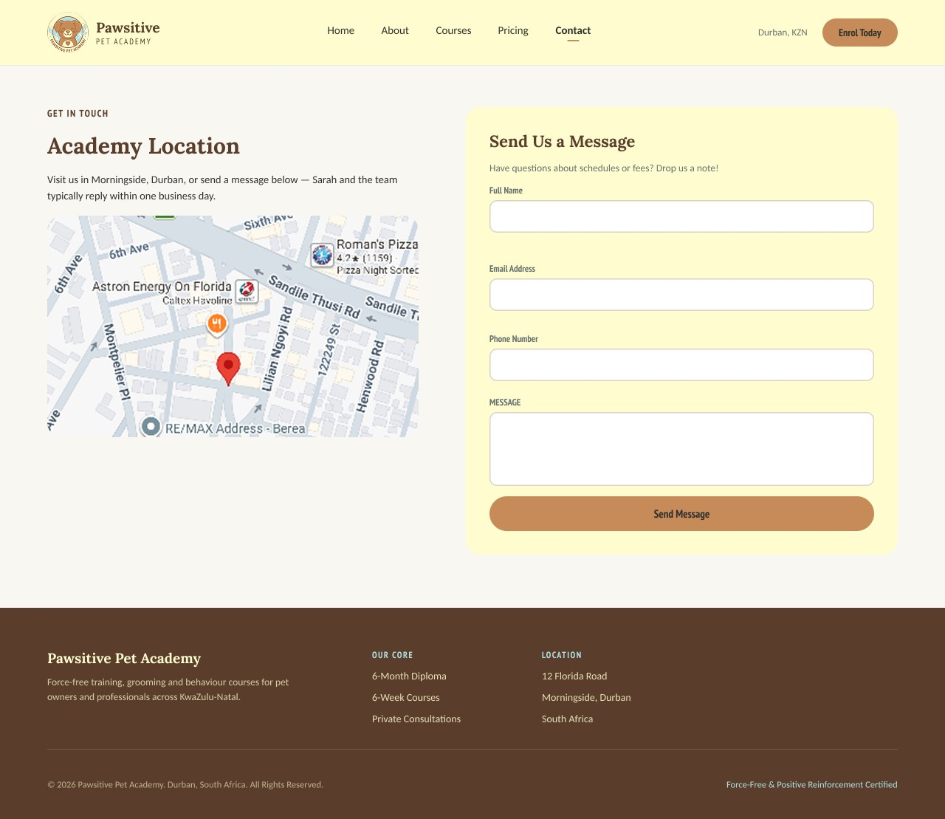
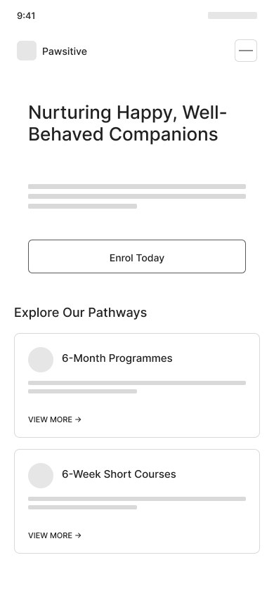
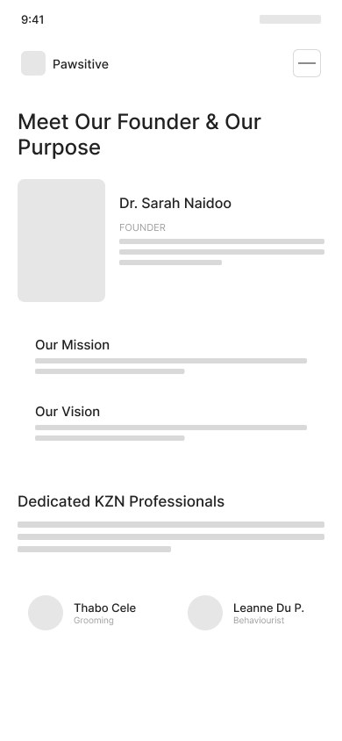
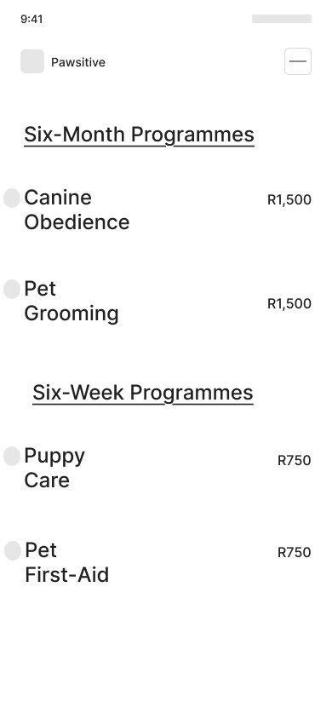
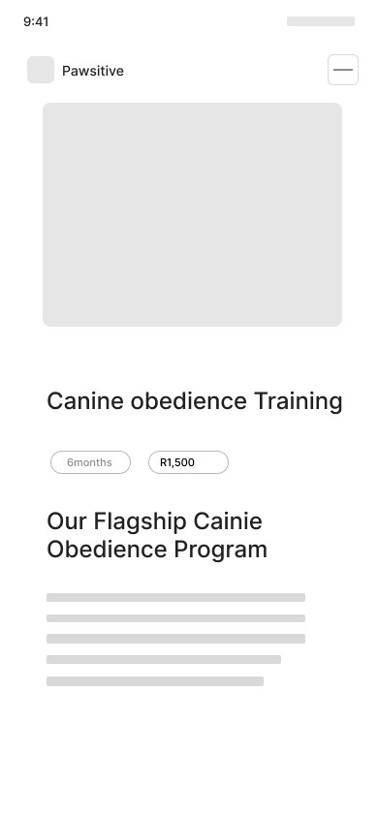
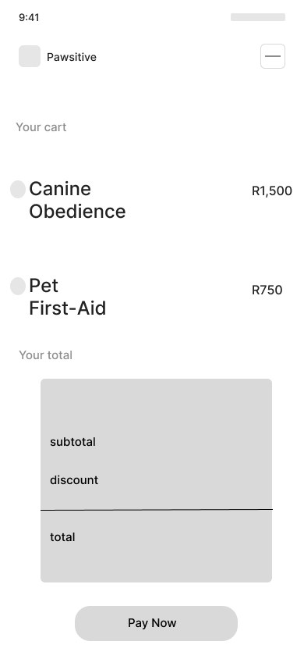
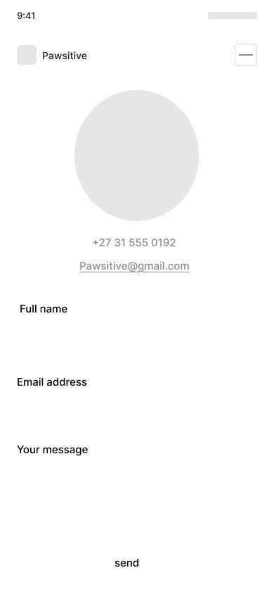
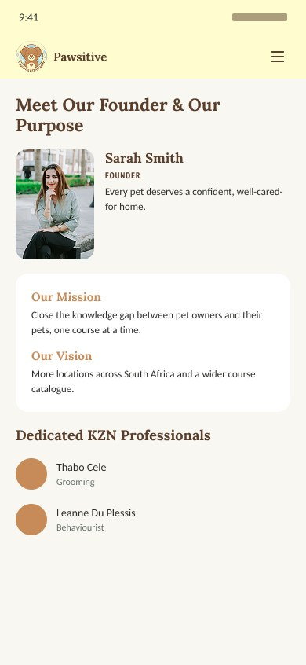
Presenter: Mohamed
Wireframes: low-fidelity to high-fidelity
12 low-fidelity screens, then 6 desktop and 7 mobile high-fidelity screens, all in Figma
Low-fidelity (12)
High-fidelity (6 + 7)
Low-fi: grey boxes, layout and flow only. No colour, no photos.
High-fi: real palette, fonts, photos and content.
Top row: website screens. Bottom row: mobile screens.
Notes:
Low-fi was built in Figma in August: 6 web and 6 mobile screens, boxes and layout only, to agree on structure before colour. High-fi came in September: 6 desktop and 7 mobile screens (the mobile set adds the splash screen) with the real palette, fonts, photos and copy. Next slides show two before-and-after examples.

Slide 18
Presenter: Mohamed
Before and after: Fees Calculator (website)
Same layout, now with brand colour, real prices and a clear total
Low-fi
High-fi
Low-fi placed a rates table and a discount table. High-fi adds the cream/blue/tan palette, the tan call-to-action and a highlighted enrolment summary.
Notes:
Before: grey placeholder boxes, just a rates table, the discount structure and a summary line. After: the same structure with the real palette, a powder blue summary box for the total, and tan for the action. The structure survived because it worked.

Slide 19
Presenter: Mohamed
Before and after: Fees Calculator (mobile)
Low-fi, then high-fi, and what changed in the finished app
What changed in the build
• All 7 courses are listed with a checkbox each
• A 5%, 10% or 15% discount appears automatically
• 15% VAT is added after the discount (the mockup did not show it)
• Navigation became a bottom bar: Home, Courses, Fees, Contact
Low-fi
High-fi
Notes:
Low-fi was a cart and a grey summary. High-fi added colour and a clean summary card. The Figma screens were a guide, not an exact copy: the finished Android app lists all seven courses, adds 15% VAT after the discount and uses a bottom navigation bar.

Slide 20
Presenter: Mohamed
Design choices: colour and type
Soft, warm and easy on the eyes, on the website and in the app
Cream
Powder Blue
Tan
Fonts
#FFFDD0
#B0E0E6
#C68B59
Headings
Book Antiqua
Main backgrounds. Soft and warm.
Cards and sections that group information.
Actions only: buttons, borders, highlights.
Subheadings
Arial Narrow
Body text
Calibri
Tan is kept for things people click, so the eye goes straight to the next step. Cream and blue carry everything else.
Serif headings feel warm; clean body text stays easy to read.
Notes:
Palette: cream for backgrounds, powder blue for grouping information, tan only for actions. That keeps the site and the app consistent and easy to scan. Fonts: Book Antiqua for headings, Arial Narrow for subheadings, Calibri for body text. In Figma the brand fonts were not available so I used close substitutes in the high-fi screens.

Slide 21
Presenter: Mohamed
Why the app uses bottom tabs
A phone is a thumb device, so the main places stay one tap away
• Four main places always visible: Home, Courses, Fees, Contact
• Easy to reach with one thumb, unlike a menu at the top
• Hidden menus (hamburger) get used less; visible tabs get used more
• The website keeps a top bar instead. Different screen, different pattern
• Less-used pages (About Us, Pricing) sit in a top menu
App bottom bar
Fees and Contact are the two pages people want most, so they are in the bar, not behind a menu.
Home
Courses
Fees
Contact
Notes:
Research from Nielsen Norman Group says tab bars are one of the most reliable mobile patterns because key destinations stay visible, and hiding navigation behind a hamburger reduces use. On the web we use a persistent top bar; on mobile we switched to bottom tabs. The final app has Home, Courses, Fees and Contact in the bar, with About Us and Pricing in a top menu.

Slide 22
Presenter: Mohamed
My pages: Fees Calculator
On the website and in the app
How it works
• Tick the courses you want
• Subtotal, discount, VAT and total update at once
• Request a quote when ready
Website (left) and Android app (right). Same prices and rules on both, so a quote is identical on either platform.
Notes:
Same logic on both platforms. Web is HTML, CSS and JavaScript; the app is Kotlin on Android. A user ticks courses and the maths updates immediately. 6-month courses are R1,500 and 6-week courses are R750.

Slide 23
Presenter: Mohamed
My pages: Contact Us
Everything a customer needs to reach Sarah and the team
On both platforms
• Phone, email and address (12 Florida Road, Morningside, Durban)
• Office hours: Mon to Fri, 08:00 to 17:00
• Social media links
• A map with directions
• A message form (name, email, message)
Notes:
Contact Us gives phone, email, the Morningside address, office hours Monday to Friday 08:00 to 17:00, social media, a map with a Get directions link, and a short message form that confirms when it is sent. The app has the same details with directions.

Slide 24
Presenter: Mohamed
Discount tiers, then VAT
VAT is added after the discount, so customers are taxed on what they actually pay
Courses chosen
Discount
The order of steps
1 course
0%
1
Add up the course prices
subtotal
2 courses
5%
2
Apply the discount tier
3 courses
10%
subtotal x rate
3
Add 15% VAT on what is left
4 or more
15%
(subtotal - discount) x 15%
Prices: 6-month course R1,500
6-week course R750 | VAT: 15%
4
Total
subtotal - discount + VAT
Notes:
Rules: one course gets no discount, two courses 5%, three courses 10%, four or more 15%. The discount comes off the subtotal first, then VAT of 15% is added to the discounted amount. Why that order? VAT is charged on the price the customer actually pays, so the invoice shows VAT on the discounted amount (R573.75), not on the R4,500 list price (which would be R675).

Slide 25
Presenter: Mohamed
Worked example: 4 courses
The numbers you will see in the demo
Canine Obedience Training (6 months)
R1,500.00
Check it
Pet Grooming (6 months)
R1,500.00
4 x courses picks the 15% tier.
R4,500 x 0.15 = R675 off.
R3,825 x 0.15 = R573.75 VAT.
R3,825 + R573.75 = R4,398.75.
VAT is worked out on the R3,825 the customer actually pays, not on the R4,500 list price.
Puppy Care (6 weeks)
R750.00
Pet First Aid (6 weeks)
R750.00
Subtotal
R4,500.00
Discount (15%)
-R675.00
After discount
R3,825.00
VAT (15%)
R573.75
Total
R4,398.75
Notes:
This is the example I'll run live: Canine Obedience, Pet Grooming, Puppy Care and Pet First Aid. Subtotal R4,500. At four courses the discount is 15%, which is R675. That leaves R3,825. VAT at 15% on that is R573.75. Total R4,398.75.

Slide 26
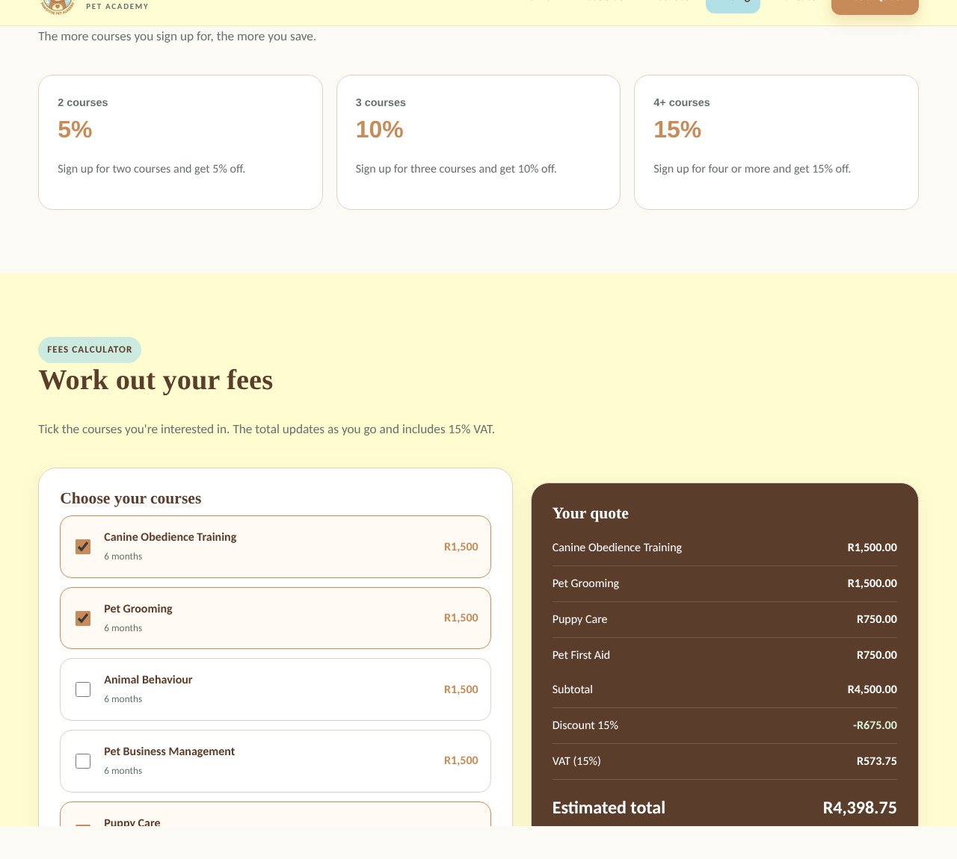
Presenter: Mohamed
The finished Fees Calculator
Real screenshot from the website with the 4 courses ticked
What to notice
• Ticked courses are highlighted
• Discount label shows 15%
• VAT is a separate line
• Total updates as you tick
• A note says Sarah emails the official quote
Notes:
This is the real website. After ticking four courses the discount label says 15%, the discount is R675, VAT is R573.75 and the estimated total is R4,398.75. The page notes that it is an estimate and Sarah emails the official quote.

Slide 27
Presenter: Mohamed
Git workflow: branches, Pull Requests, reviews
I set this up for the group on both repositories
Pull main
Branch
Commit + push
Pull Request
Review + merge
Start from the latest code
→
One branch per person, e.g. MoZa-Website
→
Save small changes to your own branch
→
Ask to merge into main
→
Someone else checks it, then merges
• Why: nobody works straight on main, so nobody can break the shared code by accident
• Reviews catch mistakes and keep everyone on the same page about what changed
• I wrote the step-by-step guide and recorded a video walkthrough for the group
Notes:
Everyone works on their own branch (I made MoZa-Website and MoZa-mobile on 21 September). You pull main first, make a branch, commit, push, then open a Pull Request. Someone else reviews it and merges it. I explained this to the group, wrote a guide, and recorded a screen video for a teammate who found the written steps hard. Honest lesson: early on I merged one of my own pull requests before it was reviewed, and that is why we agreed to always have someone else review and merge.

Slide 28
Presenter: Mohamed
A real example: Pull Request #7
Kelebogile's CSS became the first main.css in the website repo
What happened
Branch
kele-css
• I walked Kelebogile through it on a call: pull main, branch, commit, push
• She opened the Pull Request with her shared base CSS plus her summary and detail page styles
• I reviewed it and merged it into main
• Theolin and I then pushed ours the same way
Commit
634eacd
Merged as
2aea869
Opened by
Kelebogile
Reviewed and merged by
Mohamed
Date
22 October 2026
Notes:
PR #7 is a clean example of the whole workflow. Kelebogile pushed her branch kele-css, opened Pull Request #7 with her CSS (a shared base plus her summary page and detail page styles), and I reviewed and merged it on 22 October. It became the first main.css in the repository, and the other members added theirs after it.

Slide 29
Presenter: All
Live demo: Fees Calculator
Pick 4 courses, then show 15% off and VAT
1
Open the Fees Calculator
Numbers to have ready
Website: Pricing / Fees page. Everything starts at R0.00
2
Tick 4 courses
Subtotal R4,500.00
Discount 15% -R675.00
VAT R573.75
Total R4,398.75
3 courses (R3,750) would be 10%: total R3,881.25
Canine Obedience, Pet Grooming, Puppy Care, Pet First Aid
3
Point at the discount
Label changes to Discount 15%. Show -R675.00
4
Point at VAT
R573.75, charged after the discount
5
Read the total
R4,398.75
6
Untick one course
Discount drops to 10%. Shows the tiers live
Notes:
Rehearse this twice before presenting. Tick Canine Obedience, Pet Grooming, Puppy Care and Pet First Aid. Subtotal R4,500, discount 15% = R675, VAT R573.75, total R4,398.75. Then untick one course and show the discount fall to 10%. If the live site fails, use the app version or the slide with the worked numbers as a backup. Tip: on the website a course page link such as calculator page with #puppy in the address pre-ticks that course.

Slide 30
Thank you
Questions?
Meridian Tech Group | Pawsitive Pet Academy
Notes:
Thank you for listening. Happy to take questions.

Slide 31

WATCH THE FULL DEMO
Scan to watch our video
XHAW5112 Phase 2 | Group 4
Pawsitive Pet Academy Website & App Demo
youtu.be/iXkaTIPUEzo
Point your phone camera here
Notes:
Scan the QR code to watch the full recorded demo of our website and app on YouTube (unlisted): https://youtu.be/iXkaTIPUEzo

