Slide 1
Introduction

Slide 2
About me
Course Instructors
Mr. Abdul Qadeer Bilal
Ms. Ayesha Inam

Slide 3
Teacher Info.
Name: Abdul Qadeer Bilal
E-mail: a.qadeer@nu.edu.pk
Office #: 2nd Floor. #213
Visiting Hours: (Please Follow it Strictly)
Day | Time
Monday | 10:30 AM to 12:00 PM
Tuesday | 01:30 PM to 03:00 PM
Thursday | 10:30 AM to 12:00 PM

Slide 4
Course Info.
Code: EE-213
Credit Hours: 3+1
Two lectures per week each of duration 1.5 hour
Lab class each week

Slide 5
Text Books
Text Books
Assembly Language for x86 Processors
by Kip R. Irvine
6th Edition

Slide 6
Grading Policy
Class
Assignments | 5%
Quizzes | 15%
Midterm Exams | (15+15)%
Class Participation | 5%
Final Exam | 45%
Total | 100%

Slide 7
Grading Policy
All deadlines will be hard
Re-grading can be requested after grade reporting, within following time limits:
Midterm: Same day
Assignments: 2 working days
Quizzes: 2 working days
Everything will be final on 3rd day

Slide 8
General Guidelines
Start work on project/assignment right from the first day
No assignment will be accepted after due date
Assignments copied from others will be marked zero
No excuse will be accepted for a missed assignment or quiz
Unannounced quizzes, so come prepared in the class

Slide 9
Lecture 01
Week 01

Slide 10
Chapter Overview
Welcome to Assembly Language
Virtual Machine Concept
Data Representation
Boolean Operations

Slide 11
Welcome to Assembly Language
Some Good Questions to Ask
Assembly Language Applications

Slide 12
Questions to Ask
Why am I learning Assembly Language?
What background should I have?
What is an assembler?
What hardware/software do I need?
What types of programs will I create?
What do I get with this book?
What will I learn?

Slide 13
Welcome to Assembly Language (cont)
How does assembly language (AL) relate to machine language?
How do C++ and Java relate to AL?
Is AL portable?
Why learn AL?

Slide 14
Hierarchy of Computer Languages
Pascal
C
Fortran
High Level Languages
Assembly Language
Machine Language
Hardware

Slide 15
Assembly Language Applications
Some representative types of applications:
Business application for single platform
Hardware device driver
Business application for multiple platforms
Embedded systems & computer games

Slide 16
High Level Language
Called High Level because closer to human language and farther from machine language
Independent of a particular type of processor
Easier to read, write and understand because uses natural language elements
Hides implementation details
Must be translated to machine language

Slide 17
Assembly Language
Low level programming language
Used to interact with computer hardware
Specific to a particular computer architecture
The instructions in assembly language may directly match the computer’s architecture or they may be translated during execution by a program inside the processor known as a microcode interpreter
Focuses on programming microprocessors
Used to program
Embedded system
Device driver programming
Computer viruses and bootloaders

Slide 18
Machine Language
Lowest level programming language
Sequence of 1s and 0s
Easily understood by computers
Almost impossible for humans to use
Each CPU has its own unique machine language
Notes:
Processors are based on transistors which have just two states, on and off. On state can be represented by 1 and off state can be represented by 0. So basically computers can understand just 1 and 0. The language that we can use to interact with hardware on very low level is called Machine Language.

Slide 19
Conversion from High Level (HL) to Low Level (LL) Language
From Assembly to Machine Language
Assembler is used
From High Level to Machine Level Language
Compiler converts High Level Language to Object Code
Assembler is used to convert Assembly Language code to Machine Code

Slide 20
Compiler and Assembler
High Level Language
Compiler
Compiler
Assembly Language
Assembler
Machine Language

Slide 21
Assembly Language Portability
Can be compiled and run on a wide variety of computers
Assembly is designed for a specific processor family
Motorola 68x00, x86, SUN Sparc, Vax, IBM-370 are different processor architectures

Slide 22
Conversion from HL to LL Language
Natural Language: Add 5 into 3 and store the result into X
High Level Language: int X = 5 + 3;
Assembly Language:
mov ax, 5
mov bx, 3
add ax, bx
mov X, ax

Slide 23
Advantages of HL Languages
Program development is faster
High level statements: fewer instructions to code
Program maintenance is easier
For the same above reasons
Programs are portable
Contains less machine dependent details
Can be used with little or no modifications on different machines
Compiler translates to the target machine language

Slide 24
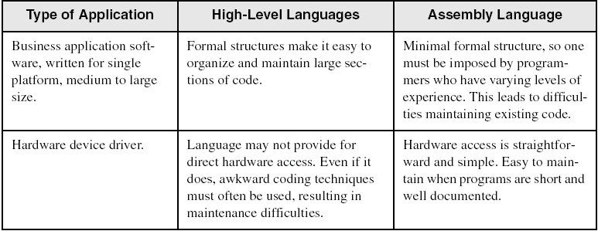
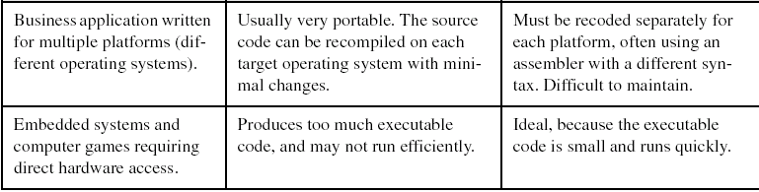
Comparing ASM to High-Level Languages

Slide 25
What's Next
Welcome to Assembly Language
Virtual Machine Concept
Data Representation
Boolean Operations

Slide 26
Virtual Machine Concept
Virtual Machines
Specific Machine Levels

Slide 27
Virtual Machines
Tanenbaum: Virtual machine concept
Programming Language analogy:
Each computer has a native machine language (language L0) that runs directly on its hardware
A more human-friendly language is usually constructed above machine language, called Language L1
Programs written in L1 can run two different ways:
Interpretation – L0 program interprets and executes L1 instructions one by one
Translation – L1 program is completely translated into an L0 program, which then runs on the computer hardware

Slide 28
Translating Languages
English: Display the sum of A times B plus C.
C++: cout << (A * B + C);
Assembly Language:
mov eax,A
mul B
add eax,C
call WriteInt
Intel Machine Language:
A1 00000000
F7 25 00000004
03 05 00000008
E8 00500000

Slide 29
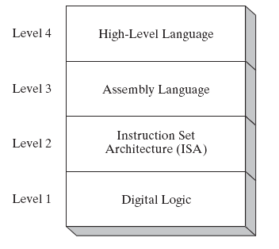
Specific Machine Levels
(descriptions of individual levels follow . . . )

Slide 30
High-Level Language
Level 4
Application-oriented languages
C++, Java, Pascal, Visual Basic . . .
Programs compile into assembly language (Level 4)

Slide 31
Assembly Language
Level 3
Instruction mnemonics that have a one-to-one correspondence to machine language
Programs are translated into Instruction Set Architecture Level - machine language (Level 2)

Slide 32
Instruction Set Architecture (ISA)
Level 2
Also known as conventional machine language
Executed by Level 1 (Digital Logic)

Slide 33
Digital Logic
Level 1
CPU, constructed from digital logic gates
System bus
Memory
Implemented using bipolar transistors
next: Data Representation

Slide 34
What's Next
Welcome to Assembly Language
Virtual Machine Concept
Data Representation
Boolean Operations

Slide 35
Data Representation
Binary Numbers
Translating between binary and decimal
Binary Addition
Integer Storage Sizes
Hexadecimal Integers
Translating between decimal and hexadecimal
Hexadecimal subtraction
Signed Integers
Binary subtraction
Character Storage

Slide 36
Data Representation
Four basic data representation techniques
Binary (base 2)
Octal (base 8)
Decimal (base 10)
Hexadecimal (base 16)
System | Base | Possible Digits
Binary | 2 | 0 1
Octal | 8 | 0 1 2 3 4 5 6 7
Decimal | 10 | 0 1 2 3 4 5 6 7 8 9
Hexadecimal | 16 | 0 1 2 3 4 5 6 7 8 9 A B C D E F

Slide 37
Binary Numbers
Digits are 1 and 0
1 = true
0 = false
MSB – most significant bit
LSB – least significant bit
Bit numbering:

Slide 38
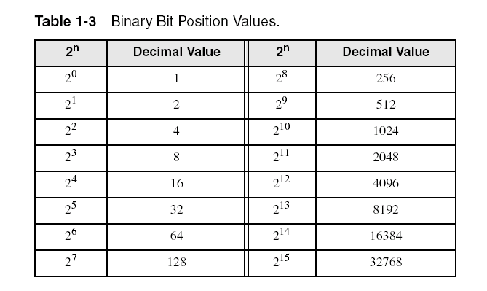
Binary Numbers
Each digit (bit) is either 1 or 0
Each bit represents a power of 2:
Every binary number is a sum of powers of 2

Slide 39
Translating Binary to Decimal
Weighted positional notation shows how to calculate the decimal value of each binary bit:
dec = (D_{n-1} × 2^{n-1}) + (D_{n-2} × 2^{n-2}) + ... + (D₁ × 2¹) + (D₀ × 2⁰)
D = binary digit
binary 00001001 = decimal 9:
(1 × 2³) + (1 × 2⁰) = 9

Slide 40
Binary to Decimal (1/2)
Dec = (D_{n-1} x 2^{n-1}) + (D_{n-2} x 2^{n-2}) + . . . + (D₁ x 2¹) + (D₀ x 2⁰)
Weighted Positional Notation method
D = binary digit
n = bit position number in binary number

Slide 41
Binary to Decimal (2/2)
0 1 1 1₂
4-bit number so n = 4
D₀ = 1
D₁ = 1
D₂ = 1
D₃ = 0
Dec = (D_{n-1} x 2^{n-1}) + (D_{n-2} x 2^{n-2}) + . . . + (D₁ x 2¹) + (D₀ x 2⁰)
= (D₄₋₁ x 2⁴⁻¹) + (D₄₋₂ x 2⁴⁻²) + . . . + (D₁ x 2¹) + (D₀ x 2⁰)
= (D₃ x 2³) + (D₂ x 2²) + . . . + (D₁ x 2¹) + (D₀ x 2⁰)
= (0 x 2³) + (1 x 2²) + (1 x 2¹) + (1 x 2⁰)
=
7

Slide 42
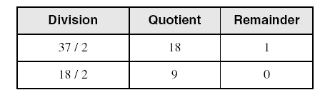
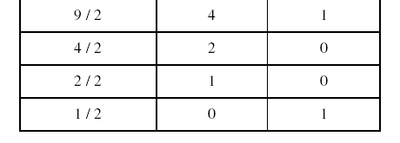
Translating Unsigned Decimal to Binary
Repeatedly divide the decimal integer by 2. Each remainder is a binary digit in the translated value:
37 = 100101

Slide 43
Decimal to Binary (2/2)
Convert 25₁₀ into binary
First remainder goes to LSB position
Division | Quotient | Remainder
25 / 2 | 12 | 1
12 / 2 | 6 | 0
6 / 2 | 3 | 0
3 / 2 | 1 | 1
1 / 2 | 0 | 1
1 1 0 0 1₂
Final result is 0001 1001
When quotient is 0, remainder goes at MSB position

Slide 44
Binary Addition
Starting with the LSB, add each pair of digits, include the carry if present.

Slide 45
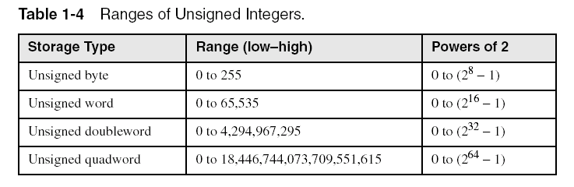
Integer Storage Sizes
Standard sizes:
What is the largest unsigned integer that may be stored in 20 bits?

Slide 46
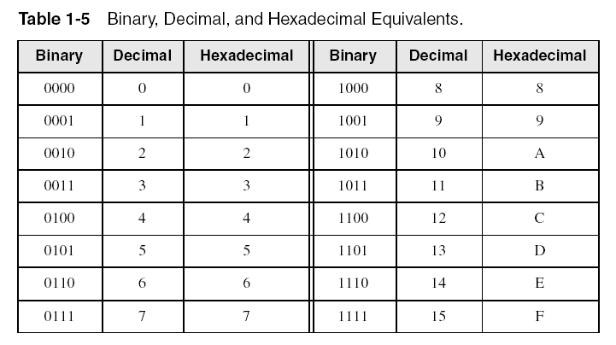
Hexadecimal Integers
Binary values are represented in hexadecimal.

Slide 47
Hexadecimal to Binary
Each hexadecimal integer corresponds to 4 binary bits
Convert each hexadecimal number to corresponding binary number
4 | F | 9 | 1
0100
1111
1001
0001
0 | 1 | 0 | 0 | 1 | 1 | 1 | 1 | 1 | 0 | 0 | 1 | 0 | 0 | 0 | 1

Slide 48

Translating Binary to Hexadecimal
Each hexadecimal digit corresponds to 4 binary bits.
Example: Translate the binary integer 000101101010011110010100 to hexadecimal:

Slide 49
Binary to Hexadecimal
Convert each 4 bits of binary into its corresponding hexadecimal
0 | 1 | 0 | 0 | 1 | 1 | 1 | 1 | 1 | 0 | 0 | 1 | 0 | 0 | 0 | 1
4
F
9
1
4 | F | 9 | 1

Slide 50
Lecture 02
Week 01

Slide 51
THANKS!
Any questions?
You can find me at:
A.qadeer@nu.edu.pk
Office #213, Visiting Hours Only

Slide 52
Converting Hexadecimal to Decimal
Multiply each digit by its corresponding power of 16:
dec = (D₃ × 16³) + (D₂ × 16²) + (D₁ × 16¹) + (D₀ × 16⁰)
Hex 1234 equals (1 × 16³) + (2 × 16²) + (3 × 16¹) + (4 × 16⁰), or decimal 4,660.
Hex 3BA4 equals (3 × 16³) + (11 * 16²) + (10 × 16¹) + (4 × 16⁰), or decimal 15,268.

Slide 53
Hexadecimal to Decimal (2/2)
3 B A 4
4-digit number so n = 4
D₀ = 4
D₁ = A
D₂ = B
D₃ = 3
= (D₄₋₁ x 16⁴⁻¹) + (D₄₋₂ x 16⁴⁻²) + (D₁ x 16¹) + (D₀ x 16⁰)
= (D₃ x 16³) + (D₂ x 16²) + (D₁ x 16¹) + (D₀ x 16⁰)
= (3 x 4096) + (11 x 256) + (10 x 16) + (4 x 1)
= (12288 + 2816 + 160 + 4) = 15268

Slide 54
Decimal to Hexadecimal (1/2)
Repeatedly divide the decimal integer by 16 until last quotient is 0
Each remainder is a hex digit
First remainder goes at least significant position and last remainder goes at most significant position

Slide 55
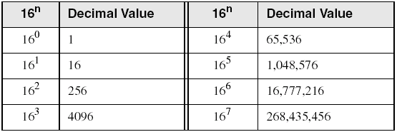
Powers of 16
Used when calculating hexadecimal values up to 8 digits long:

Slide 56
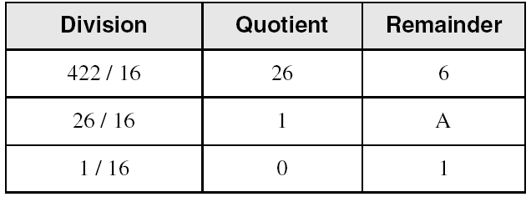
Converting Decimal to Hexadecimal
decimal 422 = 1A6 hexadecimal

Slide 57
Decimal to Hexadecimal (2/2)
Convert 2895₁₀ into hexadecimal
First remainder goes to LS position
Division | Quotient | Remainder
2895 / 16 | 180 | F
180 / 16 | 11 | 4
11 / 16 | 0 | B
When quotient is 0, remainder goes at MS position
B 4 F ₁₆
So 2895₁₀ = B 4 F₁₆

Slide 58
Hexadecimal Addition
Divide the sum of two digits by the number base (16). The quotient becomes the carry value, and the remainder is the sum digit.
1
1
36 28 28 6A
42 45 58 4B
78 6D 80 B5
21 / 16 = 1, rem 5
Important skill: Programmers frequently add and subtract the addresses of variables and instructions.

Slide 59
Hexadecimal Subtraction
When a borrow is required from the digit to the left, add 16 (decimal) to the current digit's value:
16 + 5 = 21
−1
C6 75
A2 47
24 2E.
Practice: The address of var1 is 00400020. The address of the next variable after var1 is 0040006A. How many bytes are used by var1?

Slide 60
Signed Integers
The highest bit indicates the sign. 1 = negative, 0 = positive
If the highest digit of a hexadecimal integer is > 7, the value is negative. Examples: 8A, C5, A2, 9D

Slide 61
Signed Integers
Signed integers are either positive or negative
Not possible to stick negative sign to a number in binary numbers
When explicitly mentioned as signed integer, then MSB decides the +ve and –ve sign
In signed binary/octal/hex integers
MSB = 1 → integers is negative
MSB = 0 → integers is positive
Negative integers are represented using 2’s complement notation

Slide 62
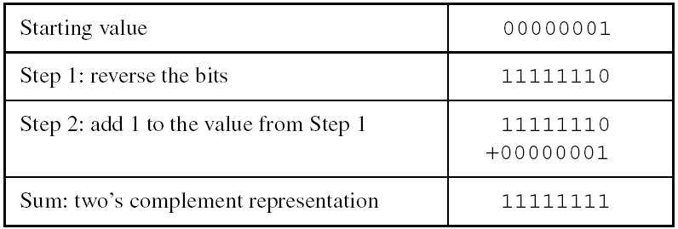
Forming the Two's Complement
Negative numbers are stored in two's complement notation
Represents the additive Inverse
Note that 00000001 + 11111111 = 00000000

Slide 63
Binary Subtraction
When subtracting A – B, convert B to its two's complement
Add A to (–B)
0 0 0 0 1 1 0 0 0 0 0 0 1 1 0 0
– 0 0 0 0 0 0 1 1 1 1 1 1 1 1 1 0 1
0 0 0 0 1 0 0 1
Practice: Subtract 0101 from 1001.

Slide 64
Learn How To Do the Following:
Form the two's complement of a hexadecimal integer
Convert signed binary to decimal
Convert signed decimal to binary
Convert signed decimal to hexadecimal
Convert signed hexadecimal to decimal

Slide 65
Range of Signed Numbers
A certain number of bits can store only a fixed number of signed integers
Bits | Range | Total Numbers
8 | -128 to +127 | 256
16 | -32768 to +32767 | 65,536
32 | -2,147,483,648 to +2,147,483,647 | 4,294,967,296
64 | -9,223,372,036,854,775,808 to +9,223,372,036,854,775,807 | 18,446,744,073,709,551,616

Slide 66
Range of Unsigned Numbers
Total numbers in signed integers is exactly equal to the total numbers in unsigned integers in the same size of bits
Bits | Range | Total Unsigned Numbers
8 | 0 to 255 | 256
16 | 0 to 65,535 | 65,536
32 | 0 to 4,294,967,295 | 4,294,967,296
64 | 0 to 18,446,744,073,709,551,615 | 18,446,744,073,709,551,616

Slide 67
2’s Complement Notation
Useful for processors to perform subtraction with addition operation
A fixed number of bits are used to represent the numbers
The leftmost bit is called sign bit
2’s complement notation is used to represent both +ve and –ve numbers

Slide 68
How to calculate 2’s complement
How to get 2’s complement of a binary number?
Take 1’s complement of that number(invert all its bits)
Add 1 into the inverted binary number
... and the result is 2’s complement of that number
1 | 0 | 0 | 1 | 0 | 1 | 1 | 0
0 | 1 | 1 | 0 | 1 | 0 | 0 | 1
+
0 | 0 | 0 | 0 | 0 | 0 | 0 | 1
0 | 1 | 1 | 0 | 1 | 0 | 1 | 0

Slide 69
2’s Complement of Hexadecimal
Invert all bits of hex number
All bits of hex numbers can be inverted simply by subtracting the number from F₁₆
Add 1 into the inverted hex number and the result is the 2’s complement
Calculate 2’s complement of (B 4 F)₁₆
F F F
4 B 0
B 4 F
4 B 0
–
+
1
4 B 0
4 B 1

Slide 70
Converting Signed Binary to Decimal
If MSB is 0, then number is +ve and convert it into decimal in usual way
If MSB is 1, then the number is in 2’s complement notation and follow these steps
Calculate its 2’s complement again
Convert this new number into decimal and add a –ve sign with it
As the number was negative
So in decimal it is
2’s comp.
1 | 0 | 0 | 1 | 0 | 1 | 1 | 0
0 | 1 | 1 | 0 | 1 | 0 | 1 | 0
Decimal
1 0 6
– 1 0 6

Slide 71
Converting Signed Decimal to Binary
Convert absolute value of decimal into binary
If original decimal number is –ve, calculate 2’s complement of the binary number
Convert -35 to binary
– 35
Absolute Value
35
Binary
0010 0011
Invert
0 | 0 | 1 | 0 | 0 | 0 | 1 | 1
1 | 1 | 0 | 1 | 1 | 1 | 0 | 0
+
0 | 0 | 0 | 0 | 0 | 0 | 0 | 1
1 | 1 | 0 | 1 | 1 | 1 | 0 | 1
– 35 = (1101 1101)₂

Slide 72
Convert Signed Decimal to Hexadecimal
Convert absolute value of decimal to hex
If decimal integer is –ve, create 2’s complement of hexadecimal integer
Convert -2895 to hexadecimal
– 2895
Absolute Value
2895
Hexadecimal
B 4 F
B 4 F
Bit Inversion
4 B 0
Add 1
4 B 1
2’s Complement

Slide 73
Converting Signed Hex to Decimal (1/3)
In signed hex number, if MSB=1, the number is –ve
To convert it into decimal, follow these steps
Create its 2’s complement
Convert the 2’s complemented hex to decimal
Attach –ve sign to the decimal number

Slide 74
Converting Signed Hex to Decimal (2/3)
Determine if Signed 8C₁₆ is +ve or –ve
By converting into binary
If MSB = 1, then number is –ve
8C₁₆ = (1000 1100)₂
Since MSB = 1, so 8C₁₆ is –ve
Another method
If leftmost digit > 7, then number is –ve
Since leftmost digit i.e. 8 > 7
8C₁₆ is –ve

Slide 75
Converting Signed Hex to Decimal (3/3)
Convert Signed A3₁₆ into decimal
A 3
A > 7 => A3 is –ve
2’s complement of A3 = 5D

Slide 76
Binary Subtraction
Big advantage of signed number is to use same circuit for addition and subtraction
To perform A – B
Calculate –B by taking 2’s complement of B
Perform A+(-B)
0 | 1 | 1 | 1 | 0 | 1 | 1 | 0
0 | 1 | 1 | 1 | 0 | 1 | 1 | 0
-
0 | 0 | 1 | 0 | 0 | 0 | 1 | 1
+
1 | 1 | 0 | 1 | 1 | 1 | 0 | 1
0 | 1 | 0 | 1 | 0 | 0 | 1 | 1

Slide 77
Integer Storage System (1/2)
Byte is the basic storage unit in x86 architecture
Byte is composed of 8 bits
Byte
8
Word
16
Doubleword
32
Quadword
64

Slide 78
Integer Storage System
Some larger measurements units
One kilobyte = 2¹⁰ bytes = 1024 bytes
One megabyte = 2²⁰ bytes = 1,048,576 bytes
One gigabyte = 2³⁰ bytes = 1,073,741,824 bytes
One terabyte = 2⁴⁰ bytes = 1,099,511,627,776 bytes
One petabyte = 2⁵⁰ bytes = 2⁴⁰ kilobytes
One exabyte = 2⁶⁰ bytes = 2¹⁰ petabytes
One zettabyte = 2⁷⁰ bytes = 2³⁰ terabytes
One yottabyte = 2⁸⁰ bytes = 2²⁰ exabytes

Slide 79
Character Storage
Character sets
Standard ASCII (0 – 127)
Extended ASCII (0 – 255)
ANSI (0 – 255)
Unicode (0 – 65,535)
Null-terminated String
Array of characters followed by a null byte
Using the ASCII table
back inside cover of book

Slide 80
Numeric Data Representation
pure binary
can be calculated directly
ASCII binary
string of digits: "01010101"
ASCII decimal
string of digits: "65"
ASCII hexadecimal
string of digits: "9C"
next: Boolean Operations

Slide 81
What's Next
Welcome to Assembly Language
Virtual Machine Concept
Data Representation
Boolean Operations

Slide 82
Boolean Operations
NOT
AND
OR
Operator Precedence
Truth Tables

Slide 83
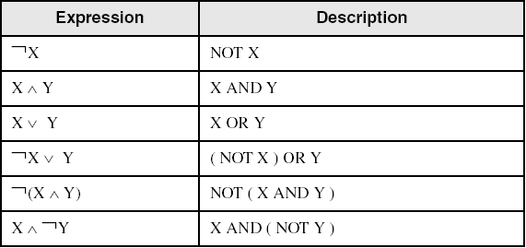
Boolean Algebra
Based on symbolic logic, designed by George Boole
Boolean expressions created from:
NOT, AND, OR

Slide 84
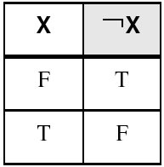
NOT
Inverts (reverses) a boolean value
Truth table for Boolean NOT operator:
Digital gate diagram for NOT:

Slide 85
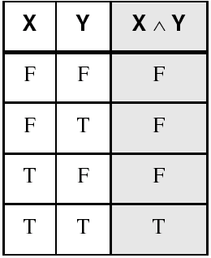
AND
Truth table for Boolean AND operator:
Digital gate diagram for AND:

Slide 86
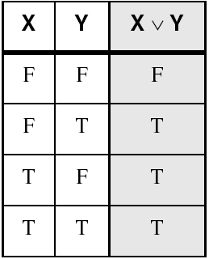
OR
Truth table for Boolean OR operator:
Digital gate diagram for OR:

Slide 87
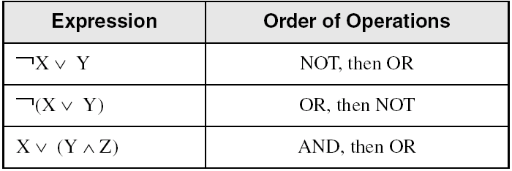
Operator Precedence
Examples showing the order of operations:

Slide 88
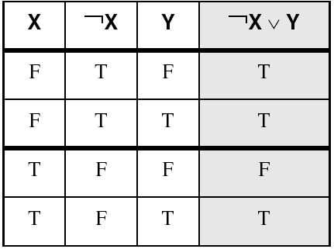
Truth Tables (1 of 3)
A Boolean function has one or more Boolean inputs, and returns a single Boolean output.
A truth table shows all the inputs and outputs of a Boolean function
Example: ¬X ∨ Y

Slide 89
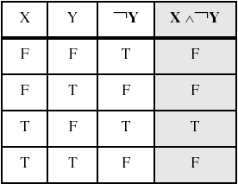
Truth Tables (2 of 3)
Example: X ∧ ¬Y

Slide 90
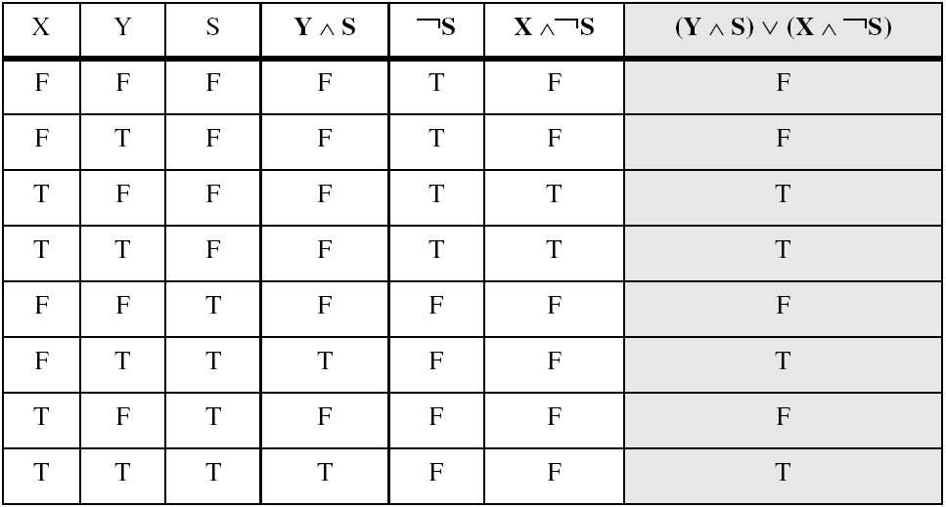
Truth Tables (3 of 3)
Example: (Y ∧ S) ∨ (X ∧ ¬S)
Two-input multiplexer

Slide 91
Summary
Assembly language helps you learn how software is constructed at the lowest levels
Assembly language has a one-to-one relationship with machine language
Each layer in a computer's architecture is an abstraction of a machine
layers can be hardware or software
Boolean expressions are essential to the design of computer hardware and software

Slide 92
THANKS!
Any questions?
You can find me at:
A.qadeer@nu.edu.pk
Office #213, Visiting Hours Only

