Slide 1

Computer Organization & Assembly Language - EE2003

Slide 2
Lecture ##
Week 15

Slide 3
Book Chapter
“Assembly Language for x86 Processors”
Author “Kip R. Irvine”
6th Edition
Chapter 9
Section 9.4

Slide 4
Two Dimensional Arrays (1/2)
Two-dimensional array is high-level abstraction of a one-dimensional array
Two methods to arrange rows and columns
Row-Major Order
Column-Major Order
x86 ISA has two operand types, base-index and base-index-displacement which are ideal to use with arrays

Slide 5
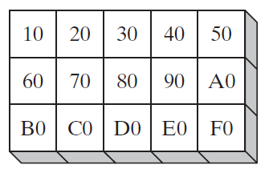
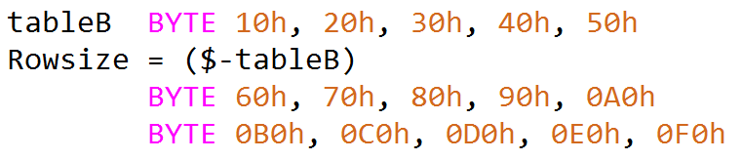
Two-Dimensional Array
Rowsize = 5
Notes:
INCLUDE Irvine32.inc
.data
hello byte "Hello World", 0
target byte 20 DUP (?)
.code
main PROC
cld
mov ecx, LENGTHOF hello
mov esi, OFFSET hello
mov edi, OFFSET target
rep movsb
mov edx, OFFSET target
call WriteString
exit
main ENDP
END main

Slide 6
Two Dimensional Arrays (2/2)
 | 0 | 1 | 2
0 | 10 | 20 | 30
1 | 40 | 50 | 60
2 | 70 | 80 | 90
Logical arrangement
Row-Major Order
10 | 20 | 30 | 40 | 50 | 60 | 70 | 80 | 90
00 | 01 | 02 | 10 | 11 | 12 | 20 | 21 | 22
Column-Major Order
10 | 40 | 70 | 20 | 50 | 80 | 30 | 60 | 90
00 | 10 | 20 | 01 | 11 | 21 | 02 | 12 | 22

Slide 7
Base-Index Operands
Base-Index operand adds the values of two registers to produce an offset
These two registers are called Base and Index
In 32-bit mode, any extended general purpose register may be used as base and index
In 16-bit mode, base register must be either BX or BP and index must be SI or DI
Syntax is [Base+Index]

Slide 8
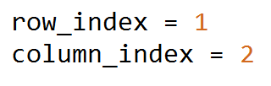
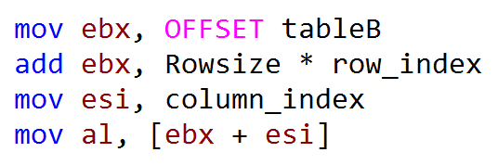
Base-Index Operand
Notes:
INCLUDE Irvine32.inc
.data
hello byte "Hello World", 0
target byte 20 DUP (?)
.code
main PROC
std
mov ecx, LENGTHOF hello
mov esi, OFFSET hello
mov edi, OFFSET target
add esi, LENGTHOF hello
add edi, LENGTHOF hello
dec esi
dec edi
rep movsb
mov edx, OFFSET target
call WriteString
call waitmsg
exit
main ENDP
END main

Slide 9
Base-Index Operand
Rowsize * row_index = 5 * 1 = 5
Notes:
INCLUDE Irvine32.inc
.data
hello byte "Hello World", 0
target byte 20 DUP (?)
.code
main PROC
std
mov ecx, LENGTHOF hello
mov esi, OFFSET hello
mov edi, OFFSET target
add esi, LENGTHOF hello
add edi, LENGTHOF hello
dec esi
dec edi
rep movsb
mov edx, OFFSET target
call WriteString
call waitmsg
exit
main ENDP
END main

Slide 10
Base-Index Operand
esi = column_index => 2
Notes:
INCLUDE Irvine32.inc
.data
hello byte "Hello World", 0
target byte 20 DUP (?)
.code
main PROC
std
mov ecx, LENGTHOF hello
mov esi, OFFSET hello
mov edi, OFFSET target
add esi, LENGTHOF hello
add edi, LENGTHOF hello
dec esi
dec edi
rep movsb
mov edx, OFFSET target
call WriteString
call waitmsg
exit
main ENDP
END main

Slide 11
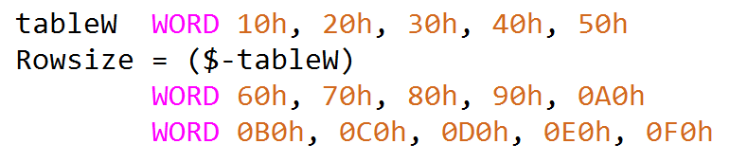
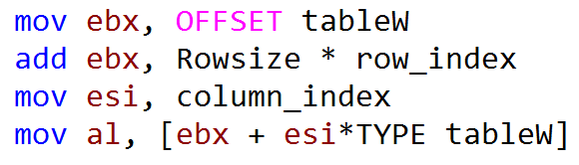
Scale Factors
Rowsize = 10

Slide 12
Accessing One-Dimensional Array
.data
arr DB 10h, 20h, 30h, 40h
.code
MOV BX, OFFSET arr
MOV SI, 2
MOV AL, [BX+SI] ;AL=
INC SI
MOV AL, [BX+SI] ;AL=

Slide 13
Accessing Two-Dimensional Array (1/2)
In row-major order
Row-offset is held in base register
Column-offset is held in index register
.data
arr DB 10h, 20h, 30h
r_size=($-arr); size of row
DB 40h, 50h, 60h
DB 70h, 80h, 90h

Slide 14
Accessing Two-Dimensional Array (2/2)
 | 0 | 1 | 2
0 | 10 | 20 | 30
1 | 40 | 50 | 60
2 | 70 | 80 | 90
Suppose we want to locate value at row=1 and col=2
.data
arr DB 10h, 20h, 30h
r_size=($-arr)
DB 40h, 50h, 60h
DB 70h, 80h, 90h
.code
r_ind=1
c_ind=2
MOV BX, OFFSET arr ;BX=100
ADD BX, r_size*r_ind;BX=100+3*1
MOV SI, c_ind ;SI=2
MOV AL, [BX+SI] ;AL=[103+2]
10 | 20 | 30 | 40 | 50 | 60 | 70 | 80 | 90
100 | 101 | 102 | 103 | 104 | 105 | 106 | 107 | 108
Address

Slide 15
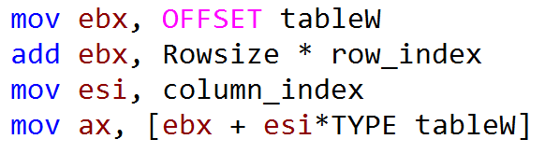
Base-Index Operand
Notes:
INCLUDE Irvine32.inc
.data
hello byte "Hello World", 0
target byte 20 DUP (?)
.code
main PROC
std
mov ecx, LENGTHOF hello
mov esi, OFFSET hello
mov edi, OFFSET target
add esi, LENGTHOF hello
add edi, LENGTHOF hello
dec esi
dec edi
rep movsb
mov edx, OFFSET target
call WriteString
call waitmsg
exit
main ENDP
END main

Slide 16
Base-Index Operand
Rowsize * row_index = 10 * 1 = 10
Notes:
INCLUDE Irvine32.inc
.data
hello byte "Hello World", 0
target byte 20 DUP (?)
.code
main PROC
std
mov ecx, LENGTHOF hello
mov esi, OFFSET hello
mov edi, OFFSET target
add esi, LENGTHOF hello
add edi, LENGTHOF hello
dec esi
dec edi
rep movsb
mov edx, OFFSET target
call WriteString
call waitmsg
exit
main ENDP
END main

Slide 17
Base-Index Operand
esi = 2
Esi * TYPE tableW = 2 * 2 = 4
Notes:
INCLUDE Irvine32.inc
.data
hello byte "Hello World", 0
target byte 20 DUP (?)
.code
main PROC
std
mov ecx, LENGTHOF hello
mov esi, OFFSET hello
mov edi, OFFSET target
add esi, LENGTHOF hello
add edi, LENGTHOF hello
dec esi
dec edi
rep movsb
mov edx, OFFSET target
call WriteString
call waitmsg
exit
main ENDP
END main

Slide 18
Base-Index-Displacement Operands(1/2)
[base + index + displacement]
displacement[base + index]
Rowsize is equal to 20 (14h).

Slide 19
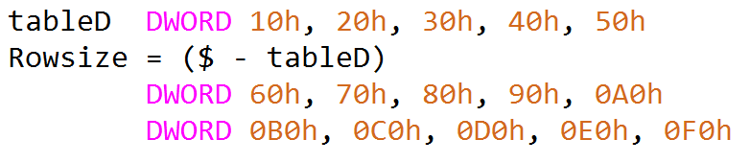
Base-Index-Displacement Operand
Rowsize = 20
Notes:
INCLUDE Irvine32.inc
.data
hello byte "Hello World", 0
target byte 20 DUP (?)
.code
main PROC
std
mov ecx, LENGTHOF hello
mov esi, OFFSET hello
mov edi, OFFSET target
add esi, LENGTHOF hello
add edi, LENGTHOF hello
dec esi
dec edi
rep movsb
mov edx, OFFSET target
call WriteString
call waitmsg
exit
main ENDP
END main

Slide 20

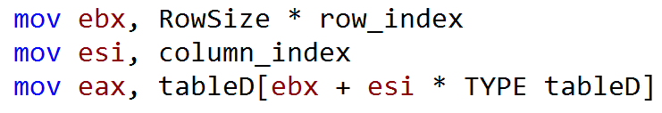
Base-Index-Displacement Operand
ebx = 20 * 2 = 40
esi = 4
Notes:
INCLUDE Irvine32.inc
.data
hello byte "Hello World", 0
target byte 20 DUP (?)
.code
main PROC
std
mov ecx, LENGTHOF hello
mov esi, OFFSET hello
mov edi, OFFSET target
add esi, LENGTHOF hello
add edi, LENGTHOF hello
dec esi
dec edi
rep movsb
mov edx, OFFSET target
call WriteString
call waitmsg
exit
main ENDP
END main

Slide 21
Base-Index-Displacement Operand
ebx = 20 * 2 = 40
4 * 4 = 16
esi = 4
Notes:
INCLUDE Irvine32.inc
.data
hello byte "Hello World", 0
target byte 20 DUP (?)
.code
main PROC
std
mov ecx, LENGTHOF hello
mov esi, OFFSET hello
mov edi, OFFSET target
add esi, LENGTHOF hello
add edi, LENGTHOF hello
dec esi
dec edi
rep movsb
mov edx, OFFSET target
call WriteString
call waitmsg
exit
main ENDP
END main

Slide 22
Base-Index-Displacement Operand
ebx = 20 * 2 = 40
4 * 4 = 16
esi = 4
Notes:
INCLUDE Irvine32.inc
.data
hello byte "Hello World", 0
target byte 20 DUP (?)
.code
main PROC
std
mov ecx, LENGTHOF hello
mov esi, OFFSET hello
mov edi, OFFSET target
add esi, LENGTHOF hello
add edi, LENGTHOF hello
dec esi
dec edi
rep movsb
mov edx, OFFSET target
call WriteString
call waitmsg
exit
main ENDP
END main

Slide 23
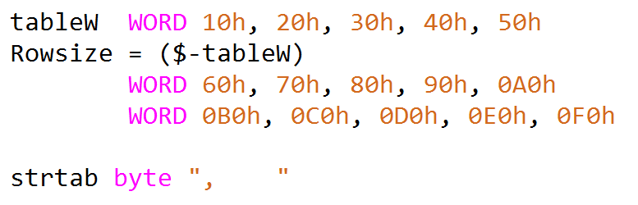
Display Two-Dimensional Array

Slide 24
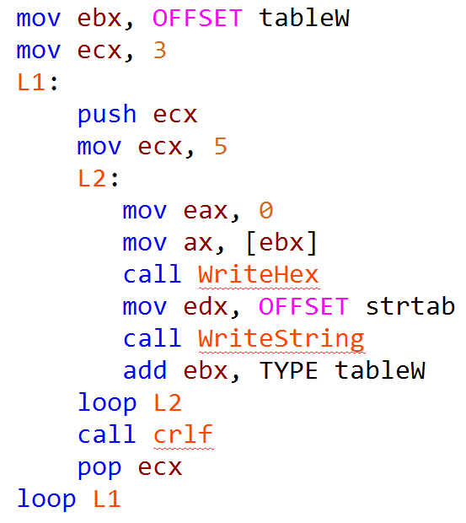

Display Two-Dimensional Array

Slide 25
Computer Organization and Assembly Language (EL 229)
File Handling

Slide 26
Outline
Writing Files
Reading Files

Slide 27
CreateFile Function
The CreateFile function either creates a new ﬁle or opens an existing ﬁle.
If successful, it returns a handle to the open ﬁle; otherwise, it returns a special constant named INVALID_HANDLE_VALUE.

Slide 28
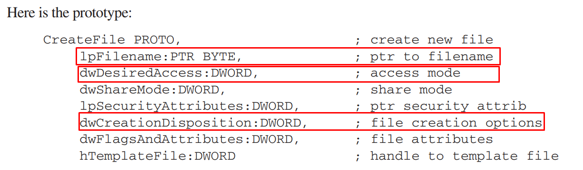
CreateFile Function

Slide 29
dwDesiredAccess
The dwDesiredAccess parameter lets you specify read access, write access, read/write access.
Value | Meaning
GENERIC_READ | Speciﬁes read access to the object. Data can be read from the ﬁle, and the ﬁle pointer can be moved. Combine with GENERIC_WRITE for read/write access.
GENERIC_WRITE | Speciﬁes write access to the object. Data can be written to the ﬁle, and the ﬁle pointer can be moved. Combine with GENERIC_READ for read/write access.

Slide 30
dwCreationDisposition
The dwCreationDisposition parameter speciﬁes which action to take on ﬁles that exist and which action to take when ﬁles do not exist.
CREATE_NEW: Creates a new file. The function fails if the ﬁle already exists. Cannot append Text in it.

Slide 31
dwCreationDisposition
CREATE_ALWAYS: Creates a new ﬁle. If the ﬁle exists, the function overwrites the ﬁle. Cannot append Text in it.
OPEN_EXISTING: Opens the ﬁle. The function fails if the ﬁle does not exist. Can append Text in it.
OPEN_ALWAYS: Opens the ﬁle if it exists. If the ﬁle does not exist, the function creates the ﬁle as if CreationDisposition were CREATE_NEW. Can append Text in it

Slide 32
dwCreationDisposition
TRUNCATE_EXISTING: Opens the ﬁle. Once opened, the ﬁle is truncated to size zero. This function fails if the ﬁle does not exist. Cannot append Text in it.

Slide 33
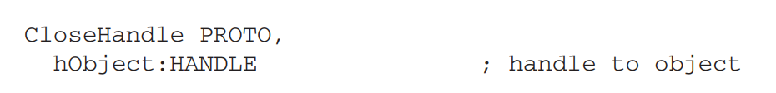
CloseHandle Function
You can use CloseHandle to close a currently open ﬁle handle. The return value is zero if the function fails.

Slide 34
WriteFile Function
The WriteFile function writes data to a ﬁle, using an output handle.
The function starts writing data to the ﬁle at the position indicated by the ﬁle’s internal position pointer.
After the write operation has been completed, the ﬁle’s position pointer is adjusted by the number of bytes actually written.

Slide 35
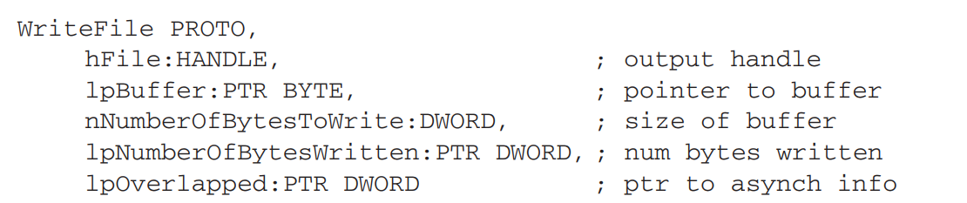
WriteFile Function

Slide 36
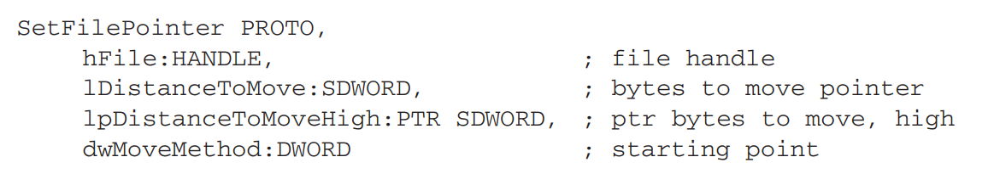
SetFilePointer Function
The SetFilePointer function moves the position pointer of an open ﬁle.
This function can be used to append data to a ﬁle or to perform random-access record processing:

Slide 37
SetFilePointer Function
dwMoveMethod speciﬁes the starting point for moving the ﬁle pointer, which is selected from three predeﬁned symbols:
FILE_BEGIN, FILE_CURRENT, and FILE_END.

Slide 38
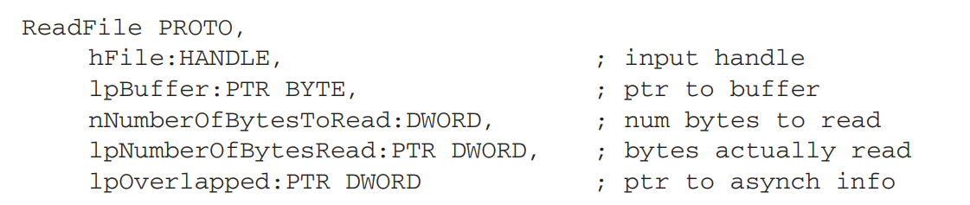
ReadFile Function
The ReadFile function reads text from an input ﬁle.

Slide 39
ReadFile Function
The hFile parameter is an open ﬁle handle returned by CreateFile;
lpBuffer points to a buffer that receives data read from the ﬁle;
nNumberOfBytesToRead speciﬁes the maximum number of bytes to read from the ﬁle;
lpNumberOfBytesRead points to an integer indicating the number of bytes actually read when the function returns;
lpOverlapped should be set to NULL (0) for synchronous reading (which we use). The return value is zero if the function fails.

Slide 40
ReadFile Function
If called more than once on the same open ﬁle handle, ReadFile remembers where it last ﬁnished reading and reads from that point on.
In other words, it maintains an internal pointer to the current position in the ﬁle.

Slide 41
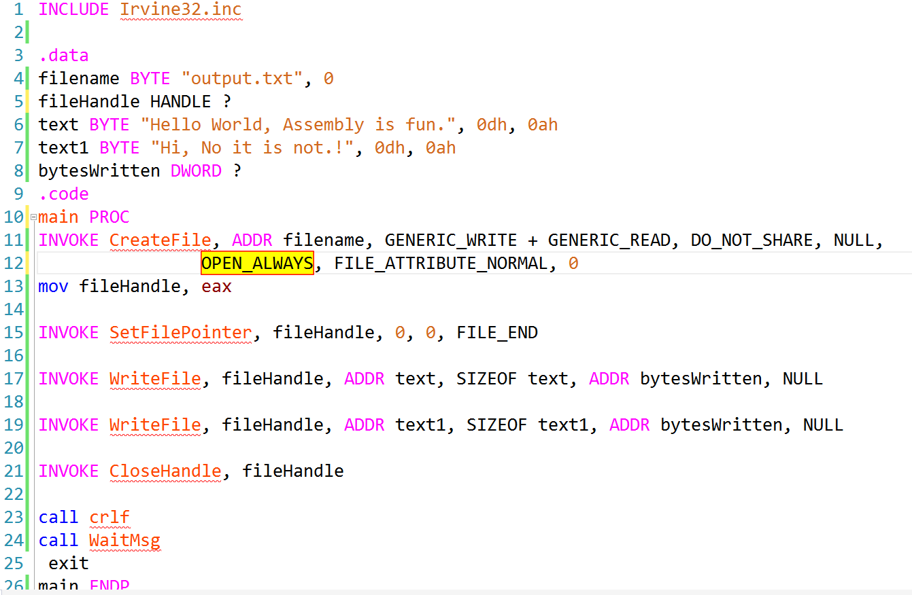
Writing to a File

Slide 42
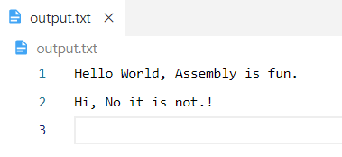
Writing to a File

Slide 43
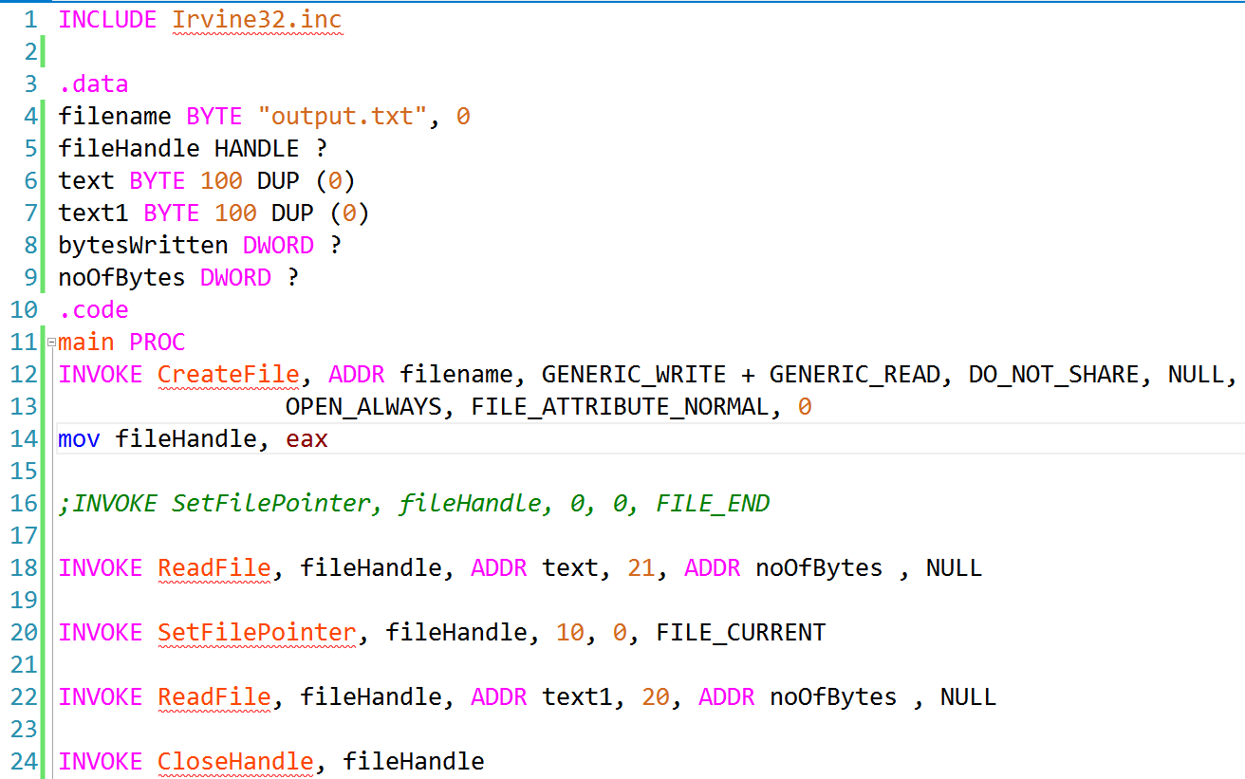
Reading from a File

Slide 44
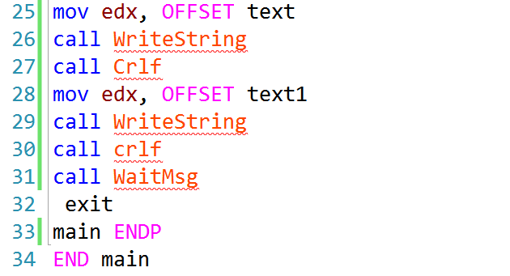
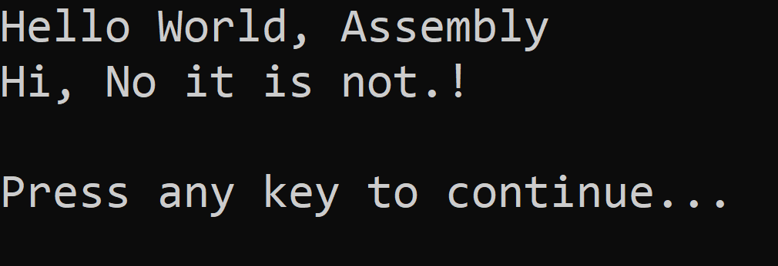
Reading from a File

Slide 45
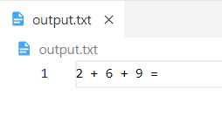
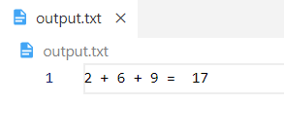
One Last Example
Read three numbers from the file, find the sum of the three numbers and write the sum to the file.
Notes:
INCLUDE Irvine32.inc
convertNumBytetoString PROTO, num:BYTE, strnum: PTR BYTE
.data
filename BYTE "output.txt", 0
fileHandle HANDLE ?
numbers BYTE 3 DUP (0)
sum BYTE ?
noOfBytes DWORD ?
numStr BYTE 4 DUP (' ')
.code
main PROC
INVOKE CreateFile, ADDR filename, GENERIC_WRITE + GENERIC_READ, DO_NOT_SHARE, NULL,
OPEN_ALWAYS, FILE_ATTRIBUTE_NORMAL, 0
mov fileHandle, eax
mov esi, OFFSET numbers
INVOKE ReadFile, fileHandle, esi, 1, ADDR noOfBytes , NULL
INVOKE SetFilePointer, fileHandle, 4, 0, FILE_BEGIN
inc esi
INVOKE ReadFile, fileHandle, esi, 1, ADDR noOfBytes , NULL
INVOKE SetFilePointer, fileHandle, 8, 0, FILE_BEGIN
inc esi
INVOKE ReadFile, fileHandle, esi, 1, ADDR noOfBytes , NULL
cld
mov esi, OFFSET numbers
mov edi, esi
mov ecx, 3
L1:
lodsb
sub al, 30H
stosb
loop L1
cld
mov esi, OFFSET numbers
mov edi, esi
mov ecx, 3
L2:
lodsb
add sum, al
loop L2
INVOKE convertNumBytetoString, sum, ADDR numStr
INVOKE SetFilePointer, fileHandle, 11, 0, FILE_BEGIN
INVOKE WriteFile, fileHandle, ADDR numStr, SIZEOF numStr, ADDR noOfBytes , NULL
INVOKE CloseHandle, fileHandle
call crlf
call WaitMsg
exit
main ENDP
convertNumBytetoString PROC, num:BYTE, strnum: PTR BYTE
mov eax, 0
mov al, num
cmp eax, 0
je terminate
mov bl, 10
mov esi, strnum
add esi, 3
LC1:
div bl
add ah, 30H
mov [esi], ah
dec esi
mov ah, 0
cmp eax, 0
je terminate
cmp eax, 10
jl done
loop LC1
done:
add al, 30H
mov [esi], al
terminate:
ret
convertNumBytetoString ENDP
END main

Slide 46
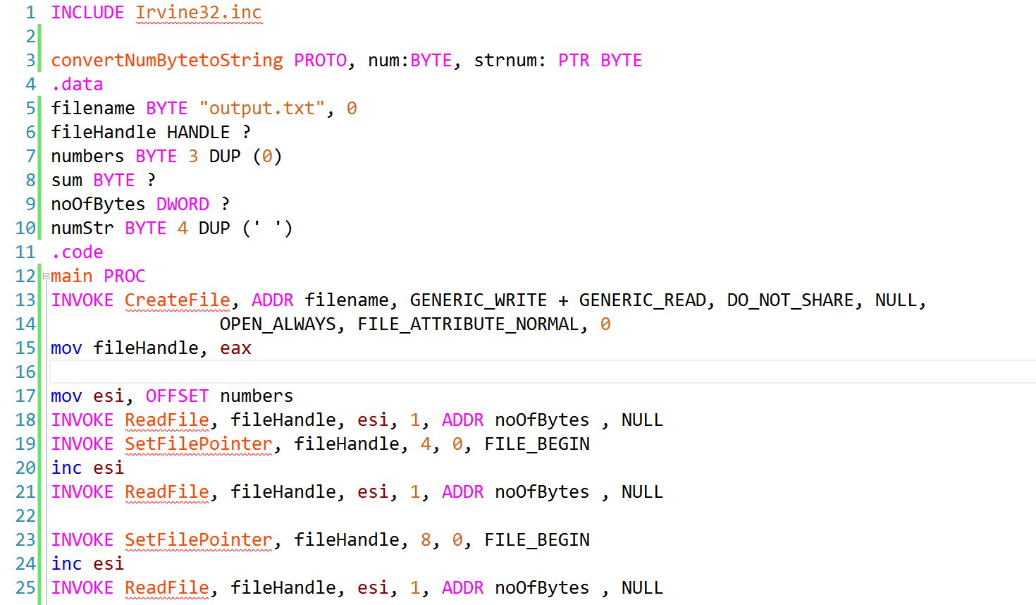

Slide 47
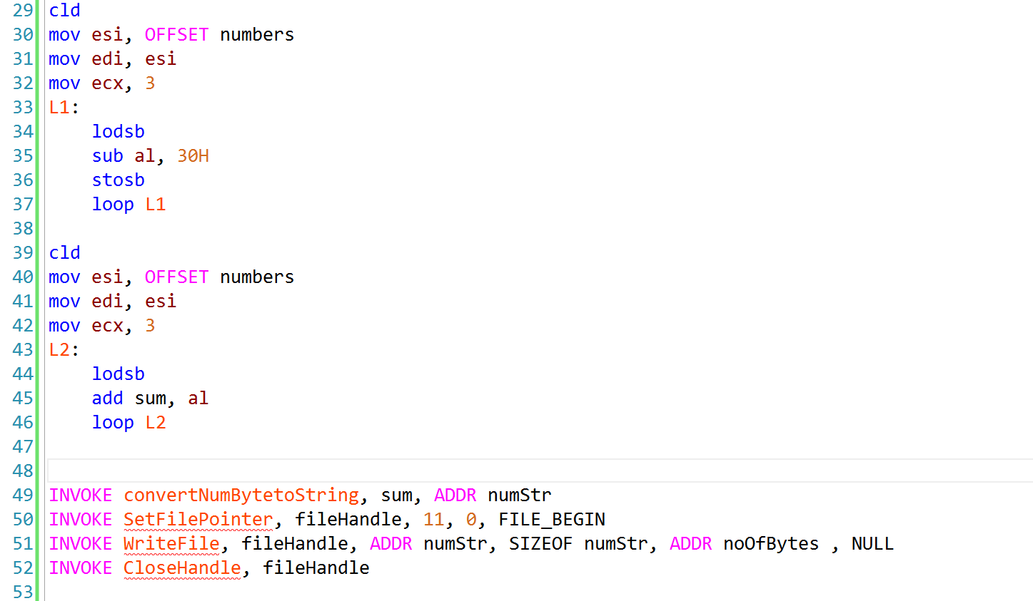

Slide 48
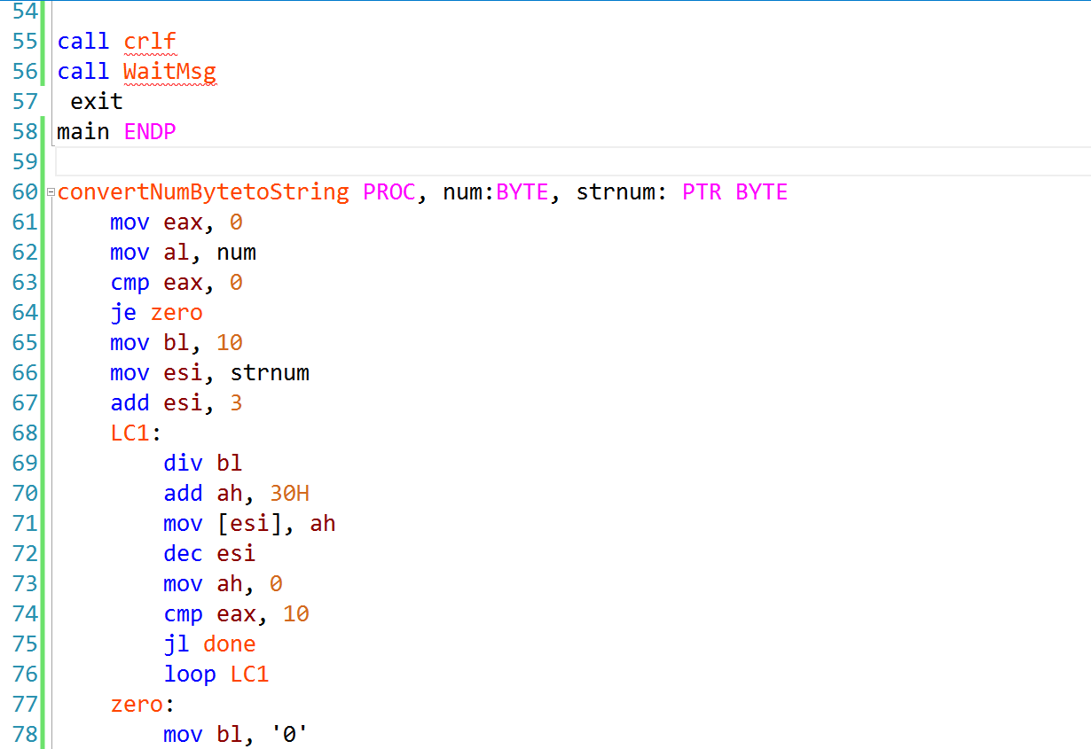

Slide 49
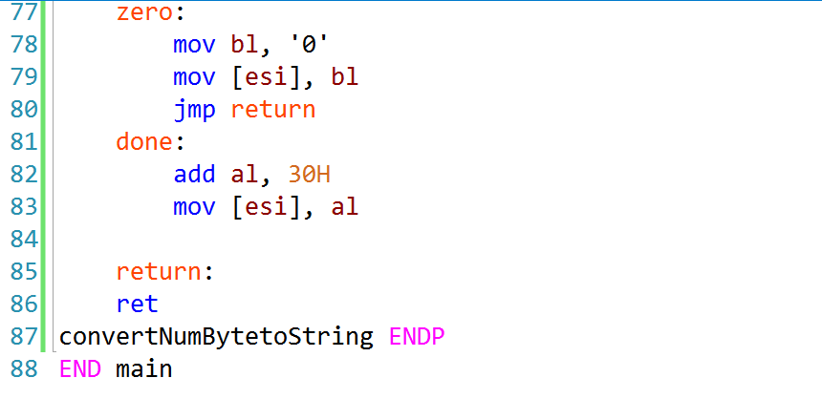

Slide 50
References
Assembly Language For x86 Processors 6th edition by Kip R. Irvine
11.1.6 Reading and Writing Files

Slide 51
THANKS!
Any questions?
You can find me at:
A.qadeer@nu.edu.pk
Office #213, Visiting Hours Only

