Slide 1

Computer Organization & Assembly Language - EE2003

Slide 2
Lecture 03
Week 02

Slide 3
Chapter Overview
General Concepts
IA-32 Processor Architecture
IA-32 Memory Management
Components of an IA-32 Microcomputer
Input-Output System

Slide 4
General Concepts
Basic microcomputer design
Instruction execution cycle
Reading from memory
How programs run

Slide 5
Organization and Architecture
Computer Architecture
Attributes of a computer that have a direct impact on the logical program execution
e.g. I/O mechanisms, memory addressing techniques
Computer Organization
Operational units and their interconnection that realizes the architectural specifications
e.g. control signals, interconnection between computer and its peripherals

Slide 6
Basic Computer Organization (1/2)
Computer has 3 main components
Processor, also called Central Processing Unit (CPU)
Memory and Storage Devices
I/O Devices
These components communicate with each other through
Data Bus
I/O Bus
Address Bus
Control Bus

Slide 7
Basic Computer Organization (2/2)
I/O Bus
Data Bus
Registers
Memory Storage Unit
I/O Device #1
I/O Device #2
Central
Processing Unit
(CPU)
ALU | CU | CLOCK
Control Bus
Address Bus

Slide 8
Basic Microcomputer Design
clock synchronizes CPU operations
control unit (CU) coordinates sequence of execution steps
ALU performs arithmetic and bitwise processing

Slide 9
Central Processing Unit (CPU)
Generally called Processor
Contains
Clock
Registers
Arithmetic Logic Unit (ALU)
Performs arithmetic and logic instructions
Control Unit (CU)
Generates the control signals required to execute the instructions

Slide 10
Clock (1/3)
Clock cycle is basic unit of time for machine instructions
Synchronizes Processor and Bus operations
Clock cycle = Clock period = 1/(Clock Rate)
Clock Rate = Clock Frequency = Cycles per sec
1 Hz clock produces 1 Clock Cycle in 1 second
1 KHz clock produces 1000 Clock Cycles in 1 second
1 MHz clock produces 1,000,000 cycles in 1 second
1 GHz clock produces 1,000,000,000 cycles in 1 second

Slide 11
Clock (2/3)
One Cycle
1
0
Clock Frequency | Clock Period (sec) | Time to execute one instruction
1 Hz | 1 | 1 sec
1 KHz | 0.001 | 1 ms (millisecond)
1 MHz | 0.000,001 | 1 μs (microsecond)
1 GHz | 0.000,000,001 | 1 ns (nanosecond)

Slide 12
Clock (2/3)
synchronizes all CPU and BUS operations
machine (clock) cycle measures time of a single operation
clock is used to trigger events

Slide 13
What's Next
General Concepts
IA-32 Processor Architecture
IA-32 Memory Management
Components of an IA-32 Microcomputer
Input-Output System

Slide 14
Memory (1/2)
Ordered sequence of bytes
Sequence number is called memory address
Byte addressable memory
Each byte has a unique address
Physical address space
Determined by the address bus width
Pentium has 32-bit address bus
Physical address space of Pentium = 2³² bytes = 4 GB
Itanium with 64-bit address bus can support up to 2⁶⁴ bytes of physical address space

Slide 15
Memory (2/2)
Address of location to be read/written is placed on the address bus
Data to be read/written is placed on the data bus by memory/processor
Two control signals read and write decide the reading or writing operations
Memory Unit
Address
Data
Read
Write

Slide 16
Physical Address Space
Address
in decimal
Address
in hex
Address space is the set of addressable memory locations (bytes)
2³²-1
FFFFFFFF
FFFFFFFE
FFFFFFFD
2
00000002
1
00000001
0
00000000

Slide 17
Reading from Memory
Multiple clock cycles are required
Memory responds much more slowly than CPU
Reading process is carried out in this way
Address is placed on the address bus
Read Line (RD) goes low indicating that processor wants to read
CPU waits for memory to respond
Read Line (RD) goes high indicating that data has been placed on the data bus

Slide 18
Memory Read and Write Cycles
In Read Cycle, the Processor
places address on address bus
asserts the memory read control signal
waits for memory to place data on the data bus
reads the data from data bus
drops the memory read signal
In Write Cycle, the Processor
places address on the address bus
asserts the memory write control signal
places the data on the data bus
waits for memory to store the data
drops the memory write signal

Slide 19
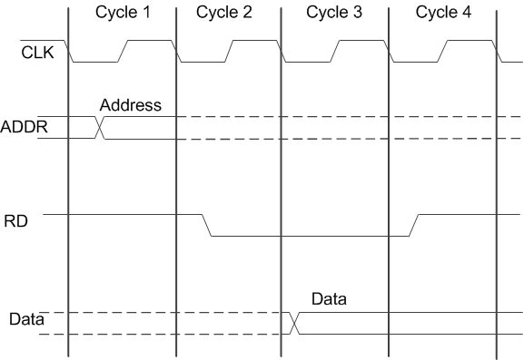
Reading from Memory

Slide 20
Memory Hierarchy
Registers
Fastest storage elements
Cache Memory
Stores recently used instructions
Main Memory
Magnetic Disk
Stores data permanently
Magnetic Tape
Regis-ters
Inboard
Storage
Cache
Higher Speed, Smaller Size
Lower cost per Byte
Main Memory
Magnetic Disk
CD-ROM
CD-RW
DVD-RW
Outboard
Storage
Off-line Storage
Magnetic Tape

Slide 21
Cache Memory
High-speed expensive static RAM both inside and outside the CPU.
Level-1 cache: inside the CPU
Level-2 cache: outside the CPU
Cache hit: when data to be read is already in cache memory
Cache miss: when data to be read is not in cache memory.

Slide 22
How a Program Runs

Slide 23
Multitasking
OS can run multiple programs at the same time.
Multiple threads of execution within the same program.
Scheduler utility assigns a given amount of CPU time to each running program.
Rapid switching of tasks
gives illusion that all programs are running at once
the processor must support task switching.

Slide 24
IA-32 Processor Architecture
Modes of operation
Basic execution environment
Floating-point unit
Intel Microprocessor history

Slide 25
Basic Execution Environment
Addressable memory
General-purpose registers
Index and base registers
Specialized register uses
Status flags
Floating-point, MMX, XMM registers

Slide 26
Registers
Very high speed memory units inside CPU
Can be categorized into
General Purpose Registers
Segment Registers
Instruction Pointer
EFLAGS Register
Control Flags
Status Flags

Slide 27
General Purpose Registers
Used primarily for arithmetic and data movement
Eight 32-bit Extended general purpose registers
Register | Description | Specialized Usage
EAX | Accumulator | Used in mul and div instruction
EBX | Base
ECX | Counter | Used in LOOP instruction
EDX | Data
EBP | Base Pointer | Used to reference local variables on stack
ESP | Stack Pointer | Points at top of the stack, used by PUSH and POP
ESI | Source Index | Used by high speed memory transfer instruction
EDI | Destination Index | Used by high speed memory transfer instruction

Slide 28
Accessing Parts of Registers (1/2)
Portions of General Purpose Registers can also be accessed
Lower 16 bits of EAX are named AX
AX can further be divided into
AL = Lower 8 bits
AH = Higher 8 bits
8 bits
8 bits
AH
AL
16 bits
AX
32 bits
EAX
31
16
15
8
7
0

Slide 29
Accessing Parts of Registers (2/2)
EAX, EBX, ECX, EDX can be accessed at word and byte level
EBP, ESP, ESI, EDI can be accessed at word level
32-bit | 16-bit | 8-bit Higher | 8-bit Lower
EAX | AX | AH | AL
EBX | BX | BH | BL
ECX | CX | CH | CL
EDX | DX | DH | DL
32-bit | 16-bit Lower
ESP | SP
EBP | BP
ESI | SI
EDI | DI

Slide 30
Segment Registers (1/2)
Six 16-bit segment registers
Indicate base addresses of pre-assigned memory areas
An assembly program usually contains 3 segments
Stack Segment: holds local function variables and function parameters
Data Segment: holds variables
Code Segment: holds program instructions

Slide 31
Segment Registers (2/2)
SS = Stack Segment
DS = Data Segment
CS = Code Segment
3 extra segment registers
ES, FS, GS (Extra Segment)
SS
ES
DS
FS
CS
GS

Slide 32
Instruction Pointer
Represented by EIP
Also called Program Counter (PC)
Contains the address of next instruction to be executed
Its value changes with the execution of program
Certain machine instructions influence the value of EIP

Slide 33
Status Flags (1/2)
EFLAGS register consists of individual binary bits
Can be categorized into
Control Flags: control the operation of CPU
Status Flags: reflect the outcome of arithmetic and logical operations
0 | 0 | 0 | 0 | 0 | 0 | 0 | 0 | 0 | 0 | ID | VIP | VIF | AC | VM | RF | 0 | NT | IOPL | OF | DF | IF | TF | SF | ZF | 0 | AF | 0 | PF | 1 | CF

Slide 34
Status Flags (2/2)
Arithmetic and Logical operations set/reset them
Status Flags are
Carry Flag (CF): set when unsigned arithmetic operation produces a carry
Overflow Flag (OF): sets when signed arithmetic result is out of range
Sign Flag (SF): sets when result of operation is –ve
Zero Flag (ZF): sets when result of operation is zero
Auxiliary Flag (AF): sets when there is a carry from bit 3 to bit 4
Parity Flag (PF): sets when parity is even

Slide 35
Floating Point Unit (FPU)
FPU performs high speed floating point operations
Integrated into main processor chip from Intel486 onward
Eight 80-bit floating point data registers
All arranged as a stack
ST(0)
ST(1)
ST(2)
ST(3)
ST(4)
ST(5)
ST(6)
ST(7)

Slide 36
THANKS!
Any questions?
You can find me at:
A.qadeer@nu.edu.pk
Office #213, Visiting Hours Only

Slide 37
Lecture 04
Week 02

Slide 38
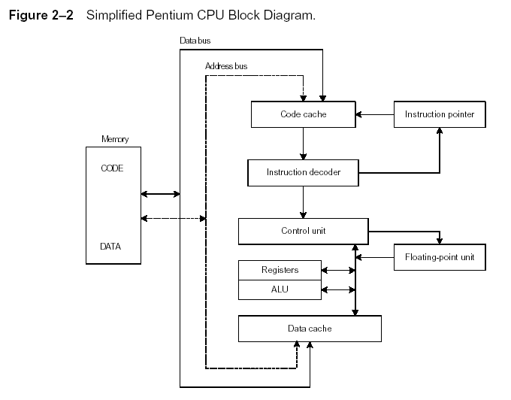
Instruction Execution Cycle
Fetch
Decode
Fetch operands
Execute
Store output

Slide 39
Instruction Execution Cycle (1/2)
A program is loaded into memory before execution
Instruction Pointer (IP) contains the address of next instruction to be executed
Instruction Queue contains the group of instructions about to be executed
Three basic steps in execution of a machine instruction
Fetch
Decode
Execute
Two more steps if the instruction uses an operand located in memory
Fetch Operand
Store Output

Slide 40
Instruction Execution Cycle (2/2)
Order of steps when instruction uses an operand located in memory
Instruction Fetch (IF)
Instruction Decode (ID)
Operand Fetch from Memory (OF)
Instruction Execute (IE)
Write Back in Memory (WB)
Instruction Execution Cycle (IEC) is the combination of all above operations

Slide 41
Instruction Fetch
Program Counter (PC) or IP holds address of next instruction to be executed
Processor fetches instruction from memory pointed to be PC
Increment PC to the next instruction
Fetching operation concludes here

Slide 42
Instruction Decode
Control Unit (CU) determines the function of the instruction
Instruction’s input operands are passed to ALU
Signals sent to ALU to perform the desired operation

Slide 43
Operand Fetch from Memory
Sometimes instructions may involve some operands located in memory
In this case, data should be retrieved from memory
The CU uses a memory read operation
CU copies these operands into Instruction Registers which are invisible to user programs

Slide 44
Instruction Execute
The instruction is ready for execution at this stage
ALU executes the instruction
ALU updates the status flags providing information about the result

Slide 45
Write Back in Memory
The output may be required to save in memory for future uses
CU performs a write operation to save this output into memory

Slide 46
IEC Graphical View
Instruction Fetch
Obtain instruction from Instruction Queue
Instruction Decode
Determine required action to be executed
Operand Fetch
Infinite Cycle
Locate and obtain operand from memory location
Instruction Execute
Compute the required operation
Write Back in Memory
Deposit results in the storage for future use

Slide 47
Intel Microprocessor History
Intel 8086, 80286
IA-32 processor family
P6 processor family
CISC and RISC

Slide 48
Early Intel Microprocessors
Intel 8080
64K addressable RAM
8-bit registers
CP/M operating system
S-100 BUS architecture
8-inch floppy disks!
Intel 8086/8088
IBM-PC Used 8088
1 MB addressable RAM
16-bit registers
16-bit data bus (8-bit for 8088)
separate floating-point unit (8087)

Slide 49
The IBM-AT
Intel 80286
16 MB addressable RAM
Protected memory
several times faster than 8086
introduced IDE bus architecture
80287 floating point unit

Slide 50
Intel IA-32 Family
Intel386
4 GB addressable RAM, 32-bit registers, paging (virtual memory)
Intel486
instruction pipelining
Pentium
superscalar, 32-bit address bus, 64-bit internal data path

Slide 51
64-bit Processors
Intel64
64-bit linear address space
Intel: Pentium Extreme, Xeon, Celeron D, Pendium D, Core 2, and Core i7
IA-32e Mode
Compatibility mode for legacy 16- and 32-bit applications
64-bit Mode uses 64-bit addresses and operands

Slide 52
Intel Technologies
HyperThreading technology
two tasks execute on a single processor at the same time
Dual Core processing
multiple processor cores in the same IC package
each processor has its own resources and communication path with the bus

Slide 53
Intel Processor Families
Currently Used:
Pentium & Celeron – dual core
Core 2 Duo - 2 processor cores
Core 2 Quad - 4 processor cores
Core i7 – 4 processor cores

Slide 54
CISC and RISC
CISC – complex instruction set
large instruction set
high-level operations
requires microcode interpreter
examples: Intel 80x86 family
RISC – reduced instruction set
simple, atomic instructions
small instruction set
directly executed by hardware
examples:
ARM (Advanced RISC Machines)
DEC Alpha (now Compaq)

Slide 55
What's Next
General Concepts
IA-32 Processor Architecture
IA-32 Memory Management
Components of an IA-32 Microcomputer
Input-Output System

Slide 56
Modes of Operation
Protected mode
native mode (Windows, Linux)
Real-address mode
native MS-DOS
System management mode
power management, system security, diagnostics
Virtual-8086 mode
hybrid of Protected
each program has its own 8086 computer

Slide 57
Addressable Memory
Protected mode
4 GB
32-bit address
Real-address and Virtual-8086 modes
1 MB space
20-bit address

Slide 58
IA-32 Memory Management
Real-address mode
Calculating linear addresses
Protected mode
Multi-segment model
Paging

Slide 59
x86 Operation Modes
x86 architecture operates in 3 basic different modes
Protected Mode
All instructions and features of processor are available
Programs cannot reference memory outside their segments
Virtual-8086 is special mode of Protected Mode
Real-Address Mode
Programs can have direct access to memory and hardware devices
… so operating system can crash in this mode
System Management Mode
Implemented in processors customized for a particular system setup
Supports power management and system security

Slide 60
x86 Memory Management
Memory is managed according to the operation mode
Real-Address Mode
Protected Mode

Slide 61
Real-Address Mode Memory Management
16-bit registers
20-bit address bus
Physical Address Space = 1MByte
Linear or Absolute Address range is 00000h to FFFFFh
How 20-bit address can be accommodated in 16-bit Registers?
Solution lies in Segmented Memory

Slide 62
Real-Address Mode Memory Management
Programs cannot use linear address directly because of 16-bit registers
Addresses are represented using 2 16-bit registers
One 16-bit value is called Segment Value which is placed in segment register
Other 16-bit value is called Offset value

Slide 63
Segmented Memory Scheme
All memory is divided in 64KBytes segments
Each segment begins at an address having a zero in its last hex digit
… this zero is omitted when representing segment value in 16-bit registers
A segment value of E000₁₆ refers to the segment address of E0000₁₆
If we have Physical Address Space of 2²⁰ bytes, and size of each segment is 64KBytes (2¹⁶bytes), how many segments do we have?

Slide 64
Segmented Memory Map
64 KBytes
7000:017A is called Logical Address
7017A is called Linear/Absolute Address
F0000
E0000
D0000
C0000
B0000
7000:FFFF
A0000
90000
80000
70000
60000
7000:017A
50000
017A
40000
7000:0000
Offset
30000
Segment
20000
Segment
10000
Offset
00000
64 KBytes

Slide 65
Calculating Linear Addresses
Given a segment address, multiply it by 16 (add a hexadecimal zero), and add it to the offset
Example: convert 08F1:0100 to a linear address
Adjusted Segment value: 0 8 F 1 0
Add the offset: 0 1 0 0
Linear address: 0 9 0 1 0

Slide 66
20-bit Linear Address Calculation
How to convert a 16-bitSeg:16-bitOffset logical address into 20-bit linear/absolute address
15
0
Segment value
In Hex
10₁₆
X
+
20-bit Linear Address in hex
In Hex
Offset value
15
0

Slide 67
Protected Mode Memory Management
Restricts application programs from accessing system hardware
Logical Address consists of
16-bit segment selector (Segment Registers)
32-bit offset value
Program’s linear address space is 4GBytes
What is address bus width?
A typical protected-mode program has three segments
Code Segment
Data Segment
Stack Segment
Segment Registers point to the Segment Descriptor Table
… Segment Descriptor Tables are created by OS to keep track of individual program segments

Slide 68
Your turn . . .
What linear address corresponds to the segment/offset address 028F:0030?
028F0 + 0030 = 02920
Always use hexadecimal notation for addresses.

Slide 69
Your turn . . .
What segment addresses correspond to the linear address 28F30h?
Many different segment-offset addresses can produce the linear address 28F30h. For example:
28F0:0030, 28F3:0000, 28B0:0430, . . .

Slide 70
Flat Segment Model
Single global descriptor table (GDT).
All segments mapped to entire 32-bit address space

Slide 71
Multi-Segment Model
Each program has a local descriptor table (LDT)
holds descriptor for each segment used by the program

Slide 72
Paging
Paging divides the linear address space into fixed-sized block called pages
IA-32 uses pages of size 4 KB
Pages are allocated space on main memory
… if main memory is full, then on hard disk
Complete set of pages mapped by OS is called Virtual Memory

Slide 73
Paging
We want to run many programs in parallel
Main memory may not be enough to load all of them at the same time
Disk storage is cheaper and we have plenty of it
Paging gives an illusion that we have unlimited main memory
The more a program depends on paging, the slower it runs
Higher amount of main memory means less usage of paging

Slide 74
What's Next
General Concepts
IA-32 Processor Architecture
IA-32 Memory Management
Components of an IA-32 Microcomputer
Input-Output System

Slide 75
Components of an IA-32 Microcomputer
Motherboard
Video output
Memory
Input-output ports

Slide 76
Motherboard
CPU socket
External cache memory slots
Main memory slots
BIOS chips
Sound synthesizer chip (optional)
Video controller chip (optional)
IDE, parallel, serial, USB, video, keyboard, joystick, network, and mouse connectors
PCI bus connectors (expansion cards)

Slide 77
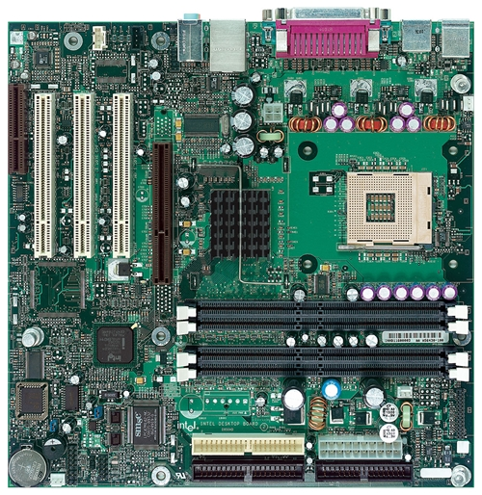
Intel D850MD Motherboard
mouse, keyboard, parallel, serial, and USB connectors
Video
Audio chip
PCI slots
memory controller hub
Pentium 4 socket
AGP slot
dynamic RAM
Firmware hub
I/O Controller
Speaker
Source: Intel® Desktop Board D850MD/D850MV Technical Product Specification
Power connector
Battery
Diskette connector
IDE drive connectors

Slide 78
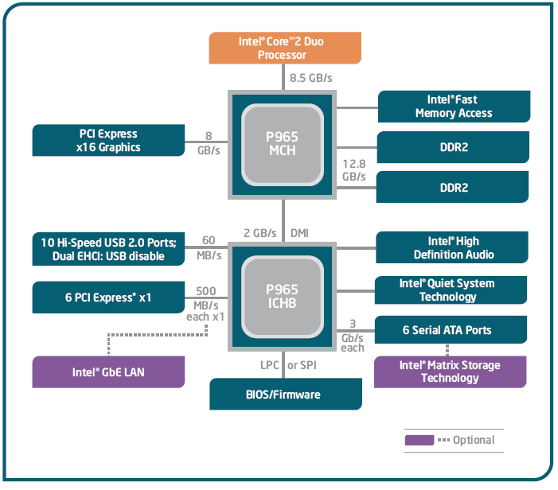
Intel 965 Express Chipset

Slide 79
Video Output
Video controller
on motherboard, or on expansion card
AGP (accelerated graphics port technology)*
Video memory (VRAM)
Video CRT Display
uses raster scanning
horizontal retrace
vertical retrace
Direct digital LCD monitors
no raster scanning required

Slide 80
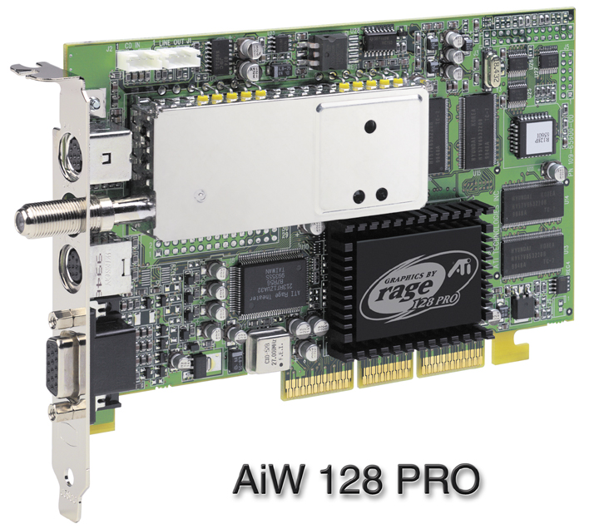
Sample Video Controller (ATI Corp.)
128-bit 3D graphics performance powered by RAGE™ 128 PRO
3D graphics performance
Intelligent TV-Tuner with Digital VCR
TV-ON-DEMAND™
Interactive Program Guide
Still image and MPEG-2 motion video capture
Video editing
Hardware DVD video playback
Video output to TV or VCR

Slide 81
Memory
ROM
read-only memory
EPROM
erasable programmable read-only memory
Dynamic RAM (DRAM)
inexpensive; must be refreshed constantly
Static RAM (SRAM)
expensive; used for cache memory; no refresh required
Video RAM (VRAM)
dual ported; optimized for constant video refresh
CMOS RAM
complimentary metal-oxide semiconductor
system setup information
See: Intel platform memory (Intel technology brief: link address may change)

Slide 82
Input-Output Ports
USB (universal serial bus)
intelligent high-speed connection to devices
up to 12 megabits/second
USB hub connects multiple devices
enumeration: computer queries devices
supports hot connections
Parallel
short cable, high speed
common for printers
bidirectional, parallel data transfer
Intel 8255 controller chip

Slide 83
Input-Output Ports (cont)
Serial
RS-232 serial port
one bit at a time
uses long cables and modems
16550 UART (universal asynchronous receiver transmitter)
programmable in assembly language

Slide 84
Device Interfaces
ATA host adapters
intelligent drive electronics (hard drive, CDROM)
SATA (Serial ATA)
inexpensive, fast, bidirectional
FireWire
high speed (800 MB/sec), many devices at once
Bluetooth
small amounts of data, short distances, low power usage
Wi-Fi (wireless Ethernet)
IEEE 802.11 standard, faster than Bluetooth

Slide 85
What's Next
General Concepts
IA-32 Processor Architecture
IA-32 Memory Management
Components of an IA-32 Microcomputer
Input-Output System

Slide 86
Levels of Input-Output
Level 3: High-level language function
examples: C++, Java
portable, convenient, not always the fastest
Level 2: Operating system
Application Programming Interface (API)
extended capabilities, lots of details to master
Level 1: BIOS
drivers that communicate directly with devices
OS security may prevent application-level code from working at this level

Slide 87
Displaying a String of Characters
When a HLL program displays a string of characters, the following steps take place:

Slide 88
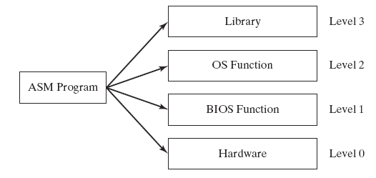
Programming levels
Assembly language programs can perform input-output at each of the following levels:

Slide 89
Summary
Central Processing Unit (CPU)
Arithmetic Logic Unit (ALU)
Instruction execution cycle
Multitasking
Floating Point Unit (FPU)
Complex Instruction Set
Real mode and Protected mode
Motherboard components
Memory types
Input/Output and access levels

Slide 90
THANKS!
Any questions?
You can find me at:
A.qadeer@nu.edu.pk
Office #213, Visiting Hours Only

