Slide 1
Database System
Nasreen Akhtar
FAST-NU
Chiniot Faisalabad Campus
nasreen.akhtar@nu.edu.pk

Slide 2
Topics
Introduction to data and information
File management system
Database
Properties of database
Database Management system
Advantages of Database system

Slide 3
Recommended books
Fundamentals of Database Systems,
3rd Edition by Elmasri & Navathe
Database System Concepts
3rd Edition by Abraham Silbershatz, Henery F. Korth, Sudarshan
An introduction to Database Systems
By C.J. Date
Modren database management system by
Jeffrey A,Hoffer

Slide 4
Introduction to database
Data: Raw facts and figures that can be recorded and have implicit meaning.
Information: Process form of data.
Ali 880
Omar 940
Awais 760

Slide 5
Introduction to database
Information: Data Processed to reveal its meaning
Information is meaningful
In today’s world, accurate, relevant and timely information is the key to good decision making
Good decision making is key to survival in today’s competitive and global environment

Slide 6
Data, information and knowledge
Data: is known recorded facts which has specific meanings or interpretation.
Example: the numbers 10.5, 22, and 119 are data
Information: is a precise, understandable and specific representation of data.
Example: The temperature of room 119 in building 22 is 10.5, is an information
Knowledge: is something which is derived or inferred from available information using some level of intelligence.
Example: Based on experience, the above information can be used to infer that the room is quite cold and could cause some inconvenience if we work on that room for a long period of time with out wearing worm clothes.

Slide 7
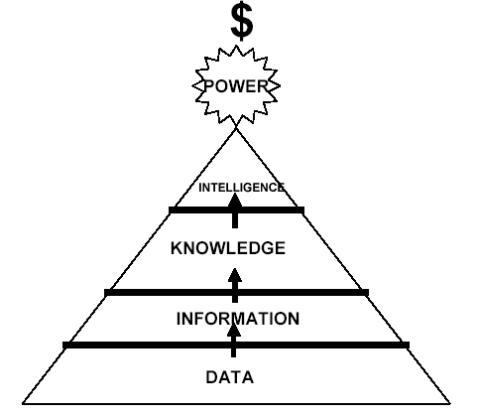
Data, information and knowledge

Slide 8
Introduction to database
Data Base can be define as
Collection of logically interrelated data that can be shared

Slide 9
Properties of Database
A database represents some aspect of the real world, sometimes called the miniworld or the universe of discourse (UoD).
A database is a logically coherent collection of data with some inherent meaning. A random assortment of data cannot correctly be referred to as a database.
A database is designed, built, and populated with data for a specific purpose. It has an intended group of users and some preconceived applications in which these users are interested.

Slide 10
Database Management System
A database management system (DBMS) is a collection of programs that enables users to create and maintain a database.
It is a general-purpose software system that facilitates the processes of defining, constructing, manipulating, and sharing databases among various users and applications.
Defining a database involves specifying the data types, structures, and constraints for the data to be stored in the database.
Constructing the database is the process of storing the data itself on some storage medium that is controlled by the DBMS.
Manipulating a database includes such functions as querying the database to retrieve specific data, updating the database to reflect changes in the miniworld, and generating reports from the data.
Sharing a database allows multiple users and programs to access the database concurrently.
We will call the database and DBMS software together a database system.

Slide 11
Example
UNIVERSITY database for maintaining information concerning students, courses, and grades in a university environment
define: file (records), data elements, data type ( for each data element)
construct: store data in the appropriate files (note that records may be related between files)
Manipulation: querying, updating
informal queries and updates must be specified precisely in the database system language before they can be processed.

Slide 12
DBMS
Users/Programmer
Application programs/Queries
DBMS
Software to process Queries/ Program
Software to access stored data
Stored database definition ( Meta data)
Stored database

Slide 13

Example
Oracle
IBM DB2
Ingress
Teradata
MS SQL Server
MS Access
MySQL etc.

Slide 14
DB Vs programming with file.
Self-Describing Nature of a Database System
single repository of data is maintained
contains not only the database itself but also a complete definition or description of the database structure and constraints (system catalogue).
information stored in the catalog is called meta-data
catalog used by the DBMS and users.
The DBMS software work equally well with any number of database applications.
Repository is a structure that stores metadata. It is used to control database operations, integrity and accuracy.

Slide 15
DB Vs programming with file.
Meta Data
Data about data OR
Data that describe the properties or characteristics of end-user data and the context of those data.
metadata contains data item name, the data type, length, minimum and maximum allowable values (where appropriate), a brief description of each data item, and the source of the data.

Slide 16
Advantages of DBS
Controlling Redundancy
Problems:
University System
Student Registration
Fee department
Library

Slide 17
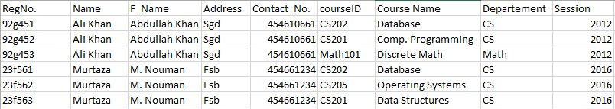
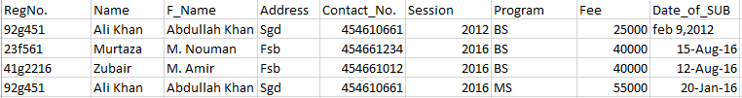
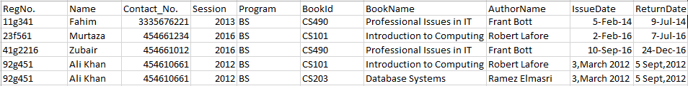
Registration
Fee
Library

Slide 18
Advantages of DBS
Controlling Redundancy
Problems:
There is the need to perform a single logical update (duplication of effort)
storage space is wasted when the same data is stored repeatedly files that represent the same data may become inconsistent
in DBMS there has the ability to control redundancy which improve the performance of the query.

Slide 19
Advantages of DBMS
Reduce data inconsistency
Data is not duplicated so need to apply only single update.
This causes consistent data.
As no row is duplicated so record of each instance is consistent and accurate.

Slide 20
Advantages of DBMS
Restricting Unauthorized Access
users or user groups are given account numbers protected by passwords, which they can use to gain access to the database through security and authorization subsystem
Providing Multiple User Interfaces
a DBMS provides a variety of user interfaces: query languages for casual users; programming language interfaces for application programmers; forms and command codes for parametric users; and menu-driven interfaces and natural language interfaces for stand-alone users.
Capabilities for providing World Wide Web access to a database

Slide 21
Advantages of DBS
Representing Complex Relationships Among Data
Enforcing Integrity Constraints
Data integrity refers to correctness and accuracy of data
The simplest type involves specifying a data type for each data item
A more complex type involves specifying that a record in one file must be related to records in other files.
Another type specifies uniqueness on data item values
It is the database designers’ responsibility to identify integrity constraints during database design.
Providing Backup and Recovery
provide facilities for recovering from hardware or software failures.(The backup and recovery subsystem )

Slide 22
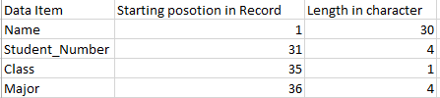
Advantages of DBMS
Program Data independence
In traditional file processing, the structure of data files is embedded in the application programs, so any changes to the structure of a file may require changing all programs that access this file.
DBMS access programs do not require such changes in most cases.
The structure of data files is stored in the DBMS catalog separately from the access programs. We call this property program-data independence.

Slide 23
Advantages of DBMS
Improved data access:
Provide access mechanism to database to perform tasks ( insert update and delete etc).
Hide the internal complexity of database from application programmer and users.
Enables the data in database to be shared among multiple application or users.

