Slide 1
Database system
Nasreen akhtar
FAST-NU
Faisalabad Chiniot Campus

Slide 2
Topics
Single VS multi user system
Transaction
Properties of transaction
Concurrency control and recovery methods.

Slide 3
Objective
compares single-user and multiuser database systems and demonstrates how concurrent execution of transactions can take place in multiuser systems.
To get knowledge about transaction and its properties
How Problem of concurrency occurs in multiuser system
Recovery methods
Serial Schedule, non serial schedule and conflict schedule
Method use to handle concurrency

Slide 4
Single user Vs multiuser System
A DBMS is single-user if at most one user at a time can use the system
It is multiuser if many users can use the system—and hence access the database—concurrently
For example, an airline reservations system is used by hundreds of travel agents and reservation clerks concurrently. Database systems used in banks, insurance agencies, stock exchanges, supermarkets, and many other applications are multiuser systems.
In these systems, hundreds or thousands of users are typically operating on the database by submitting transactions concurrently to the system.

Slide 5
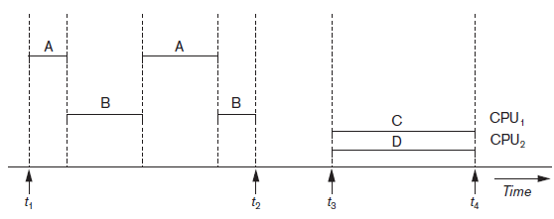
Single user Vs multiuser System
Multiple users can access databases—and use computer systems simultaneously because of the concept of multiprogramming, which allows the operating system of the computer to execute multiple programs—or processes—at the same time.
A single central processing unit (CPU) can only execute at most one process at a time.
However, multiprogramming operating systems execute some commands from one process, then suspend that process and execute some commands from the next

Slide 6
Transaction
A transaction is the basic logical unit of execution in an information system
A transaction is a sequence of operations that must be executed as a whole, taking a consistent (& correct) database state into another consistent (& correct) database state;
A collection of actions that make consistent transformations of system states while preserving system consistency
transaction includes one or more database access operations—these can include insertion, deletion, modification, or retrieval operations
database in a consistent state
database in a consistent state
Account A Fred Bloggs £1000
Transfer £500
Account A Fred Bloggs £500
Account B Sue Smith £0
Account B Sue Smith £500
begin Transaction
execution of Transaction
end Transaction
database may be temporarily in an inconsistent state during execution

Slide 7
Read only and write Transaction
If the database operations in a transaction do not update the database but only retrieve data, the transaction is called a read-only transaction
If the database operation in a transaction retrieve as well as update the database, is known as a read-write transaction.
A database is basically represented as a collection of named data items
The size of a data item is called its granularity
read_item(X). Reads a database item named X into a program variable. To simplify our notation, we assume that the program variable is also named X.
■ write_item(X). Writes the value of program variable X into the database item named X.

Slide 8
Desirable property of transaction
1 ACID properties:
Atomicity: A transaction is an atomic unit of processing; it is either performed in its entirety or not performed at all.
Execute a transaction to completion.
Transaction recovery subsystem of a DBMS is responsible to ensure atomicity.
If a transaction fails to complete for some reason, such as a system crash in the midst of transaction execution, the recovery technique must undo any effects of the transaction on the database.

Slide 9
2 ACID properties
Consistency preservation: A correct execution of the transaction must take the database from one consistent state to another.
The preservation of consistency is the responsibility of the programmers who write the database programs or of the DBMS module that enforces integrity constraints.
A database state is a collection of all the stored data items (values) in the database at a given point in time.
A database program should be written in a way that guarantees that, if the database is in a consistent state before executing the transaction, it will be in a consistent state after the complete execution of the transaction

Slide 10
3 ACID Property
Isolation: A transaction should not make its updates visible to other transactions until it is committed; this property, when enforced strictly, solves the temporary update problem and makes cascading rollbacks of transactions unnecessary
The isolation property is enforced by the concurrency control subsystem of the DBMS
Every transaction does not make its updates (write operations) visible to other transactions until it is committed
4 ACID Property
Durability or permanency: Once a transaction changes the database and the changes are committed, these changes must never be lost because of subsequent failure.

Slide 11


Concurrency
When multiple users have the ability to access the same resource and each user access to the resource and alter them simultaneously then this problem is called Concurrency.
Concurrency is high when there is no apparent wait time for a user to get its request. Concurrency is low when wait times are evident isolation
For example
time: 10:00AM time:10:01
Withdraw 5000
Read (X)
X=X-5000
Write(X)
Before transaction X=10000
Withdraw 7000
Read X
X=X-7000
Write(X)
After transaction X=3000

Slide 12
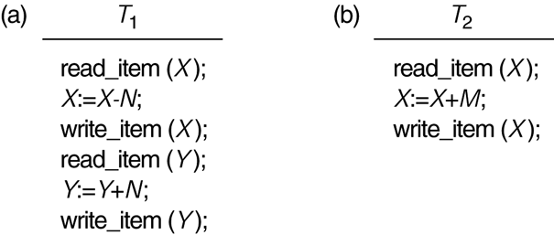
Two sample of transaction
Two sample transactions:
(a) Transaction T1
(b) Transaction T2

Slide 13
Concurrency control
Why Concurrency Control is needed:
The Lost Update Problem
This occurs when two transactions that access the same database items have their operations interleaved in a way that makes the value of some database item incorrect.
The Temporary Update (or Dirty Read) Problem
This occurs when one transaction updates a database item and then the transaction fails for some reason
The updated item is accessed by another transaction before it is changed back to its original value.
The Incorrect Summary Problem
If one transaction is calculating an aggregate summary function on a number of records while other transactions are updating some of these records, the aggregate function may calculate some values before they are updated and others after they are updated.

Slide 14
(a) The lost update problem (write write conflict)
Two transactions accessing the same database item have their operations interleaved in a way that makes the database item incorrect
item X has incorrect value because its update from T1 is “lost” (overwritten)
T2 reads the value of X before T1 changes it in the database and hence the updated database value resulting from T1 is lost
X=4
Y=8
N=2
M=3

Slide 15
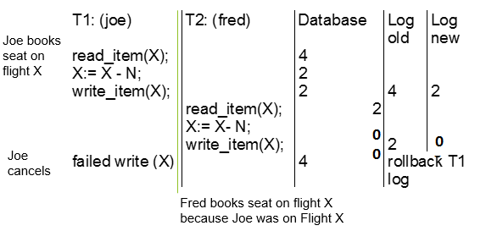
(b) The temporary update problem.
One transaction updates a database item and then the transaction fails. The updated item is accessed by another transaction before it is changed back to its original value
transaction T1 fails and must change the value of X back to its old value
meanwhile T2 has read the “temporary” incorrect value of X

Slide 16
(c) The incorrect summary problem.
One transaction is calculating an aggregate summary function on a number of records while other transactions are updating some of these records.
The aggregate function may calculate some values before they are updated and others after.
T2 reads X after N is subtracted and reads Y before N is added, so a wrong summary is the result

Slide 17
Concurrency control
Concurrency Control
Most DBMS are multi-user systems.
The concurrent execution of many different transactions submitted by various users must be organized such that each transaction does not interfere with one another in a way that produces incorrect results.
The concurrent execution of transactions must be such that each transaction appears to execute in isolation.
Recovery
System failures, either hardware or software, must not result in an inconsistent database

Slide 18
Why recovery is needed
Whenever a transaction is submitted to a DBMS for execution, the system is responsible for making sure that either all the operations in the transaction are completed successfully and their effect is recorded permanently in the database( known as committed).
The transaction does not have any effect on the database or any other transactions (transaction is aborted)
Failures are generally classified as transaction, system, and media failures. There are several possible reasons for a transaction to fail in the middle of execution:

Slide 19
Type of failure
A computer failure (system crash).
A hardware, software, or network error occurs in the computer system during transaction execution
A transaction or system error.
Some operation in the transaction may cause it to fail, such as integer overflow or division by zero.
Transaction failure may also occur because of erroneous parameter values or because of a logical programming error
Additionally, the user may interrupt the transaction during its execution.
3. Local errors or exception conditions detected by the transaction.
During transaction execution, certain conditions may occur that necessitate cancellation of the transaction. For example, data for the transaction may not be found.
insufficient account balance in a banking database, may cause a transaction, such as a fund withdrawal, to be canceled. This exception could be programmed in the transaction itself, and in such a case would not be considered as a transaction failure.

Slide 20
Type of failure
Concurrency control enforcement.
The concurrency control method may decide to abort a transaction because it violates serializability or it may abort one or more transactions to resolve a state of deadlock among several transactions
Disk failure. Some disk blocks may lose their data because of a read or write malfunction or because of a disk read/write head crash
Physical problems and catastrophes. This refers to an endless list of problems that includes power or air-conditioning failure, fire, theft, overwriting disks or tapes by mistake
Failures of types 1, 2, 3, and 4 are more common than those of types 5 or 6.
Whenever a failure of type 1 through 4 occurs, the system must keep sufficient information to quickly recover from the failure.

Slide 21
Recovery
Mirroring
keep two copies of the database and maintain them simultaneously
Backup
periodically dump the complete state of the database to some form of tertiary storage
System Logging
the log keeps track of all transaction operations affecting the values of database items. The log is kept on disk so that it is not affected by failures except for disk and catastrophic failures.

Slide 22
Transaction State
For recovery purposes the system needs to keep track of when a transaction starts, terminates and commits.
Begin_Transaction: marks the beginning of a transaction execution;
End_Transaction: specifies that the read and write operations have ended and marks the end limit of transaction execution (but may be aborted because of concurrency control);
Commit_Transaction: signals a successful end of the transaction. Any updates executed by the transaction can be safely committed to the database and will not be undone;
Rollback (or Abort): signals that the transaction has ended unsuccessfully. Any changes that the transaction may have applied to the database must be undone;
Undo: similar to ROLLBACK but it applies to a single operation rather than to a whole transaction;
Redo: specifies that certain transaction operations must be redone to ensure that all the operations of a committed transaction have been applied successfully to the database;

Slide 23
Transaction execution
Credit_labmark (sno NUMBER, cno CHAR, credit NUMBER)
old_mark NUMBER;
new_mark NUMBER;
SELECT labmark INTO old_mark FROM enrol
WHERE studno = sno and courseno = cno FOR UPDATE OF labmark;
new_ mark := old_ mark + credit;
UPDATE enrol SET labmark = new_mark WHERE studno = sno and courseno = cno ;
COMMIT;
EXCEPTION
WHEN OTHERS THEN ROLLBACK;
END credit_labmark;
For every transaction a unique transaction-id is generated by the system.
[start_transaction, transaction-id]: the start of execution of the transaction identified by transaction-id
[read_item, transaction-id, X]: the transaction identified by transaction-id reads the value of database item X. Optional in some protocols.
[write_item, transaction-id, X, old_value, new_value]: the transaction identified by transaction-id changes the value of database item X from old_value to new_value
[commit, transaction-id]: the transaction identified by transaction-id has completed all accesses to the database successfully and its effect can be recorded permanently (committed)
[abort, transaction-id]: the transaction identified by transaction-id has been aborted

Slide 24
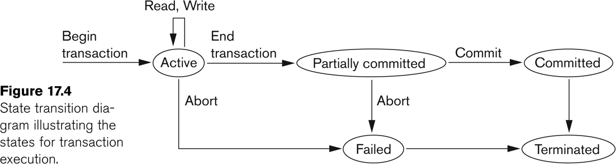
Transaction Execution
A transaction reaches its commit point when all operations accessing the database are completed and the result has been recorded in the log. It then writes a [commit, transaction-id].
If a system failure occurs, searching the log and rollback the transactions that have written into the log a
[start_transaction, transaction-id]
[write_item, transaction-id, X, old_value, new_value]
but have not recorded into the log a [commit, transaction-id]

Slide 25
System log
To be able to recover affect transaction from failures , the system maintains a log
To keep track of all transaction operations that affect the values of database items, as well as other transaction information that may be needed to permit recovery from failures.
The log is a sequential, append-only file that is kept on disk, so it is not affected by any type of failure except for disk or catastrophic failure
One (or more) main memory buffers hold the last part of the log file, so that log entries are first added to the main memory buffer.
When the log buffer is filled, or when certain other conditions occur, the log buffer is appended to the end of the log file on disk.
The log file from disk is periodically backed up to archival storage (tape) to guard against catastrophic failures.

Slide 26
System log
[start_transaction, T]. Indicates that transaction T has started execution.
[write_item, T, X, old_value, new_value]. Indicates that transaction T has changed the value of database item X from old_value to new_value.
[read_item, T, X]. Indicates that transaction T has read the value of database item X.
[commit, T]. Indicates that transaction T has completed successfully, and affirms that its effect can be committed (recorded permanently) to the database.
[abort, T]. Indicates that transaction T has been aborted.

Slide 27
Commit point of a transaction
A transaction T reaches its commit point when all its operations that access the database have been executed successfully and the effect of all the transaction operations on the database have been recorded in the log.
The transaction then writes a commit record [commit, T] into the log.
If a system failure occurs, it is possible to search back in the log for all transactions T that have written a [start transaction, T] record into the log

Slide 28
Transaction as a Concurrency Unit
Transactions must be synchronized correctly to guarantee database consistency
T1
Account B Sue Smith £0
Account A Fred Bloggs £500
Transfer £500 from A to B
Account B Sue Smith £500
Account A Fred Bloggs £1000
T1
Account A Fred Bloggs £800
Account C Jill Jones £700
Transfer £300
from C to A
Account C Jill Jones £400
Net result
Account A 800
Account B 500
Account C 400

Slide 29
schedule
Ordering of execution of operations from various transactions T₁, T₂, … , T_{n} is called a schedule S
Definition of Schedule (or history)
Schedule S of n transactions T₁, T₂, … , T_{n} is an ordering of the operations of the transactions subject to the constraint that, for each transaction T_{i} that participates in S, the operations of T_{i} in S must appear in the same order in which they occur in T_{i}.
Characteristics of a transaction schedule will determine
whether it is “easy” to recover from transaction failures
whether concurrent execution of transactions is “correct”

Slide 30
Characterizing schedule based on recovery
When transactions are executing concurrently in an interleaved fashion, then the order of execution of operations from all the various transactions is known as a schedule (or history)
Characterize the types of schedules that facilitate recovery when failures occur.
Schedule of transaction
A schedule (or history) S of n transactions T1, T2, ..., Tn is an ordering of the operations of the transactions.
Operations from different transactions can be interleaved in the schedule S
for each transaction Ti that participates in the schedule S, the operations of Ti in S must appear in the same order in which they occur in Ti.

Slide 31
Example of a schedule
Transaction T₁: r₁(X); w₁(X); r₁(Y); w₁(Y); c₁
Transaction T₂: r₂(X); w₂(X); c₂
A schedule, S:
r₁(X); r₂(X); w₁(X); r₁(Y); w₂(X); w₁(Y); c₁; c₂

Slide 32
Example of a schedule
Consider the following transaction schedule
r₁(X) w₁(X) r₂(X) r₁(Y) r₂(Y) c₂ w₁(Y) a₁
If T₁ aborts, do we need to rollback the committed transaction T₂?
Answer: No
Schedule is recoverable”
This type of schedule makes the recovery process more cumbersome because we have to rollback transactions that have committed

Slide 33
Recoverable schedule
A schedule where no committed transactions need to be rolled back
A transaction T must not commit until all transactions T’ that have written an item that T reads have committed
Examples:
r₁(X) w₁(X) r₂(X) r₁(Y) w₂(X) c₂ a₁
Nonrecoverable (T₂ must be rolled back when T₁ aborts)
r₁(X) r₂(X) w₁(X) r₁(Y) w₂(X) c₂ w₁(Y) a₁
Recoverable (T₂ does not have to be rolled back when T₁ aborts)
r₂(X) w₂(X) r₁(X) r₁(Y) w₁(X) c₂ w₁(Y) a₁
Recoverable (T₂ does not have to be rolled back when T₁ aborts)

Slide 34
Is Recoverable Schedule Sufficient?
Example:
r₁(X) w₁(X) r₂(X) w₂(X) a₁
Recoverable because T₂ has not committed before T₁
But the uncommitted transaction T₂ must still be aborted when T₁ aborts (cascading rollback)
Cascade schedule
If we have T1,T2,T3,…..Tn transaction and if Ti fail then abort all other transaction

Slide 35
Is Recoverable Schedule Sufficient?
Example:
r₁(X) w₁(X) r₂(X) w₂(X), r₃(X) w₃(X), a₁
Transaction t1 abort so t2 and t3 also abort
Cascade less schedule
A schedule with no cascading rollback, i.e., if a transaction T is aborted, we only need to rollback T and no other transactions
How do we ensure this?
Every transaction in the schedule reads only items that were written by committed transactions

Slide 36
Is Recoverable Schedule Sufficient?
If T_{i} read item X written by some transaction T_{j}
T_{j} commit before T_{i} reads
Examples:
r₁(X) w₁(X) r₂(X) r₃(X) w₂(X) c₂ a₁
Must rollback T₂ and T₃ (Not recoverable, not cascadeless)
r₁(X) r₂(X) w₁(X) r₃(X) w₂(X) c₂ a₁
Must rollback T₃ only (Recoverable, not cascadeless)
r₁(X) r₂(X) r₃(X) w₁(X) c₂ a₁
No need to rollback T₂ nor T₃ (Recoverable, cascadeless)
Cascadeless schedules are recoverable and avoid cascading rollback

Slide 37
cascadless Schedules
with concurrency, it is not always possible to restore the database to its original state after abort using the before image of data item
If T_{i} read/write item X written by some transaction T_{j}
T_{j} commit before T_{i} reads/writes
Example:
r₂(X) r₁(X) w₁(X) w₂(X) a₁
Is the transaction recoverable?
Is the transaction cascade less?
If the original value for X is 5, T₁ modifies X to 10 and T₂ modifies it to 8. After we undo the changes of T₁, will X returned to a correct value?

Slide 38
Strict Schedule
A schedule in which we can restore the database to a consistent state after abort using the before image (rollback) of data item
A schedule in which a transaction can neither read nor write an item X until the last transaction that wrote X has committed or aborted
Example:
S: r1(X) w₁(X) a₁r₂(X) w₂(X)
S: r1(X) w₁(X) c₁r₂(X) w₂(X)
r₂(X) r₁(X) w₁(X) w₂(X) a₁
Schedule is cascadeless but not strict

Slide 39
Characterizing schedule based on serializibility
A schedule S is serial if all operations in transactions are executed consecutively in the schedule
Otherwise, it is called nonserial schedule
for example, two airline reservations agents—submit to the DBMS transactions T1 and T2 at approximately the same time. If no interleaving of operations is permitted, there are only two possible outcomes:
Execute all the operations of transaction T1 (in sequence) followed by all the operations of transaction T2 (in sequence).
Execute all the operations of transaction T2 (in sequence) followed by all the operations of transaction T1 (in sequence).

Slide 40
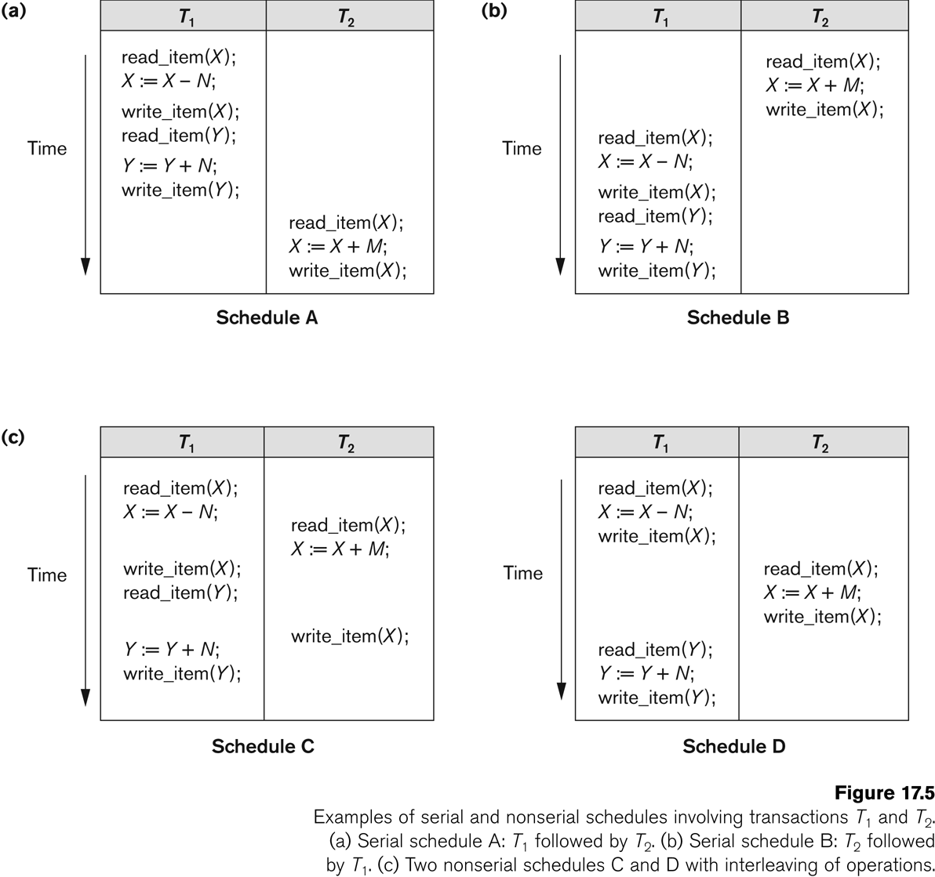
Characterizing schedule based on serializibility
Serial: r₁(X) w₁(X) r₁(Y) w₁(Y) r₂(X) w₂(X)
Nonserial: r₁(X) w₁(X) r₂(X) w₂(X) r₁(Y) w₁(Y)

Slide 41
Serial and Non-serial Schedules
A schedule S is serial if, for every transaction T participating in the schedule, all of T's operations are executed consecutively in the schedule; otherwise it is called non-serial.
Non-serial schedules mean that transactions are interleaved. There are many possible orders or schedules.
Serialisability theory attempts to determine the 'correctness' of the schedules.
A schedule S of n transactions is serialisable if it is equivalent to some serial schedule of the same n transactions.

Slide 42
Example
Schedule A
Schedule B

Slide 43
Example of Non-serial Schedules
Schedule C
Schedule D
We have to figure out whether a schedule is equivalent to a serial schedule
i.e. the reads and writes are in the right order

Slide 44
Disadvantages
CPU wastage
Smaller transaction may wait for a very long time.

Slide 45
Conflict Serializable
A schedule S is said to be conflict serializable if it is conflict equivalent to some serial schedule of the same transactions
Two schedules are said to be conflict equivalent if the order of any two conflicting operations is the same in both schedules
Two operations in a transaction schedule are in conflict if
They belong to different transactions
They access the same data item
At least one of them is a write operation
If a schedule is conflict serializable, we can reorder the nonconflicting operations until we form an equivalent serial schedule

Slide 46
Conflict serializablity
If schedule is equivalent to some serial schedule then it is called conflict serializable
s1 |  |  | s2
t1 | t2 |  | t1 | t2
Read(A) |  |  | Read(A)
Write(A) |  |  | Write(A)
 | READ(A) |  | Read(b)
 | Write(A) |  | Write(B)
Read(B) |  |  |  | Read(A)
Write(B) |  |  |  | Write(A)
 | Read(B) |  |  | Read(B)
 | Write(B) |  |  | Write(B)

Slide 47
Testing for Conflict Serializability
Construct a precedence graph (serialization graph) where
Nodes are the transactions
Create anode for each transaction
A directed edge T_{i} → T_{j} read a value of an item written by T_{j}
Create edge T_{i} → T_{j} if T_{j} writes a values into item it has been read by T_{i}
Create edge T_{i} → T_{j} if T_{j} writes after T_{i} writes ( w_{i}(X) w_{j}(X))
A schedule is conflict serializable if and only if the precedence graph has no cycles.

Slide 48
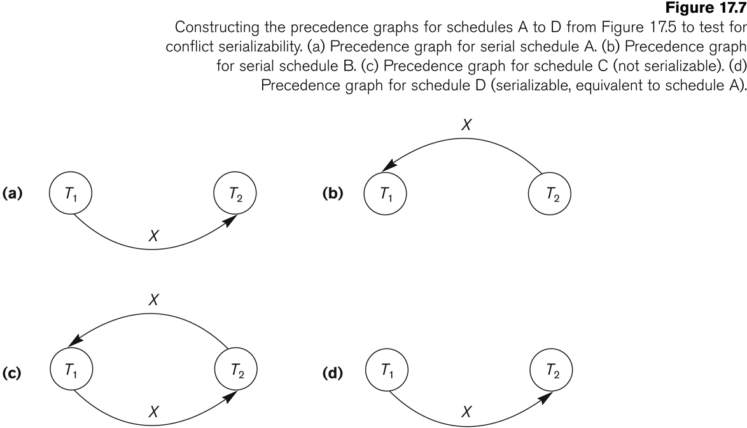
Testing for Conflict Serializability

Slide 49
Testing for Conflict Serializability
This schedule is non-serializable because precedence graph has a cycle

Slide 50
Testing for Conflict Serializability

Slide 51
Equivalent Serial Schedule
If a schedule S is conflict serializable, we can create an equivalent serial schedule S’ as follows:
Whenever an edge exists in the precedence graph from T_{i} to T_{j}, T_{i} must appear before T_{j} in the equivalent serial schedule
Schedule A is the equivalent serial schedule for schedule D
Precedence graph for schedule D

Slide 52
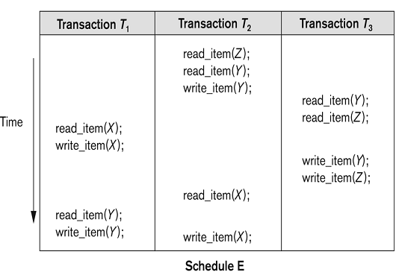
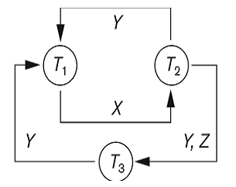
Equivalent Serial Schedule
Is it conflict serializable?
What is the equivalent serial schedule?

Slide 53
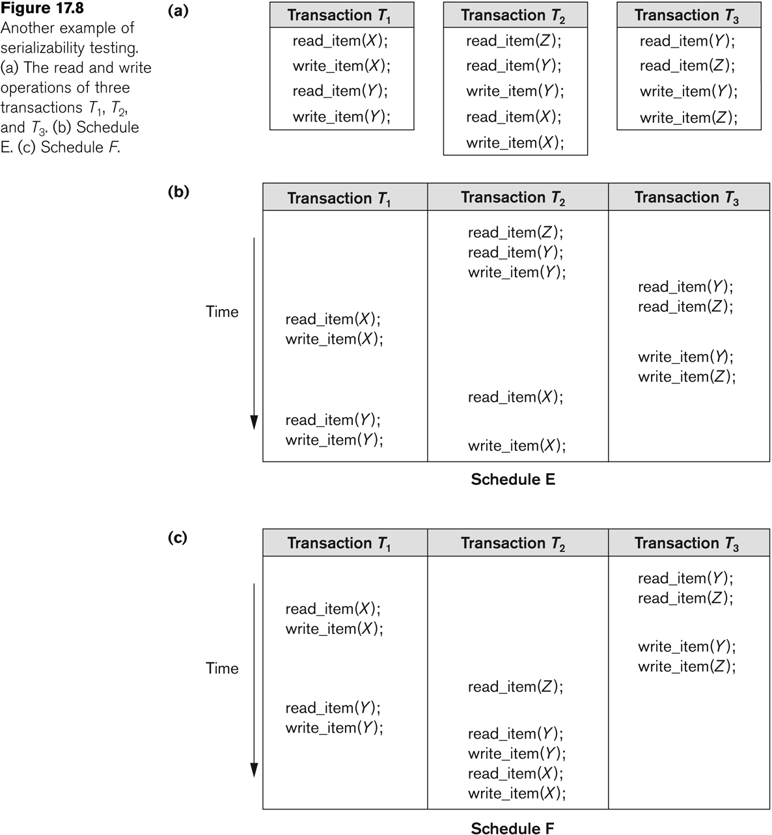
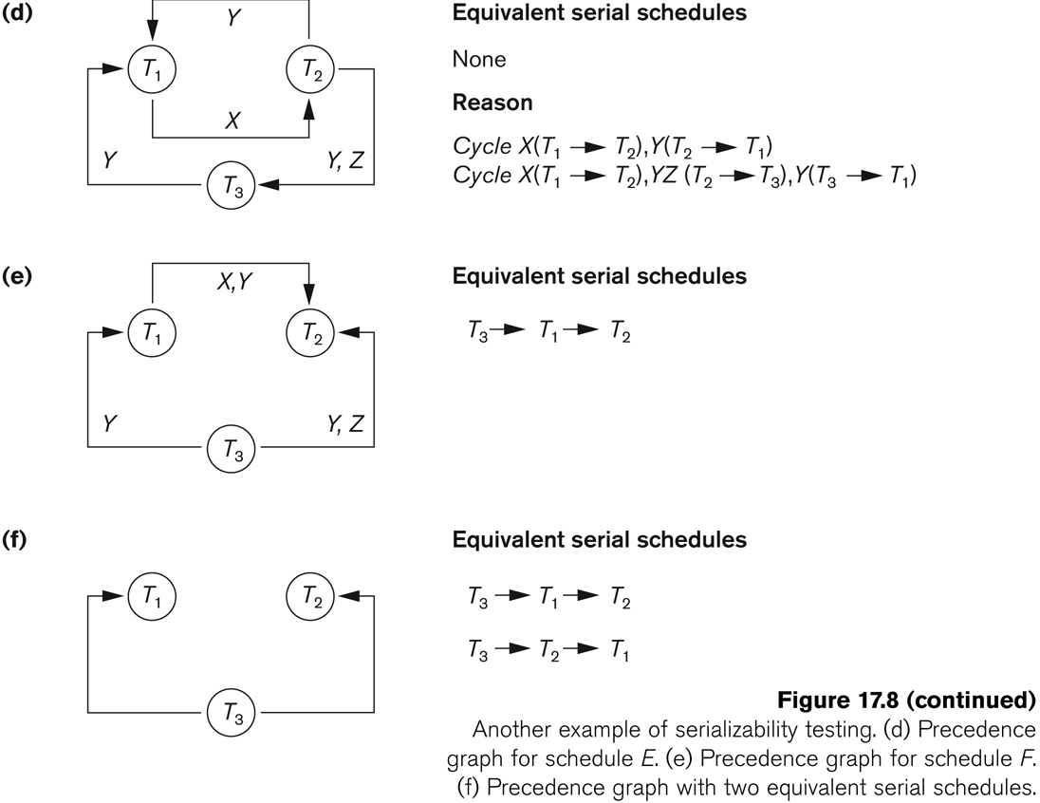
Equivalent Serial Schedule
Is it conflict serializable?
What is the equivalent serial schedule?

Slide 54
Characterizing Schedules based on Serializability
Summary
Serial schedule is inefficient (no parallelism)
Serializable schedule gives benefits of concurrent executions without giving up correctness
Concurrency control subsystem of DBMS must use certain protocol to ensure serializability of all schedules in which the transactions participate
2-Phase locking protocol (Chapter 22)
May cause deadlocks
DBMS will automatically abort one of the transactions, releasing the locks for other transactions to continue

Slide 55
Class task
Draw a directed graph for the following schedule to test whether it is conflict serializable or not.
S: R2(Z)R2(y)w2(Y)r3(y)w2(Y)r1(x)r2(x)w1(x)w2(x)

Slide 56
Conflict serializibilty
A schedule S is said to be conflict serializable if it is conflict equivalent to some serial schedule of the same transactions
Two schedules are said to be conflict equivalent if the order of any two conflicting operations is the same in both schedules
Two operations in a transaction schedule are in conflict if
They belong to different transactions
They access the same data item
At least one of them is a write operation
If a schedule is conflict serializable, we can reorder the nonconflicting operations until we form an equivalent serial schedule

Slide 57
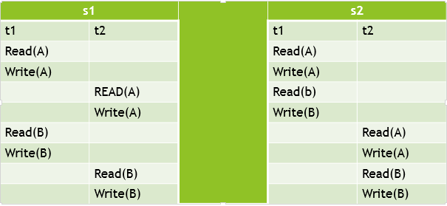
Conflict serializibilty
If schedule is equivalent to some serial schedule then it is called conflict serializable

Slide 58
Testing for Conflict Serializability
Construct a precedence graph (serialization graph) where
Nodes are the transactions
Create anode for each transaction
A directed edge T_{i} → T_{j} read a value of an item written by T_{j}
Create edge T_{i} → T_{j} if T_{j} writes a values into item it has been read by T_{i}
Create edge T_{i} → T_{j} if T_{j} writes after T_{i} writes ( w_{i}(X) w_{j}(X))
A schedule is conflict serializable if and only if the precedence graph has no cycles.

Slide 59
Example
No cycle
conflict serializable
T1 | T2 | T3
R(X)
 | R(z)
R(Z) |  | R(X)
 |  | R(Y)
 | R(Y) | W(X)
 | W(Z)
 | W(Y)
T2
T1
T3

Slide 60
Example
cyclic
Not a conflict serializable
T1 | T2 | T3
R(X)
 |  | R(X)
 |  | W(X)
W(X)
 | R(X)
T2
T1
T3

Slide 61
Testing for Conflict Serializability

Slide 62
Testing for Conflict Serializability

Slide 63
Testing for Conflict Serializability

Slide 64
Testing for Conflict Serializability
Is it conflict serializable?
What is the equivalent serial schedule?
No because of cycle

Slide 65
Testing for Conflict Serializability
Is it conflict serializable?
What is the equivalent serial schedule?

Slide 66
Concurrency control technique Two phase locking
2PL grantee serializibility
Lock is a variable associated with a data item that describes the status of the item with respect to possible operations
Locks are used as a means of synchronizing the access by concurrent transactions to the database items.
A binary lock can have two states or values: locked and unlocked (or 1 and 0)
A distinct lock is associated with each database item X. If the value of the lock on X is 1, item X cannot be accessed by a database operation that requests the item
If the value of the lock on X is 0, the item can be accessed when requested, and the lock value is changed to 1.

Slide 67
Type of lock
Three types of operations are perform
read_lock(X)
write_lock(X)
unlock(X)
There are two type of lock
A read-locked item is also called share-locked because other transactions are allowed to read the item.
A write-locked item is called exclusive-locked because a single transaction exclusively holds the lock on the item.

Slide 68
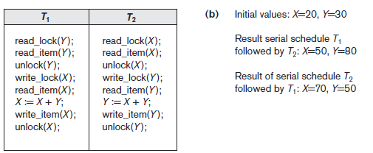
Let’s assume serial schedule S1: T1;T2

Slide 69
2PL
Let’s run T1 and T2 in interleaved fashion
Schedule S
T1
read_lock(Y);
read_item(Y);
unlock(Y);
write_lock(X);
read_item(X);
X:=X+Y;
write_item(X);
unlock(X);
T2
read_lock(X);
read_item(X);
unlock(X);
write_lock(Y);
read_item(Y);
Y:=X+Y;
write_item(Y);
unlock(Y);
unlocked too early!
Non serializible
Result: X=50, Y=50

Slide 70
2PL
A transaction is said to follow the two-phase locking protocol if
Before operating on any object, the transaction first acquires a lock on that object (the locking phase)
After releasing a lock, the transaction never acquires any more lock (the unlocking phase )
In any transaction, all locks must precede all unlock all locking operations

Slide 71
2PL
2PL has two phases
Growing phase : during which new locks on items can be acquired but none can be released
Shrinking phase : during which existing locks can be released but no new locks new locks can be acquired
Let’s assume serial schedule S1: T1;T2
Initial values: X=20, Y=30 → Result: X=50, Y=80

Slide 73
Variations
Conservative 2PL (static) 2PL: Lock all items needed BEFORE execution begins by predeclaring its read and write set
If any of the items in read or write set is already locked (by other transactions), transaction waits (does not acquire any locks)
Deadlock free but not very realistic

Slide 74
Variations
Strict 2PL: Transaction does not release its write locks until AFTER it aborts/commits
Not deadlock free but guarantees recoverable schedules (strict schedule: transaction can neither read/write X until last transaction that wrote X has committed/aborted)
Most popular variation of 2PL

Slide 75
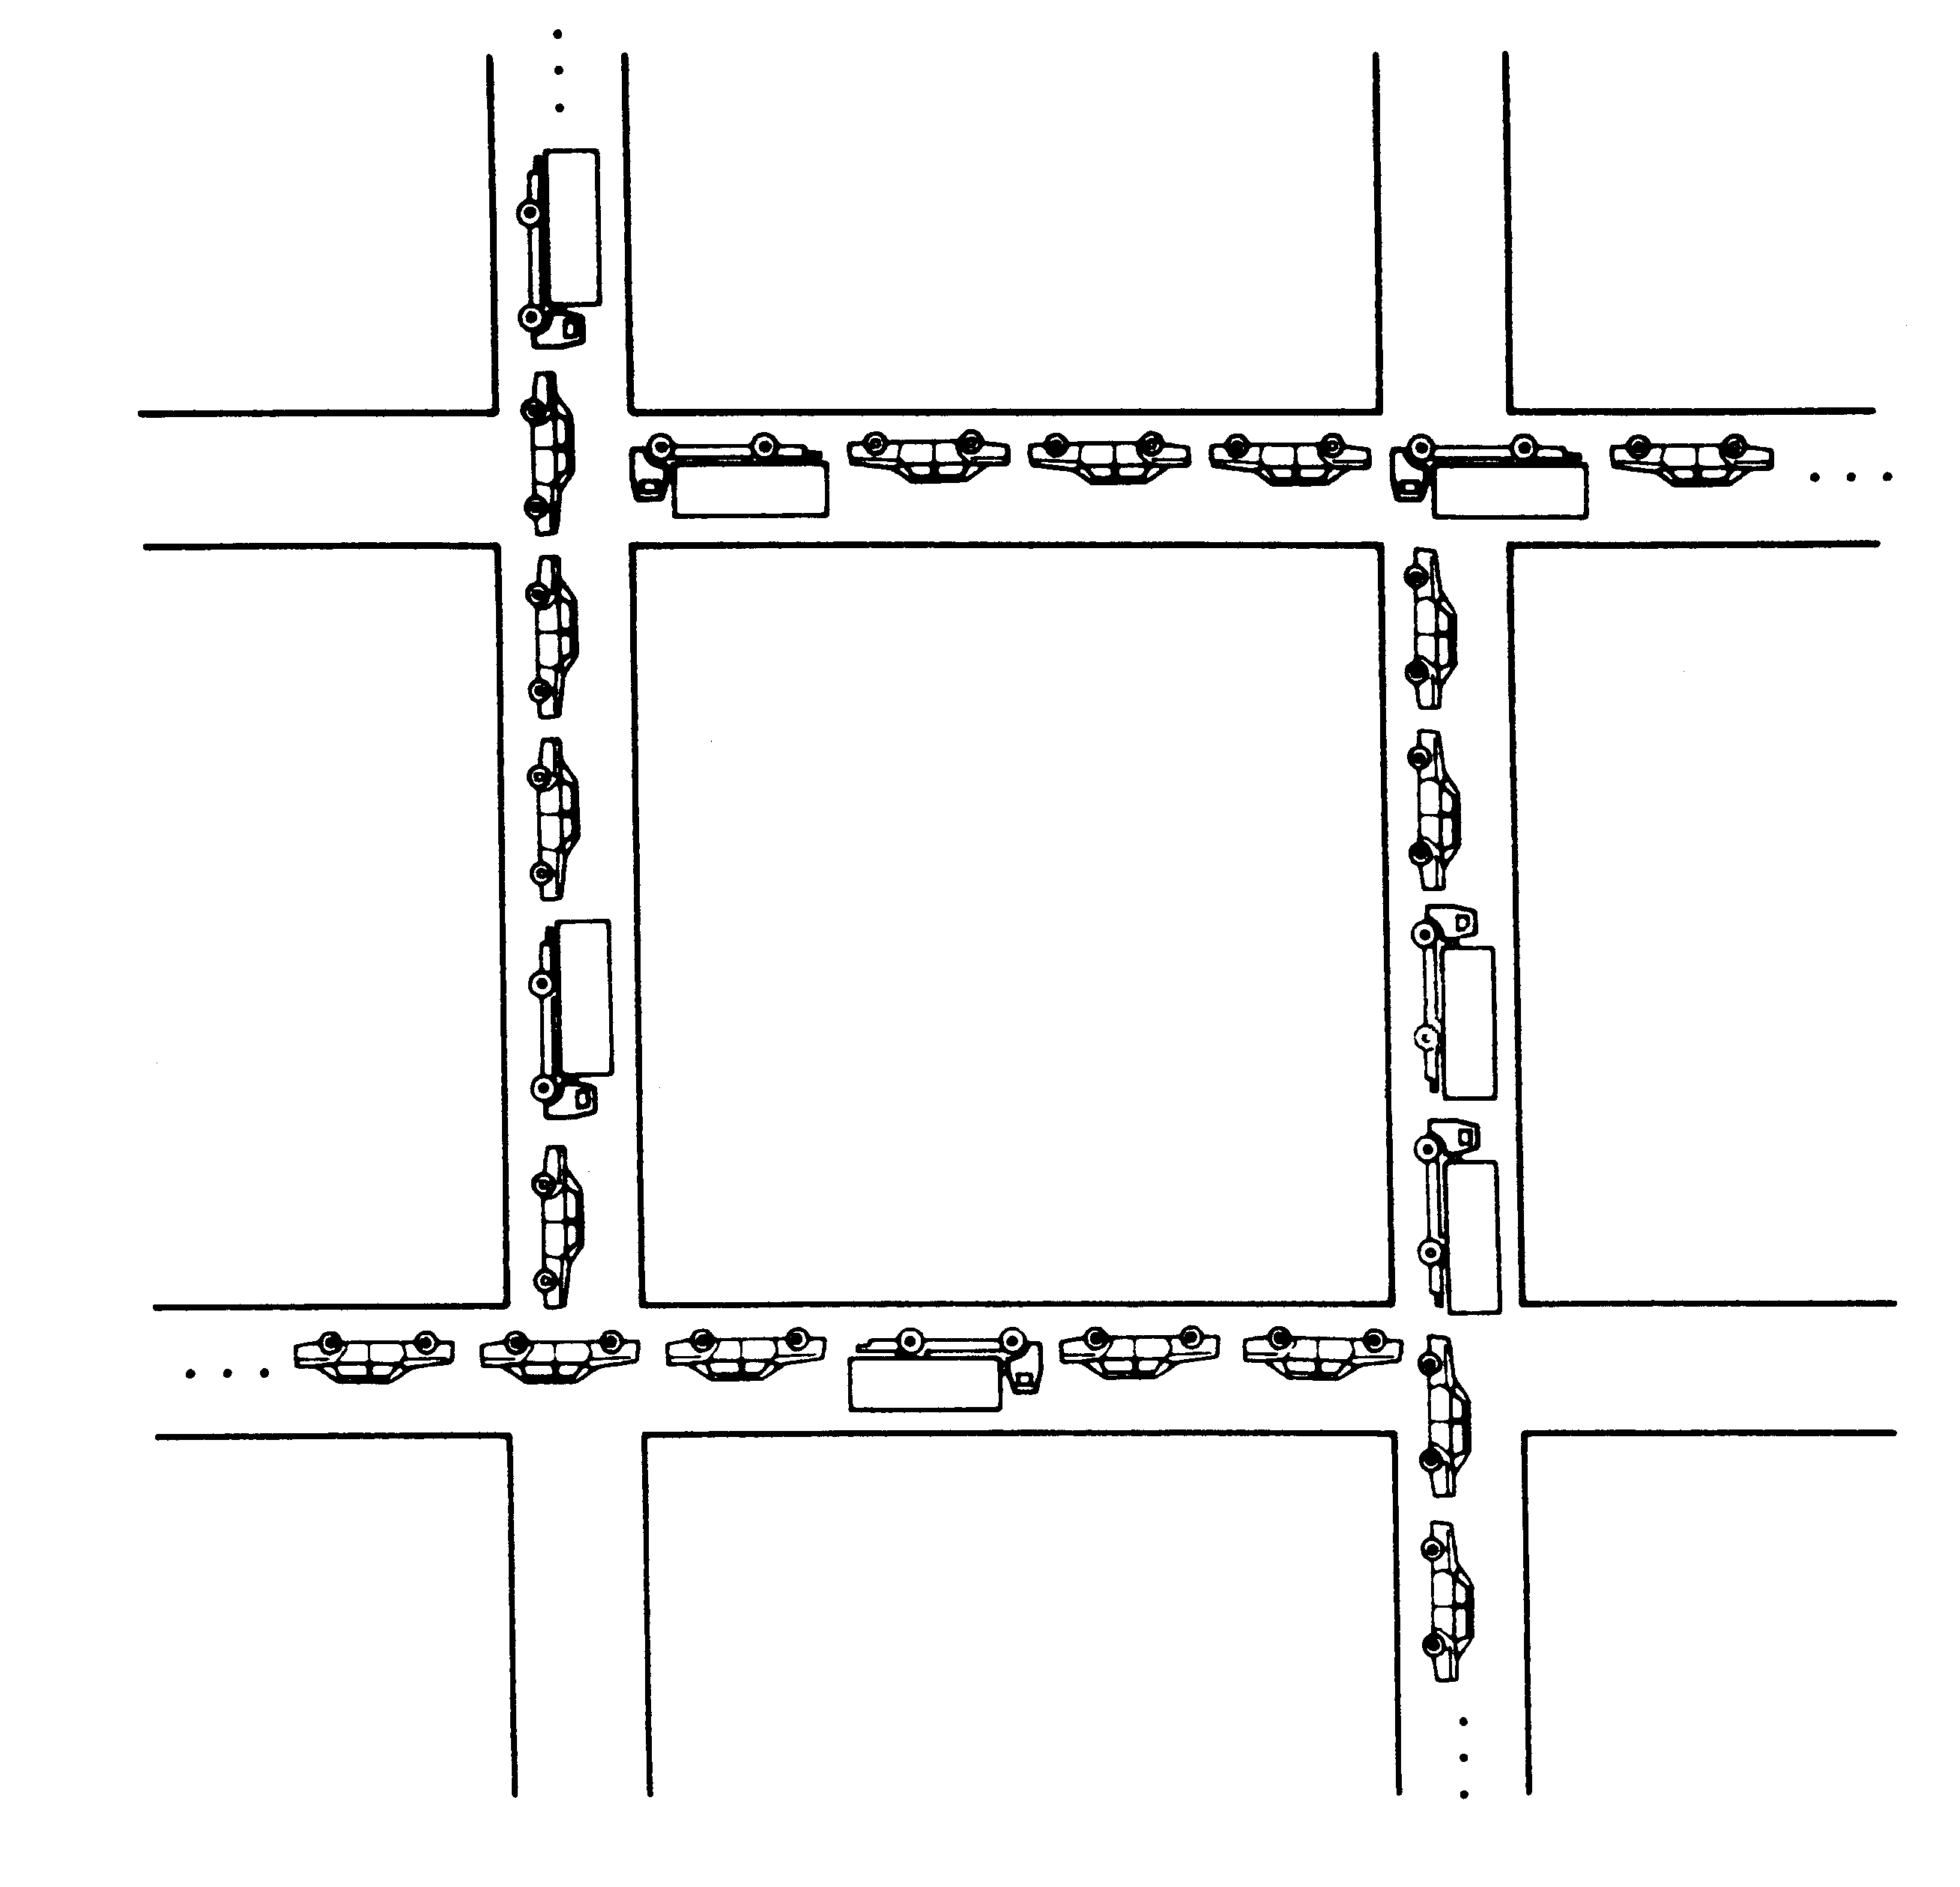
deadlock
Deadlock is a cycle of transactions that are all waiting for another transaction in the cycle to release a lock.
Deadlock occurs when each transaction T in a set of two or more transactions is waiting for some item that is locked by some other transaction T in the set. Hence, each transaction in the set is in a waiting queue, waiting for one of the other transactions in the set to release the lock on an item. But because the other transaction is also waiting, it will never release the lock.

Slide 76
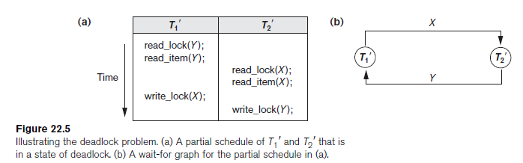
DEADLOCK

Slide 77
Four Reason for Deadlock
Mutual exclusion: only one process at a time can use a data item/ resource
Hold and wait: a process holding at least one data item/resources and is waiting to acquire additional data item/ resources held by other processes
No preemption: a data item/resource can be released only voluntarily by the process holding it, after that process has completed its task
Circular wait: there exists a set {T₀, T₁, …, T₀} of waiting transaction such that T₀ is waiting for a data item/resource that is held by T₁, and T₁ is waiting for a data item/resource that is held by
T₂, …, T_{n–1} is waiting for a data item that is held by T_{n}, and T₀ is waiting for a data item that is held by T₀.

Slide 78
Deadlock prevention
Different techniques are used to prevent deadlock
Deadlock deduction
Wait for graph
Deadlock prevention

Slide 79
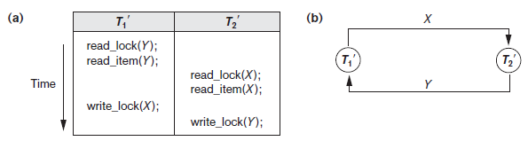
Deadlock
Deadlock occurs when each transaction T in a set of two or more transactions is waiting for some item that is locked by some other transaction T in the set.
Each transaction in the set is in a waiting queue, waiting for one of the other transactions in the set to release the lock on an item. But because the other transaction is also waiting, it will never release the lock

Slide 80
Deadlock avoidance
There are four reasons of deadlock
Mutual exclusion: only one transaction at a time can use a data item/ resource
Hold and wait: a transaction holding at least one data item/resources and is waiting to acquire additional data item/ resources held by other trasaction
No preemption: A data item/resource can be released only voluntarily by a transaction holding it, after that other transaction has completed its task
Circular wait: there exists a set {T₀, T₁, …, T₀} of waiting transaction such that T₀ is waiting for a data item/resource that is held by T₁, and T₁ is waiting for a data item/resource that is held by
T₂, …, T_{n–1} is waiting for a data item that is held by T_{n}, and T₀ is waiting for a data item that is held by T₀.

Slide 81
Deadlock avoidance
To avoid deadlock to occur avoid all the four situation

Slide 82
Deadlock avoidance
In advance lock all the data item a transaction need.
Bring a transaction in safe state.
A transaction is in safe state if it is not in a state of deadlock and can locked maximum available data item
Deadlock avoidance algorithms try not to lock data item to a transaction if it will make the system in an unsafe state.
Since acquiring data item is not done right away in some cases, deadlock avoidance algorithms also suffer from low resource utilization problem.

Slide 83
Deadlock detection
Use wait for graph technique
Most simple way to detect deadlock is to draw a wait for graph.
If there is a cycle then transactions are in the state of deadlock
Algorithm:
G=(V,E)
V represent nodes describing transaction
E represents edge
Draw edge from Ti to Tj if Ti is waiting for a data item locked by Tj

Slide 84
Deadlock detection
Transaction | Data Item | Locked Mode
T1 | Q | Shared
T2 | Q | Exclusive
 | P | Exclusive
T3 | Q | Shared
T4 | P | Exclusive
 | Q | Exclusive
T1
T2
T3
T4
NO cycle so this schedule is not in the state of deadlock

Slide 85
Deadlock prevention
There are four condition that causes deadlock to occur
Mutual exclusion: data item are not shareable
Hold and Wait: transaction is waiting for resources held by some other transaction
Non-Preemption: A transaction held a data item and is not ready to unlock until it complete its processing.
Circular wait: Transaction T1 waiting for data item locked by T2 and T2 is waiting for data item locked by T3, and Tn is waiting for data item locked by transaction T1
T1
T5
T2
T3
T4

Slide 86
Deadlock prevention
One way to prevent deadlock is to use a deadlock prevention protocol
One deadlock prevention protocol, which is used in conservative two-phase locking,
Every transaction lock all the items it needs in advance
This approach is generally not a practical assumption
if any of the items cannot be obtained, none of the items are locked
The transaction waits and then tries again to lock all the items it needs

Slide 87
Deadlock prevention
Use of Timestamp
The timestamps are typically based on the order in which transactions are started; hence, if transaction T1 starts before transaction T2, then TS(T1)< TS(T2)
The older transaction (which starts first) has the smaller timestamp value
Two schemes that prevent deadlock are
wait-die and
Wound wait.

Slide 88
Deadlock prevention
Wait and die
If TS(Ti) < TS(Tj), then (Ti older than Tj) Ti is allowed to wait; otherwise (Ti younger than Tj) abort Ti (Ti dies) and restart it later with the same timestamp.
In wait-die, an older transaction is allowed to wait for a younger transaction, whereas a younger transaction requesting an item held by an older transaction is aborted and restarted.

Slide 89
Deadlock prevention
Wound and Wait
If TS(Ti) < TS(Tj), then (Ti older than Tj) abort Tj (Ti wounds Tj) and restart it later with the same timestamp; otherwise (Ti younger than Tj) Ti is allowed to wait.
The wound-wait approach does the opposite
A younger transaction is allowed to wait for an older one, whereas an older transaction requesting an item held by a younger transaction preempts the younger transaction by aborting it
Both schemes end up aborting the younger of the two transactions

Slide 90
Deadlock prevention
Timeout based scheme:
Based on locked timeout
A transaction waiting for a data item locked by other transaction for some amount of time
When wait time of this transaction increases than the time allocated to that transaction then system consider this transaction is in the sate of deadlocked
System abort it and released all lock
Restarted transaction with the same time stamp
This method is practical because of its low overhead and simplicity.

Slide 91
Deadlock Recovery
1: Selection of Victim:
Select one transaction as victim and abort it and again start it with the same time stamp
How to select victim?
victim should be of minimum cost
Length of transaction
Data item used by transaction (less data item)
Data item that are to be locked
How many transaction are roll back if abort that one transaction

Slide 92
Deadlock recovery
Roll back
Full roll back
Roll back to the starting point and abort all the operation previously performed by transaction
Partial roll back
Roll back up to safe or locked point

Slide 93
Starvation
Starvation is problem created during victim selection
If T1 is selected as victim to abort each time so T1 cannot be stared
transaction cannot proceed for an indefinite period of time while other transactions in the system continue normally.
This may occur if the waiting scheme for locked items is unfair, giving priority to some transactions over others.
One solution for starvation is to have a fair waiting scheme, such as using a first-come-first-served queue; transactions are enabled to lock an item in the order in which they originally requested the lock.

Slide 94
Starvation
Another scheme allows some transactions to have priority over others but increases the priority of a transaction the longer it waits, until it eventually gets the highest priority and proceeds.
Starvation can also occur because of victim selection if the algorithm selects the same transaction as victim repeatedly, thus causing it to abort and never finish execution

Slide 95
Other Concurrency control Methods
TIMESTAMP:
A timestamp is a unique identifier created by the DBMS to identify a transaction
Typically, timestamp values are assigned in the order in which the transactions are submitted to the system, so a timestamp can be thought of as the transaction start time
Concurrency control techniques based on timestamp ordering do not use locks; hence, deadlocks cannot occur
Timestamps can be generated in several ways
One possibility is to use a counter that is incremented each time its value is assigned to a transaction.

Slide 96
Tmestamp
The transaction timestamps are numbered 1, 2, 3, ... in this scheme
A computer counter has a finite maximum value, so the system must periodically reset the counter to zero when no transactions are executing for some short period of time
Another way to implement timestamps is to use the current date/time value of the system clock and ensure that no two timestamp values are generated during the same tick of the clock.

Slide 97
Time stamp algorithm
The algorithm must ensure that, for each item accessed by conflicting operations in the schedule, the order in which the item is accessed does not violate the timestamp order.
read_TS(X). The read timestamp of item X is the largest timestamp among all the timestamps of transactions that have successfully read item X—that is, read_TS(X) = TS(T), where T is the youngest transaction that has read X successfully.
2. write_TS(X). The write timestamp of item X is the largest of all the timestamps of transactions that have successfully written item X—that is, write_TS(X) = TS(T), where T is the youngest transaction that has written X successfully.

