Slide 1
Database System
Nasreen Akhtar
FAST-NU
Chiniot-Faisalabad campus

Slide 2
Topics
Data modeling using ERD
Entity type. Entity Sets, weak and strong entity type
Attributes & its types.
Relationship, types of relationship sets.
Role and Structure constraints,

Slide 3
Objective
Two main activities:
Database design
Applications design
Focus in this chapter on database design
To design the conceptual schema for a database application
Applications design focuses on the programs and interfaces that access the database
Generally considered part of software engineering

Slide 4
Relational Database Design
Entity person, place, object, event, concept (often corresponds to a row in a table)
Entity Type – collection of entities (often corresponds to a table) that shared some common characteristic.
Entity Instance: Single occur ace of an entity type. OR a single identifiable real-world thing, Like: Zubair is an entity instance of STUDENT.
Attribute - property or characteristic of an entity type (often corresponds to a field in a table)
Relationship instance – link between entities (corresponds to primary key-foreign key equivalencies in related tables)
Relationship type – category of relationship…link between entity types

Slide 5
Entity
Any real-world thing (person, place, object, concept, activity) about which an enterprise records data
Entities are named with a noun
Rules: Entity is written in capital letter.
Rectangle is used to represent entity
It has two types .
Strong Entity: An Independent Entity. represented with single-line rectangle
Weak Entity: Dependent Entity represented with double-line rectangle
STUDENT
EMPLOYEE
EMPLOYEE
CHILDREN

Slide 6
Strong VS Weak Entity
Weak Entity
Strong Entity
has
EMPLOYEE
has
EMPLOYEE
CHILDREN

Slide 7
Attribute
Attribute - property or characteristic of an entity type Represented by Oval If name is compose of two or more letter than either use underscore(-) or write together having no space
Identifier must be underline
Classifications of attributes:
Simple versus Composite Attribute
Single-Valued versus Multivalued Attribute
Stored versus Derived Attributes
Identifier Attributes(key attribute) versus none key attribute
Std_id
StName

Slide 8
Attribute
-Simple: Each entity has a single atomic value for the attribute; for example SSN or Sex.
- Composite: The attribute may be composed of several components; for example Address(Apt#, House#, Street, City, State, ZipCode, Country) or Name(FirstName, MiddleName, LastName). Composition may form a hierarchy where some components are themselves composite.
Sex
State
Street
Zipcode
House#
Country
Address

Slide 9
Singled VS multivalued Attribute
-Single Valued: An entity having one and only one value. For Example :Student NAme
- Multi-valued: An entity may have multiple values for that attribute; for example Color of a CAR or PreviousDegrees of a STUDENT. Denoted as {Color} or {PreviousDegrees}.
Sex

Slide 10
Key attribute VS none key attribute
Identifier (Key) - An attribute (or combination of attributes) that uniquely identifies individual instances of an entity type. Key attribute is always underline in ERD.
None Key attribute is an attribute that is dependent on key attribute. It could not identify any record uniquely.
Std_id
StName

Slide 11
Stored vs Derived attribute
An attribute whose values can be calculated from related attribute values. For Example: CGPA, Average, Current date and age etc.
CGPA

Slide 12
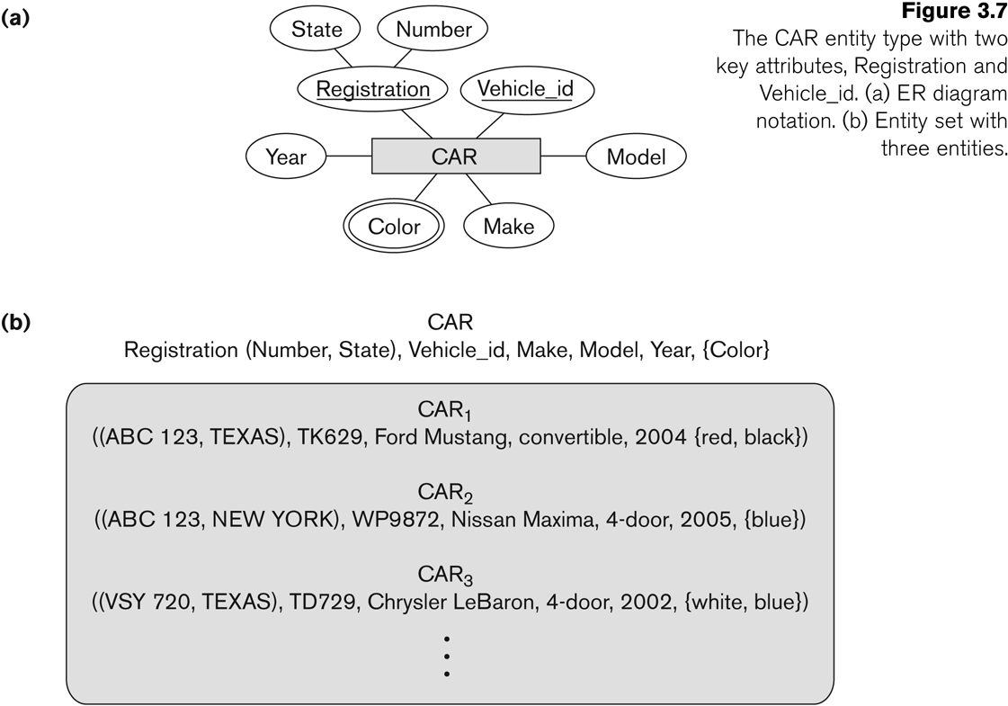
Entity Type CAR with two keys and a corresponding Entity Set

Slide 13
Relationship
An association between two or more entities, of significance to the enterprise
The relationship type is modeled as the diamond and lines between entity types…the instance is between specific entity instances
SHIP
SUPPLIER
PART
SHIP
SUPPLIER
PART
WORK FOR
EMPLOYEE
COMPANY
WORK FOR
EMPLOYEE
COMPANY

Slide 14
Associative Entity
It’s an entity – it has attributes
AND it’s a relationship – it links entities together
When should a relationship with attributes instead be an associative entity?
All relationships for the associative entity should be many
The associative entity could have meaning independent of the other entities
The associative entity preferably has a unique identifier, and should also have other attributes
The associative may be participating in other relationships other than the entities of the associated relationship
Ternary relationships should be converted to associative entities

Slide 15
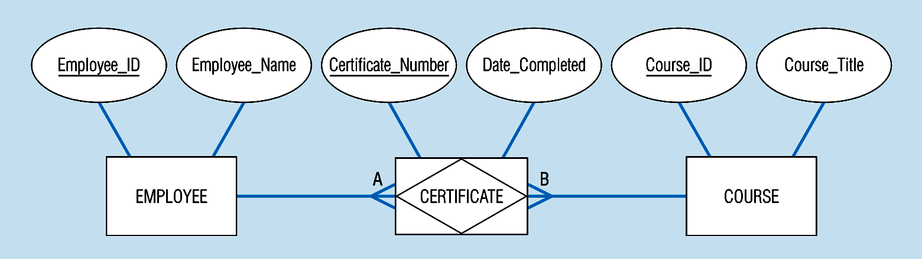
Associative entity involves a rectangle with a diamond inside.
Note that the many-to-many cardinality symbols face toward the associative entity and not toward the other entities

Slide 16
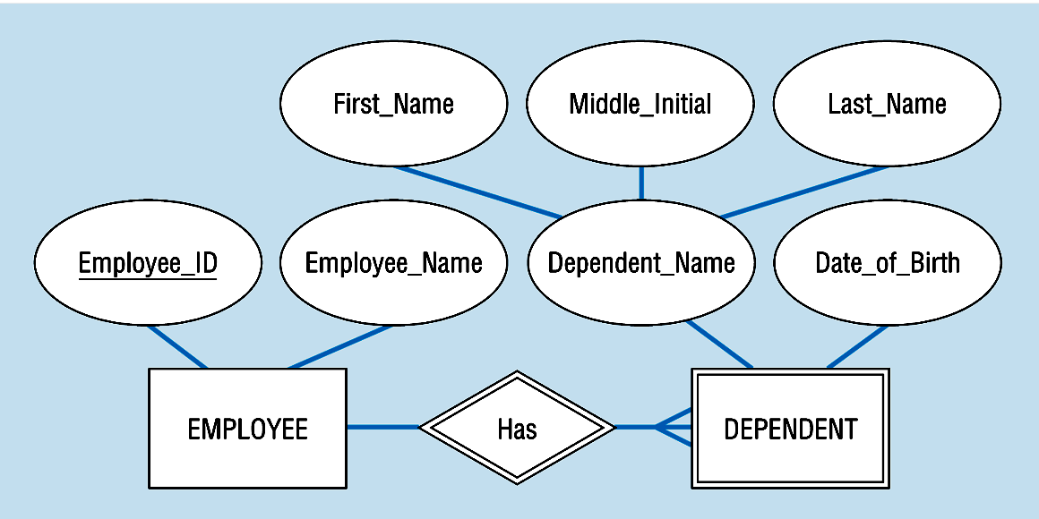
Identifying relationship
links strong entities to weak entities
represented with double line diamond

Slide 17
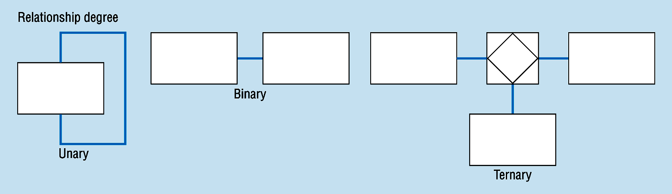
Degree of Relationships
Degree of a Relationship is the number of entity types that participate in it
Unary Relationship
Binary Relationship
Ternary Relationship
N-ary Relationship
One entity related to another of the same entity type
Entities of two different types related to each other
Entities of three different types related to each other

Slide 18
Unary Relationships
A relationship between instances of a single entity type.
Also called recursive relationship.
EMPLOYEE Manages EMPLOYEE
PERSON is Married to PERSON
Manages
Is Married to
EMPLOYEE
PERSON

Slide 19
Binary Relationships
A relationship between the instances of two entity types.
PARKING SPACE is assigned to EMPLOYEE.
STUDENT is registered in COURSES
EMPLOYEE
assigned
PARKING SPACE
STUDENT
registered
COURSES

Slide 20
Ternary Relationship
A simultaneous relationship among the instances of three entity types.
Department has employee and project, these projects are assigned to employee.
TEACHES
TEACHER
COURSES
TEACHES
TAKES
STUDENTS
TEACHER
TEACHES
COURSES
STUDENTS

Slide 21
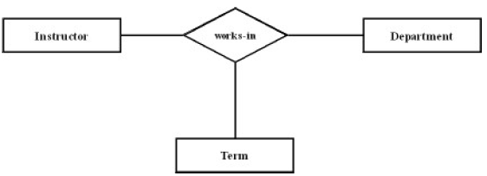
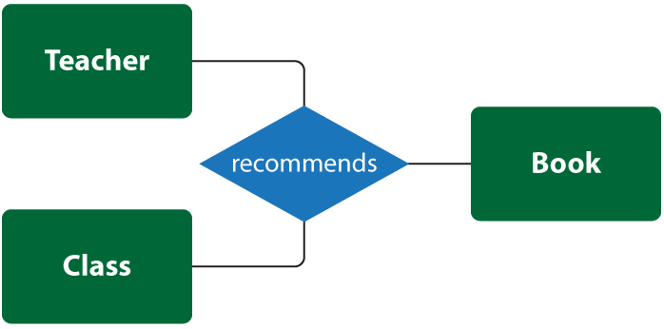

Slide 22
N-ary Relationship
A relationship between the instances of N entity types.

Slide 23

Cardinality Constraints
Number of entity instance taking part in relationship:
The number of instances of one entity that can or must be associated with each instance of another entity.
Minimum Cardinality
If zero, then optional
If one or more, then mandatory
Maximum Cardinality
The maximum number

Slide 24
Cardinality of Relationship
One – to – One (1-1)
Each entity in the relationship will have exactly one related entity
One – to – Many (1-N)
An entity on one side of the relationship can have many related entities, but an entity on the other side will have a maximum of one related entity
Many – to – Many (M-N)
Entities on both sides of the relationship can have many related entities on the other side

Slide 25
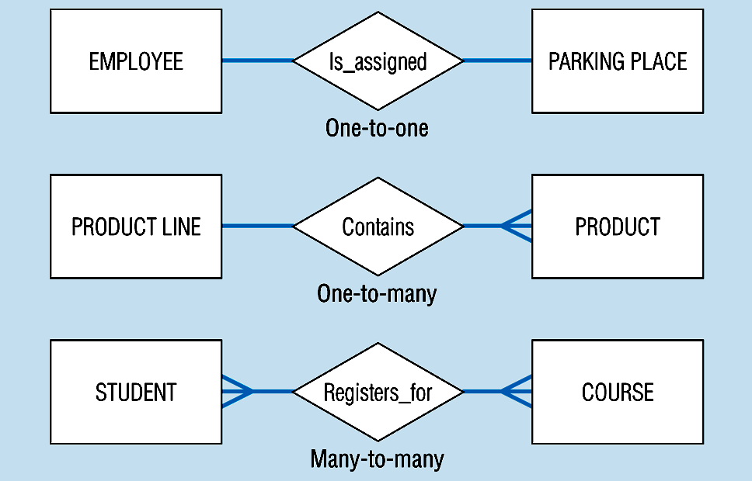

Slide 26
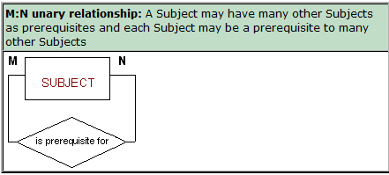
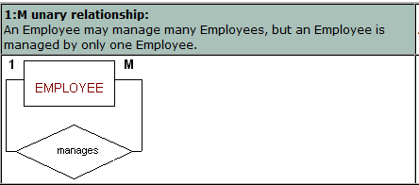

Slide 27
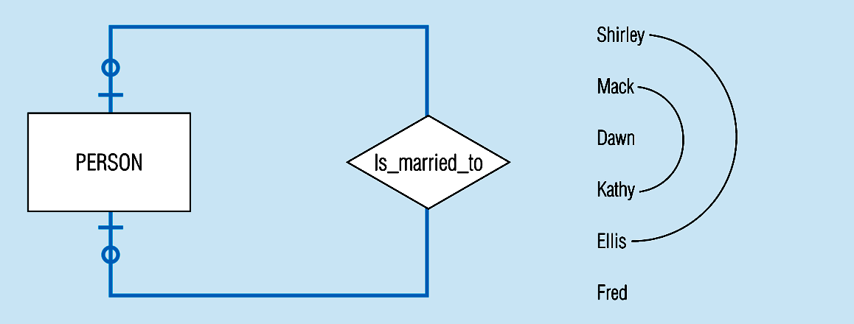
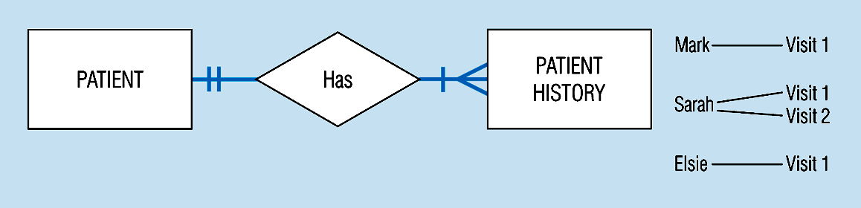
Optional cardinalities with unary degree, one-to-one relationship
Mandatory minimum cardinalities

Slide 28
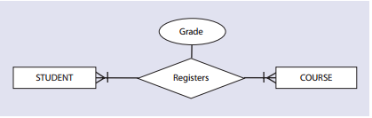
CUSTOMER
submit
ORDER

Slide 29
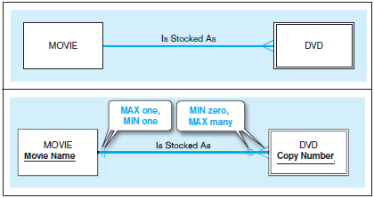
consider a video store that rents DVDs of movies. Because the store may stock more than one DVD for each movie, this is a one-to-many relationship.
Yet it is also true that the store may not have any DVDs of a given movie in stock at a particular time (e.g., all copies may be checked out).

Slide 30
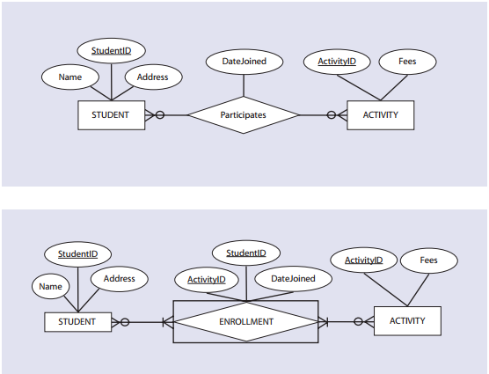
Each instance of the STUDENT entity is related to as many instances of the ENROLLMENT entity as the number of activities in which the student participates.
Therefore, there is a one-to-many relationship between the STUDENT entity type and the ENROLLMENT entity type.
Similarly, there is a one-to-many relationship between the entity types ACTIVITY and ENROLLMENT because several students may enroll in one activity.

Slide 31

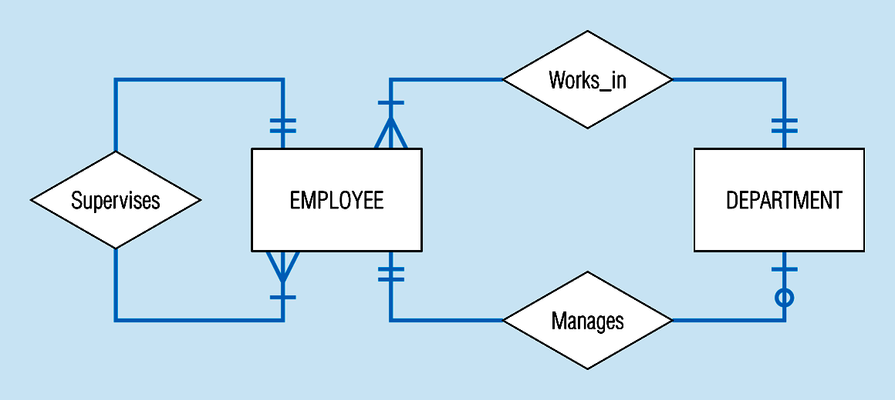
Many-to-many relationship
Example

Slide 32
has
PERSON
CARD
Is For
DRIVING LICENSE
PERSON
has
PERSON
Birth place

Slide 33
EXAMPLE COMPANY Database
Requirements for the COMPANY Database:
- The company is organized into DEPARTMENTs, department has a name, number, and an employee who manages the department.
We keep track of the start date of the department manager. A department may have several locations.
- Each department controls a number of PROJECTs. Each project has a name, number, and is located at a single location.
- We store each EMPLOYEE's social security number, address, salary, sex, and birth date. Each employee works for one department but may work on several projects.

Slide 34
EXAMPLE COMPANY Database
We keep track of the number of hours per week that an employee currently works on each project.
We also keep track of the direct supervisor of each employee
Each employee may have a number of DEPENDENTs.
For each dependent, we keep their name, sex, birth date, and relationship to the employee.

Slide 35
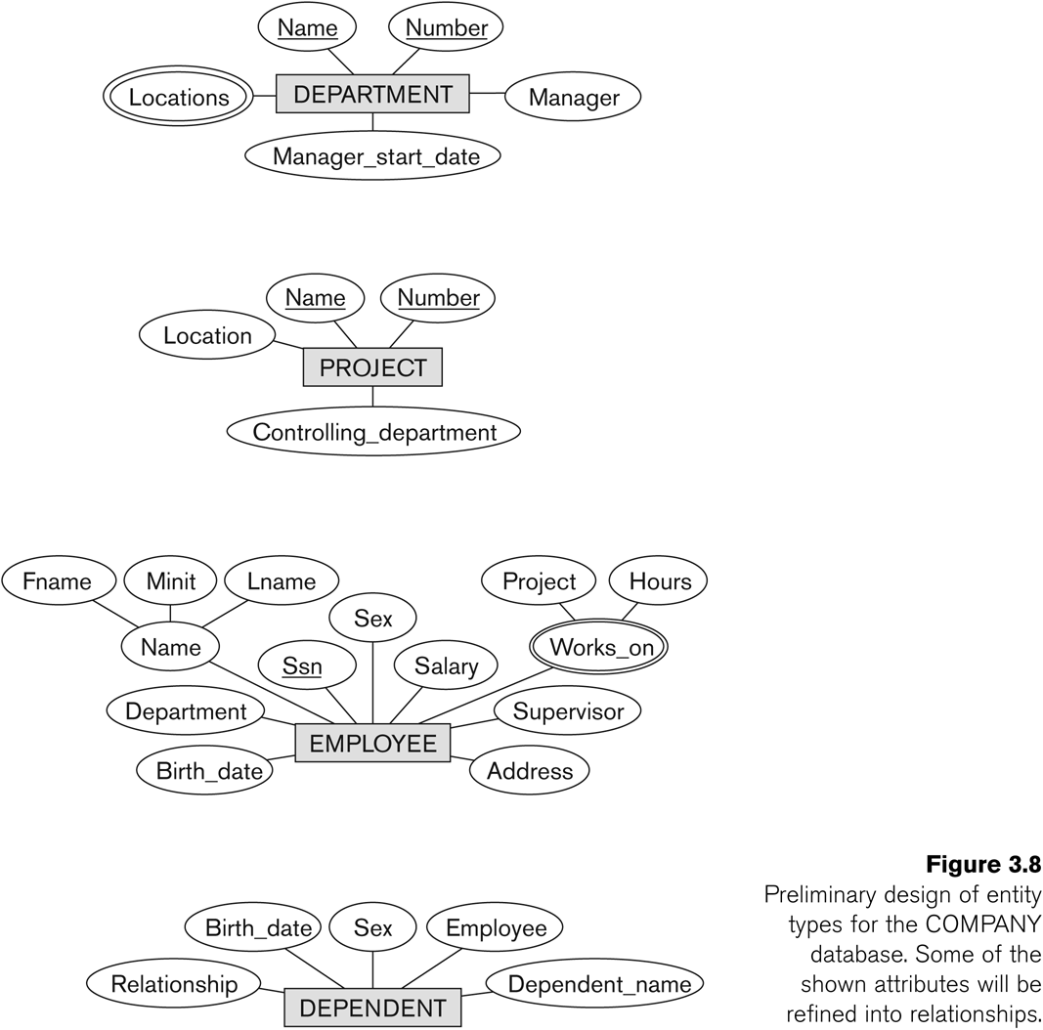
Initial Design of Entity Types: EMPLOYEE, DEPARTMENT, PROJECT, DEPENDENT

Slide 36
ERD
A graphical representation of an entity-relationship model
logical representation of the data for an organization or for a business area, using entities for categories of data and relationships for associations between entities.

Slide 37
Entity Relationship Diagram
Name
Name
Location
location
Number
Number
Manger_start_date
Pid
CONTROLs
Manger
DEPARTMENT
PROJECT
city
State
Pid
MANAGES
Country
Eid
N_o_hr
Street
Works_ On
Birth_date
Address
House#
Department
Sex
EMPLOYEE
HAS
HAS
DEPENDENT
SSn
Employee
Salary
Supervisor
Name
Lname
Relationship
Work_on
Sex
Dependent Name
Fname
Mname
Project
Hourse
Birth_date

Slide 38
Class Task 1
A hospital has a large number of registered physicians. Attributes of PHYSICIAN include Physician ID (the identifier) and Specialty.
Patients are admitted to the hospital by physicians. Attributes of PATIENT include Patient ID (the identifier) and Patient Name.
Any patient who is admitted must have exactly one admitting physician. A physician may optionally admit any number of patients. Once admitted, a given patient must be treated by at least one physician. A particular physician may treat any number of patients, or may not treat any patients.
Whenever a patient is treated by a physician, the hospital wishes to record the details of the treatment (Treatment Detail). Components of Treatment Detail include Date, Time, and Results.

Slide 39
Class Task 2
A laboratory has several chemists who work on one or more projects. Chemists also may use certain kinds of equipment on each project. Attributes of CHEMIST include Employee ID (identifier), Name, and Phone No.
Attributes of PROJECT include Project ID (identifier) and Start Date. Attributes of EQUIPMENT include Serial No and Cost. The organization wishes to record Assign Date—that is, the date when a given equipment item was assigned to a particular chemist working on a specified project
A chemist must be assigned to at least one project and one equipment item.
A given equipment item need not be assigned, and a given project need not be assigned either a chemist or an equipment item.

