Slide 1
Database system
Nasreen akhtar
FAST-NU
Faisalabad Chiniot Campus

Slide 2
Topics
Single VS multi user system
Transaction
Properties of transaction
Concurrency control and recovery methods.

Slide 3
Objective
compares single-user and multiuser database systems and demonstrates how concurrent execution of transactions can take place in multiuser systems.
To get knowledge about transaction and its properties
How Problem of concurrency occurs in multiuser system
Recovery methods
Serial Schedule, non serial schedule and conflict schedule
Method use to handle concurrency

Slide 4
Single user Vs multiuser System
A DBMS is single-user if at most one user at a time can use the system
It is multiuser if many users can use the system—and hence access the database—concurrently
For example, an airline reservations system is used by hundreds of travel agents and reservation clerks concurrently. Database systems used in banks, insurance agencies, stock exchanges, supermarkets, and many other applications are multiuser systems.
In these systems, hundreds or thousands of users are typically operating on the database by submitting transactions concurrently to the system.

Slide 5
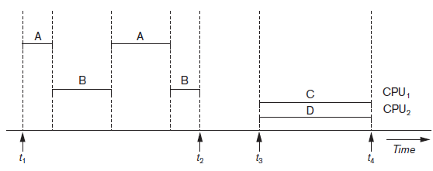
Single user Vs multiuser System
Multiple users can access databases—and use computer systems simultaneously because of the concept of multiprogramming, which allows the operating system of the computer to execute multiple programs—or processes—at the same time.
A single central processing unit (CPU) can only execute at most one process at a time.
However, multiprogramming operating systems execute some commands from one process, then suspend that process and execute some commands from the next

Slide 6
Transaction
A transaction is the basic logical unit of execution in an information system
A transaction is a sequence of operations that must be executed as a whole, taking a consistent (& correct) database state into another consistent (& correct) database state;
A collection of actions that make consistent transformations of system states while preserving system consistency
transaction includes one or more database access operations—these can include insertion, deletion, modification, or retrieval operations
database in a consistent state
database in a consistent state
Account A Fred Bloggs £1000
Transfer £500
Account A Fred Bloggs £500
Account B Sue Smith £0
Account B Sue Smith £500
begin Transaction
execution of Transaction
end Transaction
database may be temporarily in an inconsistent state during execution

Slide 7
Read only and write Transaction
If the database operations in a transaction do not update the database but only retrieve data, the transaction is called a read-only transaction
If the database operation in a transaction retrieve as well as update the database, is known as a read-write transaction.
A database is basically represented as a collection of named data items
The size of a data item is called its granularity
read_item(X). Reads a database item named X into a program variable. To simplify our notation, we assume that the program variable is also named X.
■ write_item(X). Writes the value of program variable X into the database item named X.

Slide 8
Desirable property of transaction
1 ACID properties:
Atomicity: A transaction is an atomic unit of processing; it is either performed in its entirety or not performed at all.
Execute a transaction to completion.
Transaction recovery subsystem of a DBMS is responsible to ensure atomicity.
If a transaction fails to complete for some reason, such as a system crash in the midst of transaction execution, the recovery technique must undo any effects of the transaction on the database.

Slide 9
2 ACID properties
Consistency preservation: A correct execution of the transaction must take the database from one consistent state to another.
The preservation of consistency is the responsibility of the programmers who write the database programs or of the DBMS module that enforces integrity constraints.
A database state is a collection of all the stored data items (values) in the database at a given point in time.
A database program should be written in a way that guarantees that, if the database is in a consistent state before executing the transaction, it will be in a consistent state after the complete execution of the transaction

Slide 10
3 ACID Property
Isolation: A transaction should not make its updates visible to other transactions until it is committed; this property, when enforced strictly, solves the temporary update problem and makes cascading rollbacks of transactions unnecessary
The isolation property is enforced by the concurrency control subsystem of the DBMS
Every transaction does not make its updates (write operations) visible to other transactions until it is committed
4 ACID Property
Durability or permanency: Once a transaction changes the database and the changes are committed, these changes must never be lost because of subsequent failure.

Slide 11


Concurrency
When multiple users have the ability to access the same resource and each user access to the resource and alter them simultaneously then this problem is called Concurrency.
Concurrency is high when there is no apparent wait time for a user to get its request. Concurrency is low when wait times are evident isolation
For example
time: 10:00AM time:10:01
Withdraw 5000
Read (X)
X=X-5000
Write(X)
Before transaction X=10000
Withdraw 7000
Read X
X=X-7000
Write(X)
After transaction X=3000

Slide 12
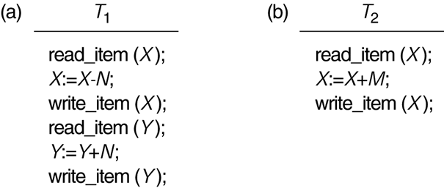
Two sample of transaction
Two sample transactions:
(a) Transaction T1
(b) Transaction T2

Slide 13
Concurrency control
Concurrency Control
Most DBMS are multi-user systems.
The concurrent execution of many different transactions submitted by various users must be organized such that each transaction does not interfere with one another in a way that produces incorrect results.
The concurrent execution of transactions must be such that each transaction appears to execute in isolation.
Recovery
System failures, either hardware or software, must not result in an inconsistent database

Slide 14
Why recovery is needed
Whenever a transaction is submitted to a DBMS for execution, the system is responsible for making sure that either all the operations in the transaction are completed successfully and their effect is recorded permanently in the database( known as committed).
The transaction does not have any effect on the database or any other transactions (transaction is aborted)
Failures are generally classified as transaction, system, and media failures. There are several possible reasons for a transaction to fail in the middle of execution:

Slide 15
Type of failure
A computer failure (system crash).
A hardware, software, or network error occurs in the computer system during transaction execution
A transaction or system error.
Some operation in the transaction may cause it to fail, such as integer overflow or division by zero.
Transaction failure may also occur because of erroneous parameter values or because of a logical programming error
Additionally, the user may interrupt the transaction during its execution.
3. Local errors or exception conditions detected by the transaction.
During transaction execution, certain conditions may occur that necessitate cancellation of the transaction. For example, data for the transaction may not be found.
insufficient account balance in a banking database, may cause a transaction, such as a fund withdrawal, to be canceled. This exception could be programmed in the transaction itself, and in such a case would not be considered as a transaction failure.

Slide 16
Type of failure
Concurrency control enforcement.
The concurrency control method may decide to abort a transaction because it violates serializability or it may abort one or more transactions to resolve a state of deadlock among several transactions
Disk failure. Some disk blocks may lose their data because of a read or write malfunction or because of a disk read/write head crash
Physical problems and catastrophes. This refers to an endless list of problems that includes power or air-conditioning failure, fire, theft, overwriting disks or tapes by mistake
Failures of types 1, 2, 3, and 4 are more common than those of types 5 or 6.
Whenever a failure of type 1 through 4 occurs, the system must keep sufficient information to quickly recover from the failure.

Slide 17
Recovery
Mirroring
keep two copies of the database and maintain them simultaneously
Backup
periodically dump the complete state of the database to some form of tertiary storage
System Logging
the log keeps track of all transaction operations affecting the values of database items. The log is kept on disk so that it is not affected by failures except for disk and catastrophic failures.

Slide 18
Transaction State
For recovery purposes the system needs to keep track of when a transaction starts, terminates and commits.
Begin_Transaction: marks the beginning of a transaction execution;
End_Transaction: specifies that the read and write operations have ended and marks the end limit of transaction execution (but may be aborted because of concurrency control);
Commit_Transaction: signals a successful end of the transaction. Any updates executed by the transaction can be safely committed to the database and will not be undone;
Rollback (or Abort): signals that the transaction has ended unsuccessfully. Any changes that the transaction may have applied to the database must be undone;
Undo: similar to ROLLBACK but it applies to a single operation rather than to a whole transaction;
Redo: specifies that certain transaction operations must be redone to ensure that all the operations of a committed transaction have been applied successfully to the database;

Slide 19
Transaction execution
Credit_labmark (sno NUMBER, cno CHAR, credit NUMBER)
old_mark NUMBER;
new_mark NUMBER;
SELECT labmark INTO old_mark FROM enrol
WHERE studno = sno and courseno = cno FOR UPDATE OF labmark;
new_ mark := old_ mark + credit;
UPDATE enrol SET labmark = new_mark WHERE studno = sno and courseno = cno ;
COMMIT;
EXCEPTION
WHEN OTHERS THEN ROLLBACK;
END credit_labmark;
For every transaction a unique transaction-id is generated by the system.
[start_transaction, transaction-id]: the start of execution of the transaction identified by transaction-id
[read_item, transaction-id, X]: the transaction identified by transaction-id reads the value of database item X. Optional in some protocols.
[write_item, transaction-id, X, old_value, new_value]: the transaction identified by transaction-id changes the value of database item X from old_value to new_value
[commit, transaction-id]: the transaction identified by transaction-id has completed all accesses to the database successfully and its effect can be recorded permanently (committed)
[abort, transaction-id]: the transaction identified by transaction-id has been aborted

Slide 20
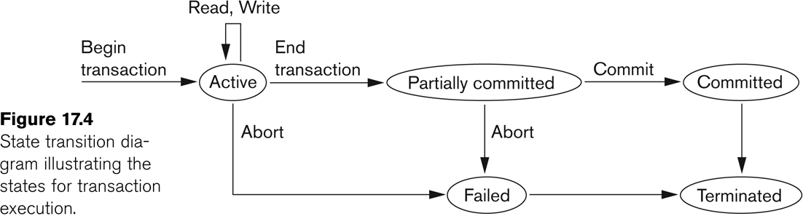
Transaction Execution
A transaction reaches its commit point when all operations accessing the database are completed and the result has been recorded in the log. It then writes a [commit, transaction-id].
If a system failure occurs, searching the log and rollback the transactions that have written into the log a
[start_transaction, transaction-id]
[write_item, transaction-id, X, old_value, new_value]
but have not recorded into the log a [commit, transaction-id]

