Slide 1

Nasreen Akhtar

Slide 2
On Relations
A binary relation from A to B: α is subset of A x B
Let A₁, A₂ , … , A_{n} be sets. An n-ary relation on these sets is a subset of A₁ x A₂ x … x A_{n} where the sets are called the domains and n is called its degree / arity.
Relational Data Model utilizes relational algebra and relational calculus
Relational Algebra defines basic definitions for relational model. The results of these operations are always a relation.
Relational Calculus provides a higher level declarative notation for specifying relational queries.

Slide 3
On Databases
A database (DB) is a large set of interrelated data.
A DBMS is a system software used in accessing the DB in a secure, efficient and convinient manner.
Data Model is a collection of concepts used in describing the structure of a database (+ operations)
Other than Relational Data Model we have Network, Hierarchical, Object Oriented, and XML Models.
Basic DB Operations are insertion, deletion, modification and retrieval.
DB model is abstraction used in interpreting data

Slide 4
More on DB
Entity represents real world objects such as student, teacher, project, course etc. Referred as tuple in RM.
An attribute is a property of interest that further describes an entity, such as student’s name or GPA.
Relationship is an association among two or more entities. Ex. student enrollment in a course. This also corresponds to a tuple in RM.
Due to its representation a relation is also referred as a table in RM.

Slide 5

Relation Examples
An attribute
St_ID | Name | Age | Dep
2009002 | A | 21 | CMPE
2008003 | B | 22 | CMPE
2009001 | D | 21 | CET
2009004 | A | 21 | CMPE
Student Relation
C_ID | Name | Dep
CMPE150 | Introduction to Programming | CMPE
MATH101 | Calculus I | MATH
CMPE220 | Discrete Comp. Structures | CMPE
St_ID | C_ID | Sem
2009001 | CMPE150 | 2010/1
2009002 | CMPE220 | 2010/2
2009001 | MATH101 | 2010/2
Student Course Enrollment Relation
Course Relation

Slide 6
Basic Relational Operations
Projection: projects a relation of arity n to arity m by selection specified attributes
  Denoted: Π_{<attribute list>} (R) , Ex: Π_{<st_id,name>} (Student)
Selection: Selects tuples from R which makes well formed formula f true
  Denoted: σ_{f} (R) , Ex: σ _{<st_id=2009001>} (Student)
Union, Intersection , Set Difference and Certesian Product the same definition as in sets
Join : R |X|_{<condition>} S = σ _{<condition>} (R x S)
  Condition is a comparison operator (=,<,> etc) between an attribute in R and an attribute in S

Slide 7
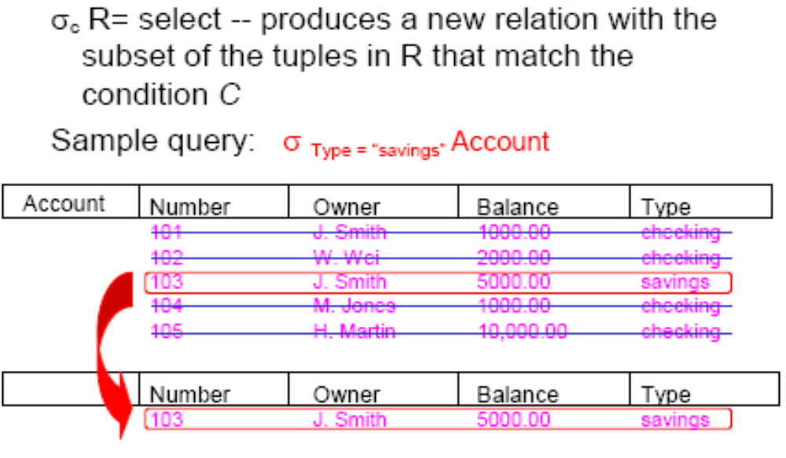
Selection
Where clause is evaluate

Slide 8
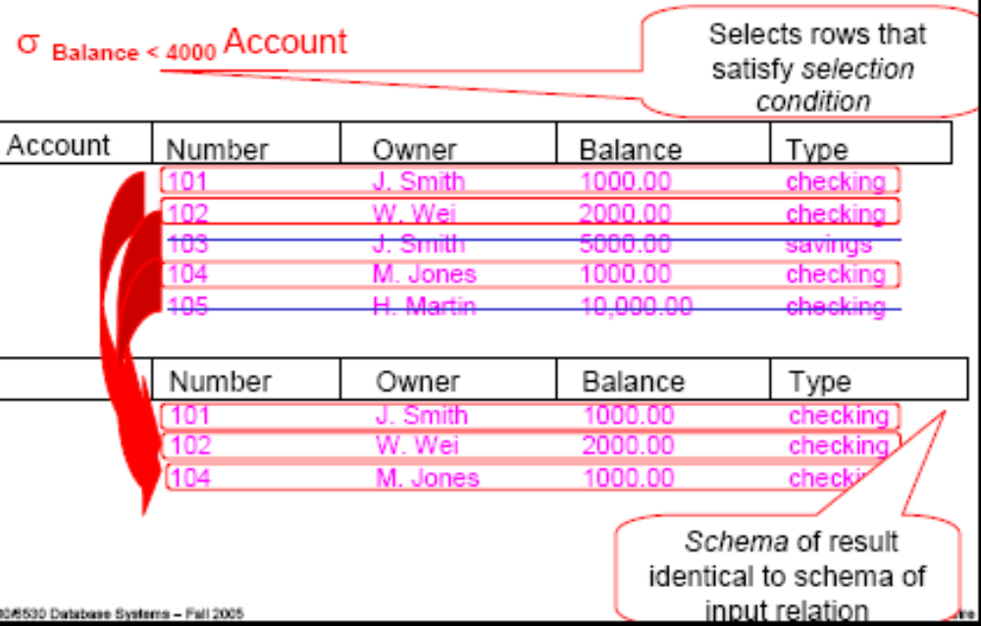
Selection

Slide 9
Projection
When we select certain attributes from the table then use projection
When * is used then no need to use projection

Slide 10
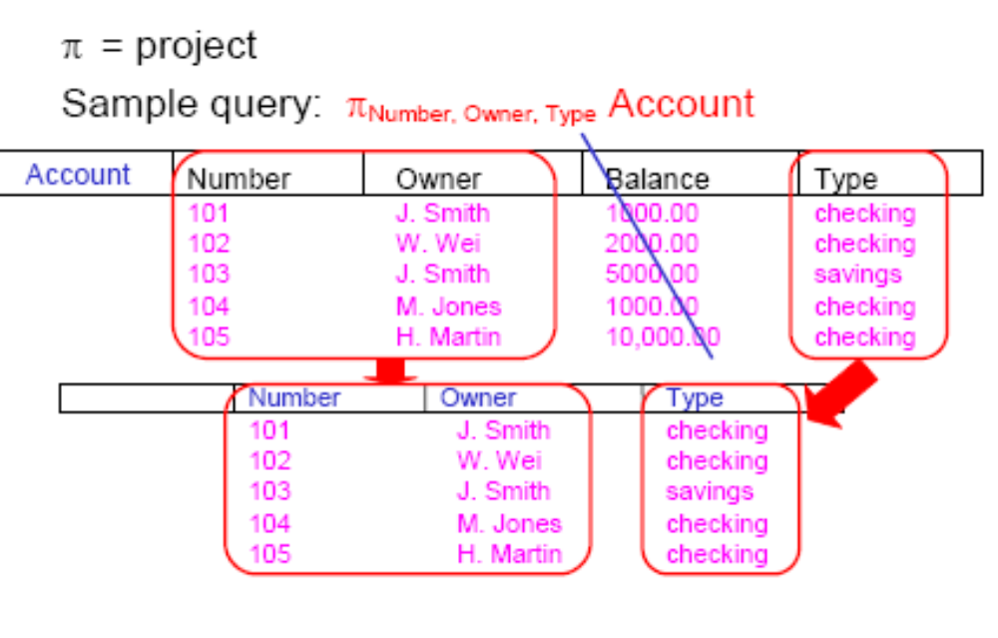
Projection

Slide 11
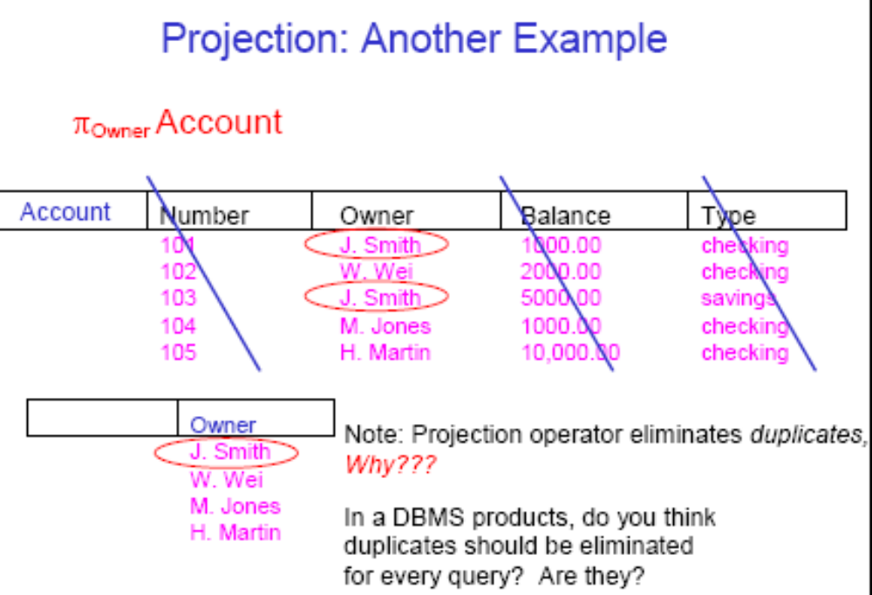
Projection Removes duplicates

Slide 12
Projection Removes duplicates

Slide 13
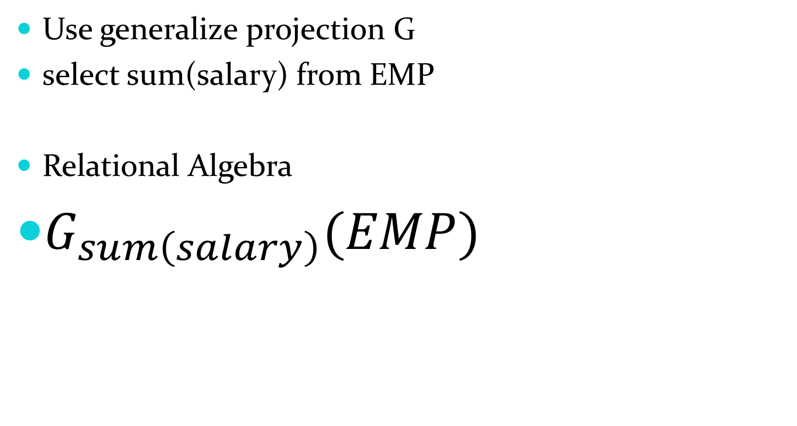
Aggregate functions

Slide 14
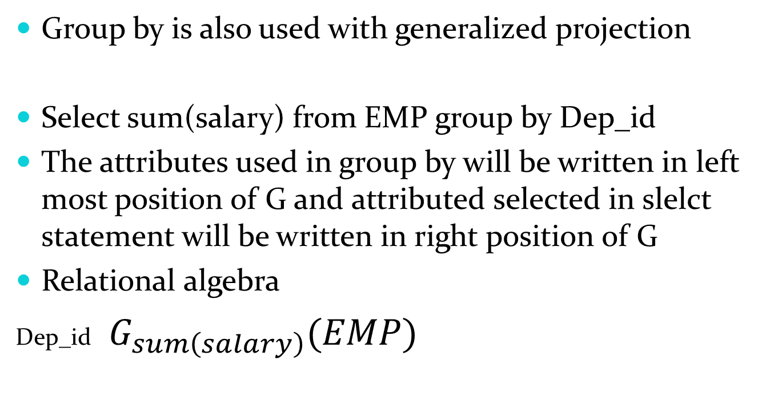
Group by

Slide 15
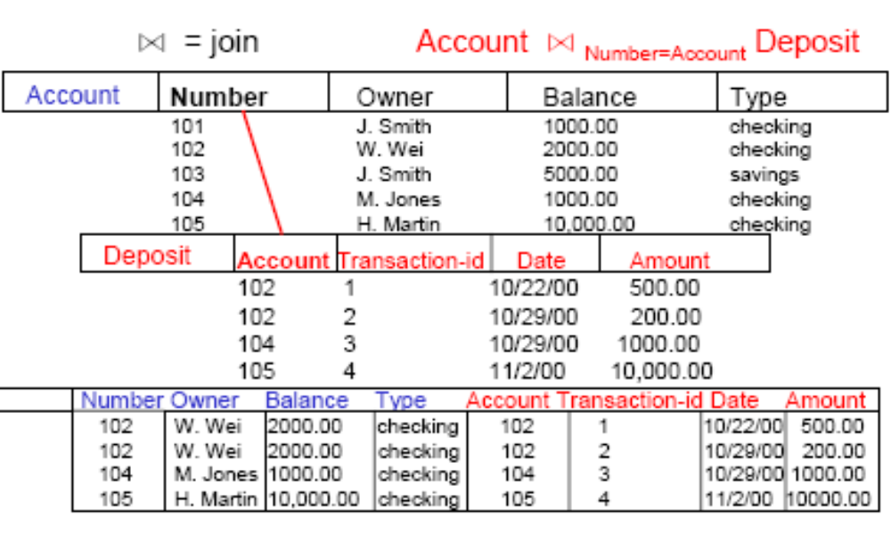
Set operators
Joins

Slide 16
Set operators
Outer Joins
loan_number
branch_name
amount
customer_name
L-170
L-230
Downtown
Redwood
3000
4000
Jones
Smith
Left Outer Join
loan Borrower
loan_number
branch_name
amount
customer_name
L-170
L-230
L-260
Downtown
Redwood
Perryridge
3000
4000
1700
Jones
Smith
null

Slide 17
Set operators
Right Outer Join
loan borrower
loan_number
branch_name
amount
customer_name
L-170
L-230
L-155
Downtown
Redwood
null
3000
4000
null
Jones
Smith
Hayes
Full Outer Join
loan borrower
loan_number
branch_name
amount
customer_name
L-170
L-230
L-260
L-155
Downtown
Redwood
Perryridge
null
3000
4000
1700
null
Jones
Smith
null
Hayes

Slide 18
