Slide 1

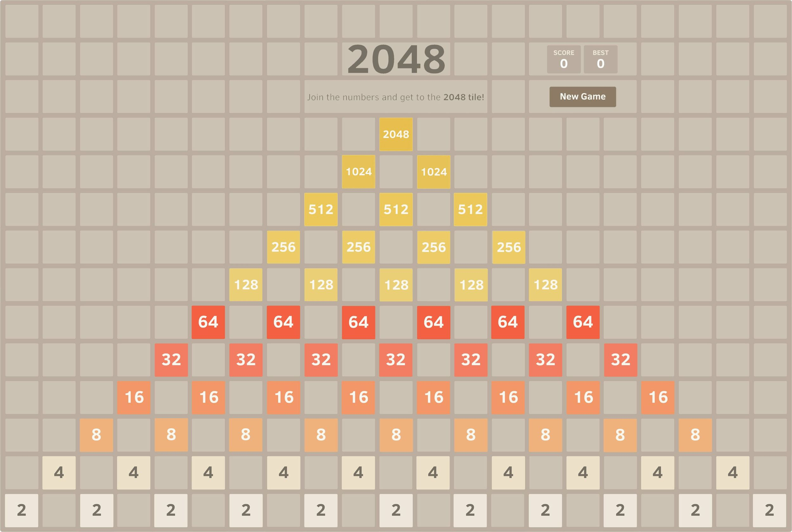
Game 2048
CS5001 final project
Mozhi Shen

Slide 2
Version 1:
Only used random, no package or reference outside CS 5001, 100% self working.
Used most of the tools we learned during class.
Pros:
It works!
Cons:
Forget to use Class to store data.
A small bug: hard to judge when the game end.
No Graphic display

Slide 3
Vision 2:
Try pygame. to create a graphic-version.
Go over 2 pygame tutorial articles, which created two simple games with animation.
https://realpython.com/pygame-a-primer/
https://www.edureka.co/blog/snake-game-with-pygame/
I want to have the blocks move!
Failed, need more time.
Need to trace the move of each block, determine where they go or end.

Slide 4

Vision 3:
No animation, Main goal first!.
Go over some tutorial on YouTube!
Class was created!

Slide 5
Thoughts/Tips:
YouTube is Great!
You can see how the program is organized
You can see the intermediate work.
Pick up colors:
https://imagecolorpicker.com/en
Deep copy of a lists would be useful, sometimes:
Import copy
A = copy.deepcopy(B)

Slide 6
If you have “left”, no need to create “right”, “up” and “down”.
A = left(A)
Right: reverse your list, do left(A), and reverse back.
Up :transpose your matrix, do left(A), and transpose back.
Down: Right + Up.
For key in “LRUD”:
if key in “UD”:
matrix.transpose()
if key in “RD”:
matrix.back()
matrix.left()
if key in “UD”:
matrix.transpose()
if key in “RD”:
matrix.back()
Thoughts/Tips

