Slide 1
COURSE TITLE: SHIP AND SHIP ROUTINES COURE CODE: MRT 232.2
TOPIC: ANCHOR WORK AND ASSOCIATED GEARS, MOORING WINCH

Slide 2
ANCHOR WORK
INTRODUCTION: An anchor refers to a nautical or marine equipment intended to restrict vehicle or structural movement in the water. Anchors achieve their purpose by either using their weight to hold structures in place, clamping on to the bed of the waterbody, or using a combination of both these techniques.
In addition, anchor can also act as drogues (positive drag mechanism) for ships and other vessels during storms. They provide a restoring drag that keeps the vessel stable and prevents slamming of the bow or flooding through green water loading during unsteady conditions.
Bow slamming refers to the of the ship violently striking the water surface due to large waves that can cause structural deformations and failure.
Green water is technical term for any water that is present on the upper decks of a vessel due to the partial flooding as a result of the natural motions of waterbodies.

Slide 3
How Anchor Works
When an anchor penetrates the surface of the seabed, suction generates resistance, created by the bottom material plus the weight of the material above the anchor. As the boat pulls on the anchor rode, the anchor digs in deeper, creating additional resistance. In rocky bottoms, anchors can't dig in, but rather snag on protrusions and hold precariously.
Setting: To ensure that an anchor "sets" well, apply tension to the rope so the anchor penetrates the bottom. Do this by making fast the line and applying power in reverse. If your boat moves, reset the anchor and try again.
Scope: scope is defined as a ratio of the length of an anchor rope from the bit to the anchor shackle and the depth of the water under the bow of the boat measured from deck height. Most anchoring texts and anchor manufacturers agree that a scope of 7:1 achieves the anchor's designed holding power, and more scope is better than less. In theory, 7:1 scope is great, but at a crowded anchorage most cruisers scoff at the idea of paying out more than 3:1 or 4:1; there just isn't that much space for boats to swing. When an anchor is securely set you can consider shortening scope in a crowded anchorage.
Resetting: It's fairly easy to set an anchor when wind and current come consistently from one direction, but if they veer, some perform better than others under varying angles of pull. Any anchor can become dislodged from the seabed if the boat swings far enough. Four techniques can alert you when your boat swings:

Slide 4
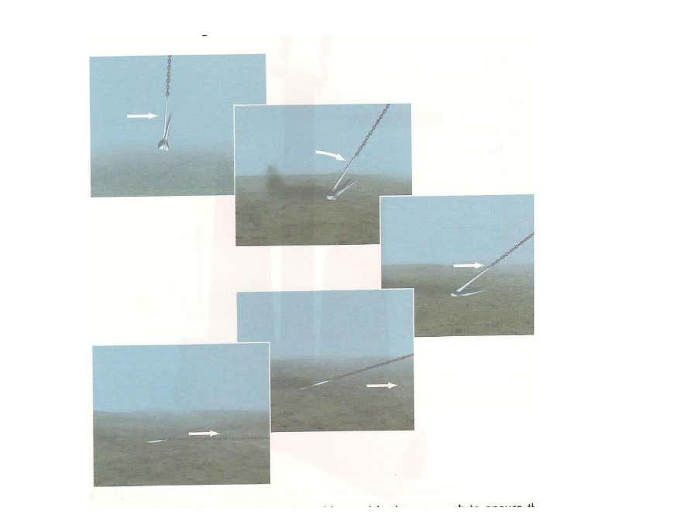

Slide 5
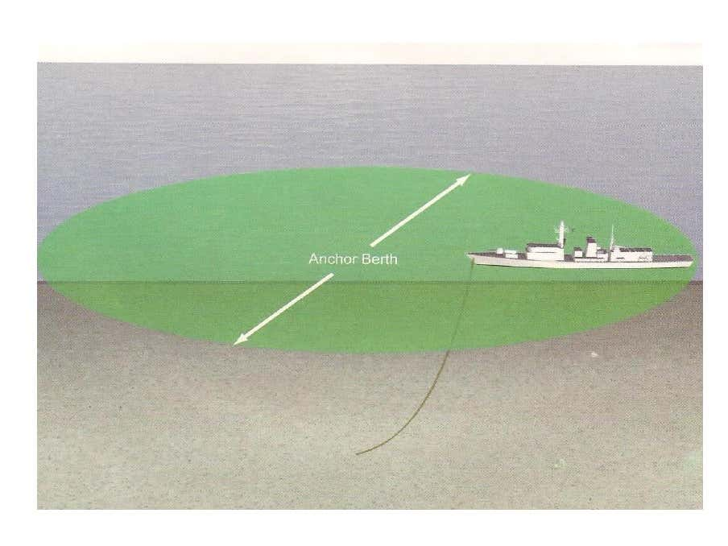
PARTS OF A LUGLESS JOINING SHACKLE AND ITS TOOLS

Slide 6
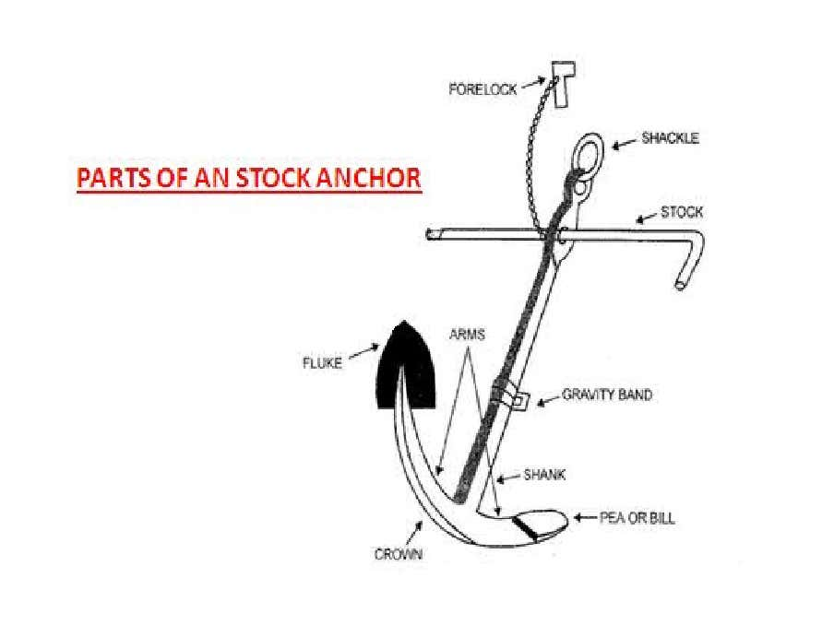

Slide 7
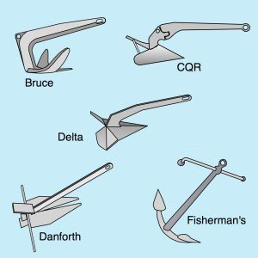
ANCHORING
A ship can be secured to the seabed by means of her anchors and cables, either with a single anchor or two anchors. The method involved in doing so is called anchoring and lifting the anchor from seabed is called weighing anchor. A dragging anchor can be checked by veering some cable. If this does not work, engine should be started to take a strain off anchor and cable. As a final step, the ship must be proceeded to sea.
TYPES OF ANCHORS
The bigger the vessel, the heavier must her anchor. Anchor also very in design and performance as well as size. The most common types use are as follows;
Admiralty Pattern Anchor: sometimes referred to as a fisherman’s anchor. It has been for many years and have good holding pull 3 to ½ times its own weight depending upon the nature of sea bottom, but it is stowed in house pipe due to its long stock. It is hardly seen onboard merchant vessel.
Admiralty Standard Stockless Anchor: this is by far the most popular anchor general use today. The stockless anchor great advantage is its close stowing property and easily housed in to house pipe when not in use. Holding pull varies depending on the nature of the bottom but as a rule of thumb it is considered to be three times of its own weight.

Slide 8
Types of anchor cont’d
Admiralty Class 14 Anchor: it looks same as a stockless anchor and used as bower anchor. This anchor due to its good holding properties has become very popular in the shipping industry. The AC type 14 anchor developed more than twice the holding power of stockless anchor of the weight.
CQR Anchor: CQR anchor referred as plough anchor. It is generally used only for small craft because it is difficult to stow in the hawse pipe. The holding power depend upon nature of the bottom but still have good holding power to its weight ratio. The ratio between holding pull and anchor weight increases as the size decreases.
Danforth Anchor: generally called as stocked close stowing anchor, accepted as small boat anchor to prevent the anchor from rolling when its flukes digs into the ground. It can be stowed into the house pipe same as stockless anchor, the ratio between holding power and anchor weight increases as the size decreases. It fits neatly into the hawse pipe and can be secured as efficiently as stockless anchor
note: the bigger the vessel, the heavier her anchor must be.

Slide 9
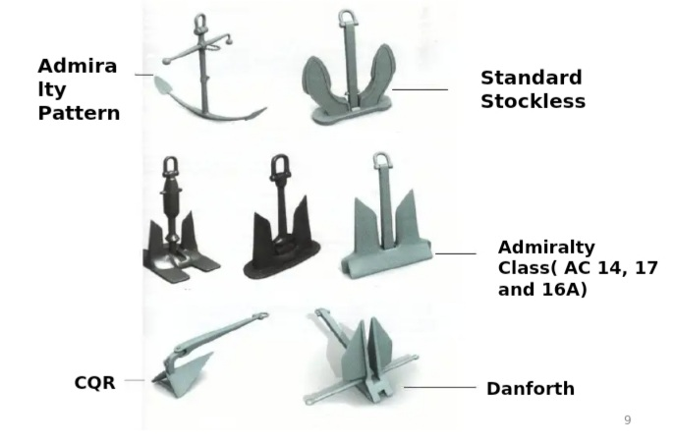
Types of anchors cont’d

Slide 10
TYPES OF SHIP ANCHORS
Bower Anchor: The ships main anchors are called the bower anchors. They are used for anchoring the ship and stowed one on each bow.
Sheet Anchor: it is an extra anchor carried for safety to back up main anchor in case one is lost.
Stream Anchor: a anchor lashed and secured at near the stern of the vessel. It is made to be used in narrow channel for preventing the stern of the vessel from swinging. But these days it is hardly carried and used.

Slide 11
CHAIN CABLE
The long shank of stockless bower anchor fits inside the house pipe, whereas its arm rest snugly against the ship side. The anchor shackle on top of the anchor is connected to a long studded chain cable. The chain is made up of length of 27.5 meters each, join together by luggless joining shackles of chain. A length of chain cable will always contain an odd number of links to ensure that the joining shackle will pass around the cable holder in correct plane. Joining shackle being slightly larger than common links should lie vertically round a cable holder and horizontally over the gypsy of windlass. There may be 8 or 9 shackles of bower anchor. The stud make the chain stronger and prevents the chain from kinking.

Slide 12
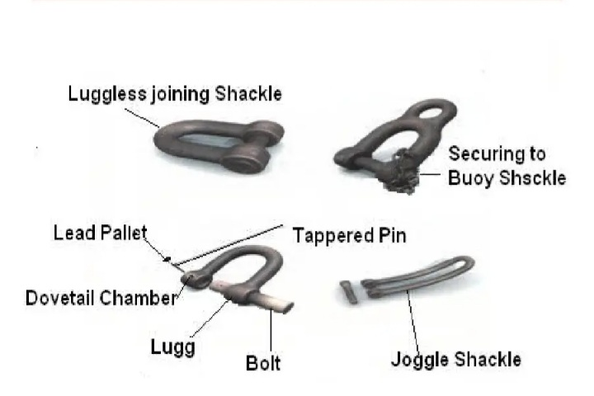
ASSOCIATED ANCHOR AND CABLE GEARS

Slide 13
TYPES OF JOINING SHACKLES
The shackles which join length of cable together may be either lugless or lugged is called joining shackle. Joining shackles are also used during towing and securing to buoy evolution.
Lugged joining shackle: it is a three part shackle join together with a pin and pallet, used to join two shackles of anchor cable.
Lugged joining shackle: it is straight shackle made of two parts and join together wit a pin and pallet.
Securing to buoy shackle: It is used to secure ship to a buoy.
Lugged anchor shackle: it is used to join onboard end of cable to anchor ring.
Joggle shackle: it is long and slightly curved shackle used for connecting a wire rope to the cable

Slide 14
WHY AND HOW A CABLE IS MARKED
When anchoring, it is important to know how much cable has run out. The cable is therefore marked at each joining shackle to assist in its identification.
The shackles and joining shackles of a cable are numbered from its outer to inner end. The first joining shackle together. Every joining shackle is painted white. One link on each side of joining shackle is also painted white and marked with turns of seizing wire around STUD. The marked links which serves to indicate the join between two shackles for example;-
To indicate 1st joining shackle, the first link on both sides of joining shackles is marked with wire turns and painted white
To indicate 2nd joining shackle, the second link on both sides of joining shackle is marked with wire and painted white
To indicate 3nd joining shackle, the third link on both sides of joining shackle is marked with wire and painted white

Slide 15
MOORING WINCH
Mooring gear
the set of fittings and mechanisms aboard a ship that are used to warp and secure the ship when it is moored at a dock, at the wall of a lock, to buoys, or alongside another vessel. A ship’s mooring equipment includes mechanisms, such as winches and capstans, that are used to take in and pay out mooring lines, which are ropes or steel cables. It also includes the following fittings: bitts and cleats, around which the mooring lines are made fast; stoppers, which temporarily hold the mooring lines; mooring chocks, rollers, and mooring pipes, which are used to change the direction of the mooring lines; manually operated or mechanized reels, on which the mooring lines are stowed; and line throwers, which throw the mooring lines from the ship.

Slide 16
Windlass
The windlass is a machine to lift or lower the anchor cable on the foc’sle deck. The windlass is combined with the rope drum also called warping drum. It consist of a horizontal athwartship shaft rotated by electric motor, hydraulic pressure by steam engine. On both the end. This shaft are fixed two warping drums which can be used for heaving the mooring hawsers. Each anchor chain rides over a Gypsy, which is just a roller revolving freely on the shaft. Grips conforming to the shape of the link are cut on the gypsies. The links of the chain lie snuggle in these grips and are gripped by them when the chain is hove up. The rotation of the gypsy can be controlled or stopped altogether by means of friction.

Slide 17
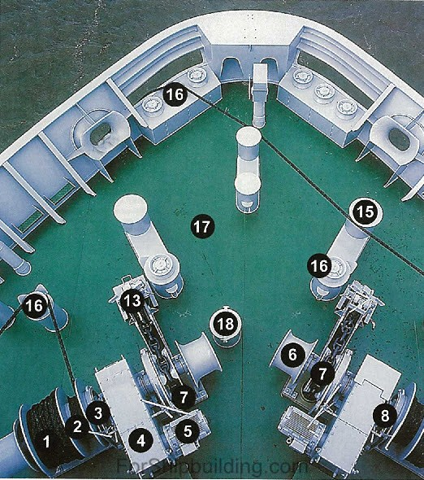
Overview of anchor mooring winch

Slide 18
Overview of anchor mooring winch cont’d
1. Storage part of the mooring drum
2. Pulling section of the drum (working part)
3. Brake band
4. Gear box
5. Electro-hydraulic motor
6. Warping head
7. Chain in the gypsy wheel
8. Dog clutch
9. Anchor
10. Hawse pipe
11. Spurling pipe
12. Chain locker
13. Chain stopper with security device
14. Guide roller
15. Bollard
16. Guide roller
17. Deck

Slide 19
Anchor equipment
Anchors can be:
Conventional anchors
– HHP anchors – High holding power
–SHHP anchors – Super high holding power
Pool anchor (HHP) type HG ‘Pool N’ anchor; Hall anchor (conventional anchor)

Slide 20
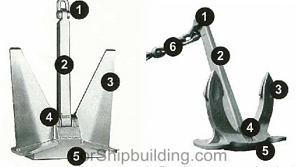
Anchor equipment cont’d

Slide 21
Anchor equipment cont’d
1. crown/ shackle
2. shank
3. flukes
4. crown pin
5. crown plate
6. anchor chain with swivel

Slide 22
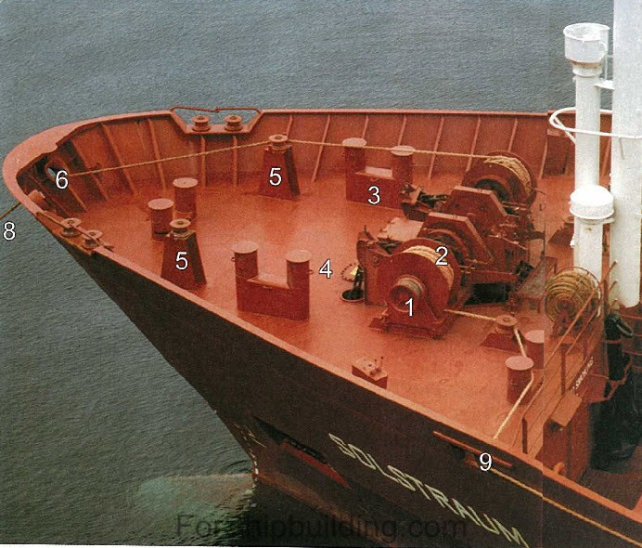
ANCHOR-MOORING GEAR

Slide 23
Anchor mooring gears cont’d
1. Warping head
2. Drum
3. Bollards
4. Eyes to connect the stoppers
5. Guide roller
6. Center lead
7. Lead way
8. Head line
9. Forward spring

Slide 24
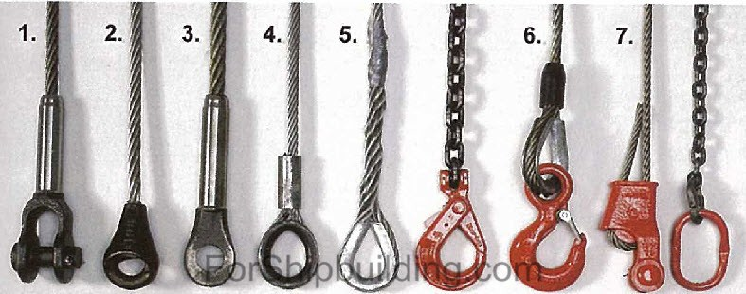
Ripping
End links
1. Gaff socket with rolled connection
2. Cast spelter socket
3. Rolled eye socket
4. Thimble Talurit eye
5. Spliced eye with thimble
6. Thimble Flemish eye, swaged
7. Wedge socket (not allowed for hoisting)

Slide 25
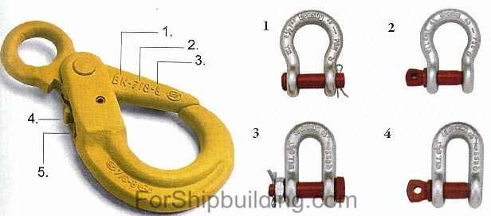
Safety hook

Slide 26
Safety hook cont’d
1. Brand or type marking
2. Chain size (chain 7/8 of an inch)
3. Class, grade 8 (high-grade steel)
4. Safety pin
5. Spring
1. Bow shackle with safety pin
2. Bow shackle with screw- bolt
3. D-shackle with safety bolt and nut
4. D-shackle with screw-bolt

Slide 27
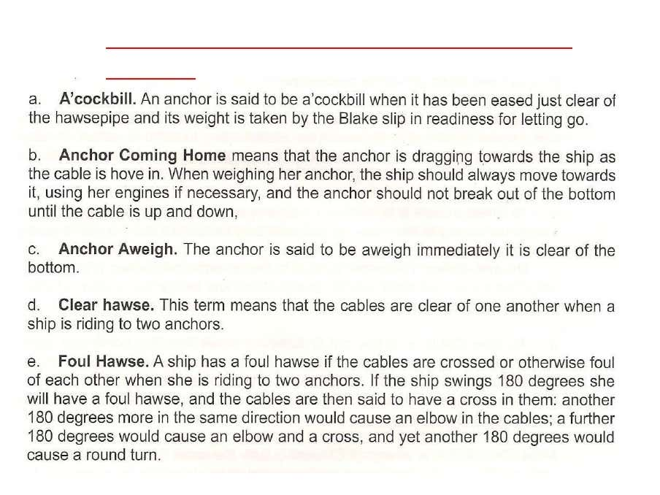
Terminology used in anchor work

Slide 28
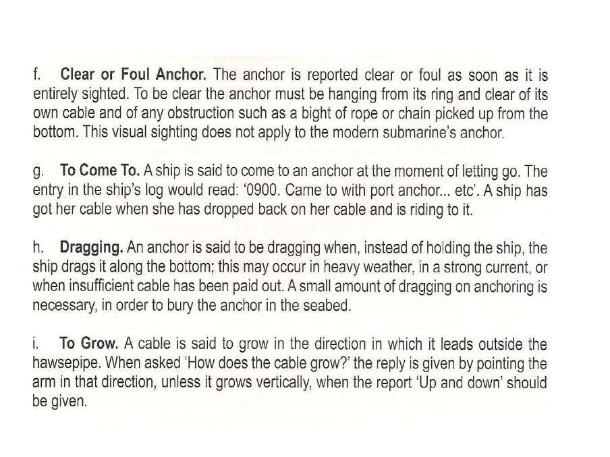
Terminology used in anchor work cont’d

Slide 29
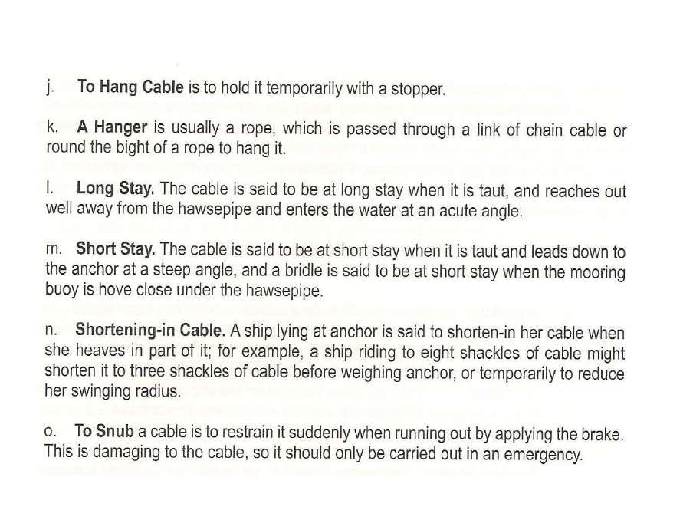
Terminology used in anchor work cont’d

Slide 30
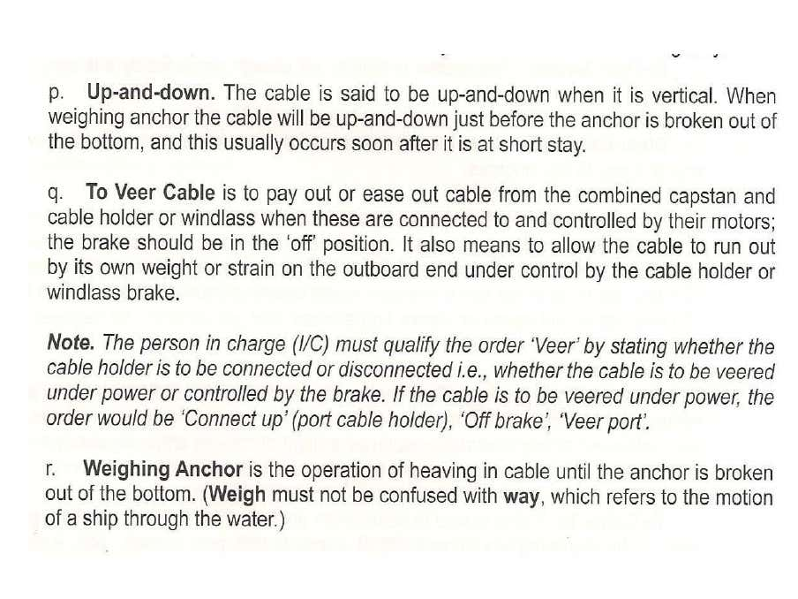
Terminology used in anchor work cont’d

Slide 31
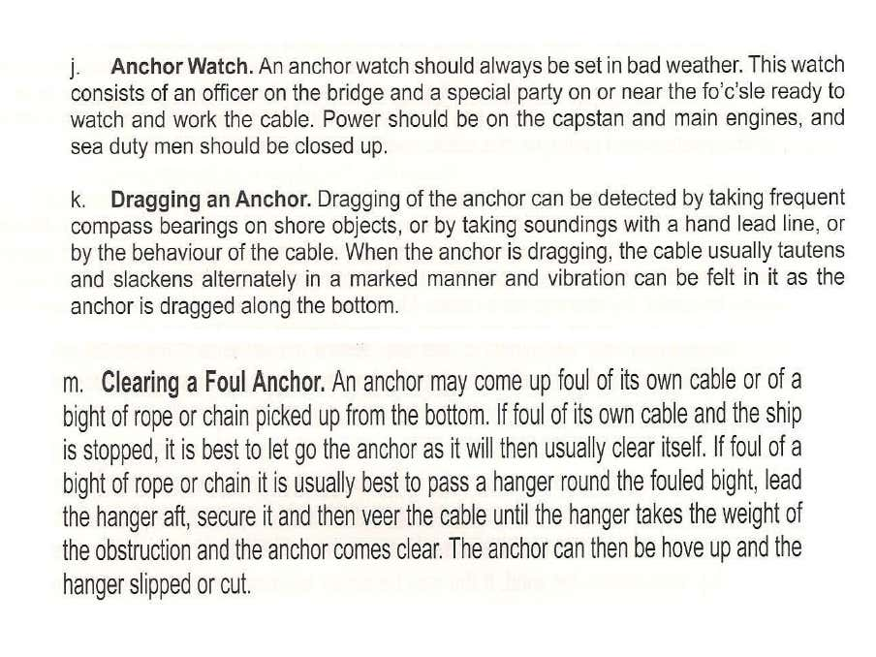
Terminology used in anchor work cont’d

