Slide 1
ELECTRODYNAMOMETER
Engr.I.C. Febaide

Slide 2
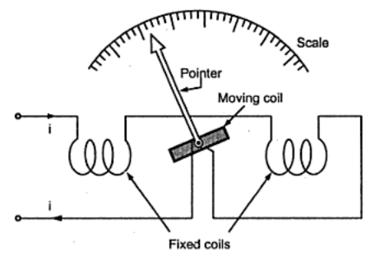
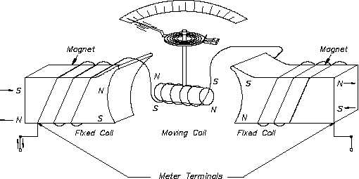
Electrodynamometer Type Instruments

Slide 3
Electrodynamometer Type Instruments
The necessity for the A.C. calibration of moving iron instruments as well as other types of instruments, which cannot be correctly calibrated, requires the use of a transfer type of instrument.
A transfer instrument is one that may be calibrated with a D.C. Source and then used without modification to measure A.C.
This requires the transfer type instrument to have same accuracy for both D.C. and A.C., which the electrodynamometer instruments have.
These standards are precision resistors and the Weston standard cell (which is a D.C. cell).
It is obvious, therefore, that it would be impossible to calibrate an A.C. instrument directly against the fundamental standards.
Electrodynamics instruments are capable of service as transfer instruments.

Slide 4
Electrodynamometer Type Instruments Working:
Electrodynamic type instruments are similar to the PMMC-type elements except that the magnet is replaced by two serially connected fixed coils that produce the magnetic field when energized.
The fixed coils are spaced far enough apart to allow passage of the shaft of the movable coil. The movable coil carries a pointer, which is balanced by counter weights. Its rotation is controlled by springs.
The motor torque is proportional to the product of the currents in the moving and fixed coils.
If the current is reversed, the field polarity and the polarity of the moving coil reverse at the same time, and the turning force continues in the original direction. Since the reversing the current direction does not reverse the turning force, this type of instruments can be used to measure AC or DC current, voltage, or its major application as a wattmeter for power measurement.

Slide 5
Electrodynamometer Type Instruments Working Principle:
Principle:
Electro-dynamometer type instruments are very similar to PMMC type instrument in which the operating field is produced, not by a permanent magnet but by another fixed coil (usually two fixed air cored coils are used).
The PMMC instrument cannot be used on A.C currents or voltages. If A.C supply is given to these instruments, an alternating torque will be developed. Due to moment of inertia of the moving system, the pointer will not follow the rapidly changing alternating torque and will fail to show any reading.
In order that the instrument should be able to read A.C quantities, the magnetic field in the air gap must change along with the change in current. This principle is used in the electro-dynamometer type instrument.

Slide 6
Electrodynamometer Type Instruments Construction:
Fixed Coils:
The field is produced by a fixed coil.
This coil is divided into two sections to give a more uniform field near the centre and to allow passage of the instrument shaft.
Fixed coils are usually wound with heavy wire carrying the main current in ammeters and watt meters.
The wire is stranded where necessary to reduce eddy current losses in conductors.
Moving Coil:
A single element instrument has one moving coil.
The moving coil is wound either as a self-sustaining coil or else on a non-metallic former.
A metallic former cannot be used as eddy current would be induced in it by the alternating field.
It should be noted that both fixed and moving coils are air cored.

Slide 7
Electrodynamometer Type Instruments Construction:
Control:
The controlling torque is provided by two control springs.
These springs act as leads to the moving coil.
Moving System:
The moving coil is mounted on an aluminum spindle.
The moving system also carries the counter weights and truss type pointer.
Sometimes a suspension may be used in case a high sensitivity is desired.
Damping:
Air friction damping is employed for these instruments and is provided by a pair of aluminum vanes, attached to the spindle at the bottom.
These vanes move in sector shaped chambers.

Slide 8
Electrodynamometer Type Instruments Construction:
Damping:
Eddy current damping cannot be used in these instruments as the operating field is very weak (on account of the fact that the coils are air cored) and any introduction of a permanent magnet required for eddy current damping would distort the operating magnetic field of the instrument.
Shielding:
The field produced by the fixed coils is somewhat weaker than in other types of instruments.
It is nearly 0.005 to 0.006 Wb/m.
In D.C. Measurements even the earth magnetic field may affect the readings.
Thus it is necessary to shield an electrodynamometer type instrument from the effect of stray magnetic fields.
Air cored electrodynamometer type instruments are protected against external magnetic fields by enclosing them in a casing of high permeability alloy.

Slide 9
Electrodynamometer Type Instruments Construction:
Shielding:
This shunts external magnetic fields around the instrument mechanism and minimizes their effects on the indication.
Cases and Scales:
Laboratory standard instruments are usually contained in highly polished wooden cases.
These cases are so constructed as to remain dimensionally stable over long periods of time.
The glass is coated with some conducting material to completely remove the electrostatic effects.
Adjustable leveling screws support the case.
A spirit level is also provided to ensure proper leveling.
The scales are hand drawn, using machine sub-dividing equipment.

Slide 10
Electrodynamometer in power measurement
It may be used to indicate both ac and dc power for any waveform of voltage and current (not restricted to sinusoidal). To measure the power of single phase, the electrodynamometer is connected as shown in Fig.
Current coil
ic
ip
Potential coil
i
e
Current coil

Slide 11
Electrodynamometer (cont.)
The field coils are connected in series and carrying the total current i_{c}. The movable coil is connected in series with R (Limiting resistor) and it carries small current i_{p} = e/R_{p} ,
R_{p} = R + coil resistance.
The deflection of the movable coil is proportional to i_{c} and i_{p} , thus the average deflection:

Slide 12
Electrodynamometer (cont.)
i_{c}= i_{p} + I
Assuming for the moment that i_{c} = i,
Then,
By definition, the average power in circuit is:

Slide 13
Electrodynamometer (cont.)
Therefore the average deflection is proportional with the average power,
i.e θ_{av} ∝ P_{av}
If e and i are sinusoidal then:
e =E_{m} sin(ωt)
, and i(t) =I_{m} sin(ωt ± θ)
Then the average angle of deflection θ_{av} will be:
Where E and I represent the rms of e and i and θ represents the phase angle between voltage and current.

Slide 14
WattMeter

Slide 15
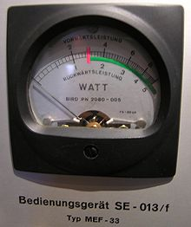
The wattmeter :
is an instrument for measuring the electric power (or the supply rate of electrical energy) in watts of any given circuit.

Slide 16
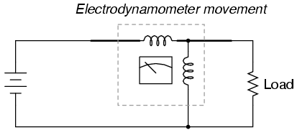
The traditional analog wattmeter is an electrodynamics instrument.
The device consists of a pair of fixed coils, known as current coils, and a movable coil known as the potential coil.

Slide 17
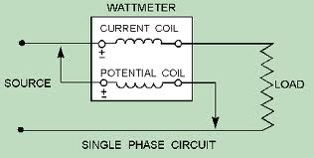
The current coils connected in series with the circuit, while the potential coil is connected in parallel.

Slide 18
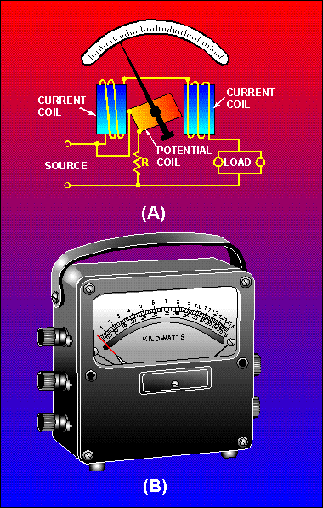
The fixed coils are made up of a few turns of a comparatively large conductor.
The potential coil consists of many turns of fine wire.
The movable coil carries a needle which moves over a suitably marked scale.
Spiral coil springs hold the needle to a zero position.

Slide 19
When line current flows through the current coil of a wattmeter, a field is
set up around the coil.
The strength of this field is proportional to the line current and in phase with
it.
The potential coil of the wattmeter generally has a high-resistance resistor connected in series with it.

Slide 20
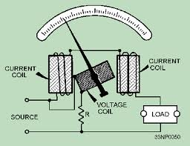
As a result, current in the potential circuit is practically in phase with line voltage. Therefore, when voltage is applied to the potential circuit, current is proportional to and in phase with the
line voltage.
The actuating force of a wattmeter comes from the field of its current coil and the field of its potential coil. The force acting on the movable coil at any instant (tending to turn it) is proportional to the instantaneous values of line current and voltage.

Slide 21
The wattmeter consists of two circuits, either of which will be damaged if too much current is
passed through them.
This fact is to be especially emphasized in the case of wattmeters, because the reading of the instrument does not serve to tell the user that the coils are being overheated. If an ammeter or voltmeter is overloaded, the pointer will be indicating beyond the upper limit of its scale

Slide 22
Power in an electric circuit is the product (multiplication) of voltage and current, so any meter designed to measure power must account for both of these variables.

Slide 23
THE END

