Slide 1
Main Shafting and propeller
Basic knowledge

Slide 2
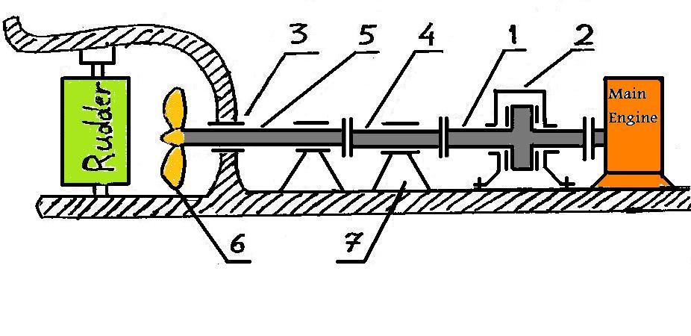
1- Thrust shaft.
2- Thrust block.
3- Stern tube.
4- intermediate shaft.
5- Propeller shaft ( screw shaft ).
6- Propeller.
7- Shaft bearing.

Slide 3
What happen when the engine runs?
when the main engine runs its
Crankshaft turns the thrust shaft (1)
Which is connected to it by a heavy flange,
The torque is transmitted to the screw shaft (5) and to the propeller boss (6) through the intermediate shaft (4) .
The thrust from the propeller is taken up by the thrust bearing which transmits the thrust to the ship’s hull and causes the ship to be propelled in the direction of the thrust. The thrust block(2) is always fitted at the aft end of the main engine crankshaft.

Slide 4
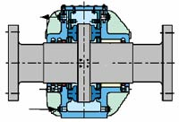
Functions of the main parts of Propulsion system:
Thrust shaft :
The function of the thrust shaft is transferring the revolution motion to the intermediate shaft and transfers the thrust from it to the thrust block.
(2) Thrust bearing:
The function of the thrust bearing is
transferring propeller thrust to the
thrust block casing which is fitted
to ship’s hull and causes the ship
to move to the thrust direction (forward. or aft).

Slide 5
Thrust block working theory :
Thrust collar is forged integrally with the thrust shaft, Thrust pads are fitted in forward and aft side of the thrust collar and they are able to tilt.
When the shaft rotates, an oil pressure is built up between the white metal face of the thrust pad and the thrust collar, The thrust will transfer from the collar to the thrust pads through the oil film to the casing which is
rigid to ship’s hull
causing movement
of the ship.
Thrust pad
Bearing
Thrust shaft
Oil bath
Thrust collar

Slide 6
(3) Stern tube:
The function of stern tube is to
support the weight of the
propeller and screw shaft, also prevents sea water
to pass through to the ship.
There are two types of stern tube:
A- water lubricating type: used in this type lignum-vita
wood or impregnated resin compound .Lubrication of
stern tube takes place when the bearings absorb water
and result a wet slippery surface has low friction ratio
with high resistance to wear.
B- oil lubricating type: used in this type lubricating oil
which lubricate stern tube bearings, mostly three stage
of seals are used to prevent water to enter the ship and
prevent oil to escape out of the ship.

Slide 7
(4) Intermediate shaft :
The function of the intermediate
shaft is transmit the rotation from
the thrust shaft to the screw shaft (propeller shaft)and
transmit the thrust from screw shaft to the thrust shaft.
(5) propeller shaft :
The function of the propeller shaft
is transmit the rotation from intermediate shaft to the propeller and transmit the thrust from the propeller to the intermediate shaft.

Slide 8
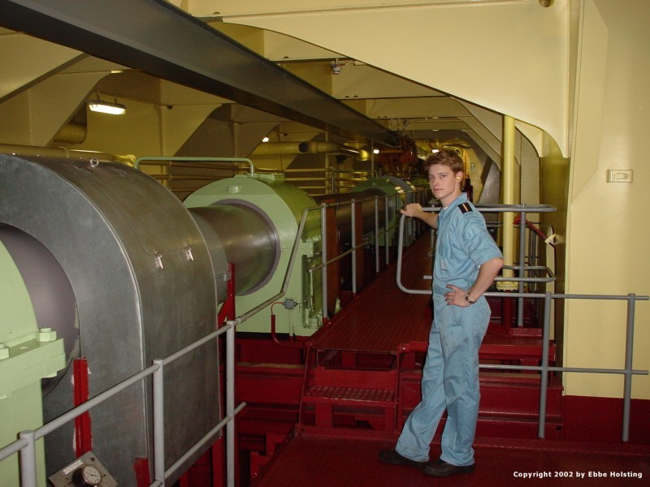

Slide 9
(6) The Propeller :The function of the propeller is to produce the thrust which transmitted to the propeller shaft , That thrust generated due to turning of propeller blades (which have designed angle shape) in the water , some ships have fixed angle propeller , in this type controlling of the ship’s speed is only by controlling main engine speed, Reversing direction ( ahead or astern) is by reversing of engine motion clockwise or anticlockwise , Other ships have controlled pitch propeller which can move propeller blades around their axis, By that way we can reverse ship direction ahead or astern by reversing propeller blades’ angle , also speed can be effected by changing that angle.

Slide 10
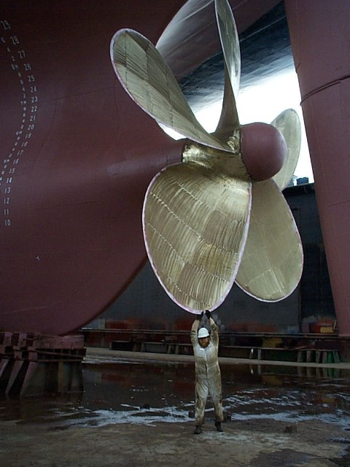

Slide 11
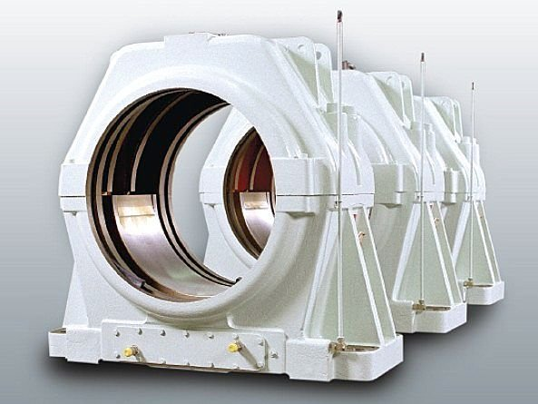
(7) Shaft bearings: The function of shaft bearings to carry shaft weight and to keep it aligned , these bearings are lubricated by oil which is cooled mostly by sea water coils passing in their sumps. Wear of these bearings above limit could cause harmful vibration and shaft misalignment.

