Slide 1
TypeScript
Eng. Arwa Osama

Slide 2
TypeScript
Typescript is a new programing language
It has been around since 2012
TypeScript
JavaScript
Depend

Slide 3
TypeScript
JavaScript
Strongly typed
Select variable
Control variable
Object Oriented
Compiled Language
Dynamically typed
Var a =’...’
String
Number
Boolean

Slide 4


TypeScript

Slide 5
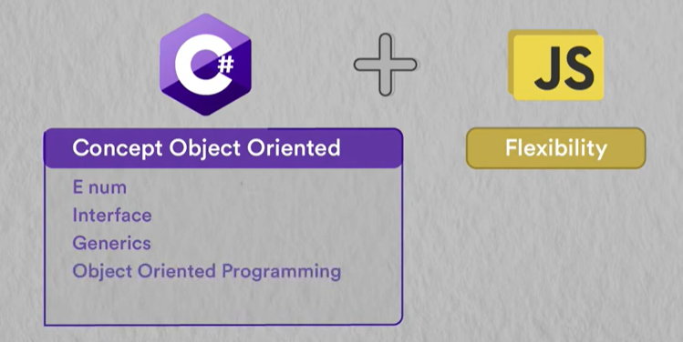

Slide 6
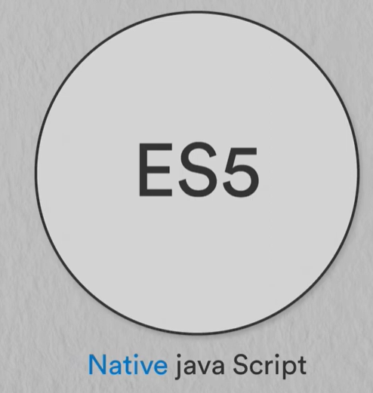
What is TypeScript?
TypeScript is a superset of javascript
TypeScript
Es7,8,9,10
Es6
Es5

Slide 7
Additional features
Type annotations
Interface
Enumerated types
Generics
Tuples
Async/await
Classes
Modules

Slide 8



usability in community
2860 companies around the world use typescript in their projects

Slide 9



Frameworks

Slide 10



Application
Any app implemented by Javascript can be done by TypeScript
Like.

Slide 11
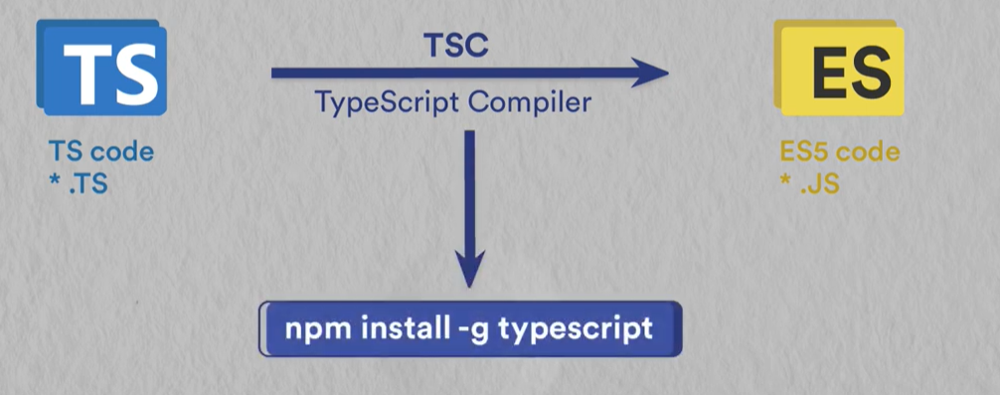

Slide 12
Node Package Manager
Command Line Utility
Package Manager for JavaScript
Install Libraries, Packages and application

Slide 13
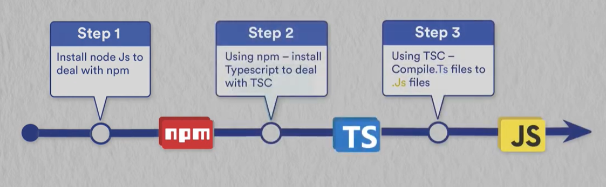
Setup Environment

Slide 14
Data types in TypeScript
Type | Description | Example
string | Represents textual data. | let name: string = "John";
number | Represents both integers and floating-point numbers. | let age: number = 25;
Boolean | Represents a true/false value. | let isActive: boolean = true;
null | Represents an intentional absence of any object value. | let data: null = null;
undefined | Represents a variable that has not been assigned a value. | let value: undefined;
bigint | Represents large integers | let bigNum: bigint = 100n;

Slide 15
Types
Type | Description | Example
any | Disables type checking, allowing any type. | let data: any = "hello";
unknown | Similar to any, but safer. Requires type checking before use. | let data: unknown = "hello";
void | Represents the absence of a value, often used as a function return type. | function log(): void { console.log("Hi"); }
never | Represents a value that never occurs (e.g., a function that always throws). | function error(): never { throw new Error(); }
object | Represents any non-primitive type (objects, arrays, functions, etc.). | let user: object = { name: "John" };
array | Represents an array of elements of a specific type. | let numbers: number[] = [1, 2, 3];
tuple | Represents an array with a fixed number of elements of known types. | let person: [string, number] = ["John", 25];
enum | Represents a set of named constants. | enum Color { Red, Green, Blue };

Slide 16
Custom Types
Type | Description | Example
interface | Defines the shape of an object. | interface User { name: string; age: number; }
type | Creates a custom type alias (can combine or extend other types). | type ID = string | number;
union | Represents a value that can be one of several types. | let id: string | number = "123";
literal | Represents a specific value as a type. | let direction: "left" | "right" = "left";
function | Defines the type of a function (parameters and return type). | type Add = (a: number, b: number) => number;
class | Defines a blueprint for creating objects with properties and methods. | class Animal { name: string; }
generics | Allows reusable, type-safe code by parameterizing types. | function identity<T>(arg: T): T { return arg; }

Slide 17
Utility Types
Type | Description | Example
Partial<T> | Makes all properties of T optional. | Partial<User>
Required<T> | Makes all properties of T required. | Required<User>
Readonly<T> | Makes all properties of T read-only. | Readonly<User>
Record<K, T> | Creates an object type with keys of type K and values of type T. | Record<string, number>
Pick<T, K> | Selects a subset of properties from T based on K. | Pick<User, "name">
Omit<T, K> | Removes a subset of properties from T based on K. | Omit<User, "age">
Exclude<T, U> | Excludes types from T that are assignable to U. | Exclude<string | number, number>
Extract<T, U> | Extracts types from T that are assignable to U. | Extract<string | number, number>
NonNullable<T> | Removes null and undefined from T. | NonNullable<string | null>

