Slide 1

Reproducible Environments and Builds with Nix
* Graphic Design is my passion
Nathan Pankhurst

Slide 2

What are we going to cover?
What is Nix?
The Nix Store
The Nix Binary Cache
How can Nix help us as Go Developers?
Nix Flakes
What they are
Reproducible Environments
Reproducible Builds
GoMod2Nix
Building Containers
Summary

Slide 3
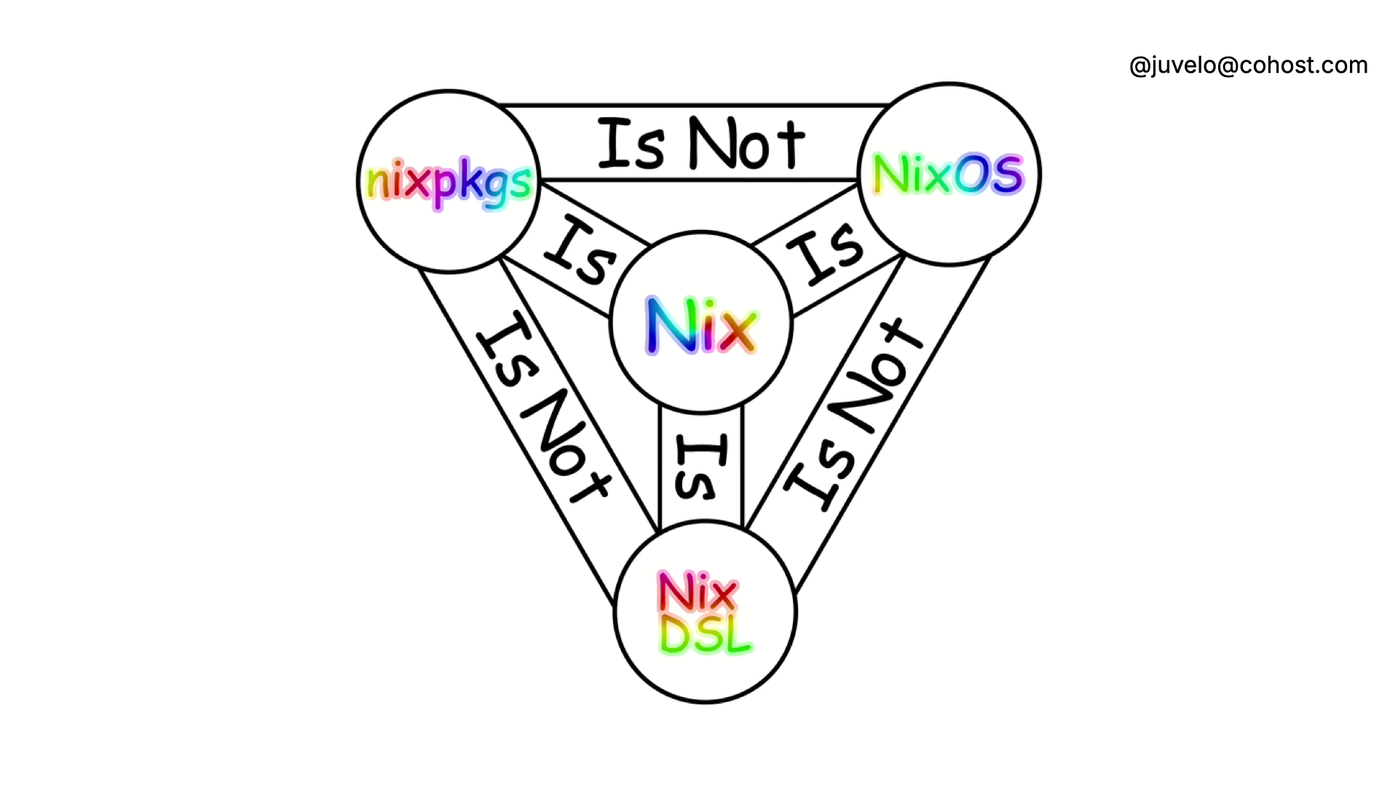
What is Nix?
Nix builds Any Version of Any Software on Any Machine*
Built from atomic Derivations
Nix Domain Specific Language
Functional
Turing Complete
Nix Package Manager
More packages than AUR (96k vs 75K) c.o https://repology.org/repositories/statistics/total
NixOS

Slide 4
Nix Store
Where Nix stores our derivations
Directories form the structure:
`/nix/store/{Derivation SHA}/{Derivation name}`
Derivations can be files or folders

Slide 5
Nix Binary Cache
Remote Cache for built Derivations.
Reduces number of builds for common Derivations.
Managed by NixOS maintainers.
Private Caches /w tools like Cachix.

Slide 6

How can Nix help us as Go Developers?
Transitive Dependency Management
Reproducible Builds
Reproducible Development Environments
Cleaner Container Builds
Unified Dev and CI/CD Processes
But it worked on my machine?..

Slide 7
Nix Flakes – What are they?
Simplifies creation of derivations to:
Inputs
Outputs
Can be synonymous with a Project File
Help enforce Reproducibility
Experimental feature
Heavily Adopted
Poorly Documented

Slide 8
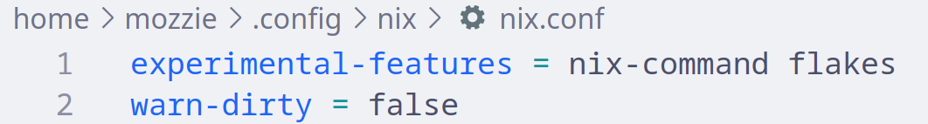
Enabling Nix Flakes
Enabled in different ways depending on system
System independent => ~/.config/nix/nix.conf:

Slide 9
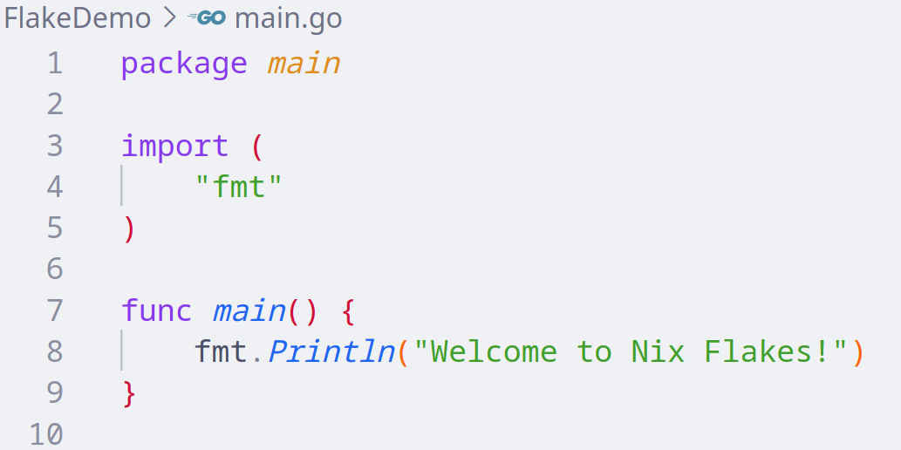
Demo App

Slide 10
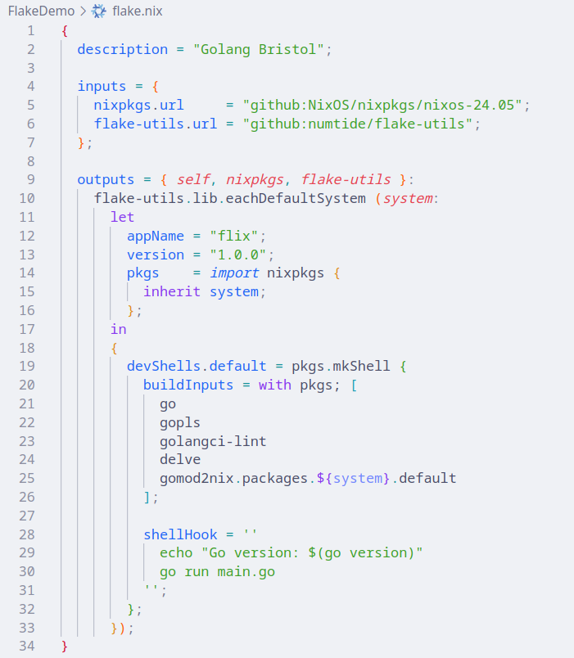
Nix Development Environment
Pinning Nixpkgs Version
Multi-system Targeting
Development Shell

Slide 11
Nix Develop

Slide 12
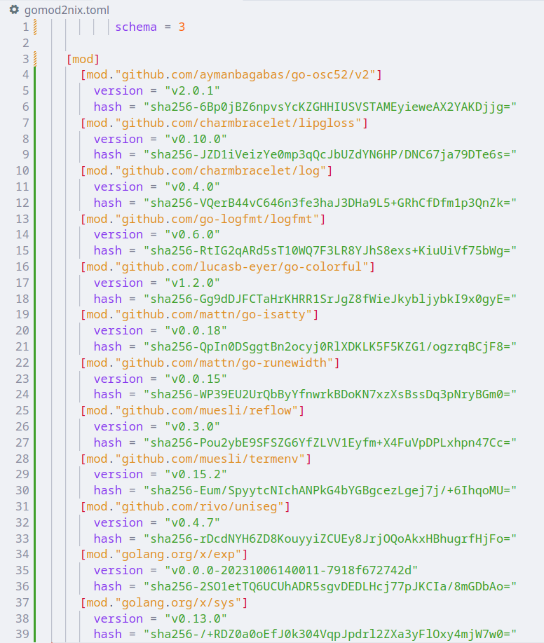
GoMod2Nix
Manage Go’s transitive dependencies in Nix;
`gomod2nix generate`
Generates a `gomod2nix.toml` dictating the contents of go.mod
GoMod2Nix doesn’t replace `go.mod` for builds
within the nix shell.

Slide 13
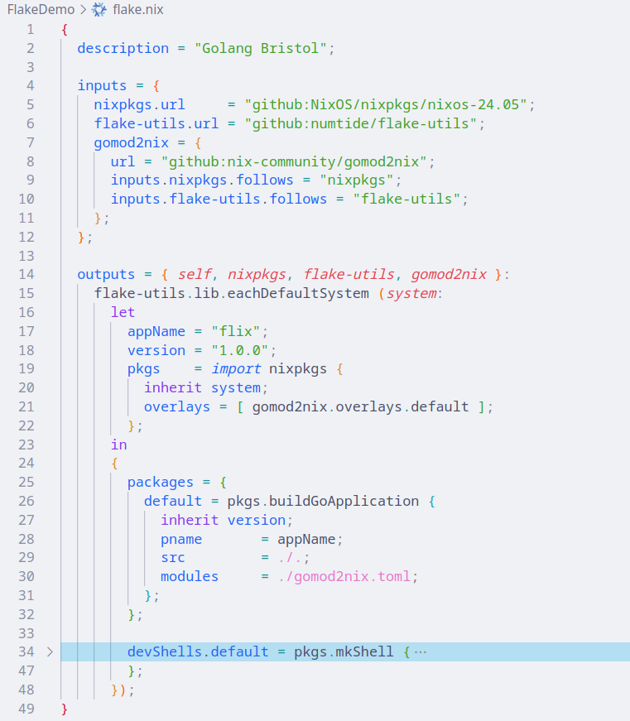
Nix Build
GoMod2Nix
Add Overlay
Define Build Step

Slide 14
Nix Build

Slide 15
Nix Run

Slide 16
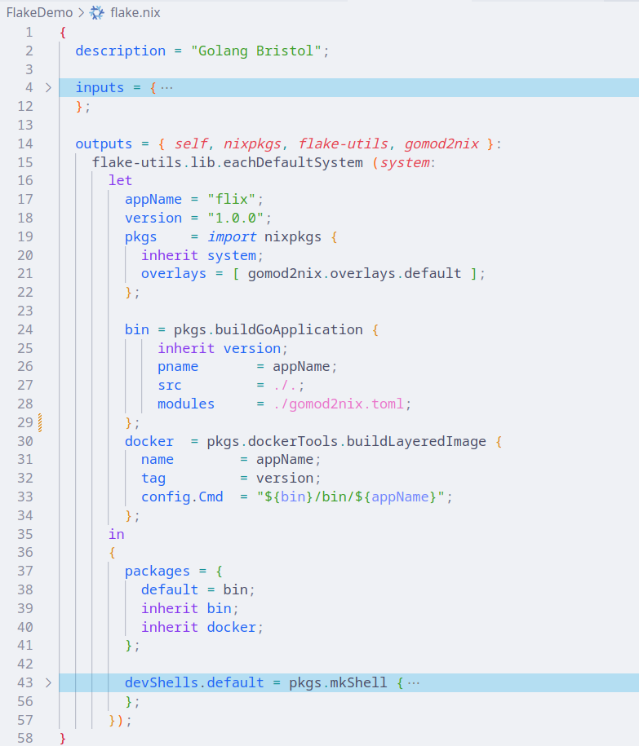
Nix Container Build
Declarations moved
to variables
Container pulls binary
from nix build
Use inherit to define
declarations in output

Slide 17
Nix Build (Container)

Slide 18
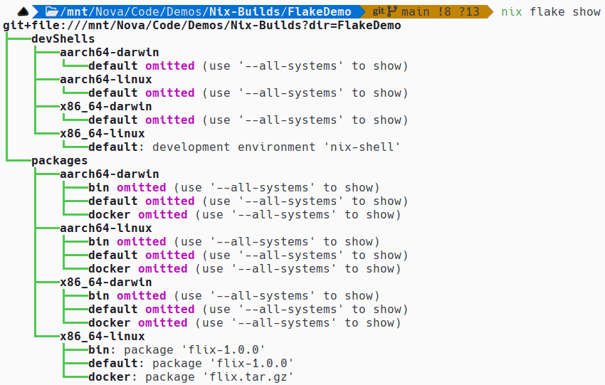
Our Flake

Slide 19
TL;DL?
Nix is a group of tools that allow us to use declaritive language to describe reproducible systems.
We can use nix flakes to manage our project’s dependencies. Inclusive and exclusive of Go Modules.
The output of our nix flake can be a Docker Image, allowing us to use nix in place of dockerfiles.
Nix enables us to unify our development environments and our CI/CD processes.

Slide 20
The Real Heroes
Erik Krieg – What is Nix/NixOS? - https://medium.com/@Erik_Krieg/what-is-nix-nixos-aab5610f0d7f
Xe Iaso – Nix is a better Docker image builder… https://xeiaso.net/talks/2024/nix-docker-build/
Haseeb Majid – Setting up a go development shell - https://haseebmajid.dev/posts/2023-10-26-how-to-setup-a-go-development-shell-with-nix-flakes/
Surma – Nix explained from the ground up - https://youtu.be/5D3nUU1OVx8?si=nbnTB5r2czDHdcX0
Vimjoyer – Nix flakes explained - https://www.youtube.com/watch?v=S3VBi6kHw5c&pp=ygUKTml4IEZsYWtlcw%3D%3D
Matthew Croughan – Use flake.nix, not Dockerfile - https://www.youtube.com/watch?v=0uixRE8xlbY&pp=ygUKTml4IEZsYWtlcw%3D%3D
Vimjoyer – Nix Dev Environments - https://www.youtube.com/watch?v=yQwW8dkuHqw&pp=ygUKTml4IEZsYWtlcw%3D%3D

