Slide 1
Automating Malicious File Neutralization
Presenter: Meera Pillai
Cybersecurity Analyst

Slide 2
Introduction
Stay@home is one of our clients, serving merchants, artisans and other professionals who have been impacted by a large-scale security threat. Since these clients are not IT experts, they rely on our cybersecurity team for their website security. A security alert was raised, which revealed that there were malicious files that were capable of executing remote commands on hundreds of client’s websites. Since there is a large number of affected sites, it is impossible to delete them all by hand. This means that there is a need to use an automated system to easily identify and eliminate the threats without compromising on the security of the client’s websites.
My Goal: As a cybersecurity analyst, I have been given the task of automating identification and neutralization using Python scripts.

Slide 3
Project Goal
• Search for malicious files across client websites.
• Identify files using predefined criteria (Conditions)
• Neutralize the files by renaming them and not deleting ( to avoid issues with critical dependencies)

Slide 4
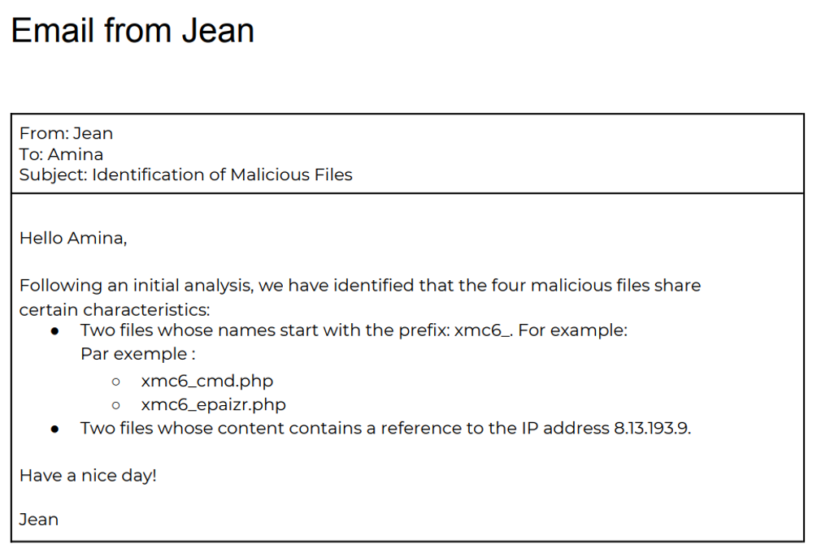
Characteristics of Malicious Files
Based on Jean’s email:
• Files with prefix: 'xmc6_' (e.g., xmc6_cmd.php, xmc6_epaizr.php)
• Files containing IP address: 8.13.193.9

Slide 5
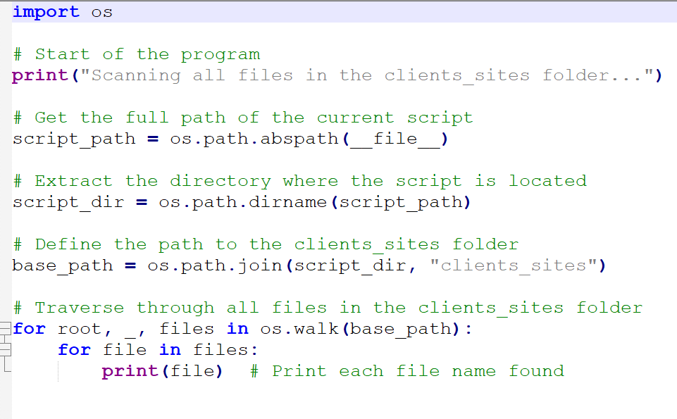
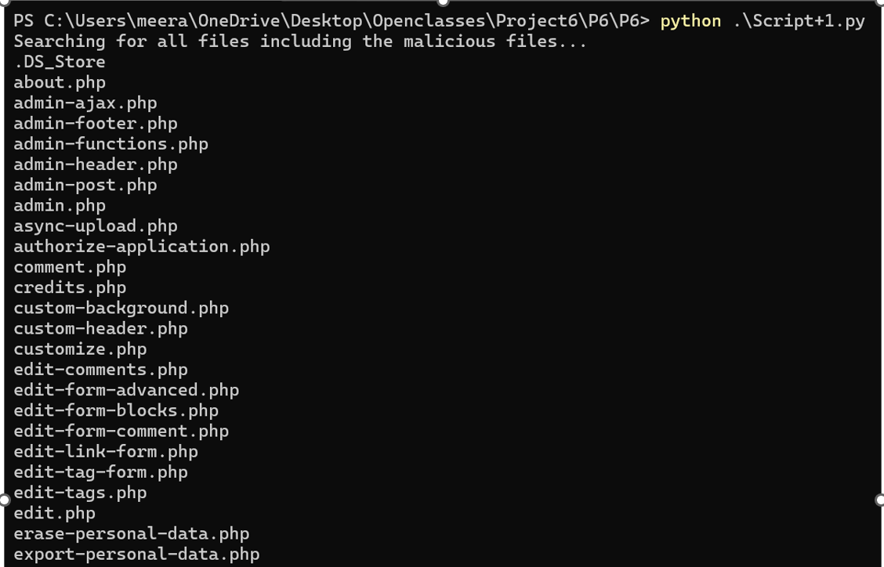
Script 1: Scanning Files
• Reads all files in the 'clients_sites' folder.
• Lists all detected files for further processing.
• Helps in identifying potentially harmful files.

Slide 6
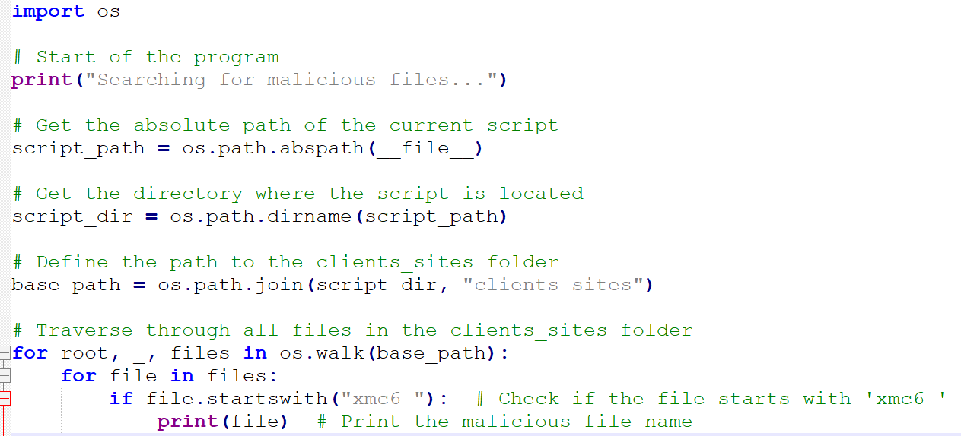
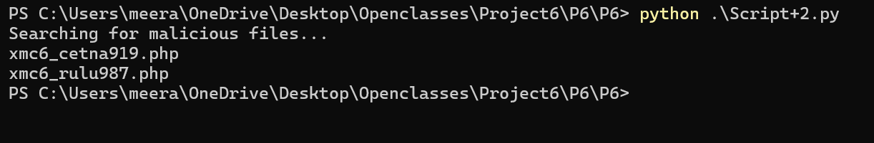
Script 2: Identifying Files by Prefix
• Extracts file names from 'clients_sites'.
• Compares names with prefix 'xmc6_'.
• Displays the names of potentially malicious files.

Slide 7
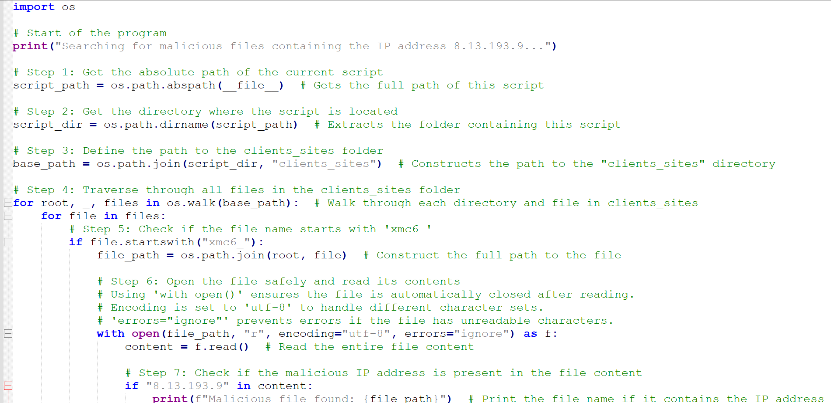
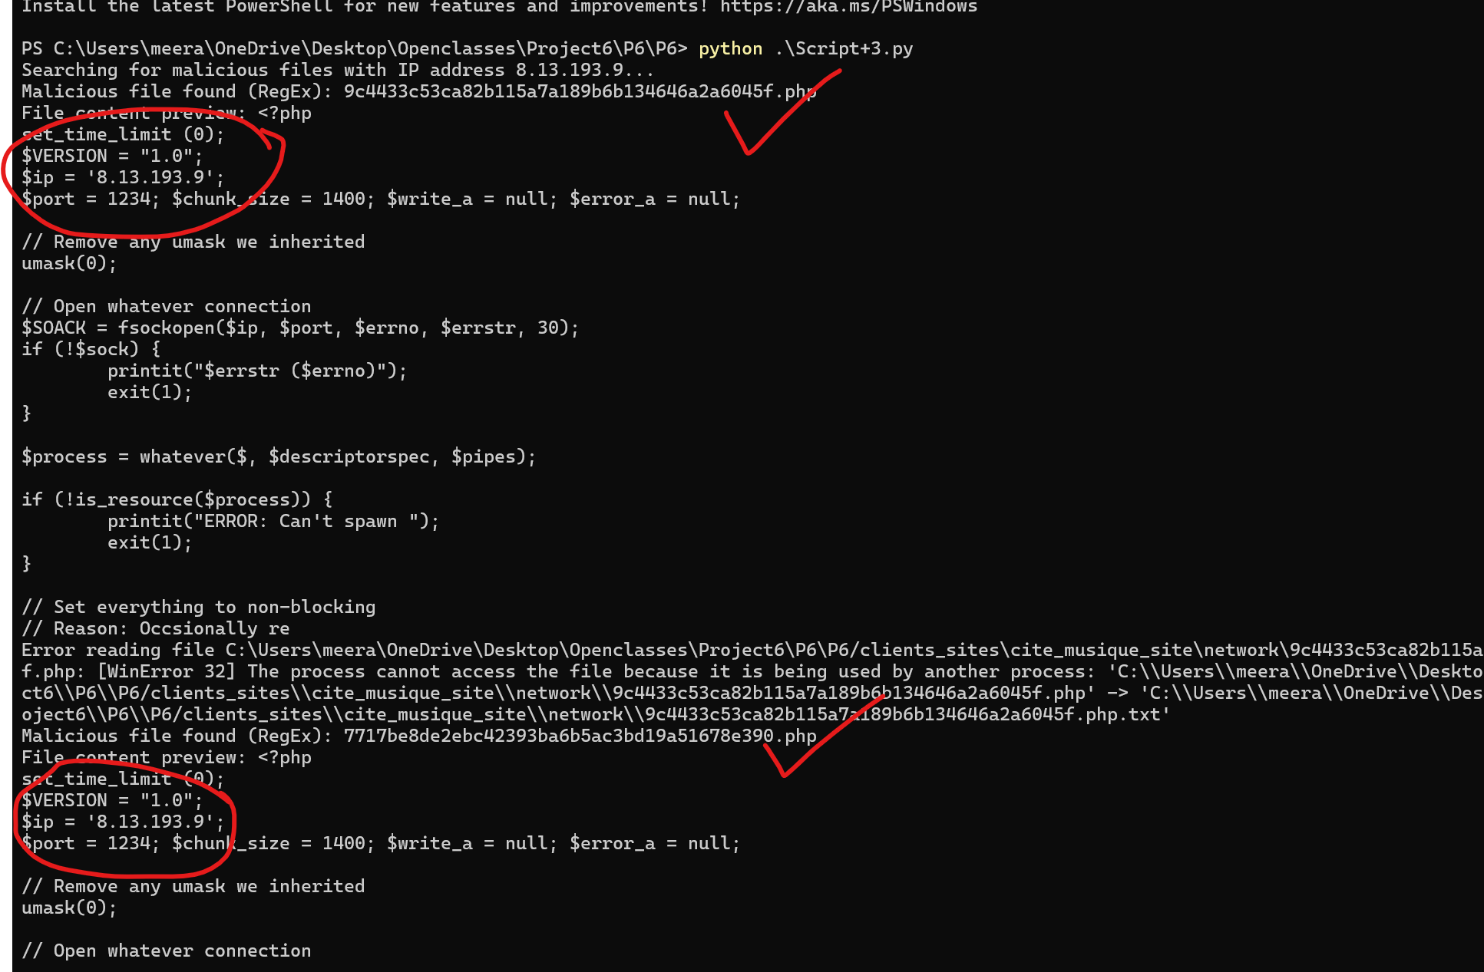
Script 3: Identifying Files by IP Address
• Searches for the IP address 8.13.193.9 in file contents.
• Uses regex (regular expression)to accurately detect matches.
• Ensures malicious files are properly flagged.

Slide 8
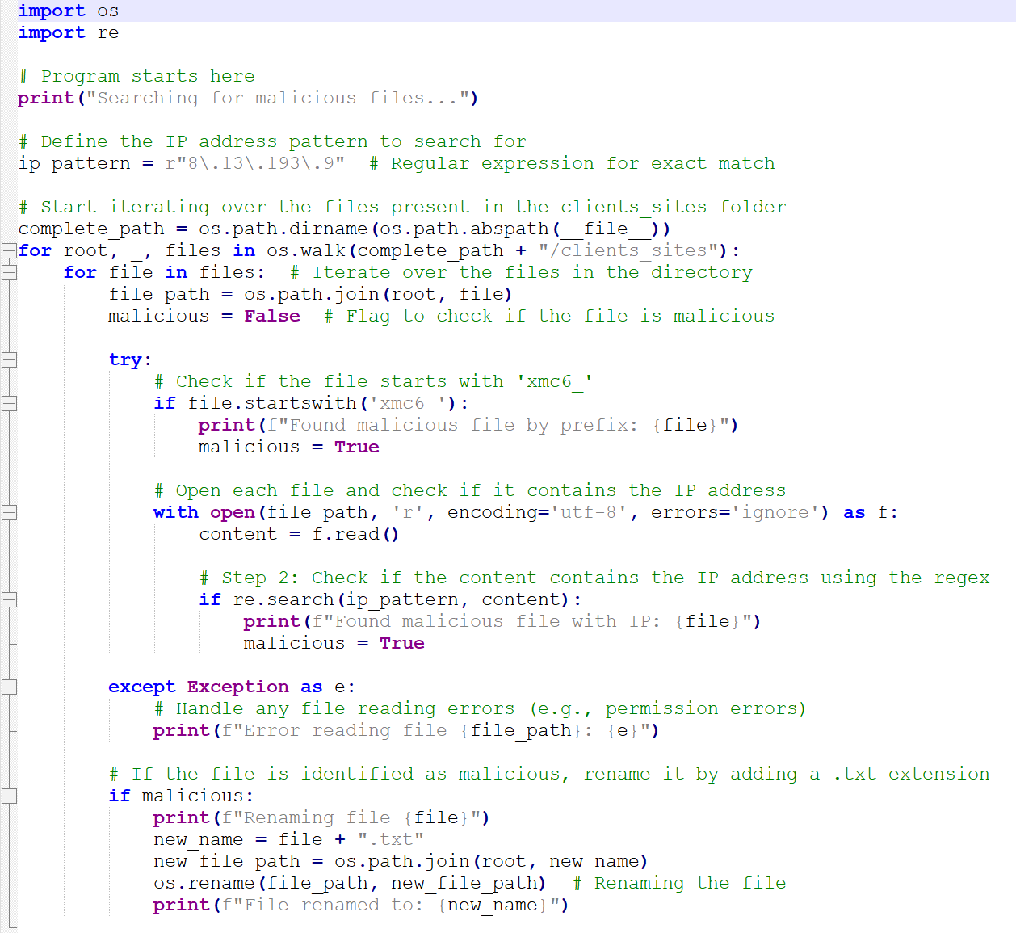
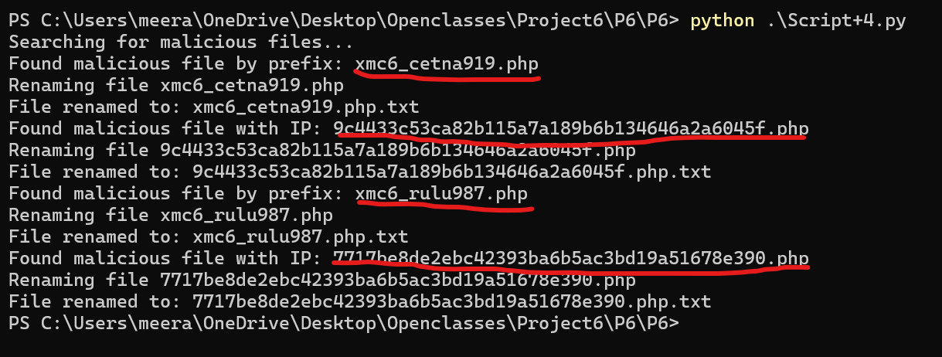
Script 4: Neutralizing Files
• Renames malicious files by adding '.txt'.
• Prevents execution of this malicious php files on web servers, while preserving for further analysis.
• Uses a boolean flag to determine if renaming is required. The file is only renamed if the flag criteria satisfies the condition (xfc6 and the ip address) and prevent unnecessary renaming of the clean files.

Slide 9
Implementation Summary
• Script 1 runs a scans for all files.
• Script 2 looks for files with 'xmc6_' prefix in front of the files.
• Script 3 detects files that have IP 8.13.193.9.
• Script 4 neutralizes all the malicious files that have been identified.

Slide 10
Challenges & Solutions
1. Handling large directories efficiently.
Challenges: The client_sites folder may contain thousands of files spread through subdirectories and if not handled properly it can slow down the scan and could consume a lot of memory.
Solution: os.walk(base_path) is used to traverse all subdirectories without loading everything in the memory all together and process the file one by one preventing excessing resource usage.
2. Avoiding false positives in detection.
Challenges : Not all the files are malicious in nature, and some are genuine and a file having IP 8.13.193.9 in comments or logs doesn’t mean that there is an active threat
Solution: The script avoids false positives by only flagging files that start with xmc6_, uses regex to exactly match on 8.13.193.9, and has a boolean flag (malicious = False) that will only rename files if they meet at least one malicious criterion.

Slide 11
Challenges & Solutions
3. Ensuring files are only renamed, not deleted.
Challenges: If deleted outright, they may make website failures as they are system critical and would remove forensic evidence needed for investigation.
Solution: Rather than deleting, the script renames files by adding.txt (file.php -> file.php.txt) thus making them non executable and kept for analysis with the ability to easily rollback if needed.
4. Handling encoding issues during file reading.
Challenges: There might be some files with non UTF-8 characters or binary content which can cause read errors or script crashes.
Solution: The script uses “with open(file_path, 'r', encoding='utf-8', errors='ignore') as f: content = f.read()”
To ensure that text files are read correctly, use encoding="utf-8". This option prevents crashes in case unreadable characters are found by using errors="ignore".

Slide 12
Q&A

