Slide 1
Global Income and Life expectancy
By Mark, Luciana, & Eileen

Slide 2
Topic
The purpose of the research is to look at the global life expectancy within the past 20 years.
Does socioeconomic status (income level) impact life expectancy?
With further examination, we can determine if life expectancy changes over time.
If life expectancy is significantly different between higher income countries and lower income countries?

Slide 3
Coding approach and Data Techniques
Dataset: worldbank (CSV): databank.worldbank.org
Dataset link (API): worldbank
API: https://datahelpdesk.worldbank.org/knowledgebase/articles/898590-country-api-queries
Visualization: Python flask + power RESTful API, HTML/CSS, JavaScript, and one database (SQlite)
Tracks: Web scraping, Leaflet and Plotly, and Dashboard page with multiple charts
Some user-driven interactions: menus, dropdowns, textboxes, etc.

Slide 4
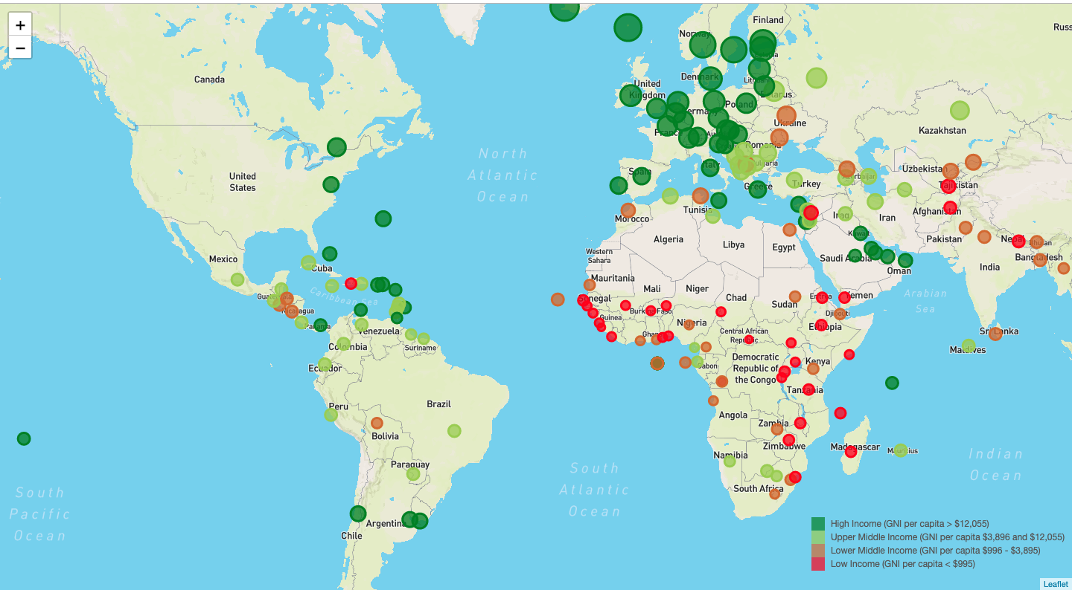
Leaflet Interactive Map

Slide 5
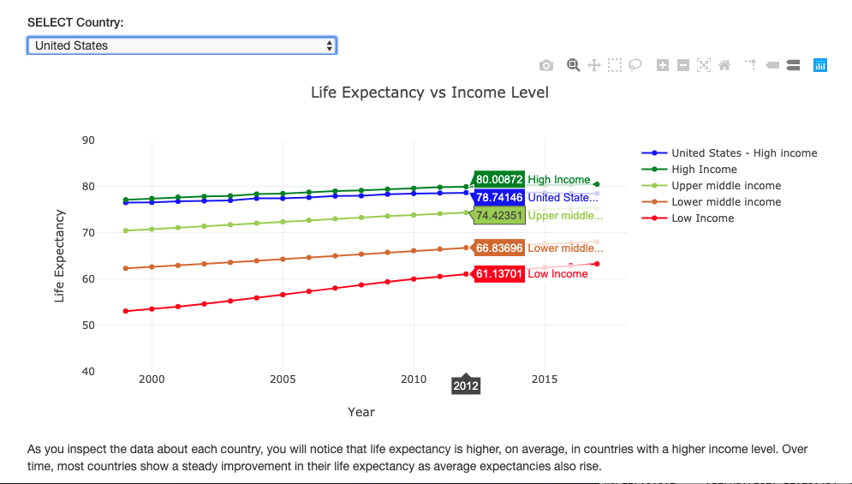
Web Dashboard & Plotly graph

Slide 6
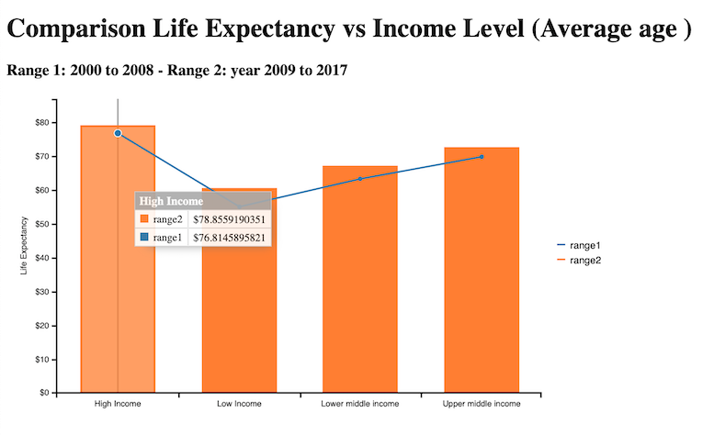
C3 bar and Line graph

Slide 7
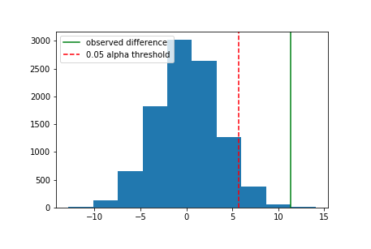
Is Life Expectancy Statistically Significantly Different Between Higher Income Countries and Lower Income Countries?

Slide 8
Our null hypothesis is that lower income countries have a larger or equal average life expectancy to the life expectancy of higher income countries.
The alternative, what we want to prove as true, is that higher income countries have a longer life expectancy than lower income countries.
Our observed difference tells us that high income countries live an average of 11.32 years longer than countries with low income. Is this statistically significant though?

Slide 9
Given our P-Value of 0.0008 we reject the null hypothesis and conclude that life expectancy is in fact statistically significantly different in high income countries than lower income countries.
Now we can say with statistical certainty that our hypothesis that higher income leads to higher life expectancy is correct.

Slide 10
Post Mortem
A difficulty that arose was using an unfamiliar JavaScript library (C3).
If we had more time, we would’ve liked to know if low life expectancy was due to not only low income, but due to a lack of healthcare.
Why life expectancies for the poor vary significantly across areas?
With a larger dataset for per person, per country, we could find more detailed results compared to the total income average per country.

Slide 11

Q & A

