Slide 1
U.S. Box Office Trends of the 2010s
Team Members - Mark Palmese, Nick Candaffio, Eileen Dolan, Tom Khambounheuang

Slide 2


Big Data and Entertainment
In 2013, Netflix made headlines when it released its original series: House of Cards
First original program by streaming service
Greenlit by using trends in their user data
Notes:
In 2013 Netflix made a big splash when it released House of Cards, an original series produced by the streaming service. In the beginning, Netflix was a service for movie rental my mail and eventually made the leap to streaming movies and tv shows over the internet. Netflix used the user data it had previously collected to gain insight into what type of show their customers would enjoy.

Slide 3
Our Question:
Can we determine what factors provide the largest box office results in movies using data

Slide 4
Specifically…
Is there any correlation between critic and user ratings with box office results in the U.S.?
Which genres of film resulted in the greatest box office success?
Does when the movie is released affect the box office
Does MPAA rating affect the box office?
Does runtime affect box office results?

Slide 5
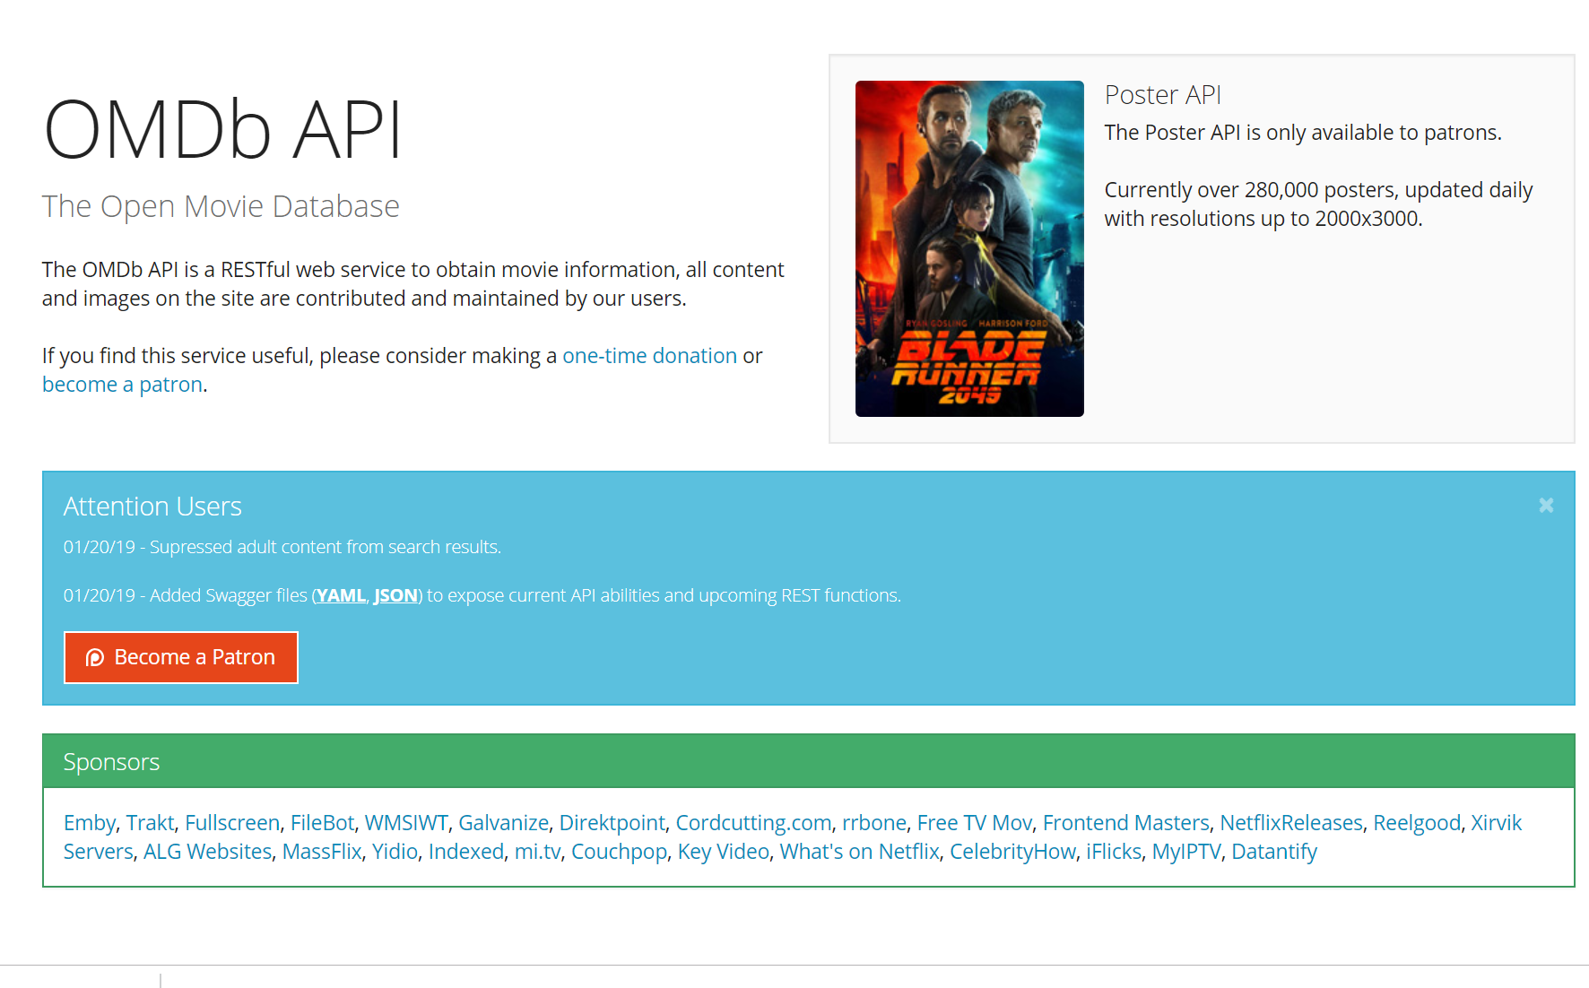
Where did we find our data?
OMDb API
An open database containing information about movies
Unfortunately, you cannot query OMDb by release date
To compensate for this, we found a csv file containing all the US movie releases from 1972-2016 on Kaggle.com
Kaggle.com is a site that hosts data science competitions

Slide 6
Data Cleanup
Issues we faced:
Merging the data two data sources
NaN vs “N/A”
Currency format string

Slide 7
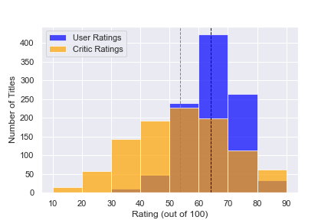
User vs Critic Rating
Two Sample P value = 3.64643515520769e-62

Slide 8
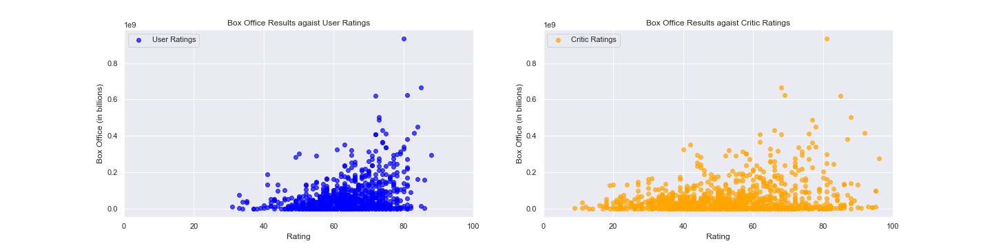
User vs Critic Rating

Slide 9
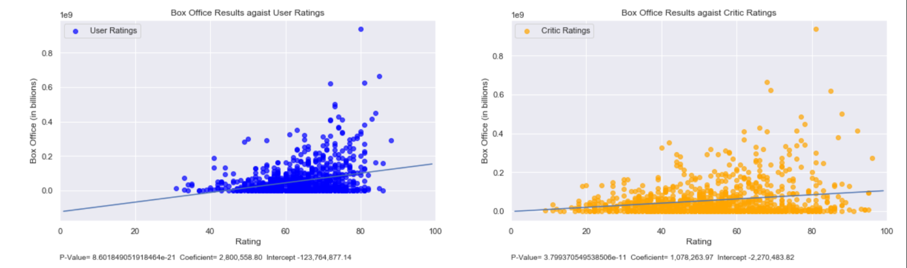
User vs Critic Rating

Slide 10
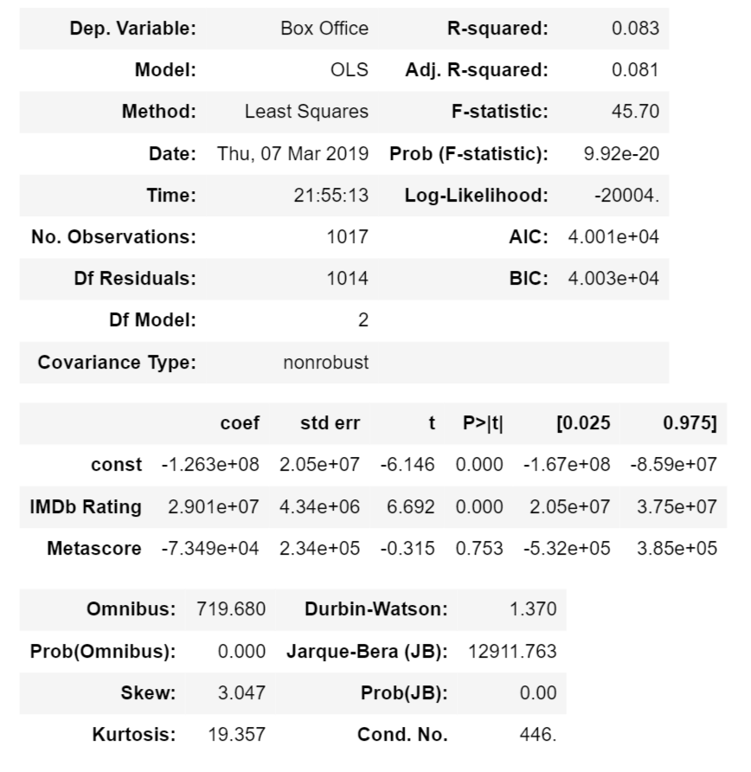
Data Analysis

Slide 11
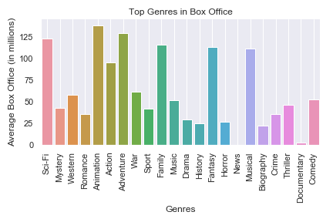
Genre and Box Office Performance

Slide 12
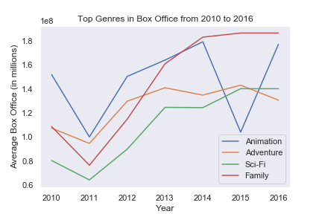
Genre and Box Office Performance

Slide 13
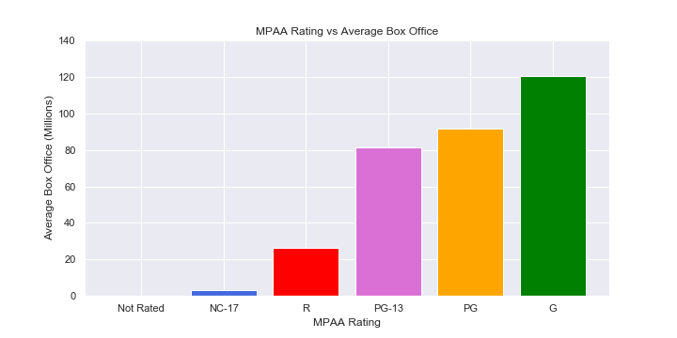
MPAA Rating

Slide 14
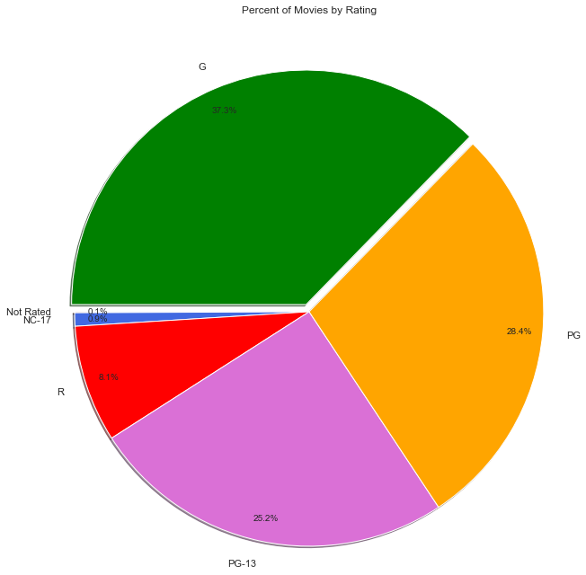
MPAA Rating

Slide 15
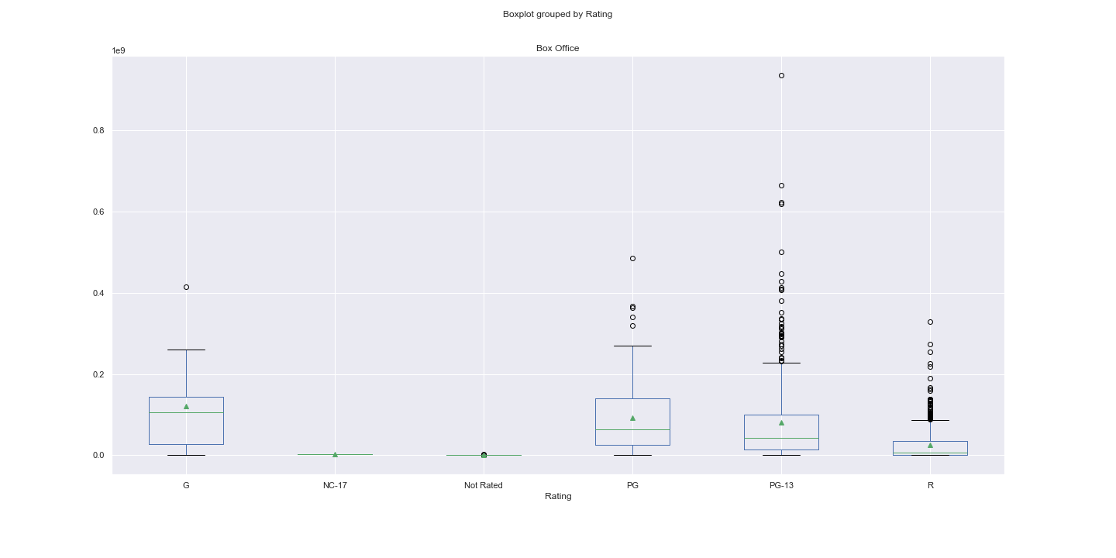
MPAA Rating
F_onewayResult(statistic=29.37724940787404, pvalue=6.545578428438524e-28)

Slide 16
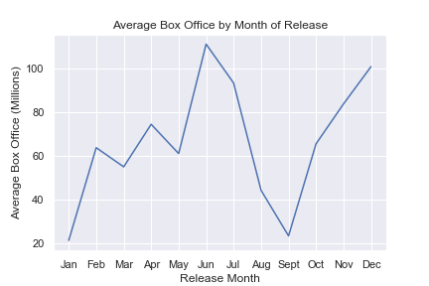
Release Date

Slide 17
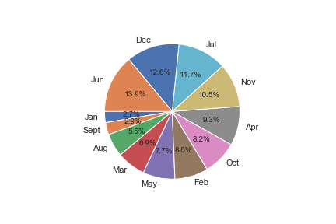
Release Date

Slide 18
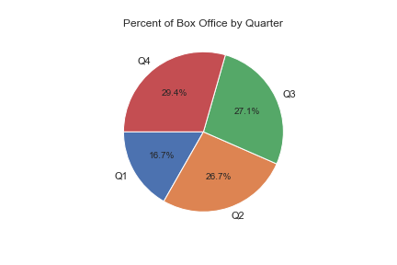
Release Date

Slide 19
Release Date

Slide 20
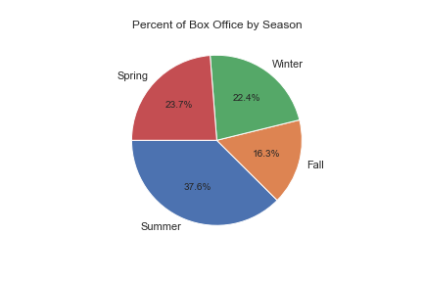
Release Date

Slide 21
Release Date

Slide 22
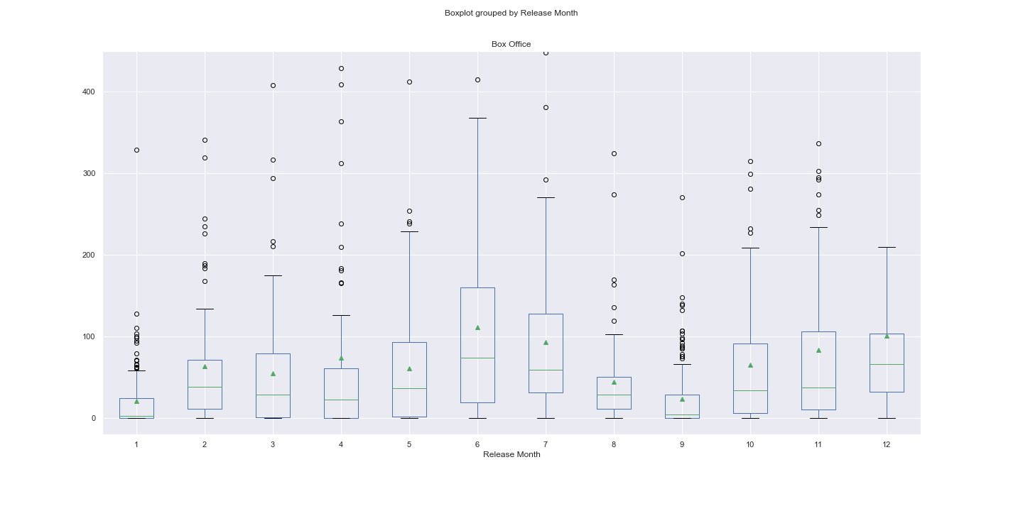
Release Date
F_onewayResult(statistic=10.874730742925472, pvalue=3.6178800066850965e-19)

Slide 23
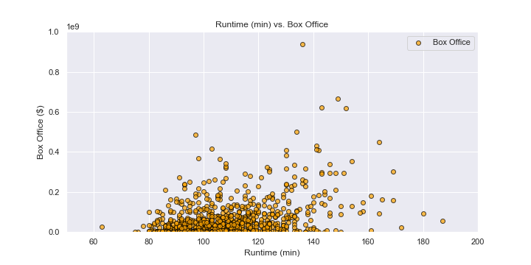
Runtime

Slide 24
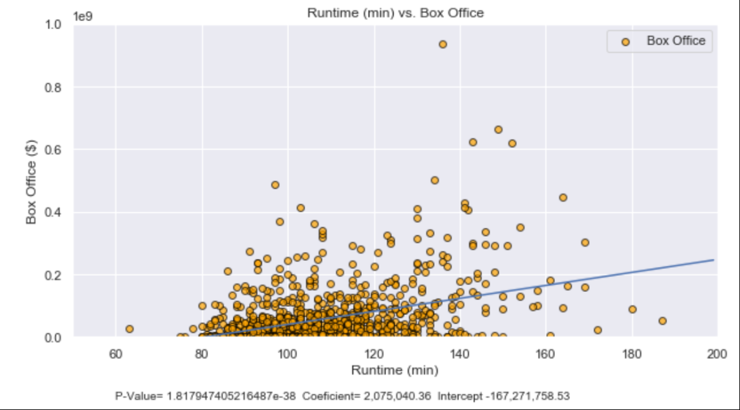
Runtime

Slide 25
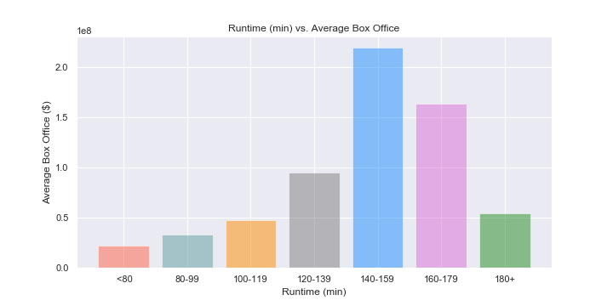
Runtime

Slide 26
Interesting Findings
Based on our intuition and the wider distribution, we expected that critic’s ratings would have been the better determinate of box office results but it was actually the user ratings
When looking at the top genres with box office success, most of the genres had a gradual increase in average revenue over the years. However, the genre with the most box office revenue had inconsistencies, with some years being drastically better than other years.
We also expected PG-13 movies to be the most profitable on average because of the number of releases. However, due to the number of flops PG-13 movies produce, it makes sense that G movies show the biggest average earnings.
While looking at monthly distribution of earnings, it was interesting to see earnings by quarter are roughly equal. By season or individual month, it is clear as to see which times of the year are most profitable.
Was not expecting to find a relationship with runtime and box office results. The thought was if a movie was good, it did not matter how long the movie was.
Given the data, an accurate assumption that can be made is that the majority of movies did not perform well and made less than $100 million at the box office.

Slide 27
Post Mortem
We would have liked to perform a statistical analysis incorporating all the variables to see how they interact, but due deficiencies in time and expertise, we could not
If there was more time to work, it would be interesting to compile a bigger list of movies to see if these trends are similar to trends in the past or if they have evolved over time.
There were issues when trying to account for inflation that we would have wanted more time to try to incorporate into our data.
Another factor to possibly look at if given more time is to find out how the budget of the movie effects how much the movie makes at the box office.

