Slide 1
Heart Disease Analysis
RU DATA SCIENCE PROJECT 4
Group members:
Steph Chestnut, Christina Gabriel, Medha Mallampati, Anna Lewis
Notes:
SC

Slide 2
Goal
The main goal is to identify the diagnosis of heart disease by building classification models on Heart Disease data, given the provided feature set. By analyzing:
age, sex, type of chest pain, patient history, etc.,
Using both VA Long Beach and Cleveland databases, we can preprocess the datasets for model prediction. After getting a good accuracy score and prediction rate, visualize the prediction model and additional analysis tables using Tableau.
Notes:
SC

Slide 3


Data Source
The dataset was retrieved from UC Irvine Machine Learning Repository at the following link:
https://archive.ics.uci.edu/dataset/45/heart+disease.
DataFrame stats:
Original:
After cleaning:
Ethics:
We made sure that the The UCI Machine Learning Repository website allows complete access to their data
Notes:
SC

Slide 4
Data Visualization
The data was visualized using Tableau, comparing different factors of the dataset,
Here is the link to our story:
https://public.tableau.com/app/profile/anna.lewis2284/viz/Project4HeartDisease_17222974244730/Story1?publish=yes
Notes:
CG

Slide 5
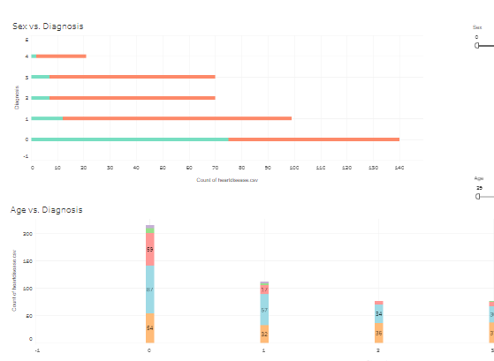
Sex vs. Age
Notes:
CG

Slide 6
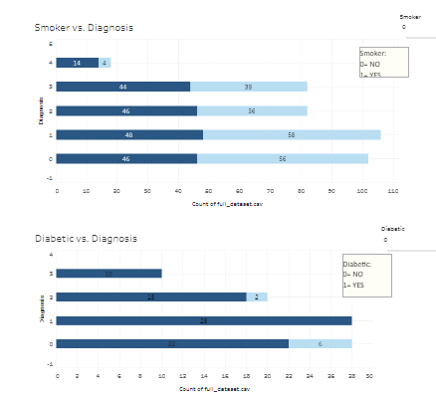
Smokers vs. Diabetics
Notes:
AL

Slide 7
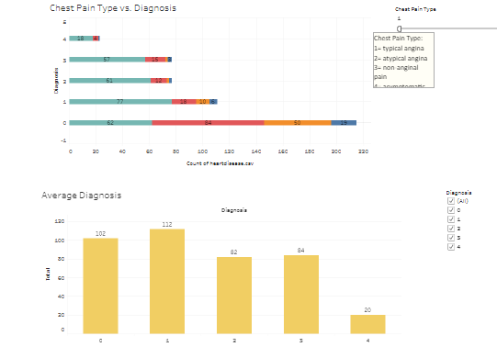
Chest Pain vs. Overall Diagnosis
Notes:
AL

Slide 8
Models Used:
Decision Tree
Neural Network
Logistic Regression
Support Vector Machine (SVM)
Notes:
MM

Slide 9
Data Model Implementation
Target Variable: ‘Diagnosis’
0 - absence of Heart Disease
1 - presence of Heart Disease (1,2,3,4)
Features: Used all features for some models.
Selected Features for other models were:
‘Cholesterol’
‘Resting Blood Pressure’
‘Max Heart Rate’
‘Age’
Notes:
MM

Slide 10
Data Model Optimization
Notes:
SC

Slide 11
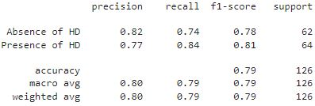
Comparing Model Scores
The top classification models for Heart Disease diagnosis were the following:
Logistic Regression (solver=’lbfgs’): Accuracy = 0.78
The model that did the best
SVM (kernel=’linear’):
Notes:
MM

Slide 12
References
https://stackoverflow.com/questions/38640109/logistic-regression-python-solvers-definitions
https://github.com/christianversloot/machine-learning-articles/blob/main/how-to-visualize-support-vectors-of-your-svm-classifier.md
https://seaborn.pydata.org/generated/seaborn.pairplot.html
Notes:
MM

