Slide 1
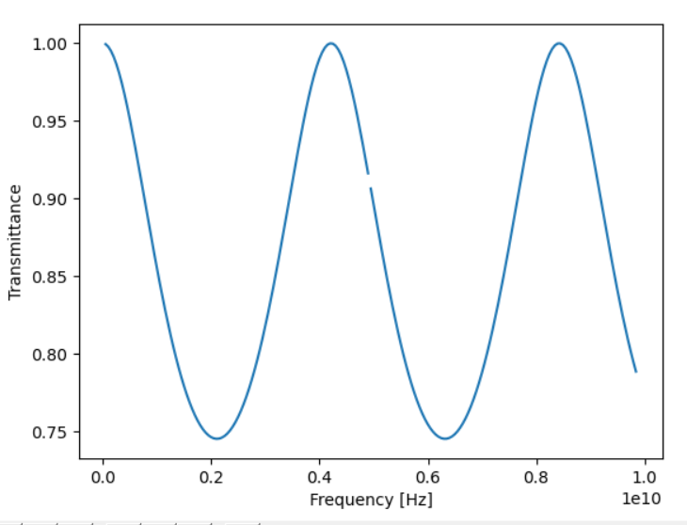
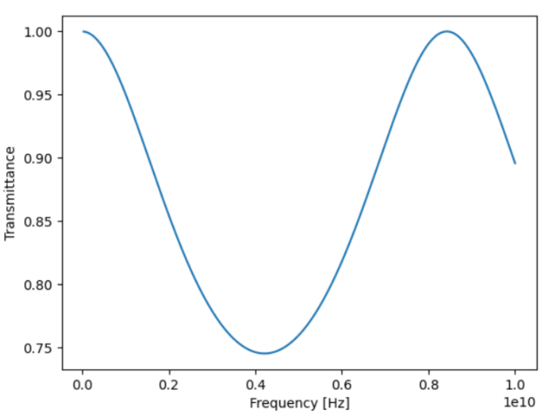
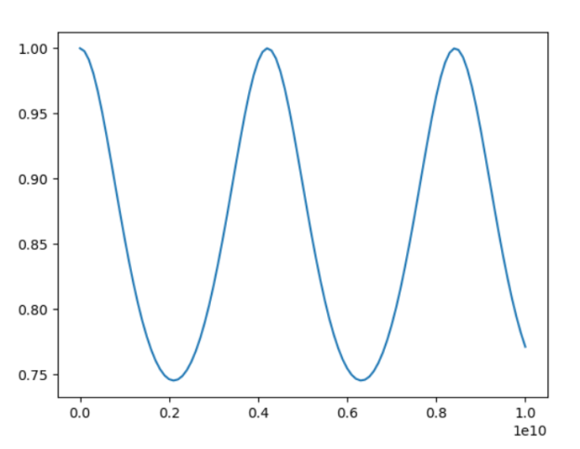
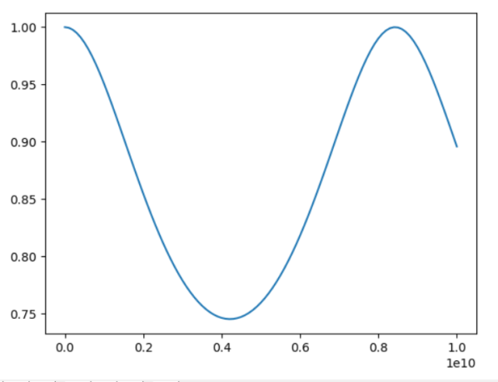
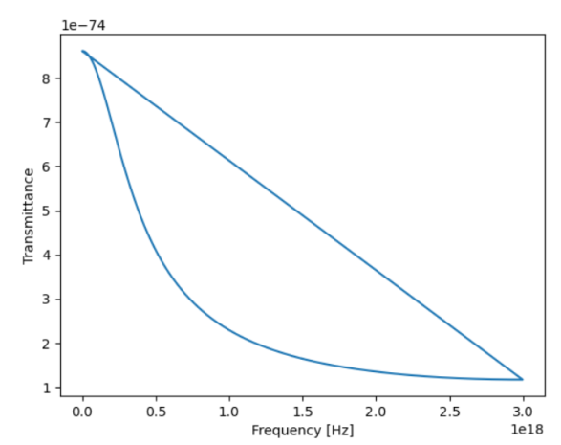
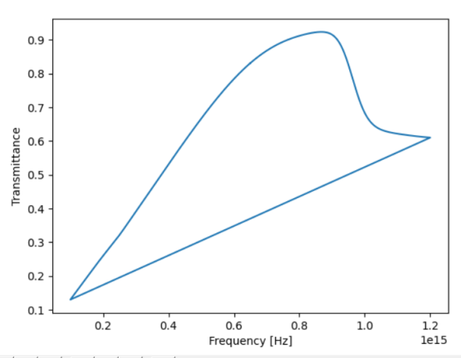
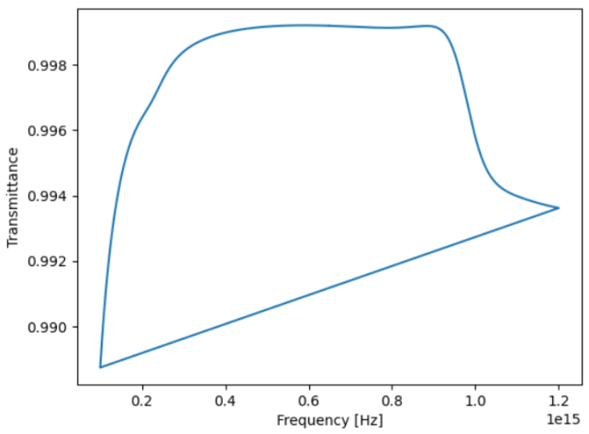
Clase aparte? Varias walls
No puede ser de 1nm, es muy pequeño!!
Normalizar frec.
Funcion ComplexField en dispersive media??
Copy.deepcopy para no cargarte la clase?
Por q la funcion fields?
Linea solver debajo for i in range(0,np.shape(Jp_old)[1]): . No pongo 1:-1? Al Jp?
Indices de h y e con cual corresponden?
fft.fftshift?
Diferencia eps_inf y eps_r
Calcular dispersive y no en solver? O que transmittance lo calcule
angulo=>eps=5, ap=cp=0
My class =>eps=5, ap=cp=0,width =>
Numerical Ag 1nm
My class analytic Ag
1 nm
My class analytic Ag
100 nm

Slide 2
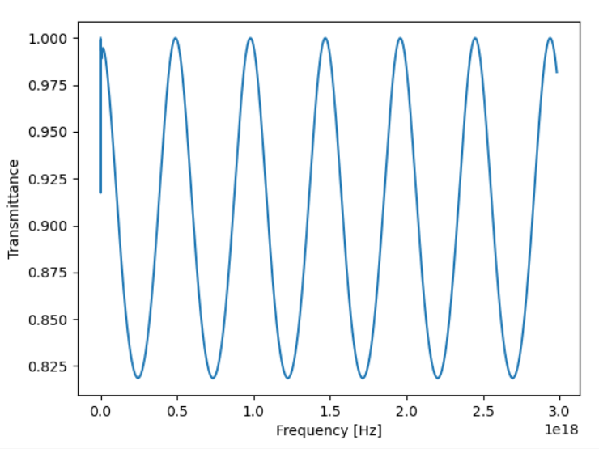
Ag
Width: 100 nm
My class analytic Ag
100 nm

Slide 3

Transmission coefficient -> ratio of the transmitted to incident electric field $T=\frac{\left|E_{t}(ω)\right|}{\left|E_{i}(ω)\right|}$
Transmittance -> fraction of the power that transmits $\frac{P_{t}(ω)}{P_{i}(ω)}$

Slide 4
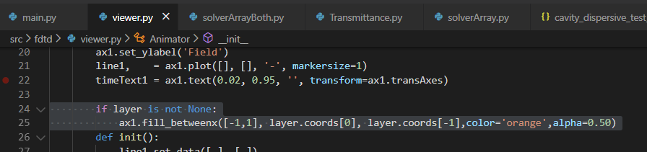
Plots layer

Slide 5
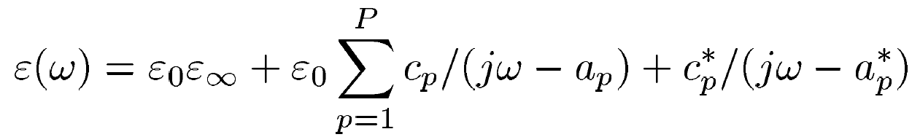
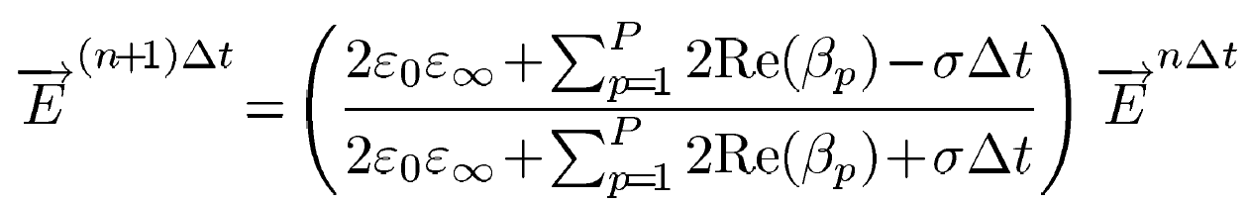
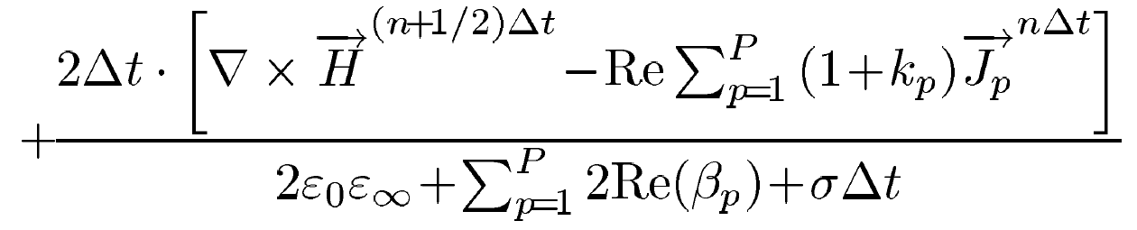
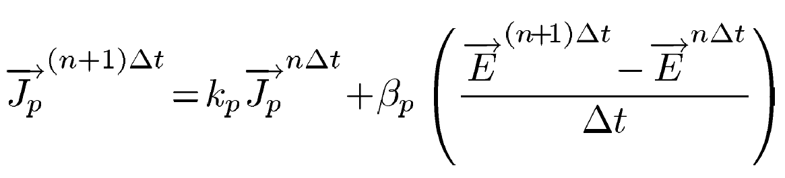
FDTD in dispersive media:

