Slide 1
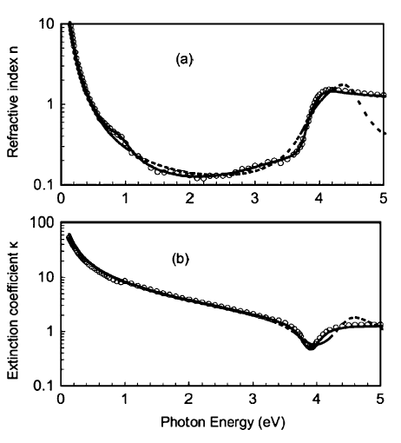
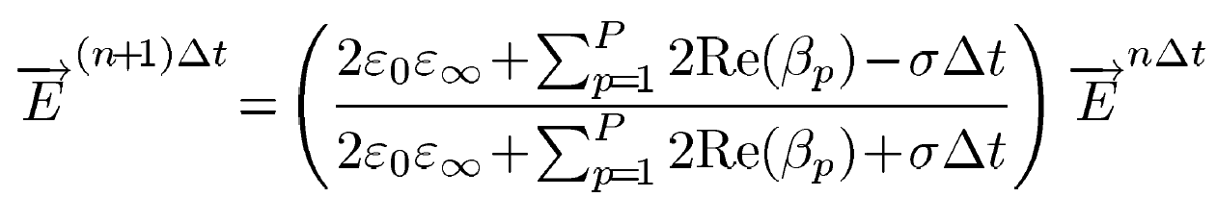
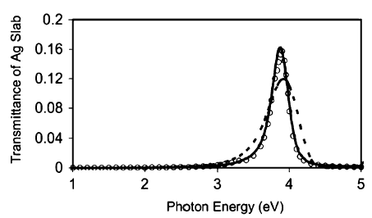
FDTD in dispersive media: Complex-Conjugate Pole-Residue Pairs Method
Dispersive material: waves of different frequencies travel at different velocities
How do we model the media?
María Pedrosa Bustos
Computational Methods in Non-Linear Physics - FisyMat

Slide 2
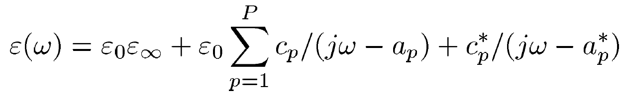
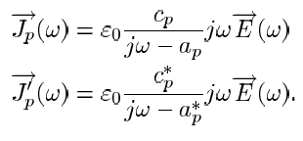
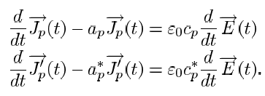
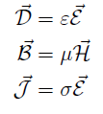
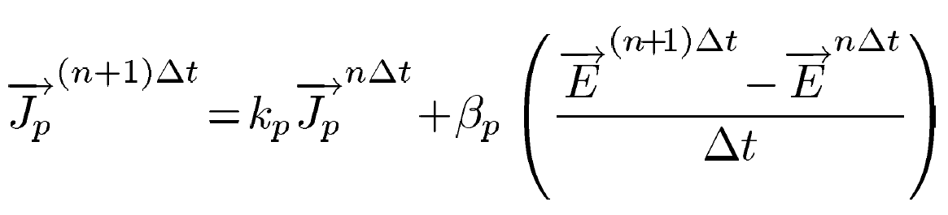
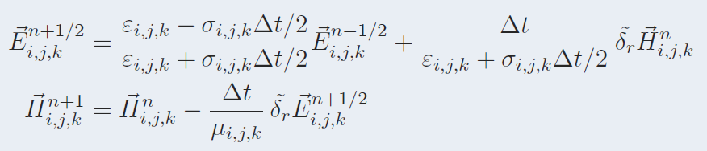

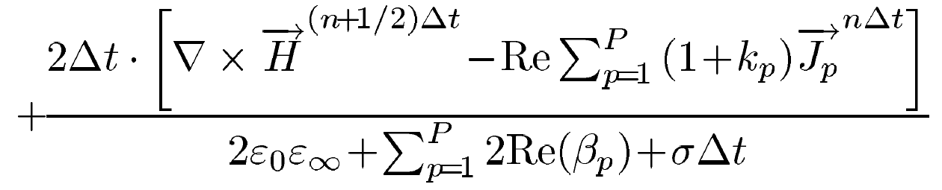
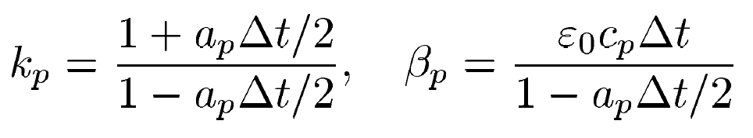

Model
permittivity as the sum of complex-conjugate pole-residue pairs
permittivity as the sum of complex-conjugate pole-residue pairs
Real part of $a_{p}$ must be negative
Maxwell equations
Auxiliary differential equation (ADE)
Same as Yee algorithm
saves memory space and CPU time consumption

Slide 3

FDTD in dispersive media: Complex-Conjugate Pole-Residue Pairs Method
Dispersive material: waves of different frequencies travel at different velocities
How do we model the media?
How do we measure the results?
Transmission/reflection coefficient -> ratio of the transmitted/reflected to incident electric field
$$T=\frac{\left|E_{t}(ω)\right|}{\left|E_{i}(ω)\right|}$$
Transmittance -> fraction of the power that transmits $reflectance=\frac{P_{t}(ω)}{P_{i}(ω)}=\frac{{\left|E_{r}(ω)\right|}^{2}}{{\left|E_{i}(ω)\right|}^{2}}$
$transmittance=1−$ $reflectance$

Slide 4
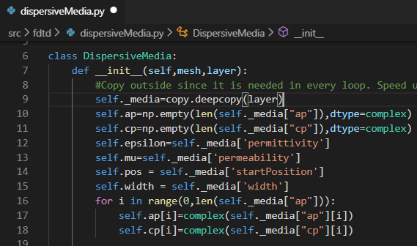

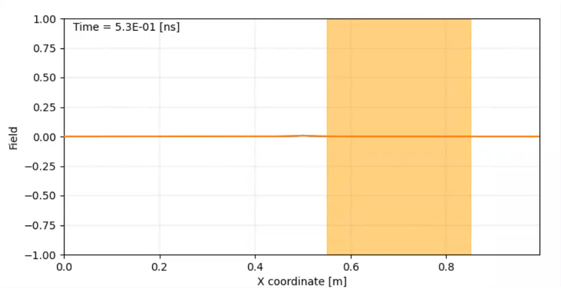



CODE
Changes in solver
Add ADE equations to updateE. Two methods:
Array of permittivities
Only apply at certain índices
Also added $μ$ option
Saves both dispersed and free space solutions
New Class for layer properties
Stores $ε_{∞}$, $μ$, $a_{p}$, $c_{p}$, layer width and position
Changes units of frequency
Calculate layer’s coordenates
Calculate $c_{p}$, $k_{p}$
Measurements: new class
Computes numerical T and R, transmittance and reflectance (using FFT)
Computes analytical T and R
Plot the results.
Changes in viewer
Display layer
Show both dispersed and free space solution
$$ε_{∞}=5$$
$$d=0.1 m$$
$$t_{max}=5.6 ns$$
$$G_{spread}=0.25 ns$$
Problems:
Need to save solution for dispersive and non dispersive media.
Be careful with the units range!

Slide 5
References
Han, Minghui & Dutton, Robert & Fan, Shanhui. (2006). Model dispersive media in finite-difference time-domainmethod with complex-conjugate pole-residue pairs. Microwave and Wireless Components Letters, IEEE.
J. A. Pereda, A. Vegas, and A. Prieto. (2002). “FDTD modeling of wave propagation in dispersive media by using the Mobius transformation technique,” IEEE Trans. Microw. Theory Tech., vol. 50, no. 7, pp. 1689–1695
Ji, Jinzu & Ma, Yunpeng & Guo, Na. (2018). Numerical calculation of the reflection, absorption and transmission of a nonuniform plasma slab based on FDTD. Optik. 165.
R. Gómez Martín. Electromagnetic field theory for physicists and engineers:Fundamentals and Applications. UGR.
L. D. Angulo. (2020). Deterministic Computational Methods Computational Methods for Non Linear Physics. UGR.
D.W. Lynch andW. R. Hunter. (1985). Handbook of Optical Constants of Solids, E. D. Palick, Ed. Orlando, FL: Academic,

Slide 6
The END

Slide 7
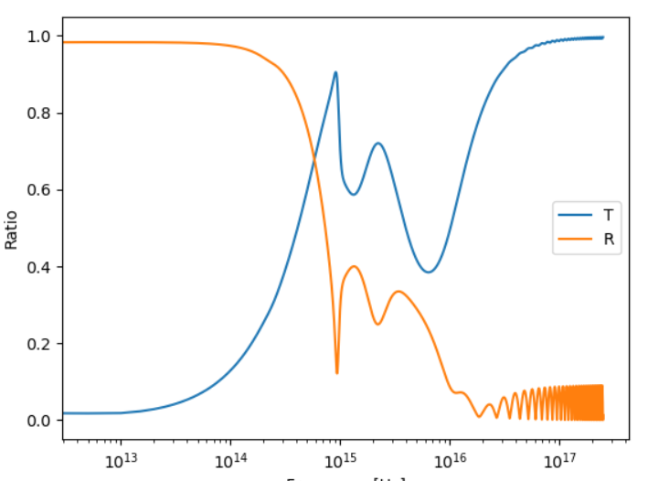
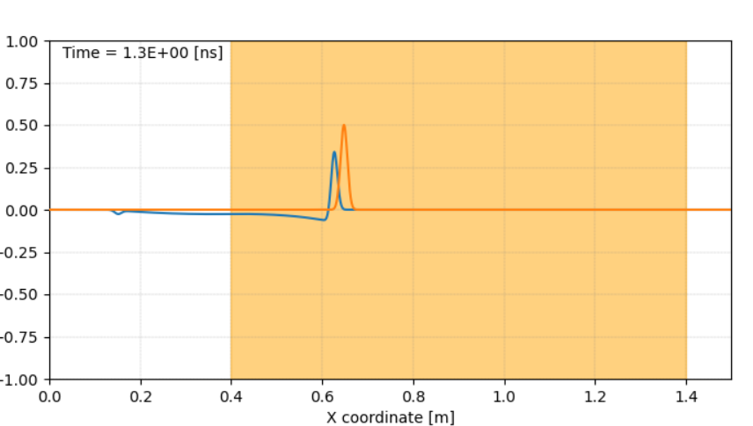
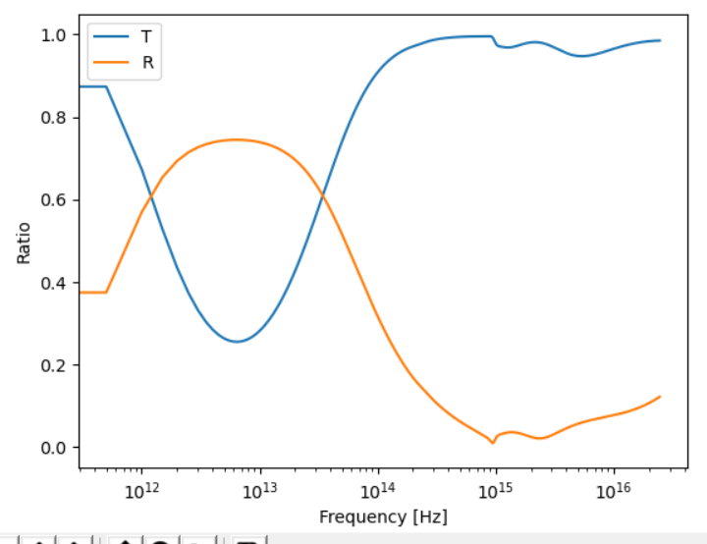
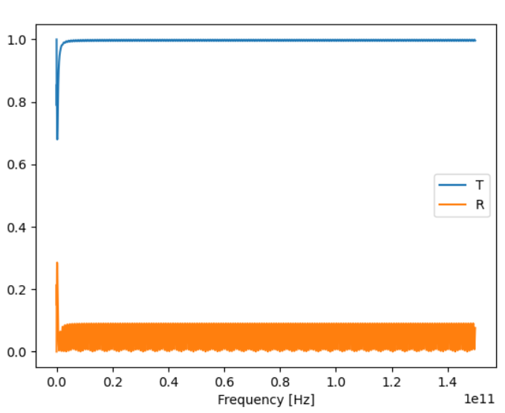
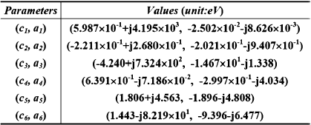
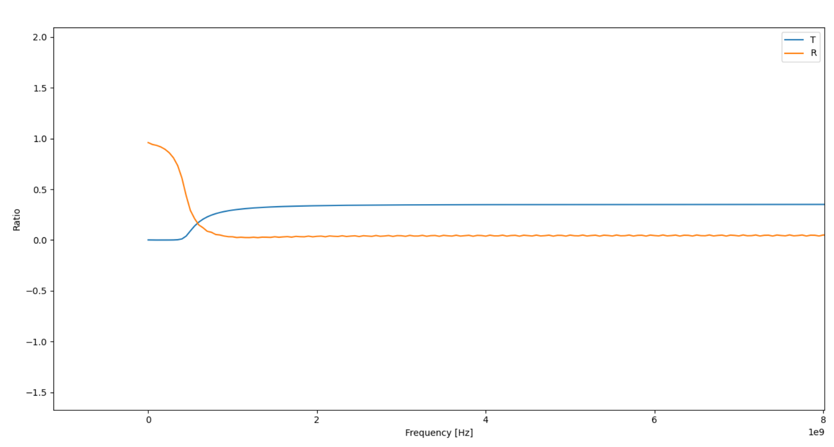
tests\cavity_dispersive_test.json
tests\cavity_dispersive_Ag.json
"finalTime": 20e-9,
"cfl": 1
"coordinates": [
0.0,
1.5,
"grid": {
"elemId": 0,
"steps": 0.001,
"bounds": ["mur", "mur"]
},
"sources": [
{
"type": "dipole",
"direction": [0.0, 0.0, 1.0],
"magnitude": {
"type": "gaussian",
"gaussianDelay": 1.25e-10,
"gaussianSpread": 0.25e-10
},
"elemId": 1
}
],
"dispersiveLayers":
{
"permittivity": 1.2,
"permeability":1,
"ap": [
"-2.502e-2-8.626e-3j",
"-2.021e-1-9.407e-1j",
"-1.467e1-1.338j",
"-2.997e-1-4.034j",
"-1.896-4.808j",
"-9.396-6.477j"
],
"cp": [
"5.987e-1+4.195e3j",
"-2.211e-1+2.680e-1j",
"-4.240+7.342e2j",
"6.391e-1-7.186e-2j",
"1.806+4.563j",
"1.443-8.219e1j"
],
"unitsFreq": "MHz",
"startPosition": 0.4,
"width": 1
},
50 nm
100 nm
Tarda mucho con parametros paper
Reproduce pico en e15
High frequencies where wavelength similar to grid spacing => error in Fouriier
Can not set values <1 in eps infitity
Can not start source very soon

Slide 8
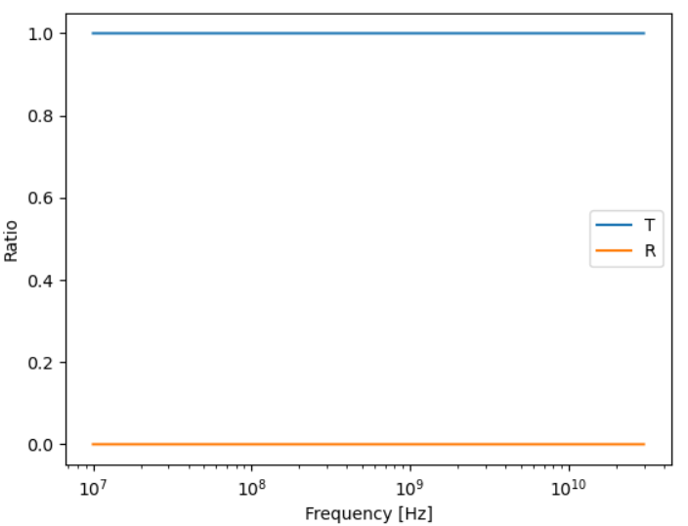
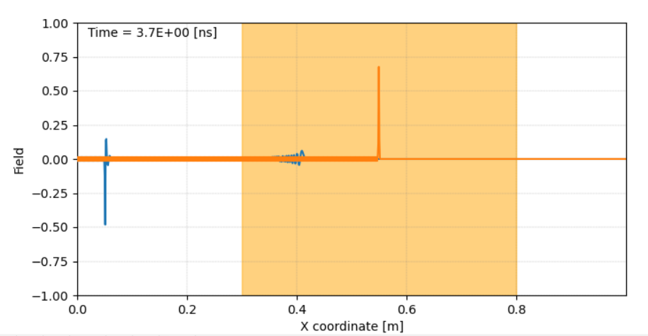
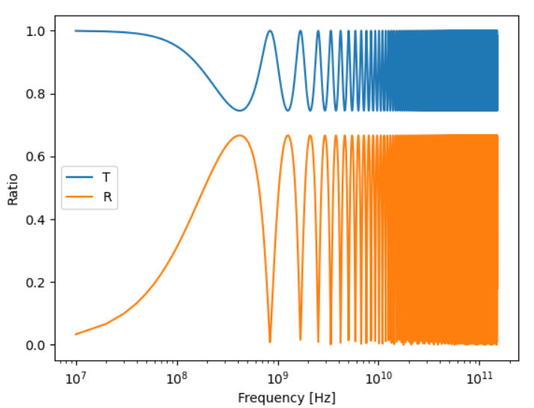
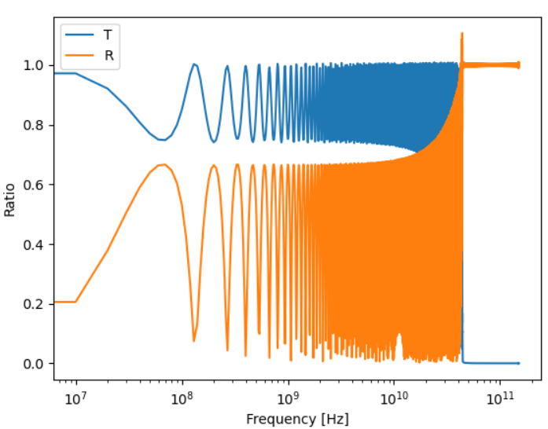
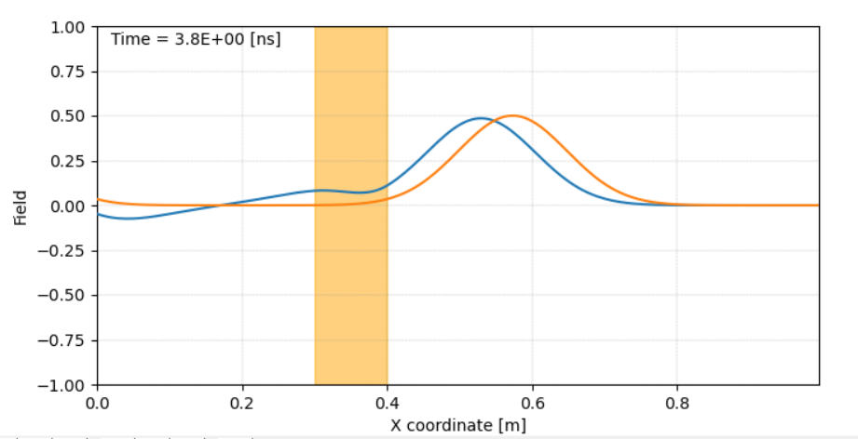
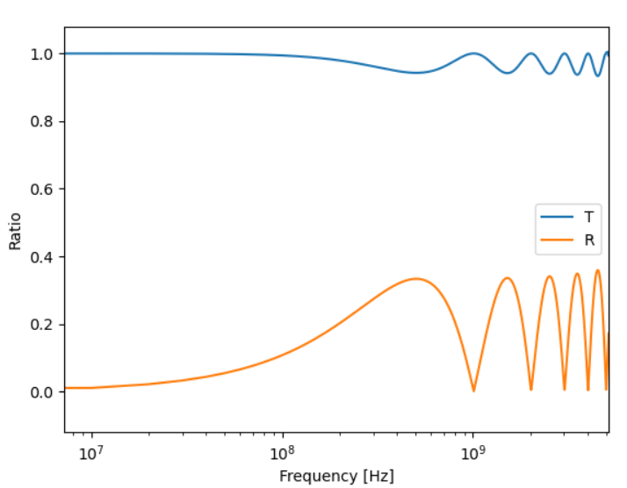
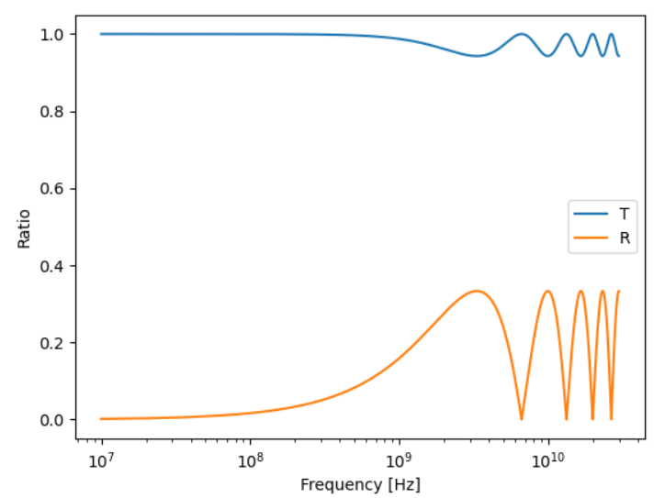
tests\cavity_dispersive_test_NoComplex_ShortDipole.json
tests\cavity_dispersive_test_NoComplex.json
{
"format": "pyfdtd1d",
"options": {
"finalTime": 1e-7,
"timeUnits": "s",
"cfl": 1
},
"coordinates": [
0.0,
1.0,
0.2
],
"elements": [
[0, 1],
[2, 2]
],
"grid": {
"elemId": 0,
"steps": 0.005,
"bounds": ["mur", "mur"]
},
"sources": [
{
"type": "dipole",
"direction": [0.0, 0.0, 1.0],
"magnitude": {
"type": "gaussian",
"gaussianDelay": 0.25e-8,
"gaussianSpread": 0.025e-8
},
"elemId": 1
}
],
"dispersiveLayers":
{
"permittivity": 2,
"permeability":1,
"ap": [
0
],
"cp": [
0
],
"unitsFreq": "Hz",
"startPosition": 0.3,
"width": 0.1
},
"probes": [
{
"name": "s1",
"elemId": 0,
"__samplingPeriod": 0.1e-9
}
]
}
Eps=1
Revota hacia atrás
Los picos no a la misma freq => creo que es por el Fourier, porque quita como una década (por donde aparece el ruido en Fourier
Delay pequeño va mal
Eps=2

Slide 9
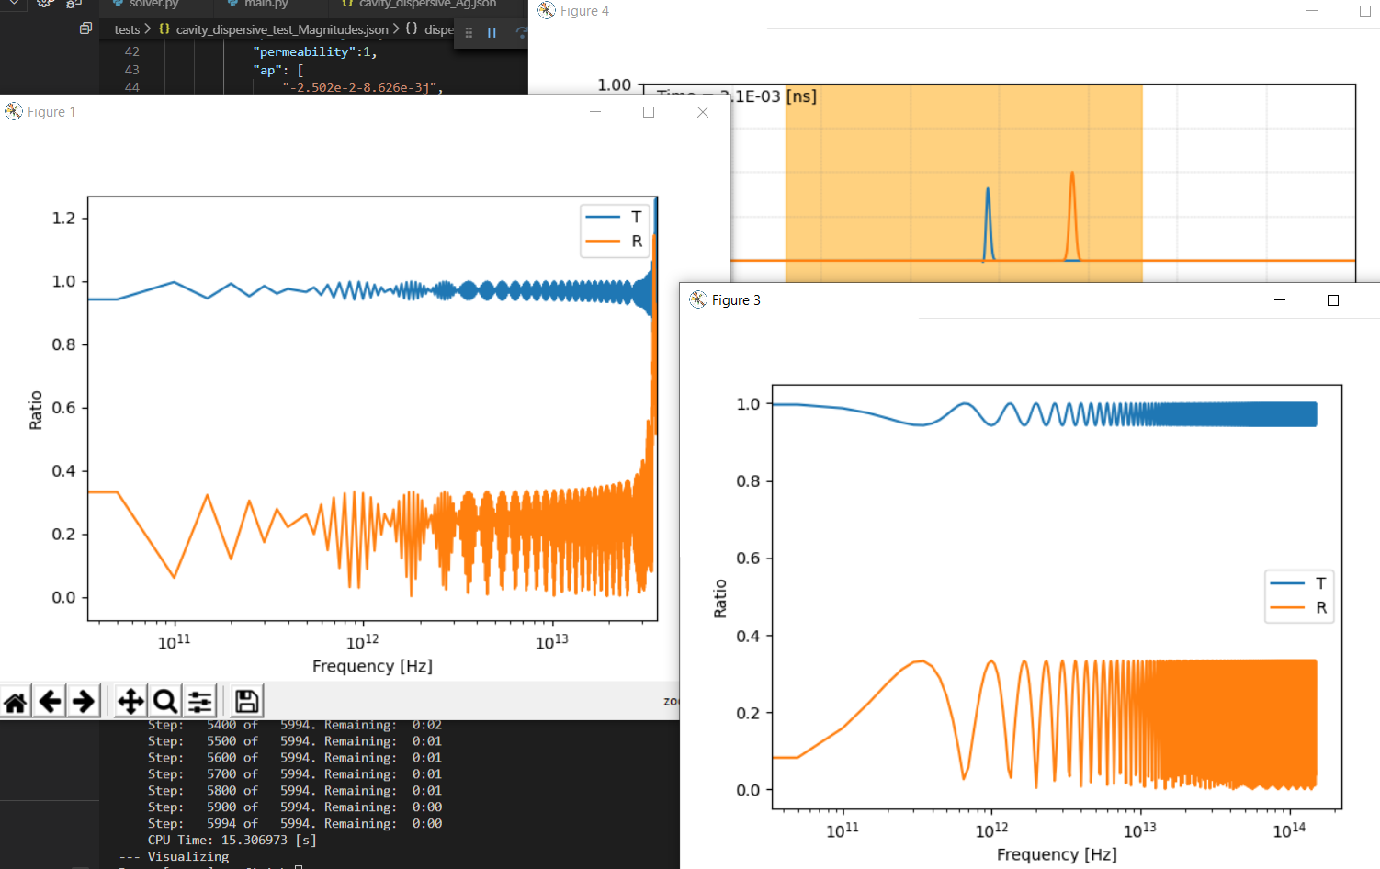
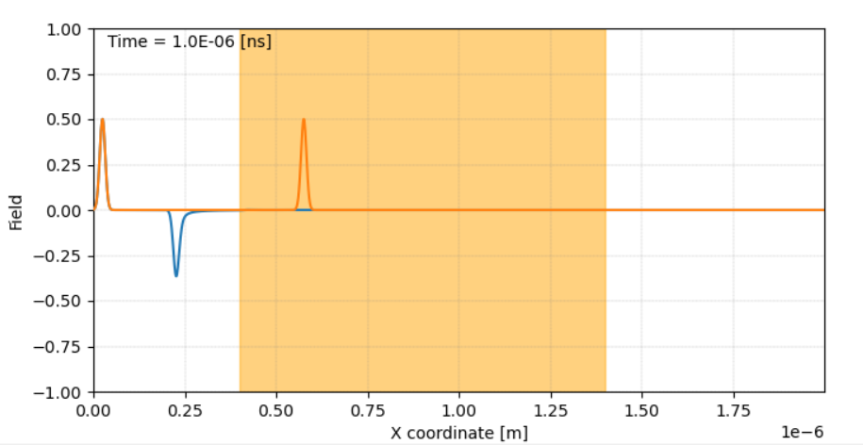
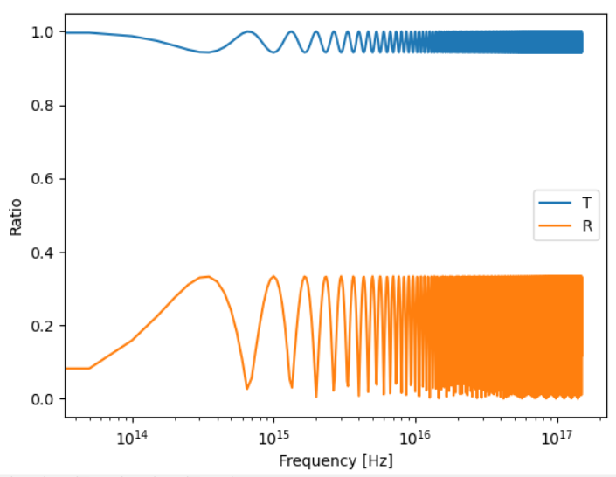
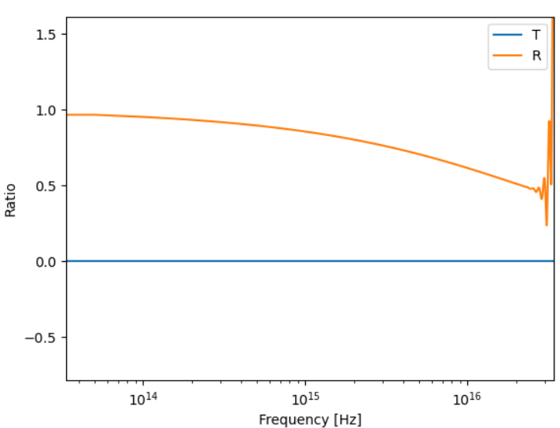
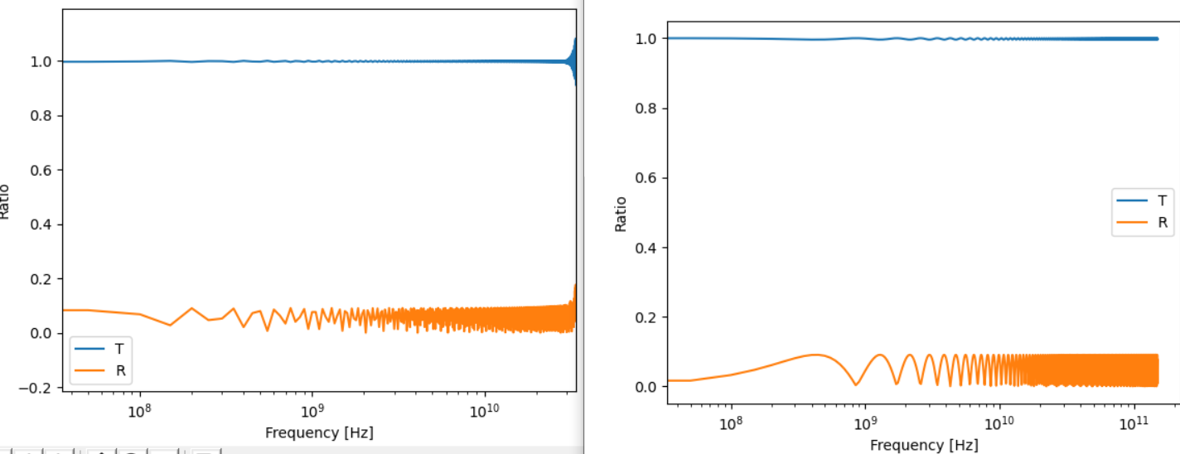
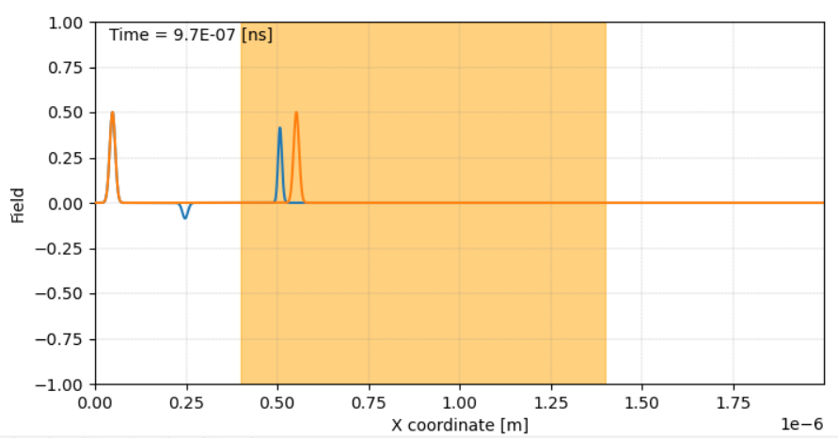
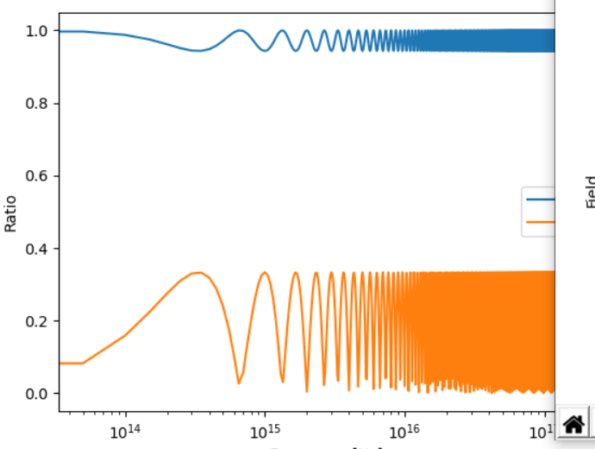
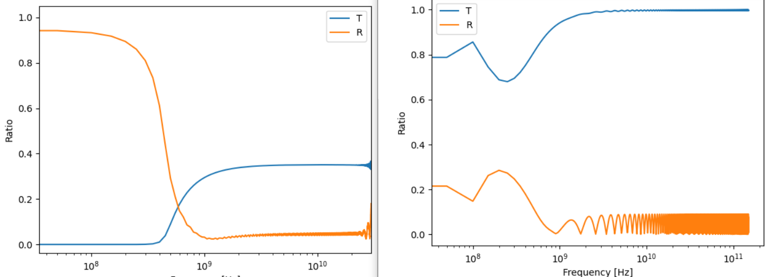
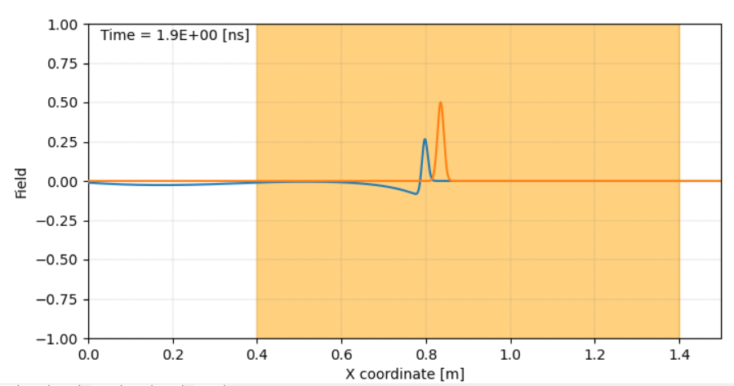
tests\cavity_dispersive_test_ShortDipole.json
tests\cavity_dispersive_test_Magnitude.json
"steps": 0.001e-3 y Ghz, => paso temporal demasiado grande
Jugar con:
Tamaño grid
Freq.
Spacing
Tiempo renderizado
Freq pequeñas => tiempos largos => spacing grande =>ajustar Tambien eps
kHz
Eps=1
{
"format": "pyfdtd1d",
"options": {
"finalTime": 20e-15,
"timeUnits": "s",
"cfl": 1
},
"coordinates": [
0.0,
2e-6,
0.3e-6
],
"elements": [
[0, 1],
[2, 2]
],
"grid": {
"elemId": 0,
"steps": 0.001e-6,
"bounds": ["mur", "mur"]
},
"sources": [
{
"type": "dipole",
"direction": [0.0, 0.0, 1.0],
"magnitude": {
"type": "gaussian",
"gaussianDelay": 1.25e-16,
"gaussianSpread": 0.25e-16
},
"elemId": 1
}
],
"dispersiveLayers":
{
"permittivity": 2,
"permeability":1,
"ap": [
"-2.502e-2-8.626e-3j",
"-2.021e-1-9.407e-1j",
"-1.467e1-1.338j",
"-2.997e-1-4.034j",
"-1.896-4.808j",
"-9.396-6.477j"
],
"cp": [
"5.987e-1+4.195e3j",
"-2.211e-1+2.680e-1j",
"-4.240+7.342e2j",
"6.391e-1-7.186e-2j",
"1.806+4.563j",
"1.443-8.219e1j"
],
"unitsFreq": "Hz",
"startPosition": 0.4e-6,
"width": 1e-6
},
"probes": [
{
"name": "s1",
"elemId": 0,
"__samplingPeriod": 0.1e-9
}
]
}
GHz
tests\cavity_dispersive_test_Both.json
Eps=2
Hz => permitividad a freq bajas por lo que no se observa ningún cambio
Hz
Conseguir freq mas bajas haciéndolo mas largo
MHz
Según simulación rebota casi todo, teórico no
GHz => explota

Slide 10
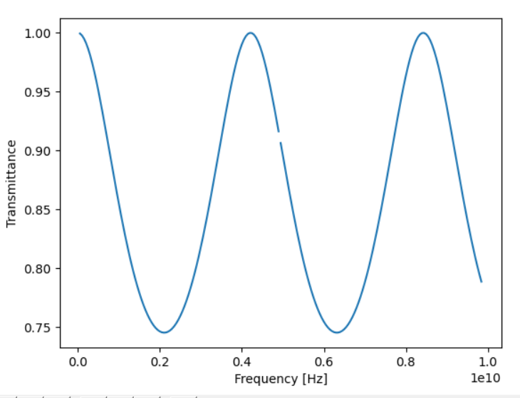
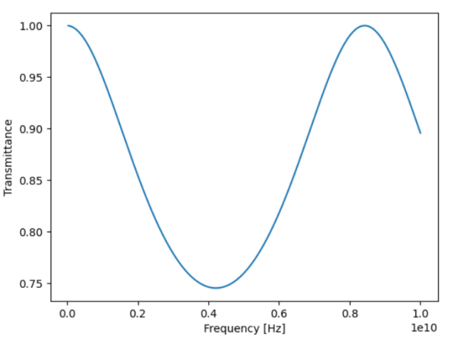
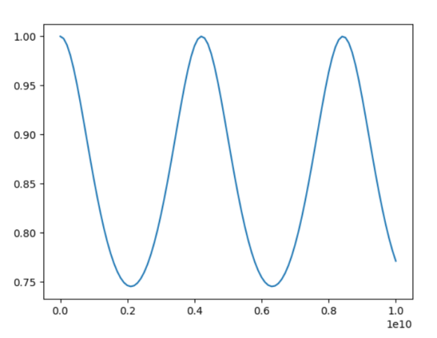
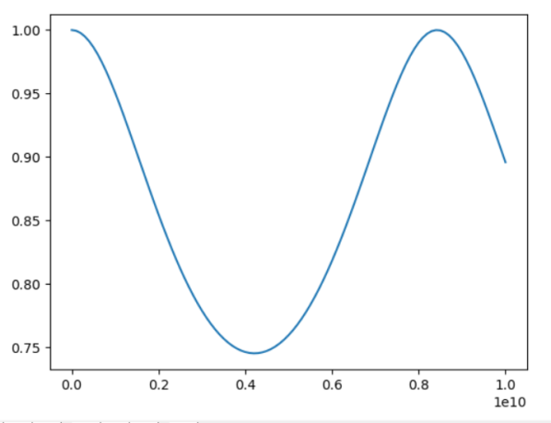
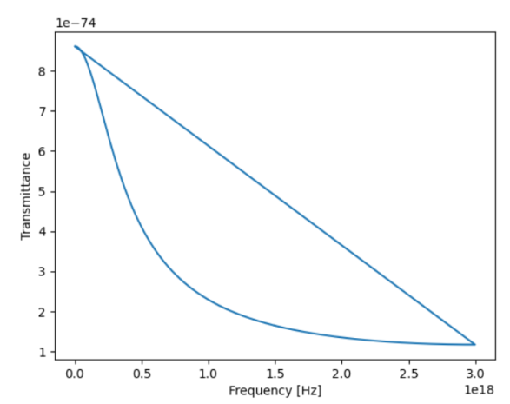
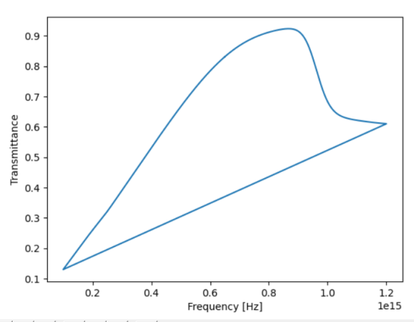
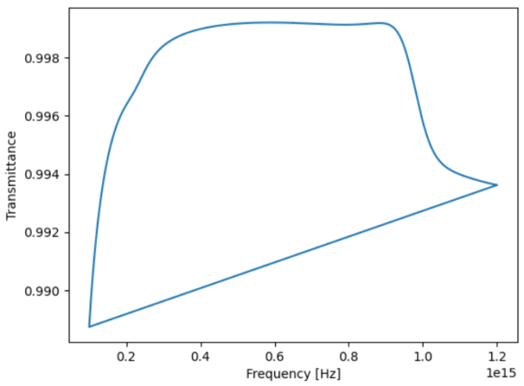
Clase aparte? Varias walls
No puede ser de 1nm, es muy pequeño!!
Normalizar frec.
Funcion ComplexField en dispersive media??
Copy.deepcopy para no cargarte la clase?
Por q la funcion fields?
Linea solver debajo for i in range(0,np.shape(Jp_old)[1]): . No pongo 1:-1? Al Jp?
Indices de h y e con cual corresponden?
fft.fftshift?
Diferencia eps_inf y eps_r
Calcular dispersive y no en solver? O que transmittance lo calcule
angulo=>eps=5, ap=cp=0
My class =>eps=5, ap=cp=0,width =>
Numerical Ag 1nm
My class analytic Ag
1 nm
My class analytic Ag
100 nm

