Slide 1



Contract Monthly Claim System
Student number: ST10445280
PROG6212
Keketso Mphuti

Slide 2
What is a cmcs?
A Contract Monthly Claim System is a web application that manages the monthly claims of an organization. It works through a system to claim and approve different submissions depending on what the organization requests.
In this case it is for Lecturers and Co-Ordinators to submit there working hours and hourly rates as well as for Human resources to overview and approve submissions.

Slide 3
The core features of this CMCS:
There is an automated claim submission that calculates aspects such as the hourly rates.
There are different roles and levels of access such a lecturers, coordinators and managers. Each role has different levels of access in terms of submission, approval, viewing, etc.
The users will be able to upload relevant documents.
There is an automated generation for invoices.

Slide 4
Roles and access levels:
Each role has its own dashboard that controls the different access levels.
Lecturers can submit claims and view their own claim history. They can upload documents and track their status claims (Approved/Rejected/Pending)
Programme coordinators can view any claims that are still pending that approve or reject them.
Academic Managers can make final approvals over the coordinator approvals. They can also look over claims that have already been approved or rejected.
Human Resources can process payments for any of the approved claims and have those invoices automatically generated.

Slide 5
Lecturer dashboard
The following screenshots present the function of the Lecturer’s dashboard. It includes actions to:
Submit Claims.
The Lecturers history of claims.
A tab to upload any relevant documents.
At the bottom of the dashboard is shows the current submitted claims and states their status (Pending/Approved/Rejected)

Slide 6
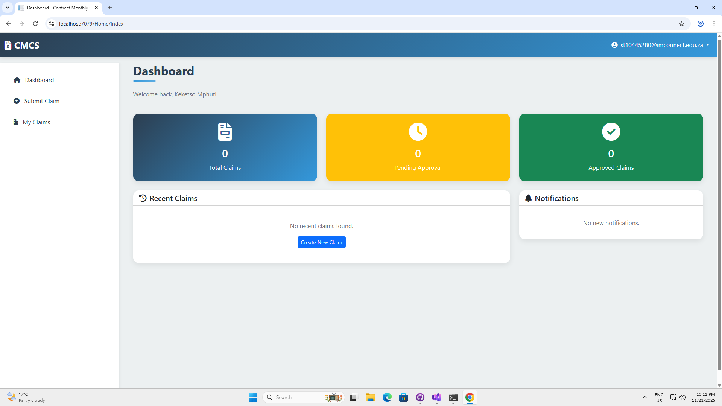
Lecturer dashboard

Slide 7
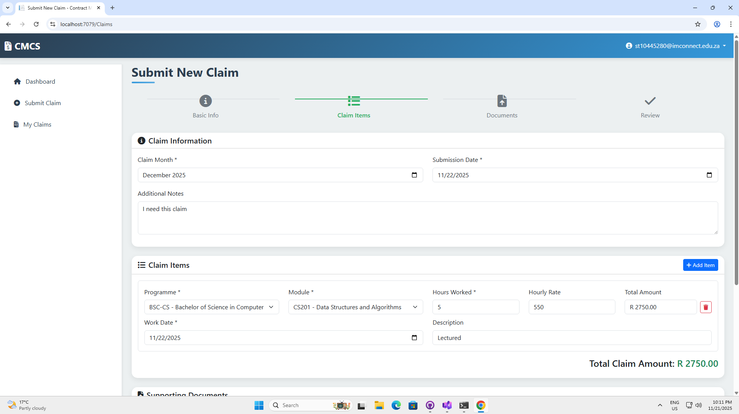
Lecturer dashboard
This is the submission form to submit a claim.

Slide 8
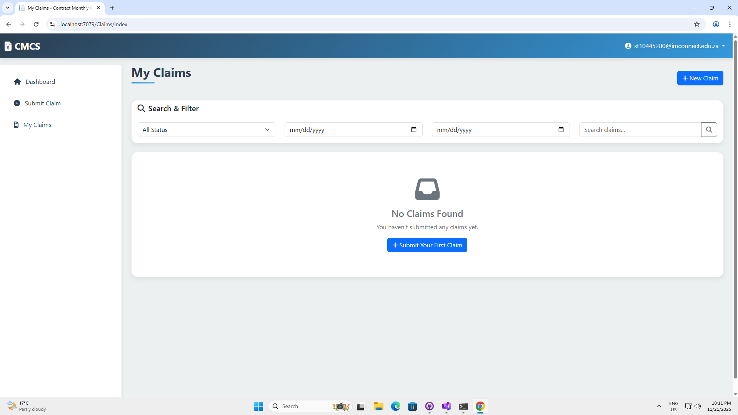
Lecturer dashboard
This is the history and status of claims that have been submitted

Slide 9
Programme coordinator dashboard
The following screenshots present the function of the Coordinator’s dashboard. It includes actions to:
View claims that need to be approved or rejected.
The history of that Programme Coordinator’s claims that they have processed.

Slide 10
Programme coordinator dashboard

Slide 11
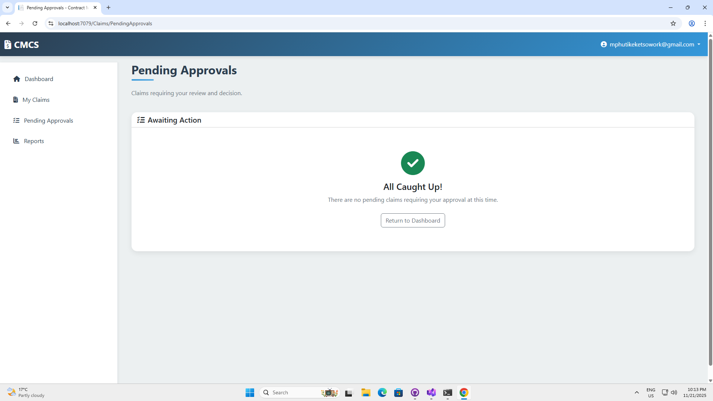
Programme coordinator dashboard
This is the page where the coordinator can review, approve or reject claims submitted by different lecturers.

Slide 12
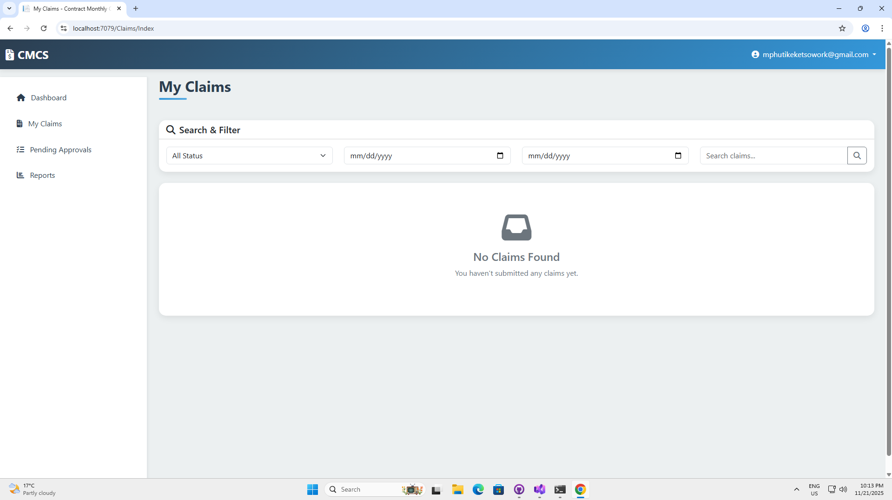
Programme coordinator dashboard
This is the page where the coordinator can go over claims they have processed.

Slide 13
Academic Manager dashboard
The following screenshots present the function of the Academic Manager’s dashboard.
It shows the total claims submitted by lecturers as well all the claims that are approved, rejected or are still waiting to be processed.
The bottom shows claims that need the manager’s final approval for specific claims.

Slide 14
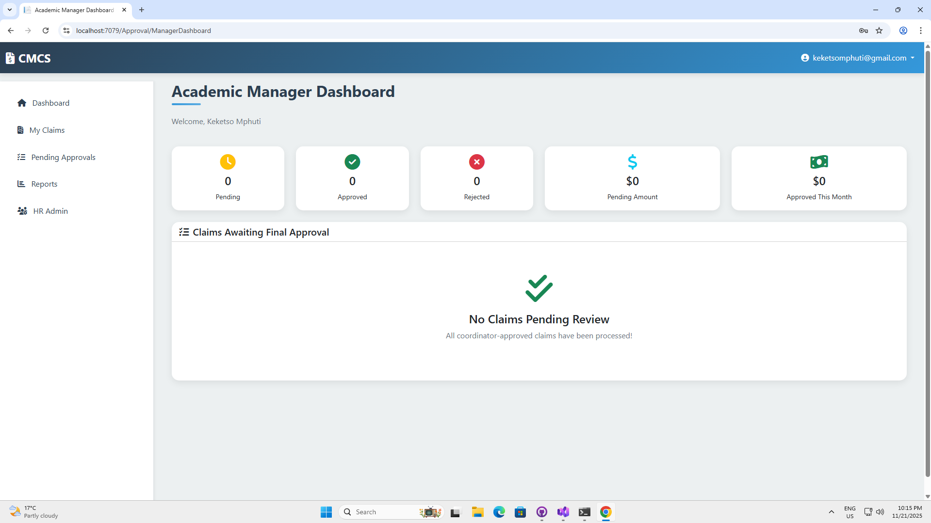
Academic Manager dashboard

Slide 15
Human resources dashboard
The following screenshots present the function of the Human Resources’ dashboard.
It shows the claims that have been approved by HR.
It also shows the total amount of money that has been paid through claims as well as claims that still need to be paid.
The bottom shows claims have been approved and need to be paid.

Slide 16
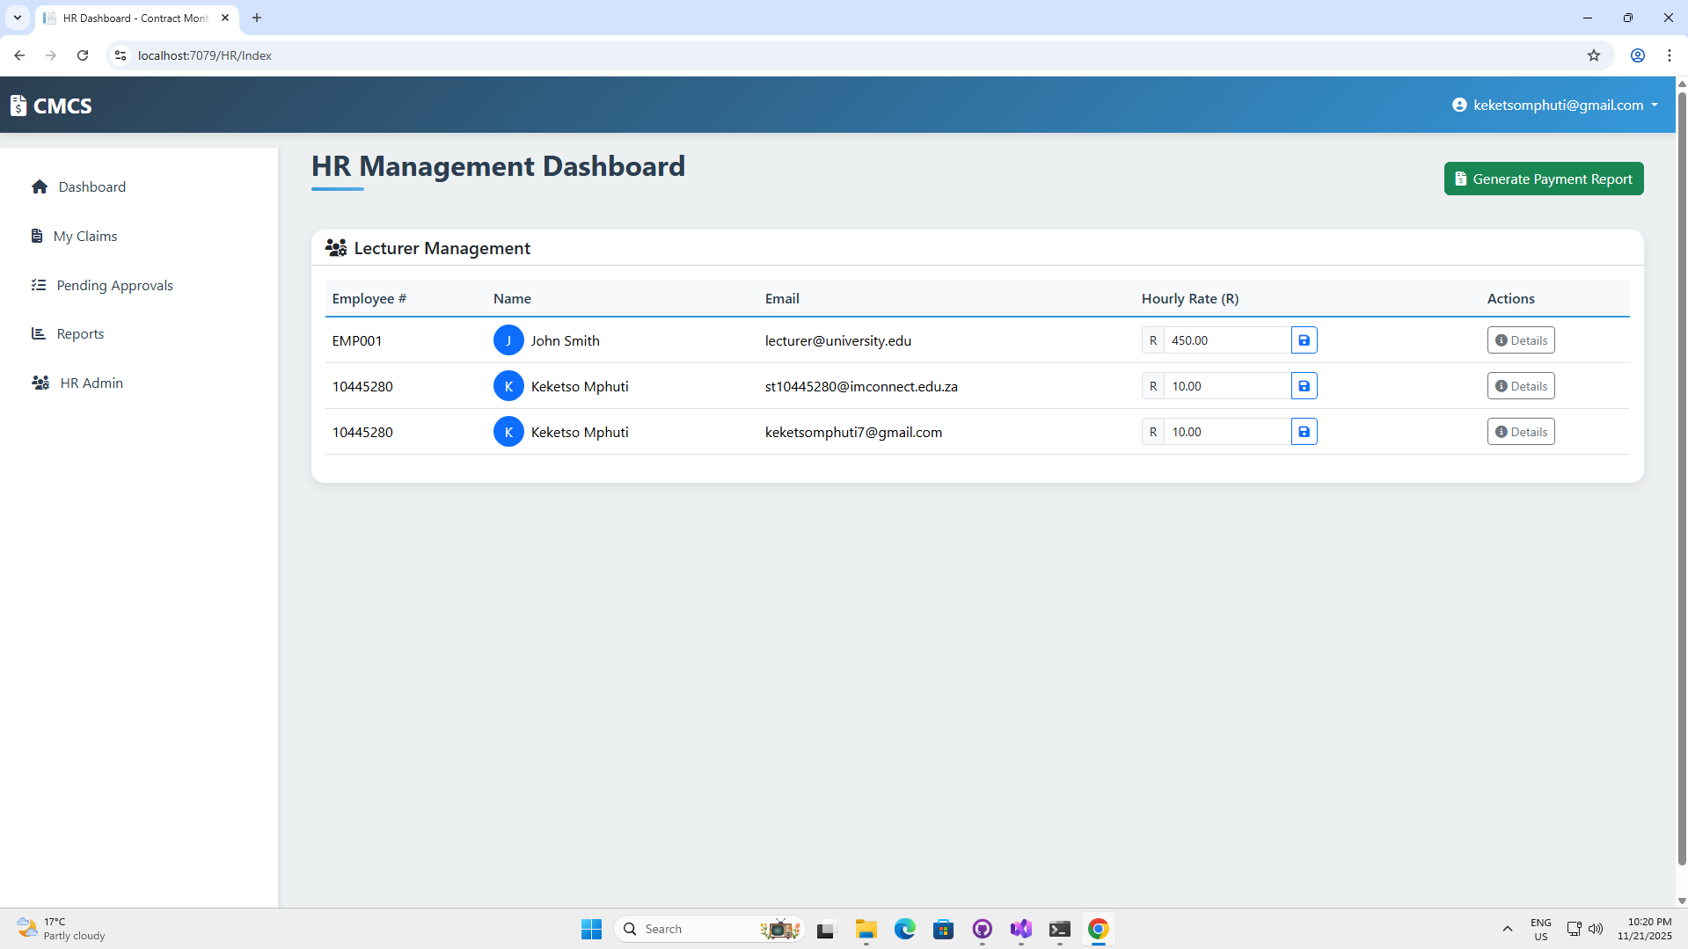
Human resources dashboard

Slide 17
Resource link:
To have a closer look at the project you can access the code through my GitHub repository:
https://github.com/MphutiKeketso/prog6212-POE-MphutiKeketso.git

