Slide 1
BI, Data Questions and the 5 whys
where do these tools fit into the data analyst role ?

Slide 2
Lecture plan
Definitions and the global BI market
Common tools you should be familiar with
Tableau
PowerBi
Qlik
Looker (and the rest)
Class discussion - what can/do companies do with BI
Formulating data questions
Activity - the 5 whys
Blog Review/feedback - Deployment challenges

Slide 3
Definitions

Slide 4
Business intelligence (BI) combines business analytics, data mining, data visualization, data tools and infrastructure, and best practices to help organizations to make more data-driven decisions. In practice, you know you’ve got modern business intelligence when you have a comprehensive view of your organization’s data and use that data to drive change, eliminate inefficiencies, and quickly adapt to market or supply changes.
Modern BI solutions prioritize flexible self-service analysis, governed data on trusted platforms, empowered business users, and speed to insight.
-tableau software

Slide 5
Business intelligence (BI) platforms enable enterprises to build BI applications by providing capabilities in three categories: analysis, such as online analytical processing (OLAP); information delivery, such as reports and dashboards; and platform integration, such as BI metadata management and a development environment.
-gartner

Slide 6
As the first ever Tableau Gold Partner and a repeat Partner of the Year, we’ve made a name for ourselves as people who know Tableau inside and out. We can easily plug into your organization and help you leverage Tableau to its fullest. Perhaps you want someone as a trusted advisor, or maybe you need quick help. Whatever the case, our broad expertise is at your disposal.
-unnamed bi consulting firm

Slide 7
The Global BI Market
Reuters predicted global revenue of BI to rise to $29.48 billion by 2022
Banking is the largest BI consumer market
Retail and Wholesale are industries which most frequently cite BI as critical to their business operations. In 2021 these industries dominated all others in their adoption of sales planning and in-memory analytics, as many are having to redesign their supply chains, multichannel selling, and services strategies.
Healthcare dominates in its adoption of people analytics
Data security is the biggest ongoing challenges in the BI industry

Slide 8
Common BI tools

Slide 9





Slide 10
Tableau
8 consecutive years as leader in Gartner quadrant
Free version is Tableau public
Paid for software ecosystem : Desktop, Prep Conductor, Server, Online
Strong user community/ YouTube presence / training alternatives
86000 customer accounts
500+ user groups in 65 countries
Largest data visualization repository in the world (2m vizzes, 2.5bn views)
Costs $70/user/month

Slide 11
PowerBi
Came top of gartner in 2021 - a clear leader since 2017
Based on excel - requires minimal retraining for excel power users and integrates into microsoft organisations (Azure, SQL, Office)
Real time data access is a big USP
Built for the general business audience rather than data analysts
5 million subscribers
Costs $10/user/month to share across an organisation as PowerBi Pro license, but the individual desktop product is free

Slide 12
Qlik
Qlik is regularly rated by analyst firm Gartner as one of the top data visualization and business intelligence (BI) vendors in the market
Primarily software as a service offering (hosted)
Paid for software ecosystem : Qlik Sense and Qlik Enterprise
Interactive dashboards and corporate KPIs from the top down
Both principal products run on Qlik's proprietary data engine, which connects to data stores and holds data in memory
50000 users
Costs $30/user/month

Slide 13
Looker
Google’s BI offering (acquired 2019)
Compatible with Google Big Query
Marketed as data discovery and exploration
Real time analysis in the cloud (rather than local in memory)
Not as visualisation heavy - choose from available visualisation templates
Support for advanced techniques like machine learning
1000 customer accounts
Costs unknown - customised to the organisation

Slide 14
Case studies by BI tool
Your task (individual):
Pick one of the BI tools we have discussed today
Review one of the business case studies from their website (or another you find with the help of your friend google!)
Summarise the overall business objective(s)
See if you can identify specific steps taken with the software /consulting services/ training/ organisational change to fulfil the company’s objectives
Is a timeline mentioned?
Notes:
Looker

Slide 15
Class discussion

Slide 16
Formulating data questions
Data Is Only As Good As The Questions You Ask
Descriptive
Exploratory
Inferential
Predictive
Causal
Mechanistic
What exactly do you want to find out?
Who are the final users of your data answers/ results?
How can you ensure data quality?

Slide 17
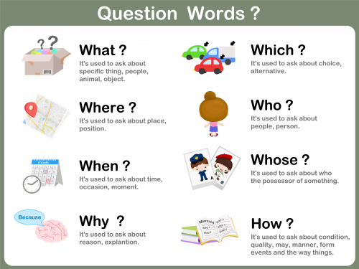

Slide 18
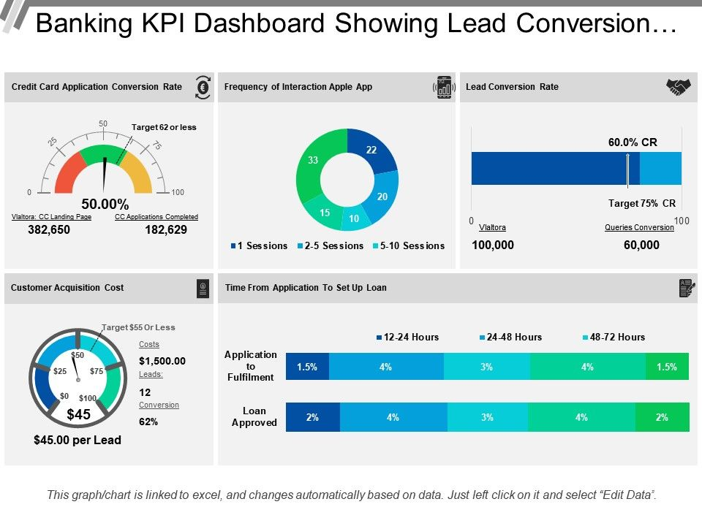
Examples of data questions by industry
BI/Data Question in Banking:
How far off target are we in the various pipeline stages of acquiring new customers? And where should we focus our efforts to improve our services?

Slide 19
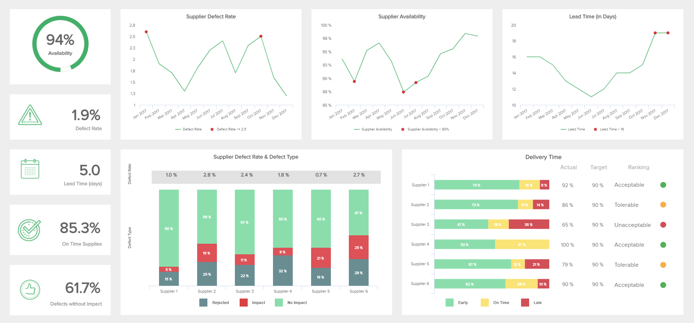
Examples of data questions by industry
BI/Data Question in Procurement: Is it possible to outperform my supply delivery process? If yes, how?

Slide 20
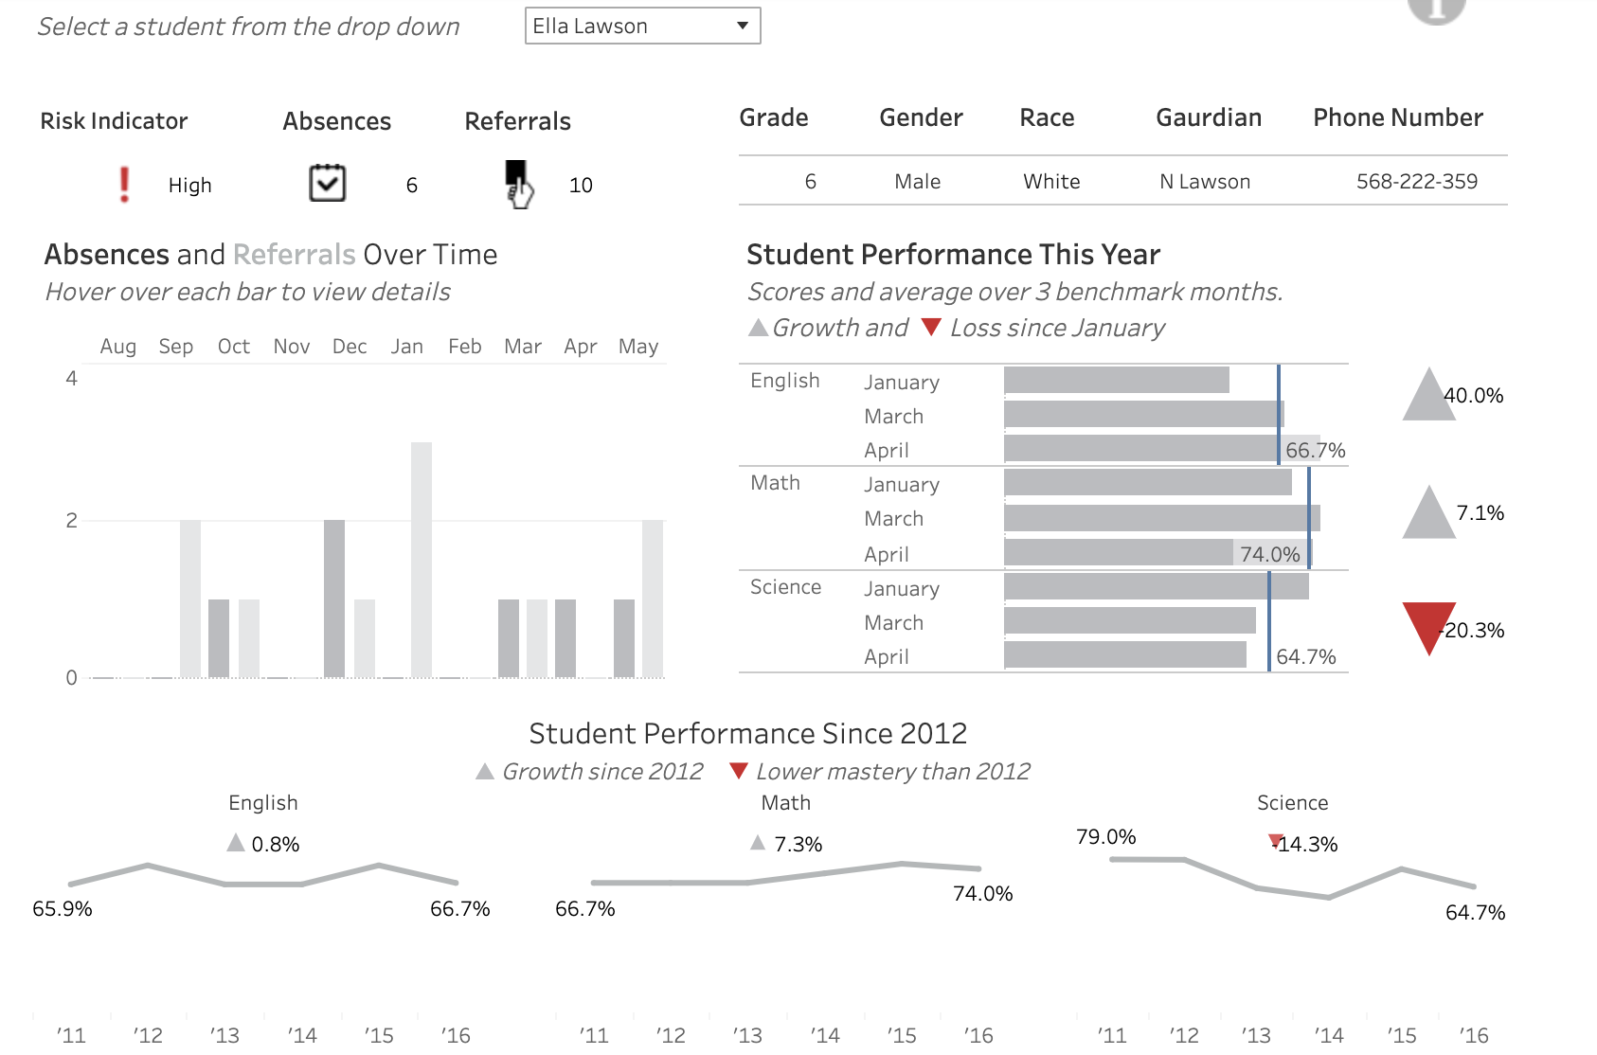
Examples of data questions by industry
BI/Data Question in Education:
How is student x doing versus the rest of my class this year? Are there particular areas this student needs to work on?

Slide 21
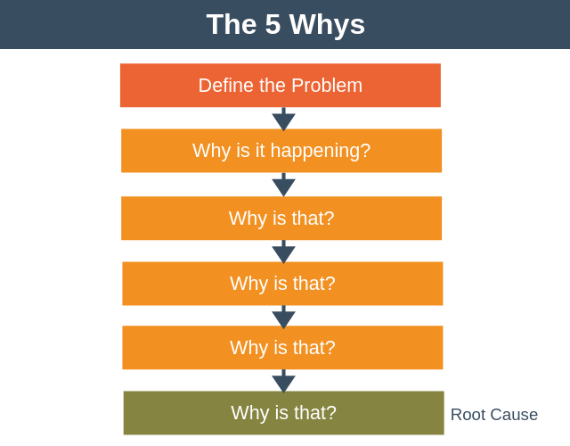
The 5 whys method
BI consultant’s every day task : use the 5 whys to discover what was going on and why it mattered.

Slide 22
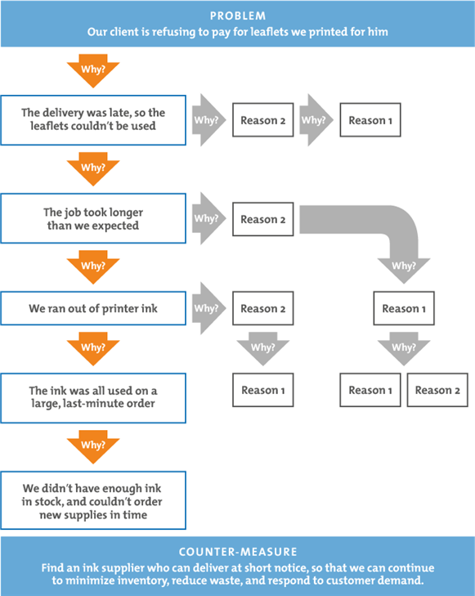
The 5 whys method
While reporting on the number of unpaid invoices or late deliveries - the root cause is easily obscured.

Slide 23
Lets try it
In pairs, take a business problem - something that frustrates you about online shopping /a restaurant you visit/ an issue you have seen at Ironhack / a situation from a previous job
Your partner will ask you 5 whys to see if they can discover the TRUE CAUSE behind the problem.

Slide 24
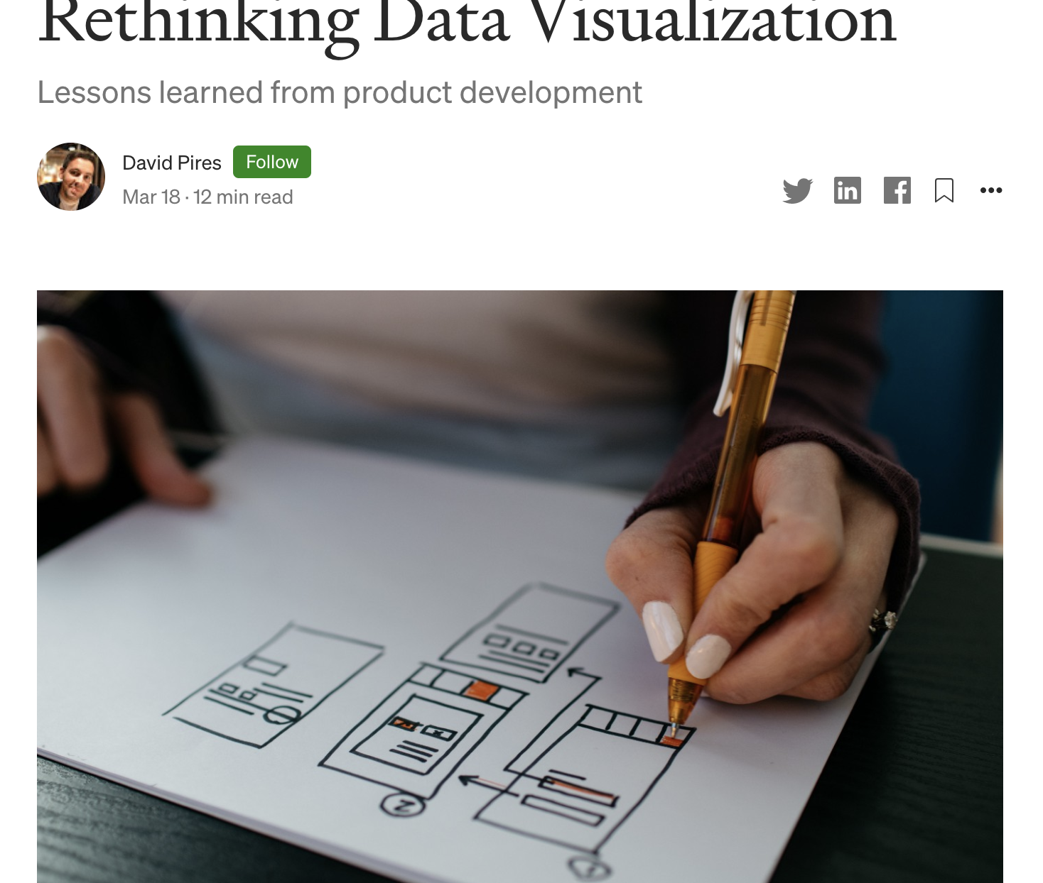
what are the mistakes often made by organisation in adopting data visualisation tools & techniques
what does David suggest could be done differently?
David Pires
Head of Data Visualisation, Expedia
Notes:
Mistakes :
proliferation of dashboards / visualisations with minor differences
Not paying attention to users needs and experiences of consuming the visualisation product
Non communication of the new viz/ dashboard --- duplicates
Things are too short term released to be embedded
Solutions : update rather than copy + modify + add to list
Move things online - continual improvement possible - direct feedback with likes
Stakeholder communication
Clear and concise - for this audience
Ask people what they want
Instructions / clarifications / help - visual instructions
Listen to your audience - dont assume

Slide 25
Job hunting q&a
Ask me about
BI consultancies
BI software companies
BI startups

