Slide 1
RESUME PROJECT CAHLLENGE 8
CODEBASICS
PRESENTATION BY S LAKSHMAN

Slide 2
OBJECTIVE
Mitron bank wants to launch new line of credit cards to scale up their business and to widen their product spectrum.
Atliq Services proposed to materialise it and Mitron bank asked them to do pilot project.
Assuming myself a Data Analyst working in Atliq services, I’m going to analyse the data, extract the insights and suggest data driven recommendations useful for Mitron Bank.

Slide 3
DATA
The first table 'dim_customers' contains information about 4000 customers, their age group, gender, resident city, profession etc
The second table 'fact_spends' gives information about the transactions made by these 4000 customers over 6 month period across 9 categories (like Bills, Groceries etc) using 4 payment platforms (debit card, credit card, UPI and net banking).
Let's dive into the analysis.

Slide 4
DEMOGRAPHIC ANALYSIS
There are 4000 customers in total.
Among them, nearly 2600 are male, rest are Female (=> app 2:1 ratio)
3100 are married and rest are single.(=> app 3:1 ratio)
There are four age groups. 70% of customers lie between 25-45 years age group.
The customers are spread around 5 cities but one quarter of them lives in Mumbai.
Occupaton wise, salaried IT employees are highest in number (around 1300) while govt employees are least in count.

Slide 5
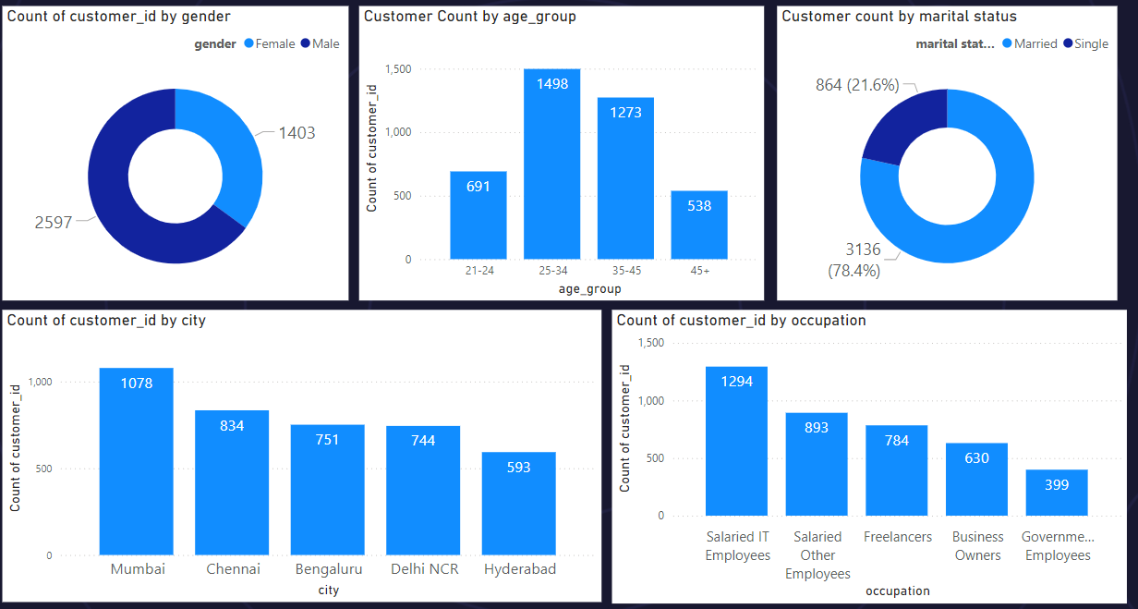

Slide 6
Income Distribution
Average Income is approximately equal relative to Gender and City
However, Average Income is incremental with age group (As age in age group increased, Income levels increased)
Relative to occupation, business owners have highest average income followed by salaried IT Employees, govt salary employees, other employees and freelancers.

Slide 7
INCOME EXPENSE ANALYSIS
INCOME UTILIZATION PERCENT = (100*AVERAGE SPENDING)/ AVERAGE INCOME
Average Income is incremental with respect to age group but expenses for 45+ age group is low compared to rest. This affects income utilization ratio (which is the ratio between avg expense and avg income). Adults between 35-45 age have highest income_utilization ratio and so are potential users of credit cards.
Income distribution across cities didn’t vary significantly but the spending distribution for the same has significant variation. .
Mumbai, New Delhi are expensive to live on one side and Chennai, Hyderabad have relatively lower cost of living on the other. Bengaluru stood in centre.
Thus, Mumbai leads in income utilization ratio followed byDelhi & Bangalore and these areas (Mumbai, Delhi, Bangalore) are the potential markets.
By occupation, Business Owners have highest average income followed by IT employees and govt employees.
While in expenditure, IT employees tops the chart, business owners stand second and Govt Employees at bottom
Salaried IT employees are undoubtedly the core targets both by intuition and by figures. By pure numbers (I mean income utilization ratio), business owners and government employees are ignorable but intuitively, business owners are both needy and amicable to credit usage and govt employees have stable income and are most reliant among the group in repayment.

Slide 8
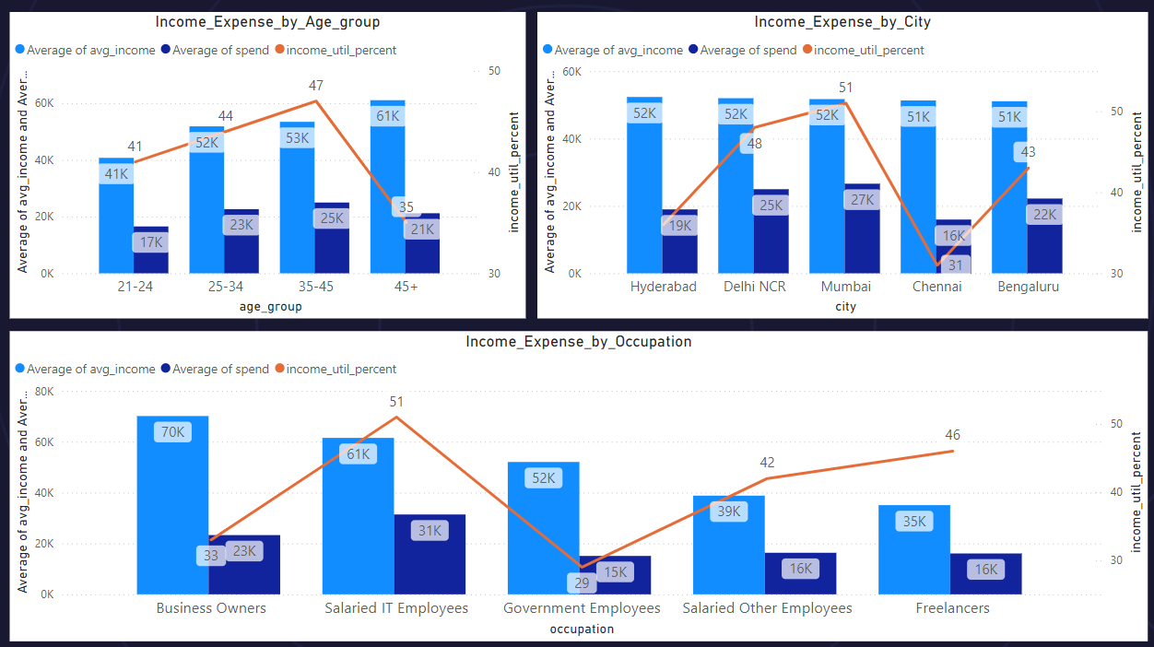

Slide 9
SPENDING ANALYSIS
Bills dominate the payment category. Also, Bills, Groceries and Electronics together cover 50% of spending amount. Health and Travel covers next 20%.
Therefore, new features of credit cards in these categories can attract new customers. Discounts in Electronics for high credit limit customers and Reward Points for bill payments and grocery purchases can be beneficial.
By payment channels, credit card dominates with 40% in all categories except Food & Groceries.
UPI, despite being the youngest among the mediums, is covering 20-30% in all categories, even leading in Food & Groceries space.
Its rapid rise can affect credit card sales. Credit card linking to UPI is introduced by RBI to boost credit flow and so, Mitron bank must provide credit card linking to UPI facaility for its customers. That brings 70% of customer spending into our court.
Debit cards (twins to credit card) still occupy 20% of space and are straight competitors to credit cards. Offers and Reward points to credit card might bring an edge over them.
Notes:
source: https://www.ey.com/en_in/insights/consulting/how-recent-changes-to-upi-are-helping-fill-india-s-credit-gap (UPI-credit card linking)

Slide 10
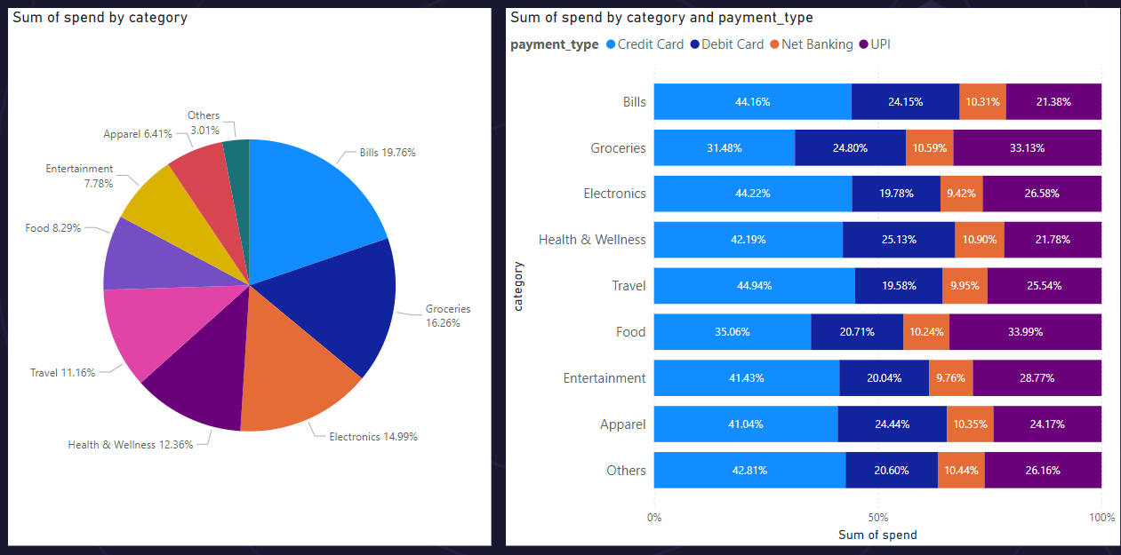

Slide 11
By payment modes, credit card dominates with 40% in all categories except Food & Groceries (due to physical hangouts). So tie up with apps, offer reward points by aggregate value of consumption. Low income & moderate spending groups are targets here. Tie up with one big player/ brand with high volume in food & groceries (McDonalds/Reliance Digital etc) and offer initial rewards scheme/ initial discounts.
UPI covers 20-30% in all and leading in Food & Groceries. Here’s a concern and a competitor. However, attempts to create credit facility in UPI by linking credit cards is on talks. So, work upon it.
How to convert debit card transactions to credit cards? Important question because around 20% transactions happen by debit cards.
44% bills paid through credit card and 24% on debit card. so, scope here to pull customers. Giving Initial 5% discounts by tieing up with websites/app platforms might help and then automating payments.

Slide 12
DEMOGRAPHIC ANALYSIS OF CREDIT CARD USAGE
Among the credit card payments, age group between 25-45 is leading . While 25-35 age group is mostly spending by credit card, adults aged 35-45 are spending the most by debit card.
Customer awareness campaigns about credit card usage for this group might drive them towards credit cards.
Mumbai, Delhi and Bangalore together covers 68% of credit card payments and this is another reason to focus on these cities
Salaried IT employees and business owners are highest users of credit card. We discussed this earlier, the income utilization ratio advised us to ignore business owners but the credit card utilization pattern speaks against it.
Married and Male are a tad active in credit card utilisation compared to female and singles. The difference is not drastic but useful to keep in mind.

Slide 13
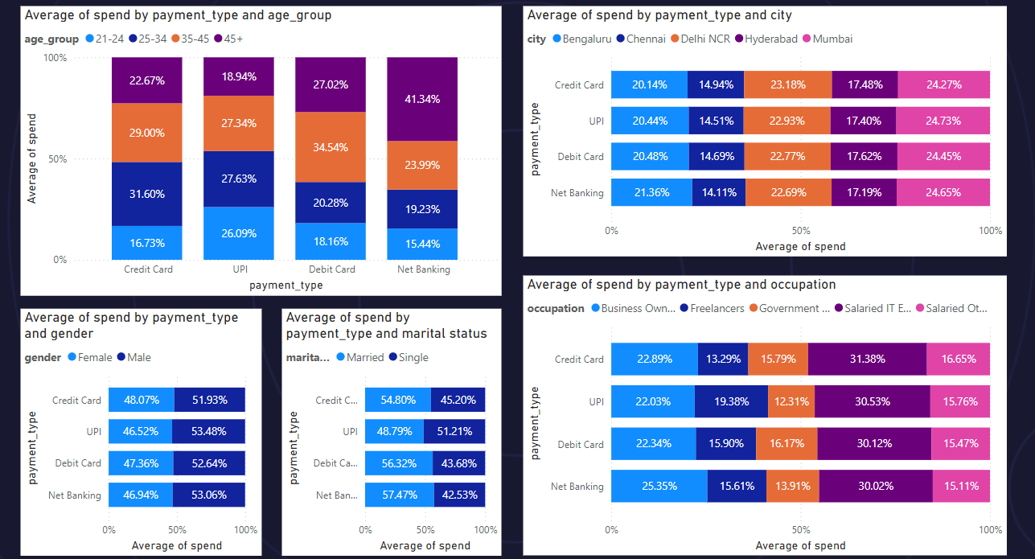

Slide 14

RECOMMENDATIONS
By demographics, Adults within 25-45 age group (esp between 35-45); residents of Mumbai, New Delhi and Bangalore; salaried IT employees and business owners by occupation are ideal lookouts for new customers.
Customer Awareness by campaigns or advertisements can bring in new customers aged between 35-45.
Offer discounts on travel and issue gold cards (with more credit limit) to business owners.
Offer discounts on Health products and increased credit limit for customers aged above 35.
Offer discounts on Electronics for Premium users with high credit limit to encourage them to use credit card for electronic purchases.
UPI seems unstoppable and creating facility to link credit card to UPI is beneficial.
Offering discounts or reward points in bill payments and groceries can pull debit card users to our credit card (remember debit cards still account for 20% transaction revenue)
Notes:
Saved credit cards and ensuring safety measures can help

Slide 15
THANK YOU

